Slide 1
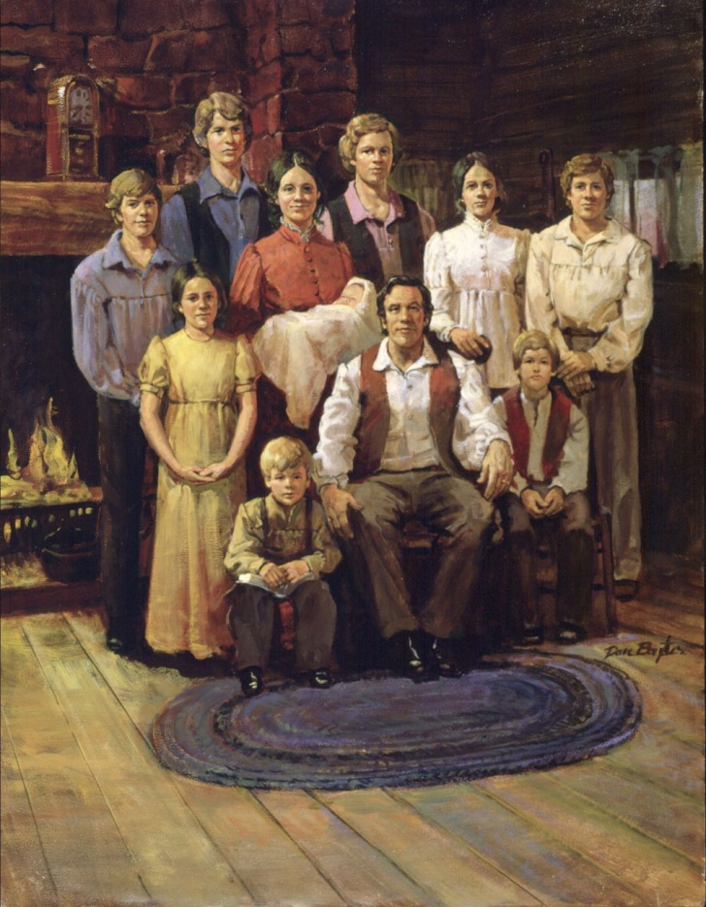
Joseph Smith’s Family—Short Biography

Slide 2
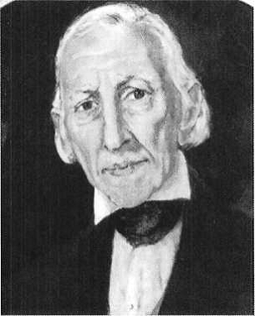
Joseph Smith Sr.
He was born on July 12, 1771 in Essex County, Massachusetts.
He was a farmer and teacher, and father of Joseph Smith Jr.
He relocated from Vermont and New Hampshire and found that prosperity was elusive
In 1816 the family moved to Palmyra, New York
He had faith in the reports of his son, Joseph Smith about the Restoration and supported him
He was one of the 8 witnesses of the Book of Mormon
He was baptized on April 6, 1830, the day the Church was organized
He was ordained the 1st Patriarch of the Church in this new dispensation
He was also a member of the 1st high council organized in Kirtland on Feb. 17, 1834
He served an extended mission in the eastern stated
He died in Nauvoo from ill health on Sept. 14, 1840
He inherited a place with Abraham at his right hand (D&C 124:19)
Who’s Who

Slide 3
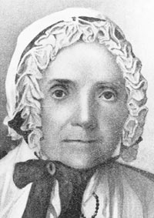
Lucy Mack Smith
She was born on July 8, 1776 in New Hampshire
She was a descendant of an immigrant from Inverness, Scotland who came to this country in 1699 and settled in Salisbury, Massachusetts
Her father, Solomon Mack, took up residence in Gilsum, New Hampshire, he was a farmer. Solomon Mack married Lydia Gates, a schoolteacher and a member of the Congregational Church. They had eight children and Lucy was the youngest.
She married Joseph Smith Sr. on January 24, 1796
She and her husband were unshakably supportive of their prophet son, Joseph Smith Jr.
On October 8, 1845 spoke before some 5,000 Saints assembled for the last conference of the Church in Nauvoo under the direction of Brigham Young
In Joseph Smith Jr.’s vision of the celestial realm on January 21, 1836 in the Kirtland Temple he was permitted to view both of his parents together with his deceased brother Alvin (D&C 137:5)
She went to live with Emma in Nauvoo, by 1852.
She passed away on May 5, 1855
Who’s Who and Joseph Smith

Slide 4
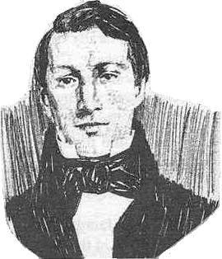
Alvin Smith
He was born February 11, 1798 (or 1799) at Tunbridge, Orange County, Vermont
He was the oldest son of Joseph and Lucy Smith
He had a strong work ethic and was a great help to his family in their years of financial struggle
He helped build across the street from their log cabin in Palmyra area
He encouraged Joseph Smith Jr., his younger brother, to continue on the Restoration
He became seriously ill in November 1823 and died of mercury poisoning from calomel, which had been administered to cure a case of “bilious colic” and died Nov. 19, 1823
On Jan. 21, 1836 the Prophet Joseph beheld his brother once again in the celestial kingdom (D&C 137:5-9)
Who’s Who and Wikipedia

Slide 5
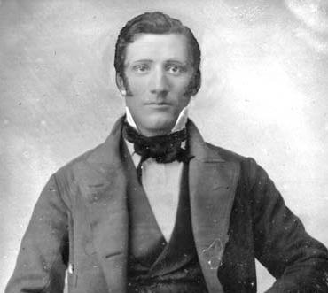
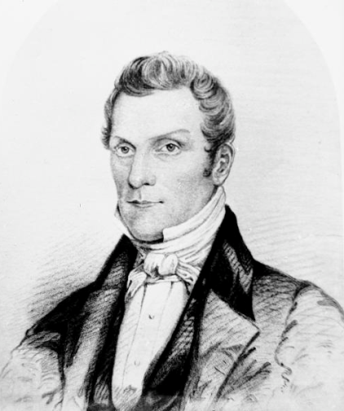
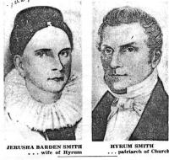
Hyrum Smith
He was born on February 9, 1800, at Tunbridge, Orange County, Vermont
He was the older brother of Joseph Smith Jr.
He married Jerusha Barden, in 1826
He was baptized by Joseph in June 1829
On April 6, 1830 he became one of the six original members of the church
He moved to Kirtland Ohio where he became an elder and later a high priest.
He served an extended mission in 1831 to Ohio and Missouri
In 1836-37 he was given higher priesthood duties, serving on the high council and as Second Counselor in the First Presidency (D&C 112:17)
In November 1838 until April 1839 he was imprisoned along with Joseph and others in the Liberty Jail
He later settled in Nauvoo and was called a patriarch to the Church by a revelation on January 19, 1841 (D&C 124:91)
He, along with Joseph Smith Jr. were martyred on June 27, 1844 at Carthage, Hancock County, Illinois
His son, Joseph F. Smith received the revelation concerning the glorious ongoing work of salvation in the spirit realm. (D&C 138:53)
Who’s Who

Slide 6
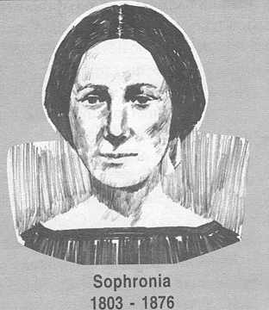
Sophronia Smith
She was born May 17, 1803 at Tunbridge, Vermont the eldest daughter of Joseph Smith Sr. and Lucy Mack Smith
She was witness to tension that existed in her family due to her mother's deep longing for religious contentment, and her father's resistance to joining any organized religion.
Whether, because of this tension, or in spite of it, faith in God was a dominant factor in her upbringing.
Father Smith always led out in family devotions, with bible reading and prayers,[each evening; and Mother Smith taught her children to read, using the bible as their first primer.
She suffered a serious case of Typhus Fever, which nearly took her life, when she was about nine years of age
At age 13 the family moved to Palmyra, New York
She was 17 years old when Joseph received his vision. She is credited with helping her sister Katharine hide them from intruders in 1827
At age 23 she and Calvin Stoddard, were married 30 December 1827. They made their home in Palmyra.
Sophronia, Calvin and their fourteen month old baby, Eunice, moved from New York to Ohio, where Eunice died on June 24, 1831. Calvin was later ex-communicated after 1833, reason unknown.
She was widowed at age 34, 1936, and married William McCleary in 1838
On 27 January 1846, William and Sophronia McCLeary were sealed for time and eternity
She and her daughter, Marie did not go west with the other saints
She passed away on October 28, 1876 at Colchester, Illinois at the age of 73
http://www.josephsmithsr.com/wiki/SMITH,_Sophronia_-_I39

Slide 7
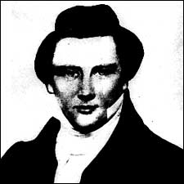
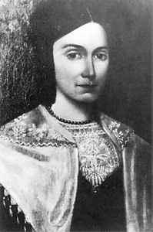
Joseph Smith Jr.
He was born December 23, 1805, in Sharon, Vermont to Joseph Smith Sr. and Lucy Mack Smith
He married Emma Hale on January 18, 1827, in South Bainbridge, New York.
They had 9 children and only 4 grew to maturity.
The Prophet Joseph was martyred June 27, 1844, in Carthage, Illinois.

Slide 8
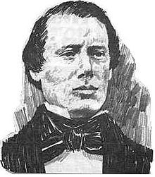
Samuel Harrison Smith—look in who’s who book
He was born on March 13, 1808 at Tunbridge, Orange County, Vermont and one of the younger brothers of Joseph Smith, Jr. He was 6th child of Joseph Smith Sr. and Lucy Mack Smith
He was baptized by Oliver Cowdery on May 25, 1829
and the 3rd person to be baptized in this dispensation
He was one of the Eight Witnesses to the Book of Mormon and one of the six original members of the church upon its organization
He helped chop the wood, plow the land, and harvest the crops in 1829 so that Joseph was free to translate the gold plates.
The Lord had counseled him in D&C 23:4 to strengthen the church
He was the first missionary in the result of converting Heber C. Kimball and Brigham Young at age 22
He married Mary Bailey on August 12, 1834. and had two daughters, Susannah and Mary, born in October 1835, and a son, Samuel Harrison Bailey Smith in August 1838
He was a member of the high council in Kirtland and later Presiding Bishop of the Church, then later serving as bishop in Nauvoo, and captain in the Nauvoo legion
Mary, died in January 1841 at age 32 after giving birth to Lucy Bailey Smith, who died several weeks later. He later married Levira Clark and had a daughter named Levira Annette
He accompanied the bodies of Hyrum and Joseph back to Nauvoo from Carthage.
He died on July 30, 1844, 34 days after the death of his brothers
Who’s Who and Larene Porter Gaunt

Slide 9
Ephraim Smith
He was born was born and died March 13, 1810, in Royalton, Vermont.

Slide 10
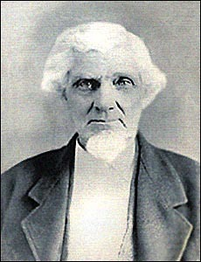
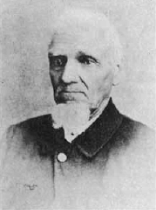
William Smith
He was born on March 13, 1811, at Royalton, Windsor County, Vermont and was the 8th child of Joseph Smith Sr. and Lucy Mack Smith
He was baptized by David Whitmer on June 9, 1830
He served as a missionary and ordained an elder
In February 1835 he became a member of the original Quorum of Twelve Apostles (D&D 124:129
He was given to outbursts of anger, even against his brother the Prophet Joseph, he demonstrated that his faith in the gospel was unstable, and did not heed to warnings to correct his ways and declined to serve a mission with the Twelve in England.
He was by lineage, ordained Patriarch to the church on May 24, 1845
But because of his attitude, his calling as an apostle was revoked on October 6, 1845 (HC 7:458)
He was excommunicated on October 12, 1845
He attempted to form his own church, but latter he joined the Reorganized Church of Jesus Christ of latter Day Saints
He died on November 13, 1893, at Osterdock, Iowa
Who’s Who

Slide 11
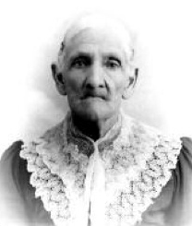
Katherine Smith
Katherine Smith (sometimes spelled Catherine) was born July 28, 1812 in Lebanon, New Hampshire.
She was the second daughter of Joseph Smith Sr. and Lucy Mack Smith. She was 15-years-old when Joseph received the golden plates.
Katherine supported and believed in her older brother's prophetic calling.
She was baptized when the church was organized in 1830. In January 1831, Katherine married a blacksmith named Wilkins Jenkins Salisbury were married on 8 June 1830, by Sidney Rigdon, they had 8 children
The Salisbury's followed Joseph, Emma and the rest of the Smith family to Kirtland, Ohio, then to Missouri and on to Illinois.
Katherine was living in Plymouth, Illinois in 1844 when she was notified of the martyrdom of her brothers Joseph and Hyrum at Carthage Jail.
Katherine and Wilkins did not follow the church to Utah, opting instead to remain behind in Illinois with her mother and remaining siblings.
After Wilkins death she married Joseph Younger, then divorced
Katherine touched the Golden Plates 3 times
She died February 1, 1900, in Fountain Green, Illinois.
http://www.supportingevidences.net/katherine-smith-salisbury/

Slide 12
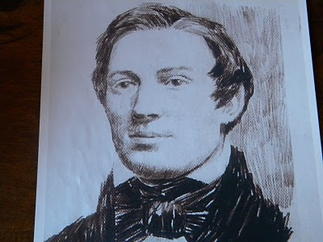
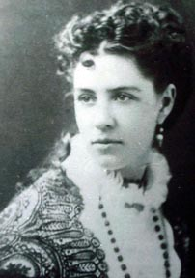
Don Carlos Smith
He was born on March 25, 1816 at Norwich, Windsor County, Vermont
He was the younger brother of Joseph Smith Jr.
He was baptized on June 9, 1830 by David Whitmer, then journeyed with his family to Kirtland, Ohio
He was ordained a high priest at 19 and became president of the high priests quorum in Kirtland
In 1838 the family moved to Missouri so he and his cousin George A. Smith traveled to Tennessee and Kentucky to obtain revenue for buying property.
While they were away, Don Carlos’s wife, Agnes Coolbrith, and two children suffered hardships because of mob violence.
When they were reunited again in Illinois he contributed service on behalf of the poor and since
He was editor of the Times and Seasons from 1839 to 1840 and president of the high priest quorum
He was elected on the Nauvoo city council and Nauvoo legion and served as regent to the University of Nauvoo
He was overtaken by an illness and passed away August 8, 1841 at the age of 25
Josephine Donna Smith pen name: Ina Coolbrith daughter of Don Carlos
Who’s Who

Slide 13
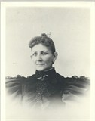
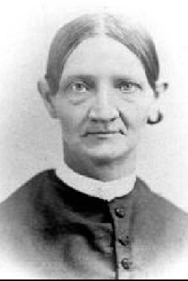
Lucy Smith Millikin
She was born July 18, 1821 youngest child of Joseph Smith Sr. and Lucy Mack Smith at Palmyra, Ontario Co., New York
She was baptized around 1830
She lived in an unincorporated settlement near Waterloo, Seneca Co., New York in 1830 and migrated to Kirtland, Geauga Co., Ohio in May 1831 then to Far West, and Quincy, Illinois in 1839
She married Arthur Millikin by Joseph Smith on June 4, 1840 in Nauvoo
She had 9 children
She joined the Female Relief Society in March 24, 1842
She moved to Maine in 1843 and returned to Nauvoo in 1844
She cared for her mother, Lucy Mack Smith from 1846-1852 and moved to Knoxville, Illinois in 1946
She was received into the Reorganized LDS Church April 8, 1873, based on original baptism
She died December 9, 1882 near Colchester, Illinois
http://josephsmithpapers.org/person/lucy-smith-millikin

Slide 14
Katherine Smith Salisbury’s Testimony
(“The Prophet’s Sister Testifies She Lifted the B. of M. Plates,” The Messenger, October 1954, 1, 6, typescript copy, LDS Church Archives. This account parallels Emma Smith’s, who said, “The plates often lay on the table without any attempt at concealment, wrapped in a small linen table cloth, which I had given him to fold them in. I once felt of the plates, as they lay on the table, tracing their outline and shape. They seemed to be pliable like thick paper, and would rustle with a metallic sound when the edges were moved by the thumb, as one does sometimes thumb the edges of a book.”(Joseph Smith III, “Last Testimony of Sister Emma,” Saints’ Herald 26, no. 19 (1 October 1879): 289–90; Dan Vogel, Early Mormon Documents, Volume I (Salt Lake City: Signature Books, 1996), 525.)
I desire before I pass away, to place my testimony on record. I have been a member of this church, ever since its first organization on the 6th day of April, 1830. I am the only surviving sister of the martyrs Joseph and Hyrum Smith and will soon be 73 years old. I can testify to the fact of the coming forth of the Book of Mormon, and also to its truth, and the truth of the everlasting gospel as contained therein.
I well remember the trials my brother had, before he obtained the records. After he had the vision, he went frequently to the hill, and upon returning would tell us, "I have seen the records, also the brass plates and the sword of Laban with the breast plate and interpreters. ...My brother William and myself are all who are left now, and we shall soon pass away, but while I can I will bear my testimony to the truth of the latter day work, both spiritual and temporal. I know that it is true." (Saints Herald 33, no. 17, 1 May 1886)

Slide 15
Sources:
Who’s Who in the Doctrine and Covenants by Ed J. Pinegar and Richard J. Allen pp 132-133, 135-137, 146-149
Joseph Smith by Robert V. Remini p 8
Other Sources:
Larene Porter Gaunt Samuel H. Smith: Faithful Brother of Joseph and Hyrum Aug. 2008 Ensign
Richard Lloyd Anderson The Alvin Smith Story: Fact and Fiction Aug. 1987 Ensign
M. Russell Ballard Hyrum Smith: “Firm As the Pillars of Heaven” Oct. 1995 Gen. Conf
Jaynann Payne Lucy Mack Smith: Woman of Great Faith Nov. 1972 Ensign
Smith, Joseph Sr. - Details
josephsmithpapers.org/person/joseph-smith-sr
And Richard Lloyd Anderson Joseph Smith, Sr. Dec. 1973 Ensign
Richard Lloyd Anderson Joseph Smith’s Brothers: Nauvoo and After Sept. 1979 Ensign
Emma Hale Smith
First General President of the Relief Society
1842–1844
Who’s Who and Joseph Smith

Slide 16
Ina Coolbrith (1842-1928) was a niece of Joseph Smith, the daughter of Don Carlos Smith. Brought by covered wagon to California as a child, she lived, after 1865, in the San Francisco Bay region. Disassociated with the Church, she became an important literary figure in California, assisting Bret Harte in editing the Overland Monthly, and associating with the literary circle which included Mark Twain, C. W. Stoddard, and Joaquin Miller. Her simple lyric poems, such as "Millennium," were collected in A Perfect Day (1881), The Singer of the Sea (1894), and Songs from the Golden Gate (1895). She was named by the California legislature as the state's first Poet Laureate.
http://mormonlit.lib.byu.edu/lit_author.php?a_id=2627
Other Interesting Stories
Touching the Plates:
Katharine’s grandson, Herbert S. Salisbury, remembered his grandmother telling [him]: “[Katharine] told me that while dusting up the room where the Prophet had his study she saw a package on the table containing the gold plates on which was engraved the story of the Book of Mormon. She said she hefted those plates and found them very heavy like gold and also rippled her fingers up the edge of the plates and felt that they were separate metal plates and heard the tinkle of sound that they made."
Samuel’s wife Mary in Mob crisis:
In March 1838, as the Saints were continuing to gather to Missouri, Samuel and Mary settled on a 160-acre tract in Marrowbone, Daviess County. Samuel began again to clear the land. Here Mary gave birth in August 1838 to a son, named Samuel Harrison Bailey Smith. When violence against the Saints escalated, Samuel went to Far West to get a wagon to move his family. While he was gone, a mob carried Mary and her newborn son on a featherbed out into the rain. They put toddlers Susannah and Mary on the bed with them and then burned the house to the ground. Soon after, a neighbor furnished a wagon, horses, and a boy to take them to Far West to find Samuel. After a day and a half in the pouring rain, they met up with Samuel, who was returning home. They went on to Far West, where Samuel’s mother cared for them. Samuel’s gentle wife, Mary, however, never fully recovered
Sophronia Smith suffered a serious case of Typhus Fever, which nearly took her life, when she was about nine years of age. Doctors declared the girl could not live, but her parents fell upon their knees beside her bed praying that God would spare their child's life. In faith and determination, her mother picked Sophronia up, wrapped her in a blanket and paced the floor hour after hour, refusing to heed those who told her she was behaving foolishly, that her child was certainly already dead. After a long time, the child sobbed, and began to breathe normally. Only then did her mother sink down in triumphant exhaustion and gratitude. This near death experience may have left Sophronia more sober than others her age—certainly she would never lack faith to be healed in later years.

Slide 17
Family of Joseph Smith Sr. and Lucy Mack Smith: The First Family of the Restoration Dec. 2005 Ensign
Joseph SMITH Sr. was born July 12, 1771, in Topsfield, Massachusetts. He married Lucy MACK on January 24, 1796, in Tunbridge, Vermont. Lucy was born July 8, 1775, in Gilsum, New Hampshire. They were the parents of 11 children, listed here in order of birth. Joseph Sr. died September 14, 1840, in Nauvoo, Illinois. Lucy died May 8, 1856, in Nauvoo, Illinois.
* Infant son SMITH was born and died in 1797, Tunbridge, Vermont.
Alvin SMITH was born February 11, 1798, in Tunbridge, Vermont, and died November 19, 1823, in Manchester Township, New York, at the age of 25.
Hyrum SMITH was born February 9, 1800, in Tunbridge, Vermont. He married Jerusha BARDEN on November 2, 1826, in Manchester Township, New York. They had six children. After Jerusha’s death, Hyrum married Mary FIELDING on December 24, 1837, in Kirtland, Ohio. They had two children. Hyrum was martyred June 27, 1844, in Carthage, Illinois. He has 13,583 known descendants. **
Sophronia SMITH was born May 17, 1803, in Tunbridge, Vermont. She married Calvin W. STODDARD on December 2, 1827, in Palmyra, New York. They had two children. After Calvin’s death, Sophronia marriedWilliam * McCLEARY on February 11, 1838, in Kirtland, Ohio. No children. She died October 28, 1876, in Colchester, Illinois. Sophronia has five known descendants. **
Joseph SMITH Jr. was born December 23, 1805, in Sharon, Vermont. He married Emma HALE on January 18, 1827, in South Bainbridge, New York. They had 11 children. The Prophet Joseph was martyred June 27, 1844, in Carthage, Illinois. He has 1,112 known descendants. **
Samuel Harrison SMITH was born March 13, 1808, in Tunbridge, Vermont. He married Mary BAILEY on August 13, 1834, in Kirtland, Ohio. They had six children. After Mary’s death, Samuel married Levira CLARKon April 29, 1841, in Nauvoo, Illinois. They had three children. Sometimes called the third martyr, Samuel died July 30, 1844, in Nauvoo, Illinois, of injuries sustained while riding from Nauvoo to Carthage to aid his brothers. He has 460 known descendants. **
Ephraim SMITH was born and died March 13, 1810, in Royalton, Vermont.
William B. SMITH was born March 13, 1811, in Royalton, Vermont. He married Caroline A. GRANT on February 14, 1833, in Kirtland, Ohio. They had two children. After Caroline’s death, he married Roxie R. GRANT on May 19, 1847, in Knox, Illinois. They had two children. After they divorced, William married Eliza E. SANBORN on November 12, 1857, in Kirtland, Ohio. They had three children. After Eliza’s death, William married Rosella GOYETTE on December 21, 1889, in Clinton, Iowa. No children. William died on November 13, 1893, in Osterdock, Iowa. He has 234 known descendants. **
* Katharine SMITH was born July 28, 1813, in Lebanon, New Hampshire. She married Wilkins J. SALISBURY on January 8, 1831, in Kirtland, Ohio. They had eight children. After his death, she married Joseph YOUNGERin Illinois. Soon afterward, they divorced. No children. She died February 1, 1900, in Fountain Green, Illinois. Katharine has 92 known descendants. **
Don Carlos SMITH was born March 25, 1816, in Norwich, Vermont. He married Agnes Moultin COOLBRITH on July 30, 1835, in Kirtland, Ohio. They had three children. He died August 7, 1841, in Nauvoo, Illinois. Don Carlos has six known descendants. **
Lucy SMITH was born July 18, 1821, in Manchester Township, New York. She married Arthur MILLIKIN on June 4, 1840, in Nauvoo, Illinois. They had nine children. She died December 9, 1882, in Colchester, Illinois. Lucy has 92 known descendants. **
https://www.lds.org/ensign/2005/12/family-of-joseph-smith-sr-and-lucy-mack-smith-the-first-family-of-the-restoration?lang=eng

