Slide 2
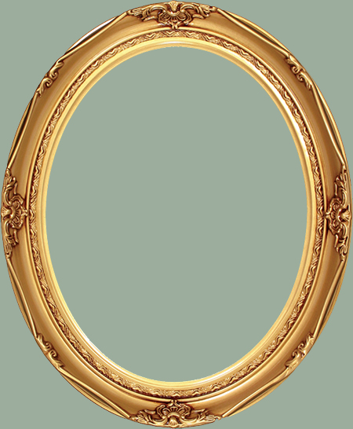
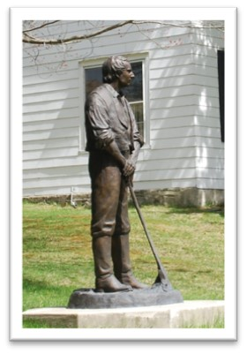
What Can happen in Five years?
What things might change in your life in 5 years?
What things are you prepared for if something happens different than what you expected?
Joseph Smith’s brother Alvin dies in 1823 and he goes to Chenango County, NY and labors for a man named
Josiah Stoal (or Stowell)
1825
Original home of Josiah Stowell and now sits vacant. Josiah Stowell took Joseph as one of his hired hands to his farm where he was employed as a wool carder, farmer, and worker looking for a silver mine.
Joseph Smith –History 1:55-56

Slide 3
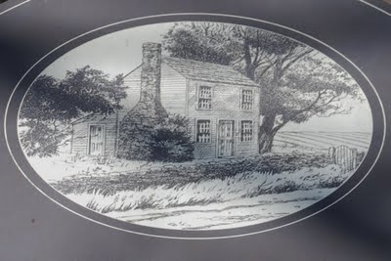
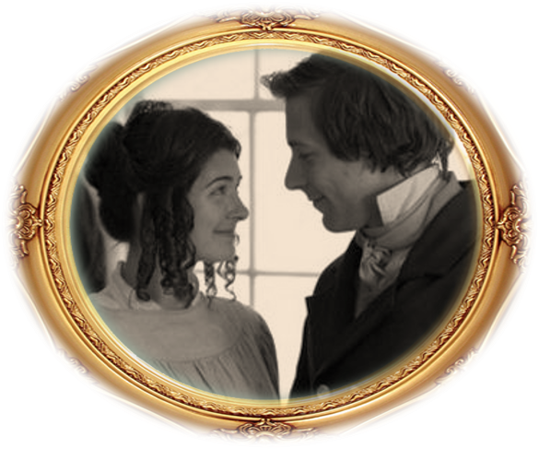
Joseph’s Life Changes
Joseph boarded with Mr. Isaac Hales who had a daughter, Emma
Rendition of home where Emma grew up
Joseph Smith –History 1:57

Slide 4
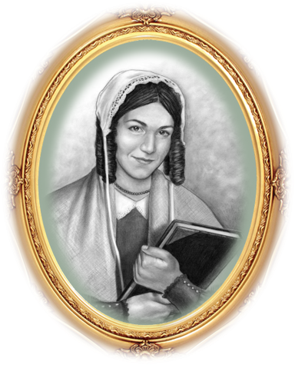
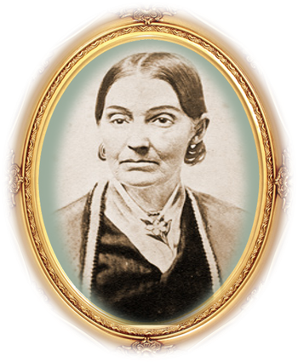
Emma Hale Smith
She was born July 10, 1804 in Harmony, Susquehanna County, Pennsylvania, daughter of Isaac Hale and Elizabeth Lewis Hale
Her father did not consent for Joseph to marry her so they eloped and married in January 1827
She assisted as a scribe in the translation of the Book of Mormon
She was baptized on June 28, 1830 by Oliver Cowdery
She was instrumental in preparing a selection of hymns for the Church
She was given a revelation (D&C 25) outlining her role in the Restoration
She was the first President of the Relief Society in 1879
She and Joseph had 9 children—only 4 grew to maturity
Following the Martyrdom she declined to go west with the Saints
She married Major Lewis Bidamon and died April 30, 1879 in Nauvoo, Illinois at the age of 74
Who’s Who

Slide 5
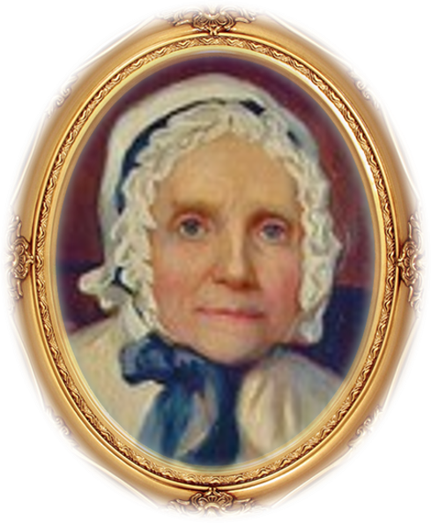
Lucy Mack Smith
“We were pleased with his choice and not only consented to his marrying her, but requested him to bring her home with him and live with us.”
Who’s Who

Slide 6
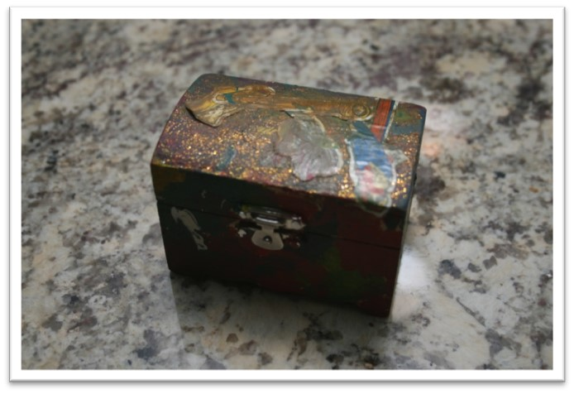
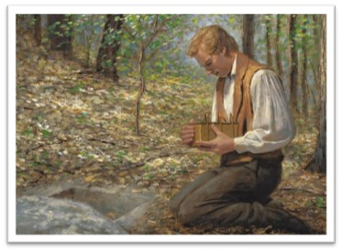
Responsibility and Preservation
How would you treat something that was valuable?
Joseph was entrusted with something very valuable, to not let them go carelessly or neglect them
Joseph Smith –History 1:59

Slide 7
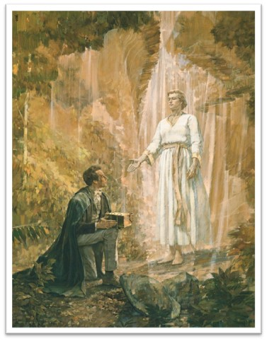
Keeping Them Safe
“The persecution became more bitter and severe than before, and multitudes were on the alert continually to get them from me if possible. But by the wisdom of God, they remained safe in my hands, until I had accomplished by them what was required at my hand.”
As we take responsibility for and preserve that which the Lord has given us, He will extend His protection and help.
Joseph Smith –History 1:60

Slide 8
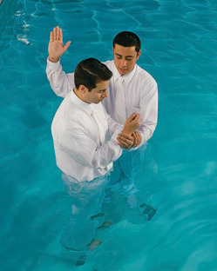
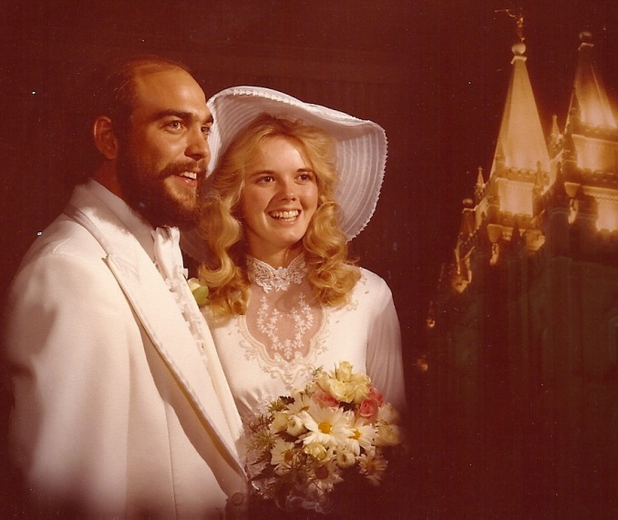
Keeping Our Sacred Obligations
We are also responsible for taking care of our covenants

Slide 9
An Excerpt—Lucy Mack Smith
“Joseph, on coming to them, took them from their secret place, and, wrapping them in his linen frock, placed them under his arm and started for home.
“After proceeding a short distance, he thought it would be more safe to leave the road and go through the woods. Traveling some distance after he left the road, he came to a large windfall, and as he was jumping over a log, a man sprang up from behind it and gave him a heavy blow with a gun. Joseph turned around and knocked him down, then ran at the top of his speed. About half a mile farther he was attacked again in the same manner as before; he knocked this man down in like manner as the former and ran on again; and before he reached home he was assaulted the third time. In striking the last one, he dislocated his thumb, which, however, he did not notice until he came within sight of the house, when he threw himself down in the corner of the fence in order to recover his breath. As soon as he was able, he arose and came to the house. He was still altogether speechless from fright and the fatigue of running”
Joseph Smith from Lucy Mack Smith
When Joseph Smith received the plates from Moroni, he initially hid them in a decayed birch log about 3 miles from his home. Joseph Smith’s mother recorded what occurred as he later retrieved the plates from his hiding place and brought them home:
Joseph Smith –History 1:62

Slide 10
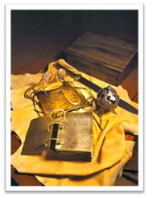
Urim and Thummim
The Urim and Thummim was “an instrument prepared of God to assist man in obtaining revelation from the Lord and in translating languages” (Bible Dictionary, “Urim and Thummim”). Joseph Smith used the Urim and Thummim to aid in the translation of the Book of Mormon. In addition to the Urim and Thummim, the Prophet used a seer stone in the translation process.
Joseph Smith –History 1:59

Slide 11
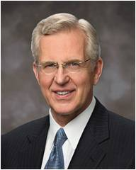
Respect for Sacred Things
“Be wise with what the Lord gives you. It is a trust. …
“Rather than drifting into carelessness, may your life be one of increasing exactness in obedience. I hope you will think and feel and dress and act in ways that show reverence and respect for sacred things, sacred places, sacred occasions”
Elder D. Todd Christofferson
Joseph Smith –History 1:60

Slide 12
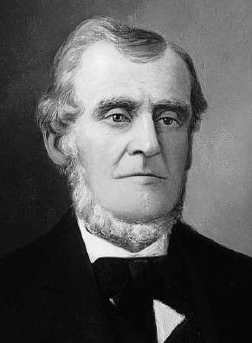
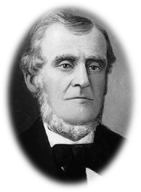
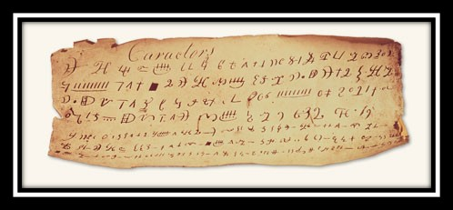
Martin Harris’ Journey
In 1828, Joseph Smith copied some of the characters onto a piece of paper. Martin Harris asked if he could present a copy of some of the characters from the plates to scholars in New York who had knowledge of ancient languages and civilizations. Several copies of the characters were made. It is unknown whether this was the actual copy that Martin Harris presented to the scholars.
Joseph Smith –History 1:63-65

Slide 13
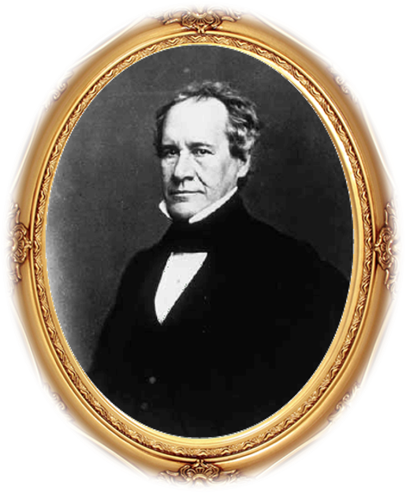
Taking the Writings to a Professor
“I went to the city of New York, and presented the characters which had been translated, with the translation thereof, to Professor Charles Anthon, a gentleman celebrated for his literary attainments. Professor Anthon stated that the translation was correct, more so than any he had before seen translated from the Egyptian. I then showed him those which were not yet translated, and he said that they were Egyptian, Chaldaic, Assyriac, and Arabic; and he said they were true characters. He gave me a certificate, certifying to the people of Palmyra that they were true characters, and that the translation of such of them as had been translated was also correct. I took the certificate and put it into my pocket, and was just leaving the house, when Mr. Anthon called me back, and asked me how the young man found out that there were gold plates in the place where he found them. I answered that an angel of God had revealed it unto him.”
Joseph Smith –History 1:64

Slide 14
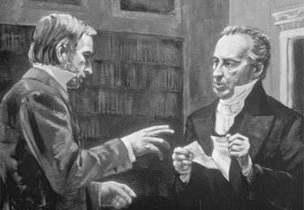
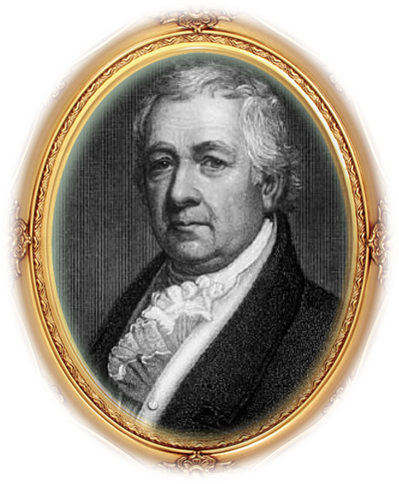
Tearing the Translation
“He then said to me, ‘Let me see that certificate.’ I accordingly took it out of my pocket and gave it to him, when he took it and tore it to pieces, saying that there was no such thing now as ministering of angels, and that if I would bring the plates to him he would translate them. I informed him that part of the plates were sealed, and that I was forbidden to bring them. He replied, ‘I cannot read a sealed book.’
I left him and went to Dr. Mitchell, who sanctioned what Professor Anthon had said respecting both the characters and the translation.”
Dr. Samuel Latham Mitchell—1764-1831
Born in Long Island--manual
Joseph Smith –History 1:65

Slide 15
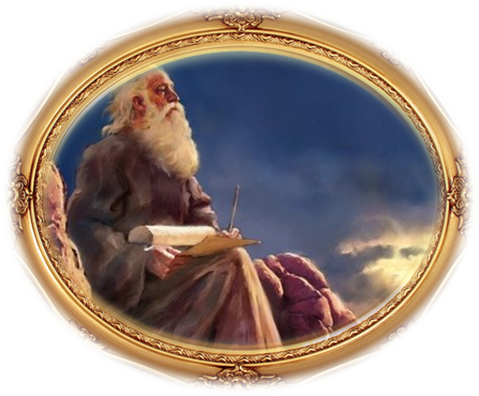
Prudent Men Shall Be Hid
For the Lord hath poured out upon you the spirit of deep sleep, and hath closed your eyes: the prophets and your rulers, the seers hath he covered.
And the vision of all is become unto you as the words of a book that is sealed, which men deliver to one that is learned, saying, Read this, I pray thee: and he saith, I cannot; for it is sealed:
And the book is delivered to him that is not learned, saying, Read this, I pray thee: and he saith, I am not learned.
Isaiah 29:10-12
The prophecies of the Lord’s servants will come to pass
Joseph Smith –History 1:63-65

Slide 16
Sources:
Video:
A Marvelous Work and a Wonder (3:57)
Who’s Who in the Doctrine and Covenants by Ed. J. Pinegar and Richard J. Allen pg. 133-134
Emma Smith Art sketch –Chris White Photo Courtesy of RLDS Archives
Lucy Mack Smith, History of Joseph Smith by His Mother, ed. Preston Nibley [1958], 93).
Joseph Smith (in Lucy Mack Smith, History of Joseph Smith by His Mother, ed. Preston Nibley [1958], 108).
Elder D. Todd Christofferson (“A Sense of the Sacred” [Church Educational System fireside for young adults, Nov. 7, 2004], 9,
Manual on Dr. Samuel L. Mitchell-- Chapter Four: A Period Of Preparation, 1823–29
Church History In The Fulness Of Times Student Manual, (2003), 37–51
Presentation by ©http://fashionsbylynda.com/blog/

Slide 17
Joseph Smith—History 1:59–62. “By means of the Urim and Thummim I translated”
Elder Neal A. Maxwell of the Quorum of the Twelve Apostles said the following about the translation process and Joseph Smith’s use of the Urim and Thummim and the seer stone:
“The Prophet Joseph alone knew the full process, and he was deliberately reluctant to describe details. We take passing notice of the words of David Whitmer, Joseph Knight, and Martin Harris, who were observers, not translators. David Whitmer indicated that as the Prophet used the divine instrumentalities provided to help him, ‘the hieroglyphics would appear, and also the translation in the English language … in bright luminous letters.’ Then Joseph would read the words to Oliver (quoted in James H. Hart, “About the Book of Mormon,” Deseret Evening News, 25 Mar. 1884, 2). Martin Harris related of the seer stone: ‘Sentences would appear and were read by the Prophet and written by Martin’ (quoted in Edward Stevenson, “One of the Three Witnesses: Incidents in the Life of Martin Harris,” Latter-day Saints’ Millennial Star, 6 Feb. 1882, 86–87). Joseph Knight made similar observations (see Dean Jessee, “Joseph Knight’s Recollection of Early Mormon History,” BYU Studies 17 [Autumn 1976]: 35).
“Oliver Cowdery is reported to have testified in court that the Urim and Thummim enabled Joseph ‘to read in English, the reformed Egyptian characters, which were engraved on the plates’ (“Mormonites,” Evangelical Magazine and Gospel Advocate, 9 Apr. 1831). If these reports are accurate, they suggest a process indicative of God’s having given Joseph ‘sight and power to translate’ (D&C 3:12).
“If by means of these divine instrumentalities the Prophet was seeing ancient words rendered in English and then dictating, he was not necessarily and constantly scrutinizing the characters on the plates—the usual translation process of going back and forth between pondering an ancient text and providing a modern rendering.
“The revelatory process apparently did not require the Prophet to become expert in the ancient language. …
“Whatever the details of the process, it required Joseph’s intense, personal efforts along with the aid of the revelatory instruments. The process may have varied as Joseph’s capabilities grew, involving the Urim and Thummim but perhaps with less reliance upon such instrumentalities in the Prophet’s later work of translation. Elder Orson Pratt of the Quorum of the Twelve Apostles said Joseph Smith told him that he used the Urim and Thummim when he was inexperienced at translation but that later he did not need it, which was the case in Joseph’s translation of many verses of the Bible (see Latter-day Saints’ Millennial Star, 11 Aug. 1874, 498–99)” (“By the Gift and Power of God,” Ensign, Jan. 1997, 39).

Slide 18
Elder Neal A. Maxwell
“Many who read the Book of Mormon understandably desire to know more about its coming forth, including the actual process of translation. This was certainly so with faithful and loyal Hyrum Smith. Upon inquiring, Hyrum was told by the Prophet Joseph that ‘it was not intended to tell the world all the particulars of the coming forth of the Book of Mormon’ and that ‘it was not expedient for him to relate these things’ (History of the Church, 1:220). Thus what we do know about the actual coming forth of the Book of Mormon is adequate, but it is not comprehensive. …
“Whatever the details of the process, it required Joseph’s intense, personal efforts along with the aid of the revelatory instruments. The process may have varied as Joseph’s capabilities grew, involving the Urim and Thummim but perhaps with less reliance upon such instrumentalities in the Prophet’s later work of translation. Elder Orson Pratt of the Quorum of the Twelve Apostles said Joseph Smith told him that he used the Urim and Thummim when he was inexperienced at translation but that later he did not need it, which was the case in Joseph’s translation of many verses of the Bible (see Latter-day Saints’ Millennial Star, 11 Aug. 1874, 498–99). …
“Why do we not have more disclosure concerning the process of translation of the Book of Mormon? Perhaps the full process was not disclosed because we would not be ready to understand it, even if given. Perhaps, too, the Lord wanted to leave the Book of Mormon in the realm of faith, though it is drenched with intrinsic evidence. After all, Christ instructed Mormon, who was reviewing the Savior’s own teachings among the Nephites, not to record all of them on the plates because ‘I will try the faith of my people’ (3 Ne. 26:11). Perhaps the details of translation are withheld also because we are intended to immerse ourselves in the substance of the book rather than becoming unduly concerned with the process by which we received it” (“By the Gift and Power of God,” Ensign, Jan. 1997, 39, 41).
Joseph Smith—History 1:63–65. Who were the scholars Martin Harris visited?
Martin Harris visited at least three men who had reputations as able linguists. In Albany, New York, he talked with Luther Bradish, a diplomat, statesman, world traveler, and student of languages. In New York City he visited Dr. Samuel Mitchell, vice president of Rutgers Medical College. He also visited a man who knew several languages including Hebrew and Babylonian. This was Professor Charles Anthon of Columbia College in New York City, who was among the leading classical scholars of his day. At the time of Martin Harris’s visit, Charles Anthon was adjunct professor of Greek and Latin. He knew French, German, Greek, and Latin and was familiar, if books in his library are evidence, with the latest discoveries pertaining to the Egyptian language, including the early work of Champollion.

Slide 19
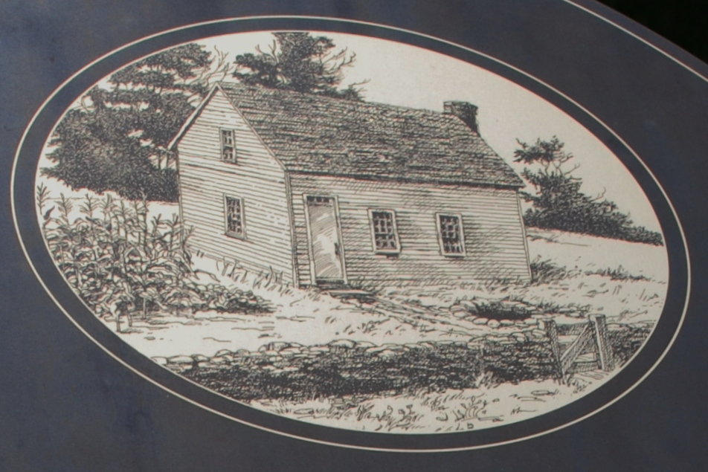
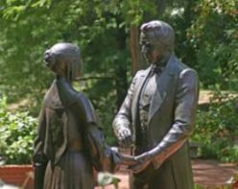
Joseph said that he was married to Emma Hale on January 1827 "while I was yet employed in the service of Mr. Stoal." (There are two known spellings of Josiah's last name, Stowell and Stoal.) After Joseph and Emma were married, the newlyweds were taken by Josiah to Joseph's parents home in Manchester, New York, (the Smith Family Farm) where they stayed from January to December 1827.
Joseph and Emma lived in a small three room farm house on a 13 1/2 acre farm that they purchased from Emma's brother. The house burned down in 1918, but this sketch (below) was made from a photograph of the original home before it burned.
While living on this small farm Joseph translated most of the Book of Mormon, with Oliver Cowdery acting a scribe. Also, while they were living here Emma was asked to make a selection of sacred hymns which became the first hymn book for the Church.
Emma's parents, Isaac and Elizabeth Hale, lived on a farm next to where Joseph and Emma settled. The sketch below is an artist's rendition of their home, the home where Emma grew up.
Joseph Smith—History 1:56. “Hence arose the very prevalent story of my having been a money-digger”
Since the early days of the Restoration, critics have attacked Joseph Smith’s character because he was employed as a youth to dig for money. Critics labeled his efforts as “money-digging” or “treasure-seeking” in an effort to blot his character. Joseph Smith grew up in a time and culture in which treasure-seeking or digging for buried gold and silver was common and accepted. In his history, Joseph Smith explains that he and his family were hired to dig for silver (see Joseph Smith—History 1:56).
http://wattspalmyramission.blogspot.com/2011/04/historic-harmony-susquehanna-river-lds.html

