Slide 2
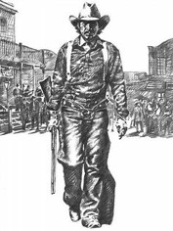
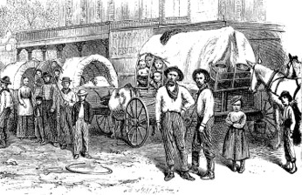
Background
They demanded that no more Latter-day Saints be allowed to move to Jackson County and said that those already living there must pledge to leave as soon as possible.
In addition, they demanded that the Church newspaper stop publication.
On Saturday, July 20, 1833, between 400 and 500 angry Missouri citizens met at the courthouse in Independence, Missouri. They chose a committee to draft a document outlining their demands of the Mormons.
When these demands were presented to the Church leaders in Missouri, the Church leaders were startled and asked for three months to consider the proposition and to consult with Church leaders in Ohio.
The group of Missouri citizens presenting the demands denied the Church leaders’ request.
The Saints then asked for 10 days, but they were allowed only 15 minutes to respond.
Fulness of Times Student Manual

Slide 3
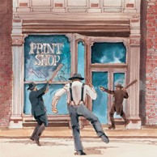
The Missourians at the meeting in the Independence courthouse quickly turned into a mob and decided to destroy the printing office and the press.
They broke into the printing office, threw the furniture into the street and garden, broke the press, scattered the type, and destroyed nearly all the printed work, including most of the unbound sheets of the Book of Commandments.
The mob next went to destroy the Gilbert and Whitney Store. However, Sidney Gilbert met the mob before they could carry out their plan and promised that he would pack the goods and leave in three days.
Fulness of Times Student Manual

Slide 4
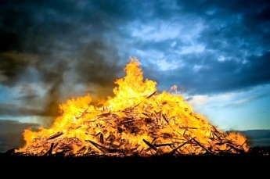
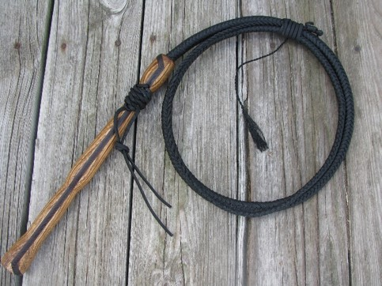
Three days later, on July 23, a mob appeared again in Jackson County, Missouri, this time armed with rifles, pistols, whips, and clubs. They set fire to haystacks and grain fields and destroyed several homes, barns, and businesses.
They eventually confronted six Church leaders who, seeing that the property and lives of the Saints were in jeopardy, offered their lives as a ransom.
Rejecting this offer, the mob leaders threatened that every man, woman, and child would be whipped unless they consented to leave the county.
Edward Partridge, William Phelps,
Isaac Morley, A. Sidney Gilbert, John Whitmer, and John Corrill
Under pressure, the brethren signed an agreement to leave Jackson County.
Half of the Church members and most of the leaders would leave by January 1, 1834, and the rest would leave by April 1, 1834.
The mob allowed John Corrill and Sidney Gilbert to remain to sell the property of the Saints who had been driven out.
Fulness of Times Student Manual

Slide 5
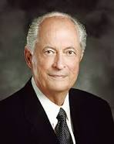
Sabaoth
Hebrew word meaning “hosts” or “armies.”
What, then, does it mean to wait upon the Lord?
In the scriptures, the word wait means to hope, to anticipate, and to trust. To hope and trust in the Lord requires faith, patience, humility, meekness, long-suffering, keeping the commandments, and enduring to the end”
Robert D. Hales
If we give thanks in all things and wait patiently on the Lord, then the Lord can make our afflictions work together for our good
D&C 98:1-2

Slide 6
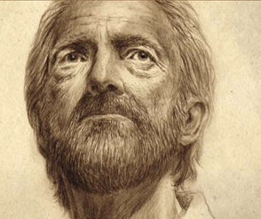
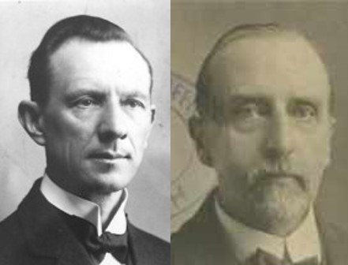
A Call To Show Great Faith
Example:
The Trials of Job
“Even the evil designs of men, in the hands of the Masterworkman, will turn out for the benefit of the people of God, and for His glory.
The divine Will overrules all things for the final good of His children.”
Smith and Sjodahl
Though he slay me, yet will I trust in him: but I will maintain mine own ways before him.
Job 13:15
D&C 98:3

Slide 7
Law of Forgiveness
“It is natural for people’s feelings to be aroused when they suffer unjust abuses. …some felt a desire to retaliate.
“…The law of forgiveness and retribution depicted in the latter half of this revelation is most worthy of careful study. This law applies to individuals and to families, as well as to the Church at large.”
Joseph Fielding Smith
For the eyes of the Lord are over the righteous, and his ears are open unto their prayers: but the face of the Lord is against them that do evil
1 Peter 3:12
D&C 98:4

Slide 8
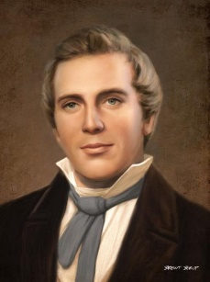
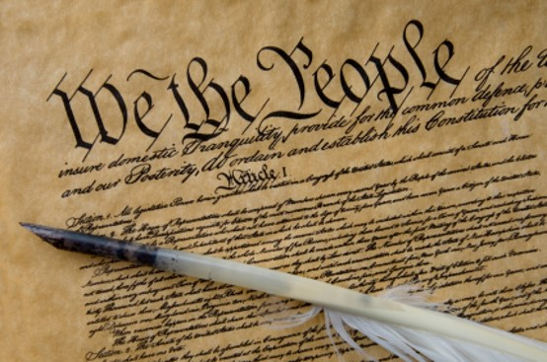
Principle of Freedom
Constitutional Law of the Land
“that principle of freedom in maintaining rights and privileges” and belonged “to all mankind”
We believe in being subject to kings, presidents, rulers, and magistrates, in obeying, honoring, and sustaining the law.
“It is one of the first principles of my life, and one that I have cultivated from my childhood, having been taught it by my father, to allow every one that liberty of conscience. I am the greatest advocate of the Constitution of the Untitled States there is on the earth. In my feelings I am always ready to die for the protection of the weak and oppressed in their just rights”
Joseph Smith
D&C 98:4-10

Slide 9
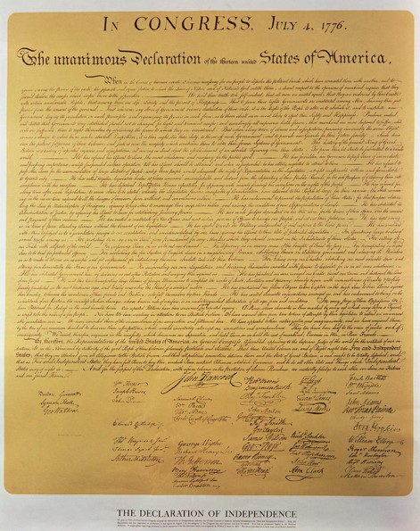
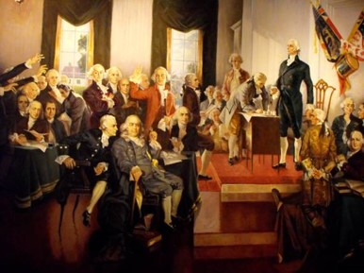
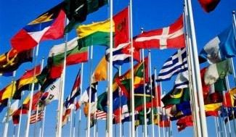
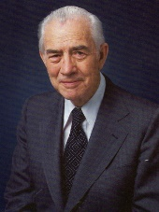
Purpose of the Law
“Without the Constitution there would be no government such as the Lord had in mind.
“The Lord gave us that government by providing the Constitution written by the hands of wise men whom he raised up for this very purpose.
“It was an act of God. It was another step in establishing the free conditions under which the gospel could be restored and then taken by the believing Gentiles to all other nations.”
Elder Mark E. Petersen
D&C 98:8

Slide 10
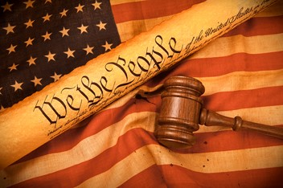
Benefits of the Law
“All the laws of god and the laws of nature and the laws of the land are made for the benefit of man, for his comfort, enjoyment, safety, and well-being; and it is up to the individual to learn these laws and to determine whether or not he will enjoy these benefits by obeying the law and keeping the commandments.
President N. Eldon Tanner
How do I know that a given law is constitutional and justifiable before the Lord?
“Any law that supports the principle of freedom in maintaining the rights and privileges, of mankind is constitutional in the eyes of the Lord”
“Any law that restricts or diminishes the right of agree agency of an individual is not constitutional.”
(see comment of Elder Marion G. Romney)
D&C 98:5-6

Slide 11
When Wicked Rules—Others Mourn
“However, constitutional laws alone do not necessarily insure a righteous environments as a blessing for the people.”
“The Lord expects His people to be righteously involved in the political process.”
We must seek and uphold honest and righteous men to administer righteous laws
D&C 98:9-10 Otten and Caldwell

Slide 12
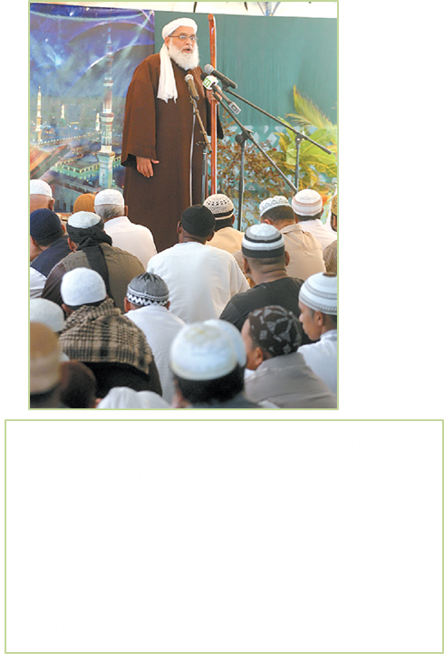
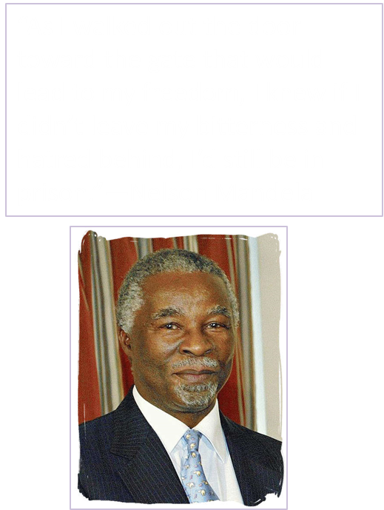
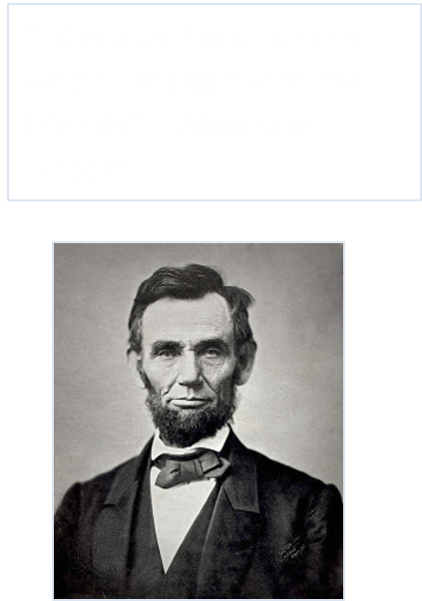
Men of Honor

Slide 13
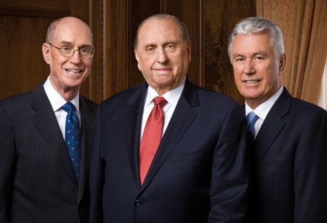
The following letter was issued by the First Presidency of The Church of Jesus Christ of Latter-day Saints on September 11, 2008, to be read to Church congregations throughout the United States:
Political Participation, Voting, and the Political Neutrality of the Church
As citizens we have the privilege and duty of electing office holders and influencing public policy. Participation in the political process affects our communities and nation today and in the future.
Latter-day Saints as citizens are to seek out and then uphold leaders who will act with integrity and are wise, good, and honest. Principles compatible with the gospel may be found in various political parties.
Therefore, in this election year, we urge you to register to vote, to study the issues and candidates carefully and prayerfully, and then to vote for and actively support those you believe will most nearly carry out your ideas of good government.
The Church affirms its neutrality regarding political parties, platforms, and candidates. The Church also affirms its constitutional right of expression on political and social issues.
Sincerely yours,
Thomas S. Monson Henry B. Eyring Dieter F. Uchtdorf The First Presidency (2016)

Slide 14
Forsake All Evil
Everything that is contrary to the will of God
All good includes all that is in harmony with the will of God
The Lord will test us to see if we will keep our covenants even when it is difficult to do so
Obedience to the commandments of God opens a door to the revelations of God
D&C 98:11-13

Slide 15
Fear Not Your Enemies
Live to be immune from the world
Be in the line of duty
Be worthy of the Fellowship with God
Stand spotless before the world—without blemish or transgression
Be ready, in frame of understanding, mind, and conduct
D&C 98:14-15 President Joseph F. Smith (excerpt from)

Slide 16
Proclaim Peace
There is no blessing greater than peace
There is no greater evil than war
Our righteous attitudes are pre-requisite to our righteous relationship to the Lord
An evil reaction is not in harmony with the godliness required of the Saints
D&C 98:16-22

Slide 17
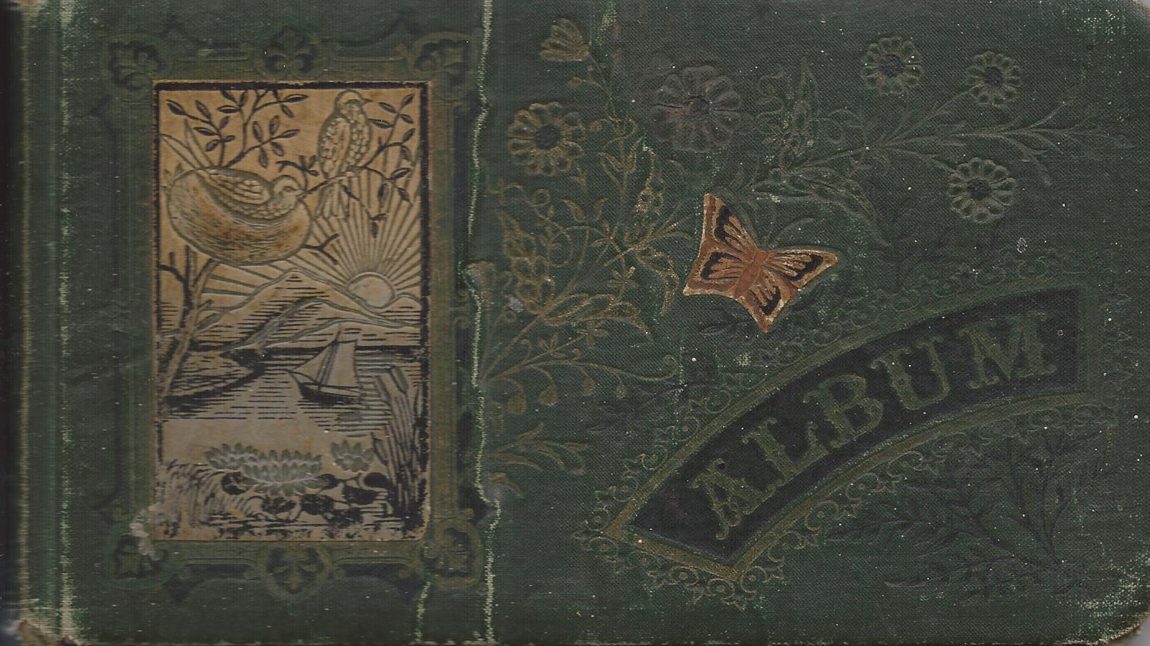
Turn the Hearts of the Children
This is the great mission of the Church of Jesus Christ of Letter-day Saints. War is one with he evils they must forsake; peace is one of the blessings they must cleave to. For they are to link together the hearts of the ancestors and their descendants.”
Smith and Sjodahl
D&C 98:16-22

Slide 18
Sources:
Videos: Afflictions Can Be For Our Good (1:44)
Prayers Feel Unanswered (You Tube) Michael S. Wilcox (1:00:00)
God Will Lift Us Up (4:59)
Legacy Video (time codes: 5:39 and 7:45
(See Church History in the Fulness of Times Student Manual, 2nd ed. [Church Educational System manual, 2003], 132–34.)
Robert D. Hales (“Waiting upon the Lord: Thy Will Be Done,” Ensign or Liahona, Nov. 2011, 72).
Hyrum M. Smith and Janne M. Sjodahl Doctrine and Covenants Commentary pg. 616, 621
Joseph Fielding Smith CHMR, Vol. 2, p. 191
Joseph Smith Teachings of the Prophet Joseph Smith p. 326
Elder Mark E. Petersen (Great Prologue, pp. 74–75, 78.)
President N. Eldon Tanner April 1970 Conf. Report
L.G. Otten and C.M. Caldwell Sacred Truths of the Doctrine and Covenants pg. 166
President Joseph F. Smith The Gospel a Shield from Terror, Improvement Era, July 1917, p. 827
Presentation by ©http://fashionsbylynda.com/blog/

Slide 19
Elder Mark E. Petersen explained:
“When the Kirtland Temple was to be dedicated and the Prophet Joseph sought direction from the Lord in accomplishing this important responsibility, the Lord gave to the Prophet the dedicatory prayer for the occasion. It was revelation—the word of the Lord—and not of man. Yet in it, the Lord directed the prophet to pray: "… may those principles, which were so honorably and nobly defended, namely, the Constitution of our land, by our fathers, be established forever.’ (D&C 109:54.) This is significant!
“Let us recall again the words of the Lord to the Nephites. Said he, in speaking of this mighty nation of the Gentiles that he said would be established on this land in latter days: ‘For it is wisdom in the Father that they should be established in this land, and be set up as a free people by the power of the Father. …’ (3 Nephi 21:4. Italics added.)
“Without the Constitution there would be no government such as the Lord had in mind. The Lord gave us that government by providing the Constitution written by the hands of wise men whom he raised up for this very purpose. It was an act of God. It was another step in establishing the free conditions under which the gospel could be restored and then taken by the believing Gentiles to all other nations.
“As the Lord indicated so plainly through Nephi and likewise in his own declaration to the Nephites after his resurrection as quoted above, it was a giant step in the divine plan to fulfill the promise made to Abraham, that God would recover his scattered seed by the preaching of the gospel. (See 1 Nephi 22:7–11; 3 Nephi 21:4.) His sheep would know his voice.
“This, then, is why there is a United States.
“The Prophet Joseph Smith said that ‘the Constitution of the United States is a glorious standard; it is founded in the wisdom of God. It is a heavenly banner. …’ (Teachings of the Prophet Joseph Smith, p. 147. Italics added.)
“He also said, ‘I am the greatest advocate of the Constitution of the United States there is on earth.’ (Ibid., p. 326.)
“The Constitution provided freedom of religion, speech, press, and assembly. Therefore, under the Constitution the Lord could restore the gospel and reestablish his church. The preparation of the Constitution was the work of his own hand. The restoration of the gospel was likewise his work. Both were part of a greater whole. Both fit into his pattern for the latter days.
“There would be no state church in America to interfere. All men in this land now were given the right to worship God according to the dictates of their own conscience, and that included Joseph Smith and his followers. It is true they were persecuted, as the people of God always have been, but the law—the Constitution—provided the very thing the Lord had in mind: freedom to reestablish his work in these last days, for he had so arranged it. …
“For years the Church has held that the Constitution is an inspired document. But how many know why it was inspired and what the Almighty had in mind in giving such inspiration?
“May we never forget the underlying reasons for it all: to provide a proper place for the restoration of the gospel and to allow for the worldwide preaching of that sacred word.
“Let us always remember that its formation was one of the vital steps preparatory to the second coming of the Savior.” (Great Prologue, pp. 74–75, 78.)

Slide 20
Elder Marion G. Romney
“We who hold the Priesthood must beware concerning ourselves, that we do not fall into the traps he (Satan) lays to rob us of our freedom. We must be careful that we are not led to accept or support in any way any organization, cause, or measure which, in its remotest effect, would jeopardize free agency, whether it be in politics, government, religion, employment, education, or any other field. It is not enough for us to be sincere in what we support. We must be right?” (CR October 1960 p. 75)

