Slide 2
Support and Sustain
To give support or relief to
To support as true, legal, or just
To allow or admit as valid
To agree with or approve of (someone or something)
To show that you approve of (someone or something) by doing something
To give help or assistance to (someone or something)
Uphold
to allow or admit as valid
D&C 107:21-22

Slide 3
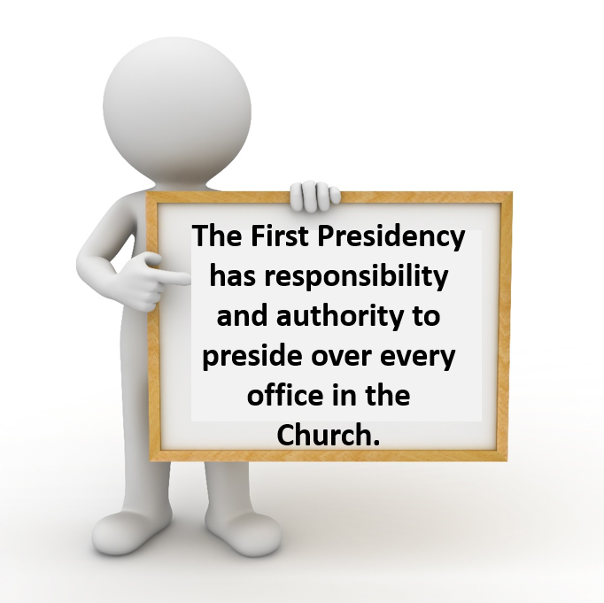
The First Presidency
This is the highest priesthood quorum of the church. All others function under their authority and direction. Members of this quorum hold all the keys of the kingdom of God. They direct the use of the Lord’s power and authority throughout the world.
D&C 107:22 Otten and Caldwell

Slide 4
The Quorum of the Twelve
“Each member of the Quorum of Twelve Apostles holds the keys of the kingdom in concert with the other members of the Quorum and function under the direction of the First Presidency of the Church.”
“The Quorum of the Twelve Apostles is equal in authority and power to the First Presidency.”
D&C 107:24 Otten and Caldwell

Slide 5
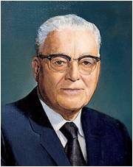
“All members of the First Presidency and the Twelve are regularly sustained as ‘prophets, seers, and revelators,’ as you have done today.
This means that any one of the apostles, so chosen and ordained, could preside over the Church if he were ‘chosen by the body [which has been interpreted to mean, the entire Quorum of the Twelve], appointed and ordained to that office, and upheld by the confidence, faith, and prayer of the church,’ to quote from a revelation on this subject, on one condition, and that being that he was the senior member, or the president, of that body.”
President Harold B. Lee
D&C 107:22

Slide 6
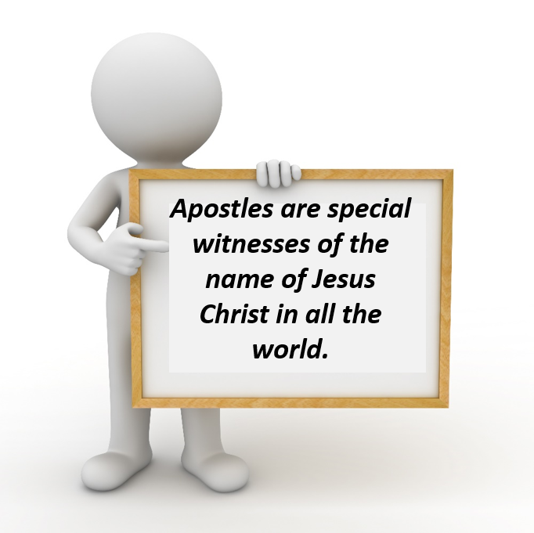
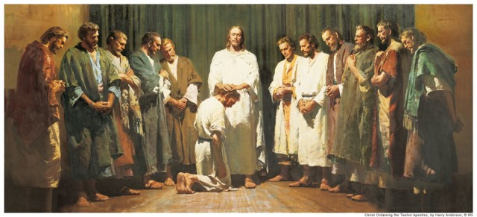
Special Witnesses
The word means “one sent forth.”
It was the title Jesus gave to the Twelve whom He chose and ordained (John 15:16) to be His closest disciples during His ministry on earth and whom He sent forth to represent Him after His Ascension into heaven.
D&C 107:23-24 Bible Dictionary

Slide 7
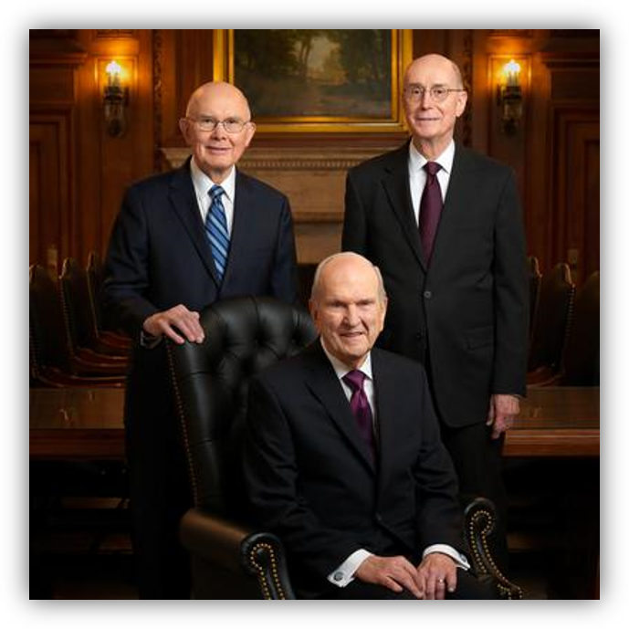
Senior Apostle
President of the Church is the senior Apostle on the earth and that the counselors in the First Presidency are also Apostles.
Therefore, members of the First Presidency are also special witnesses of the name of Jesus Christ.
D&C 107:23

Slide 8
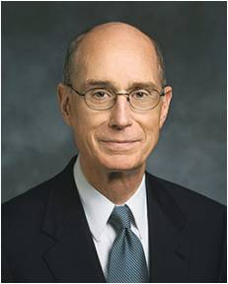
“For us to sustain those who have been called … , we must examine our lives, repent as necessary, pledge to keep the Lord’s commandments, and follow His servants. …
“… It would be wise to determine to sustain with our faith and our prayers all those who serve us in the kingdom. I am personally aware of the power of the faith of members of the Church to sustain those who have been called. … I have felt in powerful ways the prayers and the faith of people whom I do not know and who know me only as someone called to serve through the keys of the priesthood.”
President Henry B. Eyring

Slide 9
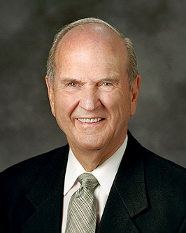
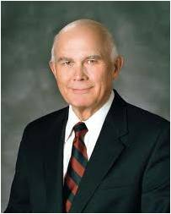
Ordained Apostles
When men are ordained Apostles, they are given the same priesthood keys as the President of the Church.
However, the President of the Church, as the presiding high priest over the Melchizedek Priesthood, is the only man on the earth who is authorized to exercise all of the keys of the priesthood. The other Apostles use these priesthood keys as authorized by the President of the Church.
When a President of the Church dies, the First Presidency is dissolved and the Quorum of the Twelve, which is equal in authority and power to the First Presidency, becomes the presiding body of the Church.
As President of the Quorum of the Twelve, the senior living Apostle is then authorized to exercise all of the keys of the priesthood.
As of Today Jan. 2019—Who is the successor of President Nelson?
D&C 107:23

Slide 10
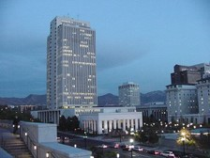
The Seventy
Some Seventies are assigned to headquarters administrative functions, but most live and work within a specific geographic region of the Church. Like the Apostles, they also travel frequently to visit and teach congregations of the Church.
THERE ARE CURRENTLY EIGHT QUORUMS of the Seventy. Each quorum may have up to 70 members. Members of Quorums of the Seventy are often referred to simply as “Seventies.” Seventies are called to proclaim the gospel and build up the Church. They work under the direction of the Quorum of the Twelve Apostles and the Presidency of the Seventy
Members of the First Quorum of the Seventy are called to serve until the age of 70, at which time they are given emeritus status (similar to being released).
Members of the Second Quorum of the Seventy typically serve for three to five years; after this time, they are released. Members of the First and Second Quorums of the Seventy are considered General Authorities, meaning that they have authority to serve anywhere in the world. Members of the remaining quorums are called Area Seventies, and their authority is limited to the area where they serve.
D&C 107:25 Quorums of the Seventy

Slide 11
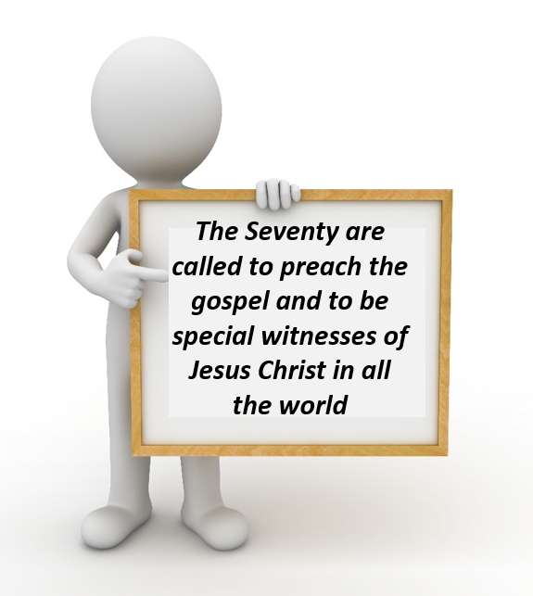
Callings of the Seventies
“Seventies act by assignment and by the delegation of authority from the First Presidency and Quorum of the Twelve Apostles. …
The Presidency of the Seventy are set apart and are given the keys to preside over the Quorums of Seventy”
Handbook 2
Do you know who your area Seventy is?
D&C 107:25

Slide 12
Making Decisions
How do groups of people generally make decisions?
How do you think these approaches compare to how the First Presidency, the Quorum of the Twelve Apostles, and the Seventy make decisions?
D&C 107:27-32

Slide 13
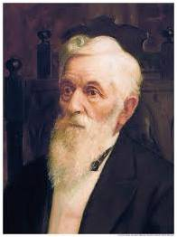
“Here are my counselors. We are one. We are united. … And here we have twelve men sitting in front with us—Twelve Apostles. There are many of these that you know. …
We are united together. We do not quarrel with each other. We do not slander one another, but we go where counsel requires and we are heart and soul together.
What for? Not to make ourselves rich, not to make ourselves wealthy, but to see what we can accomplish in the interests of the people, and we are laboring continually to see what we can do. We come together every week and we talk about what we can do for the people.”
President Lorenzo Snow
D&C 107:27-32

Slide 14
Spiritual Authorities
If a decision of one of the leading quorums of the Church is thought to have been made in unrighteousness, the matter may be brought before “a general assembly of the several quorums”, which is the combined assembly of the First Presidency, the Quorum of the Twelve Apostles, and the First Quorum of the Seventy.
These bodies are the “spiritual authorities of the church”, and the only appeal from a decision of one of these quorums is to this combined assembly.
D&C 107:32

Slide 15
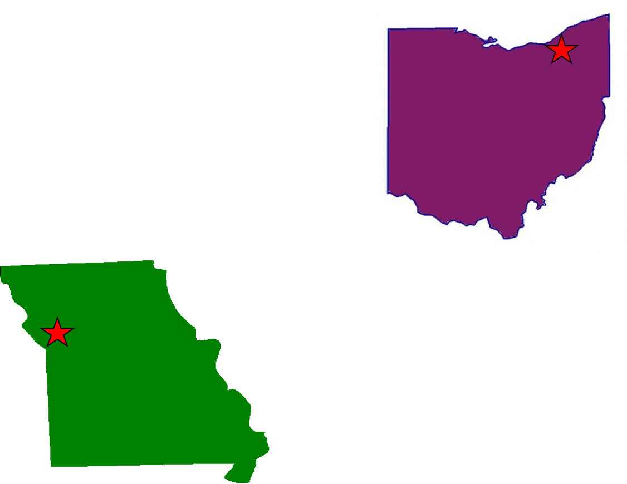
Standing High Councils
“In 1835 when D&C 107 was reveled there were two high councils, on in Ohio and the other in Missouri.
The one in Ohio was the first organized, and the minutes of that organization are recorded in section 102.
The minutes constitute in some respects guidelines for high councils today, especially in the functioning of courts.
Since it was the only high council in the Church when it was organized in February 1834, the Kirtland high council was presided over by the First Presidency and had general jurisdiction throughout the church.
D&C 107:36-37

Slide 16
D&C 107:33-38

Slide 17
Sources:
Videos:
Succession in the Presidency (1:07)
Special Witness: Elder Ballard(3:48)
Sustaining the Prophets (2:10)
L.G. Otten and C.M. Caldwell Sacred Truths of the Doctrine and Covenants pg. 225
President Henry B. Eyring (“The True and Living Church,” Ensign or Liahona, May 2008, 21).
President Harold B. Lee (In Conference Report, Apr. 1970, p. 123.)
Quorums of the Seventy Organization General Authorities and Officers lds.org
(Handbook 2: Administering the Church [2010],2.1.1)
President Lorenzo Snow (In Conference Report, Oct. 1900, p. 5.)
Presentation by ©http://fashionsbylynda.com/blog/

Slide 18
Special Witnesses:
Elder David A. Bednar of the Quorum of the Twelve Apostles taught what it means to be a special witness of the name of Christ:
“The role of an Apostle today is the same as it was anciently (see Acts 1:22; 4:33). Our commission is to go into all the world and proclaim ‘Jesus Christ, and him crucified’ (see Mark 16:15;1 Corinthians 2:2). An Apostle is a missionary and a special witness of the name of Christ. The ‘name of Christ’ refers to the totality of the Savior’s mission, death, and resurrection—His authority, His doctrine, and His unique qualifications as the Son of God to be our Redeemer and our Savior. As special witnesses of the name of Christ, we bear testimony of the reality, divinity, and resurrection of Jesus Christ, His infinite and eternal Atonement, and His gospel” (“Special Witnesses of the Name of Christ,” The Religious Educator: Perspectives on the Restored Gospel, vol. 12, no. 2 [2011], 1).
Although both the Quorum of the Twelve and the First Quorum of the Seventy are to carry the gospel to the world, their specific duties are different, as Elder Howard W. Hunter outlined:
“With the rapid growth of the Church and the heavy demands on the Twelve to provide leadership and administration and teach all nations, it becomes clear why the Lord has directed the building up of the First Quorum of the Seventy. The recent decision to do so by the First Presidency and the Quorum of the Twelve reminds us of an interesting historical parallel of an episode recorded by Luke in the Acts of the Apostles. The foreign or Hellenistic Jews in Jerusalem were complaining that their widows were being neglected and not taken care of like the widows of the native Jews. When the apostles heard of this murmuring, a significant thing happened: [Acts 6:2–4].
“In other words, the Twelve told the meeting that it was not reasonable for them to leave their important office of teaching the gospel to provide for the daily welfare of the widows and serve their tables. There were other good men who could look after these duties so the Twelve could continue to devote themselves to the charge of teaching the gospel to all persons. The result of the decision to call others to assist with the details was this: [Acts 6:7]. …
“In December 1978, the First Presidency and Quorum of the Twelve made a similar determination that it was no longer advisable for the Twelve to occupy their time in the details of administration of the many Church departments. They delegated seven men, designated as the presidents of the First Quorum of the Seventy, to give supervision to these details so that the Twelve could devote their full energies to the overall direction of the work, and, as directed by the Doctrine and Covenants, ‘To build up the church, and regulate all the affairs of the same in all nations’ [D&C 107:33].
“I fully believe that in the near future we will see some of the greatest advancements in spreading the gospel to all nations that have ever taken place in this dispensation or any previous dispensation. I am sure that we will be able to look back in retrospect—as a result of the decision recently made—and record as Luke did, ‘And the word of God increased’ [Acts 6:7].” (“All Are Alike unto God,” in Speeches of the Year, 1979 [Provo: Brigham Young University Press, 1980], pp. 34–35.)
Decisions of the First Presidency:
“No decision emanates from the deliberations of the First Presidency and the Twelve without total unanimity among all concerned. At the outset in considering matters, there may be differences of opinion. These are to be expected. These men come from different backgrounds. They are men who think for themselves. But before a final decision is reached, there comes a unanimity of mind and voice.
“This is to be expected if the revealed word of the Lord is followed. Again I quote from the revelation:
“‘The decisions of these quorums, or either of them, are to be made in all righteousness, in holiness, and lowliness of heart, meekness and long suffering, and in faith, and virtue, and knowledge, temperance, patience, godliness, brotherly kindness and charity;
“‘Because the promise is, if these things abound in them they shall not be unfruitful in the knowledge of the Lord’ (D&C 107:30–31).
“I add by way of personal testimony that during the twenty years I served as a member of the Council of the Twelve and during the nearly thirteen years that I have served in the First Presidency, there has never been a major action taken where this procedure was not observed. I have seen differences of opinion presented in these deliberations. Out of this very process of men speaking their minds has come a sifting and winnowing of ideas and concepts. But I have never observed serious discord or personal enmity among my Brethren. I have, rather, observed a beautiful and remarkable thing—the coming together, under the directing influence of the Holy Spirit and under the power of revelation, of divergent views until there is total harmony and full agreement. Only then is implementation made. That, I testify, represents the spirit of revelation manifested again and again in directing this the Lord’s work” President Gordon B. Hinckley(“God Is at the Helm,” Ensign, May 1994, 54, 59).

Slide 19
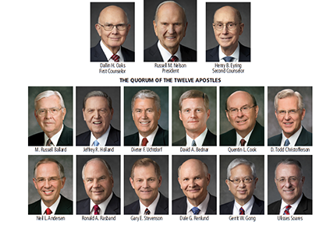
Kirtland, Ohio and Missouri High Council:
President John Taylor explained: “In Kirtland, Ohio, a great many things were revealed through the Prophet. … The High Council in Kirtland was presided over by Joseph Smith and his Counselors; and hence there were some things associated with this that were quite peculiar in themselves. It is stated that when they were at a loss to find out anything pertaining to any principles that might come before them in their councils, that the presidency were to inquire of the Lord and get revelation on those subjects that were difficult for them to comprehend.” (In Journal of Discourses, 19:241.)
After the Missouri high council was organized, the Prophet said that “if I should now be taken away, I had accomplished the great work the Lord had laid before me, and that which I had desired of the Lord; and that I had done my duty in organizing the High Council, through which council the will of the Lord might be known on all important occasions, in the building up of Zion, and establishing truth in the earth” (History of the Church, 2:124).
“This indicates the importance attached to the organization of the High Council in Zion,” wrote Smith and Sjodahl. “The standing High Councils in the various Stakes are presided over by the Stake presidency, and their jurisdiction is confined to the Stakes in which they are located.” (Commentary, p. 703; see also Notes and Commentary on D&C 102:30–32 for an explanation of the relationship between stake high councils and the standing high council of the Church.)
“The Lord indicates that the High Council in Zion (Missouri) was to form a quorum equal in authority, in the affairs of the Church, to the councils of Twelve (High Councils) at the Stakes of Zion (vs. 37). And so today a High Council in any Stake of Zion is as important as that in any other Stake. The authority and power of any Stake High Council is local and confined to the boundaries of the Stake concerned.” (Sperry, Compendium, p. 565.)

Slide 20
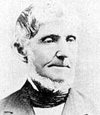
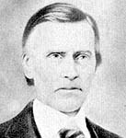
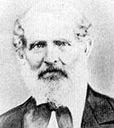
First Seven Presidents of the Seventy and First Council of the Seventy, 1835 to 1975
1. Hazen Aldrich—Set apart as one of the first seven presidents February 28, 1835; released April 6, 1837, having previously been ordained a high priest.
2. Joseph Young—Born April 7, 1797, at Hopkinton, Mass., to John Young and Abigail Howe. Ordained a seventy February 28, 1835, under the hands of Joseph Smith, Sidney Rigdon, and Frederick G. Williams; set apart as one of the first seven presidents February 28, 1835, at age 37; died July 16, 1881, at Salt Lake City, Utah.
3. Levi Ward Hancock—Born April 7, 1803, at Springfield, Mass., to Thomas Hancock and Amy Ward. Ordained a seventy February 28, 1835, under the hands of Joseph Smith, Sidney Rigdon, and Frederick G. Williams; set apart as one of the first seven presidents February 28, 1835, at age 31; released April 6, 1837, having supposedly previously been ordained a high priest; restored to his former place in the First Council September 3, 1837, because he had not been ordained a high priest; died June 10, 1882, at Washington, Utah.
4. Leonard Rich—Set apart as one of the first seven presidents February 28, 1835; released April 6, 1837, having previously been ordained a high priest.
5. Zebedee Coltrin—Born Sept. 7, 1804, at Ovid, N.Y., to John Coltrin, Jr., and Sarah Graham. Set apart as one of the first seven presidents February 28, 1835, at age 30; released Apr. 6, 1837, having previously been ordained a high priest; died July 21, 1887, at Spanish Fork, Utah.
6. Lyman Royal Sherman—Born May 22, 1804, at Salem, Mass., to Elkanah Sherman and Asenath Hulbert. Set apart as one of the first seven presidents February 28, 1835, at age 30; released Apr. 6, 1837, having previously been ordained a high priest; died Jan. 27, 1839.
7. Sylvester Smith—Set apart as one of the first seven presidents Feb. 28, 1835: released Apr. 6. 1837, having previously been ordained a high priest.
8. John Gould—Born May 11, 1808. Ordained a seventy and set apart as one of the first seven presidents Apr. 6, 1837, at age 28; released Sept. 3, 1837, to become a high priest.
9. James Foster—Born Apr. 1, 1775, at Morgan Co., Ind. Ordained a seventy Apr. 6, 1837, under the hands of Sidney Rigdon and Hyrum Smith; set apart as one of the first seven presidents Apr. 6, 1837, at age 62; died Dec. 21, 1841, at Morgan Co., Ill.
10. Daniel Sanborn Miles—Born July 23, 1772, at Sanbornton, N.H., to Josiah Miles and Marah Sanborn. Ordained a seventy Apr. 6, 1837, by Hazen Aldrich; set apart as one of the first seven presidents Apr. 6, 1837, at age 64; died in 1845, at Hancock Co., Ill.
11. Josiah Butterfield—Born Mar. 13 or 18, 1795, at Soco, Maine, to Abel Butterfield and Mary or Mercy ________. Ordained a seventy Apr. 6, 1837, under the hands of Sidney Rigdon and Hyrum Smith; set apart as one of the first seven presidents Apr. 6, 1837, at age 42; excommunicated Oct. 7, 1844; died at Monterey Co., Calif., Apr. 1871.
12. Salmon Gee—Born Oct. 16, 1792, at Lyme, Conn., to Zopher Gee and Esther Beckwith. Ordained a seventy Apr. 6, 1837, under the hands of Sidney Rigdon and Hyrum Smith; set apart as one of the first seven presidents Apr. 6, 1837, at age 44; fellowship withdrawn Mar. 6, 1838; died Sept. 13, 1845, at Ambrosia, Iowa.
13. John Gaylord—Born July 12, 1797, in Pennsylvania, to Chauncey Gaylord. Ordained a seventy Dec. 20, 1836, by Hazen Aldrich; set apart as one of the first seven presidents Apr. 6, 1837, at age 39; excommunicated Jan. 13, 1838; rejoined the Church at Nauvoo Oct. 5, 1839; died July 17, 1878.

Slide 21
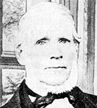
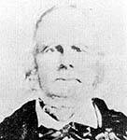
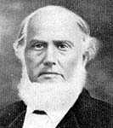
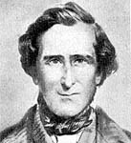
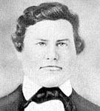
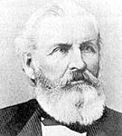
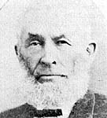
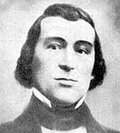
First Seven Presidents of the Seventy and First Council of the Seventy, 1835 to 1975 Continued
14. Henry Harriman—Born June 9, 1804, at Rowley, Mass., to Enoch Harriman and Sarah Brocklebank. Ordained a seventy March 1835, under the hands of Joseph Smith and Sidney Rigdon; set apart as one of the first seven presidents Feb. 6, 1838, at age 33; died May 17, 1891, at Huntington, Utah.
15. Zera Pulsipher—Born June 24, 1789, at Rockingham, Vt., to John Pulsipher and Elizabeth Dutton. Ordained a seventy Mar. 6, 1838, under the hands of Joseph Young and James Foster; set apart as one of the first seven presidents Mar. 6, 1838, at age 48; released Apr. 12, 1862; died Jan. 1, 1872, at Hebron, Utah.
Roger Orton was excommunicated Nov. 30, 1837; returned to the Church; sustained as one of the first seven presidents Apr. 7, 1845, but was never set apart and did not function; dropped from this position Oct. 6, 1845.
16. Albert Perry Rockwood—Born June 5, 1805, at Holliston, Mass., to Luther Rockwood and Ruth Perry. Ordained a seventy Jan. 5, 1839, under the hands of Joseph Young, Henry Harriman, and Zera Pulsipher; set apart as one of the first seven presidents Dec. 2, 1845, at age 40; died Nov. 26, 1879, at Sugar House, Utah.
18. Jedediah Morgan Grant—Born Feb. 21, 1816, at Windsor, N.Y., to Joshua Grant and Athalia Howard. Ordained a seventy Feb. 28, 1835, under the hands of Joseph Smith, Sidney Rigdon, and Frederick G. Williams; set apart as one of the first seven presidents Dec. 2, 1845, at age 29; sustained as second counselor to President Brigham Young, Apr. 7, 1854.
17. Benjamin Lynn Clapp—Born Aug. 19, 1814, at West Huntsville, Ala., to Ludwig Lewis Clapp and Margaret Ann Loy. Ordained a seventy Oct. 20, 1844, under the hands of Joseph Young and Levi W. Hancock; set apart as one of the first seven presidents Dec. 2, 1845, at age 31; excommunicated Apr. 7, 1859; died in 1860 in California.
19. Horace Sunderlin Eldredge—Born Feb. 6, 1816, at Brutus, N.Y., to Alanson Eldredge and Esther Sunderlin. Ordained a seventy Oct. 13, 1844, by Joseph Young; sustained as one of the first seven presidents Oct. 7, 1854, at age 38; died Sept. 6, 1888, at Salt Lake City, Utah.
20. Jacob Gates—Born Mar. 9, 1811, at Saint Johnsbury, Vt., to Thomas Gates and Patty Plumley. Ordained a seventy Dec. 19, 1838, under the hands of Joseph Smith and Sidney Rigdon; sustained as one of the first seven presidents Oct. 8, 1862, at age 51; died Apr. 14, 1892, at Provo, Utah.
21. John Van Cott—Born Sept. 7, 1814, at Canaan, N. Y., to Losee Van Cott and Lovinia Pratt. Ordained a seventy Feb. 25, 1847, by Joseph Young; sustained as one of the first seven presidents Oct. 8, 1862, at age 48; died Feb. 18, 1883, at Salt Lake City, Utah.

Slide 22
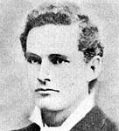
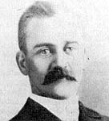
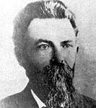
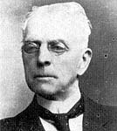
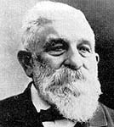
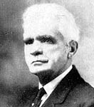
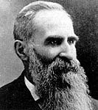
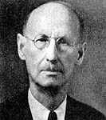
First Seven Presidents of the Seventy and First Council of the Seventy, 1835 to 1975 Continued
22. William Whittaker Taylor—Born Sept. 11, 1853, at Salt Lake City, Utah, to John Taylor and Harriet Whittaker. Ordained a seventy Oct. 11, 1875, by Orson Pratt; sustained as one of the first seven presidents Apr. 7, 1880, at age 26; died Aug. 1, 1884, at Salt Lake City, Utah.
23. Abraham Hoagland Cannon—Born Mar. 12, 1859, at Salt Lake City, Utah, to George Quayle Cannon and Elizabeth Hoagland. Ordained a seventy Oct. 9, 1882, by George Q. Cannon; sustained as one of the first seven presidents Oct. 8, 1882, at age 23; ordained an apostle Oct. 7, 1889.
Theodore Belden Lewis—Born Nov. 18, 1843, at St. Louis, Mo., to Thomas Anderson Lewis and Martha J. O. Belden. Ordained a high priest at Nephi, Utah (date not known); sustained as one of the first seven presidents Oct. 8, 1882, at age 38. On Oct. 9, when he appeared to be set apart, he reported that he was a high priest, and so he was not set apart and did not function in this position.
24. Seymour Bicknell Young—Born Oct. 3, 1837, at Kirtland, Ohio, to Joseph Young and Jane Adeline Bicknell. Ordained a seventy Feb. 18, 1857, by Edmund Ellsworth; set apart as one of the first seven presidents Oct. 14, 1882, at age 45; sustained as one of the first seven presidents Apr. 8, 1883; died Dec. 15, 1924, at Salt Lake City, Utah.
25. Christian Daniel Fjeldsted—Born Feb. 20, 1829, at Amagar, Sundbyvester Co., Copenhagen, Denmark, to Hendrik Ludvig Fjeldsted and Ann Catrine Hendriksen. Ordained a seventy Feb. 5, 1859, by William H. Walker; sustained as one of the first seven presidents Apr. 6, 1884, at age 55; died Dec. 23, 1905, at Salt Lake City, Utah.
26. John Morgan—Born Aug. 8, 1842, at Greensburg, Ind., to Gerrard Morgan and Ann Eliza Hamilton. Ordained a seventy Oct. 8, 1875, by Joseph Young; sustained as one of the first seven presidents Oct. 5, 1884, at age 42; died Aug. 14, 1894, at Preston, Idaho.
27. Brigham Henry Roberts—Born Mar. 13, 1857, at Warrington, Lancashire Co., England, to Benjamin Roberts and Ann Everington. Ordained a seventy Mar. 8, 1877, by Nathan T. Porter. Sustained as one of the first seven presidents Oct. 7, 1888, at age 31; died Sept. 27, 1933, at Salt Lake City, Utah.
28. George Reynolds—Born Jan. 1, 1842, at Marylebone, London Co., London, England, to George Reynolds and Julie Ann Tautz. Ordained a seventy Mar. 18, 1866, by Israel Barlow; sustained as one of the first seven presidents Apr. 5, 1890, at age 48; died Aug. 9, 1909, at Salt Lake City, Utah.
29. Jonathan Golden Kimball—Born June 9, 1853, at Salt Lake City, Utah, to Heber Chase Kimball and Christeen Golden. Ordained a seventy July 21, 1886, by William M. Allred; sustained as one of the first seven presidents Apr. 5, 1892, at age 38; killed in an automobile accident Sept. 2, 1938, near Reno, Nevada.

Slide 23
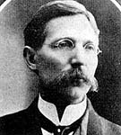
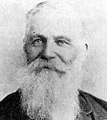
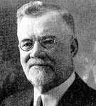
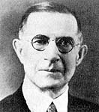
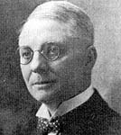
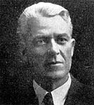
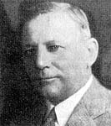
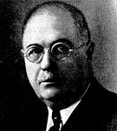
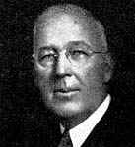
First Seven Presidents of the Seventy and First Council of the Seventy, 1835 to 1975 Continued
32. Joseph William McMurrin—Born Sept. 5, 1858, at Tooele, Utah, to Joseph McMurrin and Margaret Leaing. Ordained a seventy Apr. 21, 1884, by Royal Barney; sustained as one of the first seven presidents Oct. 5, 1897, and set apart Jan. 21, 1898, at Liverpool, England, at age 39; died Oct. 24, 1932, at Los Angeles, Calif.
30. Rulon Seymour Wells—Born July 7, 1854, at Salt Lake City, Utah, to Daniel Hanmer Wells and Louisa Free. Ordained a seventy Oct. 22, 1875, by Brigham Young; sustained as one of the first seven presidents Apr. 5, 1893, at age 38; died May 7, 1941, at Salt Lake City, Utah.
31. Edward Stevenson—Born May 1, 1820, at Gibraltar, Spain, to Joseph Stevenson and Elizabeth Stevens. Ordained a seventy May 1, 1844, by Joseph Young; sustained as one of the first seven presidents Oct. 7, 1894, at age 74; died Jan. 27, 1897, at Salt Lake City, Utah..
33. Charles Henry Hart—Born July 5, 1866, at Bloomington, Idaho, to James Henry Hart and Sabina Scheib. Ordained a seventy Aug. 10, 1890, by John Henry Smith; sustained as one of the first seven presidents Apr. 9, 1906, at age 39; died Sept. 29, 1934, at Salt Lake City, Utah.
34. Levi Edgar Young—Born Feb. 2, 1874, at Salt Lake City, Utah, to Seymour Bicknell Young and Ann Elizabeth Riter. Ordained a seventy June 18, 1897, by Seymour B. Young; sustained as one of the first seven presidents Oct. 6, 1909, and set apart Jan. 23, 1910, at age 36; died Dec. 13, 1963, at Salt Lake City, Utah.
35. Rey Lucero Pratt—Born Oct. 11, 1878, at Salt Lake City, Utah, to Helaman Pratt and Emeline Victoria Billingsley. Ordained a seventy Sept. 23, 1911, by Rulon S. Wells; sustained as one of the first seven presidents Jan. 29, 1925, and set apart Apr. 7, 1925, at age 46; died Apr. 14, 1931, at Salt Lake City, Utah.
36. Antoine Ridgeway Ivins—Born May 11, 1881, at Saint George, Utah, to Anthony Woodward Ivins and Elizabeth A. Snow. Ordained a seventy Dec. 28, 1913, by Fred E. Barker; sustained as one of the First Council of the Seventy, Oct. 4, 1931, at age 50; ordained a high priest June 11, 1961, by David O. McKay; died Oct. 18, 1967, at Salt Lake City, Utah.
37. Samuel Otis Bennion—Born June 9, 1874, at Taylorsville, Utah, to John Rowland Bennion and Emma Jane Terry. Ordained a seventy Mar. 14, 1904, by Samuel Gerrard; sustained as one of the First Council of the Seventy Apr. 6, 1933, at age 58; died May 28, 1946, at Salt Lake City, Utah.
38. John Harris Taylor—Born June 28, 1875, at Salt Lake City, Utah, to Thomas E. Taylor and Emma L. Harris. Ordained a seventy Jan. 24, 1896, by Heber J. Grant; sustained as one of the First Council of the Seventy Oct. 6, 1933, at age 58; died May 28, 1946, at Salt Lake City, Utah.

Slide 24
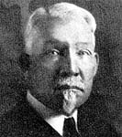
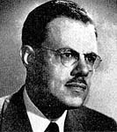
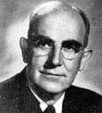
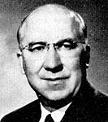
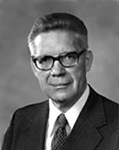
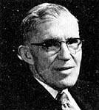
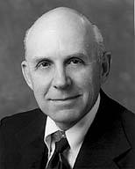
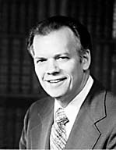
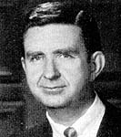
First Seven Presidents of the Seventy and First Council of the Seventy, 1835 to 1975 Continued
39. Rufus Kay Hardy—Born May 28, 1878, at Salt Lake City, Utah, to Rufus H. Hardy and Annie Kay. Ordained a seventy July 2, 1897, by John Henry Smith; sustained as one of the First Council of the Seventy Oct. 6, 1934, and set apart Feb. 7, 1935, at age 56; died Mar. 7, 1945, at Salt Lake City, Utah.
40. Richard Louis Evans—Born Mar. 23, 1906, at Salt Lake City, Utah, to John A. Evans and Florence Neslen. Ordained a seventy Aug. 5, 1938, by Rulon S. Wells; sustained as one of the First Council of the Seventy Oct. 7, 1938, at age 32; ordained an apostle Oct. 8, 1953.
41. Oscar Ammon Kirkham—Born Jan. 22, 1880, at Lehi, Utah, to James Kirkham and Martha Mercer. Ordained a seventy Feb. 26, 1906, by Joseph W. McMurrin; sustained as one of the First Council of the Seventy Oct. 5, 1941, at age 61; died Mar. 10, 1958, at Salt Lake City, Utah.
42. Seymour Dilworth Young—Born Sept. 7, 1897, at Salt Lake City, Utah, the son of Seymour Bicknell Young, Jr., and Carlie Louine Clawson. Ordained a seventy Jan. 9, 1920, by Seymour B. Young; sustained as one of the First Council of the Seventy Apr. 6, 1945, at age 47; ordained a high priest June 11, 1961, by Henry D. Moyle.
43. Milton Reed Hunter—Born Oct. 25, 1902, at Holden, Utah, to John E. Hunter and Margaret Teeples. Ordained a seventy Aug. 31, 1928, by Rulon S. Wells; sustained as one of the First Council of the Seventy Apr. 6, 1945, at age 42; ordained a high priest June 11, 1961, by David O. McKay; died Jun. 27, 1975, at Salt Lake City, Utah.
44. Bruce Redd McConkie—Born Jul. 29, 1915, at Ann Arbor, Mich., to Oscar Waller McConkie and Margaret Vivian Redd. Ordained a seventy Feb. 28, 1937, by Rufus K. Hardy; sustained as one of the First Council of the Seventy Oct. 6, 1946, at age 31; ordained a high priest Jun. 11, 1961, by Henry D. Moyle; ordained an apostle Oct. 12, 1972, by Harold B. Lee.
45. Marion Duff Hanks—Born Oct. 13, 1921, at Salt Lake City, Utah to Stanley Alonzo Hanks and Maude Frame. Ordained a seventy May 5, 1944, by Antoine R. Ivins; sustained as one of the First Council of the Seventy Oct. 4, 1953, at age 32; ordained a high priest Jul. 27, 1961, by David O. McKay; sustained as an Assistant to the Quorum of the Twelve Apr. 6, 1968.
46. Albert Theodore Tuttle—Born Mar. 2, 1919, at Manti, Utah, to Albert M. Tuttle and Clarice Beal. Ordained a seventy Sept. 25, 1939, by Rulon S. Wells; sustained as one of the First Council of the Seventy Apr. 6, 1958, at age 39; ordained a high priest Jul. 27, 1961, by Henry D. Moyle.
47. Paul Harold Dunn—Born Apr. 24, 1924, at Provo, Utah, to Joshua Harold Dunn and Geneve Roberts. Ordained a seventy Oct. 15, 1950, by Levi Edgar Young; sustained as one of the First Council of the Seventy Apr. 6, 1964, at age 40; ordained a high priest Apr. 9, 1964, by David O. McKay.

Slide 25
First Seven Presidents of the Seventy and First Council of the Seventy, 1835 to 1950 Continued
48. Hartman Rector, Jr.—Born Aug. 20, 1924, at Moberly, Mo., to Hartman Rector and Vivian Fay Garvin. Ordained a seventy May 19, 1956, by George Q. Morris; sustained as one of the First Council of the Seventy Apr. 6, 1968, at age 43; ordained a high priest Apr. 8, 1968, by Nathan Eldon Tanner.
49. Loren Charles Dunn—Born Jun. 12, 1930, at Tooele, Utah, to Alex F. Dunn and Carol Horsfall. Ordained a seventy Aug. 23, 1965, by John Longden; sustained as one of the First Council of the Seventy Apr. 6, 1968, at age 37; ordained a high priest Apr. 8, 1968, by S. Dilworth Young
50. Rex Dee Pinegar—Born Sept. 18, 1931, at Orem, Utah, to John F. Pinegar and Grace Murl Ellis. Ordained a seventy Apr. 28, 1957, by Marion D. Hanks; sustained as one of the First Council of the Seventy Oct. 6, 1972, at age 41; ordained a high priest Nov. 8, 1974, by Spencer W. Kimball.
51. Gene Raymond Cook—Born Sept. 1, 1941, at Lehi, Utah, to Clarence H. Cook and Myrl Thornton. Ordained a seventy Aug. 10, 1967, by James A. Cullimore; sustained as one of the First Council of the Seventy Oct. 3, 1975, at age 34.
The Seventies: A Historical Perspective
BY ELDER S. DILWORTH YOUNG
Of the First Council of the Seventy
July 1976 Ensign

