Slide 2
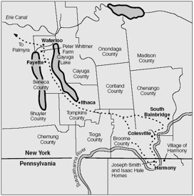
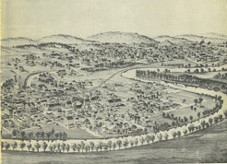
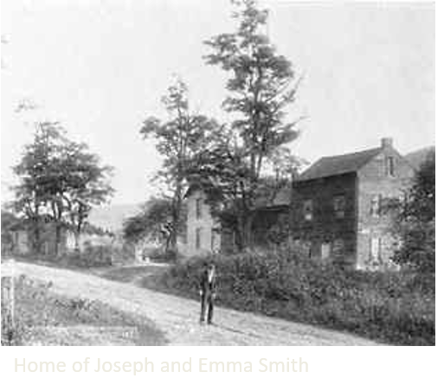
Losing the Gift—Restoring the Gift
Revelation
Harmony, Pennsylvania
Around 1828 Summer and 1829
Darkened—the loss of the Spirit
Because of the lost manuscripts Joseph Smith had lost the ability to translate by means of the Urim and Thummim
Joseph Smith repented and the gifts were restored and he could continue the work of the Lord
D&C 10:1-4

Slide 3
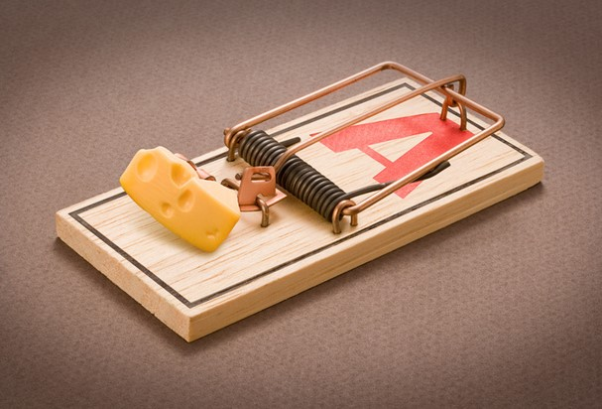
The Intentions of Satan
How could a device like this represent Satan’s intentions toward us?
The Great Enemy
“Satan” means “adversary”
D&C 10:5

Slide 4
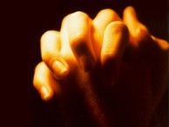
Pray Always
Joseph Smith was constantly admonished to pray
“A pretender would not have been admonished to pray, but to repent.
Hypocrites do not pray, though they may say long prayers.
One who prays earnestly will not be led astray; or will he lead others into error…”
Commentary
As we pray always, we will have power to overcome Satan and those who serve him.
D&C 10:5

Slide 5
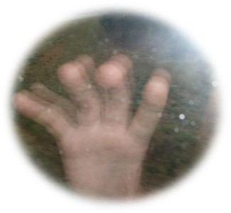
Doctrinal Mastery
“Pray always, that you may come off conqueror; yea, that you may conquer Satan, and that you may escape the hands of the servants of Satan that do uphold his work.”
D&C 10:5
D&C 10:5

Slide 6
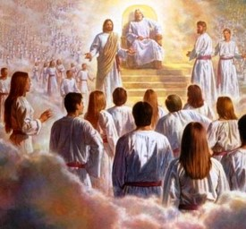
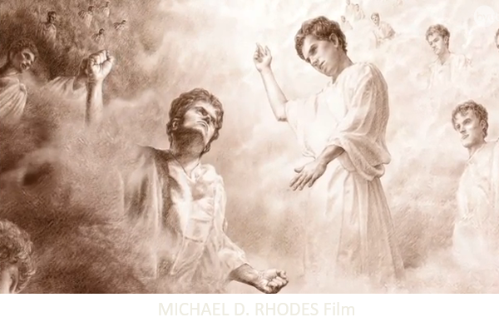
Satan Puts Into Hearts of Men
“In the great Council in heaven he proposed to redeem mankind by compulsion, if God would give him His honor. That proposition was rejected by the Council, and another, made by the Beloved Son, was adopted.
Satan, instead of yielding to the majority…rebelled and, at the head of other rebellious spirits, endeavored to carry out his plan in opposition to that which had been accepted.
Then he was “cast down” and became Satan.” Moses 4:1-4
Commentary
D&C 10:10

Slide 7
Satan is Cunning
“If the Prophet attempted another translation, his enemies would “prove” that he was merely a pretender, by giving publicity to the stolen manuscript, changed to suit their proposes.”
Commentary
Satan desires to destroy the work of the Lord and our souls.
“… he persuadeth no man to do good, no, not one; neither do his angels; neither do they who subject themselves unto him.” (Moro. 7:17.)
D&C 10:14

Slide 8
What kind of deceptions does Satan use to destroy the Lord and our souls?
How does Satan seek to destroy the work of the Lord and our souls?
How can being aware of Satan’s intention help us avoid and escape his trap?
D&C 10:25-33

Slide 9
Two Records From Nephi
Joseph was not to translate the lost portion a second time.
He was, however, to translate the plates of Nephi
The Book of Lehi
He preserved an account of events connected with the departure of his father (Lehi) from Jerusalem, and their landing in America. This history was continued for 400 years, down to the reign of King Benjamin, chiefly an ecclesiastical history.
The Prophet Mormon found these “smaller plates: of Nephi and attached them to his own abridgment of the “larger plates.” Mormon also added to these plates.
He (Nephi) preserved an account of his father Lehi’s life and genealogy, and the history of his people.
The Prophet Mormon made an abridgment from this vast amount of historical material. The Prophet Joseph translated this abridgement, and it was the first part of that translation which was lost.
The small plates of Nephi
D&C 10:38-42

Slide 10
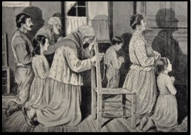
Those Who Desire
“And, behold, all the remainder of this work does contain all those parts of my gospel which my holy prophets, yea, and also my disciples, desired in their prayers should come forth unto this people.”
Granted to them according to their faith
D&C 10:46-47

Slide 11
Purpose of the Book of Mormon
The Holy Bible
“Mormon’s hope was that this work would be preached among the ancient inhabitants of the American Continents, to reach the descendants of the Lamanites and those associated with them and also to other nations that might come to the Western World.”
Commentary
“The Book of Mormon does not take the place of the Bible; it confirms that sacred record, at a time when so-called Higher Critics are doing all in their power to destroy the belief in the divine authority of the Scripture.
It is a “New Witness” for the authenticity of the Bible. It claims no other position in sacred literature. It is the “Stick of Ephraim joined to the “Stick of Judah” according to the word of the Lord.” (Ezekiel 37:15-19)
D&C 10:48-56

Slide 12
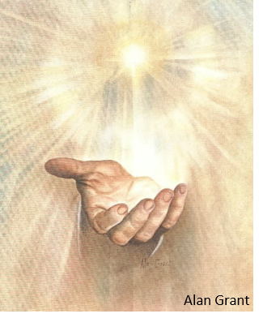
The Lord Jesus Christ is the Light
“And the light shineth in darkness; and the darkness comprehended it not.”
John 1:5
“That was the true Light, which lighteth every man that cometh into the world.”
John 1:9
What will the Book of Mormon bring to light?
The true points of Jesus Christ’s doctrine
D&C 10:62

Slide 13
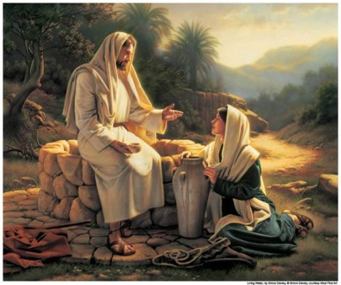
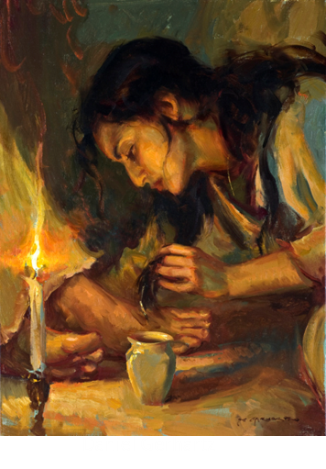
The Doctrine of Christ
“Whosoever repenteth and cometh unto me, the same is (of) my church.: To repent is to turn from evil; to “come to Christ” is to believe on Him and obey His commandments.”
Gates of Hell
“This, in the New testament (Matt. 16:18) means the power of the unseen world, Hades or Sheol, and especially the power of death.
The faithful members of the church will not be overcome by the destructive forces, but triumph over them and live forever.”
D&C 10:67-69---Commentary

Slide 14
D&C 10:70

Slide 15
Sources:
Video: “The Work of God” (13:34)
https://www.lds.org/media-library/video/2010-07-010-the-work-of-god?lang=eng
Doctrine and Covenants Commentary by Hyrum M. Smith pgs.50-52, 57-59
messiah jesus christ mormon film MICHAEL D. RHODES
Painting by Daniel Gerhartz
Light by Alan Grant
Presentation by ©http://fashionsbylynda.com/blog/

Slide 16
Doctrine and Covenants 10:45. “Greater views upon my gospel”
Elder Jeffrey R. Holland of the Quorum of the Twelve Apostles taught that the Lord’s “wise purpose” (see 1 Nephi 9:5; Words of Mormon 1:7) for commanding the writing and preserving of the small plates of Nephi went beyond compensating for the loss of the 116 pages of manuscript:
“It strikes me that there is a wiser purpose than that [compensating for the loss of the 116 pages], or, more accurately, a wiser purpose in that. The key to such a suggestion of a wiser purpose is in verse 45 of Doctrine and Covenants section 10. As the Lord instructs Joseph on the procedure for translating and inserting the material from the small plates into what had been begun as the translation of the abridged large plates, he says, ‘Behold, there are many things engraven upon the [small] plates of Nephi which do throw greater views upon my gospel’ (emphasis added).
“So, clearly, this was not a quid pro quo in the development of the final Book of Mormon product. It was not tit for tat, this for that—you give me 116 pages of manuscript and I’ll give you 142 pages of printed text. Not so. We got back more than we lost. And it was known from the beginning that it would be so. It was for a wiser purpose. We do not know exactly what we missed in the 116 pages, but we do know that what we received on the small plates was the personal declarations of three great witnesses, three of the great doctrinal voices of the Book of Mormon, testifying that Jesus is the Christ. …
“My, how we wish we had all of those plain and precious testimonies which have been stripped from the Biblical record. But at least as readers of the Book of Mormon, we have Nephi, Jacob, and Isaiah to speak to us immediately as personal eye-witnesses of the premortal Savior. They are recipients of marvelous revelations regarding his life and ministry and of God’s covenant relationship with the House of Israel, ancient and modern. …
“I think it would be exciting if the 116 pages of manuscript turned up some day, but if they were delivered to my office tomorrow I would never trade them for the material in the small plates of Nephi, for the ‘greater views’ given through the great prophetic sentinels who stand at the gate of the book. So tell your students to stop complaining and get reading—including Isaiah” (“A Standard unto My People” [address to CES religious educators, Aug. 9, 1994], 7–9,LDS.org ).

