Slide 2
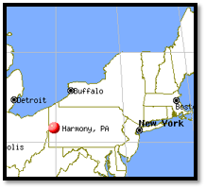
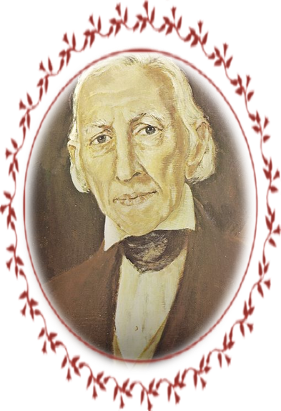
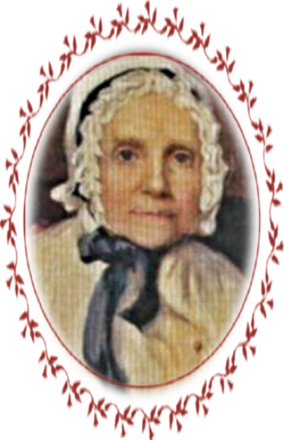
Joseph Smith Sr.
February 1829
Joseph Smith’s father had a desire to serve, but he didn’t know what the Lord wanted him to do.
Joseph Smith Sr. and his wife, Lucy, visited their son in Harmony, Pennsylvania.
During that visit, Joseph Smith Jr.
received a revelation in answer to
his father’s question.
D&C 4:1-7

Slide 3
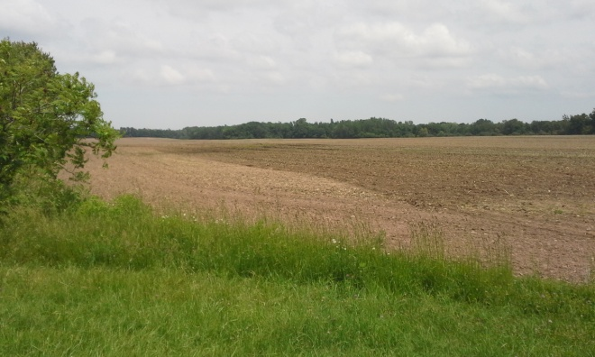
Accepting a Calling
Joseph Smith Sr. was one of the first to accept a calling from God
Joseph Smith was laboring in Harmony, Pa., taking refuge from the persecution he received from the people in New York
Joseph Smith Sr. was one of the Eight Witnesses of the Book of Mormon and one of the first to be baptized when the Church was officially organized on April 6, 1830. He also served as the first Patriarch to the Church and as Assistant Counselor to the First Presidency.
D&C 4:2

Slide 4
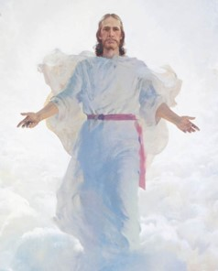
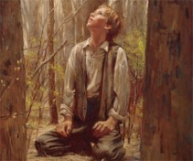
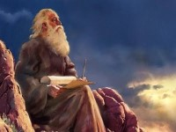
A Marvelous Work
The Book of Mormon is marvelous
It was brought to light by immortal hands
It was brought by a young man, of little education and humble circumstances to be translated from a different language and published
It teaches of prophecies and the story of a different society unknown to man
It has encountered bitter opposition, yet brings joy to those who embrace it
Isaiah’s prophecy has been fulfilled
Isaiah 29:8,9
Not only the coming of the Book of Mormon but it has reference to the restoration in the Dispensation of the Fulness of Times
D&C 4:1---Commentary

Slide 5
Serve Him
With All your heart, might, mind, and strength
All devotion, will-power, reasoning, and physical strength…all dedicated to the Lord
If we serve God with all of our heart, might, mind, and strength, we may stand blameless before Him at the last day.
This is a way of saying that a person must be totally committed to the work and have no reservation.
Manual
D&C 4:2

Slide 6
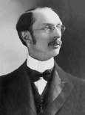
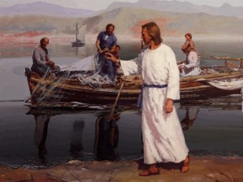
A Desire To Serve
If you have a desire to serve you will be called
“My understanding is that the most important mission that I have in this life is: first, to keep the commandments of God, as they have been taught to me; and next, to teach them to my Father’s children who do not understand them…
“It is not necessary for you to be called to go into the mission field in order to proclaim the truth. Begin on the man who lives next door by inspiriting confidence in him, by inspiriting love in him for
you because of your righteousness,
and your missionary work has
already begun.”
Elder George Albert Smith
D&C 4:3

Slide 7
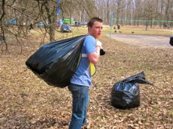
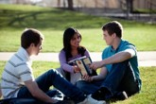
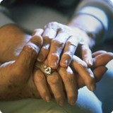
“Some of the most important service you can give will be within your own home.
You can also serve in your Church assignments, school, and community.
You can serve by doing temple and family history work.
You can serve by sharing the gospel with others now and as a full-time missionary in the future.
Often the most meaningful service is expressed through simple, everyday acts of kindness.
Seek the guidance of the Holy Ghost each day to know whom to serve and how to help meet their needs. Follow the example of the Savior as you serve others”
For the Strength of Youth

Slide 8
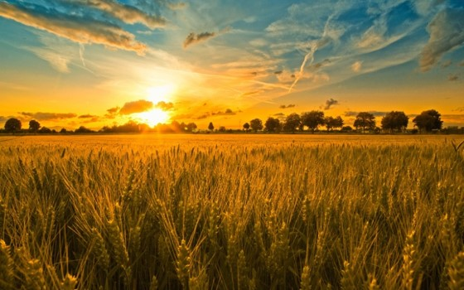
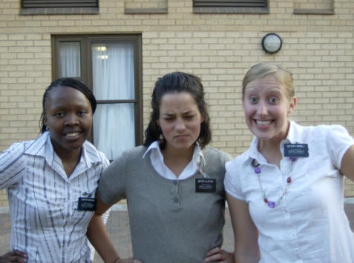
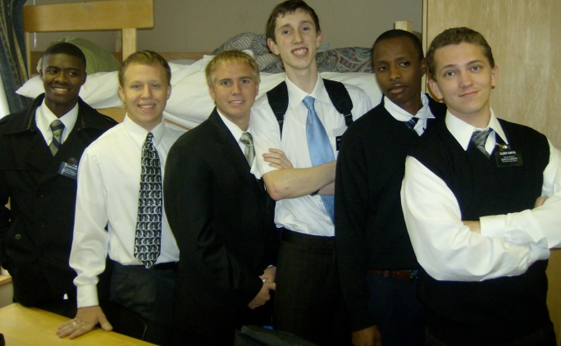
The Field is White
“The field was ripe for harvest at the time the Lord established the Church. The world had been prepared during many centuries, by religious movements. To thrust in the sickle and reap is to lay up a store for the future…
…Sowing and reaping follow each other. The early period of the Church was a time of reaping. Later, missionary labor became more like gleaning, and then sowing.”
Commentary
D&C 4:4

Slide 9
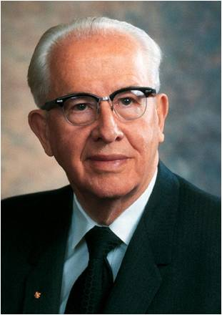
“Men and women who turn their lives over to God will discover that He can make a lot more out of their lives than they can.
He will deepen their joys, expand their vision, quicken their minds, strengthen their muscles, lift their spirits, multiply their blessings, increase their opportunities, comfort their souls, raise up friends, and pour out peace.
Whoever will lose his life in the service of God will find eternal life.”
President Ezra Taft Benson
As we labor diligently to bring others unto Jesus Christ, we can also receive salvation for ourselves.

Slide 10
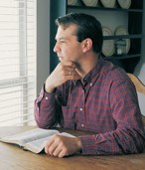
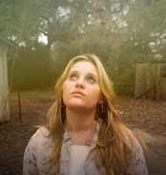
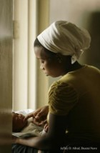
Faith, Hope, and Charity
“Whereby are given unto us exceeding great and precious promises: that by these ye might be partakers of the divine nature, having escaped the corruption that is in the world through lust.
And beside this, giving all diligence, add to your faith virtue; and to virtue knowledge;
And to knowledge temperance; and to temperance patience; and to patience godliness;
And to godliness brotherly kindness; and to brotherly kindness charity.
For if these things be in you, and abound, they make you that ye shall neither be barren nor unfruitful in the knowledge of our Lord Jesus Christ.
2 Peter 1:4-8
D&C 4:5-7

Slide 11
Sources:
Video:
Unselfish Service (2:25)
The Vineyard (3:48)
Missionaries to Match Our Message (2:25)
Excerpts from Doctrine and Covenant Commentary by Hyrum M. Smith pg. 23-24
Doctrine and Covenants Student Manual Religion 324-325, pg. 12
” (For the Strength of Youth [booklet, 2011], 32).
The Teachings of Ezra Taft Benson pg. 361

Slide 12
Response Key
1 = never 2 = sometimes 3 = often 4 = almost always 5 = always
Faith
1. ____ I believe in Heavenly Father and Jesus Christ.
2. ____ I trust Heavenly Father enough to accept His will and do whatever He asks.
3. ____ I have the faith necessary to help make good things happen in my life and the lives of others.
4. ____ I have enough faith in Jesus Christ to obtain answers to my prayers.
Hope
1. ____ One of my greatest desires is to inherit eternal life in the celestial kingdom of God.
2. ____ I feel peaceful and optimistic about the future.
3. ____ I firmly believe that someday I will dwell with God and become like Him.
Charity and Love
1. ____ I feel a sincere desire for the eternal welfare and happiness of other people.
2. ____ When I pray, I ask for charity—the pure love of Christ.
3. ____ I try to help other people when they are struggling or discouraged.
4. ____ I look for opportunities to serve other people.
Eye Single to the Glory of God
1. ____ I focus my efforts on the things of God rather than the things of the world.
2. ____ I focus my thoughts on the things of God rather than the things of the world.
3. ____ I do good things because I love God, not because I want to impress others.
Virtue
1. ____ I am clean and pure in heart.
2. ____ I am dependable—I do what I say I will do.
3. ____ I focus on righteous, uplifting thoughts and put unwholesome thoughts out of my mind.
4. ____ I repent of my sins and strive to overcome my weaknesses.
Knowledge
1. ____ I feel confident in my understanding of gospel doctrines and principles.
2. ____ I study the scriptures daily.
3. ____ I receive knowledge and guidance through the Spirit.
Temperance
1. ____ I live the Word of Wisdom, as outlined in D&C 89.
2. ____ I control what I think, say, and do, even in tense or frustrating situations.
3. ____ I successfully balance schoolwork, family time, Church callings, and social life.
Patience
1. ____ I am patient with myself and rely on the Lord as I work to overcome my weaknesses.
2. ____ I am patient with the faults and weaknesses of others.
3. ____ I face problems and challenges calmly and hopefully.
Brotherly Kindness
1. ____ I am nice to others, even when they might not deserve it.
2. ____ I say positive things about others.
3. ____ I am considerate of the feelings of others.
Godliness
1. ____ I know Heavenly Father lives, and I want to be like Him.
2. ____ I try to be like Heavenly Father and Jesus Christ in all that I think, say, and do.
Humility
1. ____ I am sincerely grateful for the blessings I receive from Heavenly Father.
2. ____ My prayers are sincere and meaningful.
3. ____ I appreciate advice and guidance from my leaders, teachers, and parents.
4. ____ I strive to be submissive to Heavenly Father’s will, whatever it may be.
Diligence
1. ____ I work effectively, even when I’m not under pressure or close supervision.
2. ____ I focus my efforts on the most important things.
3. ____ I work hard until a job is finished successfully.

