Slide 2
Seeing is Believing?
What is something you have only heard about but would like to see with your own eyes?
Why would you like to see it?
After Martin Harris had lost the 116 pages, he repented but still had the desire to see the plates

Slide 3
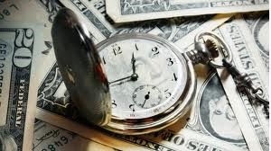
March 1829
Historical Background
Why did Martin Harris seek an additional witness of the existence of the plates?
His wife, Lucy Harris, was upset about the time and money her husband was dedicating to the publication of the Book of Mormon.
She was also angry with Joseph Smith for having denied her earlier requests to see the gold plates.
She filed a legal complaint against Joseph and gathered a number of people who were willing to testify that he had lied about the existence of the plates. In addition to the threat of the lawsuit against Joseph, these people warned Martin that if he did not join them in testifying of Joseph Smith’s alleged deception and fraud, Martin would be complicit with Joseph and would join him in prison.

Slide 4
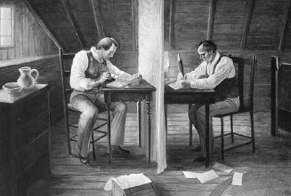
Being a Scribe
At this time, Martin had never seen the gold plates himself, although he had acted as a scribe for Joseph.
After traveling to Joseph’s home in Harmony, Pennsylvania, Martin expressed his desire to receive a further witness of the reality of the gold plates.
He may have believed that if he could see the plates himself, he would be prepared to testify in court of their existence and clear his and Joseph Smith’s names of fraud.

Slide 5
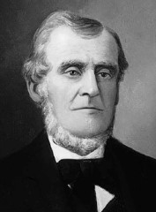
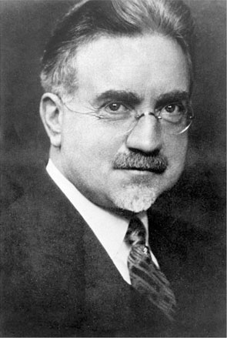
March 1829
The Request
“Behold, I say unto you, that as my servant Martin Harris has desired a witness at my hand, that you, my servant Joseph Smith, Jun., have got the plates of which you have testified and borne record that you have received of me;”
“Martin Harris was a religious minded, prosperous farmer. He appears to have been a rather wilful but honest man, who wanted to be sure of everything he undertook. It was he who took the transcript of the characters from the Book of Mormon plates to Professor Anthon for verification”
John A. Widtsoe
“…But he was not yet satisfied. He seems to have asked for further evidence that the Prophet Joseph actually had the plates…”
Manual
D&C 5:1

Slide 6
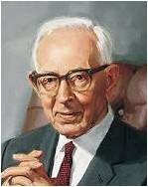
The Answer
How did the Lord tell Joseph to answer Martin?
Why couldn’t Joseph Smith show Martin Harris the plates?
“Frequently when [people] … hear the story of the coming forth of the Book of Mormon, they ask if the plates are in some museum where they may be seen. Some of them with some scientific training, [suggest] that if the scholars could see and examine the plates and learn to read them, they would then bear witness to the truth of the Book of Mormon and the veracity of Joseph Smith, and the whole world would then be converted”
Joseph Fielding Smith
D&C 5:5-7

Slide 7
The Reasoning
What reasons did the Lord give for why Joseph Smith should not display the plates before the world?
If people did not believe the Lord’s words revealed through Joseph Smith, they still would not believe if they saw the plates;
The Lord reserved the plates from the world for a wise purpose
What can we learn about Joseph Smith’s unique calling?
The Lord called Joseph Smith to deliver His word to the world.
D&C 5:7-10

Slide 8
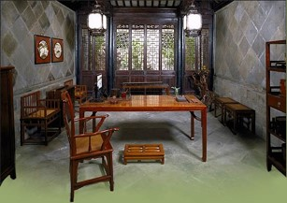
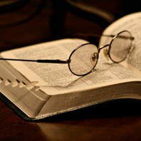
True Conversion
“We have learned that people are not converted by miracles or by examining records. If the Lord had placed the plates where the scholars could examine them, they would have scoffed at them just as much as they do today.”
“People are converted by their hearts being penetrated by the Spirit of the Lord when they humbly hearken to the testimonies of the Lord’s servants. The Jews witnessed the miracles of our Lord, but this did not prevent them from crying out against him and having him crucified.”
Manual
D&C 5:10

Slide 9
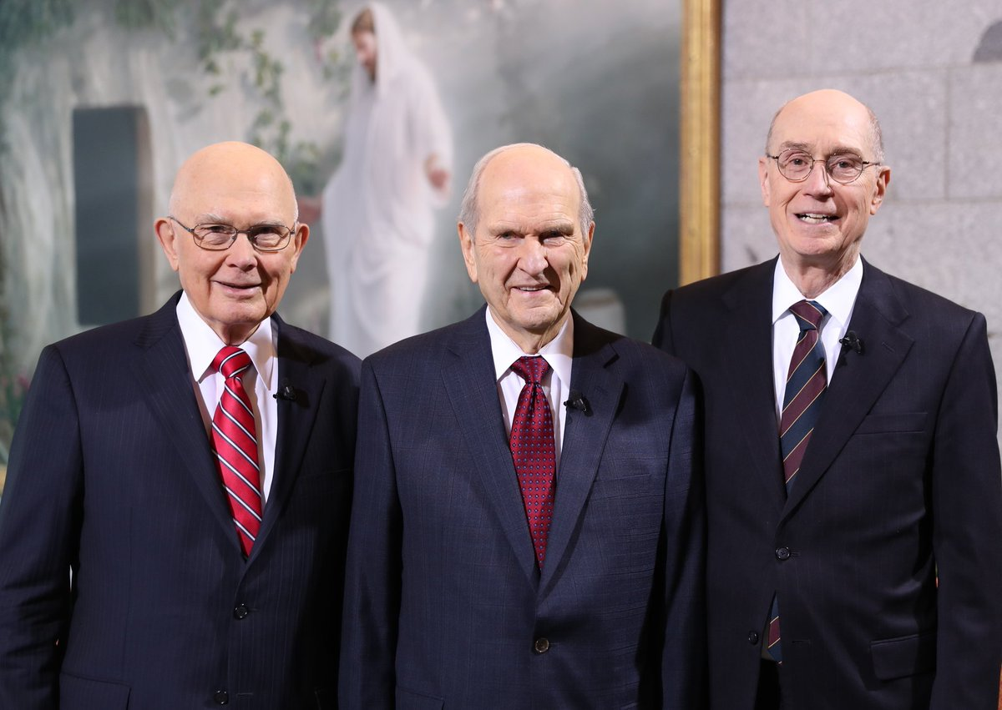
3 Witnesses
“…in the mouth of two or three witnesses shall every word be established” (2 Corinthians 13:1).
“In giving the world the testimony of three witnesses in addition to Joseph Smith, the Lord fulfilled the law. We are called upon in this life to walk by faith, not by sight, not by the proclamation of heavenly messengers with the voice of thunder, but by the proclamation of accredited witnesses whom the Lord sends and by whom every word shall be established.”
Joseph Fielding Smith
D&C 5:11-13

Slide 10
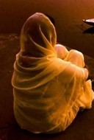
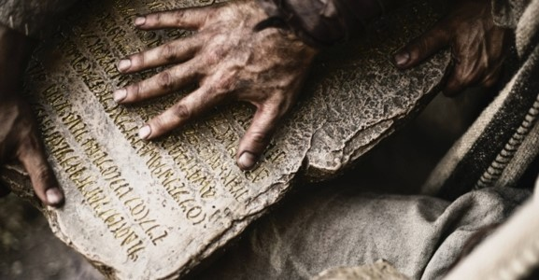
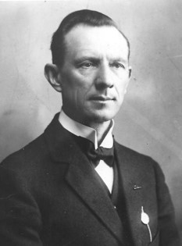
Song of Solomon
Clear as the Moon—
Fair as the Sun—
Terrible as an army with banners
“Who is she that looketh forth as the morning, fair as the moon, clear as the sun, and terrible as an army with banners?”
Song of Solomon 6:10
“Where Shulamite…that is, indescribably beautiful, but at the same time inaccessible to flatterers, unconquerable, as an army under banners. –this would apply to the Church.”
“When the prophet was revising by inspiration the books of the Bible the Lord revealed to him that the song of Solomon is not an inspired book, therefore the Prophet did not include it in his revision.”
Hyrum M. Smith
D&C 5:14

Slide 11
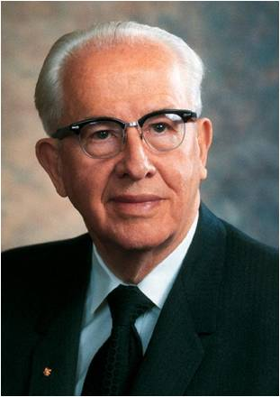
A Promise and a Warning
“We each need to get our own testimony of the Book of Mormon through the Holy Ghost. Then our testimony, coupled with the Book of Mormon, should be shared with others so that they, too, can know through the Holy Ghost of its truthfulness”
Ezra Taft Benson
If we will believe on the Lord’s words, He will confirm their truth through His Spirit
Those who heed their testimony will find God’s word in the Book of Mormon and will receive the Holy Ghost and be born again. But those who reject this testimony shall come under condemnation.
Manual
D&C 5:16-18

Slide 12
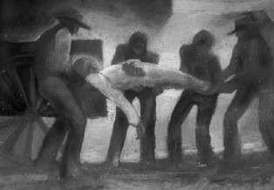
Foreknowledge of Death
The Lord’s foreknowledge of the Prophet Joseph’s death by violence for his part in the latter-day work.
“And that you be firm in keeping the commandments wherewith I have commanded you; and if you do this, behold I grant unto you eternal life, even if you should be slain.”
“And even if they do unto you even as they have done unto me, blessed are ye, for you shall dwell with me in glory.”
D&C 6:30
“For where a testament is, there must also of necessity be the death of the testator.
For a testament is of force after men are dead: otherwise it is of no strength at all while the testator liveth.”
Hebrews 9:16-17
Testator: a person who dies leaving a will or testament in force
D&C 5:22

Slide 13
Steps to Receiving
Conditions:
Prayful
Humility
Sincerity
Just as there are several steps to turning on a light bulb, Martin Harris learned that there would be several steps to receiving the witness of the plates he desired from the Lord.
D&C 5:23-24

Slide 14
Pray in Humility and Faith
How do you think praying with humility, faith, and sincerity might prepare us to receive answers from the Lord?
When have you heard or offered a prayer that you felt was offered in humility, faith, and sincerity?
What made this prayer different from other prayers you had heard or offered?
If we sincerely pray in humility and faith, then we can receive answers according to our righteous desires.
D&C 5:24

Slide 15
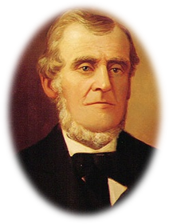
Expectations and Choice
If Joseph is to show the plates to Martin the Lord expects him to:
Testify that he has seen them by the power of God, and that they are true
But if he denies them:
He will have broken the covenant and be condemned
Martin Harries was given a condition to humble himself and willing to bear his testimony to the world.
He was given liberty to choose to accept or reject… God does not deprive man of his agency.
If he refused to comply he was told not to trouble the Lord anymore.
D&C 5:25-28

Slide 16
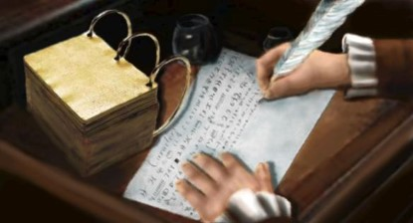
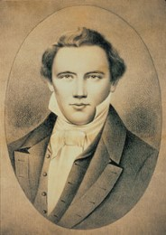
Stop for a Season
(At this time) the Lord directed the Prophet to discontinue the work of translation for the time being. He was about to raise up another friend to him, who would take the place of martin Harris as an assistant and scribe.
Hyrum M. Smith
Unless the Prophet followed the instructions here given, the plates and the sacred instrument would be taken from him
D&C 5:30-31

Slide 17
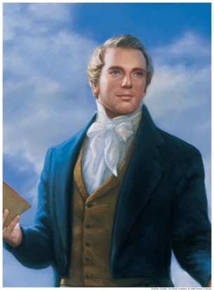
Lifted Up
“And if thou art faithful in keeping my commandments, thou shalt be lifted up at the last day. Amen.”
…to be exalted and receive honor and glory
D&C 5:35

Slide 18
Sources:
Video:
Book of Mormon Testimonies(3:47)—
Widtsoe, Joseph Smith pg. 53
Doctrine and Covenants Student Manual 324-325 pg. 13. (Church History and Modern Revelation, 1:39–40.)pg.13
Joseph Fielding Smith (Church History and Modern Revelation, 2 vols. [1953], 1:40).
Joseph Fielding Smith (Church History and Modern Revelation, 1:40.)
Hyrum M. Smith Doctrine and Covenants Commentary pg. 27, 30
Ezra Taft Benson (“The Book of Mormon and the Doctrine and Covenants. ”Ensign, May 1987, 84).
Presentation by http://fashionsbylynda.com/blog/

Slide 19
Song of Solomon
“The fact remains no matter what view we take of it that an expression of this kind full of beauty and poetry could be found even in an uninspired book. Even should this be the case it is no reason why the Lord could not use it in a revelation given to the church in our own day.”
Hyrum M. Smith pgs. 27-28
D&C 105: 31 But first let my army become very great, and let it be sanctified before me, that it may become fair as the sun, and clear as the moon, and that her banners may be terrible unto all nations;
D&C 109:73 That thy church may come forth out of the wilderness of darkness, and shine forth fair as the moon, clear as the sun, and terrible as an army with banners;

