Slide 2
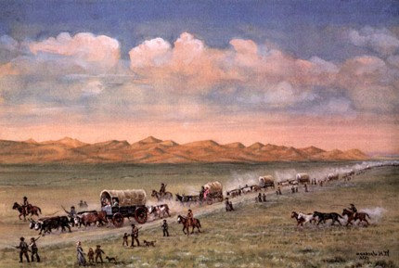
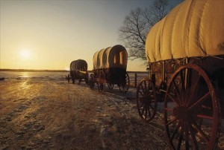
The Call to Come West
The Saints who arrived in the Salt Lake Valley in 1847 went to work to develop agricultural and other resources for future immigration.
In September 1851, Brigham Young and his counselors in the First Presidency reiterated the call for all the Saints living in Iowa and around the world to gather in the Salt Lake Valley.
Many Latter-day Saints responded to President Young’s call at great sacrifice. Members of the Twelve were sent to oversee the migration, and in 1852 more Saints traveled the trail to the Salt Lake Valley than in any other year. Additionally, many Saints journeyed to the Salt Lake Valley in handcart companies between 1856 and 1860.

Slide 3
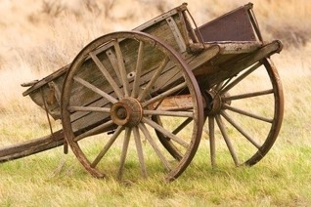
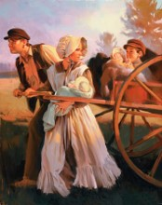
Handcarts
1856
President Brigham Young proposed that emigrants should travel using handcarts instead of wagons because of financial hardships. Handcarts were much less expensive and would allow more of the Saints to emigrate
Nearly 3,000 Mormon pioneers from England, Wales, Scotland and Scandinavia made the journey from Iowa or Nebraska to Utah in ten handcart companies
They were only allowed to bring only 17 pounds (about 7.7 kilograms) of personal belongings. Each child could bring 10 pounds (about 4.5 kilograms).
The belongings were weighed for each individual, and anything that exceeded the weight limit was discarded.

Slide 4
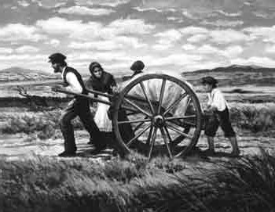
Resupply Points
Teams of people were stationed in Iowa City (the end of the rail line) to build handcarts, sew tents (some tents were sewn by the pioneers on the ocean voyage), and gather the necessary supplies for the emigrant groups to cross the 1300 miles from Iowa City to their Zion in the west.
The immigrants were given supplies at Iowa City to reach Florence/Winter Quarters, where they were resupplied to reach Ft. Laramie. It is important to note that other teams were organized to leave Salt Lake City at appropriate times to meet the groups along the way with additional supplies. Fort Laramie was a resupply point, as was Fort Bridger.
Fort Laramie
Winter Quarters
Fort Bridger
Iowa City

Slide 5
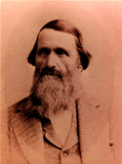
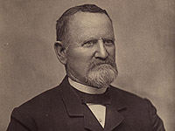
First Two Companies
Nearly 500 people total left Iowa City in early June and arrived in Salt Lake City on Sept 26 with only 8 deaths along the way
Daniel D. McArthur Company
2nd handcart company had 44 handcarts, and 2 wagons in the company when it began its journey from the outfitting post at Iowa City, Iowa
Departure: June 11, 1856
Arrival: September 26, 1856
Number in Company: 236
Most of the people in this company crossed the Atlantic on the ships Enoch Train and S. Curling. They traveled from New York City to Iowa City, Iowa, and there spent about a month getting the handcarts and supplies ready to set out. On June 11, they moved out, two days after Ellsworth's 1st handcart company had left.
Edmund Ellsworth Company
1st handcart company had about 280 individuals, 56 handcarts, and 3 wagons when it began its journey from the outfitting post at Iowa City, Iowa. Captain Ellsworth walk the entire distance
Departure: June 9, 1856
Arrival: September 26, 1856
Number in Company: 331
McArthur's company earned the name of "Crack Company" because they were a spirited and fit group and were highly regarded by all who met them en route.

Slide 6
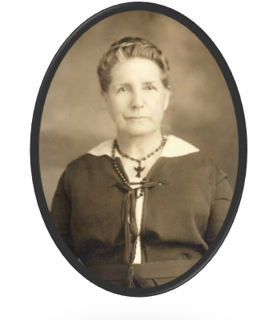
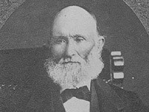
Third Company
One time on the Platte River, two other little girls an[d] I took a handcart loaded it with little children, too small to walk, and went for a trip after we had our dinner. We thought it was going to help the company out. The road was sandy and hot, the cart very hard to pull, so we pulled off the road to rest, thinking we would see the company when it passed. But, we missed it. We had t[o] travel along the dark road alone, until at last we saw the campfires ahead near the river. They had eaten their suppers, then sent some men to hunt for us. We were very tired, but received a lecture, never to be forgotten.
When ever we were near an Indian camp, they would come and want to trade with us. Sandy, the teamster, didn’t have much to trade, so he teasingly said he would trade me for a pair of moccasins. The Indians took him seriously and followed the wagons for three days to get me. I was hidden under the supplies in the wagons to keep them from finding me. This was another lesson learned about Indians. Ellen Jane Perks (age 12)
Edward Bunker Company
3rd handcart company. About 320 individuals were in the company when it began its journey from the outfitting post at Iowa City, Iowa. This company left Florence, Nebraska on July 30.
Departure: June 23, 1856
Arrival: October 2, 1856
Number in Company: 229

Slide 7
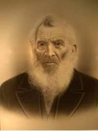
Wagon Company Leaving the Same Time
Jacob Croft Company
Arrived, on the 11th inst., Capt. [Jacob] Croft and company, mostly from Texas and Cherokee lands.
Depart: June 26, 1856
Arrival: October 11, 1856
Number in Company: 63

Slide 8
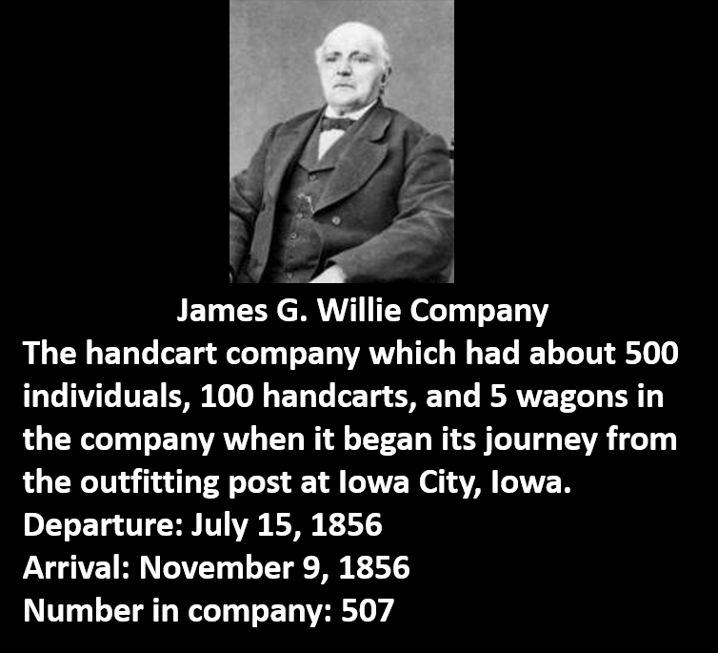
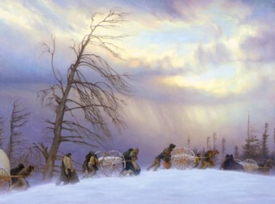
Fourth Company
About 761 immigrants arrived in New York on June 14, 1856. 507 listed in the Company left Florence, Nebraska on August 19, 1856 on their trek across the plains, traveling about eighteen miles a day. Due to the lateness of the year they encountered many difficulties crossing the mountains in the snow. Many lost their lives from exposure, hunger and cold. They arrived November 9, 1856.
When his company was about to perish from starvation, with but a single companion, Captain Willie went in search of the supply trains from the valley, which he found after an absence of three days. It is evident from the narrative of Mr. (John) Chislett, who was one of his sub-captains, that Captain Willie saved his company from perishing. Upon their arrival most of the company had their feet and legs frozen. Grandfather had burlap wrapped around his feet for shoes. His feet and legs were so badly frozen that it was feared for some time that he would lose his legs. They entered the valley on November 9, 1856, reporting 77 deaths, 3 births and 3 marriages on the trip.

Slide 9
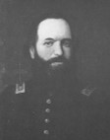
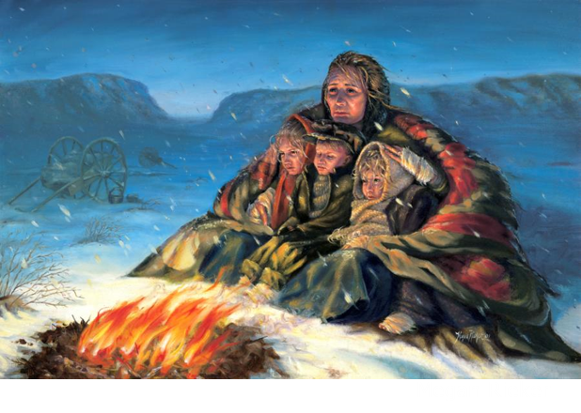
Fifth Company
Aaron and Elizabeth Jackson had just crossed a wide river:
“About nine o’clock I retired. … I slept until, as it appeared to me, about midnight. I was extremely cold. The weather was bitter. I listened to hear if my husband breathed—he lay so still. I could not hear him. I became alarmed. I put my hand on his body, when to my horror I discovered that my worst fears were confirmed. My husband was dead. … I called for help to the other inmates of the tent. They could render me no aid. … When daylight came, some of the male part of the company prepared the body for burial. … They wrapped him in a blanket and placed him in a pile with thirteen others who had died, and then covered him up in the snow. …
“I will not attempt to describe my feelings at finding myself thus left a widow with three children, under such excruciating circumstances. I cannot do it. But I believe the Recording
Angel has inscribed in the archives above, and that my
sufferings for the Gospel’s sake will be sanctified unto me
for my good”
--Elizabeth Jackson
Edward Martin Company
5th handcart company contained 575 individuals, 145 handcarts, and 8 wagons were in this company when it began its journey from the outfitting post at Iowa City, Iowa.
Departure: July 28, 1856
Arrival: December 1, 1856
Number in Company: 643

Slide 10
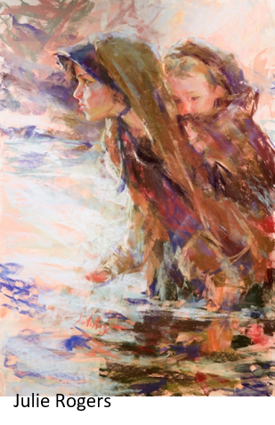
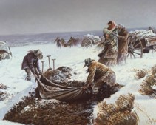
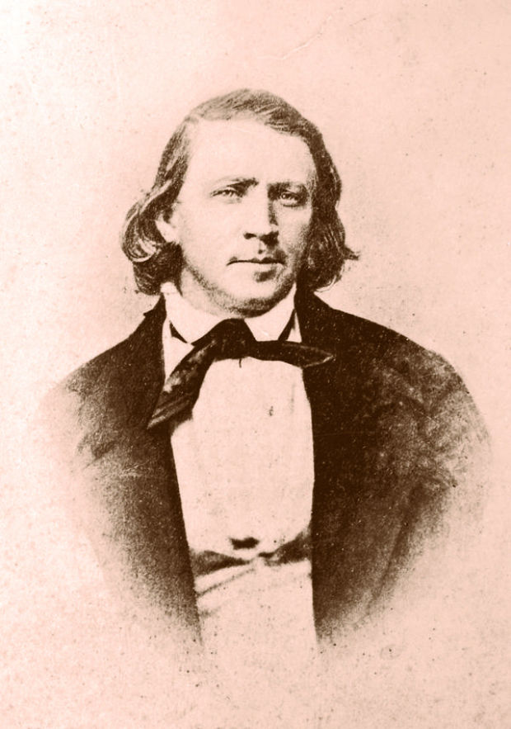
The Plan For A Rescue
Elder Richards and several returning missionaries passed the Martin and Willie companies in early September 1856, they were surprised at the condition in which they found the Willie company due to reduced provisions, the condition of some carts, and the loss of 30 cattle in a stampede. They promised they would return with help.
President Brigham Young had no knowledge of any other groups crossing the plains that season until Elder Richards arrived in Salt Lake City on October 4 and told him of the situation.
The next morning at Sunday morning services in the bowery in Salt Lake City, President Young announced, with an urgency he said was dictated by the Holy Ghost:
“Many of our brethren and sisters are on the plains with hand-carts, … and they must be brought here. … Go and bring in those people now on the plains, and attend strictly to those things which we call temporal, … otherwise your faith will be in vain.”
Deseret News, Oct. 15, 1856, 252.
The next day was the first day of general conference, and President Young again called for teams and wagons as he had the day before.

Slide 11
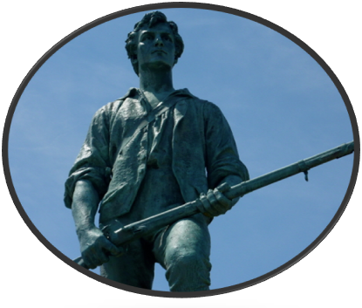
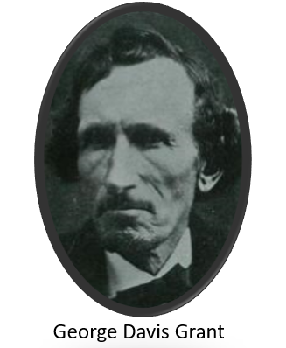
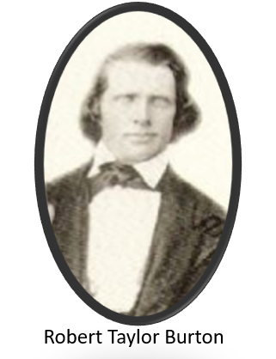
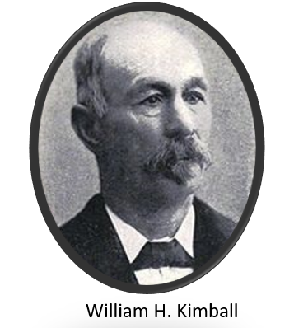
Rescue Party
On Tuesday, October 7, a rescue party with 16 supply wagons met at Big Mountain. Leader George D. Grant chose Robert T. Burton and William H. Kimball as his assistants. They were experienced leaders of the local militias, of which all men were members. The others who volunteered were experienced frontiersmen or were Minute Men—a group of strong, fearless young men attached to each local militia.
By the end of October, at least 250 rescue teams were on the road. Even so, it would be 63 days before all the surviving immigrants would be safely in Salt Lake City. Although exact numbers are elusive and the numbers greatly decreased after the arrival of the rescue party, best estimates put the death toll at 69 in the Willie company, 150–170 in the Martin company, 10 in the Hodgett company, and 19 in the Hunt company. The leading causes of death were starvation, exposure, exhaustion, and dysentery.
Guant and Dekker

Slide 12
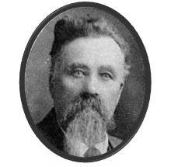
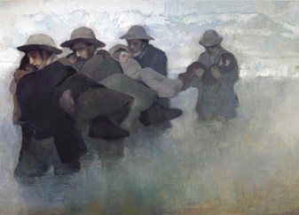
Sweet Water
When the handcart company reached the Sweetwater, it was filled with floating ice. Elder John Jacques reported that this passage was almost beyond the ability of the people:
“It was the last ford that the emigrants waded over. The water was not less than two feet deep…but it was intensely cold. The ice was three or four inches thick and the bottom of the river muddy or sandy. I forget exactly how wide the stream was there, but I think thirty or forty yards. It seemed a good deal wider than that to those who pulled their handcarts through it (in Whitney 1:562)”
Stephen Wells Taylor, age 21, was among the first group of rescuers to answer Brigham Young's first public call to bring the late 1856 immigrants in to the Salt Lake Valley
As the women shrank back and men wept at the prospect, four eighteen-year-old boys from the valley, C. Allen Huntington, George W. Grant, and David P. Kimball, stepped forward and picked up women and children and even some of the men, and carried them one by one across the snowbound river, crossing it many times late in the afternoon. Solomon F. Kimball reports that the strain was so terrible, and exposure so great that in later years these boys died from the effects of carrying the emigrants through the icy water (S.F. Kimball 1914, 288)
Janet Burton Seegmiller

Slide 13
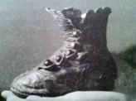
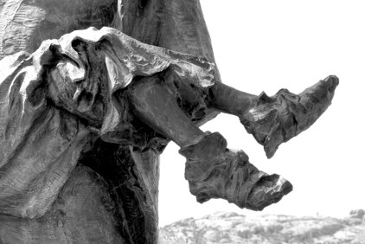
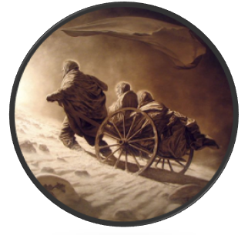
Children in the Handcart Companies
On October 23, the Willie company traveled about 15 miles (24 kilometers) through blizzard conditions. The first 3 miles (5 kilometers) included a 600-foot (180-meter) climb up a hill called Rocky Ridge.
“Thirteen members of the Willie Company who perished from cold, exhaustion, and starvation are buried in a common grave at Rock Creek Hollow. … Two of those buried at Rock Creek Hollow were heroic children of tender years: Bodil [Mortensen, age eleven], from Denmark, and James Kirkwood, age eleven, from Scotland.
“James Kirkwood was from Glasgow, Scotland. On the trip west, James was accompanied by his widowed mother and three brothers, one of whom, Thomas, was nineteen and crippled and had to ride in the handcart. James’s primary responsibility on the trek was to care for his little four-year-old brother, Joseph, while his mother and oldest brother, Robert, pulled the cart. As they climbed Rocky Ridge, it was snowing and there was a bitter cold wind blowing. It took the whole company [twenty] hours to travel fifteen miles. When little Joseph became too weary to walk, James, the older brother, had no choice but to carry him. Left behind the main group, James and Joseph made their way slowly to camp. When the two finally arrived at the fireside, James ‘having so faithfully carried out his task, collapsed and died from exposure and over-exertion’”
President James E. Faust
“Bodil apparently was assigned to care for some small children as they crossed Rocky Ridge. [After] they arrived at camp, … she was found frozen to death leaning against the wheel of her handcart, clutching sagebrush.

Slide 14
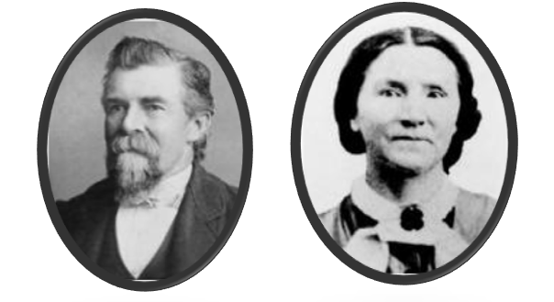
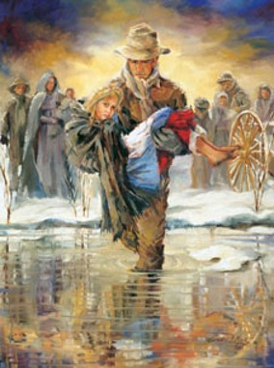
Francis and Betsy Webster
In 1856, Francis and Betsy Webster had enough money to travel to Utah in a wagon, but they donated their money to a fund created to help the Saints emigrate to Utah (the Perpetual Emigrating Fund).
Their donation allowed an additional nine individuals to travel by handcart. Francis and Betsy, who were expecting a baby, traveled to Salt Lake City with the Martin handcart company and suffered along with the rest of the company.
“I ask you to stop this criticism for you are discussing a matter you know nothing about. Cold historical facts mean nothing here for they give no proper interpretation of the questions involved. Mistake to send the handcart company out so late in the season? Yes. But I was in that company and my wife was in it. … We suffered beyond anything you can imagine and many died of exposure and starvation. But did you ever hear a survivor of that company utter a word of criticism? …

Slide 15
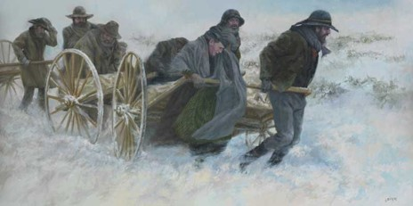
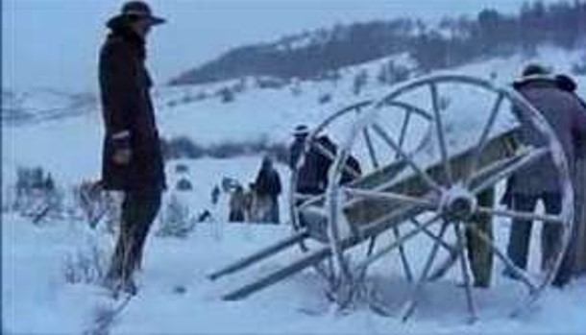
Choosing the Handcart Company
Years later, as Brother Webster sat in a Sunday School class, he listened to some Church members criticize Church leaders for the handcart tragedy. Unable to constrain himself, he arose and testified of the blessings of being in the Martin handcart company. Invite a student to read Francis Webster’s testimony aloud, and ask students to identify one way in which those who suffered with the handcart companies were blessed.
“I have looked back many times to see who was pushing my cart but my eyes saw no one. I knew then that the Angels of God were there.
“Was I sorry that I chose to come by handcart? No. Neither then nor one moment of my life since. The price we paid to become acquainted with God was a privilege to pay and I am thankful that I was privileged to come to Zion in the Martin Handcart Company.”
Francis Webster

Slide 16
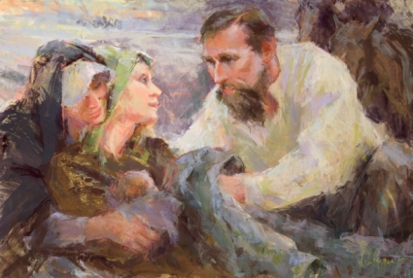
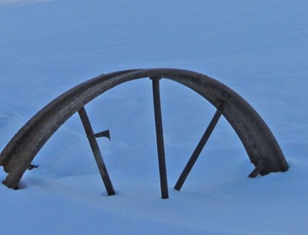
The Handcart Companies
Six more handcart companies crossed the plains after 1856. To demonstrate that the idea was still viable, seventy missionaries made the trip in the opposite direction in the spring of 1857.
Five companies, totaling 1,076 immigrants with 223 handcarts, crossed west with little difficulty: two in 1857, one in 1859, and two in 1860. In all, 2,962 immigrants walked to Utah with handcarts.
About 250 died along the way-all but about 30 of those in the Willie and Martin companies
Harold B. Library BYU
Julie Rogers

Slide 17
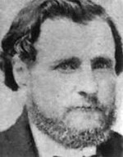
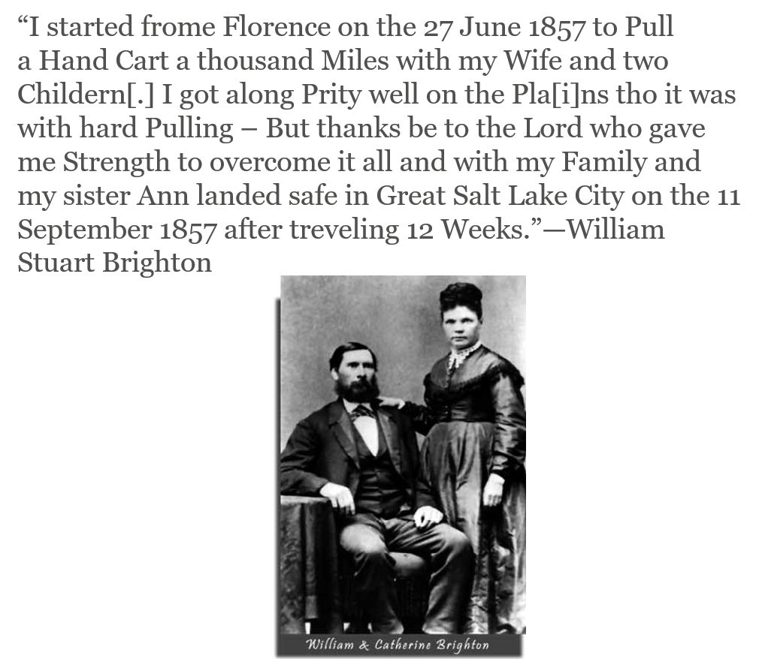
Sixth Company
Israel Evans Company
6th handcart company which had 149 individuals and 28 handcarts in the company when it began its journey from the outfitting post at Iowa City, Iowa.
Departed May 22-23, 1857 and arrived September 11-12, 1857.
Number in company: 82

Slide 18
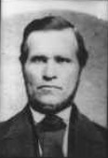
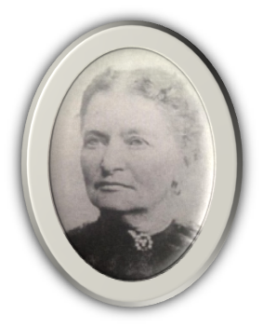
Seventh Company
Kersten Erickson Benson
“(The first 3 weeks) the hardships had proved that my Father and Mother and Grandmother, who was 75 years old could not stand the journey, and it was decided that they stay behind in Omaha—I came to the conclusion that I could not leave my aged parents in a strange country and so made up my mind to stay with them. The Captain C. Christensen, came to me and advised me to leave my parents and promised me if I would do so, God would bless me and them and preserve us—This was a very sore trial to me. But I put my trust in God and the promises of His Priesthood. and He has brought them to pass—
On the 15 of June 1857 we started on the plains, a day I shall never forget—full of sorrow in parting from my parents—
About the fifth day out, I was so worn out pulling over the rough roads—up hills—and through the sand and discouraged because I did not believe that I could stand the journey, and I came to the conclusion that I might as well die there as suffer longer—and I was lonely for I had no relatives in the company.
So I purposely staid behind while the company were travelling and laid down in the grass expecting to die there—believing there was no one behind me and I would not be found. Soon after the Captain came along and found me and helped me along and promised me that when we came to a hill or sand, he would come and help me pull. And he kept his promise and helped me[.] Soon after this the old couple who were with my hand cart died and I was changed to another cart that had 6 pullers, and my task was easier than before.”
Christian Christiansen Company
7th handcart company which had about 330 individuals, 68 handcarts, and 3 wagons in the company when it began its journey from the outfitting post at Iowa City, Iowa. This company was first headed by James Park, David Dille, and George Thurston. But because Christian Christiansen could speak the language he was made captain.
Departure: June 15, 1857
Arrival: September 13, 1857
Number in Company: 214

Slide 19
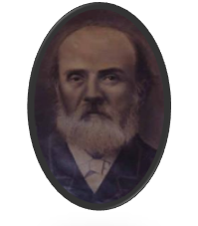
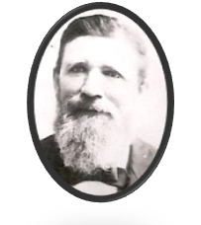
Eighth Company
"We traveled on until the next day, when, to our sorrow, our rations were reduced to a pound of flour for four days, and then we felt more than ever the pangs of hunger; children were crying for bread and their parents were unable to give them any.
"We traveled on as best we could. We had in our company, brethren who were fishermen, and they expected to catch some fish when we came to the Platte River and the other streams. They were well supplied with fishing tackle, but they too were disappointed.
"As we traveled, we came to a bed of cactus, commonly known as the prickly-pear. We tried many ways to cook them. Some took their last morsel of bacon and peeled the pears and then fried them with it; some peeled and boiled them; some peeled and roasted them in the fire. A few persons did mange to eat a little, but it was a general failure.
"One day at noon we came to a spring in a grove of timber. As we stopped our carts we saw a large sage hen just over our heads
in a tree. I took my gun and shot it, and thus we were again
provided with meat. Thus the Lord blessed us above many
of our companions.”
William Atkin (retold by Luella M. Atkin—granddaughter)
George Rowley Company
8th handcart company. 235 individuals, 60 handcarts, and 8 wagons were in the company when it began its journey from the outfitting post at Florence, Nebraska (now Omaha).
Departure: June 7, 1859
Arrival: September 4, 1859
Number in Company: 279
The three sons of Captain Rowley walked most of the way. The youngest, Alma, was six years old. Shoes gave out and they had to tie rags around their feet.

Slide 20
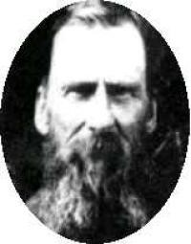
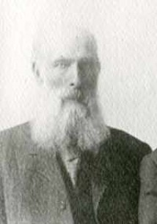
Ninth Company
“Sunday, July 1. A good meeting was held in the forenoon and a council meeting was also held by the brethren in which instructions of a timely nature were given. At the testimony meeting held in the evening one of the sisters spoke in tongues, in which she asserted that no evil should befall us as we proceeded on our journey, if we were faithful; also one of the brethren belonging to the wagon company spoke in tongues. A company carrying freight to the Valley passed us during the day.”
Henry James Harrison
Daniel Robison Company
9th handcart company. 233 individuals, 43 handcarts, and 6 wagons were in the company when it began its journey from the outfitting post at Florence, Nebraska (now Omaha).
Departure: June 6, 1860
Arrival: August 27, 1860
Number in Company: 258

Slide 21
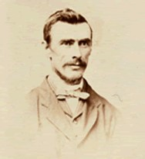
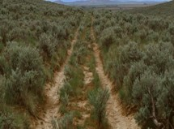
Handcarts and Wagons
According to the Lars Christian Peterson journal, a small portion of this company left on June 9th with handcarts and arrived in Salt Lake City two weeks prior to the main body of the company, which consisted of 380 individuals and 56 wagons. This main portion of the company began its journey June 23-26th from the outfitting post at Florence, Nebraska (now Omaha).
Robert F. Neslen Company
Departure June 23, 1859
Arrival September 15, 1859
Number in Company 384

Slide 22
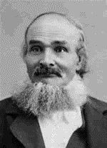
Tenth Company
On the 3rd [July 1860] the company was fully organized, consisting of twenty-one carts, it was divided into three divisions. Fisher was in charge of the first section, A[nders] Christensen in charge of the second section, while I looked after the third division. Six wagons, drawn by oxen, accompanied us, hauling our tents, provisions, and sundries. Oscar Stoddard was our captain. On the 4th we received one hundred pounds of flour to each cart and then pulled out of town. My cart was quite heavy as the only help I had to pull was the little my wife and children could do, while at the other carts there were two or three men.
On the 18th the captain’s mule ran away but was soon found. A couple of days later the oxen got on a rampage and ran into a corn field, damaging the crop to the extent of eight dollars which we had to pay.
On the 24th of September, 1860, we took up our handcarts for the last time; we pulled them fourteen miles on to the camp grounds in Salt Lake City. Here we set them down, never more to realize how heavy they had been, how hard to pull.
Fjeld, Carl Johan Ellefsen
Oscar O. Stoddard Company
10th handcart company. 126 individuals, 22 handcarts, and 6 wagons were in the company when it began its journey from the outfitting post at Florence, Nebraska (now Omaha).
Departure: July 6, 1860
Arrival: September 24, 1860
Number in Company: 154

Slide 23
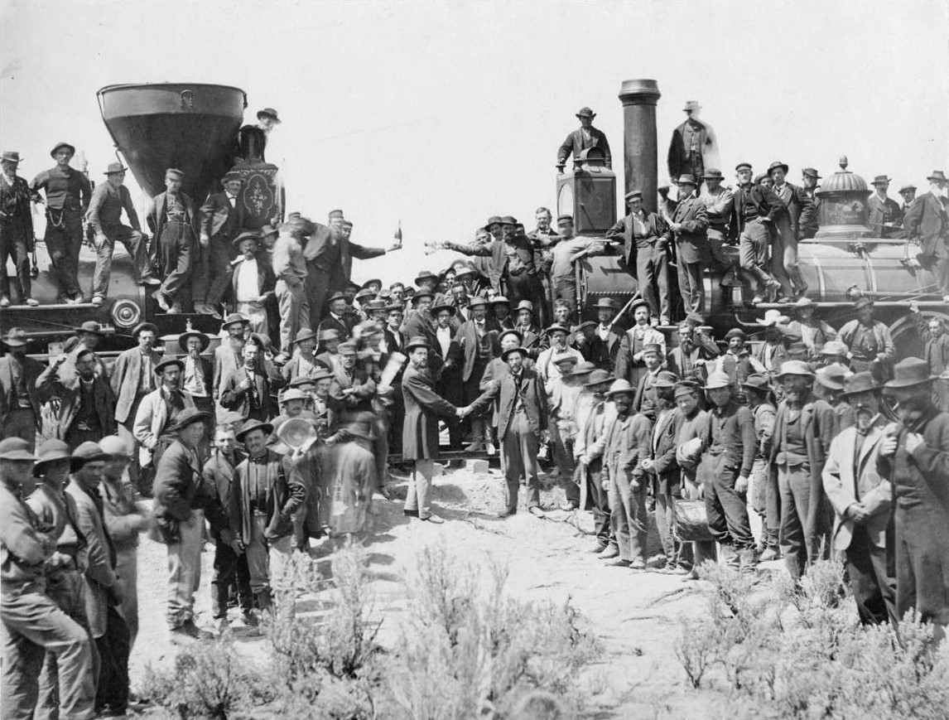
Trains
Once the railway was finished the Saints had an easier passage to the west

Slide 24
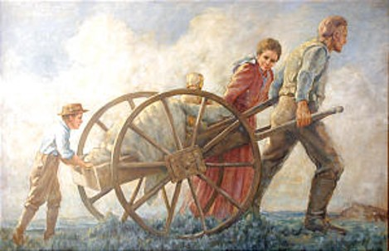
“I am grateful that today none of our people are stranded on the Wyoming highlands. But I know that all about us there are many who are in need of help and who are deserving of rescue. Our mission in life, as followers of the Lord Jesus Christ, must be a mission of saving.
There are the homeless, the hungry, the destitute. Their condition is obvious. We have done much. We can do more to help those who live on the edge of survival.
“We can reach out to strengthen those who wallow in the mire of pornography, gross immorality, and drugs. Many have become so addicted that they have lost power to control their own destinies. They are miserable and broken. They can be salvaged and saved. …
“It is not with those on the high plains of Wyoming that we need be concerned today. It is with many immediately around us, in our families, in our wards and stakes, in our neighborhoods and communities”
President Gordon B. Hinckley

Slide 25
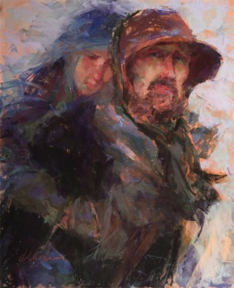
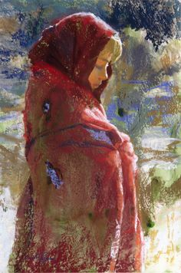
Our Personal Trek
Julie Rogers
“If we are faithful the day will come when those deserving pioneers and ancestors, whom we rightly praise for having overcome the adversities in their wilderness trek, will praise today’s faithful for having made their way successfully through a desert of despair and for having passed through a cultural wilderness, while still keeping the faith.”
Elder Neal A. Maxwell
Julie Rogers

Slide 26
Sources:
Videos:
Our Mission of Saving (1:11)
Watched Over by God: Elizabeth Panting's Journey to Zion (16:21)
Faithful Handcart Children (2:31)
“A Priceless Heritage” [time code 5:32 to 7:58].)
Elizabeth Jackson (Leaves from the Life of Elizabeth Horrocks Jackson Kingsford [1908], 6–7; see also history.lds.org).
S.F. Kimball (1914) mentions only three boys—Huntington, Grant, and Kimball—But John Jacque’s record adds Taylor to the list (in Whitney 1:562)
Whitney, Orson F. History of Utah. 4 vols. Salt Lake City
“The Life and Story of Robert Taylor Burton” by Janet Burton Seegmiller Page 158
LaRane Proter Gaunt and Linda Dekker Go and Bring Them In December 2006 Ensign
President Gordon B. Hinckley (“Our Mission of Saving,” Ensign, Nov. 1991, 59).
Francis Webster (in William R. Palmer, “Pioneers of Southern Utah,” The Instructor, vol. 79, no. 5 [May 1944], 217–18).
President James E. Faust (“A Priceless Heritage,” Ensign, Nov. 1992, 84–85).
Elder Neal A. Maxwell (If Thou Endure It Well[1996], 28).
Most Pioneer journal stories are found at overlantravels
Mormon Pioneer companies https://history.lds.org/overlandtravels/
http://eugenehalverson.blogspot.com/2011/07/smith-parker-chidester.html

Slide 27
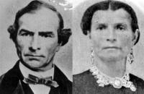
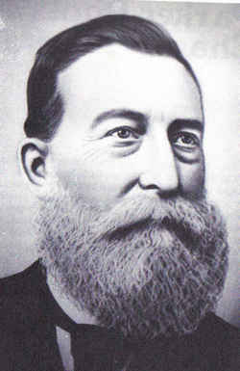
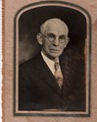
Edmund Ellsworth’s Company . . . in the year 1856, I left my situation to go to Utah after working for Mr Bent 16 years[.] on March the 19th I left Birmingham for Liverpool[.] went on the river on the 21st and set sale on the 23 easter Sunday on the sailing vesil Enoch Trane [Train]. and we arived at Boston on the 30th[.] from there we went to New york thence to Iowa City thence about 4 miles to the camping ground were we staid 6 weaks and 3 days wating for Hand Carts being made for my self and Wife [Rebecca Jane Finch Argyle] and 6 Children[.] tooke up our march with the first han[d]cart Company that ever Crost the planes[.] myself and two of my Children pulled two carts for 14 fourteen hundred Miles[.] My Wife was Confined soone after we got to Utah and she had to walk all the way with the exception of one half Day[.] this was a hard trip but I never complained but always made the best of it[.] we stade ten Days at Florance [Florence] then started to cross the planes and we arived in Utah on the 26 Day of september with all of my family alive for which I thank God.”
Argyle, Joseph, Reminiscences and journal, 1870 May-1894 Oct., 63.
Captain Daniel D. McArthur Company:
In early July a terrible thunderstorm tore up tents and drenched everyone. They were also delayed looking for people who veered off the road. At one point an 8-year-old boy, (Arthur Hartley Parker) got lost on the road. They halted for a day to search for him but then had to move on, leaving the boy's father to continue the search alone. Four days afterward, a reunited father and son joyfully rejoined the company, waving a red shawl as they approached the camp.
"The Red Shawl". Falling asleep at the wrong place had greater hazards for six-year-old Arthur Parker. He had crept into the shade to rest during a morning break on a sultry June day in 1896 and had been left behind. His parents, Robert and Ann Parker, had assumed he was playing along the way with other children and did not miss him until they stopped that afternoon to make camp in the face of a sudden thunderstorm. It was then they realized Arthur was not with them. Who can imagine the rising panic these parents felt in the next two days as the company remained while the men searched for their son? Finally, on July 2, with no alternative, the company was ordered west. Robert Parker went back alone to continue searching for his missing child. As he was leaving, his wife pinned a red shawl around his shoulders and said words such as these: "If you find him dead, wrap him in the shawl to bury him. If you find him alive, use this as a flag to signal us." Then with a sinking heart, she and their other children struggled on. Out on the trail each night Ann scanned the horizon for her husband, eyes straining for the sign. Day after frightening day-nothing. Then, just at sundown on July 5, she saw a figure approaching from the east. In the last light of the setting sun she saw the glimmer of the bright, red shawl. One of the diaries records, "Anne Parker fell in a pitiful heap upon the sand, and that night, for the first time in six nights, she slept." On July 5, Archer Walters recorded, "Brother Parker came into camp with a little boy that had been lost. Great joy through the camp. The mother's joy I cannot describe." It seems the little boy, sick with illness and terror, had been found by a woodcarver who had cared for him until his father had found him.
Arthur Parker
Robert Parker
https://history.lds.org/overlandtravels/companyDetail?lang=eng&companyId=111

Slide 28
The seventh handcart company:
Christian Christiansen Company:
Most of the people in the Christian Christiansen handcart company were Scandinavians (Danes, Norwegians, and Swedes). They numbered about 330 souls, including a girl with a wooden leg and a 60-year-old blind woman. Because the Perpetual Emigrating Fund was exhausted, the emigrants had to purchase their own outfits with pooled resources. They had 68 handcarts, 3 wagons, 10 mules, and 1 cow. The cow soon died but others were purchased along the way. Likewise, the travelers purchased a fourth wagon and oxen to pull it. Elder J. P. Park, a Scotsman, was the company captain, but he had to communicate with his charges through an interpreter because he could not speak nor understand their language. Also, he was reportedly unsympathetic towards them. "The less said about this unfortunate choice of a leader for such a people as us," wrote an emigrant, "the better for him."
Christian Christiansen Jr as a young man served in the Danish Army. Because of numerous other soldiers bearing the name of Christiansen, Christian was called Christian Dalby, after the name of the town from which he served. Many of Christian Christiansen's descendants bear the name of Dalby to this day.
A story of Anna Marie Anderson Sorenson who, on July 20th, while near the Nebraska-Wyoming border, slipped away from the camp and went into the willows near the Wood River. She returned somewhat later carrying her new infant in her arms, which she had delivered by herself in the bushes and wrapped in her apron. When the company prepared to go on, Anna Sorenson took her place by the carts, prepared to do her part. Captain Christiansen, observing her great courage, insisted that she ride for that day. Gratefully she followed his instructions and enjoyed the great luxury of riding with her baby. The next day she went back to the old routine and walked for the remainder of the journey. Her child was born, her duty now lay in caring for her family and doing her share toward speeding the journey to Zion.
One of C.C.A Christensen’s paintings
“Crossing the River Platte”
Seventh Handcart Company:
Composed by Carl Christian Anthon Christensen:
HANDCART SONG FROM 1857 Come, brethren, let us all gladly Go together to Salt Lake City, And if we get tired, don't be faint-hearted; Spit in your fist, and that's all there is to it. We're going to our beloved home, Always forward. Dulfdulidu.7 And if it seems a little hard, still we can take it. The handcart does feel strange and new, It is true, from one view; But every fellow in some way Will take hold better every day Till in the end it goes right neatly, Doesn't it? Dulidulidu . And even if it seems a little hard, we can take it. So it goes, up and down, More and more, for several weeks, Till we get up on the mountain. At its top we will stop. There Salt Lake Valley we will see And a little snow-dulidulidu. The last tug was a little hard, but we could take it. Then we go merrily down again; Come, my follower and friend! Our trip is now almost at an end. We are free as a bee. Now we quickly hurry on Toward our joyful home-dulidulidu¬And even if it was a little hard, We could take it. The journey then continued by rail to Iowa City, which was the westernmost point the iron horse had reached, and there we were to begin our honeymoon trip with handcarts.

Slide 29
The eighth company:
George and Ann Rowley:
They had six children, but were unfortunate enough to lose all three girls at an early age. One (Rachael) was burnt to death, one drowned in the mill race, and one was born at sea, died, and buried in the ocean while on their way to America. The names of their children that are known are William Brown Rowley, April 8 1847; Joseph Smith Rowley, May 17, 1849; Rachael, birth date unknown; and Alma, August 25, 1853. They heard the gospel of Jesus Christ preached by LDS missionaries in 1844, the same year they married. Ann said, "My father and mother joined the Church and died in the old country. I was instrumental in the hand of the Lord in bringing them into the Church.
He (George) was preparing to leave when his daughter Rachael was killed in an accident. She fell and was fatally burned on the stove. Rachael was buried December 17, 1854, the day before George had to leave for Liverpool. It was a great test of his faith, but he put his trust in God to protect his family as he left. It was only their faith, that by leaving it would later be possible for him to bring his family to America, which gave him to the strength to do so. Ann, stricken with grief, stayed behind to support herself and her sons the best she could while he was gone. George was to sail for America on the ship "Ellen Maria." He arrived in Liverpool, England, and went in a tugboat to the ship. He worked to put all the luggage on board by December 20, when another vessel ran against the ship causing a leak that took nearly a month to repair. –Ann Rowley (Note: it was 5 years when his family would join him on April 11, 1859 and set sail for America) Family Search
The ninth company:
Captain Daniel Robison:I was appointed Captain of the company. “Although it was one of the last companies, it was one of the most successful in its journey. I tried very hard to avoid any trouble which might arise and was very much respected by all the people in the company.
“When we camped at night the carts were placed in a circle leaving an open space of about ten feet. This circle was used as a corral to unyoke the oxen. They were then driven perhaps a half-mile away to feed. Here they were guarded until midnight by two of the men, then they were relieved by others. In the morning each man yoked up his own oxen. Breakfast was hurriedly eaten and were we lined up for another hot day. The carts were loaded with cooking utensils, sometime the little children were put on the carts if their feet had gotten too tire to walk any farther. Most of the mothers trudged along on the scorching ground barefooted. Some carried young babies, others leading barefoot little children by the hand, pausing now and the, trying to do something to relieve the pain in their blistered feet. Only our prayers and the knowledge that we would soon be to Zion kept us going those long hot dusty miles. We often felt kinship to the children of Israel, putting our trust in the Lord and were not deceived for our journey was a peaceful one.”
Daniel Robison
Wife: Rachel Smith
Family Search

Slide 30
The Tenth and Last handcart Company:
Account of a 6 year old
The first night out the mosquitoes gave us a hearty welcome. Father had bought a cow to take along, so we could have milk on the way. At first he tied her to the back of the cart, but she would sometimes hang back, so he thought he would make a harness and have her pull the cart while he led her. By this time mother’s feet were so swollen that she could not wear shoes, but had to wrap her feet with cloth. Father thought that by having the cow pull the cart mother might ride. This worked well for some time.
One day a group of Indians came riding up on horses. Their jingling trinkets, dragging poles and strange appearance frightened the cow and sent her chasing off with the cart and children. We were afraid that the children might be killed, but the cow fell into a deep gully and the cart turned upside down. Although the children were under the trunk and bedding, they were unhurt, but after that father did not hitch the cow to the cart again. He let three Danish boys take her to hitch to their cart. Then the Danish boys, each in turn, would help father pull our cart.
After about three weeks my mother’s feet became better so she could wear her shoes again. She would get so discouraged and down-hearted; but father never lost courage. He would always cheer her up by telling her that we were going to Zion, that the Lord would take care of us, and that better times were coming.
At times we met or were passed by the overland stage coach with its passengers and mail bags and drawn by four fine horses. When the Pony Express dashed past it seemed almost like the wind racing over the prairie.
Our provisions began to get low. One day a herd of buffalo ran past and the men of our company shot two of them. Such a feast as we had when they were dressed. Each family was given a piece of meat to take along. My brother John, who pushed at the back of our cart, used to tell how hungry he was all the time and how tired he got from pushing. He said he felt that if he could just sit down for a few minutes he would feel so much better. But instead, father would ask if he couldn’t push a little harder. Mother was nursing the baby and could not help much, especially when the food ran short and she grew weak. When rations were reduced father gave mother a part of his share of the food, so he was not so strong either.
When we got that chunk of buffalo meat father put it in the handcart. My brother John remembered that it was the fore part of the week and that father said we would save it for Sunday dinner. John said, "I was so very hungry and the meat smelled so good to me while pushing at the handcart that I could not resist. I had a little pocket knife and with it I cut off a piece or two each half day. Although I was afraid of getting a severe whipping after cutting a little the first few times, I could not resist taking a little each half day. I would chew it so long it got perfectly tasteless. When father went to get the meat on Sunday noon he asked me if I had been cutting off some of the meat. I said ‘Yes, I was so hungry I could not let it alone.’ Instead of giving me a scolding or whipping, father turned away
and wiped tears from his eyes.”
At last, when we reached the top of Emigration Canyon, overlooking Salt Lake, on that September day, 1860, the whole company stopped
to look down through the valley. Some yelled and tossed their hats in the air. A shout of joy arose at the thought that our long trip was over,
that we had at last reached Zion, the place of rest. We all gave thanks to God for helping us safely over the Plains and mountains to our
destination.
Mary Ann Stucki Reber Hafen

Slide 31
The Fourth Sweetwater Rescuer—Stephen Taylor
John Jaques John Jaques (1827-1900), born in Moraket Bosworth, Leicestershire, England, became a Latter-day Saint in 1845. He emigrated with his family to America in 1856 and crossed the plains with the fated Martin Handcart Company. His daughter was among those who died. He returned to England as a missionary (1869-71), and there, at Stratford-upon-Avon, he penned the Mormon hymn, "O Say, What Is Truth." After his return from England he worked for the Deseret News and in the Church Historian's Office.
“The Life and Story of Robert Taylor Burton” by Janet Burton Seegmiller Page 158When the handcart company reached the Sweetwater, it was filled with floating ice. Elder John Jacques reported that this passage was almost beyond the ability of the people:
“It was the last ford that the emigrants waded over. The water was not less than two feet deep…but it was intensely cold. The ice was three or four inches thick and the bottom of the river muddy or sandy. I forget exactly how wide the stream was there, but I think thirty or forty yards. It seemed a good deal wider than that to those who pulled their handcarts through it (in Whitney 1:562)”
As the women shrank back and men wept at the prospect, four eighteen-year-old boys from the valley, C. Allen Huntington, George W. Grant, Stephen Taylor, and David P. Kimball, stepped forward and picked up women and children and even some of the men, and carried them one by one across the snowbound river, crossing it many times late in the afternoon. Solomon F. Kimball reports that the strain was so terrible, and exposure so great that in later years these boys died from the effects of carrying the emigrants through the icy water (S.F. Kimball 1914, 288)
Notes: S.F. Kimball (1914) mentions only three boys—Huntington, Grant, and Kimball—But John Jacque’s record adds Taylor to the list (in Whitney 1:562)
Whitney, Orson F. History of Utah. 4 vols. Salt Lake City
On 4 November they came to the Sweetwater River, near Devil’s Gate. The river was about 100 feet wide and almost waist deep in places. To make it worse, big chunks of ice were floating in the water. For the weakened members of the Martin Company, the crossing appeared almost impossible.
One of the handcart pioneers later remembered that some of the pioneers were able to ford the river, but others could not. At that point, several members of the rescue party—one account names C. Allen Huntington, Stephen W. Taylor, and teenagers David P. Kimball and George W. Grant—stepped forward to help. These courageous men “waded the river, helping the handcarts through and carrying the women and children and some of the weaker of the men over” (John Jaques, “Some Reminiscences,” Salt Lake Daily Herald, 15 Dec. 1878, 1; see also 19 Jan. 1879, 1).
One of the women who was carried over the river later recalled: “Those poor brethren [were] in the water nearly all day. We wanted to thank them, but they would not listen to [us]. My dear mother felt in her heart to bless them for their kindness. She said, ‘God bless you for taking me over this water and in such an awful, rough way.’ [They said], ‘Oh, … I don’t want any of that. You are welcome. We have come to help you.’ ” This sister also reported that one of the rescuers “stayed so long in the water that he had to be taken out and packed to camp, and he was a long time before he recovered, as he was chilled through. And in after life he was always afflicted with rheumatism” (Patience Loader Rozsa Archer, reminiscence, in Women’s Voices: An Untold History of the Latter-day Saints, 1830–1900, ed. Kenneth W. Godfrey, Audrey M. Godfrey, and Jill Mulvay Derr [1982], 236; spelling and punctuation standardized).
These rescuers and what they had done were brought to President Young’s attention. “When President Brigham Young heard of this heroic act,” one writer stated, “he wept like a child, and declared that this act alone would immortalize them” (Solomon F. Kimball, “Our Pioneer Boys,” Improvement Era, July 1908, 679).

Slide 32
John Chislett--Willie Handcart Company:
“We traveled on in misery and sorrow day after day. Sometimes we made a pretty good distance but at other times we were only able to make a few miles progress. Finally we were overtaken by a snow storm which the shrill wind blew furiously about us. The snow fell several inches deep as we traveled along, but we dared not stop for we had a sixteen mile journey to make and short of it we could not get wood and water.
“As we were resting for a short time at noon, a light wagon was driven into our camp from the west. Its occupants were Joseph A. Young and Stephen Taylor. They informed us that a train of supplies was on the way and we might expect to meet it in a day or two. More welcome messengers never came from the courts of glory than these two young men were to us. They lost no time after encouraging us all they could to press forward, but sped on further east to convey these glad tidings to Edward Martin and the fifth handcart company who left Florence about two weeks after us and who it was feared were even worse off than we were. As they went from our view, many a hearty “God bless you” followed them.
“The storm which we encountered, our brethern from the Valley also met and not knowing that we were so utterly destitute they encamped to await fine weather but when Captain [James G.] Willie found them and explained our real condition, they at once hitched up their teams and made all speed to come to our rescue. On the evening of the third day after Captain Willie’s departure, just as the sun was sinking beautifully behind the distant hills, on an eminence immediately west of our camp, several covered wagons, each drawn by four horses, were seen coming towards us. The news ran through the camp like wildfire and all who were able to leave their beds turned out en masse to see them. A few minutes brought them sufficiently near to reveal our faithful captain slightly in advance of the train. Shouts of joy rent the air; strong men wept till tears ran freely down their furrowed and sun burnt cheeks and little children partook of the joy which some of them hardly understood, and fairly danced around with gladness. Restraint was set aside in the general rejoicing and as the brethern entered our camp the sisters fell upon them and deluged them with kisses. The brethern were so overcome that they could not for some time utter a word, but in choking silence repressed all demonstrations of those emotions that evidently mastered them. Soon, however, feeling was somewhat abated and such a shaking of hands, such words of welcome and such invocation of God’s blessings have seldom been witnessed.
“I was installed as regular commissary to the camp. The brethern turned over to me flour, potatoes, onions and a limited supply of warm clothing for both sexes, besides quilts, blankets, buffalo robes, woolen socks, etc. I first distributed the necessary provisions and after supper divided the clothing, bedding, etc. where it was most needed. That evening, for the first time in quite a period the songs of Zion were to be heard in the camp and peals of laughter issued from the little knots of people as they chatted around the fires. The change seemed almost miraculous, so sudden was it from grave to gay, from sorrow to gladness, from mourning to rejoicing. With the cravings of hunger satisfied, and with hearts filled with gratitude to God and our good brethern, we all united in prayer and then retired to rest.
“Among the brethern who came to our succor were Elders W. H. Kimball and G. D. Grant. They had remained but a few days in the Valley before starting back to meet us. May God ever bless them for their generous, unselfish kindness and their manly fortitude. They felt that they had, in great measure, contributed to our sad position; but how nobly, how faithfully, how bravely they worked to bring us safely to the Valley, to the Zion of our hopes!
“After getting over the pass, we soon experienced the influence of a warmer climate and for a few days we made good progress. We constantly met teams from the Valley, with all the necessary provisions. Most of these went on to Martin’s company but enough remained with us for our actual wants. At Fort Bridger we found a great many teams that had come to our help. The noble fellows who came to our assistance invariable received us joyfully and did all in their power to alleviate our sufferings. May they never need similar relief.
“After arriving in the Valley, I found that President Young, on learning from the brethern who passed us on the road, of the lateness of our leaving the frontier, set to work at once to send us relief. It was the October Conference when they arrived with the news. Brigham at once suspended all conference business and declared that nothing further should be done until every available team was started out to meet us. He set the example by sending several of his best mule teams, laden with provisions. Heber Kimball did the same and hundreds of others followed their noble example. People who had come from distant parts of the territory to attend conference, volunteered to go out to meet us and went at once. The people who had no teams gave freely of provisions, bedding, etc., all doing their best to help us.
“We arrived in Salt Lake City on the 9th of November but Martin’s company did not arrive until about the 1st of December. They numbered near 600 on starting and lost over one fourth of their number by death. The storm which overtook us while making the 16 mile drive on the Sweetwater, reached them at North Platte. There they settled down to await help or die, being unable to go any farther. Their camp ground became indeed a veritable grave yard before they left it and their dead lie even now scattered along from that point to Salt Lake.”

Slide 33
Journal Entry From Robert Taylor Burton: excerpts
The Rescuers left Salt Lake on October 7, 1856 going east. They met Brother James G. Willie on October 20th, then traveled early in the morning on the 21st to meet the company. On October 26th they camped near Devil’s Gate. They heard of nothing of the companies behind them. A. Young, Abel Garr, and Dan Jones went to look for the other companies. And they returned on Oct. 30th that the company had been camped at the Platte River for several days.
The company started again for the Valley and on November 1st Robert Taylor Burton and the Grant Brothers went back further east to meet William B. Hodgett’s company which was 4 or 5 miles back. Joseph S. Young and Abel Garr were sent with an express to Salt Lake about the situation on Nov. 3rd.
On Nov. 4th Captain Martins camp moved 3 miles.
Nov. 5th Captain Hunt’s company arrived here at 8 p.m. and on Nov. 6th the thermometer read 11 degrees below zero. No one moved the next two days.
Nov. 9th the Willie Handcart Company arrived.
On Nov. 10th Captains Hunt’s company moving and the last wagon moved on about 2 o’clock. Grant, Wheelock, Stephen Taylor and Burton moved on at 3 o’clock and camped with Captain Hodgett’s company at night.
On Nov. 15th the rescuers made it to Sweet Water.
They arrived in the Valley on Nov. 30th
John A. Hunt Wagon Company
Departure: August 1, 1856
Arrival: December 10, 1856
on the same trail and time as the Willie and Martin Handcart Companies. About 300 individuals and 56 wagons were in the company when it began its journey from the outfitting post at Iowa City, Iowa. Dan Jones was the captain initially for only about two weeks, then John Hunt became captain.
William B. Hodgett’s Company (Wagon)
Departure: July 30, 1856
Arrival: December 10, 1856
About 150 individuals and about 33 wagons were in the company when it began its journey from the outfitting post at Iowa City, Iowa.

Slide 34
The Perpetual Emigrating Fund Company was organized in October 1849. The "donations to the fund" helped outfit members "for the trek west" from 1850 to 1887. It also funded voyages to America starting in 1856. The fund was dis-incorporated in 1887 under the provisions of the Edmunds-Tucker Act. Approximately 30,000 people were assisted with all or part of their transportation expenses during the thirty-seven years of the Fund's operation. (Mormon Historical Studies, Fall 2000, p142)
There is no complete list of members who used PEF. Many members used the fund, and paid their debt; enabling other members to emigrate. However, in 1877 a list called Names of Persons and Sureties Indebted to the Perpetual Emigrating Fund Company from 1850 to 1877 was created. This was a list of everyone who used PEF but had not paid their debt. Then as part of the Jubilee year of the Church, the "Worthy Poor" were forgiven their debt. --Family Search
Handcarts to Zion by Leroy R. Hafen and Ann W. Hafen
http://books.google.com/books?id=XgLIT0OrVb8C&pg=PA153&lpg=PA153&dq=Israel+Evans+handcarts&source=web&ots=TdtgJIdJGu&sig=CSku-unz8lmZmAVGLYPC46Md9Q8&hl=en&sa=X&oi=book_result&resnum=3&ct=result#v=onepage&q=Israel%20Evans%20handcarts&f=false

