Slide 2
Sexual relations outside of marriage
Gender
The importance of marriage and family
Roles
of fathers
Abortion
Divorce
Same-sex marriage
Roles of mothers
Having Children

Slide 3
September 23, 1995
“With so much of sophistry that is passed off as truth, with so much of deception concerning standards and values, with so much of allurement and enticement to take on the slow stain of the world, we have felt to warn and forewarn.
In furtherance of this we of the First Presidency and the Council of the Twelve Apostles now issue a proclamation to the Church and to the world as a declaration and reaffirmation of standards, doctrines, and practices relative to the family which the prophets, seers, and revelators of this church have repeatedly stated throughout its history”
--President Gordon B. Hinckley

Slide 4
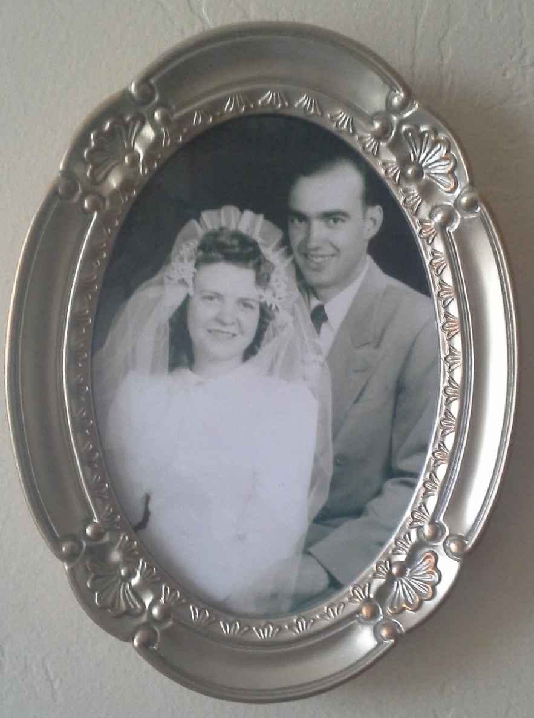
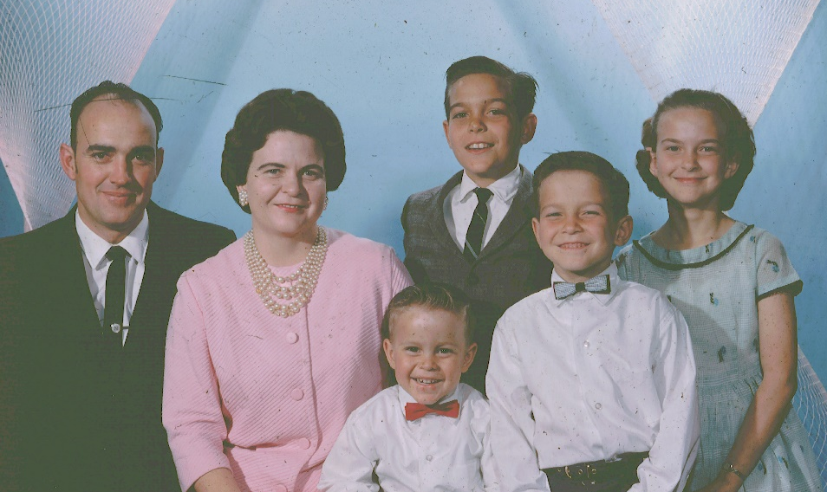
Marriage
The First Presidency and Council of the Twelve Apostles of The Church of Jesus Christ of Latter-day Saints
We, the First Presidency and the Council of the Twelve Apostles of The Church of Jesus Christ of Latter-day Saints, solemnly proclaim that marriage between a man and a woman is ordained of God and that the family is central to the Creator’s plan for the eternal destiny of His children.
The Blau Family
Nibley,, Utah
Marriage between a man and a woman is ordained of God
The family is central to Heavenly Father’s plan
Paragraph 1

Slide 5
Gender
All human beings—male and female—are created in the image of God.
Each is a beloved spirit son or daughter of heavenly parents, and, as such, each has a divine nature and destiny.
Gender is an essential characteristic of individual premortal, mortal, and eternal identity and purpose.
Leeta Richardson Blau
George Blau
Paragraph 2

Slide 6
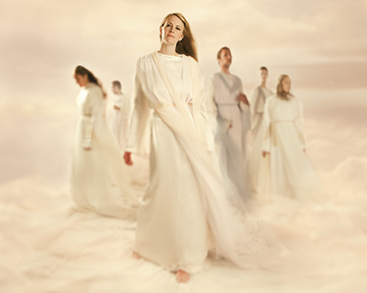
Premortal Realm
In the premortal realm, spirit sons and daughters knew and worshipped God as their Eternal Father and accepted His plan by which His children could obtain a physical body and gain earthly experience to progress toward perfection and ultimately realize their divine destiny as heirs of eternal life.

Slide 7
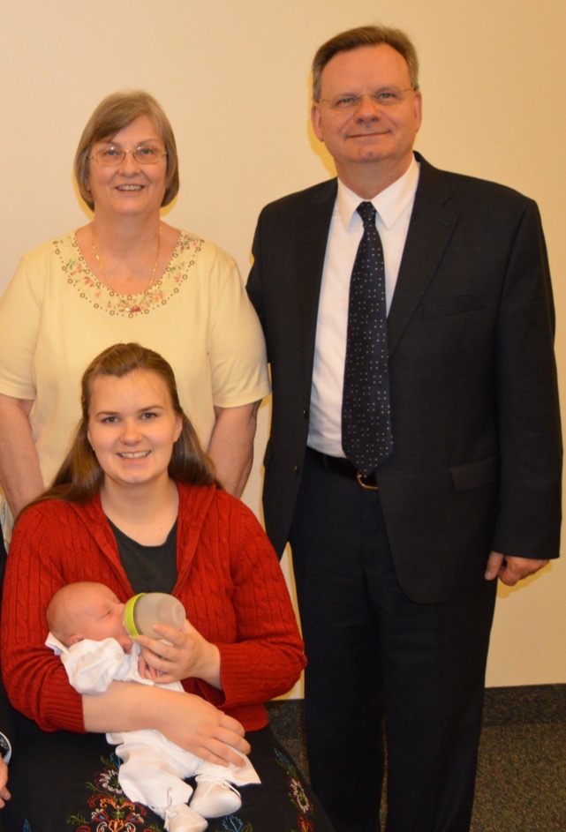
Divine Plan of Happiness
The divine plan of happiness enables family relationships to be perpetuated beyond the grave.
Sacred ordinances and covenants available in holy temples make it possible for individuals to return to the presence of God and for families to be united eternally.
The Miller Family
Caserta, Italy
Paragraph 3

Slide 8
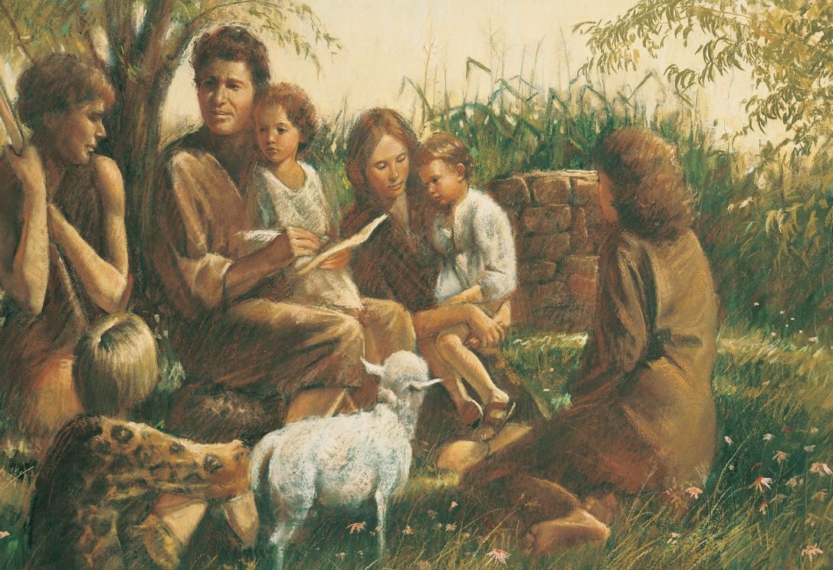
To Have Children
The first commandment that God gave to Adam and Eve pertained to their potential for parenthood as husband and wife.
God’s commandment for husbands and wives to have children remains in force today
Paragraph 4

Slide 9
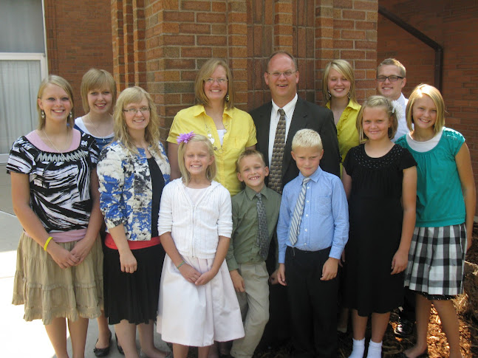
Lawfully Wedded
We declare that God’s commandment for His children to multiply and replenish the earth remains in force.
We further declare that God has commanded that the sacred powers of procreation are to be employed only between man and woman, lawfully wedded as husband and wife.
Paragraph 4
The Rhiner Family

Slide 10
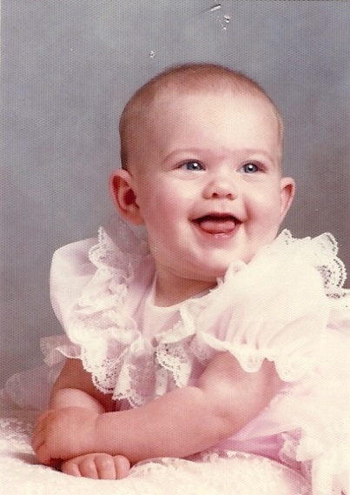
Divinely Appointed
We declare the means by which mortal life is created to be divinely appointed. We affirm the sanctity of life and of its importance in God’s eternal plan.
Paragraph 3 and 5

Slide 11
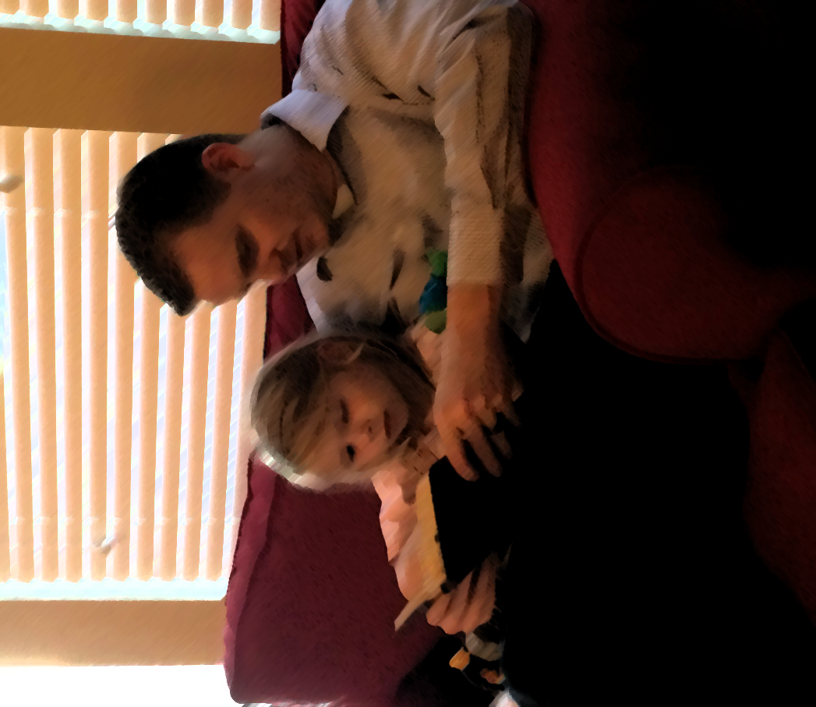
Husband and wife have a solemn responsibility to love and care for each other and for their children. “Children are an heritage of the Lord”
Lo, children are an heritage of the Lord: and the fruit of the womb is his reward. Psalm 127:3

Slide 12
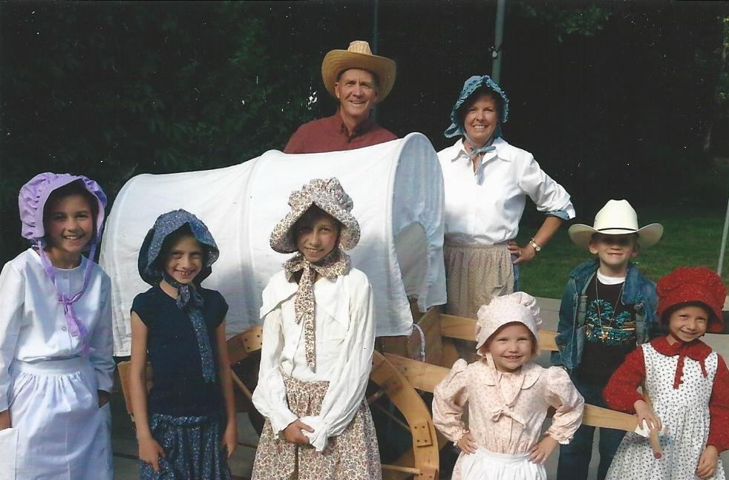
Blau and Frandsen
The Jenson’s and the Dudley’s
Parents have a sacred duty to rear their children in love and righteousness, to provide for their physical and spiritual needs, and to teach them to love and serve one another, observe the commandments of God, and be law-abiding citizens wherever they live.

Slide 13
Husbands and wives—mothers and fathers—will be held accountable before God for the discharge of these obligations.
The Sovine Family
Logan, Utah

Slide 14
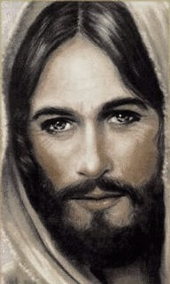
The family is ordained of God. Marriage between man and woman is essential to His eternal plan. Children are entitled to birth within the bonds of matrimony, and to be reared by a father and a mother who honor marital vows with complete fidelity.
Happiness in family life is most likely to be achieved when founded upon the teachings of the Lord Jesus Christ.
Gary and Pat Blau
Mesa, Arizona

Slide 15
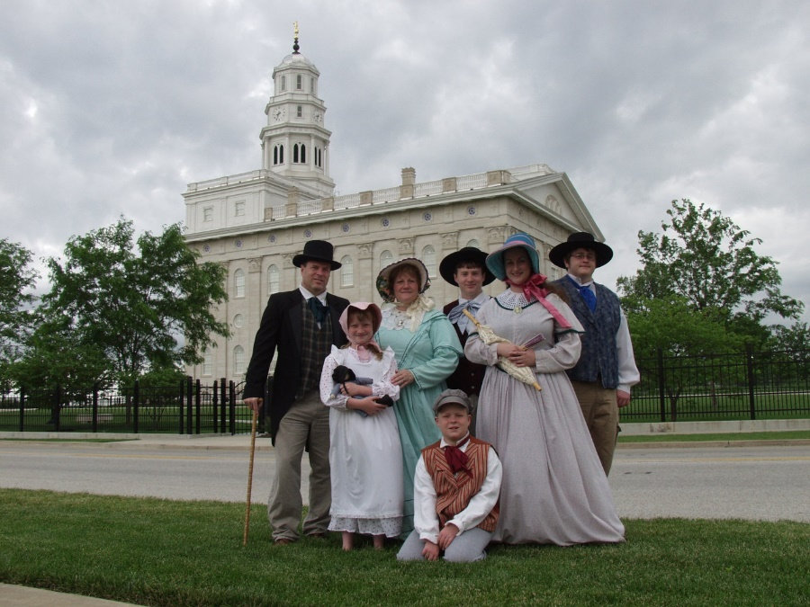
Successful marriages and families are established and maintained on principles of faith, prayer, repentance, forgiveness, respect, love, compassion, work, and wholesome recreational activities.
The Campbell Family
Mt. Pleasant, Utah

Slide 16
By divine design, fathers are to preside over their families in love and righteousness and are responsible to provide the necessities of life and protection for their families.
Joseph Moroni Green Family

Slide 17
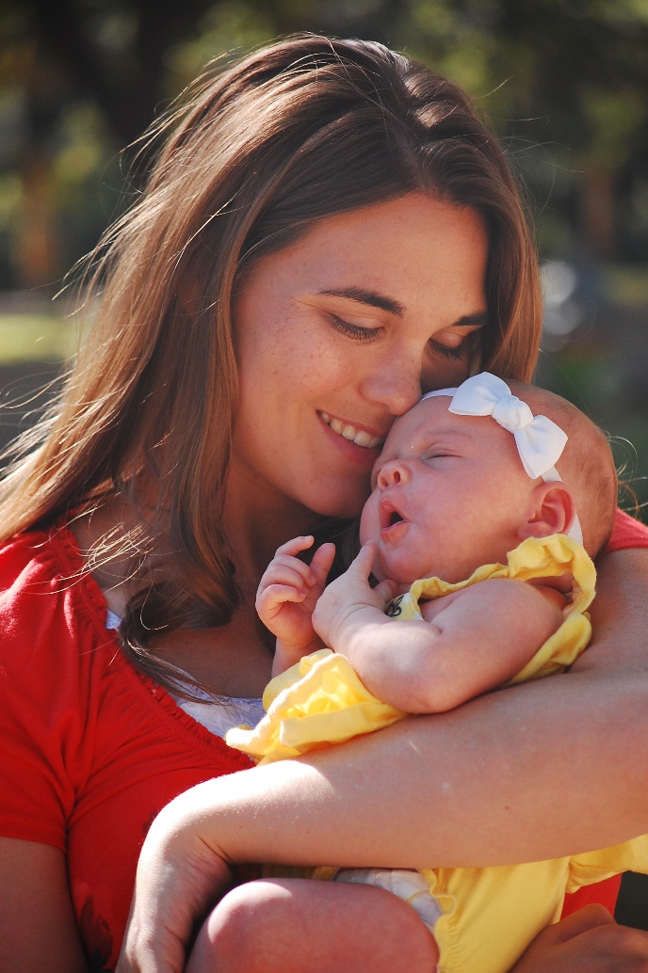
Mothers are primarily responsible for the nurture of their children. In these sacred responsibilities, fathers and mothers are obligated to help one another as equal partners.
Disability, death, or other circumstances may necessitate individual adaptation.
Extended families should lend support when needed.

Slide 18
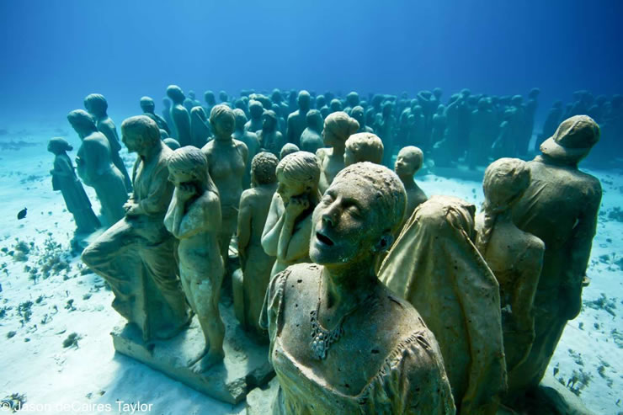
We warn that individuals who violate covenants of chastity, who abuse spouse or offspring, or who fail to fulfill family responsibilities will one day stand accountable before God.
Jason deCaires Taylor—underwater statues
Further, we warn that the disintegration of the family will bring upon individuals, communities, and nations the calamities foretold by ancient and modern prophets.
Mother and Child—
Arlington

Slide 19
We call upon responsible citizens and officers of government everywhere to promote those measures designed to maintain and strengthen the family as the fundamental unit of society.

Slide 20
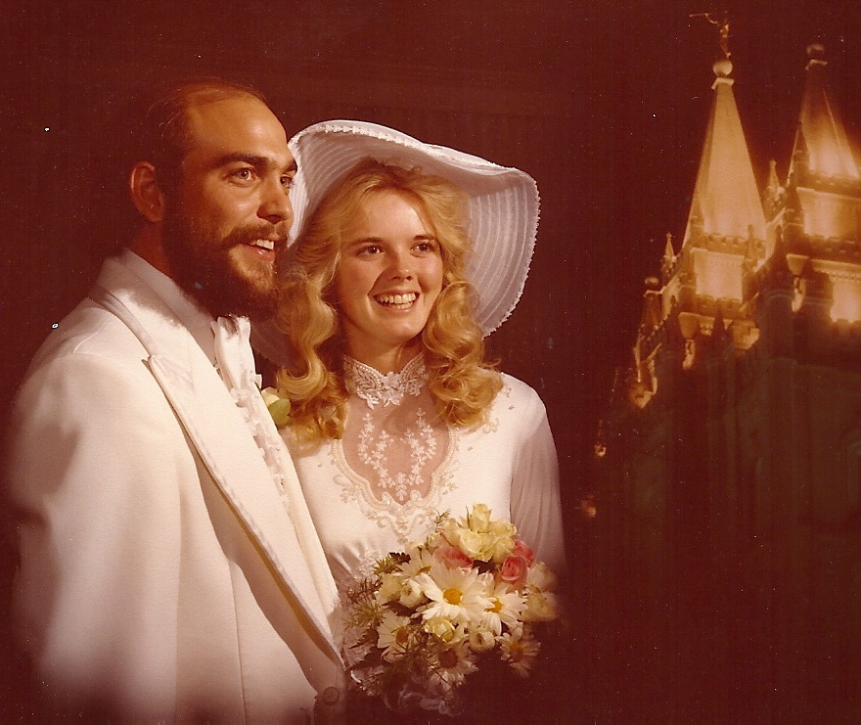
“I also assert the virtue of a temple marriage. It is the highest and most enduring type of marriage that our Creator can offer to His children.”
“While salvation is an individual matter, exaltation is a family matter.”
That proclamation on the family helps us realize that celestial marriage brings greater possibilities for happiness than does any other relationship.”
Elder Russell M. Nelson

Slide 21
Sources:
Videos: Defenders of the Proclamation(1:05)
Proclamation (2:12)
Gender is an Essential Characteristic (1:51)
President Gordon B. Hinckley (“Stand Strong against the Wiles of the World,” Ensign, Nov. 1995, 100).
http://twistedsifter.com/2011/01/astonishing-underwater-sculptures-by-jason-decaires-taylor-30-pics/
Defenders of the Proclamation(1:05)
Proclamation (2:12)
“Gender Is an Essential Characteristic.”
Elder Russell M. Nelson Celestial Marriage
October 2008 General Conference

Slide 22
“A Righteous marriage is a commandment and an essential step in the process of creating a loving family relationship that can be perpetuated beyond the grave.
“Two compelling doctrinal reasons help us to understand why eternal marriage is essential to the Father’s plan.
Elder David A. Bednar
(“Marriage Is Essential to His Eternal Plan,” Elder David A. Bednar Ensign, June 2006, 82–84).
“Reason 1: The natures of male and female spirits complete and perfect each other, and therefore men and women are intended to progress together toward exaltation.
“The eternal nature and importance of marriage can be fully understood only within the overarching context of the Father’s plan for His children. …
“‘Gender is an essential characteristic of individual premortal, mortal, and eternal identity and purpose’ and in large measure defines who we are, why we are here upon the earth, and what we are to do and become. For divine purposes, male and female spirits are different, distinctive, and complementary.
“After the earth was created, Adam was placed in the Garden of Eden. Importantly, however, God said it was ‘not good that the man should be alone’ (Genesis 2:18; Moses 3:18), and Eve became Adam’s companion and helpmeet. The unique combination of spiritual, physical, mental, and emotional capacities of both males and females were needed to implement the plan of happiness. Alone, neither the man nor the woman could fulfill the purposes of his or her creation.
“By divine design, men and women are intended to progress together toward perfection and a fulness of glory. Because of their distinctive temperaments and capacities, males and females each bring to a marriage relationship unique perspectives and experiences. The man and the woman contribute differently but equally to a oneness and a unity that can be achieved in no other way. The man completes and perfects the woman and the woman completes and perfects the man as they learn from and mutually strengthen and bless each other. ‘Neither is the man without the woman, neither the woman without the man, in the Lord’ (1 Corinthians 11:11; italics added).
“Reason 2: By divine design, both a man and a woman are needed to bring children into mortality and to provide the best setting for the rearing and nurturing of children.
“The commandment given anciently to Adam and Eve to multiply and replenish the earth remains in force today. ‘God has commanded that the sacred powers of procreation are to be employed only between man and woman, lawfully wedded as husband and wife. … The means by which mortal life is created [are] divinely appointed.’ Thus, marriage between a man and a woman is the authorized channel through which premortal spirits enter mortality. Complete sexual abstinence before marriage and total fidelity within marriage protect the sanctity of this sacred channel.
“A home with a loving and loyal husband and wife is the supreme setting in which children can be reared in love and righteousness and in which the spiritual and physical needs of children can be met. Just as the unique characteristics of both males and females contribute to the completeness of a marriage relationship, so those same characteristics are vital to the rearing, nurturing, and teaching of children” (“Marriage Is Essential to His Eternal Plan,” Elder David A. Bednar Ensign, June 2006, 82–84).

Slide 23
The Church’s position on same-sex marriage
“The Church distinguishes between same-sex attraction and behavior. While maintaining that feelings and inclinations toward the same sex are not inherently sinful, engaging in homosexual behavior is in conflict with the ‘doctrinal principle, based on sacred scripture … that marriage between a man and a woman is essential to the Creator’s plan for the eternal destiny of His children’ [“First Presidency Statement on Same-Gender Marriage”].
“Because the Church believes that the sacred powers of procreation are ‘to be exercised only between a man and a woman lawfully wedded as husband and wife … any other sexual relations, including those between persons of the same gender, undermine the divinely created institution of the family.’ Accordingly, the Church favors measures that define marriage as the union of a man and a woman. However, ‘protecting marriage between a man and a woman does not remove Church members’ Christian obligations of love, kindness and humanity toward all people’
[“The Divine Institution of Marriage,” Aug. 13, 2008, mormonnewsroom.org]” (“Same-Sex Attraction,” LDS.org).

Slide 24
The Family: A Proclamation to the World
The First Presidency and Council of the Twelve Apostles of The Church of Jesus Christ of Latter-day Saints
We, the First Presidency and the Council of the Twelve Apostles of The Church of Jesus Christ of Latter-day Saints, solemnly proclaim that marriage between a man and a woman is ordained of God and that the family is central to the Creator’s plan for the eternal destiny of His children.
All human beings—male and female—are created in the image of God. Each is a beloved spirit son or daughter of heavenly parents, and, as such, each has a divine nature and destiny. Gender is an essential characteristic of individual premortal, mortal, and eternal identity and purpose.
In the premortal realm, spirit sons and daughters knew and worshipped God as their Eternal Father and accepted His plan by which His children could obtain a physical body and gain earthly experience to progress toward perfection and ultimately realize their divine destiny as heirs of eternal life. The divine plan of happiness enables family relationships to be perpetuated beyond the grave. Sacred ordinances and covenants available in holy temples make it possible for individuals to return to the presence of God and for families to be united eternally.
The first commandment that God gave to Adam and Eve pertained to their potential for parenthood as husband and wife. We declare that God’s commandment for His children to multiply and replenish the earth remains in force. We further declare that God has commanded that the sacred powers of procreation are to be employed only between man and woman, lawfully wedded as husband and wife.
We declare the means by which mortal life is created to be divinely appointed. We affirm the sanctity of life and of its importance in God’s eternal plan.
Husband and wife have a solemn responsibility to love and care for each other and for their children. “Children are an heritage of the Lord” (Psalm 127:3). Parents have a sacred duty to rear their children in love and righteousness, to provide for their physical and spiritual needs, and to teach them to love and serve one another, observe the commandments of God, and be law-abiding citizens wherever they live. Husbands and wives—mothers and fathers—will be held accountable before God for the discharge of these obligations.
The family is ordained of God. Marriage between man and woman is essential to His eternal plan. Children are entitled to birth within the bonds of matrimony, and to be reared by a father and a mother who honor marital vows with complete fidelity. Happiness in family life is most likely to be achieved when founded upon the teachings of the Lord Jesus Christ. Successful marriages and families are established and maintained on principles of faith, prayer, repentance, forgiveness, respect, love, compassion, work, and wholesome recreational activities. By divine design, fathers are to preside over their families in love and righteousness and are responsible to provide the necessities of life and protection for their families. Mothers are primarily responsible for the nurture of their children. In these sacred responsibilities, fathers and mothers are obligated to help one another as equal partners. Disability, death, or other circumstances may necessitate individual adaptation. Extended families should lend support when needed.
We warn that individuals who violate covenants of chastity, who abuse spouse or offspring, or who fail to fulfill family responsibilities will one day stand accountable before God. Further, we warn that the disintegration of the family will bring upon individuals, communities, and nations the calamities foretold by ancient and modern prophets.
We call upon responsible citizens and officers of government everywhere to promote those measures designed to maintain and strengthen the family as the fundamental unit of society.
This proclamation was read by President Gordon B. Hinckley as part of his message at the General Relief Society Meeting held September 23, 1995, in Salt Lake City, Utah.

