Slide 2
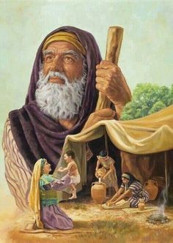
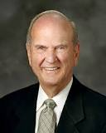
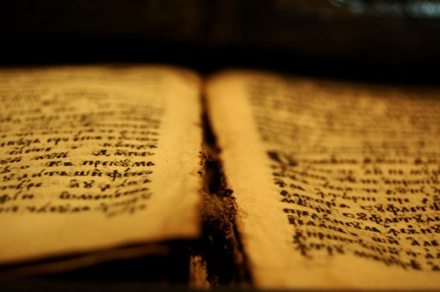
Led By a Living Prophet
In ancient times, prophets were chosen by the Lord and authorized to speak for Him. Likewise, in our day the words of the living prophet represent the voice of the Lord unto us and to the world.
Members of The Church of Jesus Christ of Latter-day Saints are blessed to be led by a living prophet, seer, and revelator.
What I the Lord have spoken, I have spoken, and I excuse not myself; and though the heavens and the earth pass away, my word shall not pass away, but shall all be fulfilled, whether by mine own voice or by the voice of my servants, it is the same.
D&C 1:38
Search these commandments, for they are true and faithful, and the prophecies and promises which are in them shall all be fulfilled.
D&C 1:37

Slide 3
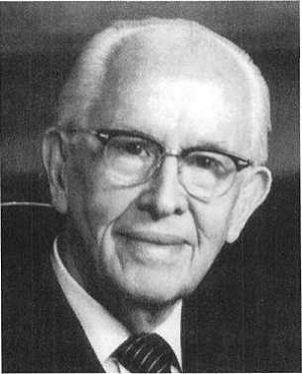
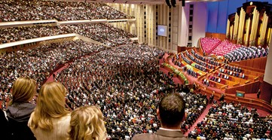
The Most Important Prophet
Who is the most important prophet for you?
“The most important prophet, so far as we are concerned, is the one who is living in our day and age.”
Why do you think the living prophet is the most important prophet for us?
“This is the prophet who has today’s instructions from God to us. … Every generation has need of the ancient scripture, plus the current scripture from the living prophet.
Therefore, the most crucial reading and pondering that you should do is of the latest inspired words from the Lord’s mouthpiece. That is why it is essential that you have access to and carefully read his words in Church periodicals.”
Ezra Taft Benson

Slide 4
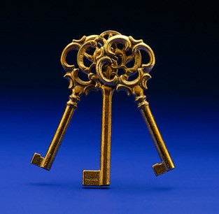
Sustaining All Leaders
We sustain all the members of the First Presidency and the Quorum of the Twelve Apostles as prophets, seers, and revelators.
However, the President of the Church is the only person who is authorized to exercise all the priesthood keys on the earth and the only person who is authorized to receive and declare revelations for the entire Church.

Slide 5
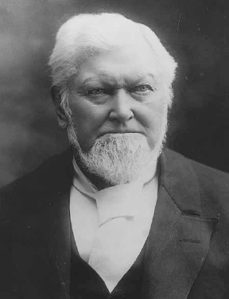
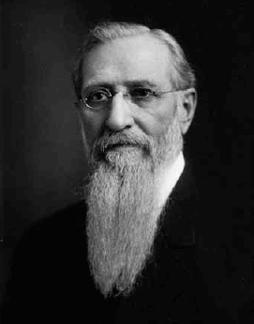
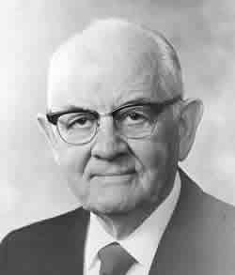
Changes
When has the President of the Church declared revelations for the entire Church or announced significant changes in the way the Church operates?
Declared previously unknown truths about the postmortal spirit world
D&C 138
Official Declaration 2
priesthood were to be made available to all worthy members of the Church
Official Declaration 1
Manifesto regarding plural marriage

Slide 6
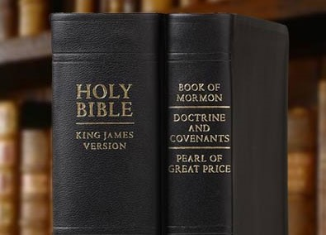
Messages From Heaven
“One of the glorious messages of the Restoration of the Church of Jesus Christ is that God continues to speak to His children! He is not hidden in the heavens but speaks today as He did in ancient days. …
“God’s priceless instructions to humankind are found in the Bible, the Book of Mormon, the Doctrine and Covenants, and the Pearl of Great Price.
In addition, the Lord speaks to us through His servants, as He will again at … general conference.”
President Dieter F. Uchtdorf

Slide 7
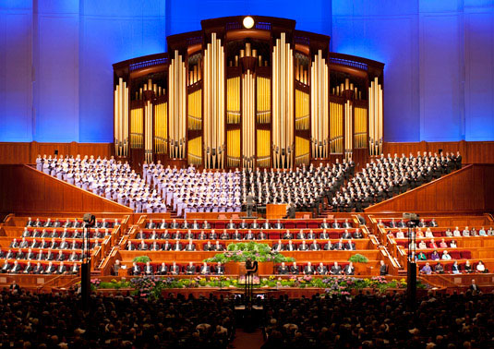
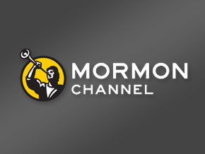
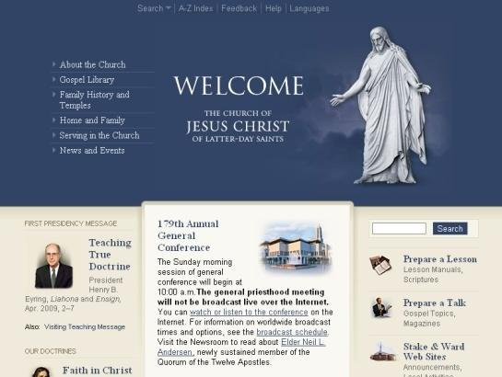
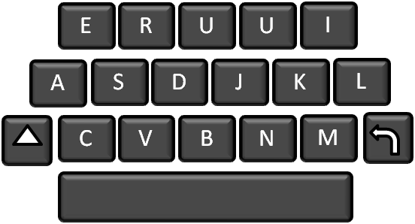
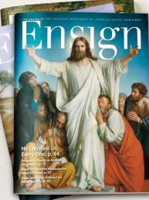
Through His Living Prophet
The Lord continues to speak to us today through His living prophet.
Where can we find the words of the living prophet?
President Dieter F. Uchtdorf

Slide 8
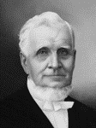
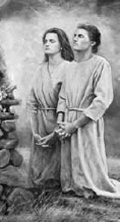
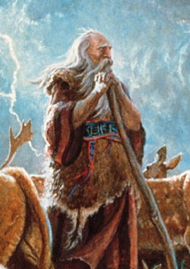
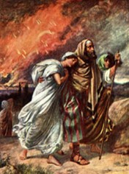
The Living Priesthood
And from the time that Adam first received a communication from God, … it always required new revelations, adapted to the peculiar circumstances in which the churches or individuals were placed.
“We require a living tree—a living fountain—living intelligence, proceeding from the living priesthood in heaven, through the living priesthood on earth. …
Adam’s revelation did not instruct Noah to build his ark; nor did Noah’s revelation tell Lot to forsake Sodom; nor did either of these speak of the departure of the children of Israel from Egypt.”
President John Taylor

Slide 9
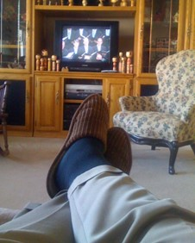
Preparing Yourself To Receive the Message
“As you prepare for general conference, I invite you to ponder questions you need to have answered. For example, you might yearn for direction and guidance by the Lord regarding challenges you are facing.”
“Members of the Church are entitled to personal revelation as they listen to and study the inspired words spoken at general conference.”
“Answers to your specific prayers may come directly from a particular talk or from a specific phrase. At other times answers may come in a seemingly unrelated word, phrase, or song. A heart filled with gratitude for the blessings of life and an earnest desire to hear and follow the words of counsel will prepare the way for personal revelation.”
President Dieter F. Uchtdorf

Slide 10
Teaching By Repetition
“Don’t discount a message merely because it sounds familiar.”
“Prophets have always taught by repetition; it is a law of learning.
You will hear repetition in themes and doctrines in general conference.
Let me reassure you: this is not due to a lack of creativity or imagination.”
“We continue to hear messages on similar issues because the Lord is teaching and impressing upon our minds and hearts certain foundational principles of great eternal importance that must be understood and acted upon before we can move on to other things.
A wise builder first lays the foundation before erecting the walls and the roof.”
President Dieter F. Uchtdorf

Slide 11
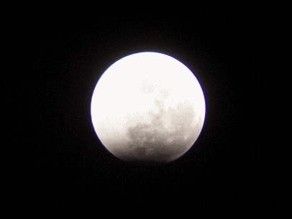
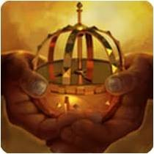
Prophets Speak For Our Time
“The words spoken at general conference should be a compass that points the way for us during the coming months.”
“If we listen to and follow the promptings of the Spirit, they will serve as a Liahona, guiding us through the unknown, challenging valleys and mountains that are ahead.” (see 1 Nephi 16).
“Since the world began, God has raised up prophets who speak the will of heaven to the people of their times.
It is our responsibility to listen and then apply the messages the Lord provides for us.”
President Dieter F. Uchtdorf

Slide 12
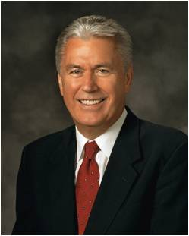
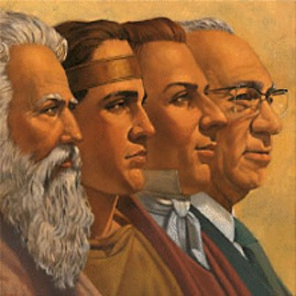
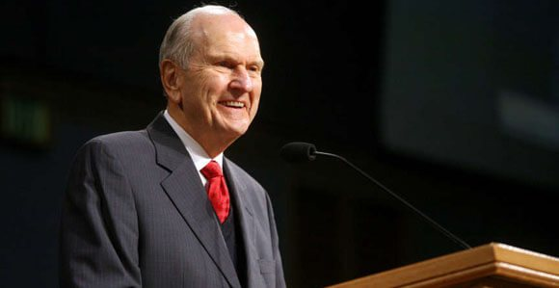
This Is No Ordinary Blessing
“Our merciful and loving Heavenly Father has not forsaken and will not forsake His children.
Today, as well as in times past, He has appointed apostles and prophets. He continues to reveal His word to them.”
“What a marvelous privilege it is to hear God’s messages for each of us during general conference!
Let us prepare well for this great blessing of divine guidance delivered by His chosen servants.”
President Dieter F. Uchtdorf

Slide 13
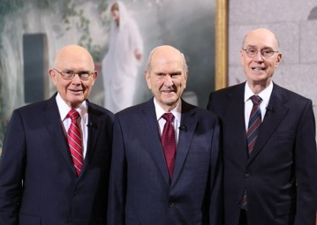
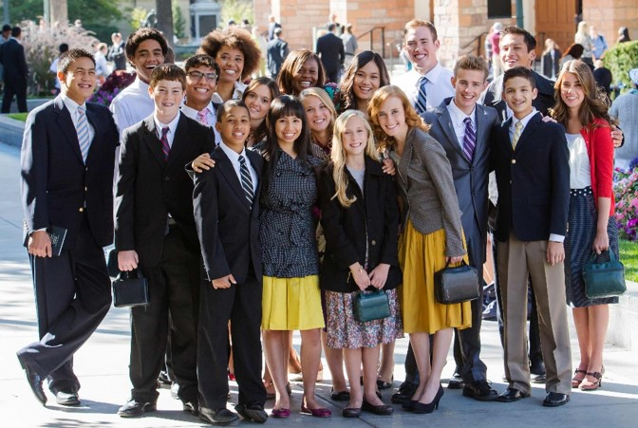
After the Message, Ask Yourself:
Which of these principles or doctrines do I feel are especially relevant to me? Why?
In what ways am I and my family trying to follow the counsel of the prophet?
Why is it important I study and apply what the current President of the Church is teaching?
What messages do I feel the Lord wants me to receive?
What will I do because of the prophet’s recent counsel?

Slide 14
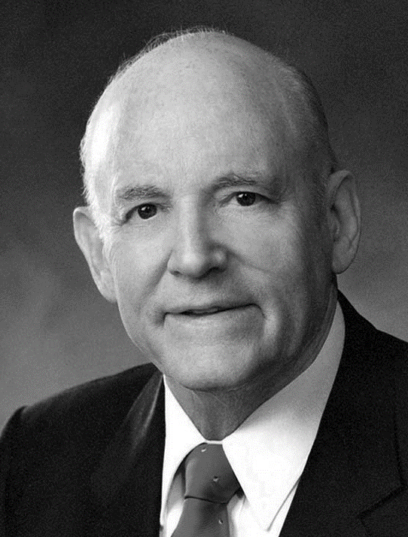
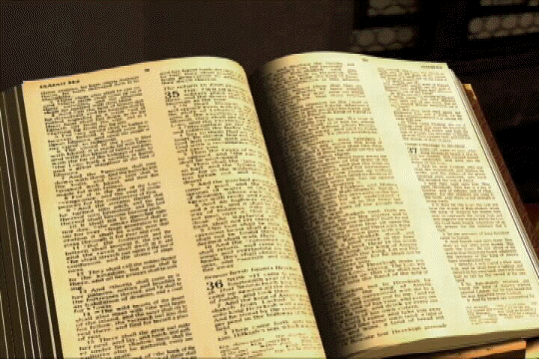
The End of Seminary But The Beginning of New Knowledge
“When we follow the counsel of our leaders to read and study the scriptures, benefits and blessings of many kinds come to us. This is the most profitable of all study in which we could engage.”
“Scriptures contain the record of the self-revelation of God, and through them God speaks to man.”
“There is nothing more helpful than prayer to open our understanding of the scriptures. Through prayer we can attune our minds to seek the answers to our searchings.”
“Not only should we study each day, but there should be a regular time set aside when we can concentrate without interference.”
Excerpts from President Howard W. Hunter

Slide 15
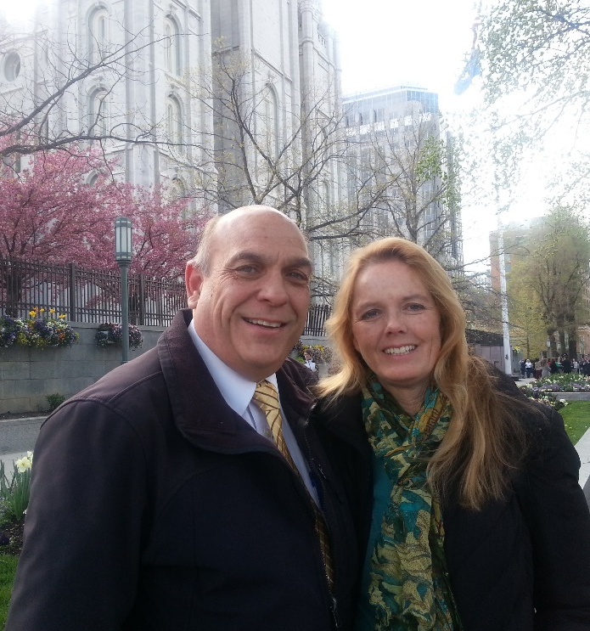
My Testimony
During this year I have gain a tremendous yearning for learning, and deep new respect for the Latter-day Saints who began building their testimonies on a newly found Book of Mormon.
I can’t even imagine the great strength it took to believe in something so new, yet so old, and I can’t imagine suffering the great persecution the early Saints did along with the Prophet Joseph Smith.
Through all the reading and scripture studying I questioned the exactness of the Doctrine and Covenants…and I can tell you without a doubt that the things I learned and pondered are true.
I believe Joseph Smith did receive the priesthood, which was taken from the
earth…and restored it to its fullest by revelation from Heavenly Father.
I believe in a Heavenly Father, and in His Son, Jesus, and in the power and
companionship of the Holy Ghost. Many mornings that companionship has
brought more comfort than I could possibly dream of.
Thank you for being with me this Seminary year and sharing the most
important principles of the gospel.
A special thank you my husband who totally supports me.---Sister Blau

Slide 16
Sources:
Videos:
The Lord Communicates through Prophets (1:52)
Learning From General Conference (1:24)
God's Words Never Cease (2:54)
Ezra Taft Benson (“Jesus Christ—Gifts and Expectations,” New Era, May 1975, 17).
President Dieter F. Uchtdorf (“Why Do We Need Prophets?” Ensign, March 2012, 4).
President John Taylor (in The Gospel Kingdom, sel. G. Homer Durham [1987], 34).
President Dieter F. Uchtdorf General Conference—No Ordinary Blessing September 2011 First Presidency Message
President Howard W. Hunter Reading the Scriptures October 1979 General Conference
Presentation by ©http://fashionsbylynda.com/blog/

Slide 17
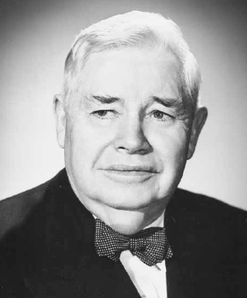
President Ezra Taft Benson taught:
“Of all mortal men, we should keep our eyes most firmly fixed on the captain, the prophet, seer, and revelator, and president of The Church of Jesus Christ of Latter-day Saints. This is the man who stands closest to the fountain of living waters. There are some heavenly instructions for us that we can only receive through the prophet. A good way to measure your standing with the Lord is to see how you feel about, and act upon, the inspired words of his earthly representative, the prophet-president. The inspired words of the president are not to be trifled with. All men are entitled to inspiration, and various men are entitled to revelation for their particular assignment. But only one man stands as the Lord’s spokesman to the Church and the world, and he is the president of the Church. The words of all other men should be weighed against his inspired words.
“Though his prophet is mortal, God will not let him lead his church astray. (See Discourses of Wilford Woodruff, pp. 212–13.) God knows all things, the end from the beginning, and no man becomes president of the church of Jesus Christ by accident, or remains there by chance, or is called home by happenstance.
“The most important prophet, so far as we are concerned, is the one who is living in our day and age. This is the prophet who has today’s instructions from God to us. God’s revelation to Adam did not instruct Noah how to build the ark. Every generation has need of the ancient scripture, plus the current scripture from the living prophet. Therefore, the most crucial reading and pondering that you should do is of the latest inspired words from the Lord’s mouthpiece. That is why it is essential that you have access to and carefully read his words in Church periodicals” (“Jesus Christ—Gifts and Expectations,” New Era, May 1975, 16–17).
President J. Reuben Clark Jr. also emphasized the need for listening to living prophets:
“Some time ago a pamphlet came across my desk. … On the outside page it was stated, ‘We need a prophet,’ and as I read it then, and as I think of it now, I think how blind the world is. …
“… We do not lack a prophet; what we lack is a listening ear by the people and a determination to live as God has commanded” (in Conference Report, Oct. 1948, 79–80).

