Slide 2
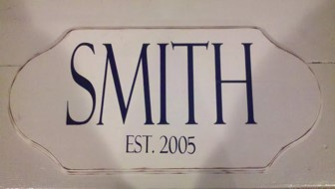
What is in a Name?
Surname:
A surname is a name added to a given name and is part of a personal name.
In many cases, a surname is a family name and many dictionaries define "surname" as a synonym of "family name".
In the western hemisphere, it is commonly synonymous with "last name", since it is usually placed at the end of a person's given name.

Slide 3
What Does Your Surname Mean?
Smith Name Meaning English:
Occupational name for a worker in metal, from Middle English smith (Old English smið, probably a derivative of smitan ‘to strike, hammer’).
Metal-working was one of the earliest occupations for which specialist skills were required, and its importance ensured that this term and its equivalents were perhaps the most widespread of all occupational surnames in Europe.
Medieval smiths were important not only in making horseshoes, plowshares, and other domestic articles, but above all for their skill in forging swords, other weapons, and armor.
This is the most frequent of all American surnames
Jones Name Meaning English and Welsh:
Patronymic from the Middle English personal name Jon(e) (see John).
English, Welsh, German, etc.: ultimately from the Hebrew personal name yo?hanan ‘Jehovah has favored (me with a son)’ or ‘may Jehovah favor (this child)’.
This personal name was adopted into Latin (via Greek) as Johannes, and has enjoyed enormous popularity in Europe throughout the Christian era, being given in honor of St. John the Baptist, precursor of Christ, and of St. John the Evangelist, author of the fourth gospel, as well as others of the nearly one thousand other Christian saints of the name.

Slide 4
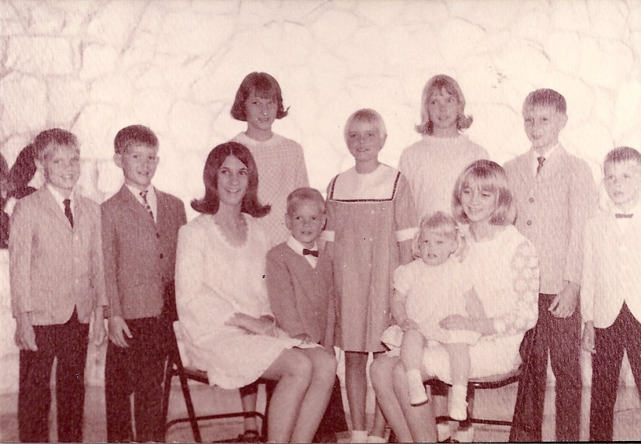
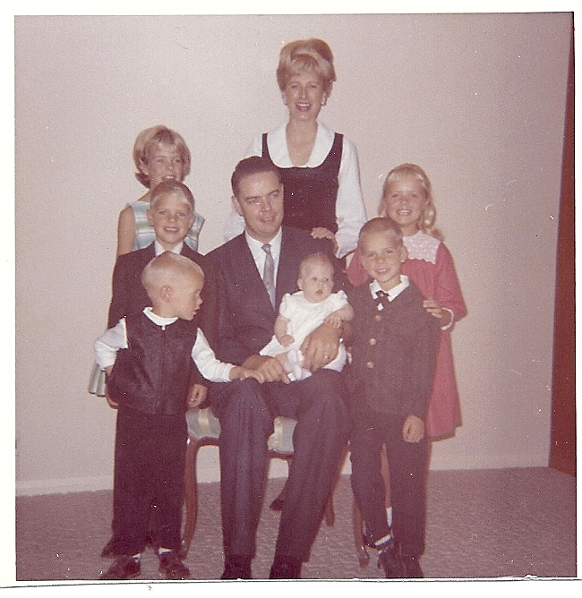
Privileges and Responsibilities in a Name
Privileges :
A place to live, family love, security, and being raised in the Church.
Responsibilities :
Helping to keep the home safe, treating family members with respect, doing household chores, and bringing honor to the family name.

Slide 5
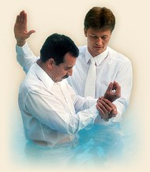
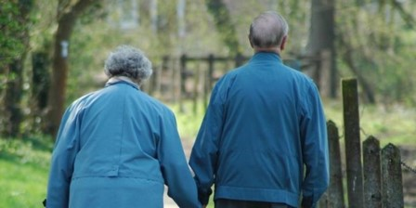
Privileges and Responsibilities
PRIVILEGES
Receive and be taught by the Holy Ghost
Invite others to be baptized and endure to the end
Receive salvation in the kingdom of the Father
RESPONSIBILITIES
Have faith, hope, and charity
Avoid contending with other churches
Speak the truth in soberness
Repent and endure to the end
D&C 18:18

Slide 6
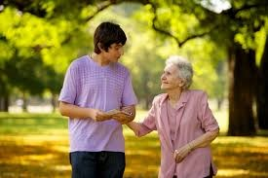
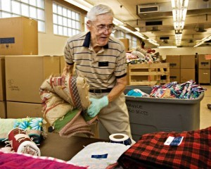
Faith, Hope, and Charity
“And now abideth faith, hope, charity, these three; but the greatest of these is charity.”
1 Corinthians 13:13
“Charity is the pure love of Christ, and it endureth forever, and whoso is found possessed of it at the last day, it shall be well with him.”
Moroni 7:47
D&C 18:19

Slide 7
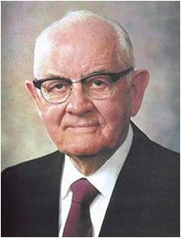
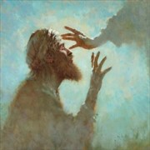
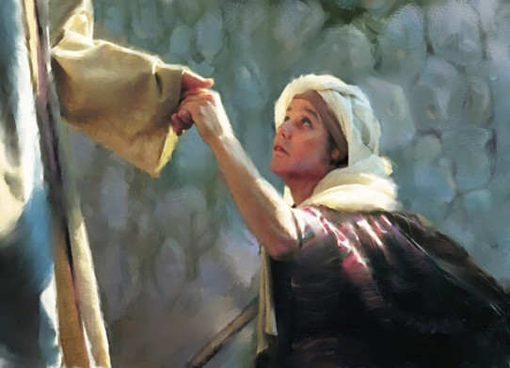
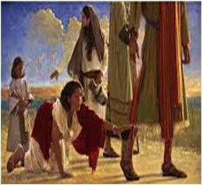
Savior’s Example of Charity
The greatest acts of charity come from giving of yourself and receiving expressions of charity with humility as well.
“[The Savior’s] gifts were rare ones: eyes to the blind, ears to the deaf, and legs to the lame; cleanliness to the unclean, wholeness to the infirm, and breath to the lifeless.
His gifts were … forgiveness to the repentant, hope to the despairing. His friends gave him shelter, food, and love. He gave them of himself, his love, his service, his life. … We should strive to give as he gave. To give of oneself is a holy gift”
President Spencer W. Kimball
D&C 18:19

Slide 8
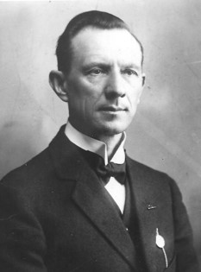
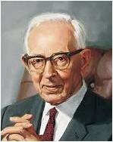
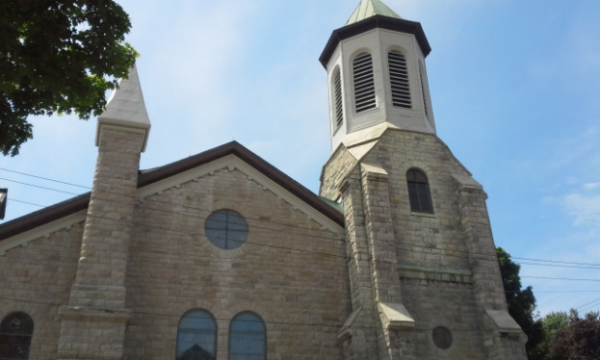
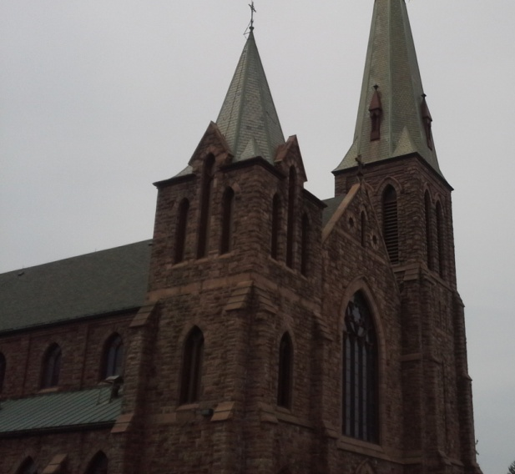
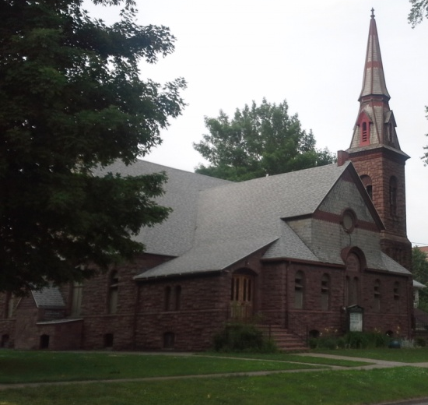
Contend Against No Church
The word contend carries with it ideas of debate, striving, struggling, and even quarreling and disputing.
“It is the calling of a minister of the Lord to preach the gospel and not to engage in endless and unprofitable controversies.”
Hyrum M. Smith
“We must understand that this is instruction to us to contend against all evil, that which is opposed to righteousness and truth”
President Joseph Fielding Smith
D&C 18:20

Slide 9
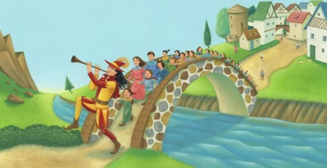
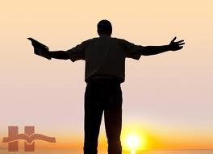
Those Who Lead Men Away From God
The use of the word church to describe Satan and his followers has confused some because they think of the term in the more limited sense of a specific religious organization. But if one thinks of the phrase “the church and kingdom of God,” one has a better concept of what is meant by the church of the devil. It is his kingdom, the sphere of his influence, the whole of his area of power.
Manual
“The titles church of the devil and great and abominable church are used to identify all churches or organizations of whatever name or nature—whether political, philosophical, educational, economic, social, fraternal, civic, or religious—which are designed to take men on a course that leads away from God and his laws and thus from salvation in the kingdom of God”
Elder Bruce R. McConkie
D&C 18:20

Slide 10
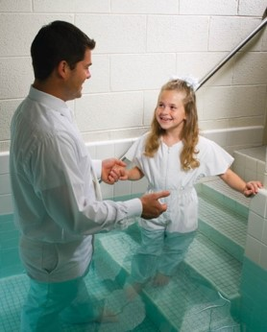
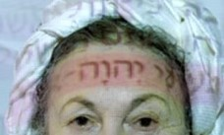
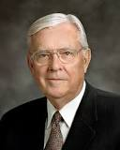
Take Upon You the Name Of Christ
To take upon one’s self the name of Christ, is to acknowledge Him as the Master.
Slaves in the olden times, sometimes had the name of their master on their foreheads.
Hyrum M. Smith
“We take the name of Christ upon us in the waters of baptism. We renew the effect of that baptism each week as we partake of the sacrament, signifying our willingness to take His name upon us and promising always to remember Him …
“We are asked to stand as a witness of Him. …
This means that we must be willing to let others know whom we follow and to whose Church we belong: the Church of Jesus Christ. We certainly want to do this in the spirit of love and testimony. We want to follow the Savior by simply and clearly, yet humbly, declaring that we are members of His Church”
Elder M. Russell Ballard
D&C 18:21-25

Slide 11
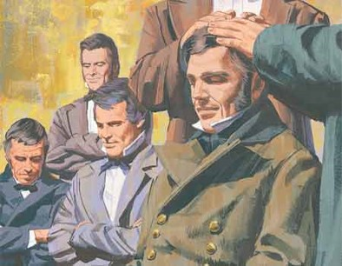
Selecting Apostles
What desires would these twelve disciples have?
To take upon His name with full purpose of heart
What would these men be called to do?
To go and preach the gospel to everyone, and be ordained of “me” to baptize in “my” name
The Lord’s Twelve Apostles are called to preach and administer the gospel to the entire world.
D&C 18:26-29

Slide 12
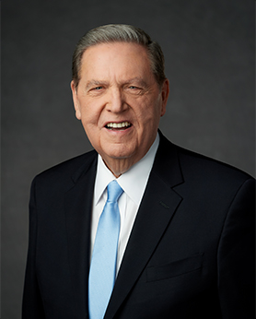
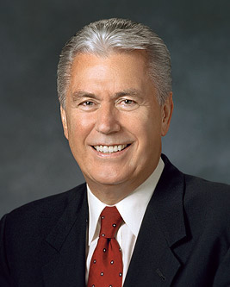
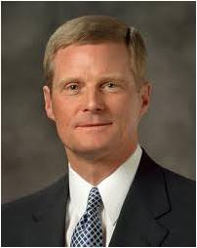
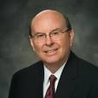
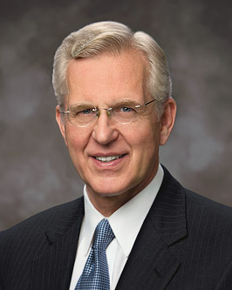
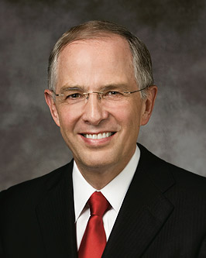
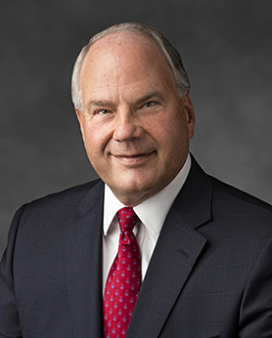
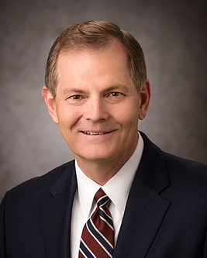
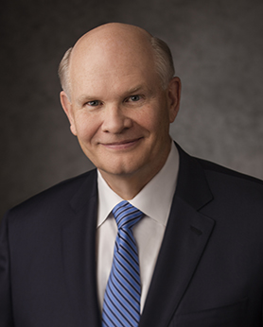
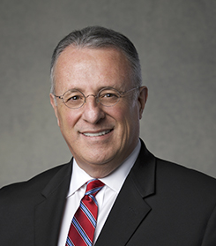
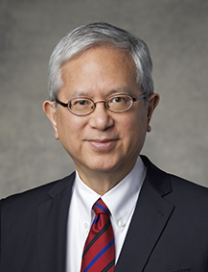
Which members of the current Quorum of the Twelve Apostles can you remember?
President Dallin H. Oaks
President Russell M. Nelson
President Henry B. Eyring
M. Russell Ballard
Jeffrey R. Holland
Dieter F. Uchtdorf
David A. Bednar
Quentin L. Cook
D. Todd Christofferson
Neil L. Anderson
Ronald A. Rasband
Gary E. Stevenson
Dale G. Renlund
Ulisses Soares
Gerrit W. Gong

Slide 13
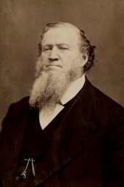
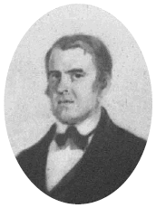
Searching For Qualifying Men
The duty of the Twelve is to carry the message of Christ to the world.
They are His messengers.
They have power over unclean spirits and diseases. They have the “keys of the kingdom of god:; That is, authority to act in the name of Christ.
They are witnesses.
They must know for themselves that their message is true, for they cannot testify to what they know only by hearsay.”
Hyrum M. Smith
Oliver and David were told to search for men the Lord would call as the first members of the Quorum of the Twelve Apostles in the latter days.
The future Apostles would demonstrate the desires and works the Lord had spoken of
Martin Harris also received the responsibility to search out the Twelve Apostles.
The first members of the Quorum of the Twelve Apostles in the latter days were called on February 14, 1835, nearly five years after the official organization of the Church.
D&C 18:31-42

Slide 14
“Obviously my greatest thrill and the most joyful of all realizations is that I have the opportunity, as Nephi phrased it, to ‘talk of Christ, … rejoice in Christ, … preach of Christ, [and] prophesy of Christ’ (2 Ne. 25:26) wherever I may be and with whomever I may find myself until the last breath of my life is gone.
Surely there could be no higher purpose or greater privilege than that of ‘special [witness] of the name of Christ in all the world’ (D&C 107:23).
“… Beyond my words and teachings and spoken witness, my life must be part of that testimony of Jesus. My very being should reflect the divinity of this work. I could not bear it if anything I might ever say or do would in any way diminish your faith in Christ, your love for this church, or the esteem in which you hold the holy apostleship.
“I do promise you—as I have promised the Lord and these my brethren—that I will strive to live worthy of this trust and serve to the full measure of my ability”
Elder Jeffrey R. Holland

Slide 15
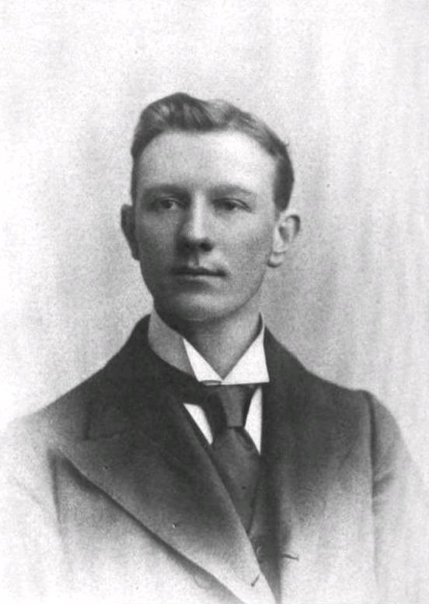
Searching For Qualifying Men
For the Apostles
“They must walk uprightly and sin not; they must have integrity. They were to ordain priests and Teaches, to preach by the power of the Holy ghost, and to testify of the Lord that they have heard His voice and know His words.
“No man is perfect, but one who strives earnestly to conquer weaknesses and grow unto perfection does not “sin.” That is to say, he is not a “sinner.” A sinner is one who indulges in sin habitually because he takes pleasure in it.”
Hyrum M. Smith
D&C 18:37-42

Slide 16
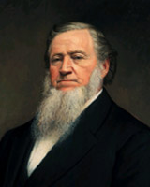
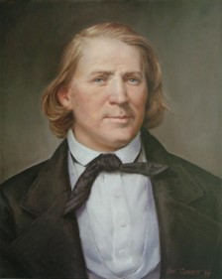
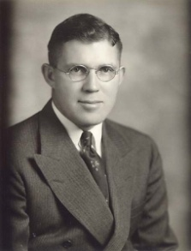
Hearing One’s Voice
“In 1835 the Twelve were chosen, as you know, and on one occasion they were called together and given their instructions. Oliver Cowdery was the spokesman; and after having given them some very powerful and heartwarming instruction, so moved was he, himself, that he had to stop two or three times to weep. He finally read the revelation [now designated as section 18].
“Brigham Young was so impressed by it that he copied it in his laborious handwriting into his diary. I am impressed by it likewise. These are the words: [D&C 18:34–36].
“The thing that impresses me about this is, and I have never thought of it before, when I read a verse in the Doctrine and Covenants I am hearing the voice of the Lord as well as reading his words, if I hear by the Spirit.
“Now I have heard it said many times by men that they have often
asked the Lord for a special testimony and oftentimes haven’t had
it. They seem to want to hear the voice of the Lord. I confess I have
often wanted to hear the voice of the Lord, without knowing that
all these years I have been hearing it with deaf ears. This woke me
up.”
Elder S. Dilworth Young
D&C 18:34-36

Slide 17
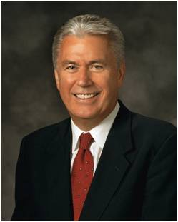
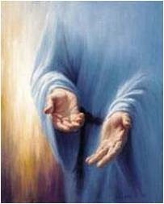
By Your Hands—a Marvelous Work
“Those who are favored with divine instructions must follow them; if they do not, they cannot be saved in the Kingdom of God.”
Hyrum M. Smith
“As we emulate [the Savior’s] perfect example, our hands can become His hands; our eyes, His eyes; our heart, His heart. …
“With this in mind, let our hearts and hands be stretched out in compassion toward others, for everyone is walking his or her own difficult path.
As disciples of Jesus Christ, our Master, we are called to support and heal rather than condemn.”
President Dieter F. Uchtdorf
We can hear the voice of Jesus Christ as we read the scriptures by the power of the Spirit.
D&C 18:43-47

Slide 18
Sources:
Video:
Miracles of Restoration –talk by Elder Holland (18:16)
Meaning of names—Ancestory.com
President Spencer W. Kimball (The Wondrous Gift [1978], 2).
Hyrum M. Smith Doctrine and Covenants Commentary pg. 85, 86, 88, 90
President Joseph Fielding Smith (Church History and Modern Revelation, 2 vols. [1953], 1:83).
Elder Bruce R. McConkie (Mormon Doctrine, pp. 137–38).
Student Manual Doctrine and Covenants Religion 324-325 pg. 36
Elder M. Russell Ballard (“The Importance of a Name,” Ensign or Liahona, Nov. 2011, 79–80).
Elder Jeffrey R. Holland (“Miracles of the Restoration,” Ensign, Nov. 1994, 31).
President Dieter F. Uchtdorf (“You Are My Hands,” Ensign or Liahona, May 2010, 68–69).
Elder S. Dilworth Young (In Conference Report, Apr. 1963, p. 74.)
Presentation by ©http://fashionsbylynda.com/blog/

Slide 19
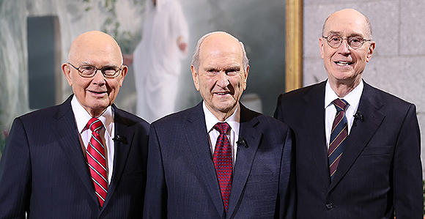
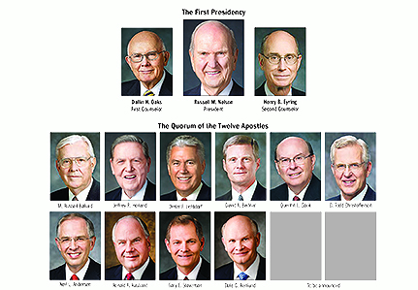
Improper to Contend:
The Prophet Joseph Smith taught the same principle: “The Elders would go forth, and each must stand for himself … to go in all meekness, in sobriety, and preach Jesus Christ and Him crucified; not to contend with others on account of their faith, or systems of religion, but pursue a steady course. This I delivered by way of commandment; and all who observe it not will pull down persecution upon their heads, while those who do, shall always be filled with the Holy Ghost; this I pronounced as a prophecy, and sealed with hosanna and amen.” (History of the Church, 2:431.)
Who is Hyrum M. (Mack) Smith? (March 21, 1872 – January 23, 1918) was a member of the Quorum of the Twelve Apostles of The Church of Jesus Christ of Latter-day Saints (LDS Church).
Smith was born in Salt Lake City, Utah Territory, the eldest son of church apostle and future church president Joseph F. Smith and Edna Lambson. Smith was named after his paternal grandfather Hyrum Smith, who was the elder brother of LDS Church founder Joseph Smith and a prominent leader of the early Church.
Smith attended Latter-day Saint College, from which he graduated in 1894. On November 15, 1895, he married Ida Bowman and the next day left her behind so he could go and serve a mission in Great Britain. From October 1896 until February 1898 he presided over the Newcastle Conference.[
After returning from his mission abroad Smith worked at ZCMI while also serving as a part-time missionary in Salt Lake City.[
Smith was ordained an apostle of the church on October 24, 1901 at the age of 29, by his father, who was by then president of the church.
In 1913 Smith was called as the president of the European Mission of the church. He served in this capacity until 1916, when the activities of the mission were suspended due to World War I.
Smith was married to Ida Elizabeth Bowman, with whom he had five children, one of whom was Joseph Fielding Smith, a one-time presiding patriarch of the church. Another of Smith's children was Geraldine Smith, the mother of M. Russell Ballard.
Smith wrote a commentary on the Doctrine and Covenants with Janne M. Sjödahl.
Smith died prematurely in Salt Lake City from a ruptured appendix at the age of 45. He was buried at Salt Lake City Cemetery.

Slide 20
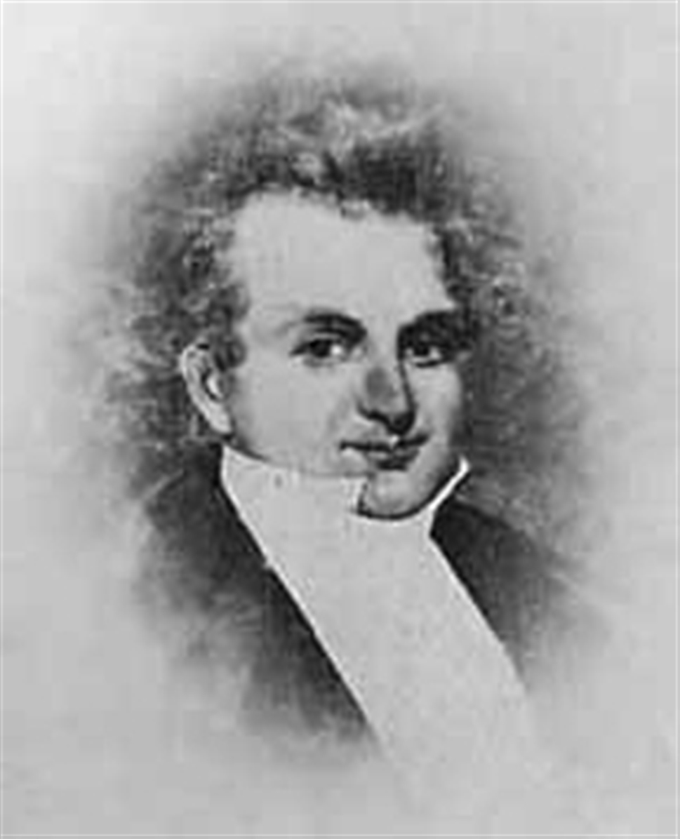
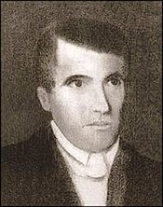
Apostles from 1835-1840
14 February 1835
Quorum of the Twelve Apostles is organized. Oliver Cowdery, Martin Harris, and David Whitmer choose the first 12 members. Lyman E. Johnson, Brigham Young and Heber C. Kimball ordained.
15 February 1835
Orson Hyde, David W. Patten, Luke S. Johnson, William E. McLellin, John F. Boynton and William Smith ordained.
21 February 1835
Parley P. Pratt ordained.
25 April 1835
Thomas B. Marsh ordained.
26 April 1835
Orson Pratt ordained.
2 May 1835
Thomas B. Marsh sustained as President of the Quorum of the Twelve
3 September 1837
John F. Boynton disfellowshipped. He was excommunicated later that year.
13 April 1838
Lyman E. Johnson and his brother, Luke S. Johnson excommunicated.
11 May 1838
William E. McLellin excommunicated.
25 October 1838
David W. Patten killed in Battle of Crooked River.
19 December 1838
John Taylor and John E. Page ordained.
17 March 1839
Thomas B. Marsh excommunicated.
26 April 1839
Wilford Woodruff and George A. Smith ordained.
4 May 1839
William Smith and Orson Hyde removed from the Quorum by vote of the church.
25 May 1839
William Smith restored to Quorum by vote of the Church.
27 June 1839
Orson Hyde restored to the Quorum by vote of the church.
14 April 1840
Willard Richards ordained in England. Also the first occasion where Brigham Young was formally sustained President of the Quorum of the Twelve Apostles
Wikipedia…to see more go to Joseph Smith and apostles http://en.wikipedia.org/wiki/Quorum_of_the_Twelve#Members_of_the_Quorum.2C_prior_to_1844

Slide 21
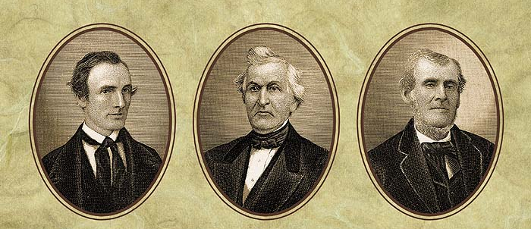
Apostles from 1835-1840
Oliver Cowdery
David Witmer
Martin Harris
Lyman E. Johnson
Brigham Young
Heber C. Kimball
Parley P. Pratt
Thomas B. Marsh
Orson Pratt
Orson Hyde David W. Patten Luke S. Johnson William E. McLellin,
Wilford Woodruff
George Albert Smith
John Taylor
John E. Page
John F. Boynton William Smith
Willard Richards

