Slide 2
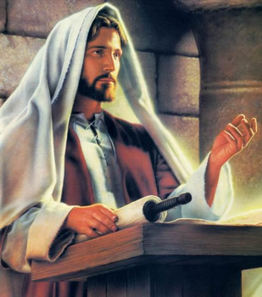
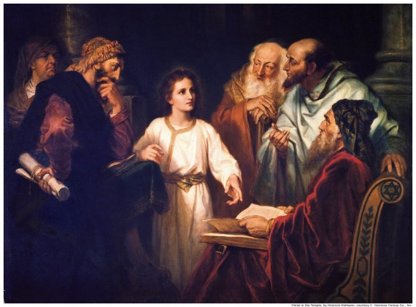
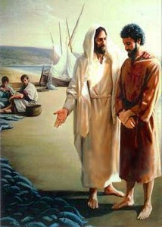
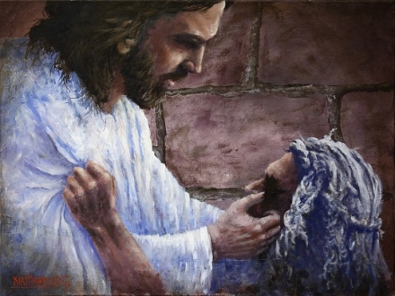
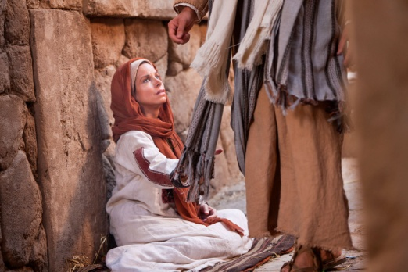
Duties of the Priesthood
April 6, 1830
Preach
To deliver a sermon or religious address to an assembled group of people, typically in church.
Teach
To cause or help (someone) to learn about a subject by giving lessons
Expound
To teach something in greater detail
Exhort
Warn
Invite
To strongly encourage someone to do something
to urge or advise to be careful
To ask (someone) to Come Unto Christ
D&C 20:38

Slide 3
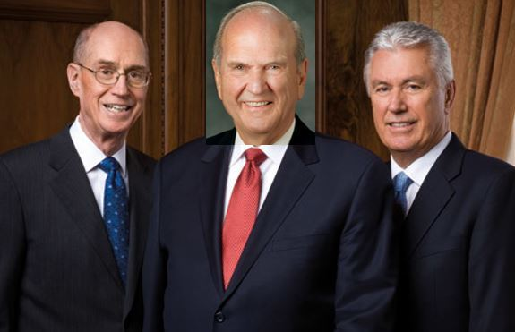
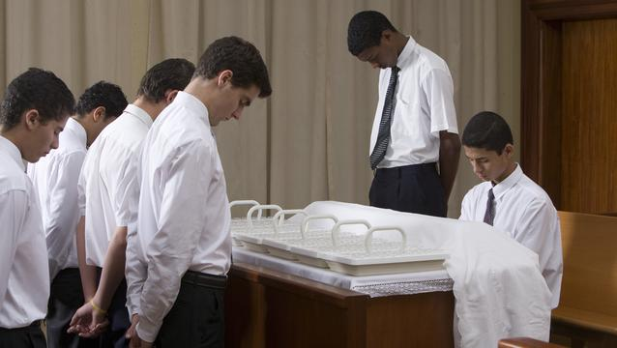
Aaronic Priesthood
Prophets, apostles, other Church leaders, and full-time missionaries have these responsibilities.
However,
These are duties that all priesthood holders, including Aaronic Priesthood holders, can carry out.
The Aaronic Priesthood holders in your class have been trusted with significant opportunities to serve.

Slide 4
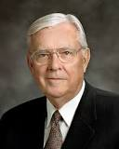
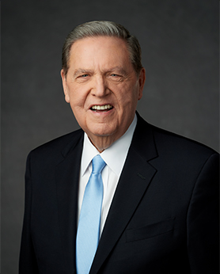
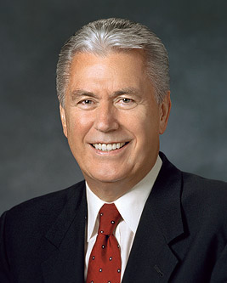
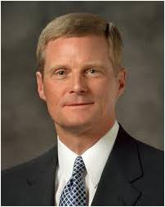
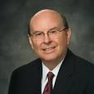
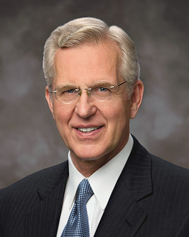
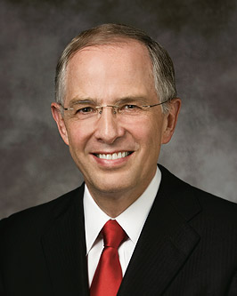
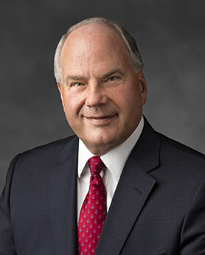
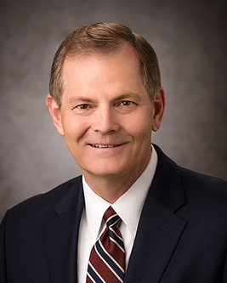
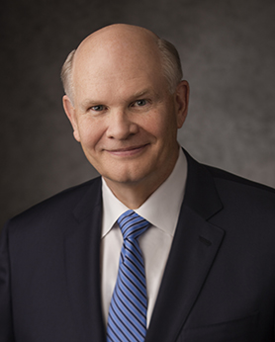
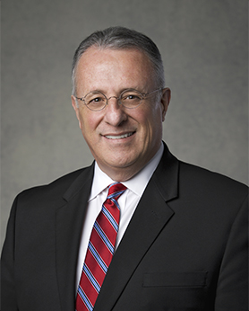
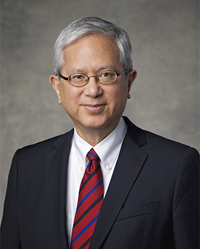
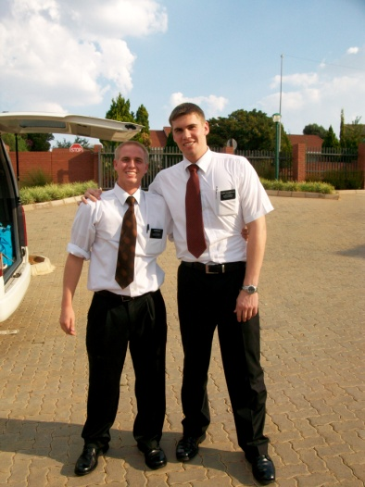
Duties of an Elder
Elders
D&C 20:38-45
An Apostle is an Elder
Baptize and Confirm the Gift of the Holy Ghost by laying on of hands
Ordain other Elders, Priest, Teachers and Deacons
Administer the Sacrament
Teach, Expound, Exhort, and watch of the church
Take lead in all meetings and conduct with the Holy Spirit
M. Russell Ballard
Jeffrey R. Holland
Dieter F. Uchtdorf
David A. Bednar
Quentin L. Cook
D. Todd Christofferson
Neil L. Anderson
Ronald A. Rasband
Gary E. Stevenson
Dale G. Renlund

Slide 5
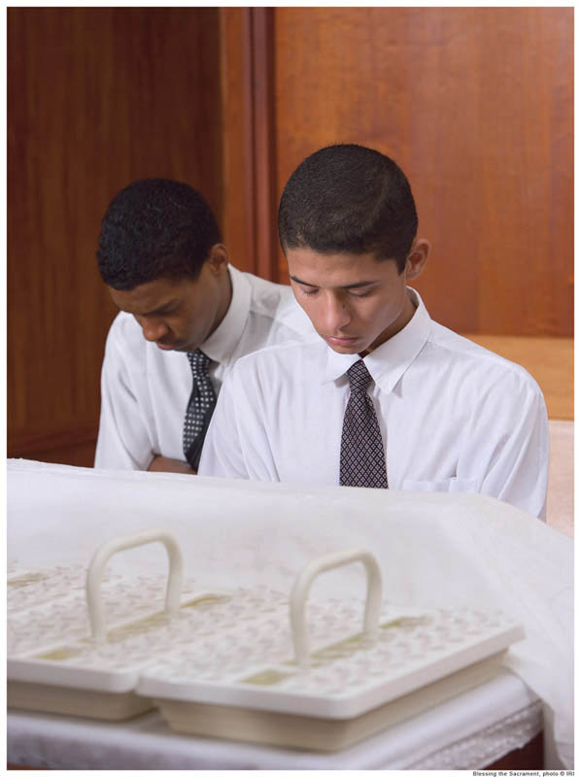
Duties of a Priest
Priests
D&C 20:46-52
Teach, Expound, Exhort, Baptize
Administer the Sacrament
Visit the house of each member, and exhort them to pray vocally and in secret and attend to all family duties.
Ordain other Elders, Priest, Teachers and Deacons
Confirm the Gift of the Holy Ghost
Take lead in all meetings when there is no Elder present
Assist an Elder if occasion arises

Slide 6
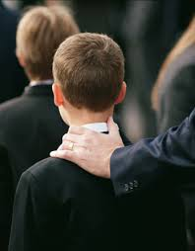
Duties of a Teacher
Teachers and Deacons
D&C 20:53-59
Watch over the church continually and strengthen them
To see that there is no iniquity in the church, neither hardness with each other, neither lying, backbiting, nor evil speaking
See that the church meet together often, and also see that all the members do their duty.
To take the lead of meetings in the absence of the elder or priest—
They are to assisted always, in all their duties in the church, by the deacons, if occasion requires.
But neither teachers nor deacons have authority to baptize, administer the sacrament, or lay on hands;
To warn, expound, exhort, and teach, and invite all to come unto Christ.

Slide 7
As a priesthood holder is ordained to additional offices of the priesthood, he retains the lesser offices and their associated responsibilities.
As Heavenly Father’s sons receive higher offices of the priesthood, they receive more responsibilities and opportunities to serve others.
All priesthood holders have the responsibility to perform ordinances and to watch over members of the Church and minister to them.

Slide 8
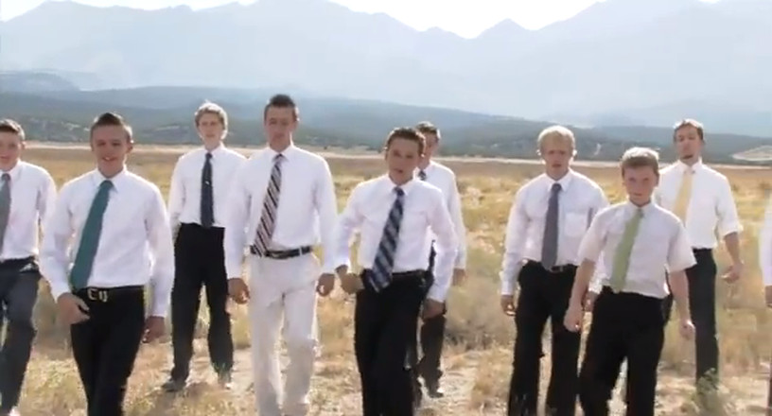
At All Times
“If you are a priesthood holder, remember that the priesthood should be a part of you at all times and in all circumstances. It is not like a cloak that you can put on and take off at will. Any ordination to a priesthood office is a call to lifelong service, with the promise that the Lord will qualify you to do His work according to your faithfulness.
“You must be worthy in order to receive and exercise priesthood power. The words you speak and your everyday behavior affect your ability to serve. Your behavior in public must be above reproach. Your behavior in private is even more important”
True to the Faith
“The purpose of priesthood authority is to give, to serve, to lift, to inspire”
Elder Richard G. Scott

Slide 9
Young Women
Young women have many opportunities to serve.
Some may choose to serve missions, and they will someday have the privilege of being members of Relief Society, “work[ing] alongside men who hold the priesthood to increase faith and personal righteousness, strengthen families and homes, and seek out and help those in need” Daughters in My Kingdom

Slide 10
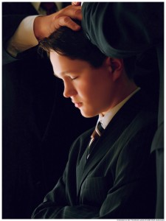
To Be Ordained
“Every elder, priest, teacher, or deacon is to be ordained according to the gifts and callings of God unto him; and he is to be ordained by the power of the Holy Ghost, which is in the one who ordains him.”
D&C 20:60

Slide 11
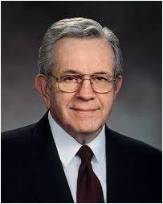
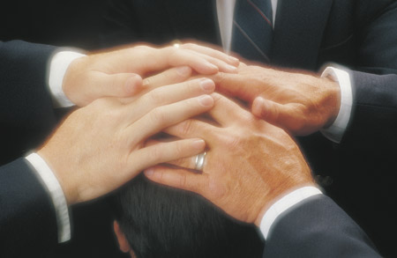
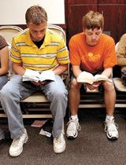
Authority
“Your authority comes through your ordination; your power comes through obedience and worthiness. …
“Power in the priesthood comes from doing your duty in ordinary things:
attending meetings, accepting assignments, reading the scriptures, keeping the Word of Wisdom.”
Elder Boyd K. Packer

Slide 12
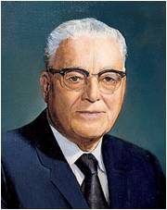
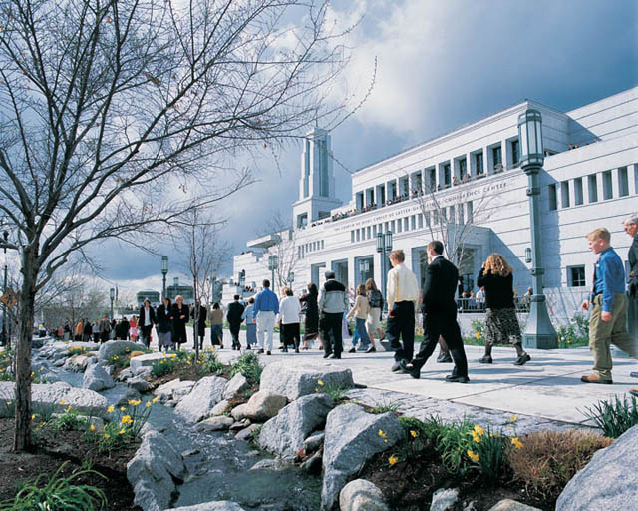
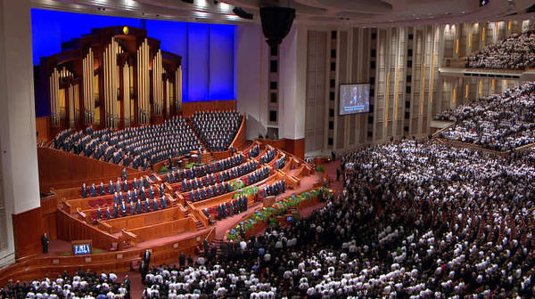
Purposes
“Now, you Latter-day Saints, I think you have never attended a conference where in these three days you have heard more inspired declarations on most every subject and problem about which you have been worrying.
If you want to know what the Lord would have the Saints know and to have his guidance and direction for the next six months, get a copy of the proceedings of this conference, and you will have the latest word of the Lord as far as the Saints are concerned.”
President Harold B. Lee
D&C 20:61-63

Slide 13
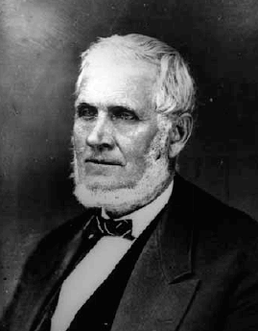
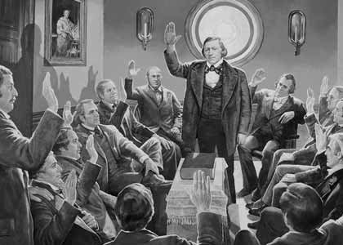
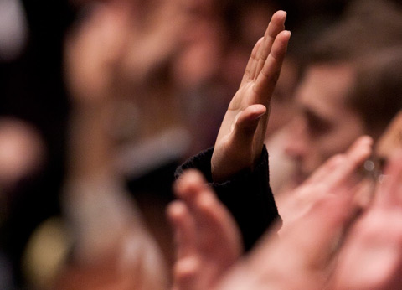
The Vote
“What is meant by sustaining a person? …
…if a man be a teacher, and I vote that I will sustain him in his position, when he visits me in an official capacity I will welcome him and treat him with consideration, kindness and respect and if I need counsel I will ask it at his hand, and I will do everything I can to sustain him.
That would be proper and a principle of righteousness, and I would not say anything derogatory to his character. If that is not correct I have it yet to learn.
And then if anybody in my presence were to whisper something about him disparaging to his reputation, I would say, Look here! are you a Saint? Yes. Did you not hold up your hand to sustain him? Yes. Then why do you not do it? Now, I would call an action of that kind sustaining him.
If any man make an attack upon his reputation—for all men’s reputations are of importance to them—I would defend him in some such way.”
President John Taylor
D&C 20:65

Slide 14
Sources:
Video:
Becoming a Priesthood Man: Priesthood Duty (4:53)
Power in the Priesthood (0:55)
Video: Priesthood Responsibilities (2:50)
(True to the Faith: A Gospel Reference[2004], 127).
Elder Richard G. Scott “Honor the Priesthood and Use It Well,” Ensign or Liahona, Nov. 2008, 46.)
(Daughters in My Kingdom: The History and Work of Relief Society [2011], 7).
Elder Boyd K. Packer (“The Aaronic Priesthood,” Ensign, Nov. 1981, 32–33).
President Harold B. Lee (In Conference Report, Oct. 1973, p. 168; or Ensign, Jan. 1974, p. 128.)
President John Taylor (In Journal of Discourses, 21:207–8.)
Presentation by ©http://fashionsbylynda.com/blog/

Slide 15
What Is Meant by “an Apostle Is an Elder”?
“We learn at this time the Lord revealed that the designation ‘Elder’ is one applicable to the apostles and likewise to all others who hold the Melchizedek Priesthood. The use of this designation makes it needless to use unnecessarily sacred terms as ‘Apostle,’ ‘Patriarch,’ ‘High Priest,’ etc. It is proper in general usage to speak of the apostles, the seventies and all others holding the Melchizedek Priesthood as ‘elders.’ Of course, the term President, in speaking of the First Presidency, is the proper designation.” (Smith, Church History and Modern Revelation, 1:95.)
What Is the Major Function of the Office of Deacon?
With no specific responsibilities assigned to the office of deacon, “the duty of Deacons is to assist the Teachers. A Deacon holds the power and authority first bestowed in the Aaronic Priesthood. One who performs those duties well, thereby qualifies himself for the more advanced positions.” (Smith and Sjodahl, Commentary, p. 108; see also Enrichments M and N in the Appendix.)
The Duties :
President Wilford Woodruff said: “I traveled thousands of miles and preached the Gospel as a Priest, and, as I have said to congregations before, the Lord sustained me and made manifest His power in the defense of my life as much while I held that office as He has done while I have held the office of an Apostle. The Lord sustains any man that holds a portion of the Priesthood, whether he is a Priest, an Elder, a Seventy, or an Apostle, if he magnifies his calling and does his duty” (Deseret Weekly, Nov. 7, 1896, 641). (See also Boyd K. Packer, “The Aaronic Priesthood,” Ensign, Nov. 1981, 33.)
President Boyd K. Packer of the Quorum of the Twelve Apostles emphasized that proper priesthood ordination is of great importance to the Lord:
“You can receive the priesthood only from one who has the authority and ‘it is known to the church that he has authority.’ (D&C 42:11.)
“The priesthood cannot be conferred like a diploma. It cannot be handed to you as a certificate. It cannot be delivered to you as a message or sent to you in a letter. It comes only by proper ordination. An authorized holder of the priesthood has to be there. He must place his hands upon your head and ordain you.
“That is one reason why the General Authorities travel so much—to convey the keys of priesthood authority. Every stake president everywhere in the world has received his authority under the hands of one of the presiding brethren of the Church. There has never been one exception.
“Remember these things. The priesthood is very, very precious to the Lord. He is very careful about how it is conferred, and by whom. It is never done in secret” (“The Aaronic Priesthood,” Ensign, Nov. 1981, 32).
Purpose of Priesthood:
James E. Faust of the First Presidency said:
“Caring for others is the very essence of priesthood responsibility. It is the power to bless, to heal, and to administer the saving ordinances of the gospel” (“Power of the Priesthood,” Ensign, May 1997, 41).

