Slide 2
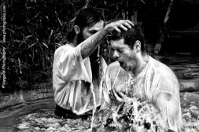
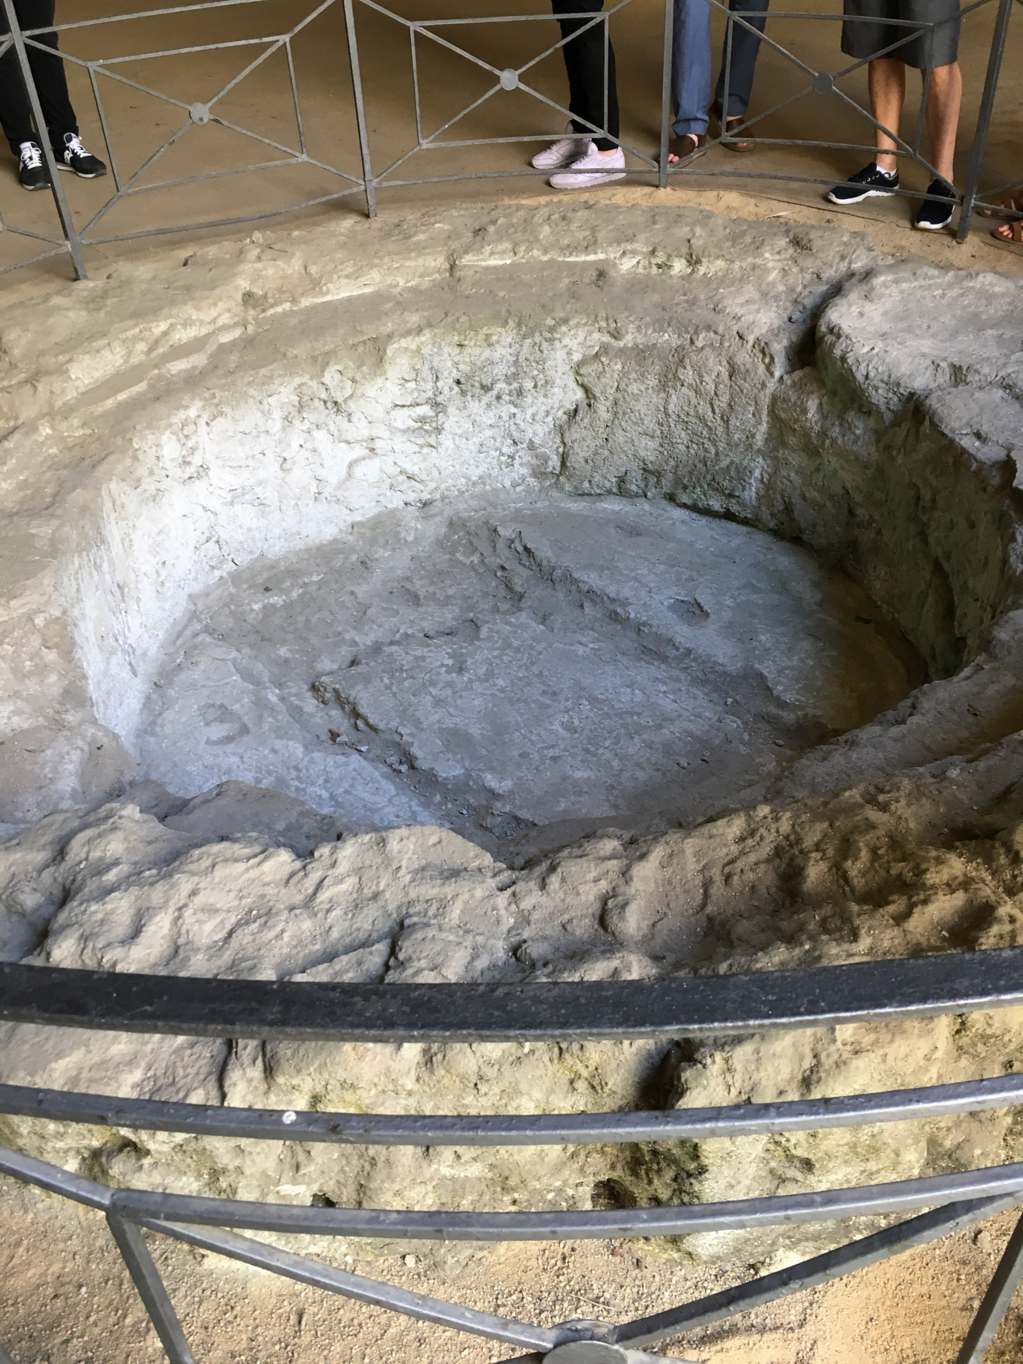
Dead Works
Unauthorized Authority:
During the Great Apostasy, the ordinances of Jesus Christ’s Church were changed, eliminated, or performed without proper authority.
Romanists hold that, in the case of an emergency, anybody—man or woman, Jew, pagan, or atheist, may administer baptism, and that it is valid, provided the administrator really intended to baptize.
Smith and Syodahl
Baptismal font in catacombs in Napoli, Italy
D&C 22:1

Slide 3
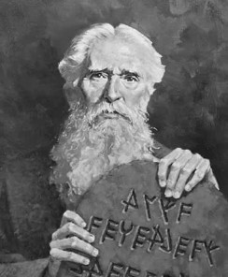
Law of Moses
The law of Moses, with its system of carnal commandments, ceremonies, rituals, and symbols, was given to help the Israelites remember God and look forward to the Atonement of Jesus Christ.
The Savior fulfilled this law through the Atonement (see Alma 34:13–14). During His mortal ministry, Jesus Christ and His Apostles labored to teach the Jews that salvation could not come by obedience to the law alone, but through the saving power of the Atonement.
The Lord compared an individual who had undergone unauthorized baptisms to those who relied on the law of Moses without having faith in Jesus Christ. This comparison emphasizes the need to let go of “dead” religious practices that cannot save us and embrace the new and everlasting covenant of the gospel, just as early Jewish converts to Christianity had to do.
D&C 22:2

Slide 4
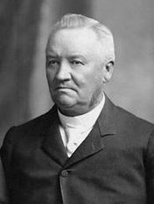
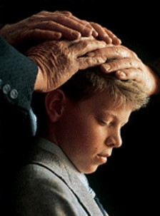
Life of the Holy Spirit
“The true Church must be established by authority of God, and there must be the life of the Holy Spirit in it. The Holy Ghost must be conferred upon the members by the ordinances ordained for its bestowal, and when the Spirit is received it will testify unto the recipients that they have obeyed the demands of the true Gospel.
Anthon H. Lund

Slide 5
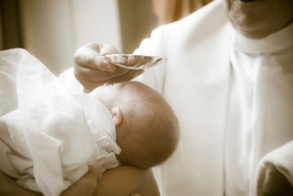
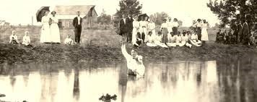
Old Covenants--Rebaptism
Many of those seeking membership in the Church had been baptized in their former faiths. They wondered why they had to be baptized again.
Baptism must be performed by one having authority from God.
Revelation in D&C 22:
The ordinance of baptism must be performed by those with the authority to grant individuals Church membership and entrance into the kingdom of God.
D&C 22:1-4

Slide 6
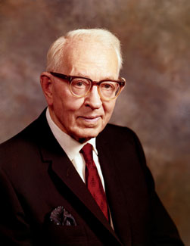
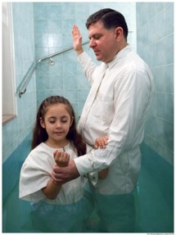
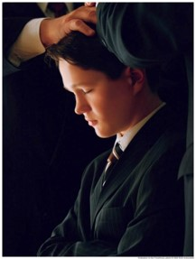
New and Everlasting Covenant
“The new and everlasting covenant is the fulness of the gospel.
It is composed of ‘All covenants, contracts, bonds, obligations, oaths, vows, performances, connections, associations, or expectations’ that are sealed upon members of the Church by the Holy Spirit of promise, or the Holy Ghost, by the authority of the President of the Church who holds the keys.
The President of the Church holds the keys of the Melchizedek Priesthood. He delegates authority to others and authorizes them to perform the sacred ordinances of the priesthood.
Joseph Fielding Smith
D&C 22:1-4

Slide 7
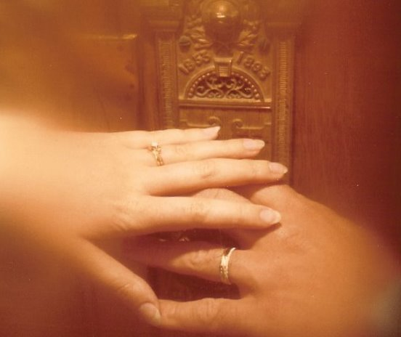
Marriage for Eternity
“Marriage for eternity is a new and everlasting covenant. Baptism is also a new and everlasting covenant [see D&C 132:22], and likewise ordination to the priesthood, and every other covenant is everlasting and a part of the new and everlasting covenant which embraces all things.”
Joseph Fielding Smith
D&C 22:1-4

Slide 8
Take Council From God Only
¶For my thoughts are not your thoughts, neither are your ways my ways, saith the Lord.
For as the heavens are higher than the earth, so are my ways higher than your ways, and my thoughts than your thoughts.”
Isaiah 55:8-9
“Wherefore, brethren, seek not to counsel the Lord, but to take counsel from his hand. For behold, ye yourselves know that he counseleth in wisdom, and in justice, and in great mercy, over all his works.”
Jacob 4:10
D&C 22:4

Slide 9
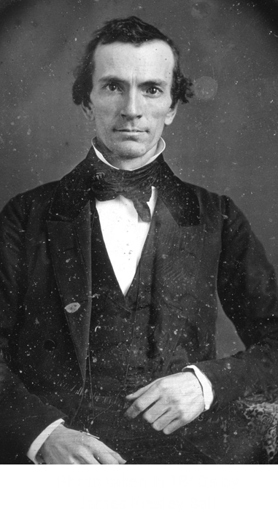
5 Men—Called of God
Oliver Cowdery, On May 15, 1829, Cowdery and Smith received the Aaronic priesthood from John the Baptist, after which they baptized each other in the Susquehanna River. Then the Melchizedek Priesthood shortly thereafter from Peter, James, and John.
The Lord exhorted him to not be prideful and avoid temptation. To make known to the world the gospel and to preach the truth.
D&C 23:1-2

Slide 10
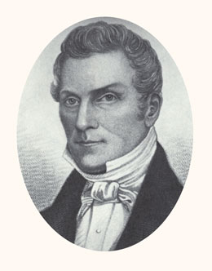
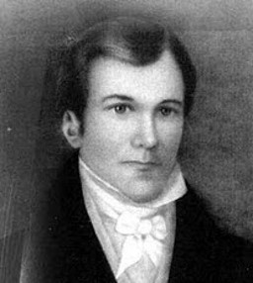
5 Men—Called of God
Hyrum Smith, an older brother of the Prophet, assisted in the publication of the Book of Mormon by working directly with the printer. He served as president of the first branch of the Church in Colesville, New York. Hyrum was faithful to the Lord and the Church throughout his life.
Samuel Smith, a younger brother of the Prophet, was baptized in May 1829. In June 1830, he departed on a mission and placed a Book of Mormon that would eventually lead to the conversion of Brigham Young and many of his family members. Samuel was loyal to his family and to the Church throughout his life. Samuel was not ready to preach when this revelation was given, but two months later he would begin his missionary service.
D&C 23:3-4

Slide 11
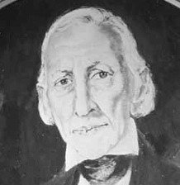
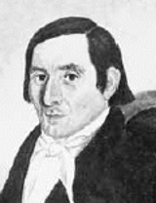
5 Men—Called of God
Joseph Smith Sr., the Prophet’s father, joined the Church the day it was organized. The following summer, he and his son Don Carlos embarked on a mission to extended family in New York. He became a high priest and the first patriarch of the Church. Joseph Smith Jr. described his father as “a man faithful to his God and to the Church in every situation and under all circumstances through which he was called to pass”
History of the Church
Joseph Knight Sr. was a close friend of Joseph Smith Jr. and had shown him great kindness. He provided the Prophet with supplies while he worked on the translation of the Book of Mormon. He had felt a desire to be baptized with others on the day the Church was organized, but he refrained because he wanted to study the Book of Mormon further. He later wrote, “I should [have] felt better if I had … gone forward” to be baptized (as quoted in Larry Porter,
The Joseph Knight Family Article
D&C 23

Slide 12
Divine Truth Bestowed
“When a person is a recipient of divine truth, he is obligated to conform his life to that truth. By so doing, that individual is approved of the Lord. When a person knowingly lives contrary to the Lord’s will he is under condemnation in the sight of the Lord.”
Otten and Caldwell

Slide 13
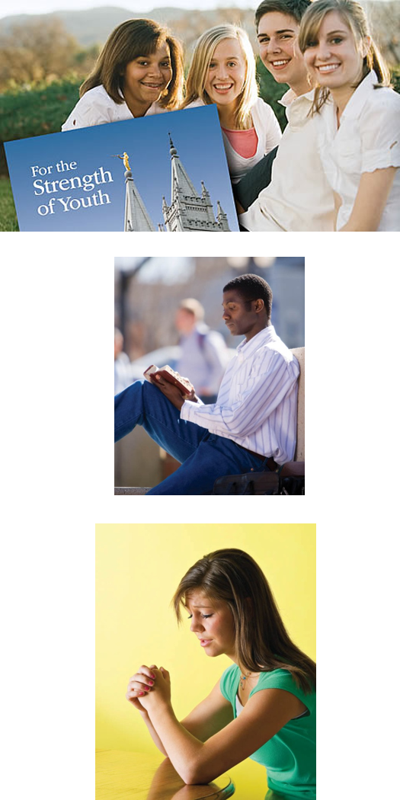
As we desire to serve the Lord, we can receive personal guidance from Him.
The Lord will bless us as we follow the guidance He gives us.

Slide 14
Sources:
Hyrum M. Smith and Janne M. Sjodahl Commentary pg. 119
Anthon H. Lund CR, October 1915 p. 10 (Otten and Caldwell Sacred Truths of the Doctrine and Covenants pg. 97)
Joseph Fielding Smith (Answers to Gospel Questions, comp. Joseph Fielding Smith Jr., 5 vols. [1957–66], 1:65).
Joseph Smith Sr. History of the Church, 4:192
“The Joseph Knight Family,” Ensign, Oct. 1978, 40; spelling and capitalization standardized).
Otten and Caldwell Sacred Truths of the Doctrine and Covenants pg. 104
Stuart Miles digital free photography Your way My way
Presentation by ©http://fashionsbylynda.com/blog/

Slide 15
Importance of Restoration:
Elder James E. Talmage of the Quorum of the Twelve Apostles explained:
“When the Lord established his Church amongst the Nephites upon this continent, he told those who were chosen and ordained, unto whom authority was given, just how to administer the ordinance of baptism. They were to say: ‘Having authority given me of Jesus Christ, I baptize you in the name of the Father and of the Son, and of the Holy Ghost.’ That does not give us in this age any such authority. The words that Christ spoke unto his apostles of old would be no authority unto the apostles today, nor unto any of the elders of the Church. I repeat, the words that he, the Lord, spoke unto the disciples who were chosen from among the Nephites would be no authority unto us; but in this day and age he has spoken again, and has given that same power and authority to speak in his name, and to administer the ordinances of the gospel, after the pattern that he has set; and therefore the elders and priests who take candidates, who have professed their faith, and who have repented of their sins, into the waters of baptism today, declare that they have authority given them; and, being commissioned of Jesus Christ, they baptize in the name of the Father and of the Son and of the Holy Ghost” (in Conference Report, Apr. 1924, 68; see also Doctrine and Covenants Student Manual, 2nd ed. [Church Educational System manual, 2001] , 46).
Some early Church converts did not understand that the Lord does not accept a baptism unless it is performed by someone holding priesthood authority. President Joseph Fielding Smith explained:
“Immediately after the Church was organized, converts were made. Some of these had belonged to churches which believed in baptism by immersion. In fact, many of the early converts of the Church had previously accepted this mode, believing that it was right. The question of divine authority, however, was not firmly fixed in their minds. When they desired to come into the Church, having received the testimony that Joseph Smith [was a true prophet], they wondered why it was necessary for them to be baptized again when they had complied with an ordinance of baptism by immersion” (Church History and Modern Revelation [1953], 1:109).
“Enter ye in at the gate”
Baptism is the gate, or requirement, for entry into the celestial kingdom for anyone who has reached the age of accountability (see2 Nephi 31:15–21). The ordinance of baptism, while absolutely essential, becomes valid only when it is accompanied by a corresponding change of heart that leads to a new life.
Elder John A. Widtsoe of the Quorum of the Twelve Apostles described such a changed life:
“I remember the man who baptized me into the Church, a very common, ordinary man … with a jug of beer two or three times a day, a glass of whiskey a little later, … tobacco mostly all day long, living a useless, purposeless life, except for three meals a day, and the satisfaction of some of the carnal appetites. He heard the Gospel and accepted it. It was good. It was something he had been longing for. The man grew in power and stature in the Church. As I recall it, he filled five or six missions and presided over one of the missions of the Church. He was the same man, with the same arms, same feet, same body, same mind, but changed because of the Spirit that comes with the acceptance of eternal truth” (in Conference Report, Apr. 1952, 34; see also Doctrine and Covenants Student Manual, 2nd ed. [Church Educational System manual, 2001]

Slide 16
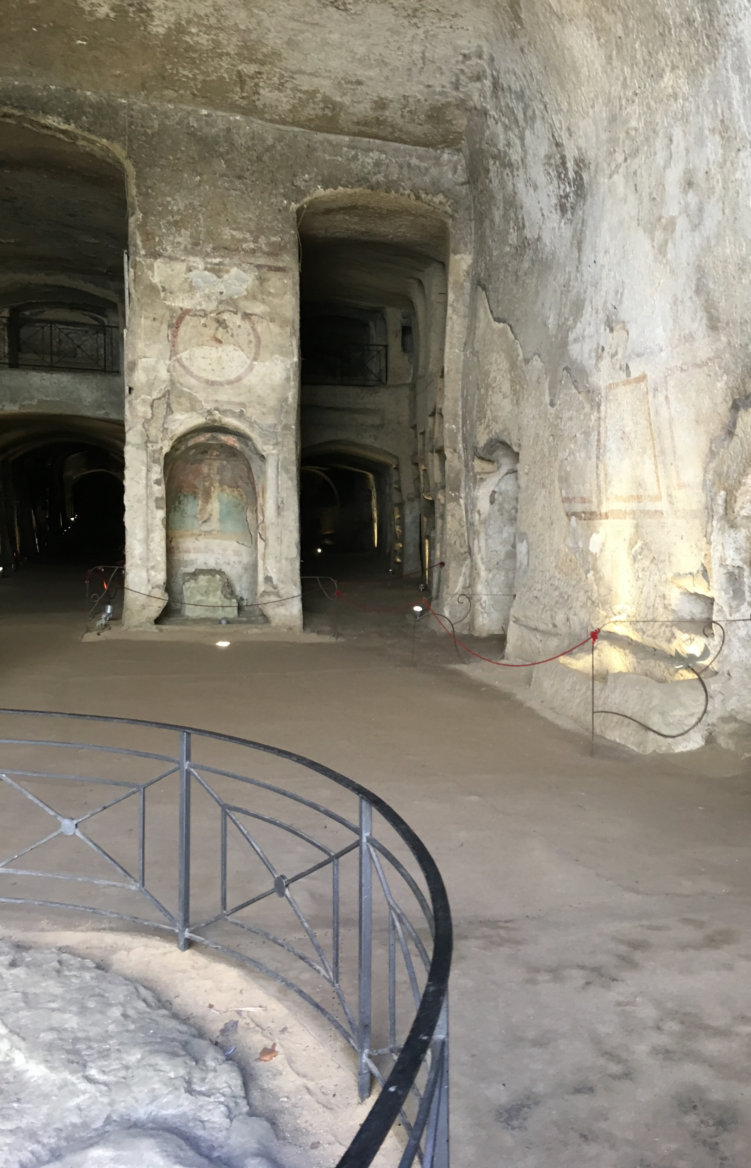
In the History of Mormonism, Samuel Smith, born March, 1808, was Joseph's younger brother. He was baptized into the Church of Jesus Christ of Latter-day Saints on May 25, 1829, at the age of 22. He was the third person to be baptized in the church, and receiving the priesthood. Joseph then asked Samuel to be the first missionary. His first day of being on a mission, Samuel walked 25 miles, carrying only a knapsack full of Book of Mormons. Samuel visited four houses along the way, but none of them wanted to buy a copy. Tired, hungry, and discouraged, Samuel stopped by an inn to rest. He asked the innkeeper if he wanted to buy a Book of Mormon. He told the innkeeper about his brother receiving revelation from an angel where the plates were buried. Angry, the innkeeper called Samuel a liar and threw him out of his inn. So Samuel had to sleep under an apple tree on the ground. The next morning Samuel stopped by a widow's house. In return, the widow gave Samuel some breakfast. He gave her a Book of Mormon in return. Then he walked eight miles and shared the Book of Mormon with John Greene, a Methodist minister.
He only took it see if others he knew might be interested in buying a copy. Mr. Greene’s wife, Rhoda, was Brigham Young’s sister, but Brigham did not know about the church yet. Two months later, Samuel returned to the Greene's home. When he arrived, Mr. Greene wasn't home, but Mrs. Greene told Samuel that she had read the book. The Spirit prompted Samuel to leave the book with her, and he did. Later, Mrs. Greene convinced her husband to read the book, and the couple was later baptized. Samuel also sold a copy of the Book of Mormon to Brigham Young’s brother: Phineas Young, a Methodist preacher. Samuel told Phineas about the book, including how he is one of the witnesses of the Golden Plates. Phineas thanked Samuel for his time, and had it in his mind to find errors in the book and expose it to the world. A week later, and after reading the book twice, Phineas told his congregation that he believed the Book of Mormon. Later in the summer, the Young family read the Book of Mormon, including Brigham Young. Even though Samuel baptized no one, and would feel like he didn't succeed in his calling, his efforts would later convert many church members, including Brigham Young who would be the next prophet of the church, and Heber C. Kimball, an Apostle to the church. Samuel died a month after Joseph did in 1844, from gunshot wounds received from the mob while he was fleeing on horseback.
Posted by Ben Sokaol Dec. 2012
The Catacombs of San Gennaro are underground paleo-Christian burial and worship sites in Naples, Italy, carved out of tuff, a porous stone. They are situated in the northern part of the city, on the slope leading up to Capodimonte (it), consisting of two levels, San Gennaro Superiore, and San Gennaro Inferiore. The catacombs lie under the Rione Sanità neigborhood of Naples, sometimes called the "Valley of the Dead".[ The site is now easily identified by the large church of Madre del Buon Consiglio.
Other ritual spaces included a confessional, baptismal font, a carved tuff table used as a seat for a consignatorium (area for confirmation), or “oleorum” table for holy oils, and possibly, monastic and hermit cells.
^{Wikipedia}

