Slide 2
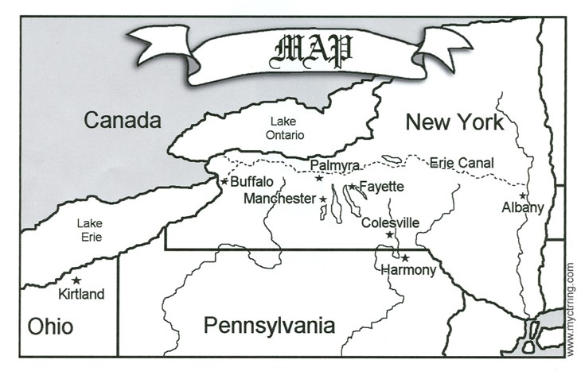
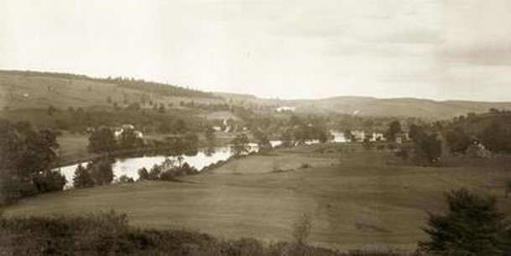
Historical Setting
June 1830
After the Church was organized, the Prophet Joseph Smith visited groups of friends in Manchester, Fayette and Colesville, New York.
In Colesville Joseph was teaching the gospel to a number of people who were anxious to be baptized.
Their interest in the church created feelings of opposition among the sectarian priests who feared the loss of their followers.
HC

Slide 3
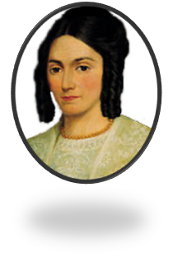
Mob Action
A stream was dammed to prepare for baptisms the next day (Sunday), but a hostile mob destroyed the dam during the night.
Early Monday morning, the dam was rebuilt and 13 people were baptized, including Emma Smith. By the time the baptisms were completed, however, a mob of nearly 50 men had gathered, insulting and threatening to harm the Saints.
HC

Slide 4
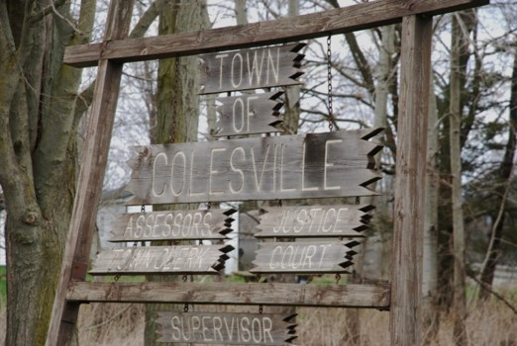
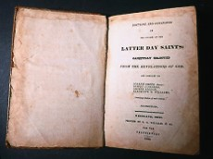
Joseph Arrested
That evening, the Saints met to confirm those who had been baptized earlier that day, but before the confirmations could be performed, Joseph was arrested on charges of “being a disorderly person, of setting the country in an uproar by preaching the Book of Mormon.
This resulted in a trial and eventually acquittal, with harassments throughout the proceedings.
After the trial, Joseph and Oliver Cowdery returned to the Prophet’s home in Harmony, Pennsylvania.
The Prophet received three revelations known as sections 24, 25, and 26.
HC

Slide 5
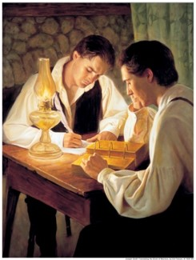
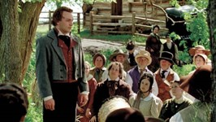
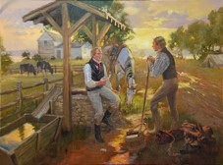
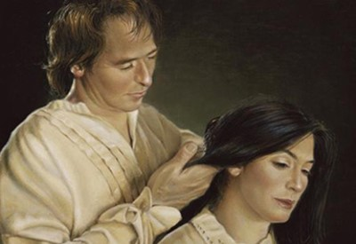
How Rough Did It Get?
Joseph’s Schedule:
Committed to translate and publish the Book of Mormon
Organizing the Lord’s Church
Sending missionaries to the Saints and others
To provide temporally for his family (which he missed the planting season)

Slide 6
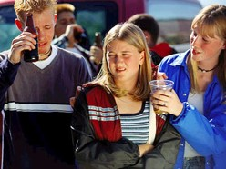
How Rough Can It Get?
Your Schedule:
Finishing High School
Deciding on college or a mission
Peer pressure
Family situations
Funding for College/and or mission

Slide 7
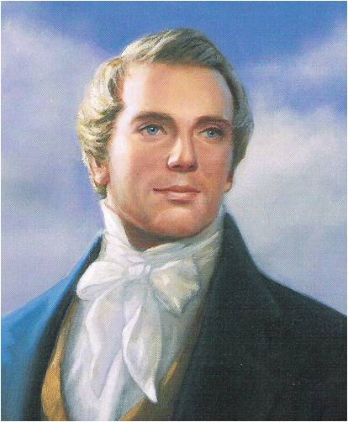
The Lord’s Answer
To Joseph:
Magnify Your Calling
Secure your temporal needs
Then speedily go to Colesville, Fayette, and Manchester and the Lord will bless them spiritually and temporally
Continue to pray
Continue to translate the Book of Mormon
Be Patient
To You:
Magnify Your Calling
Save your earnings for your needs, not your wants
Continue to serve others and look for missionary opportunities among your friends
Continue to pray
Continue to read
and study the
scriptures
Be Patient
D&C 24:3-8

Slide 8
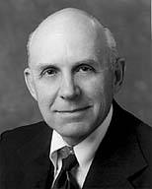
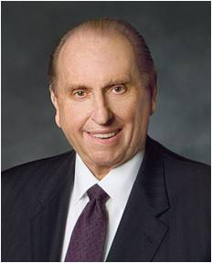
Supporting a Mission
The Lord promised Joseph that his temporal needs would be taken care of if he would “magnify” his calling.
The members were encouraged to support and sustain the Prophet in every possible way.
With the great increase in the number of new missionaries - many coming from modest means - President Thomas S. Monson invited members to donate generously to the missionary fund.—May 18, 2013
“Do not squander your missionary funds for a bike, then a scooter, then a car or stereo, and records, etc. Do not rationalize that this is an “investment” which can be transferred into ready cash just before you go. Self-denial and purposeful saving may well be the greatest blessing to come from your missionary service.”
A. Theodore Tuttle
D&C 24:3-9

Slide 9
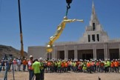
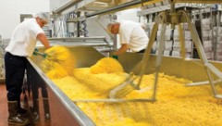
All our service in God’s kingdom is predicated on his eternal law which states: ‘The laborer in Zion shall labor for Zion; for if they labor for money they shall perish.’ (2 Ne. 26:31.)
“We know full well that the laborer is worthy of his hire, and that those who devote all their time to the building up of the kingdom must be provided with food, clothing, shelter, and the necessaries of life.
We must employ teachers in our schools, architects to design our temples, contractors to build our synagogues, and managers to run our businesses. But those so employed, along with the whole membership of the Church, participate also on a freewill and voluntary basis in otherwise furthering the Lord’s work.
Bank presidents work on welfare projects. Architects leave their drafting boards to go on missions.
Contractors lay down their tools to serve as home teachers or bishops. Lawyers put aside Corpus Juris and the Civil Code to act as guides on Temple Square. Teachers leave the classroom to visit the fatherless and widows in their afflictions. Musicians who make their livelihood from their artistry willingly direct church choirs and perform in church gatherings. Artists who paint for a living are pleased to volunteer their services freely.”
Bruce R. McConkie
D&C 24:3-9

Slide 10
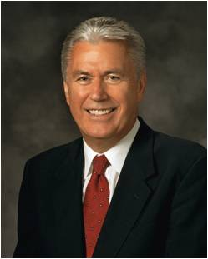
“Patience—the ability to put our desires on hold for a time—is a precious and rare virtue. We want what we want, and we want it now. Therefore, the very idea of patience may seem unpleasant and, at times, bitter.
Nevertheless, without patience, we cannot please God; we cannot become perfect. Indeed, patience is a purifying process that refines understanding, deepens happiness, focuses action, and offers hope for peace.”
“There is an important concept here: patience is not passive resignation, nor is it failing to act because of our fears.
Patience means active waiting and enduring. It means staying with something and doing all that we can—working, hoping, and exercising faith; bearing hardship with fortitude, even when the desires of our hearts are delayed. Patience is not simply enduring; it is enduring well!”
If we are patient and endure our afflictions, the Lord will be with us
President Dieter F. Uchtdorf

Slide 11
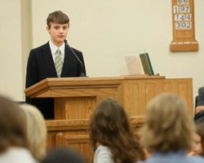
“Continue In Bearing My Name”
All persons who are baptized as members of the Church covenant to take upon them the name of Christ and be known as Christians.
They thus bear witness to all others by their words and deeds concerning the Savior and His mission.
“And the members shall manifest before the church, and also before the elders, by a godly walk and conversation, that they are worthy of it, that there may be works and faith agreeable to the holy scriptures—walking in holiness before the Lord.” D&C 20:69
D&C 24:10

Slide 12
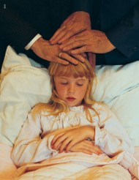
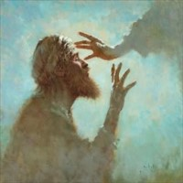
Miracles
“Oliver Cowdery was commanded to avoid requiring miracles outside of those associated with the preaching of the gospel unless commanded of the Lord
It is expected that priesthood holders acting properly will do works of the priesthood.
The miracles … are gifts of the Spirit (Holy Ghost) bestowed upon those who believe and obey the gospel of Christ and are intended not to convert people to the truth but to bless those who are already converted.
By requiring the person who is in need of a miracle to request it, the scriptures are fulfilled, that is, the miracle is performed in behalf of one who believes and is, therefore, a sign of his faith.”
Student Manual
D&C 24:13-14

Slide 13
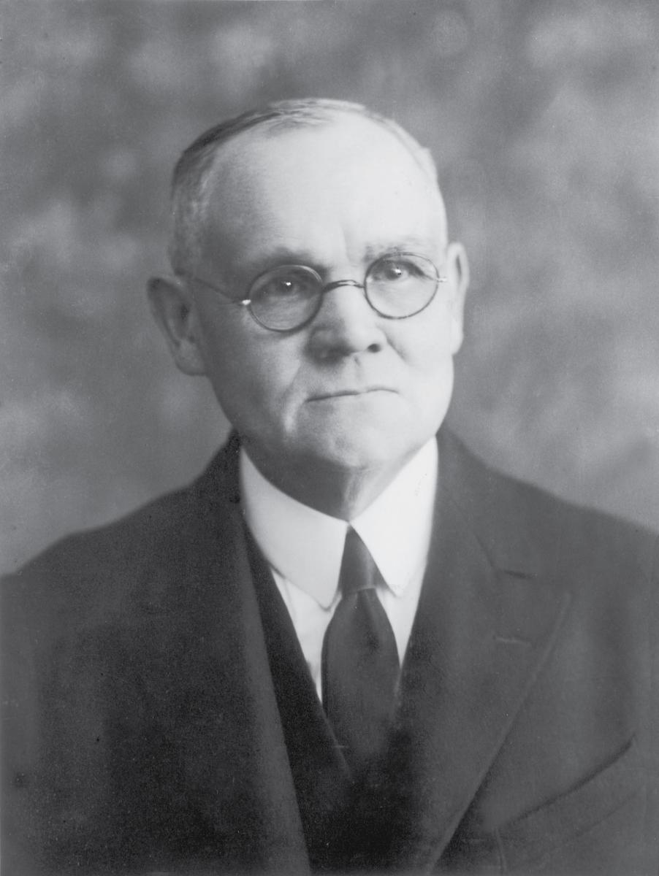
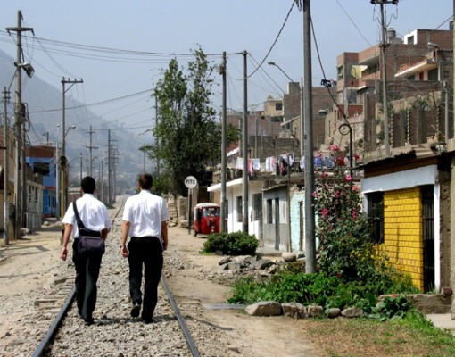
Shake the Dust
“To ceremonially shake the dust from one’s feet as a testimony against another was understood by the Jews to symbolize a cessation of fellowship and a renunciation of all responsibility for consequences that might follow. It became an ordinance of accusation and testimony by the Lord’s instructions to His apostles. …
In the current dispensation, the Lord has similarly directed His authorized servants to so testify against those who wilfully and maliciously oppose the truth when authoritatively presented.
The responsibility of testifying before the Lord by this accusing symbol is so great that the means may be employed only under unusual and extreme conditions, as the Spirit of the Lord may direct”
Elder James E. Talmage
D&C 24:15

Slide 14
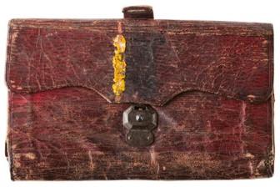
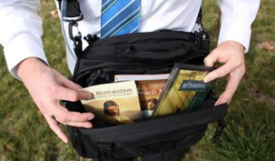
No Purse, No Scrip
Joseph and Oliver were to traveled without money, relying on the goodness of Church members and others to provide food and shelter.
Today, full-time missionaries are not commanded to go without purse or scrip.
D&C 24:18

Slide 15
“Prune My Vineyard”
See Allegory of the Olive Tree
Jacob 5
“In this dispensation the Lord’s vineyard covers the whole earth, and the laborers are going forth to gather scattered Israel before the appointed day of burning when the vineyard will be purified of corruption.”
Elder Bruce R. McConkie
D&C 24:19

Slide 16
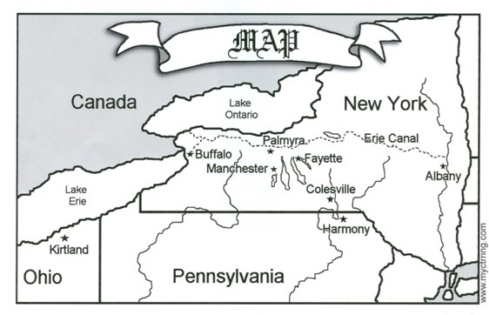
Go West—the Next Conference
“Going ‘to the west’ meant going to Fayette, New York, a distance of about a hundred miles; and the ‘next conference’ was held at Fayette on September 26 and 27, 1830.
‘Studying the scriptures’ probably had something to do with the translation of the Bible, since the earliest manuscript entries, recorded in the summer and fall of 1830, are in the handwriting of John Whitmer and Oliver Cowdery.
Apparently the ‘translation’ and the ‘study’ were being conducted at the same time; perhaps they were actually one and the same.” (Matthews, Joseph Smith’s Translation of the Bible, p. 27.)
D&C 26:1

Slide 17
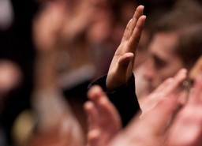
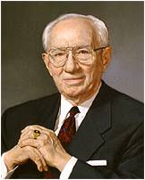
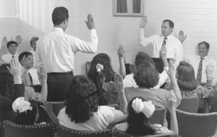
Law of Common Consent
“common consent” refers to Church members using their agency to express their willingness or unwillingness to support a proposal from a Church leader.
In sacrament meetings and stake and general conferences, we are asked to signify consent by raising our right hands.
“The procedure of sustaining is much more than a ritualistic raising of the hand. It is a commitment to uphold, to support, to assist those who have been selected.”
Gordon B. Hinckley
Not only are Church officers sustained by common consent, but this same principle operates for policies, major decisions, acceptance of new scripture, and other things that affect the lives of the Saints.
Student Manual
D&C 26:2

Slide 18
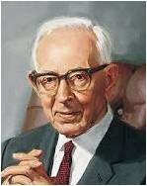
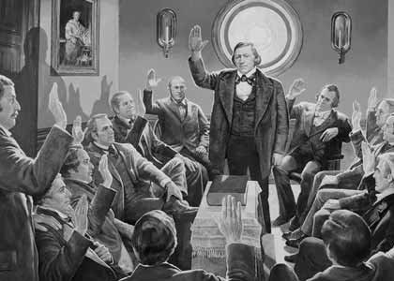
Holding An Office
“No man can preside in this Church in any capacity without the consent of the people.
The Lord has placed upon us the responsibility of sustaining by vote those who are called to various positions of responsibility.
No man, should the people decide to the contrary, could preside over any body of Latter-day Saints in this Church, and yet it is not the right of the people to nominate, to choose, for that is the right of the priesthood.”
Joseph Fielding Smith
D&C 26:2

Slide 19
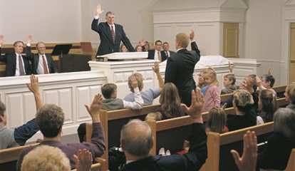
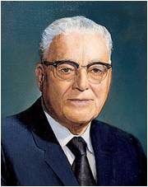
Sustaining One Into Office
“When we sustain officers, we are given the opportunity of sustaining those whom the Lord has already called by revelation. … The Lord, then, gives us the opportunity to sustain the action of a divine calling and in effect express ourselves if for any reason we may feel otherwise.
To sustain is to make the action binding on ourselves to support those people whom we have sustained.
When a person goes through the sacred act of raising his arm to the square, he should remember, with soberness, that which he has done and commence to act in harmony with his sustaining vote both in public and in private.”
Elder Loren C. Dunn
“When you vote affirmatively you make a solemn covenant with the Lord that you will sustain, that is, give your full loyalty and support, without equivocation or reservation, to the officer for whom you vote”
Harold B. Lee
D&C 26:2

Slide 20
Sources:
Video:
Mountains to Climb (5:04)
History of the Church Vol. 1, pp. 86-144 and CHMR Vol. 1, pp. 114, History of the Church, 1:86–88
President Dieter F. Uchtdorf Continue in Patience April 2010 General Conf.
Bruce R. McConkie (In Conference Report, Apr. 1975, p. 77; or Ensign, May 1975, p. 52.)
Theodore Tuttle Your Mission Preparation Oct. 1974 Gen. Conf.
Student Manual Religion 324-325 Doctrine and Covenants pg. 149-150
Elder Bruce R. McConkie Mormon Doctrine p. 149, 150, 452
Elder James E. Talmage (Jesus the Christ,3rd ed. [1916], 345; see also Doctrine and Covenants Student Manual, 2nd ed. [Church Educational System manual, 2001], 50).
Gordon B. Hinckley (“This Work Is Concerned with People,” Ensign, May 1995, 51).
Joseph Fielding Smith (Smith, Doctrines of Salvation, 3:123; see also D&C 20:65
Elder Loren C. Dunn (In Conference Report, Apr. 1972, p. 19; or Ensign, July 1972, p. 43.)
(Harold B. Lee, in Conference Report, Apr. 1970, p. 103).
Presentation by ©http://fashionsbylynda.com/blog/

Slide 21
Miracles:
President Spencer W. Kimball taught that “where [the Lord’s] priesthood was and where faith was found, there would be the signs of power, not for show but for a blessing to the people” (“President Kimball Speaks Out on Administration to the Sick,” New Era, Oct. 1981, 45). In our day, believers receive healings and miracles just as they always have. However, we do not hear about all healings and miracles that occur. Such experiences are sacred. Many times, people who receive such miracles feel prompted to keep them quiet and private.
President Joseph Fielding Smith taught of the circumstances in which a non-consenting vote would be given:
“I have no right to raise my hand in opposition to a man who is appointed to any position in this Church, simply because I may not like him, or because of some personal disagreement or feeling I may have, but only on the grounds that he is guilty of wrong doing, of transgression of the laws of the Church which would disqualify him for the position which he is called to hold” (Doctrines of Salvation, comp. Bruce R. McConkie, 3 vols. [1954–56], 3:124; see also Doctrine and Covenants Student Manual, 2nd ed. [Church Educational System manual, 2001], 52).
Magnifying our Callings:
The word magnify is commonly interpreted to mean “enlarge.” In order for an enlargement to take place, one needs to gather the powers of the existing resources and focus them on a given point. This is illustrated in the process by which a magnifying lens enlarges by focusing the powers of the available light.
Joseph Smith was to concentrate and focus all his energies and talents to the calling given him by the Lord at that time. He was to pray, write, expound the scriptures, exercise patience and administer the affairs of the Church. As he utilized all of his available resources in the magnifying of his calling , the Lord would then give the increase and enlarge his abilities and the fruits of his labors.” Otten and Caldwell Sacred Truths of the Doctrine and Covenants pp. 107
The Law of Common Consent
Elder Bruce R. McConkie explained that “administrative affairs of the Church are handled in accordance with the law of common consent. This law is that in God’s earthly kingdom, the King counsels what should be done, but then he allows his subjects to accept or reject his proposals. Unless the principle of free agency is operated in righteousness men do not progress to ultimate salvation in the heavenly kingdom hereafter. Accordingly, church officers are selected by the spirit of revelation in those appointed to choose them, but before the officers may serve in their positions, they must receive a formal sustaining vote of the people over whom they are to preside. (D. & C. 20:60–67; 26:2; 28; 38:34–35; 41:9–11; 42:11; 102:9; 124:124–145.)” (Mormon Doctrine, pp. 149–50.)

