Slide 2
Emma
She was born on July 10, 1804, in Harmony, Susquehanna County, Pennsylvania and daughter of Isaac Hale and Elizabeth Lewis Hale
Her father withheld consent for her to marry Joseph, so they eloped in January 1827
She assisted her husband as a scribe in the translation of the Book of Mormon.
She was baptized on June 28, 1830 by Oliver Cowdery
She was instrumental in preparing a selection of hymns for the church D&C 25
She is also mentioned in D&C 132 concerning the Lord’s law of marriage
She was the first President of the Relief Society in 1879
She had 9 children and only 4 lived to maturity
After Joseph was martyred, she declined to go west with the Saints
She married Major Lewis Bidamon and passed away on April 30, 1879 in Nauvoo, Illinois at the age of 74 and was buried next to the plot where the Prophet Joseph was buried.
Who’s Who

Slide 3
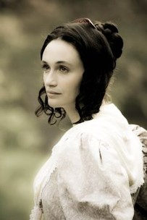
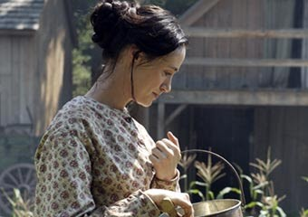
Before Marriage
It is reported that Emma was a beautiful woman with an attractive personality, and she had the reputation of being a refined and dignified woman who was an excellent housekeeper and cook.
Her Methodist upbringing had helped her develop a great love of music.

Slide 4
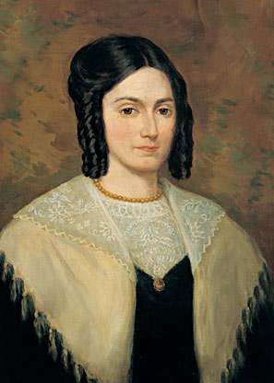
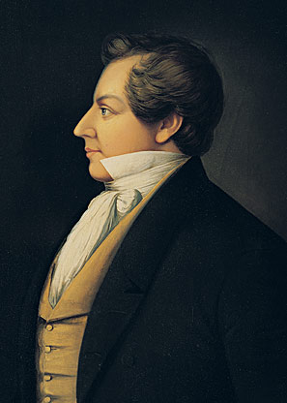
Married Life
The first three years for the newly married couple were indeed tense and trying ones.
Eight months after their marriage Joseph received the golden plates from the angel Moroni.
From that moment on their lives were punctuated with persecution and trial. Emma passed through these trying experiences with her husband. She was at his side during those agonizing months when Joseph lost the gift to translate. She served as his scribe for a while.

Slide 5
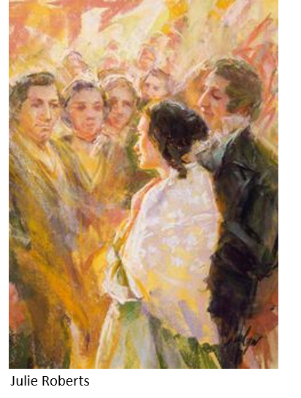
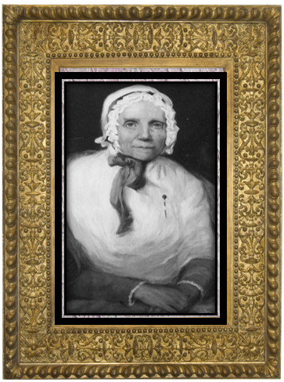
Life As A Companion
She traveled with the Prophet on many of his missionary journeys and shared with him the joy and sorrow associated with the preaching of the gospel.
“I have never seen a woman in my life, who would endure every species of fatigue and hardship, from month to month, and from year to year, with that unflinching courage, zeal, and patience, which she has ever done; for I know that which she has had to endure … she has breasted the storms of persecution, and buffeted the rage of men and devils, which would have borne down almost any other woman.” Lucy Mack Smith

Slide 6
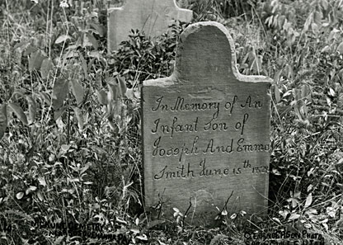
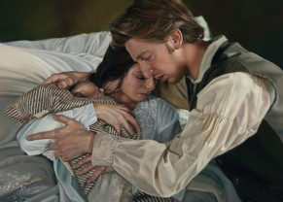
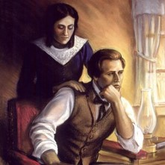
Tribulation
Emma experienced tragedy, heartache, and persecution.
While living in Harmony, Pennsylvania, Emma gave birth to a son named Alvin who did not long survive. Emma herself became critically ill, and Joseph feared she would not live.
Liz Lemon Swindle
When she recovered, she heard the devastating news that the 116 translated pages of manuscript had been lost by Joseph’s friend Martin Harris. Even in her frail health, Emma consoled her heartbroken husband, who had lost the power to translate. Together, they awaited the Lord’s will for the translation of the plates. She was later forced to leave her home in Harmony because of threats from malicious people.

Slide 7
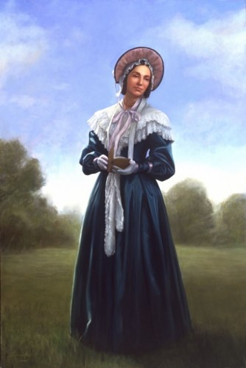
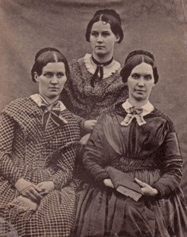
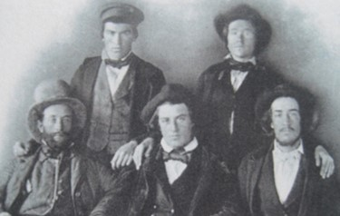
Revelation
Between Emma’s Baptism and her confirmation Joseph Smith received a revelation concerning Emma’s calling and recorded it in D&C 25
Sons and Daughters:
“All men and women are the offspring of God and they will become sons and daughters of God through obedience to all ordinances and covenants of the Gospel.”
Smith and Sjodahl
Walking in the paths of virtue--
Promises of receiving and inheritance in Zion
D&C 25:1-2

Slide 8
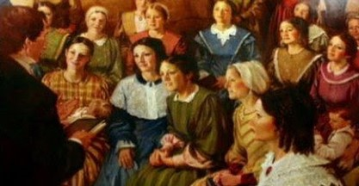
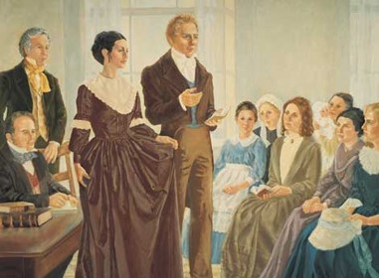
An Elect Lady
When the Relief Society was organized in 1842 (more than a decade after this revelation was given), Emma Smith was called to be the organization’s first president. On that occasion, the Prophet Joseph Smith read the revelation contained in Doctrine and Covenants 25.
He then explained that Emma was “elect” because she had been “elected to a certain work … and that the revelation was then fulfilled by [her] election to the Presidency of the Society, she having previously been ordained to expound the Scriptures”
History of the Church
D&C 25:3

Slide 9
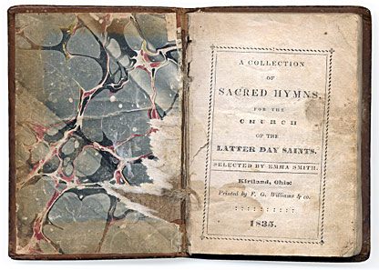
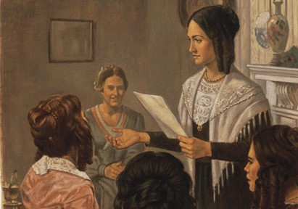
Sacred Hymns
The first hymnal of the "Church of the Latter Day Saints" was published in Kirtland, Ohio by "F. G. Williams & co." The title page names Emma Smith as the only compiler of the hymnal.
While the book carries "1835" as its publication date it probably came off the press early 1836.
It contains the texts for 90 hymns, at least fifty of them "overtly borrowed and rewritten Protestant hymns," and about forty probably written by members of the church. Of the 40 original hymns, most have been attributed to W. W. Phelps.
D&C 25:11

Slide 10
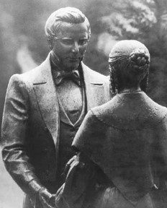
Revelation For Emma
Council
Murmur not
Comfort and console
Do not fear
Lay aside the things of the world
Lift up “thy heart” and rejoice and “cleave” the covenants made
Beware of Pride
Let “thy soul delight in thy husband”
Keep the commandments
Calling
Go with him as he travels and be his scribe
Make a selection of sacred hymns to be sung in church
Promises
She will receive the Holy Spirit
She will gain knowledge
She will receive blessings
Her husband will support her
Her husband’s glory shall come upon him
D&C 25:4-16

Slide 11
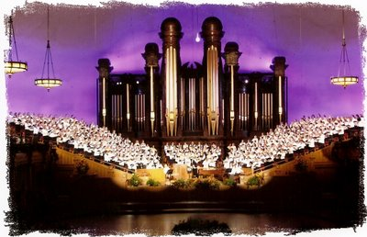
We are to lay aside the things of the world and seek for that which is eternal
As we worship the Lord through righteous music, He will bless us.
We can find joy and comfort in cleaving to the covenants we have made with God.
If we will keep God’s commandments continually, we will receive a crown of righteousness.

Slide 12
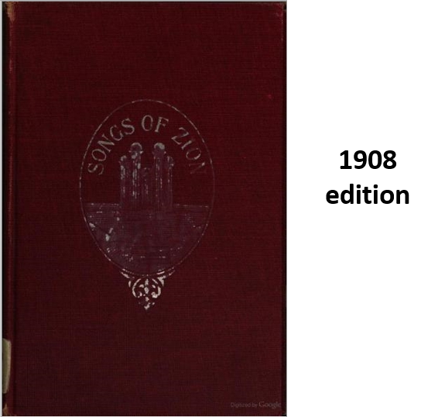
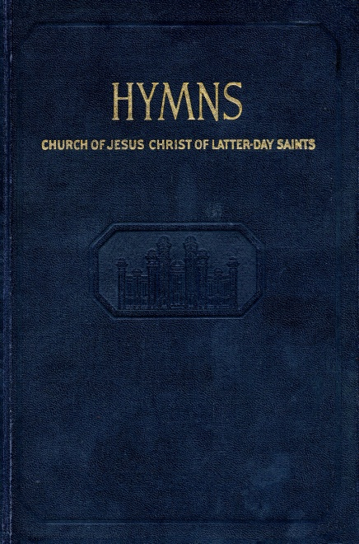
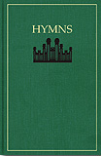
Sacred Hymns
In order to sing by the Spirit, and with the understanding, it is necessary that the church of the Latter Day Saints should have a collection of "Sacred Hymns," adapted to their faith and belief in the gospel, and, as far as can be, holding forth the promises made to the fathers who died in the precious faith of a glorious resurrection, and a thousand years' reign on earth with the Son of Man in his glory..
1980
Notwithstanding the church, as it were, is still in its infancy, yet, as the song of the righteous is a prayer unto God, it is sincerely hoped that the following collection, selected with an eye single to his glory, may answer every purpose till more are composed, or till we are blessed with a copious variety of the songs of Zion.
1948 edition
D&C 25:11 Preface in the Hymn Book

Slide 13
Doctrinal Mastery
“Wherefore, lift up thy heart and rejoice, and cleave unto the covenants which thou hast made.”
D&C 25:13

Slide 14
Emma Smith
Over the years, Emma Smith lost six children to death and endured relentless persecution with her husband. Her house was broken in to, she was left homeless several times, and she often had to rely on the kindness of others to obtain the necessities of life. Eventually, even her beloved Joseph was taken from her and violently murdered.

Slide 15
Sources:
Videos:
The Song of the Heart (2:49)
Emma Smith Follows the Lord’s Counsel (10:35)
An Elect Lady (5:18)
Who’s Who in the Doctrine and Covenants by Ed J. Pinegar and Richard J. Allen pg. 133-134
Doctrine and Covenants Student Manual Religion 324-325 pg. 50
Lucy Mack Smith(History of Joseph Smith, pp. 190–91.)
Hyrum M. Smith and Janne M. Sjodahl Doctrine and Covenants Commentary pg. 128
History of the Church, 4:552–53.
Hymn Book Preface http://josephsmithpapers.org/paperSummary/collection-of-sacred-hymns-1835#!/paperSummary/collection-of-sacred-hymns-1835&p=5
Lucy Mack Smith’s (History of Joseph Smith by His Mother, ed. Preston Nibley [1958], 190–91).
Presentation by ©http://fashionsbylynda.com/blog/

Slide 16
First Presidency Preface to Hymns
Three months after the Church was organized, the Lord, through the Prophet Joseph Smith, instructed Joseph's wife, Emma, to make a selection of sacred hymns for the Church: “For my soul delighteth in the song of the heart; yea, the song of the righteous is a prayer unto me, and it shall be answered with a blessing upon their heads” (D&C 25:12).
Now, 150 years after the first hymnbook was published by the Church, we are pleased to present this revision. Many hymns found in our original hymnbook and in subsequent editions are included, as are a number of newly added hymns. All have been selected to meet the varied needs of today's worldwide Church membership.
Music in Our Church Meetings
Inspirational music is an essential part of our church meetings. The hymns invite the Spirit of the Lord, create a feeling of reverence, unify us as members, and provide a way for us to offer praises to the Lord.
Some of the greatest sermons are preached by the singing of hymns. Hymns move us to repentance and good works, build testimony and faith, comfort the weary, console the mourning, and inspire us to endure to the end.
We hope to see an increase of hymn singing in our congregations. We encourage all members, whether musically inclined or not, to join with us in singing the hymns. We hope leaders, teachers, and members who are called on to speak will turn often to the hymnbook to find sermons presented powerfully and beautifully in verse.
Latter-day Saints have a long tradition of choir singing. Every ward and branch in the Church should have a choir that performs regularly. We encourage choirs to use the hymnbook as their basic resource.
Music in Our Homes
Music has boundless powers for moving families toward greater spirituality and devotion to the gospel. Latter-day Saints should fill their homes with the sound of worthy music.
Ours is a hymnbook for the home as well as for the meetinghouse. We hope the hymnbook will take a prominent place among the scriptures and other religious books in our homes. The hymns can bring families a spirit of beauty and peace and can inspire love and unity among family members.
Teach your children to love the hymns. Sing them on the Sabbath, in home evening, during scripture study, at prayer time. Sing as you work, as you play, and as you travel together. Sing hymns as lullabies to build faith and testimony in your young ones.
Music in Our Personal Lives
In addition to blessing us as Church and family members, the hymns can greatly benefit us as individuals. Hymns can lift our spirits, give us courage, and move us to righteous action. They can fill our souls with heavenly thoughts and bring us a spirit of peace.
Hymns can also help us withstand the temptations of the adversary. We encourage you to memorize your favorite hymns and study the scriptures that relate to them. Then, if unworthy thoughts enter your mind, sing a hymn to yourself, crowding out the evil with the good.
Brothers and sisters, let us use the hymns to invite the Spirit of the Lord into our congregations, our homes, and our personal lives. Let us memorize and ponder them, recite and sing them, and partake of their spiritual nourishment. Know that the song of the righteous is a prayer unto our Father in Heaven, “and it shall be answered with a blessing upon [your] heads.”
The First Presidency

Slide 17
How Does Emma’s Calling to Exhort the Church Relate to the Apostle Paul’s Statement That Women Are Not to “Speak” in Church?
The correct meaning of the statement of the Apostle Paul that women should not speak in church (see 1 Corinthians 14:34–35) was given in the Prophet Joseph Smith’s revision of the Bible. The Prophet changed this verse to say that women are not to “rule” in the Church. In other words women (like all Church members) are to be directed in the Church by the priesthood.
This principle was stated by the Prophet Joseph Smith to the members of the first Relief Society: “You will receive instructions through the order of the Priesthood which God has established, through the medium of those appointed to lead, guide and direct the affairs of the Church in this last dispensation; and I now turn the key in your behalf in the name of the Lord, and this Society shall rejoice, and knowledge and intelligence shall flow down from this time henceforth; this is the beginning of better days to the poor and needy, who shall be made to rejoice and pour forth blessings on your heads.” (History of the Church,4:607.)
Emma Smith’s calling to exhort the Church was in complete harmony with her future calling, under the direction of the priesthood, in the Relief Society.
What is a song of the heart? In what way might feelings of the heart be associated with true worship? Writing on the importance of music, Elder Bruce R. McConkie said:
“Music is given of God to further his purposes. Sweet melodies mellow the souls of men and help prepare them for the gospel. After men receive the truth, songs of praise to Deity help to sanctify and cleanse their souls. It follows that the best and greatest music is that in which, by both note and word, God is praised and his truths are extolled. On the other hand, music can be used for sensuous and carnal purposes. To accomplish the Lord’s aims both word and melody must be edifying and lead to wholesome thoughts and emotions. There is vulgar as well as virtuous music.
“Wholesome light music designed primarily to entertain has its place. So do the heavy classical presentations that appeal to the more musically gifted. But in meetings set apart to worship the Lord, the saints should sing songs which teach the gospel and enhance faith. Beautiful melodies alone do not suffice; the word-message must also conform to true principles. Truths taught in the hymns should be as accurately presented as they are in the scriptures themselves.” (Mormon Doctrine, p. 521;
Elder Boyd K. Packer suggested that inspiring music can become a source of spiritual power in one’s life:
“This is what I would teach you. Choose from among the sacred music of the Church a favorite hymn, one with words that are uplifting and music that is reverent, one that makes you feel something akin to inspiration. Remember President Lee’s counsel: perhaps ‘I am a Child of God’ would do. Go over it in your mind carefully. Memorize it. Even though you have had no musical training, you can think through a hymn.
“Now, use this hymn as the place for your thoughts to go. Make it your emergency channel. Whenever you find these shady actors have slipped from the sidelines of your thinking onto the stage of your mind, put on this record, as it were.
“As the music begins and as the words form in your thoughts, the unworthy ones will slip shamefully away. It will change the whole mood on the stage of your mind. Because it is uplifting and clean, the baser thoughts will disappear. For while virtue, by choice, will not associate with filth, evil cannot tolerate the presence of light.
“In due time you will find yourself, on occasion, humming the music inwardly. As you retrace your thoughts, you discover some influence from the world about you encouraged an unworthy thought to move on stage in your mind, and the music almost automatically began. …
“There are many references in the scriptures, both ancient and modern, that attest to the influence of righteous music. The Lord, Himself, was prepared for His greatest test through its influence, for the scripture records: ‘And when they had sung an hymn, they went out into the mount of Olives.’ (Mark 14:26.)” (In Conference Report, Oct. 1973, pp. 24–25; or Ensign, Jan. 1974, p. 28.)

Slide 18
The Importance of Women:
Elder Neal A. Maxwell said of women and their importance in the Lord’s plan:
“We know so little, brothers and sisters, about the reasons for the division of duties between womanhood and manhood as well as between motherhood and priesthood. These were divinely determined in another time and another place. We are accustomed to focusing on the men of God because theirs is the priesthood and leadership line. But paralleling that authority line is a stream of righteous influence reflecting the remarkable women of God who have existed in all ages and dispensations, including our own. Greatness is not measured by coverage in column inches, either in newspapers or in the scriptures. The story of the women of God, therefore, is, for now, an untold drama within a drama. …
“Just as certain men were foreordained from before the foundations of the world, so were certain women appointed to certain tasks. Divine design—not chance—brought Mary forward to be the mother of Jesus. The boy prophet, Joseph Smith, was blessed not only with a great father but also with a superb mother, Lucy Mack, who influenced a whole dispensation.
“In our modern kingdom, it is no accident that women were, through the Relief Society, assigned compassionate service. So often the service of women seems instinctive, while that of some men seems more labored. It is precisely because the daughters of Zion are so uncommon that the adversary will not leave them alone. …
“So often our sisters comfort others when their own needs are greater than those being comforted. That quality is like the generosity of Jesus on the cross. Empathy during agony is a portion of divinity!
“When the real history of mankind is fully disclosed, will it feature the echoes of gunfire or the shaping sound of lullabies? The great armistices made by military men or the peacemaking of women in homes and neighborhoods? Will what happened in cradles and kitchens prove to be more controlling than what happened in congresses? When the surf of the centuries has made the great pyramids so much sand, the everlasting family will still be standing, because it is a celestial institution, formed outside telestial time. The women of God know this.
“No wonder the men of God support and sustain you sisters in your unique roles, for the act of deserting home in order to shape society is like thoughtlessly removing crucial fingers from an imperiled dike in order to teach people to swim. …
“Finally, remember: When we return to our real home, it will be with the ‘mutual approbation’ of those who reign in the ‘royal courts on high.’ There we will find beauty such as mortal ‘eye hath not seen’; we will hear sounds of surpassing music which mortal ‘ear hath not heard.’ Could such a regal homecoming be possible without the anticipatory arrangements of a Heavenly Mother?” (In Conference Report, Apr. 1978, pp. 13–15; or Ensign, May 1978, pp. 10–11.)

