Slide 2
Danger Warnings
1. A young man has been listening to music that does not meet the standards outlined in For the Strength of Youth. Although he enjoys listening to this music, he is beginning to realize that its messages are causing him to lose the Spirit and drift away from his family, his friends, and the Church.
2. After a number of dates with one young man, a young woman begins to recognize, by the promptings of the Holy Ghost, that the young man has been slowly attempting to persuade her to break the law of chastity.

Slide 3
The Warning
The Holy Ghost will warn us when we are in danger spiritually.
However, if we do not heed His warnings, the Spirit of the Lord will withdraw from us

Slide 4
Background--1830
Shortly after a Church conference in Fayette, New York, Joseph Smith received revelations for David Whitmer, Peter Whitmer Jr., and John Whitmer.
These revelations were originally published separately, but Joseph Smith had them combined into one section in the 1835 edition of the Doctrine and Covenants.

Slide 5
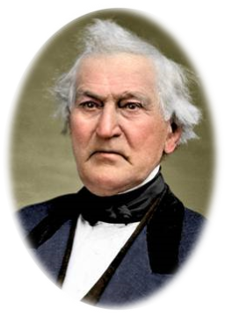
David Whitmer
He and his parents had provided a place for Joseph Smith to translate the Book of Mormon
He was one of the Three Witnesses of the Book of Mormon
He was one of the six original members of the Church
He had feared men
He had not relied on the Lord for strength
His mind had been set on the things of the world
He had not given heed to the Spirit
He had been persuaded by others
D&C 30:1-2

Slide 6
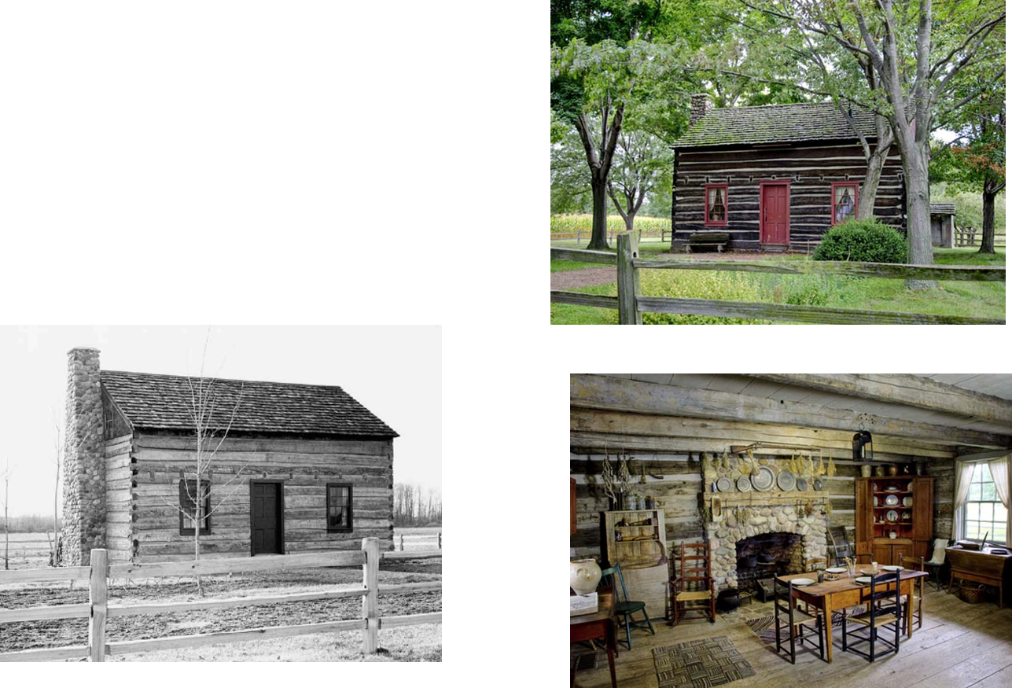
What Should David Do?
He should reside at his father’s house
He should minister to the saints of the newly found Church
He should preach the Gospel
D&C 30:4

Slide 7
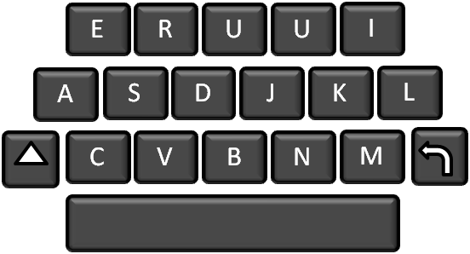
Where Are Our Minds?
There are few who have not at one time or another set their hearts on the things of this earth, giving them a higher priority than the things of God.
Most Latter-day Saints could substitute their own names in these verses in place of David Whitmer’s and find the counsel profitable.
1
1
Like David Whitmer, at such times they too are left to themselves to wonder what is wrong.
D&C 30:4

Slide 8
Rather than fear men, we should rely on the Lord for strength.
We should place our minds on the things of God more than on the things of the earth.
We should follow the Spirit and the counsel of Church leaders rather than be persuaded by those whom the Lord has not called.
D&C 30:4

Slide 9
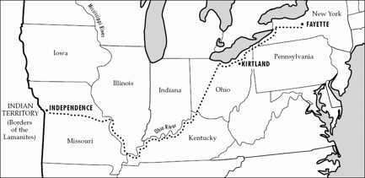
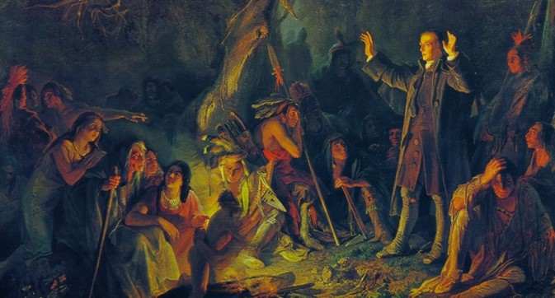
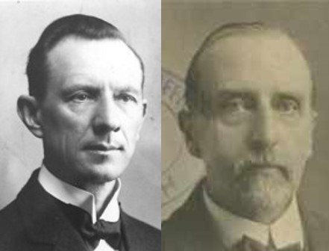
Peter Whitmer Jr.
He was to go with Oliver Cowdery on a mission
He was to pray continually and exercise faith
He was to preach to the Lamanites and build up the Church
He was to give heed to Oliver and follow his advice
“Missionary labor is complete only when the missionary is willing to follow counsel and keep the commandments of God.”
Smith and Sjodahl
D&C 30:5-8

Slide 10
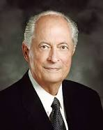
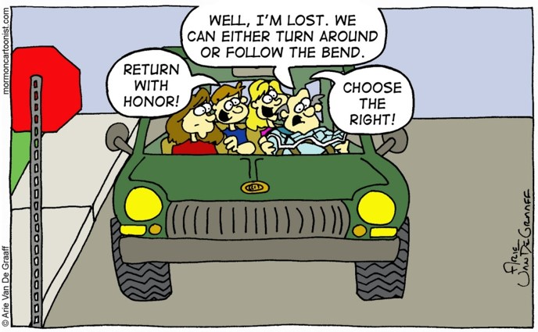
Return With Honor
This same motto, “Return with Honor,” can be applied to each of us on our eternal path of progression. Having lived with our Heavenly Father and having come to earth, we must have determination to return with honor to our heavenly home.
If we will remember who we are—sons and daughters of our Heavenly Father; why we are here—to receive our earthly bodies, gain wisdom from our experiences, and endure to the end; and where we are going—to return to our Heavenly Father, we will be able to live by the example given us by our Savior.
We can prevent many tragedies in our lives by avoiding poor judgment. In our daily lives we need to develop the ability to detect and prevent actions that can bring about disasters in case we do not recognize invulnerability, machoism, anti-authority, and impulsivity.
Elder Robert D. Hales

Slide 11
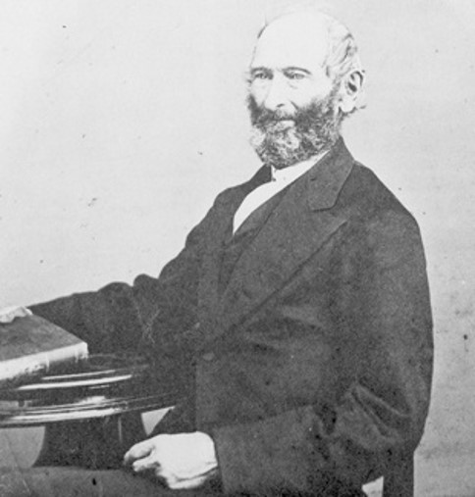
John Whitmer
He is to “proclaim” His gospel
He is to go to Philip Burrough’s and preach in the surrounding area
The Burroughs family lived about seven miles north of the Whitmers. His wife was a member of the Church, but there is no record of Philip’s membership.
John Whitmer assisted in the compilation of the Revelations, and accompanied Oliver Cowdery to Jackson County to superintend the printing of them. He was one of the seven High Priests appointed to preside in the Church in Jackson County. He was Church historian and editor of important Church publications. But he did not remain faithful.”
Smith and Sjodahl
D&C 30:9-11

Slide 12
Where Should Our Minds Be?
The Holy Bible
The
Book
of
Mormon
Doctrine
And
Covenants
ANOTHER TESTAMENT
OF JESUS CHRIST

Slide 13
Sources:
Video:
If We Put God First (2:09)
Doctrine and Covenants Student Manual Religion 324-325 pg. 64
Hyrum M. Smith and Janne M. Sjodahl Doctrine and Covenants Commentary pg. 163
Elder Robert D. Hales Return with Honor June 1999 Ensign
Presentation by ©http://fashionsbylynda.com/blog/

Slide 14
Philip Burroughs
1794–25 July 1865. Farmer.
Born in New Jersey. Son of Jonathan Burroughs and Mercy Edington.
Served in War of 1812.
Married Anna Parker, 12 Mar. 1815, in Fayette, Seneca Co., New York.
Moved to Junius, Seneca Co., by 1819.
Moved to Seneca Falls, Seneca Co., by 1830.
LDS church meeting held in his home, Sept. 1830, near Fayette.
Wife baptized into LDS church, but no record of his membership.
Moved to Portage, Allegany Co., New York, by 1840. Died in Portage.
http://josephsmithpapers.org/person/philip-burroughs
Peter Whitmer:
President Joseph Fielding Smith taught:
“Peter [Whitmer Jr.] was informed that there was none appointed to be Oliver’s counselor, except Joseph Smith. Thus Peter understood that it was his duty to take, not to give, counsel while on this journey. The fact that Oliver Cowdery had shared with Joseph Smith in the conferring of Priesthood and authority on all occasions naturally gave to him the authority to stand second in the Church to Joseph Smith in the government of the Church” (Church History and Modern Revelation, 2 vols. [1953], 1:146–47).
For more detailed Information about the Whitmer’s see
August 1979 Ensign:
The Whitmers: A Family That Nourished the Church
BY RICHARD LLOYD ANDERSON

Slide 15
Peter Whitmer Sr.
Mary Musselman Whitmer,
Married before 1798
Christian Jacob John David Catherine Peter Jr Elizabeth Nancy
Married
Ann Schott
1825
Married
Elizabeth Schott
1833
Died in her first year
Married
Vashti Higley
1832
Married
Julie Ann Jolly
1831
Married
Oliver Cowdery
1832
Married
Hirum Page
1825
Married
Sarah M Whitmer
1833
Sisters
Peter Whitmer Sr. Family

