Slide 2
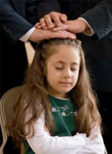
Receive Him Not
Would you accept this gift?
Are there any reasons why you would choose not to receive the gift?
Can you think of any gifts or offerings from Heavenly Father that His children have chosen not to receive?
D&C 39:1-3

Slide 3
James Covel(Covill)
“There was a man came to me by the name of James Covill, who had been a Baptist minister for about forty years, and covenanted with the Lord that he would obey any command that the Lord would give to him through me, as His servant, and I received the following:
[D&C 39]
Joseph Smith

Slide 4
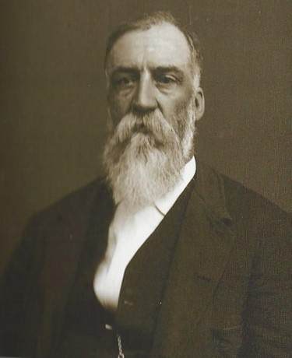
Sacrifices
To accept such a call would require him to forsake many of his former beliefs, to confess to his followers that he had now found a fulness of the truth, and to move to Ohio to join the Saints. It would also require that he find another way to make a living.
Marvelous promises had been made to James Covill
if he would obey the word of the Lord that had been
given to him.
What sacrifices would be required of him to join the Church and move to Ohio? … James Covill decided to reject the revelation of God.
“As James Covill rejected the word of the Lord, and returned to his former principles and people, the Lord gave unto me and Sidney Rigdon the following revelation [D&C 40], explaining why he obeyed not the word”
Joseph Smith
Student Manual

Slide 5
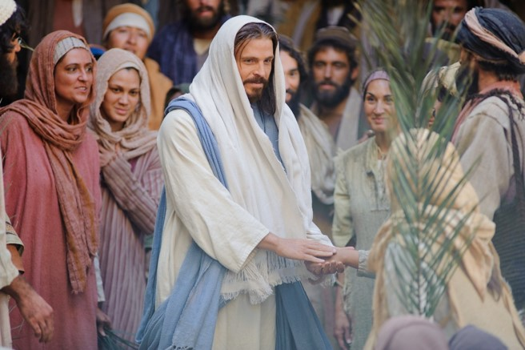
The True Gospel
“The gospel of Jesus Christ is the plan of salvation. …
“Literally, gospel means good tidings from God or God-story. Thus it is the glad tidings or good news concerning Christ, his atonement, the establishment of his earthly kingdom, and a possible future inheritance in his celestial presence.
‘And this is the gospel,’ the Prophet recorded by way of revelation, ‘the glad tidings, which the voice out of the heavens bore record unto us—That he came into the world, even Jesus, to be crucified for the world, and to bear the sins of the world, and to sanctify the world, and to cleanse it from all unrighteousness; That through him all might be saved whom the Father had put into his power and made by him.’
Bruce R. McConkie
D&C 39:5-6

Slide 6
Our Father—The Savior
“The Savior becomes our Father, in the sense in which this term is used in the scriptures, because he offers us life, eternal life, through the atonement which he made for us”
Joseph Fielding Smith
If we receive Jesus Christ, He will give us power to become His children.
“And now, because of the covenant which ye have made ye shall be called the children of Christ, his sons, and his daughters; for behold, this day he hath spiritually begotten you; for ye say that your hearts are changed through faith on his name; therefore, ye are born of him and have become his sons and his daughters.”
Mosiah 5:7
D&C 39:5-6

Slide 7
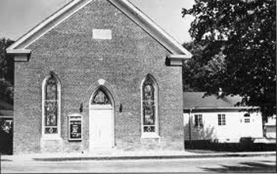
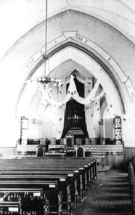
The Covenants
James Covel, who had been a well-respected Methodist minister for about 40 years. Just before Joseph Smith received this revelation, James Covel had learned about the restored gospel of Jesus Christ.
Although he was not a member of the Church, he had covenanted to obey any commandment he received through Joseph Smith.
As a minister, if James Covel were to be baptized, he would have to give up the positions, associations, and income he had established over 40 years
D&C 39:5-6

Slide 8
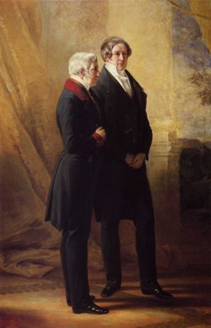
Pride
James Covill had rejected the Lord many times because of pride and the cares of the world. Little is known about James Covill, other than what Joseph Smith recorded
“Frequently, pride gets in our way and becomes our stumbling block.
But each of us needs to ask himself the question: ‘Is your pride more important than your peace?’
“All too frequently, one who has done many splendid things in life and made an excellent contribution will let pride cause him to lose the rich reward to which he would be entitled otherwise.”
Elder Spencer W. Kimball
D&C 39:7-9

Slide 9
Come Unto Christ Liberty
Depths of Humility
Seek help from God
Blessings
Prosperity
Humility Cycle
Misery/Endless Wo
We come to ourselves
Selfishness
Self-Indulgence
Become “Lifted Up”
Inequality
Class divisions
Hatred
War
Pride Cycle
Persecution of Others
Seek Control over others
Use others
Insensitivity
Past Feeling
Personal Apostasy
Sin and Bondage
Becky Davies

Slide 10
If … Then
The Lord offered James the fulness of the gospel, which included responsibilities and blessings he did not have before, such as the gift of the Holy Ghost and ordination to the priesthood.
The Lord’s promised blessings are conditional upon our hearkening to His voice
What conditions has the Lord placed on you before you can receive those blessings?
D&C 39:10-12

Slide 11
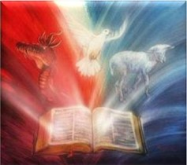
Called To Preach In Ohio
The Lord gave James instructions about what to teach and how to teach it.
1. The kingdom of heaven is at hand (see v. 19).
2. The servants of God are to prepare the way for His coming (see v. 20).
3. No one knows the day and hour of His coming (see v. 21).
4. Those who receive the Holy Ghost will be looking for His coming and will know Him (see v. 23).
5. He will come quickly (see v. 24).
D&C 39:13-24

Slide 12
The Last Days
“We do not know when the calamities and troubles of the last days will fall upon any of us as individuals or upon bodies of the Saints. The Lord deliberately withholds from us the day and hour of his coming and of the tribulations which shall precede it—all as part of the testing and probationary experiences of mortality. He simply tells us to watch and be ready.”
Elder Bruce R. McConkie

Slide 13
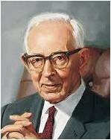
Fear of Persecution
“James Covill was convinced of the truth, for it is clear that the Lord revealed to him things which he and the Lord alone knew to be the truth.
However, when he withdrew from the influence of the Spirit of the Lord and had time to consider the fact that he would lose the fellowship of the world, and his place and position among his associates, he failed and rejected the promises and blessings which the Lord offered him.”
President Joseph Fielding Smith
James Covill’s situation is liken to the Parable of the Sowers

Slide 14
Parable of the Sower
Matthew 13:1-9; 20-22

Slide 15
The Sowers…
the seeds grow differently depending on the ground they fall on.
The STONY PLACES --those who hear and receive the word of God but do not allow it to take root or grow in their heart

Slide 16
Sources:
Videos:
Pride Keeps Us from Choosing the Lord (0:45)
We Can Find Happiness (6:19)
Doctrine and Covenants Student Manual Religion 324-325 pg. 79
Joseph Smith (History of the Church, 1:143; 1:145).
Bruce R. McConkie (Mormon Doctrine, pp. 331–32.)
Joseph Fielding Smith Doctrines of Salvation, comp. Bruce R. McConkie, 3 vols. [1954–56], 1:29).
Elder Spencer W. Kimball (Miracle of Forgiveness, p. 297; see also D&C 121:34–40.)
Elder Bruce R. McConkie (In Conference Report, Apr. 1979, pp. 132–33; or Ensign, May 1979, p. 93.)
President Joseph Fielding Smith (Church History and Modern Revelation, 1:174.)
Becky Davies Pride Cycle Chart Poway Institutes
Presentation by ©http://fashionsbylynda.com/blog/

Slide 17
Come Unto Christ Liberty
Depths of Humility
Seek help from God
Blessings
Prosperity
Humility Cycle
Misery/Endless Wo
We come to ourselves
Selfishness
Self-Indulgence
Become “Lifted Up”
Inequality
Class divisions
Hatred
War
Pride Cycle
Persecution of Others
Seek Control over others
Use others
Insensitivity
Past Feeling
Personal Apostasy
Sin and Bondage
Becky Davies

Slide 18
Sections 39 and 40:
These two sections deal with James Covill’s mission call and subsequent rejection of it. These sections are placed right in the middle of several sections in the D&C where the Lord is explaining how to build Zion and redeem his people. Of note is 39:16-18, where the Lord explains that preaching the gospel message will “stay (the Lord’s) hand in judgment upon the nations”. This judgment is war- the way we prevent the horrible wars described in the scriptures in relation to the Last Days is to preach the gospel. I asked the students if they ever started something that they were fired up about and then later quit due to lack of interest, being overwhelmed, or just plain laziness. They can all readily identify with James Covill. Then I ask if they ever persevered through these challenges and finished what they started. We had a good discussion on this topic, and I don’t believe it is a coincidental that this story of James is found here in the sections on consecration.
http://ldsscriptureteachings.org/page/37/
Covel or Covill:
The 1981 version also listed a revelation to James Covill, a Baptist minister; however it turns out his name should have been spelled Covel, and he was a Methodist minister.
Joseph Smith received two revelations in January 1831 (Doctrine and Covenants 39 and 40) directed to one "James Covill." Joseph and his scribes noted that Covill "had been a Baptist minister for about forty years." Historians discovered nothing about a Baptist minister named James Covill, but documents unearthed by the Joseph Smith Papers Project revealed that he was actually a Methodist minister. This sliver of information opened the door to information about a very well-known Methodist minister in upstate New York by the name of James Covel.
Christopher Jones mines this Methodist vein productively and pieces together a short biography of Covel and shows why his Methodist background could have both attracted him to Mormonism and at the same time discouraged him from converting. Early Mormonism had much in common with Methodism, particularly regarding missionary work. But certain doctrines, such as baptism by immersion and priesthood authority located in the hands of a young prophet, may have troubled a man like Covel.
https://byustudies.byu.edu/showtitle.aspx?title=8964
Rejection of the Gospel:
In 1831, some members of the United Methodist Church did not believe in rebaptism; nor did they believe that any man had the power to bestow the Holy Ghost. James Covel, who was a Methodist minister, may have been troubled by the command to be rebaptized (see D&C 39:10). Additionally, James Covel had spent seven years as a circuit rider (a traveling minister) under primitive and harsh conditions. He had retired from riding a preaching circuit in 1797. When the Lord called him to embark on a mission, Covel may have felt that the assignment to travel the frontier to preach was too much of a sacrifice. This may be part of the “cares of the world” (D&C 40:2) that caused him to reject the covenant he had made.
Someone named James:
The earliest copy of Doctrine and Covenants 39 indicated only that it was a revelation given for someone named James. The published copy of the revelation expanded the name of the recipient to “James (C.,).” In the 1835 edition of the Doctrine and Covenants, his name was identified as “James Covill.” In the 1981 edition of the Doctrine and Covenants, he was identified as a Baptist minister. However, recent research indicates that this revelation was given to JamesCovel, who was a Methodist minister.

Slide 19
James Covill---is represented as the gospel that is planted in Stony places
The WAYSIDE represents people who hear the word of God but do not understand it or do not want to understand it. These people have no principle of righteousness in them. Their hearts are full of iniquity and have no desire for the gospel truths. Satan quickly takes hold of their hearts and just as quickly drives away the small amount of the word of God that has been place in their hearts. I imagine there is no room in their hearts for the gospel truth. These must be the people who reject the missionary’s effect, who slam the doors in the face of the missionaries, who mock the Church and us, the members of the Church. Some of these people may even be among our friends. Some of them may even be among our own family members.
The STONY PLACES represent people who hear and receive the word of God but do not allow it to take root or grow in their heart. These people, when they first heard the gospel, feel the spirit and come to church for a very short time. They soon fall away, because their understanding of gospel principles is as shallow as the soil in stony ground. As soon as they are faced with difficult times they fall away. They are easily offended. These people may be investigators who come to church for a short while and then stop coming. These may even be people who are baptized into the Church then soon after fall away for various reasons.
The THORNY PLACES represent people who hear the word of God, accept the gospel, get baptized into the Church but then get distracted by the care of the world, such as money, pride, lying, cheating, materialism, keeping up with the Jones’, peer pressure, gluttony, selfishness, or laziness to name but a few distractions. These people do not endure to the end. They allow the care of the world to slowly, over a period of time, cloud their minds and to become more important to them than the gospel of Jesus Christ, to draw them away from the truths. Therefore, they eventually die in spirit before they get a chance to bear any fruit. The care of the world will eventually choke and strangle their root and kill them.
The GOOD GROUND represents people who hear the word of God, and understand it (because they want to). They work hard to do works of righteousness and endure to the end. These are the people who have a strong testimony of the Lord Jesus Christ. They believe in Him and trust Him. They are productive, because they serve the Lord by carrying out His work on this earth, by sharing the gospel with others, by fulfilling and magnifying their callings, by keeping to the covenants they made with God when they were baptized. They strive to keep all the commandments of God. They serve with love. They follow the examples of our Lord Jesus Christ. Because of their faithfulness and their service, they are truly blessed. The Lord does not take without giving back. He harvests the fruits from our labour of love and obedience. In return He blesses us with the fruits of his love and the sacrifice He made for us.
http://mormonbible.org/new-testament/the-parables-of-christ/the-parable-of-the-sower

