Slide 2
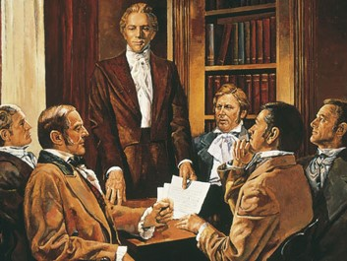
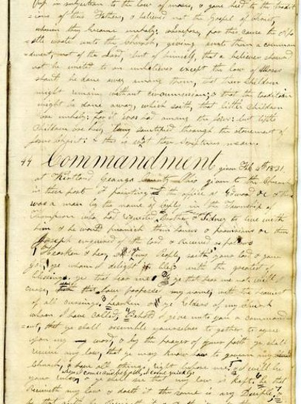
Background
February 9, 1831
Shortly after Joseph Smith arrived in Kirtland, 12 Elders of the Church gathered together and united in prayer, as the Lord had commanded them.
D&C 42:1-73
Joseph received further instruction on February 23 which was D&C 42:74-93.
Taken together, these revelations are known as “the law of the Church”

Slide 3
Laws and Commandments

Slide 4
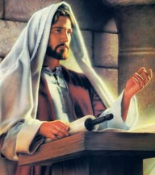
Laws and Commandments
The word law in a gospel sense refers to the statutes, judgments, and principles of salvation revealed by the Lord to man. Christ is the law.
He gave it and embodies its principles. In this sense, the law of the Lord is a revelation of His character and attributes.
“Behold, I am the law, and the light. Look unto me, and endure to the end, and ye shall live; for unto him that endureth to the end will I give eternal life.”
3 Nephi 15:9

Slide 5
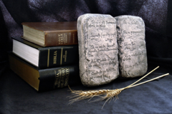
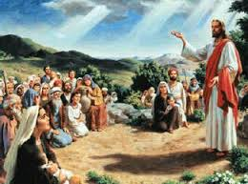
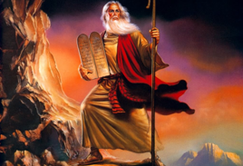
Laws to Prepare Zion
God has given laws to assist us in our quest to become like the Father and the Son. No one can come to the Father except through obedience to the laws that Christ has given.
The violation of these laws is what constitutes sin (see 1 John 3:4).
The Lord in His infinite love and wisdom often gives laws to His children suited to their level of preparation.
The law of Moses was given to prepare the children of Israel for higher laws.
The laws given in section 42 were to enable the Saints to purify their lives in preparation for the establishment of Zion.
Student Manual

Slide 6
Commanded to Gather
In His Name
For a little season and with the Power of the Holy Spirit
Go
Forth
Where a New Jerusalem shall be revealed
Two by Two
Westward and build up the church where you can
Baptizing by water and calling for repentance
D&C 42:4-9

Slide 7
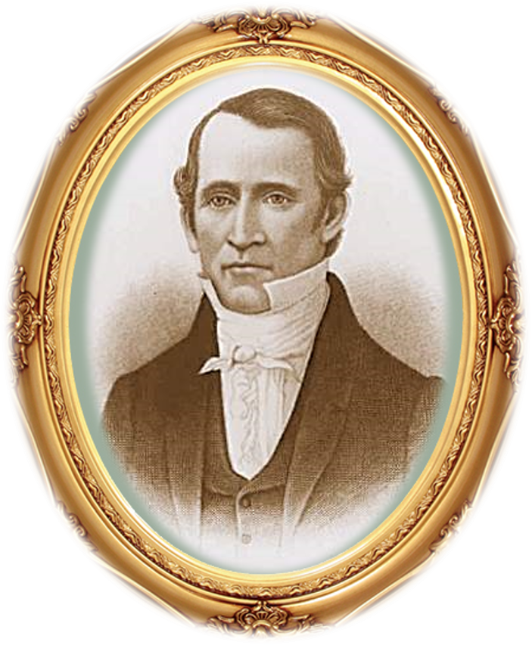
Edward Partridge
He was appointed by the Lord and if he didn’t live up to his covenants his position would be given to another worthy person
D&C 42:10

Slide 8
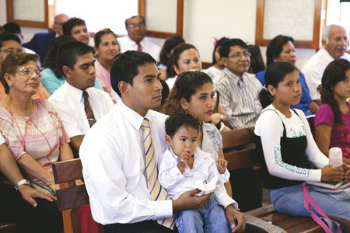
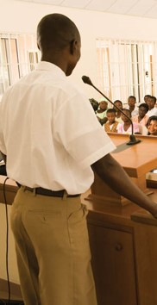
Situation
You are sitting in the chapel waiting for sacrament meeting to begin.
The members of the bishopric or branch presidency have been delayed and have not yet arrived.
Someone from the congregation gets up and explains that he would like to extend a few callings and teach some new doctrine that has been revealed to him.
D&C 42:11

Slide 9
How do Church members today learn that a person has received a ward or stake calling and will be set apart or ordained by Church leaders?
The names of those who are called are presented to the membership of the Church for a sustaining vote.
Those who teach and build up the Church must be called of God and ordained or set apart by the authorized leaders of the Church
Principle of Common Consent
D&C 42:11

Slide 10
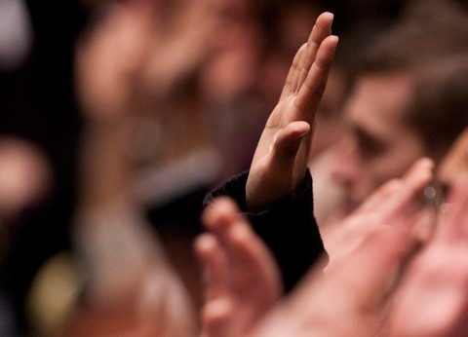
Sustaining
Sustaining Church leaders helps us know who has been called to lead and teach in the Church.
It can also help prevent individuals from assuming responsibilities that have not been assigned to them and for which they have no authority.
D&C 42:11

Slide 11
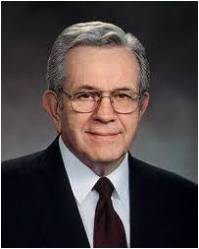
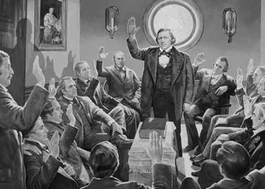
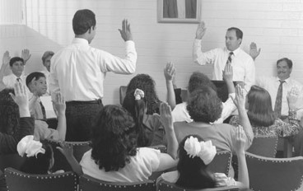
“It is known to the church that he has authority”
of the Quorum of the Twelve Apostles explained one reason why it is important to sustain those called to positions in the Church:
“This common procedure occurs whenever leaders or teachers are called or released from office or whenever there is reorganization in a stake or a ward or a quorum or in the auxiliaries.
It is unique to The Church of Jesus Christ of Latter-day Saints.
“We always know who is called to lead or to teach and have the opportunity to sustain or to oppose the action. It did not come as an invention of man but was set out in the revelations
In this way, the Church is protected from any imposter who would take over a quorum, a ward, a stake, or the Church”
President Boyd K. Packer
D&C 42:11

Slide 12
Doctrinal Mastery
Again I say unto you, that it shall not be given to any one to go forth to preach my gospel, or to build up my church, except he be ordained by some one who has authority, and it is known to the church that he has authority and has been regularly ordained by the heads of the church.
D&C 42:11

Slide 13
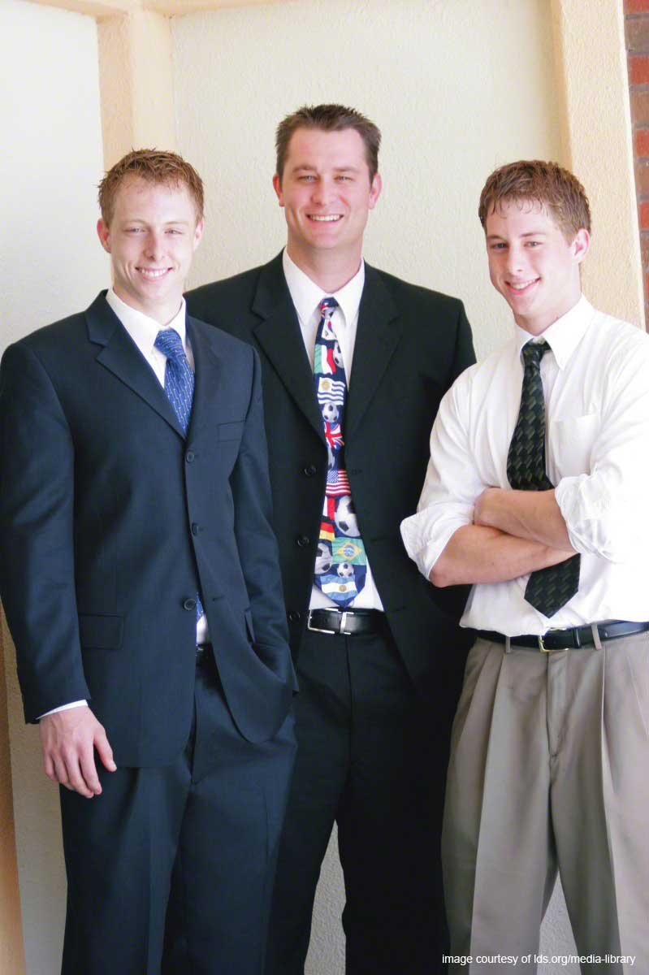
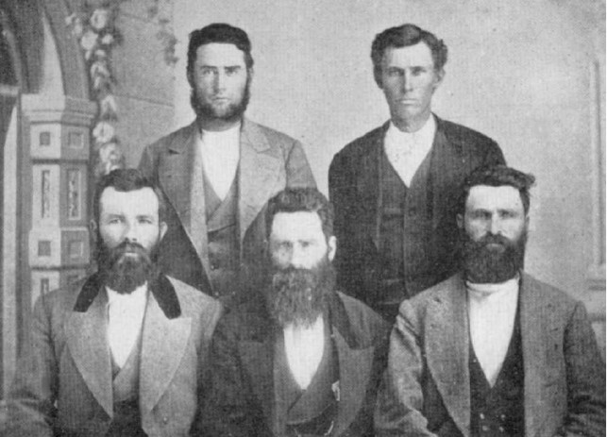
Responsibility
Teach the principles of the gospel contained in the Bible and the Book of Mormon.
They shall keep the covenants and directed by the Holy Spirit.
Elders
Teachers
Priests
D&C 42:12-13

Slide 14
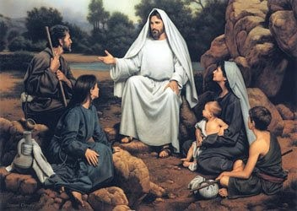
Teaching by the Spirit
“The scriptures say, ‘The Spirit shall be given unto you by the prayer of faith; and if ye receive not the Spirit ye shall not teach’.
This teaches not just that you won’t teach or that you can’t teach or that it will be pretty shoddy teaching.
No, it is stronger than that. It is the imperative form of the verb. ‘Ye shall not teach.’
Put a thou in there for ye and you have Mount Sinai language. This is a commandment”
Jeffrey R. Holland
D&C 42:10

Slide 15
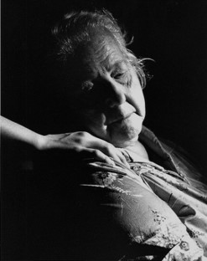
The Role of the Holy Ghost
Why is it important for us to have the Holy Ghost with us when teaching the gospel?
How can having the Holy Ghost with you help those you teach?
The Holy Ghost knows all things and bears record of the Father and the Son.
“But the Comforter, which is the Holy Ghost, whom the Father will send in my name, he shall teach you all things, and bring all things to your remembrance, whatsoever I have said unto you.
Peace I leave with you, my peace I give unto you: not as the world giveth, give I unto you. Let not your heart be troubled, neither let it be afraid.”
John 14:26-27
D&C 42:16-17

Slide 16
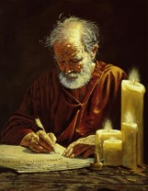
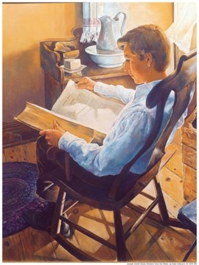
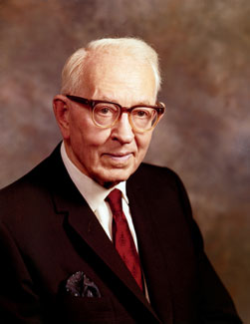
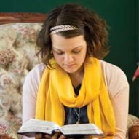
“No one should be called upon to teach and no one should attempt to teach the doctrines of the Church unless he is fully converted and has an abiding testimony of their truth.
This testimony can only be received through prayerful study and obedience to all the commandments of the Lord.
No man or woman can teach by the Spirit what he or she does not practice.
Sincerity, integrity and loyalty are essential factors, and these will be accompanied by the spirit of prayer.
The Comforter, ‘who knoweth all things,’ we should rely on, and then our teachings shall be approved of our Father in Heaven.”
President Joseph Fielding Smith

Slide 17
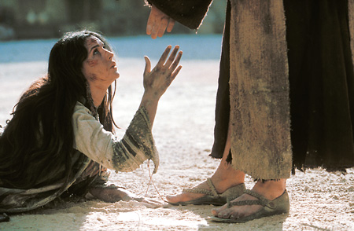
The “Shalt Not” Commandments
D&C 42:18–19
D&C 42:20
D&C 42:21
D&C 42:22–23
D&C 42:24–26
D&C 42:27
Lusting After Others
Stealing
Speaking evil of others
Killing
Adultery
Lying
D&C 42:18-29

Slide 18
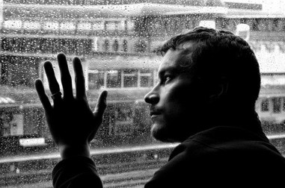
Why is lust such a deadly sin?
“Well, in addition to the completely Spirit-destroying impact it has upon our souls, I think it is a sin because it defiles the highest and holiest relationship God gives us in mortality—the love that a man and a woman have for each other and the desire that couple has to bring children into a family intended to be forever.
Someone said once that true love must include the idea of permanence. True love endures.
But lust changes as quickly as it can turn a pornographic page or glance at yet another potential object for gratification walking by, male or female.”
Elder Jeffrey R. Holland

Slide 19
Love VS Lust
True love we are absolutely giddy about—…; we shout it from the housetops…
…lust is characterized by shame and stealth and is almost pathologically clandestine [obsessively secretive]—the later and darker the hour the better, with a double-bolted door just in case.
Love makes us instinctively reach out to God and other people.
Lust, on the other hand, is anything but godly and celebrates self-indulgence.
Love comes with open hands and open heart.
Lust comes with only an open appetite.
“These are just some of the reasons that prostituting the true meaning of love—either with imagination or another person—is so destructive. It destroys that which is second only to our faith in God—namely, faith in those we love. It shakes the pillars of trust upon which present—or future—love is built, and it takes a long time to rebuild that trust when it is lost. Push that idea far enough—whether it be as personal as a family member or as public as elected officials, business leaders, media stars, and athletic heroes—and soon enough on the building once constructed to house morally responsible societies, we can hang a sign saying, ‘This property is vacant.’”
Elder Jeffrey R. Holland

Slide 20
Sources:
Video:
Why Does God Give us Commandments? (0:39)
Jeffrey R. Holland (“Teaching, Preaching, Healing,” Ensign, Jan. 2003, 41).
Doctrine and Covenants Student Manual Religion 324-325 Section 42
President Boyd K. Packer (“The Weak and the Simple of the Church,” Ensign or Liahona, Nov. 2007, 6).
President Joseph Fielding Smith (Church History and Modern Revelation, 1:184–85.)
Jeffrey R. Holland (“Place No More for the Enemy of My Soul,” Ensign or Liahona, May 2010, 44–45).
Presentation by ©http://fashionsbylynda.com/blog/

Slide 21
Teaching in the Church:
Elder Spencer W. Kimball spoke of the special obligations resting on those who teach the gospel:
“Apparently there were in the early church those who taught for doctrines the sophistries of men. There are those today who seem to take pride in disagreeing with the orthodox teachings of the Church and who present their own opinions which are at variance with the revealed truth. Some may be partially innocent in the matter; others are feeding their own egotism; and some seem to be deliberate. Men may think as they please, but they have no right to impose upon others their unorthodox views. Such persons should realize that their own souls are in jeopardy. The Lord said to us through the Prophet Joseph: [D&C 42:12–14].
“The great objective of all our work is to build character and increase faith in the lives of those whom we serve. If one cannot accept and teach the program of the Church in an orthodox way without reservations, he should not teach. It would be the part of honor to resign his position. Not only would he be dishonest and deceitful, but he is also actually under condemnation, for the Savior said that it were better that a millstone were hanged about his neck and he be cast into the sea than that he should lead astray doctrinally or betray the cause or give offense, destroying the faith of one of ‘these little ones’ who believe in him. And remember that this means not only the small children, it includes even adults who believe and trust in God. …
“In our own society, the murderer who kills the body is hunted, imprisoned, and executed, but the character who kills the soul by implanting doubt and shattering faith is permitted not only to go free but also is often retained in high places. The body which is killed will rise again in the resurrection with little damage to its eternal welfare, but he whose faith has been shattered may suffer long ages before complete restoration of spiritual stature can be had, if at all.” (In Conference Report, Apr. 1948, pp. 109–10; see also D&C 52:9.)
The role of sisters in missionary work:
President Thomas S. Monson emphasized the Lord’s command that elders preach the gospel. He also explained the role of sisters in missionary work:
“First, to young men of the Aaronic Priesthood and to you young men who are becoming elders: I repeat what prophets have long taught—that every worthy, able young man should prepare to serve a mission. Missionary service is a priesthood duty—an obligation the Lord expects of us who have been given so very much. Young men, I admonish you to prepare for service as a missionary. Keep yourselves clean and pure and worthy to represent the Lord. Maintain your health and strength. Study the scriptures. Where such is available, participate in seminary or institute. Familiarize yourself with the missionary handbook Preach My Gospel.
“A word to you young sisters: while you do not have the same priesthood responsibility as do the young men to serve as full-time missionaries, you also make a valuable contribution as missionaries, and we welcome your service” (“As We Meet Together Again,” Ensign or Liahona, Nov. 2010, 5–6).
Cleave Unto Her… D&C 42:22:
“‘Thou shalt love thy wife with all thy heart, and shalt cleave unto her and none else’ (D&C 42:22). To my knowledge there is only one other thing in all scripture that we are commanded to love with all our hearts, and that is God Himself. Think what that means!
“This kind of love can be shown for your wives in so many ways. First and foremost, nothing except God Himself takes priority over your wife in your life—not work, not recreation, not hobbies. Your wife is your precious, eternal helpmate—your companion.
“What does it mean to love someone with all your heart? It means to love with all your emotional feelings and with all your devotion. Surely when you love your wife with all your heart, you cannot demean her, criticize her, find fault with her, or abuse her by words, sullen behavior, or actions.
“What does it mean to ‘cleave unto her’? It means to stay close to her, to be loyal and faithful to her, to communicate with her, and to express your love for her” President Ezra Taft Benson (“To the Fathers in Israel,” Ensign, Nov. 1987, 50).

