Slide 2
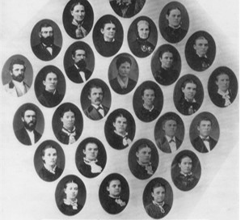
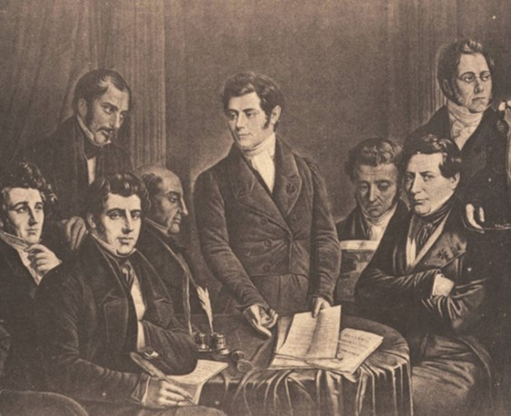
Early Communal Systems
During Joseph Smith’s day, some groups of people attempted to form communal systems in which the group shared ownership of all the wealth and resources.
Prior to the revelation on the law of consecration, some members of the Church in Ohio had established such a group. Some of their practices were problematic:

Slide 3
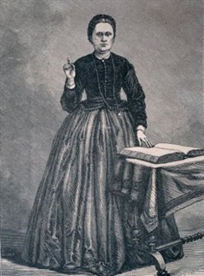
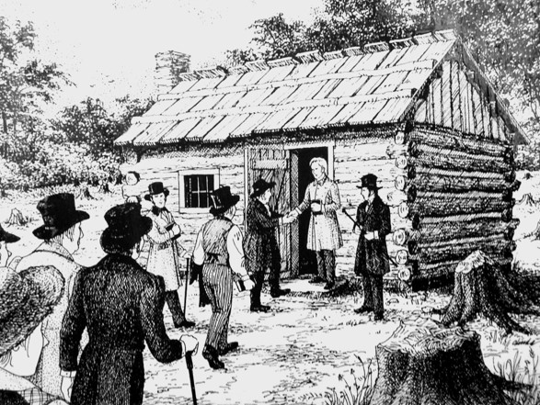
“When [Joseph Smith] arrived in Ohio [he] discovered a group of about fifty people who had established a cooperative venture based on their interpretation of statements in the book of Acts, describing the early Saints as having all things in common.
This group, known as ‘the family,’ … were members of the Church living on Isaac Morley’s farm near the village of Kirtland. When John Whitmer arrived in mid-January, he noted that what they were doing created many problems.

Slide 4
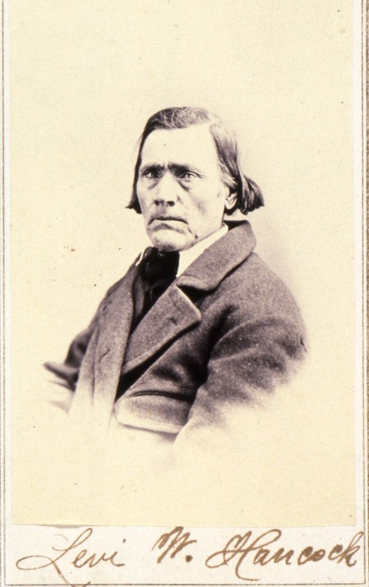
For example, Heman Bassett took a pocket watch belonging to Levi Hancock and sold it. When asked why, Heman replied, ‘Oh, I thought it was all in the family.’ Levi responded that he did not like such ‘family doing’ and would not endure it any longer.

Slide 5
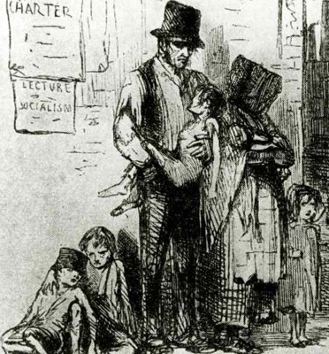
Meeting the Growing Economic Needs
“The Prophet Joseph … realized the need to establish a more perfect system to meet the growing economic needs of the Church.
Revenue was required to finance various Church undertakings, such as publishing revelations and missionary tracts. … Money, goods, and property were needed to help the poor and to assist immigrants who were sacrificing much to gather to Ohio, so Joseph inquired of the Lord”
Church History
The revelation recorded in Doctrine and Covenants 42, which revealed the Lord’s law of consecration, was one of several revelations that came in response to Joseph’s inquiry.

Slide 6
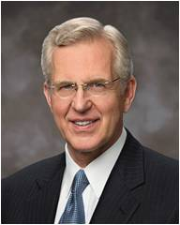
Consecration
February 1831
The Lord commanded the Saints to consecrate their properties to support the poor
“To consecrate is to set apart or dedicate something as sacred, devoted to holy purposes”
Elder D. Todd Christofferson
The Lord commands us to care for the poor and those in need

Slide 7
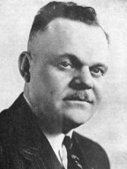
All Things Are Mine
“The basic principle and the justification for the law of consecration ‘is that everything we have belongs to the Lord; therefore, the Lord may call upon us for any and all of the property which we have, because it belongs to Him. … President Marion G. Romney
I, the Lord, stretched out the heavens, and built the earth, my very handiwork; and all things therein are mine.
And it is my purpose to provide for my saints, for all things are mine.
But it must needs be done in mine own way; and behold this is the way that I, the Lord, have decreed to provide for my saints, that the poor shall be exalted, in that the rich are made low.
For the earth is full, and there is enough and to spare; yea, I prepared all things, and have given unto the children of men to be agents unto themselves.”
D&C 104:14-17
D&C 42:30-34

Slide 8
The Needs of a Family
The needs of a family
Families who have their needs met
Families who do not have enough money or goods to support their needs
D&C 42:30-34

Slide 9
Stewardship
Every family worked with the bishop and received what was called a “stewardship” (D&C 42:72). This means that each family was entrusted with property and resources from the Lord.
Each family was entrusted with property and resources from the Lord. Families had private ownership of the property and resources they received, and they were to use their agency to manage their stewardship.
The needs of a family
As stewards of the Lord’s property and resources, they were accountable to Him and fully responsible for what He entrusted to them.
The Church modified this practice of Law of Consecration in 1833
D&C 42:30-34

Slide 10
Allocating Funds
Wherefore, let my servant Edward Partridge, and those whom he has chosen, in whom I am well pleased, appoint unto this people their portions, every man equal according to his family, according to his circumstances and his wants and needs.”
D&C 51:3
The allocation of portions was based on each family’s circumstances, wants, and needs.
D&C 42:30-34

Slide 11
Allocating Funds
What did the Lord require of people who declared their wants and needs to the bishop?
They were to be just, or, in other words, fair and honest
D&C 42:30-34

Slide 12
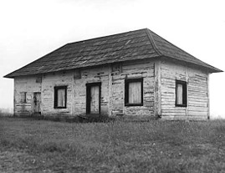
Residue
What did the Lord instruct the Saints to do with the leftover property, or the “residue”?
They were to use it to help the poor, finance Church buildings, and help members who were in need.
What do you think the pitcher represents in these verses?
The storehouse
D&C 42:33-34

Slide 13
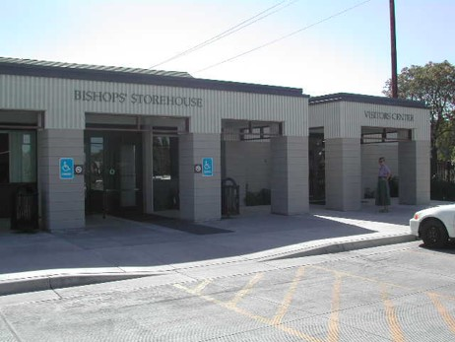
Bishop’s Storehouse
“More than 180 years later, bishops’ storehouses around the world continue to support bishops in the call to ‘be faithful; stand in the office which [the Lord has] appointed unto [them]; succor the weak, lift up the hands which hang down, and strengthen the feeble knees’.
“Whether it is a building containing food and other supplies or a set of resources in the ward a bishop can draw from, bishops’ storehouses are being used to care for those in need.
The Lord’s storehouse is available to every bishop and exists in every ward. Contrary to conventional wisdom, the Lord’s storehouse is not limited to a building or a warehouse filled with commodities awaiting distribution.’
D&C 42:34 Church News

Slide 14
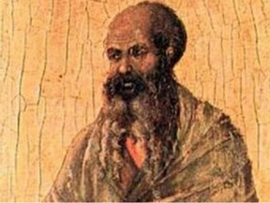
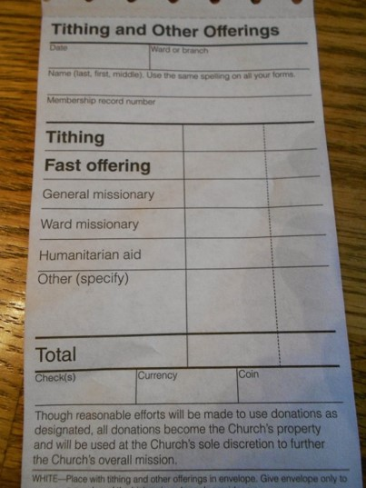
Fast Offerings
“Where a brick and mortar storehouse is not available, bishops can purchase needed commodities from local merchants using fast offerings.”
“Bring ye all the tithes into the storehouse, … and prove me now herewith, saith the Lord of hosts, if I will not open you the windows of heaven, and pour you out a blessing, that there shall not be room enough to receive it.”
Malachi 3:10
D&C 42:34 Church News

Slide 15
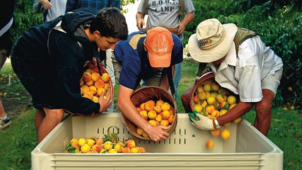
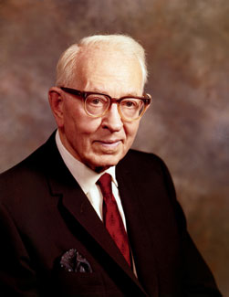
“The United Order, or law of consecration, does not contemplate that the idler shall eat the bread of the laborer.
While all shall share in common and none shall possess above another, yet all must give service and labor for the benefit of all”
President Joseph Fielding Smith

Slide 16
Doing Good To Others
As we do good unto others, we do it unto the Lord
“For inasmuch as ye do it unto the least of these, ye do it unto me.”
D&C 42:38

Slide 17
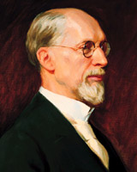
Living Within Our Means
The Lord does not expect us to make our own clothing. However, He does want us to be neat and clean in our appearance.
Let us be more concerned about the adornment of our minds that are eternal, rather than adornment of our persons with things that are of no lasting benefit.”
George Albert Smith
D&C 42:40-41

Slide 18
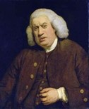
Idleness
Lazy-- a term which generally refers to a lack of motion and/or energy.
“People say nothing is impossible, but I do nothing every day.” ― A.A. Milne, Winnie-the-Pooh
To the Seminary Student
“The happiest part of a man's life is what he passes lying awake in bed in the morning.” ― Samuel Johnson
D&C 42:42

Slide 19
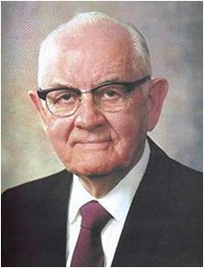
“Consecration is the giving of one’s time, talents, and means to care for those in need—whether spiritually or temporally—and in building the Lord’s kingdom”
President Spencer W. Kimball

Slide 20
Sources:
Videos:
They Gave Up Their Christmas(4:45)
Caring for the Poor and Needy(5:40)
Sacrifice Whatever the Lord Requires (1:11)
(Church History in the Fulness of Times Student Manual, 2nd ed. [Church Educational System manual, 2003], 95).
[Levi W. Hancock, “Levi Hancock Journal,” LDS Historical Department, Salt Lake City, p. 81.]”
Elder D. Todd Christofferson (“Reflections on a Consecrated Life,” Ensign or Liahona, Nov. 2010, 16).
President Marion G. Romney (J. Reuben Clark, Jr., in Conference Report, Oct. 1942, p. 55)” (“Living the Principles of the Law of Consecration,” Ensign, Feb. 1979, 3).
President Joseph Fielding Smith(Church History and Modern Revelation, 2 vols. [1953], 1:205).
George Albert Smith (In Conference Report, Apr. 1915, p. 97.)
Spencer W. Kimball (“Welfare Services: The Gospel in Action,” Ensign, Nov. 1977, 78).
“Bishops’ Storehouse Opens the Windows of Heaven,” Church News and Events, May 20, 2011, LDS.org).
Presentation by ©http://fashionsbylynda.com/blog/

Slide 21
Laws of Consecration compared to socialistic programs:
The Lord’s law of consecration compared to socialistic programs
Some have suggested that the practice of the law of consecration and the system of the united order are only a religious kind of socialism or communism. Others assert that it was a development either from the economic philosophies of Joseph Smith’s day or from communal experiments within the new religion. Such assumptions are false. In more recent times President Marion G. Romney of the First Presidency outlined the revealed system of the united order:
“(1) The cornerstone of the United Order is belief in God and acceptance of him as Lord of the earth and the author of the United Order. …
“(2) The United Order is implemented by the voluntary free-will actions of men, evidenced by a consecration of all their property to the Church of God. …
“(3) … The United Order is operated upon the principle of private ownership and individual management. …
“(4) The United Order is non-political. …
“(5) A righteous people is a prerequisite to the United Order. …
“The United Order exalts the poor and humbles the rich. In the process both are sanctified. The poor, released from the bondage and humiliating limitations of poverty, are enabled as free men to rise to their full potential, both temporally and spiritually. The rich, by consecration and by imparting of their surplus for the benefit of the poor, not by constraint but willingly as an act of free will, evidence that charity for their fellowmen characterized by Mormon as ‘the pure love of Christ.’ (Moro. 7:47.)” (in Conference Report, Apr. 1966, 97).
President J. Reuben Clark Jr. of the First Presidency said: “The United Order has not been generally understood. … [It] was not a communal system. … The United Order and communism are not synonymous” (in Conference Report, Oct. 1943, 11).
Personal Responsibility:
President Romney explained that we need to take personal responsibility for caring for the poor and needy: “In this modern world plagued with counterfeits for the Lord’s plan, we must not be misled into supposing that we can discharge our obligations to the poor and the needy by shifting the responsibility to some governmental or other public agency. Only by voluntarily giving out of an abundant love for our neighbors can we develop that charity characterized by Mormon as ‘the pure love of Christ.’ (Moro. 7:47)” (“Caring for the Poor and Needy,” Ensign, Jan. 1973, 98).
Idleness: President Clark made the following statements about government gratuities:
“The dispensing of these great quantities of gratuities has produced in the minds of hundreds of thousands—if not millions—of people … a love for idleness, a feeling that the world owes them a living. It has made a breeding ground for some of the most destructive political doctrines that have ever found any hold, … and I think it may lead us into serious political trouble” (quoted in Marion G. Romney, “Church Welfare Services’ Basic Principles,” Ensign, May 1976, 121).
“Society owes to no man a life of idleness, no matter what his age. I have never seen one line in Holy Writ that calls for, or even sanctions this. In the past no free society has been able to support great groups in idleness and live free” (in Conference Report, Apr. 1938, 107).
Fast Offerings: In addition to paying tithing, we are commanded to give of our substance to assist the poor and needy. One way to do this is by fasting and going without food and drink for two consecutive meals. The Lord restored the principle of fasting through the Prophet Joseph Smith, and the Church designates one Sunday a month as a day of fasting. Fasting, which has always been an indication of the true church, is an opportunity for spiritual renewal and growing closer to our Heavenly Father. As part of the fast, members of the Church contribute a generous fast offering for the care of the poor and the needy. This offering should be at least the value of the two meals the Church member went without while fasting. These funds are used to provide food, shelter, and other necessities to people in need, both locally and worldwide. There is no standard donation amount for fast offerings. As you contribute generously to these funds, you will be blessed both spiritually and temporally for your desire to help others. Tithing and Fast Offerings, (2007), 1–14

