Slide 2
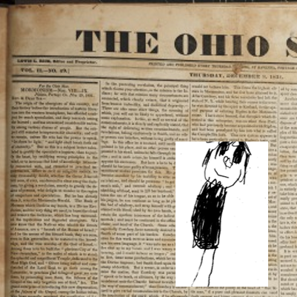
Background
March 1831
Civic leaders, ministers, newspaper editors, and parishioners joined together in an effort to stop the conversion of their neighbors to the new religion.
“Many false reports, lies, and foolish stories, were published in the newspapers, and circulated in every direction, to prevent people from investigating the work, or embracing the faith”
Joseph Smith

Slide 3
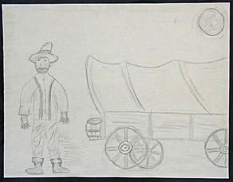
Background
March 1831
During these trying times of slander and abuse, the Lord blessed the Saints with revelations of comfort, peace, and assurance.
One of these revelations was section 45
“To the joy of the Saints who had to struggle against every thing that prejudice and wickedness could invent, I received the following in D&C 45” Joseph Smith

Slide 4
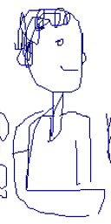
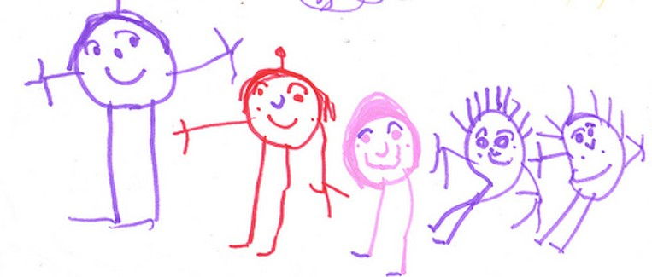
Qualities
What qualities would a person need to have before you would want to listen to his or her counsel?
Would you be more likely to listen to someone who cares about you?
Would you be more likely to listen to someone who knows about the subject in which they are offering?

Slide 5
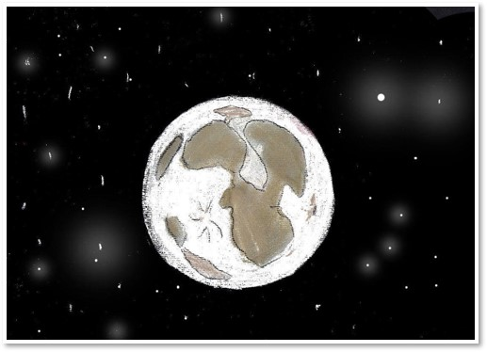
Jesus Created
45:1

Slide 6
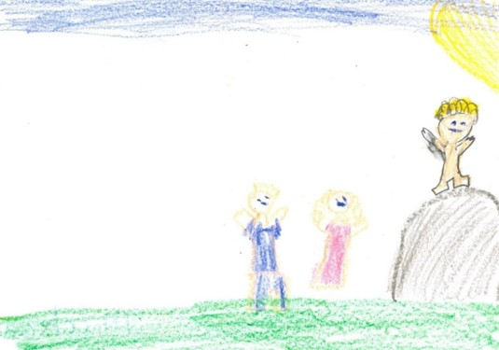
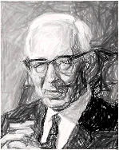
In An Hour When Ye Think Ye Not
“One of the great failings of mankind is to ignore warnings of punishment for sin. In all ages of the world it has been the peculiar belief of men that the sayings of the prophets were to be fulfilled in times still future. That is true of the people today. We have had ample warning of the nearness of the coming of the great and dreadful day of the Lord. The signs are upon us in all their power. …
In this revelation we are given the warning that the summer is passing and if we are heedless of the warning we will find the summer past, the harvest ended and our souls not saved. While no man knows the day or the hour, yet if we are taken unawares, we will be without excuse, for the signs are ample and we now see them being fulfilled.”
President Joseph Fielding Smith
45:2

Slide 7
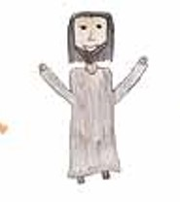
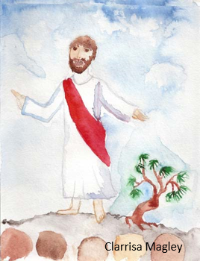
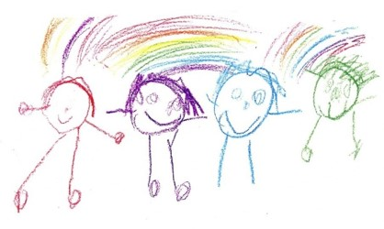
Advocate
Judge
Defendant
Advocate
Heavenly Father
Us
Jesus Christ
An advocate is someone who pleads the cause of someone else. Sometimes this happens in a court of law, where an advocate presents evidence to a judge on behalf of someone who has been condemned.
45:4-5

Slide 8
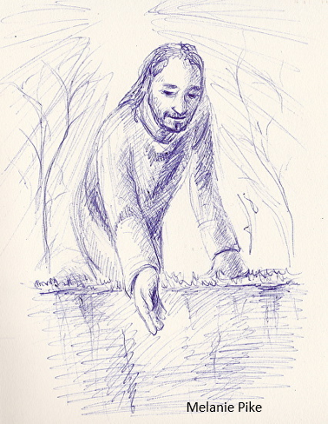
Our Advocate
His perfection and His suffering pay the price to satisfy justice for those of His “brethren that believe on my name.”
Imagine the indescribable sorrow of standing before the judgment bar with no one to step forward, no one to speak for you.
How tragic that some will not come to Him in true faith and repentance so that He can take their guilt upon Him and become their advocate with the Father.
45:4-5

Slide 9
While It is Called “Today”
Modern revelation states that the earth’s temporal history spans seven thousand years, divided into periods of one thousand years each (see D&C 77:6–7).
Since the earth will have a temporal existence before it is celestialized, and since it is known that the earth is now in the sixth period of a thousand years, or the sixth “day,” in the Lord’s terminology the present period is “today” and Christ will come “tomorrow.”
In a later revelation, the Lord used this same terminology, indicating that “now it is called today until the coming of the Son of Man,” that “after today cometh the burning,” that “tomorrow all the proud and they that do wickedly shall be as stubble”
Student Manual
45:6

Slide 10
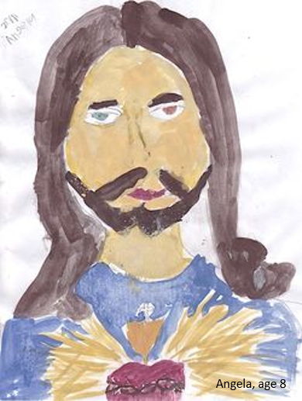
The Life and Light
Jesus Christ is the beginning and the end.
Jesus Christ is the light and the life of the world.
Jesus Christ has sent His “everlasting covenant … to be a light to the world, and to be a standard for [His] people.” In another revelation, He said that His everlasting covenant is “the fulness of [His] gospel”
45:7-8

Slide 11
City of Enoch
“When the Millennial reign comes, the holy men of old shall see it in their ‘flesh,’ for they will be resurrected and take their place among the Saints”
Smith and Sjodahl
45:11-15

Slide 12
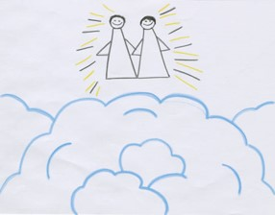
Sources:
Video:
Christlike Attributes (2:53)
Joseph Smith (History of the Church, 1:158).
President Joseph Fielding Smith (Church History and Modern Revelation, 1:195.)
Doctrine and Covenants Religion 324-325 Student Manual Section 45
Smith and Sjodahl, Commentary, p. 255
Presentation by ©http://fashionsbylynda.com/blog/

Slide 13
Judgment:
The imagery of a judicial system is often invoked when the Last Judgment is mentioned in scriptures.
Man goes before the “judgment bar” (
2 Nephi 33:15), there to be “arraigned” (Alma 11:44) and face God, “the Judge of all” (Hebrews 12:23).
As part of that imagery, Jesus is called the Advocate (paraclaytos). In the King James Version of the New Testament, Jesus is called the “advocate” only once (1 John 2:1).
The same word (paraclaytos) is used for the Holy Ghost, although it is translated “Comforter” (John 14:16).
Thus, Jesus is one Paraclete, or Comforter, and the Holy Ghost is called “another Comforter” (John 14:16).
The Greek word comes from para,to the side of, and kalayo, to summon. “Hence, originally, one who is called to another’s side to aid him, as an advocate in a court of justice” (Vincent, Word Studies, 1:486).
In the terminology of today’s legal system, an advocate is a lawyer who pleads another’s cause in a court of law, or in other words, an attorney for the defense.
Usually, the attorney for the defense pleads the cause on the basis that the client is innocent; or if guilty, that extenuating circumstances should be considered and mercy extended. At the time of eternal judgment, we will stand before the bar of God accused of being imperfect and unworthy to enter God’s presence, “for all have sinned, and come short of the glory of God” (Romans 3:23).
At that time we have an Advocate with the Father.
He will stand beside us to plead our cause before the Great Judge; however, He does not plead our case by pointing to our lack of guilt; rather, it is His own sinlessness to which He calls God’s attention (see D&C 45:4).
His perfection and His suffering pay the price to satisfy justice for those of His “brethren that believe on my name” (v. 5). Imagine the indescribable sorrow of standing before the judgment bar with no one to step forward, no one to speak for you.
How tragic that some will not come to Him in true faith and repentance so that He can take their guilt upon Him and become their advocate with the Father. Student Manual Religion 324-325
Role of the Savior as a mediator…President Boyd K. Packer of the Quorum of the Twelve Apostles explains:
“Each of us lives on a kind of spiritual credit. One day the account will be closed, a settlement demanded. However casually we may view it now, when that day comes and the foreclosure is imminent, we will look around in restless agony for someone, anyone, to help us.
“And, by eternal law, mercy cannot be extended save there be one who is both willing and able to assume our debt and pay the price and arrange the terms for our redemption. “Unless there is a mediator, unless we have a friend, the full weight of justice untempered, unsympathetic, must, positively must fall on us. The full recompense for every transgression, however minor or however deep, will be exacted from us to the uttermost farthing.
“But know this: Truth, glorious truth, proclaims there is such a Mediator.
“‘For there is one God, and one mediator between God and men, the man Christ Jesus.’ (1 Tim. 2:5)” (“The Mediator,” Ensign, May 1977, 55–56).
President Packer emphasized that the Lord is acting as our Advocate with the Father in our everyday lives:
“For some reason, we think the Atonement of Christ applies only at the end of mortal life to redemption from the Fall, from spiritual death. It is much more than that. It is an ever-present power to call upon in everyday life. When we are racked or harrowed up or tormented by guilt or burdened with grief, He can heal us. While we do not fully understand how the Atonement of Christ was made, we can experience ‘the peace of God, which passeth all understanding.’ [Philippians 4:7.]” (“The Touch of the Master’s Hand,” Ensign, May 2001, 23).

