Slide 2
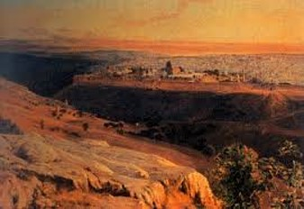
Sermon of the Mount
After leaving the temple, the Savior and His disciples climbed the Mount of Olives, where they had a dramatic view of the temple and Jerusalem. Here His disciples asked, “When shall these things be … and what is the sign of thy coming?”
The full sermon is given in Matthew 24-25 and given on the Mount of Olives.
Joseph Smith included them in the Pearl of Great Price (Joseph-Matthew 1:4)
Mark and Luke also recorded portions of the discourse, though not as fully as did Matthew Mark 13:1–37; Luke 21:5–36.
D&C 45:16

Slide 3
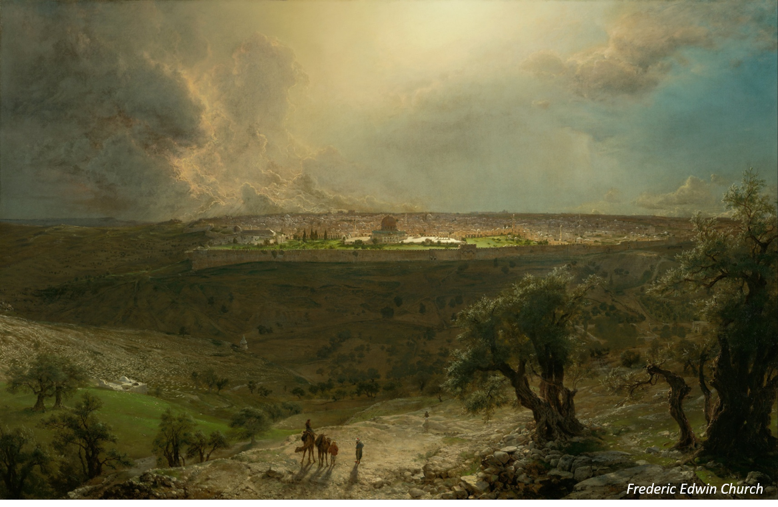
“And Jesus left them, and went upon the Mount of Olives. And as he sat upon the Mount of Olives, the disciples came unto him privately, saying: Tell us when shall these things be which thou hast said concerning the destruction of the temple, and the Jews; and what is the sign of thy coming, and of the end of the world, or the destruction of the wicked, which is the end of the world?”
JST-Matthew 1:4

Slide 4
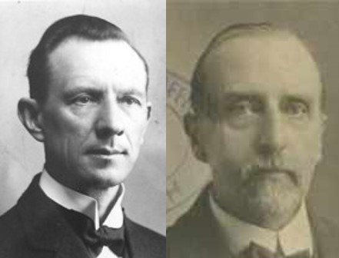
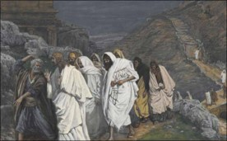
The Bondage
The separation of the spirits from the bodies
The bondage will end when Christ is resurrected.
The disciples wanted to know what signs they might recognize when their day of redemption was near, when the spirit and body should unite again.
The Saints were looking for the signs also of the coming of the Lord.
D&C 45:17 Smith and Sjodahl

Slide 5
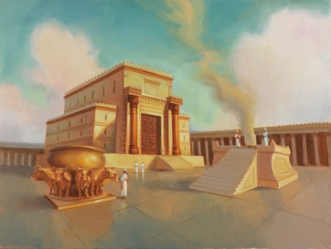
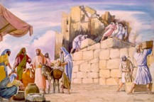
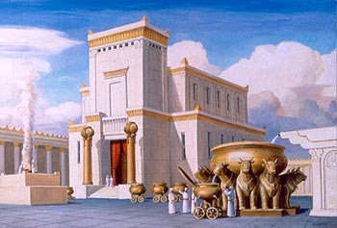
The Temple
The temple was built on Mount Moriah—the ground purchased by David from Araunah, the Jebusite.
The first temple erected on that site was built by Solomon and dedicated in the year BC 1004 and destroyed by the Chaldeans BC 588
Zerubbabel erected a second temple on the same site. It did not contain the ark. The Shekinah” and the presence of the Lord had departed.
The sacred fire and urim and thummim also had been lost.
D&C 45:18 Smith and Sjodahl

Slide 6
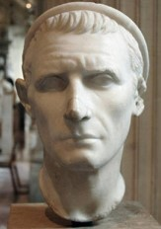
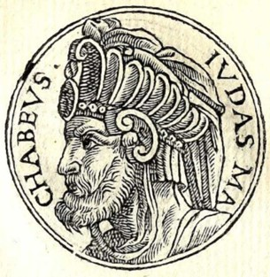
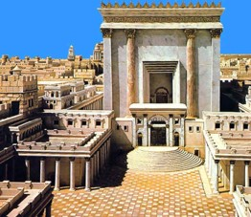
Profane and Purify
Antiochus Epiphanes defiled the temple in BC 143 and Judas Maccabeus purified it three years later.
The temple was used for 5 centuries.
A few years before the birth of Christ, Herod the Great undertook to repair and reconstruct it.
Thousands of laborers worked for 9 years on it.
Herod spared no expense on building this beautiful temple
D&C 45:18 Smith and Sjodahl

Slide 7
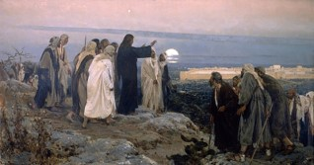
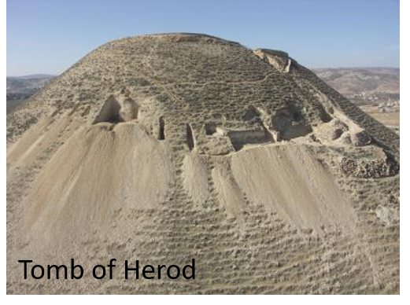
Prophecy Of The Temple
When Jesus talked to the disciples of the temple he was prophesying of the future destruction of it.
Long after Herod’s death, the work of enlargement and ornamentation was continued.
It had been 46 years in construction.
When the workers were discharge they could not find work so the destruction was started by workmen who rioted among themselves.
D&C 45:18 Smith and Sjodahl

Slide 8
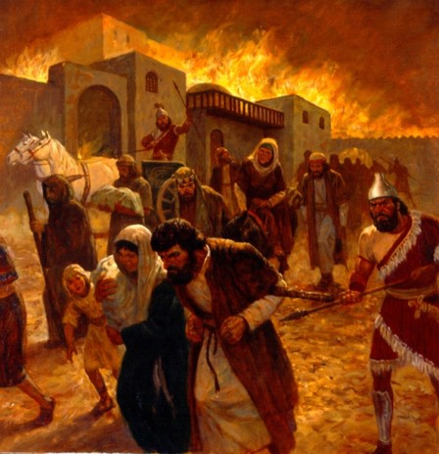
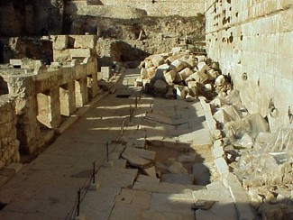
“As a Thief”--Unexpected
Destroyed and Scattered
In 66 AD Cestus Gallus marched into Judea and threatened Jerusalem.
The Christians fled to Pella while the Jews stayed in Jerusalem
Overthrowing the Jewish state, the temple became a fort to the Romans, then they set fire to it. In 70 AD the large stones and the destruction upon the temple came down.
Famine prevailed, those who left the city to search for food were crucified, ravaged, sold into slavery.
More than a million and half Jews perished.
D&C 45:18-19 Smith and Sjodahl

Slide 9
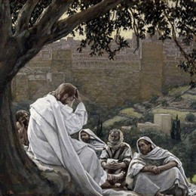
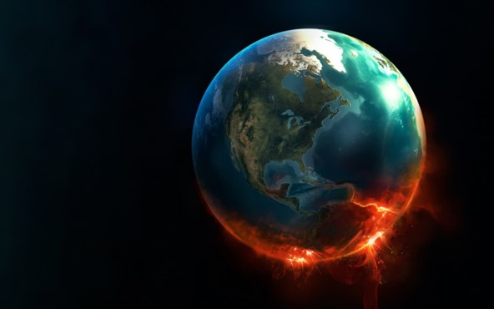
This Generation of Jews
Our Lord told the Twelve that the generation of Jews then living should not pass away until the desolation predicted should come. The prophesy was delivered 37 years before its fulfillment.
Our Lord reminded His Disciples of the fact that they knew that the “end of the world” was drawing near, also hat the heavens and the earth would pass-away.
The end of the world—Christ’s coming
Heavens and earth pass away—the purification of this Earth by fire
D&C 45:21-23 Smith and Sjodahl

Slide 10
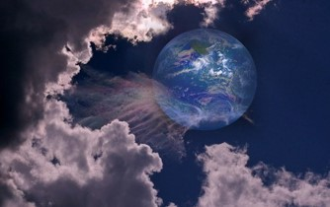
The End of the World
“The end of the world is the end of unrighteousness or of worldliness as we know it, and this will be brought about by ‘the destruction of the wicked.’
When our world ends and the millennial era begins, there will be a new heaven and a new earth.
Lust, carnality, and sensuousness of every sort will cease, for it will be the end of the world.” Elder Bruce R. McConkie
Read Isaiah 65:17-25
“And prepare for the revelation which is to come, when the veil of the covering of my temple, in my tabernacle, which hideth the earth, shall be taken off, and all flesh shall see me together.
And every corruptible thing, both of man, or of the beasts of the field, or of the fowls of the heavens, or of the fish of the sea, that dwells upon all the face of the earth, shall be consumed;”
D&C 101:23-24
D&C 45:22

Slide 11
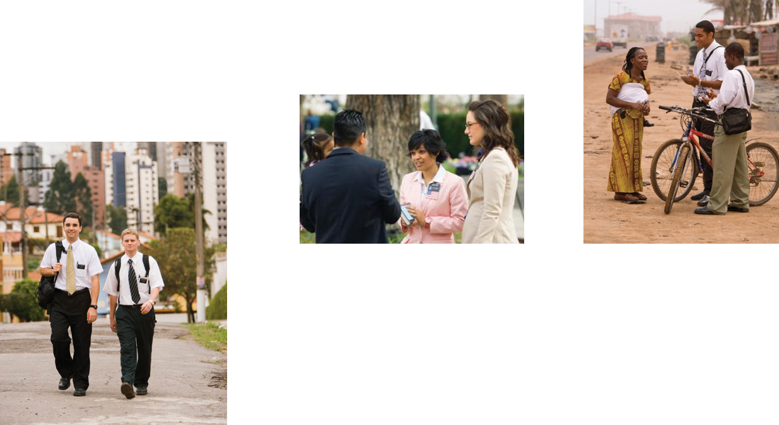
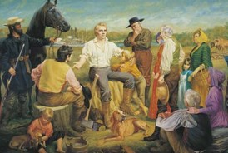
Times of the Gentiles
The gospel being preached first to the Gentiles in the latter days.
Joseph Smith “was of the Gentiles, meaning that he was a citizen of a Gentile Nation and also that he was not a Jew. … Indeed, the gospel has come forth in the last days in the times of the Gentiles and, in large measure, will not go to the Jews until the Gentile fulness comes in.
Elder Bruce R. McConkie
D&C 45:25-26

Slide 12
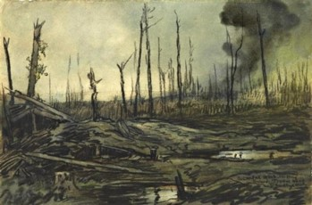
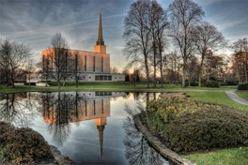
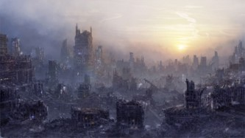
Signs of the Second Coming
Heard of wars—wars rumors of wars, earth in commotion—so dreadful that their hearts fail them—fear
Love of men wax cold—Christian unity—co-operation
A light shall break forth—the fulness of the gospel
In that generation—the generation where the fulness of the gospel would shine
Overflowing scourge—sickness, covering the land.
Holy places—God’s people will be gathered to these places—places where they have been purified.
Earthquakes and desolation—men against men, armies against armies
“no man stood with him”
2 Timothy 4:16
D&C 45:26-33 Smith and Sjodahl

Slide 13
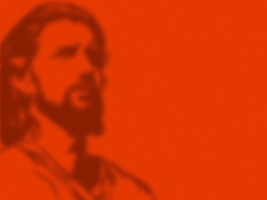
Worldly Views as a Sign
Christ will not come until the end of the Earth.
Christ will not come until the majority of the race is converted.
There is no Christ.
There will be no Millennium and no personal reign of Christ on the Earth
D&C 45:26-33

Slide 14
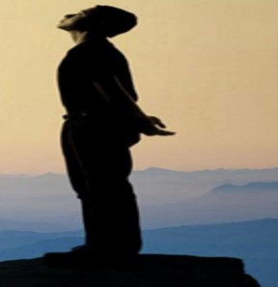
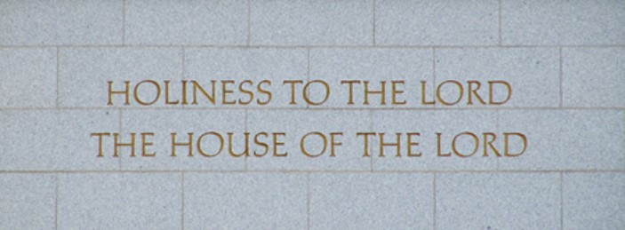
Stand In Holy Places
“Wherefore, stand ye in holy places, and be not moved, until the day of the Lord come; for behold, it cometh quickly, saith the Lord.Amen.”
D&C 87:8
“‘Holy places’ may have more to do with how one lives than where one lives. If we live worthy of the constant companionship of the Holy Ghost, then we stand in a holy place. … A holy place is any place where a person enjoys the Spirit of God”
D&C 45:32

Slide 15
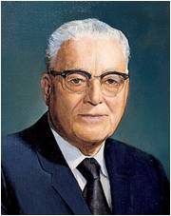
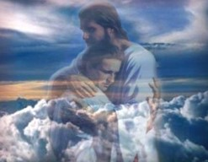
Where is Safety?
“In these days of our generation, many of you are asking: Where is safety?
“The word of the Lord is not silent. He has admonished us: ‘But my disciples shall stand in holy places, and shall not be moved; but among the wicked, men shall lift up their voices and curse God and die.’
“The Lord has told us where these ‘holy places’ are: ‘And it shall come to pass among the wicked, that every man that will not take his sword against his neighbor must needs flee unto Zion for safety.’…
D&C 45:32,68 President Harold B. Lee

Slide 16
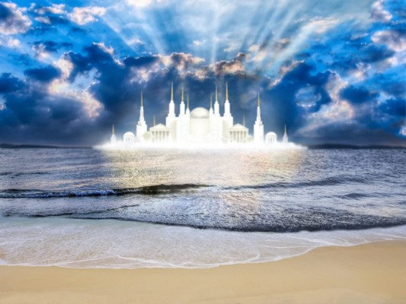
Where is Zion?
“During the various periods of time or dispensations, and for specific reasons, the Lord’s prophets, his ‘mouthpieces,’ as it were, have designated gathering places where the Saints were to gather. After designating certain such places in our dispensation, the Lord then declared: ‘Until the day cometh when there is found no more room for them; and then I have other places which I will appoint unto them, and they shall be called stakes, for the curtains or the strength of Zion.”
“Thus, clearly the Lord has placed the responsibility of directing the work of gathering in the hands of his divinely appointed leaders. May I fervently pray that all Saints and truth-seekers everywhere will attune their listening ears to these prophet-leaders. …
D&C 45:32,68 President Harold B. Lee

Slide 17
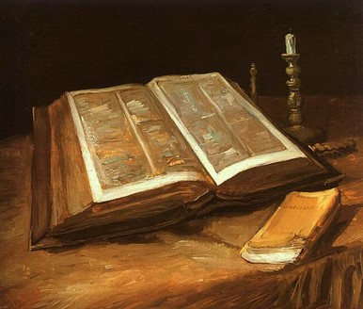
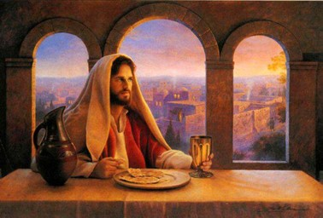
Numbered Among the Pure in Heart
“As one studies the Lord’s commandments and attending promises upon compliance therewith, one gets some definite ideas as to how we might ‘stand in holy places,’ as the Lord commands—if we will be preserved with such protection as accords with his holy purposes, in order that we might be numbered among the ‘pure in heart’ who constitute Zion, as I have read from the Lord’s own words.”
D&C 45:32,68 President Harold B. Lee

Slide 18
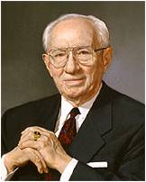
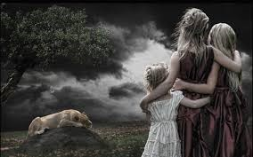
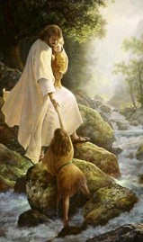
Be Not Troubled
Learning about the signs of the Second Coming can help us live without speculation, fear, or anxiety.
“Be not troubled, for, when all these things shall come to pass, ye may know that the promises which have been made unto you shall be fulfilled.”
“Let us rather live each day so that if the Lord does come while we are yet upon the earth we shall be worthy of that change which will occur as in the twinkling of an eye and under which we shall be changed from mortal to immortal beings.”
President Gordon B. Hinckley
D&C 45:35

Slide 19
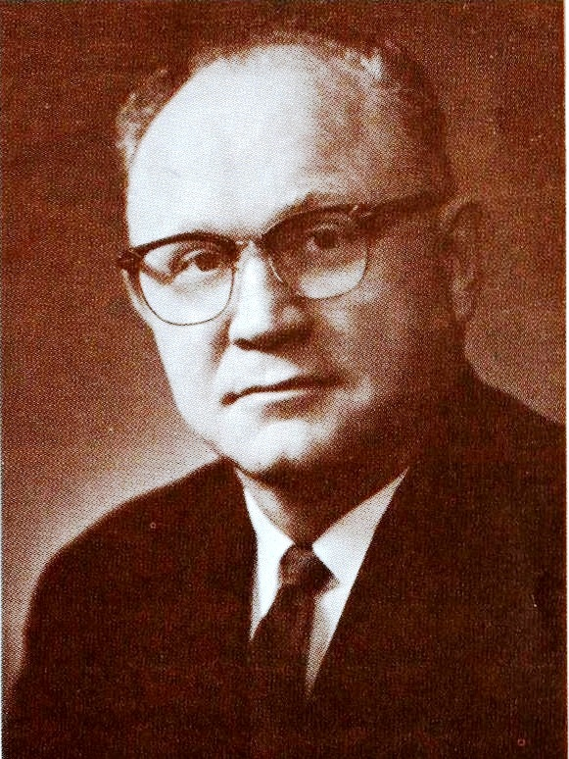
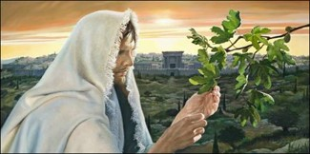
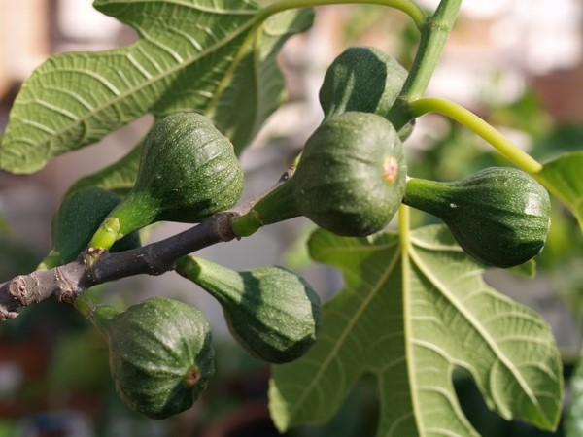
Parable of the Fig Tree
“Before the second coming of Jesus Christ, certain promised signs and wonders are to take place, making it possible for his Saints to know the approximate time of his coming. Jesus said:
“Now learn a parable of the fig tree; When his branch is yet tender, and putteth forth leaves, ye know that summer is nigh:
“So likewise ye, when ye shall see all these things, know that it is near, even at the doors.” (Matt. 24:32–33.)
President Kimball gave this counsel, “The leaves are commencing to show on the fig tree.”’
Elder Bernard P. Brockbank
D&C 45:37

Slide 20
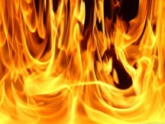
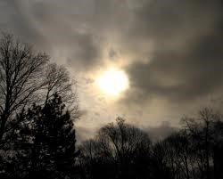
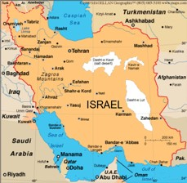
More Signs Before His Coming
Blood, fire, and vapors of smoke—destructive agencies of modern warfare and their death-dealing effects
The sun shall be darkened
The remnant shall be gathered—return of the Jews to Jerusalem.
The spirit of gathering accompanies the acceptance of the gospel.
Those who received the glad message generally have a desire to go where the people of god dwell.
Look for me---many will be prepared
D&C 45:40-47

Slide 21
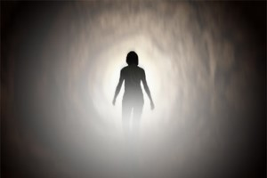
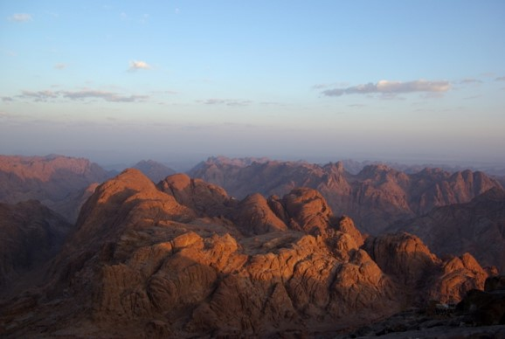
Signs While He is Here
Saints come forth--The departed Saints will be resurrected
Everywhere they shall be quickened “in the twinkling of an eye” and join the resurrected Saints and ascend with them.
Judgment upon the nations shall be held.
Our Lord will descend with His Saints.
He will again stand upon “this mountain.” the Mount of Olives
There will be an earthquake: the Mount will be cleft, and the whole “earth” shall hear it.
The Lord will speak, as form Mount Sinai, and the Nations of the Earth will hear it and mourn for their folly.
Satan will be Bound
D&C 45:47-55

Slide 22
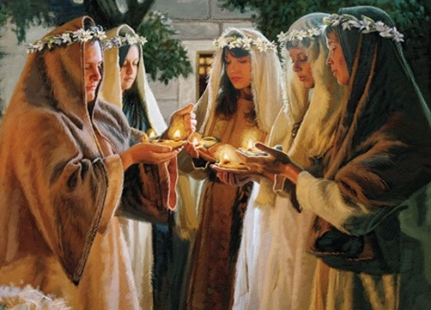
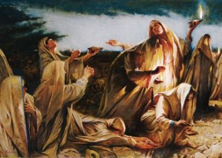
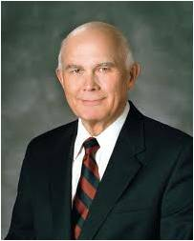
Parable of 10 Virgins Fulfilled
The faithful members of the church will be compared to the Parable of the 10 Virgins
The Lord will be in their midst and he will be their king and lawgiver.
He will establish His Celestial reign upon this Earth during a thousand years
“The arithmetic of this parable is chilling. The ten virgins obviously represent members of Christ’s Church, for all were invited to the wedding feast and all knew what was required to be admitted when the bridegroom came. But only half were ready when he came.”
Elder Dallin H. Oaks
D&C 45:56-59

Slide 23
Sources:
Notes from Hyrum M. Smith and Janne M. Sjodahl Doctrine and Covenants Commentary pgs. 259-265
Video Presentations:
Be Not Troubled (5:14)
Preparing for the Second Coming (2:51)
They that are Wise (8:43)
Taking the Spirit as Our Guide (1:41)
Elder Bruce R. McConkie (Mormon Doctrine, p. 848.)
(Mormon Doctrine, 2nd ed. [1966], 311
President Gordon B. Hinckley We Need Not Fear His Coming fireside address was given at Brigham Young University on 25 March 1979—see more of address in handouts
Bernard P. Brockbank “The Leaves Are Commencing to Show on the Fig Tree” April Conf. 1976
(Doctrine and Covenants Student Manual, 2nd ed. [Church Educational System manual, 2001], 196).
President Harold B. Lee (In Conference Report, Oct. 1968, pp. 61–62.)
Elder Dallin H. Oaks (“Preparation for the Second Coming,”Ensignor Liahona, May 2004, 8).
Presentation by ©http://fashionsbylynda.com/blog/

Slide 24
In the Olivet Discourse, the Savior gave four signs to indicate when the times of the Gentiles were over. Three are given in section 45, and one is given in Luke’s account of the great discourse.
1. The Jews will be gathered back to the land of Jerusalem (see D&C 45:25). In the April 1960 general conference, Elder George Q. Morris of the Quorum of the Twelve discussed this sign:
“I think perhaps we may well now not continue saying the Jews are going to gather in Jerusalem. I think now we may well say they have gathered. The ultimate returns will come later as they develop this land and are joined by others. …
“This statement by a writer is very interesting:
“‘Strangely enough when the State of Israel was reborn in 1948, it was a nation of 600,000, the same number which the Bible reports that Moses led out of bondage in Egypt. It now numbers some two million, the same number which it is said populated the ancient Kingdom of Solomon, when Israel was in all its glory.’
“That is why we may now say that the Jews have returned to Palestine.” (In Conference Report, Apr. 1960, pp. 100–101.)
2. It will be in a time of great social turmoil (see D&C 45:26–27). One need only follow current events as reported in the news media for a day or two to see turmoil like the Savior described
3. The Gentiles will for the most part reject the gospel (see D&C 45:28–30). President Joseph Fielding Smith, writing about these verses, said: “‘And when the times of the Gentiles is come in, a light shall break forth among them that sit in darkness, and it shall be the fulness of my Gospel,’ the Lord said in this revelation [D&C 45:28]. The meaning is that when the time had come for the restoration of the Gospel—in the times of the Gentiles—that it would not be perceived because the hearts of the people are turned away by the precepts of men. However, in that generation this should happen, the times of the Gentiles should be fulfilled.” (Church History and Modern Revelation, 1:196.)
4. Jerusalem will no longer be “trodden down of the Gentiles” (Luke 21:24). Again President Smith explained: “When we consider the words of the Savior to his disciples, that the Jews should be scattered and ‘Jerusalem shall be trodden down of the Gentiles until the times of the Gentiles are fulfilled,’ we have a fair understanding of the meaning of this … verse [D&C 45:30] in this revelation. Jerusalem was trodden down of the Gentiles from the day of its destruction until the close of the year 1917, when it was freed from Turkish rule by General Edmund H. Allenby of the British forces. After the war Palestine became a British mandate, and Great Britain by proclamation declared that country to be a refuge for the Jews, who were invited to return. … It is very significant, however, that Jerusalem is no longer trodden down by the Gentiles and the Jews are again gathering there. This is the sign given by our Lord, for the end of the times of the Gentiles. We are now in the transition period and shortly the day of the Jew will dawn and the Gospel will be taken to them and to the remnants on this land.” (Church History and Modern Revelation, 1:196–97.)
D&C 45:24-29:
When Joseph Fielding Smith wrote those words in 1947, Israel had not yet been made a state; they were still under the British mandate. But on 15 May 1948, Israel became an independent nation and declared Jerusalem to be her capital. In the war that followed this declaration, the Jews could maintain control of western Jerusalem only. East Jerusalem became part of the state of Jordan. In general conference in 1966, Elder Smith, now President of the Quorum of the Twelve, said: “Jesus said the Jews would be scattered among all nations and Jerusalem would be trodden down by the Gentiles until the times of the Gentiles were fulfilled. (Luke 21:24.) The prophecy in Section 45, verses 24–29, of the Doctrine and Covenants regarding the Jews was literally fulfilled. Jerusalem, which was trodden down by the Gentiles, is no longer trodden down but is made the home for the Jews. They are returning to Palestine, and by this we may know that the times of the Gentiles are near their close.” (In Conference Report, Apr. 1966, p. 13.)
During the Six-Day War of 1967, Israel conquered the West Bank, including Jerusalem, and for the first time since the city fell to the legions of Titus in A.D. 70, Jerusalem came completely under the control of a Jewish government.
Stand in Holy Places:
We must be vigilant in a world which has moved so far from that which is spiritual. It is essential that we reject anything that does not conform to our standards, refusing in the process to surrender that which we desire most: eternal life in the kingdom of God. The storms will still beat at our doors from time to time, for they are an inescapable part of our existence in mortality. We, however, will be far better equipped to deal with them, to learn from them, and to overcome them if we have the gospel at our core and the love of the Savior in our hearts. The prophet Isaiah declared, “The work of righteousness shall be peace; and the effect of righteousness quietness and assurance for ever.
President Thomas S. Monson Stand in Holy Places October 2011 Gen. Conf

Slide 25
We Need Not Fear His Coming:
If anyone were to ask me the day and the hour of the Second Coming, I could only answer that I do not know. But while neither I nor any other man knows when He will come, there are some things that I do know—and that knowledge comes from the scriptures, and the testimony of its truth comes by the power of the Holy Ghost. Although I do not know the time, I look forward to the Lord’s coming..
It will be a time of great and terrible fears, of cataclysmic upheavals of nature, of weeping and wailing, of repentance too late, and of crying out unto the Lord for mercy. But for those who in that judgment are found acceptable, it will be a day for thanksgiving, for the Lord shall come with his angels, and the apostles who were with him in Jerusalem, and those who have been resurrected. Further, the graves of the righteous will be opened and they shall come forth. Then will begin the great Millennium, a period of a thousand years when Satan shall be bound and the Lord shall reign over his people. Can you imagine the wonder and the beauty of that era when the adversary shall not have influence? Think of his pull upon you now and reflect on the peace of that time when you will be free from such influence. There will be quiet and goodness where now there is contention and evil.
…Let us rather live each day so that if the Lord does come while we are yet upon the earth we shall be worthy of that change which will occur as in the twinkling of an eye and under which we shall be changed from mortal to immortal beings. And if we should die before he comes, then—if our lives have conformed to his teachings—we shall arise in that resurrection morning and be partakers of the marvelous experiences designed for those who shall live and work with the Savior in that promised Millennium.
We need not fear the day of his coming; the very purpose of the Church is to provide the incentive and the opportunity for us to conduct our lives in such a way that those who are members of the kingdom of God will become members of the kingdom of heaven when he establishes that kingdom on the earth. Very quickly, by way of conclusion, may I suggest just two or three things, which if observed, will assist.
President Gordon B. Hinckley We Need Not Fear His Coming fireside address was given at Brigham Young University on 25 March 1979
“Then Shall the Lord Set His Foot upon This Mount”
“This mount” refers to the Mount of Olives on which the Savior was sitting when he gave this great discourse. Parley P. Pratt described in a pamphlet the great events depicted here: “Zechariah, chapter 14, has told us much concerning the great battle and overthrow of the nations who fight against Jerusalem, and he has said, in plain words, that the Lord shall come at the very time of the overthrow of that army; yes, in fact, even while they are in the act of taking Jerusalem, and have already succeeded in taking one-half the city, spoiling their houses, and ravishing their women. Then, behold, their long-expected Messiah, suddenly appearing, shall stand upon the Mount of Olives, a little east of Jerusalem, to fight against those nations and deliver the Jews. Zechariah says the Mount of Olives shall cleave in twain, from east to west, and one-half of the mountain shall remove to the north while the other half falls off to the south, suddenly forming a very great valley into which the Jews shall flee for protection from their enemies as they fled from the earthquake in the days of Uzziah, king of Judah; while the Lord cometh and all the saints with Him. Then will the Jews behold that long, long-expected Messiah, coming in power to their deliverance, as they always looked for him. He will destroy their enemies and deliver them from trouble at the very time they are in the utmost consternation, and about to be swallowed up by their enemies. But what will be their astonishment when they are about to fall at the feet of their Deliverer and acknowledge him their Messiah! They discover the wounds which were once made in his hands, feet, and side; and on inquiry, at once recognize Jesus of Nazareth, the King of the Jews, the man so long rejected. Well did the prophet say that they shall mourn and weep, every family apart, and their wives apart. But, thank heaven, there will be an end to their mourning; for he will forgive their iniquities and cleanse them from uncleanness. Jerusalem shall be a holy city from that time forth, and all the land shall be turned as a plain from Geba to Rimmon. She shall be lifted up and inhabited in her place, and men shall dwell there. There shall be no more utter destruction of Jerusalem, ‘And the Lord shall be king over all the earth: in that day shall there be one Lord, and his name one.’ (Zechariah 14:9.)” (Voice of Warning, pp. 32–33.)
Mount of Olives:
By and by, when all things are prepared—when the Jews have received their scourging, and Jesus has descended upon the Mount of Olives, the Ten Tribes will leave Zion, and will go to Palestine, to inherit the land that was given to their ancient fathers, and it will be divided among the descendants of Abraham, Isaac, and Jacob by the inspiration of the Holy Ghost.
They will go there to dwell in peace in their own land from that time, until the Earth shall pass away. But Zion, after their departure will still remain upon the Western hemisphere, and she will be crowned with glory as well as old Jerusalem, and, as the Psalmist David says, she will become the joy of the whole Earth ***
Zion will be caught up when Jesus comes, to met Him. Jesus will descend not only upon the Mount of Olives, but He will descend and stand upon Mount Zion. But before He stands upon it, it will be caught up to meet Him in the air. Will the building of Zion be caught up? Yes. And its land? Yes.
And Jesus will stand upon Mount Zion according to the prediction of John the Revelator, and He will reign over His people during a thousand years; and His associated will be the resurrected righteous of all former dispensations” (Orson Pratt, Jour. of Dis., Vol. XVIII., p. 66)

