Slide 2
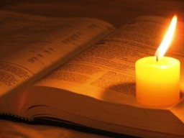
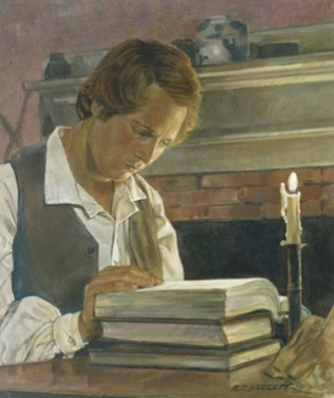
Errors in the Bible
In studying the Bible Joseph found great comfort in its words.
However, as he studied it, he noticed errors and felt that some information was missing or incomplete.
“It was apparent that many important points touching the salvation of man had been taken from the Bible, or lost before it was compiled” Joseph Smith
“I believe the Bible as it read when it came from the pen of the original writers. Ignorant translators, careless transcribers, or designing and corrupt priests have committed many errors”
Joseph Smith

Slide 3
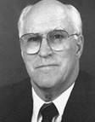
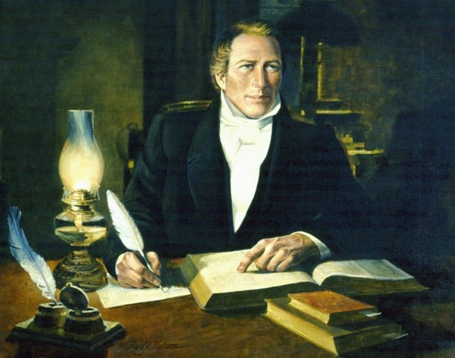
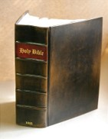
Background
1831
The Joseph Smith Translation is “a revision or translation of the King James Version of the Bible begun by the Prophet Joseph Smith in June 1830.
He was divinely commissioned to make the translation and regarded it as ‘a branch of his calling’ as a prophet.”
Although the work was essentially completed by July 1833, the Prophet continued to make small modifications until his death in 1844. “Some parts of the translation were published during his lifetime.”
Joseph and Emma Smith's family Bible is for sale at an asking price of $1.5 million, at Ken Sanders Rare Books. The owner is anonymous.
Kristin Murphy, Deseret News
2010
D&C 45:60-61 Robert J. Matthews

Slide 4
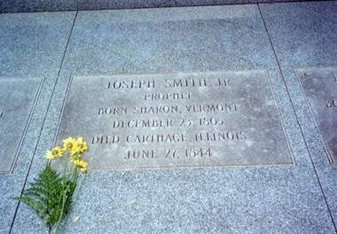
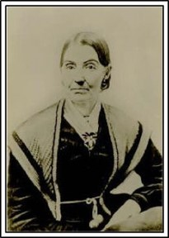
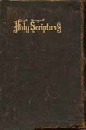
However, due to persecution, lack of financial resources, and his responsibilities for the administration of the Church, Joseph Smith was not able to publish all of his revisions of the Bible prior to his death.
In addition, the Church lacked the manuscript. It remained in the possession of Joseph’s widow, Emma Smith, after his death.
In 1866 Emma gave this manuscript to the Reorganized Church of Jesus Christ of Latter Day Saints (RLDS), now known as the Community of Christ, which obtained a copyright and published the translation in 1867.
D&C 45:60-61 Robert J. Matthews

Slide 5
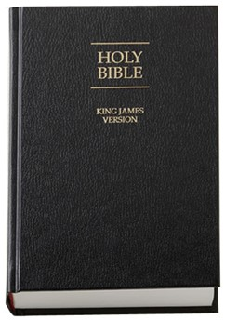
Eventually the book of Moses and Joseph Smith—Matthew were published as part of the Joseph Smith Translation.
However, what we use in our scriptures now is only a portion of Joseph Smith’s translation of the Bible. “While there were several reasons why the entire text of the Joseph Smith Translation was not incorporated in the 1979 LDS edition of the Bible, unreliability of the JST text was not one of them.
Passages of doctrinal significance were given preference, and since space was a major factor, not everything was included.”
D&C 45:60-61 Robert J. Matthews

Slide 6
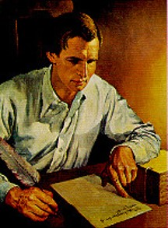
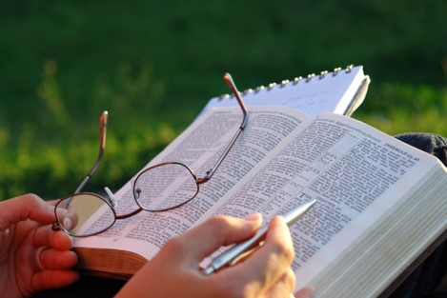
Commanded
Around the fall of 1830, Joseph Smith was commanded by the Lord to translate the Bible. He did not translate the Bible from one language to another; nor did he have an original biblical manuscript to work from.
Instead, Joseph would read and study passages from the King James Version of the Bible and then make corrections and additions as inspired by the Holy Ghost. Thus, the translation was more of an inspired revision than a traditional translation.

Slide 7
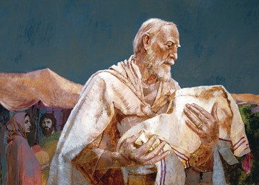
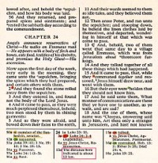
3,400 Verses
The Joseph Smith Translation is estimated to have affected at least 3,400 verses in the King James Version of the Bible.
These differences include additions (to clarify meaning or context), deletions, rearranged verses, and complete restructurings of certain chapters.
The Joseph Smith Translation clarified doctrinal content, especially the mission of Jesus Christ, the nature of God, the nature of man, the Abrahamic covenant, the priesthood, and the Restoration of the gospel.
The Latter-day Saint edition of the King James Version of the Bible printed after 1979 includes more than 600 changes from the Joseph Smith Translation.
Short changes are noted in the footnotes, and larger selections are found in the Bible appendix.

Slide 8
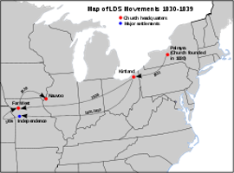
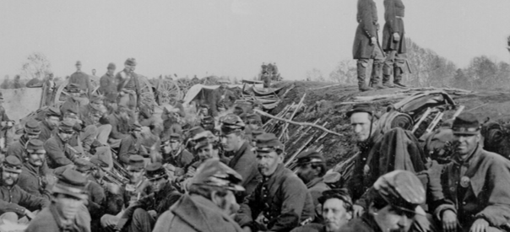
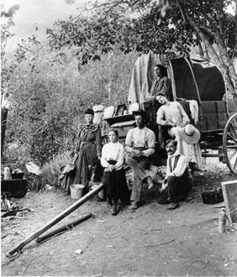
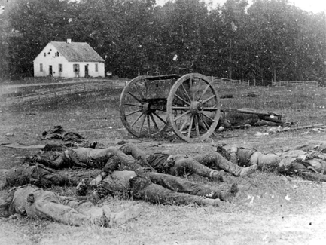
A Warning to Move West
The Lord directed the early Saints to move westward, “out from the eastern lands.”
the westward movement members of the Church at the time this revelation was given would be from New York to Ohio.
In 1861, nearly 17 years after Joseph Smith’s death, a Civil War began in the United States.
It is estimated that this war caused more than 1 million casualties, as well as much destruction of property, bringing hardship to families and communities across the country.
Those Saints who continued to follow the Lord’s counsel to gather from the east were blessed with relative peace and security in Utah.
D&C 45:62-64

Slide 9
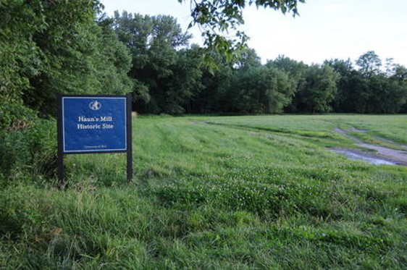
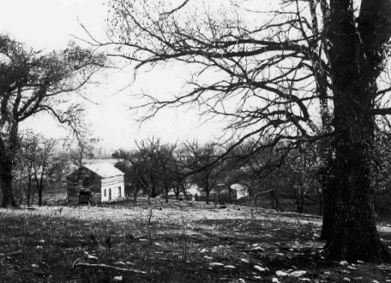
Gather Your Riches
To purchase land where the Saints could live in unity, peace, and safety.
Inheritance--- land upon which the Saints could dwell and worship the Lord.
D&C 45:65

Slide 10
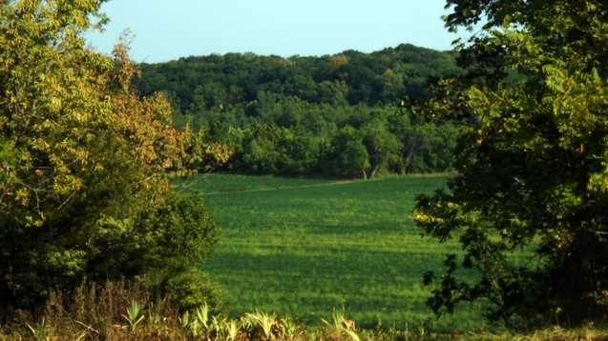
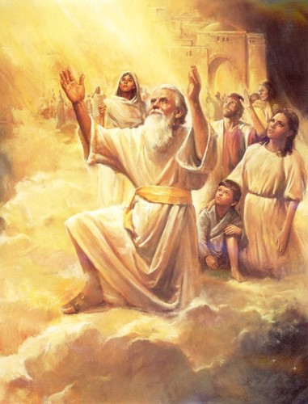
To Zion—New Jerusalem
Gathering, preparation, defense, and refuge
Prior to the Second Coming will be so extensive and devastating that if the Lord did not prepare a means of preservation, His people too would perish.
But He has prepared a means for His people to escape those terrible times; that means is Zion.
Enoch was told that the Lord would preserve His people in the tribulations of the last days by gathering His elect to Zion where they could gird up their loins.
D&C 45:66-67 and Moses 7:61

Slide 11
At War With One Another
All those who do not take arms against his neighbors must flee to Zion for safety
“And that the gathering together upon the land of Zion, and upon her stakes, may be for a defense, and for a refuge from the storm, and from wrath when it shall be poured out without mixture upon the whole earth.”
D&C 115:6
D&C 45:68-69

Slide 12
How Can We Flee for Safety?
D&C 45:68-69

Slide 13
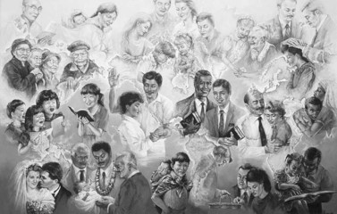
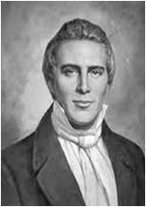
A Place of Righteousness
“Zion … is a place of righteousness, and all who build thereon are to worship the true and living God, and all believe in one doctrine, even the doctrine of our Lord and Savior Jesus Christ”
Joseph Smith
“Without Zion, and a place of deliverance, we must fall; because the time is near when the sun will be darkened, and the moon turn to blood, and the stars fall from heaven, and the earth reel to and fro. Then, if this is the case, and if we are not sanctified and gathered to the places God has appointed, with all our former professions and our great love for the Bible, we must fall; we cannot stand; we cannot be saved; for God will gather out his Saints from the Gentiles, and then comes desolation and destruction, and none can escape except the pure in heart who are gathered.”
Joseph Smith
D&C 45:71

Slide 14
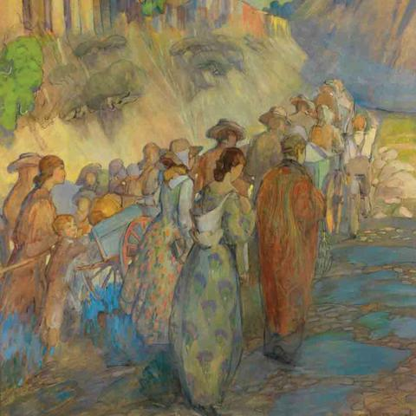
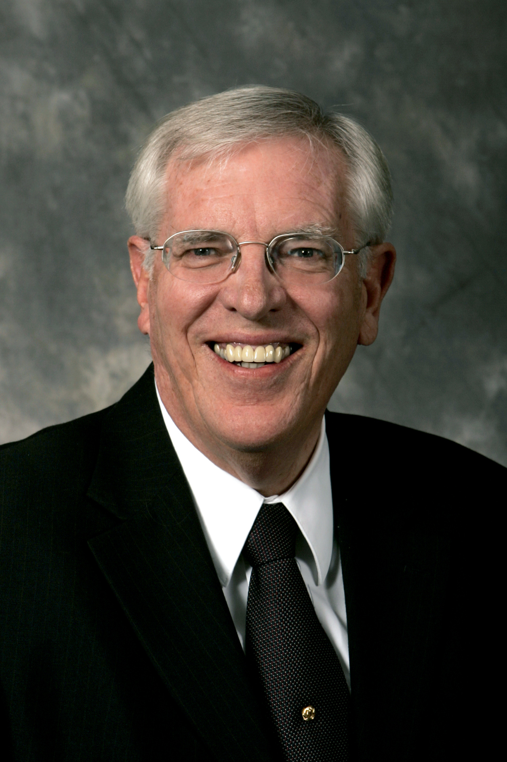
There is something we can start today. Build Zion. “Zion” are the pure in heart. The first step is to have a pure heart. Satan will do all he can to keep Zion from being established and his method is to subtly entice us to impurity. Purity is the name of the game in these last days. We must be pure!
Richard Draper

Slide 15
Sources:
Video:
Gathering to Lands of Promise(2:07)
(Teachings of Presidents of the Church: Joseph Smith [2007], 217).
Teachings: Joseph Smith, 207).
Robert J. Matthews, “I Have a Question,” Ensign, June 1992, 29). (See Robert J. Matthews, “Q and A,” New Era, Apr. 1977, 46–47.)
Zion: A Destination and a Process (0:39)
Joseph Smith (in History of the Church, 2:254).
Joseph Smith Teachings, p. 71
Richard Draper Keys to Understanding the Book of Revelation
Presentation by ©http://fashionsbylynda.com/blog/

Slide 16
A revision or translation of the King James Version of the Bible begun by the Prophet Joseph Smith in June 1830. He was divinely commissioned to make the translation and regarded it as “a branch of his calling” as a prophet. Although the major portion of the work was completed by July 1833, he continued to make modifications while preparing a manuscript for the press until his death in 1844, and it is possible that some additional modifications would have been made had he lived to publish the entire work. Some parts of the translation were published during his lifetime.
The translation process was a learning experience for the Prophet, and several sections of the Doctrine and Covenants (and also other revelations that are not published in the Doctrine and Covenants) were received in direct consequence of the work (D&C 76–77; 91). Also, specific instruction pertaining to the translation is given in D&C 37:1; 45:60–61; 76:15–18; 90:13; 94:10; 104:58; 124:89. The book of Moses and the 24th chapter of Matthew (JS—M), contained in the Pearl of Great Price, are actual excerpts from the JST. Many excerpts from the JST are also given in the appendix and footnotes in the edition of the KJV that accompanies this dictionary. The JST to some extent assists in restoring the plain and precious things that have been lost from the Bible (see 1 Ne. 13–14).
Although not the official Bible of The Church of Jesus Christ of Latter-day Saints, the JST offers many interesting insights and is an invaluable aid to biblical interpretation and understanding. It is a most fruitful source of useful information for the student of the scriptures. It is likewise a witness for the divine calling and ministry of the Prophet Joseph Smith.

