Slide 2
Reading About Zion
Before this revelation was given, the members of the Church had read in the Book of Mormon about a New Jerusalem that would be located in America
1830
And behold, this people will I establish in this land, unto the fulfilling of the covenant which I made with your father Jacob; and it shall be a New Jerusalem. And the powers of heaven shall be in the midst of this people; yea, even I will be in the midst of you.
3 Nephi 20:22
The
Book
of
Mormon
ANOTHER TESTAMENT
OF JESUS CHRIST
And that a New Jerusalem should be built up upon this land, unto the remnant of the seed of Joseph, for which things there has been a type.
Ether 13:6

Slide 3
Revelations of Zion
The Holy city would be erected “on the borders by the Lamanites
D&C 28:9
The Lord promised He would reveal the exact location of the New Jerusalem
D&C 42:62
The Saints receive the information of the location of Zion
D&C 57

Slide 4
Anxiety For A Zion
1831
‘When will the wilderness blossom as the rose?
When will Zion be built up in her glory, and where will Thy temple stand, unto which all nations shall come in the last days?’
Our anxiety was soon relieved by receiving the following:
D&C 57
(History of the Church, 1:189.)

Slide 5
Center Place For Zion
Kirtland
1831
Independence
Saints who had gathered in Ohio began their journey to settle in the area of Jackson County, Missouri.
In a revelation to the Prophet Joseph Smith on July 20, 1831 the Lord designated Independence, Missouri, as the “center place” of Zion
D&C 57:3

Slide 6
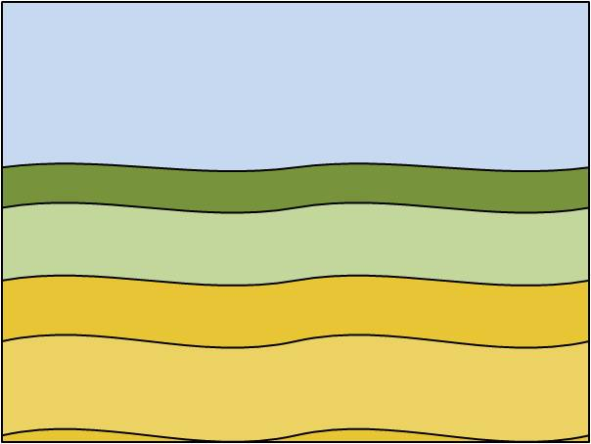
Purchasing Land in Zion
For Sale
The Saints were to begin purchasing land in the area, and they were also to keep the Lord’s commandments in preparation for the building of Zion.
Over time, however, contentions arose between the Saints and many of the citizens of Jackson County, Missouri, which led to mob violence against the Saints. The Saints were forced to leave Jackson County in November and December 1833.
Independence
1833

Slide 7
The Storm
Kirtland
Independence
What are some ways you might find refuge from the storm?
How might a tent be helpful in this situation?

Slide 8
Isaiah’s Zion
Isaiah 54:2
“Enlarge the place of thy tent, and let them stretch forth the curtains of thine habitations: spare not, lengthen thy cords, and strengthen thy stakes.”
Zion must be built on principles of the law of the celestial kingdom
Spiritual Protection

Slide 9
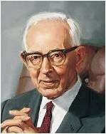
Those Who Gather In Zion
Zion shall flourish
Ensign– A signal to assemble
The day shall come—assemble for the last time.
D&C 64:41-43
“That ensign [is] the Church of Jesus Christ of Latter-day Saints, which was established for the last time, never again to be destroyed or given to other people. It was the greatest event the world has seen since the day that the Redeemer was lifted upon the cross and worked out the infinite and eternal atonement. It meant more to mankind than anything else that has occurred since that day”
Joseph Fielding Smith

Slide 10
How is Zion Built?
D&C 105:5
And Zion cannot be built up unless it is by the principles of the law of the celestial kingdom; otherwise I cannot receive her unto myself.

Slide 11
How is Zion Built?
D&C 82:14-19
Food
D&C 97:10-16
D&C 97:21-22, 25-27
D&C 133:4-9

Slide 12
Working Together For Zion
Independence
Kirtland
900 Miles
The Saints worked together to contribute funds and resources to lay the foundation of the city of Zion
In July 1831 many of the Saints traveled the nearly 900 miles to Independence, Missouri, to settle and build Zion.
Others remained in Kirtland and in other areas in the east.
A stake would be organized in Kirtland on February 17, 1834.

Slide 13
Ohio and Zion
1831
Ohio
1831
1832
Church leaders compiled revelations to be printed
1831
Joseph continues to receive revelations and continues to translate the Bible
Oliver Cowdery and John Whitmer take revelations to Missouri
Some Church members contributed money to help purchase land and supplies in Missouri.
1832
1832
Joseph took a trip to Missouri to visit saints in Zion
Many Saints move to Missouri, so about 1/3 members live in Jackson county
1832

Slide 14
Missouri and Zion
1831
1832
Missouri
1831
1832
The Church leaders in Missouri worked to meet the needs of the incoming Saints.
They purchase land and set up a store and printing press
Some members allowed their selfishness and greet to prevent them from living the law of consecration
1833
1833
William W. Phelps was to print the revelations called the “Book of Commandments”
1833
Populations of Saints increased to almost 1,200

Slide 15
Problems in Zion
1833
Jackson County
One religious leader spread lies about the members of the Church and encouraged the citizens to commit acts of violence against them
Missourians became concerned about the rapid growth of the “Mormon”
Local religious leaders disagreed with the Saints’ beliefs
William W. Phelps published an article “Free People of Color” which caused a mob to destroyed most of the unbound sheets of the Book of Commandments
Bishop Partridge and Charles Allen were tarred and feathered
July 20, 1833
Nov.-Dec. 1833
Saints were forced to leave Jackson County

Slide 16
Can You Build A Zion?
Behold, I say unto you, there were jarrings, and contentions, and envyings, and strifes, and lustful and covetous desires among them; therefore by these things they polluted their inheritances.
They were slow to hearken unto the voice of the Lord their God; therefore, the Lord their God is slow to hearken unto their prayers, to answer them in the day of their trouble.
D&C 101:6-7
But behold, they have not learned to be obedient to the things which I required at their hands, but are full of all manner of evil, and do not impart of their substance, as becometh saints, to the poor and afflicted among them;
And are not united according to the union required by the law of the celestial kingdom;
Therefore, in consequence of the transgressions of my people, it is expedient in me that mine elders should wait for a little season for the redemption of Zion—
D&C 105:3-4
9
Being driven and smitten by the hands of mine enemies, on whom I will pour out my wrath without measure in mine own time.
For I have suffered them thus far, that they might fill up the measure of their iniquities, that their cup might be full;
And that those who call themselves after my name might bechastened for a little season with a sore and grievous chastisement, because they did not hearken altogether unto the precepts and commandments which I gave unto them.
D&C 103:2-4

Slide 17
The Future of Zion
Zion is the Pure in Heart
Therefore, verily, thus saith the Lord, let Zion rejoice, for this is Zion—the pure in heart; therefore, let Zion rejoice, while all the wicked shall mourn. D&C 97:21

Slide 18
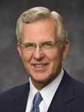
Zion For The Pure In Heart
“Much of the work to be done in establishing Zion consists in our individual efforts to become ‘the pure in heart’.
‘Zion cannot be built up unless it is by the principles of the law of the celestial kingdom,’ said the Lord; ‘otherwise I cannot receive her unto myself’.
The law of the celestial kingdom is, of course, the gospel law and covenants, which include our constant remembrance of the Savior and our pledge of obedience, sacrifice, consecration, and fidelity.
“The Savior was critical of some of the early Saints for their ‘lustful … desires’.
These were people who lived in a non-television, non-film, non-Internet, non-iPod world. In a world now awash in sexualized images and music, are we free from lustful desires and their attendant evils?
Far from pushing the limits of modest dress or indulging in the vicarious immorality of pornography, we are to hunger and thirst after righteousness.
To come to Zion, it is not enough for you or me to be somewhat less wicked than others. We are to become not only good but holy men and women.
Elder D. Todd Christofferson

Slide 19
Sources:
Joseph Fielding Smith (Doctrines of Salvation, 3 vols. [1954–56], 3:254–55).
Elder D. Todd Christofferson (“Come to Zion,” Ensign or Liahona, Nov. 2008, 38–39).
Presentation by ©http://fashionsbylynda.com/blog/

Slide 20
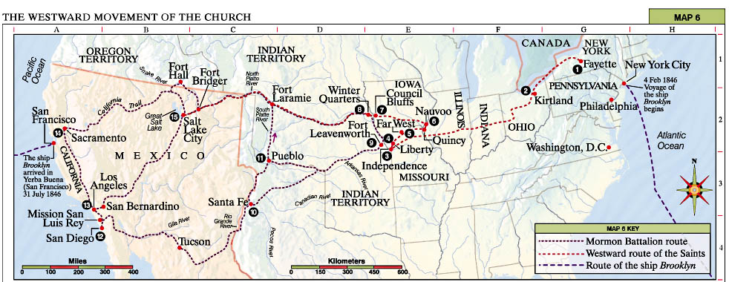
Fayette The Prophet Joseph Smith left Fayette for Kirtland, Ohio, in January 1831. The three New York branches (Fayette, Colesville, and Manchester) followed in April and May 1831 under the Lord’s command to gather (see D&C 37–38).
Kirtland The headquarters of the Church was primarily in Kirtland from 1831 to 1838.
Independence The Lord identified Independence (in Jackson County, Missouri) as the center place of Zion in July 1831 (see D&C 57:3). Mobs forced the Saints out of Jackson County in November 1833.
Liberty The Saints from Jackson County gathered in Clay County from 1833 to 1836, when they were again required to leave. The Prophet Joseph Smith and five others were unjustly imprisoned here from December 1838 to April 1839.
Far West A refuge was established here for the Saints 1836–38. It was the headquarters of the Church in 1838. In 1838–39 the Saints were forced to flee to Illinois.
Nauvoo The headquarters of the Church 1839–46. After the martyrdom of the Prophet and his brother Hyrum, the Saints moved west.
Council Bluffs The pioneers arrived here June 1846. Members of the Mormon Battalion departed on July 21, 1846, under James Allen’s leadership.
Winter Quarters Important temporary settlement, 1846–48. The vanguard company under the direction of President Brigham Young departed for the West April 1847.
Fort Leavenworth The Mormon Battalion was outfitted here before starting the march west in August 1846.
Santa Fe Philip Cooke commanded the Mormon Battalion as it marched from here October 19, 1846.
Pueblo Three sick detachments of the Mormon Battalion were ordered to Pueblo to recuperate, where they spent the winter of 1846–47 with Saints from Mississippi. These parties entered the Salt Lake Valley in July 1847.
San Diego The Mormon Battalion completed its 2,000-mile (3,200-kilometer) march here on January 29, 1847.
Los Angeles The Mormon Battalion was discharged here July 16, 1847.
Sacramento Some discharged battalion members worked here and at Sutter’s Mill farther east on the American River. They were present when gold was discovered in January 1848.
Salt Lake City Headquarters of the Church from 1847 to the present. Brigham Young arrived in the Salt Lake Valley on July 24, 1847.

Slide 21
Principles Zion is to Be Built Upon:
“The covenant of consecration encompasses sacrifice; circumscribes love, work, and self-reliance; and is fundamental to the establishment of God’s kingdom. ‘Zion cannot be built up,’ the Lord said, ‘unless it is by the principles of the law of the celestial kingdom’ [D&C 105:5.] The covenant of consecration is central to this law. We shall one day apply it in its fulness. This covenant embraces the ‘giving of one’s time, talents, and means to care for those in need—whether spiritually or temporally—and in building the Lord’s kingdom.’ [See Ensign, Aug. 1984, 4; Tambuli, Dec. 1984, 7.]
“These principles of love, work, self-reliance, and consecration are God given. Those who embrace them and govern themselves accordingly become pure in heart. Righteous unity is the hallmark of their society. Their peace and harmony become an ensign to the nations. Said the Prophet Joseph Smith:
“‘The building up of Zion is a cause that has interested the people of God in every age; it is a theme upon which prophets, priests and kings have dwelt with peculiar delight; … it is left for us to see, participate in and help to roll forward the Latter-day glory [of Zion] … a work that is destined to bring about the destruction of the powers of darkness, the renovation of the earth, the glory of God, and the salvation of the human family.’ [Teachings of the Prophet Joseph Smith, sel. Joseph Fielding Smith (1976), 231–32; emphasis added.]” Bishop Keith B. McMullin (“Come to Zion! Come to Zion!” Ensign or Liahona, Nov. 2002, 96).
Failing to Build a Zion:
“Under the direction of the Prophet Joseph Smith, early members of the Church attempted to establish the center place of Zion in Missouri, but they did not qualify to build the holy city. The Lord explained one of the reasons for their failure:
“‘They have not learned to be obedient to the things which I required at their hands, but are full of all manner of evil, and do not impart of their substance, as becometh saints, to the poor and afflicted among them;’
“‘And are not united according to the union required by the law of the celestial kingdom’ (D&C 105:3–4).
“‘There were jarrings, and contentions, and envyings, and strifes, and lustful and covetous desires among them; therefore by these things they polluted their inheritances’ (D&C 101:6).
“Rather than judge these early Saints too harshly, however, we should look to ourselves to see if we are doing any better.
“Zion is Zion because of the character, attributes, and faithfulness of her citizens. Remember, ‘the Lord called his people Zion, because they were of one heart and one mind, and dwelt in righteousness; and there was no poor among them’ (Moses 7:18). If we would establish Zion in our homes, branches, wards, and stakes, we must rise to this standard. It will be necessary (1) to become unified in one heart and one mind; (2) to become, individually and collectively, a holy people; and (3) to care for the poor and needy with such effectiveness that we eliminate poverty among us. We cannot wait until Zion comes for these things to happen—Zion will come only as they happen” Elder D. Todd Christofferson(“Come to Zion,” Ensign or Liahona, Nov. 2008, 37–38).

Slide 22
“A stake has geographical boundaries. To create a stake is like founding a City of Holiness. Every stake on earth is the gathering place for the lost sheep of Israel who live in its area. …
“Each one of us can build up Zion in our own lives by being pure in heart. And the promise is, ‘Blessed are the pure in heart: for they shall see God.’ (Matt. 5:8.) Each one of us can extend the borders of Zion by gathering our friends and neighbors into the fold of Israel” Elder Bruce R. McConkie (“Come: Let Israel Build Zion,” Ensign, May 1977, 118).
Joseph Smith’s return trip to Kirtland from Missouri
Joseph Smith wrote the following about his return journey to Kirtland after he had visited the Saints in Missouri:
“On the 6th of May [1832] I gave the parting hand to the brethren in Independence, and, in company with Brothers Rigdon and Whitney, commenced a return to Kirtland, by stage to St. Louis, from thence to Vincennes, Indiana; and from thence to New Albany, near the falls of the Ohio river. Before we arrived at the latter place, the horses became frightened, and while going at full speed Bishop Whitney attempted to jump out of the coach, but having his coat fast, caught his foot in the wheel, and had his leg and foot broken in several places; at the same time I jumped out unhurt. We put up at Mr. Porter’s public house, in Greenville, for four weeks, while Elder Rigdon went directly forward to Kirtland. During all this time, Brother Whitney lost not a meal of victuals or a night’s sleep, and Dr. Porter, our landlord’s brother, who attended him, said it was a pity we had not got some ‘Mormon’ there, as they could set broken bones or do anything else. I tarried with Brother Whitney and administered to him till he was able to be moved. While at this place I frequently walked out in the woods, where I saw several fresh graves; and one day when I rose from the dinner table, I walked directly to the door and commenced vomiting most profusely. I raised large quantities of blood and poisonous matter, and so great were the muscular contortions of my system, that my jaw in a few moments was dislocated. This I succeeded in replacing with my own hands, and made my way to Brother Whitney (who was on the bed), as speedily as possible; he laid his hands on me and administered to me in the name of the Lord, and I was healed in an instant, although the effect of the poison was so powerful, as to cause much of the hair to become loosened from my head. Thanks be to my Heavenly Father for His interference in my behalf at this critical moment, in the name of Jesus Christ. Amen.
“Brother Whitney had not had his foot moved from the bed for nearly four weeks, when I went into his room, after a walk in the grove, and told him if he would agree to start for home in the morning, we would take a wagon to the river, about four miles, and there would be a ferry-boat in waiting which would take us quickly across, where we would find a hack which would take us directly to the landing, where we should find a boat, in waiting, and we would be going up the river before ten o’clock, and have a prosperous journey home. He took courage and told me he would go. We started next morning, and found everything as I had told him, for we were passing rapidly up the river before ten o’clock, and, landing at Wellsville, took stage coach to Chardon, from thence in a wagon to Kirtland, where we arrived some time in June” (in History of the Church, 1:271–72). (See also Church History in the Fulness of Times Student Manual, 2nd ed. [Church Educational System manual, 2003], 116.)
Hostilities in Jackson County
“Before April [1833] had ended, the spirit of persecution manifested itself. At an early stage, local citizens warned Church members that they were displeased with the arrival of so many Latter-day Saints, who, they feared, would soon overwhelm them at the voting polls. The Saints were primarily from the northern states and generally were against black slavery, which was then legal in the state of Missouri. …
“A circular, sometimes referred to as the secret constitution, was passed around by the opposition to obtain the signatures of those willing to eliminate the ‘Mormon scourge.’ These feelings of animosity culminated on 20 July 1833 when a mob, numbering some 400 men, met at the courthouse in Independence to coordinate their efforts. Written demands were placed before the leaders of the Church calling upon the Saints to leave Jackson County; to cease printing their newspaper, the Evening and the Morning Star; and to not allow any additional Church members to come into Jackson County. When the mob found that the Church’s leaders would not agree to these illegal requirements, they attacked the newspaper office, which was also the home of the editor, William W. Phelps. The attackers stole the printing press and demolished the building. …
“The mob came again on 23 July [1833], and Church leaders offered themselves as ransom if they would not harm the people. But the mob threatened injury to the whole Church and forced the brethren to agree that all Latter-day Saints would leave the county. As the actions of the mob were illegal, running counter to the constitutions of the United States and the state of Missouri, Church leaders sought the aid of the governor of the state, Daniel Dunklin. He advised them of their civil rights and directed the Saints to get legal counsel. …
“In late 1833 the majority of the Saints crossed the Missouri River north into Clay County and found temporary refuge there” (Our Heritage: A Brief History of The Church of Jesus Christ of Latter-day Saints [1996], 40, 42, 43).

