Slide 2
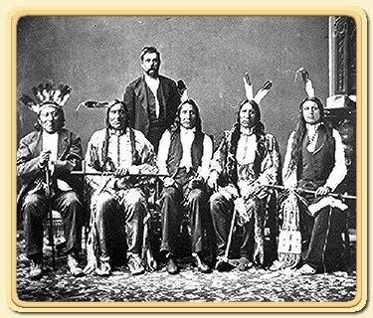
Challenges in Teaching
In January 1831, missionaries found a group of Delaware Indians living in the Indian Territory beyond the western border of Missouri.
The Delaware Indians were interested in learning the gospel contained in the Book of Mormon.
However, because the missionaries had not obtained the required permits to enter the Indian Territory and preach the gospel and because of opposition from local Indian agents and ministers, the missionaries from the Church were forced to leave the territory.
The missionaries then attempted to teach white settlers in Independence, Missouri, and the surrounding areas, but fewer than ten converts had joined the Church by July 1831.

Slide 3
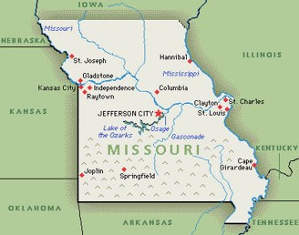
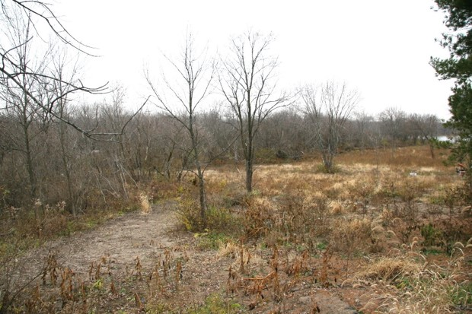
Disappointment
When elders of the Church from Ohio began arriving in Missouri in July 1831, some were disappointed with what they found.
Some of them expected to see a rapidly growing community of believers and a settlement that was prepared to accommodate the migrating Church members.
A few expressed concern because the land in Independence was undeveloped.
Additionally, some of the brethren were encouraged to stay in Missouri and purchase lands to prepare Zion for the Saints who would come later.

Slide 4
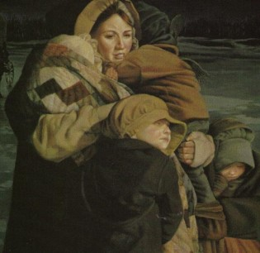
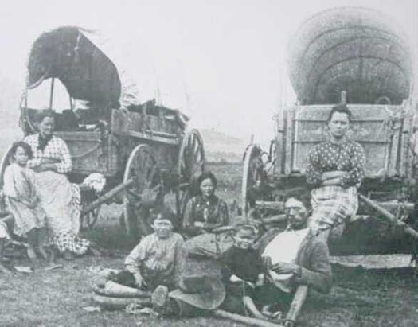
Life Will Not Be Easy
August 1831
The Lord warns the Elders and the Saints against an easy life, free from trials in Zion
They were to receive blessings but not until they endured trials
D&C 58:1-2

Slide 5
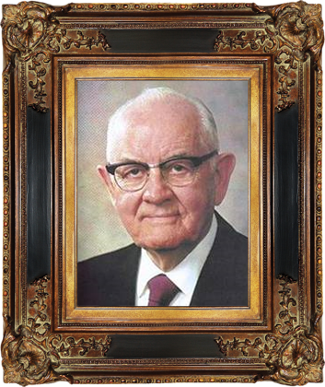
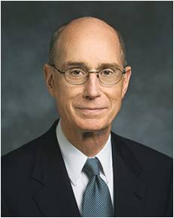
“I heard President Spencer W. Kimball, in a session of conference, ask that God would give him mountains to climb.
He said: “There are great challenges ahead of us, giant opportunities to be met. I welcome that exciting prospect and feel to say to the Lord, humbly, ‘Give me this mountain,’ give me these challenges.”
My heart was stirred, knowing, as I did, some of the challenges and adversity he had already faced. I felt a desire to be more like him, a valiant servant of God. So one night I prayed for a test to prove my courage. I can remember it vividly. In the evening I knelt in my bedroom with a faith that seemed almost to fill my heart to bursting.
Within a day or two my prayer was answered. The hardest trial of my life surprised and humbled me. It provided me a twofold lesson.
First, I had clear proof that God heard and answered my prayer of faith. But second, I began a tutorial that still goes on to learn about why I felt with such confidence that night that a great blessing could come from adversity to more than compensate for any cost.”
President Henry B. Eyring

Slide 6
Blessings Will Come
We will be blessed if we keep the Lord’s commandments. Our eternal reward will be greater if we remain faithful in tribulation
D&C 58:1-2

Slide 7
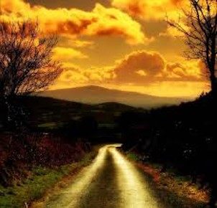
Look Beyond the Present
The Lord wanted the elders to look beyond the trials they were enduring and focus instead on the glorious future they would experience if they were faithful.
The Lord’s message to the Saints in Missouri can help us endure challenges by keeping us focused on the blessings promised to those who endure tribulation faithfully.
How can trusting that the Lord will bless you help you endure tribulation faithfully?
When have you felt that you were blessed for being faithful during tribulation?
D&C 58:3-5

Slide 8
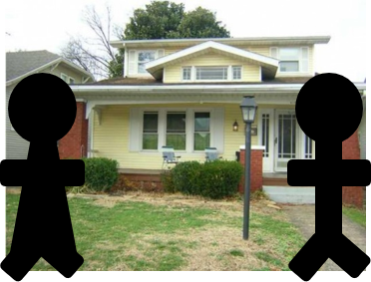
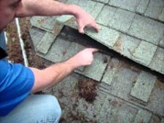
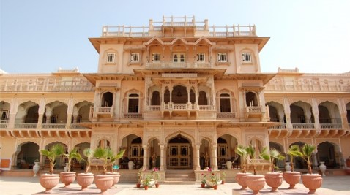
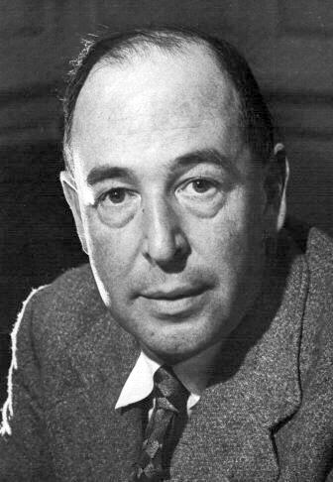
“‘Imagine yourself as a living house. God comes in to rebuild that house.
At first, perhaps, you can understand what He is doing. He is getting the drains right and stopping the leaks in the roof and so on: you knew that those jobs needed doing and so you are not surprised.
But presently he starts knocking the house about in a way that hurts abominably and does not seem to make sense. What on earth is He up to?
The explanation is that He is building quite a different house from the one you thought of—throwing out a new wing here, putting on an extra floor there, running up towers, making courtyards.
You thought you were going to be made into a decent little cottage: but He is building a palace. …’
C. S. Lewis

Slide 9
Reasons For Laying a Foundation
It is easier to know the reason why someone asks you to do something rather than doing it without understanding why

Slide 10
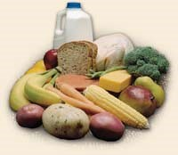
1. Obedience
Obedience is necessary for the furtherance of the Kingdom of God
The Word of Wisdom—an obedience law
Obedience to lawful authority—opposite--Rebellion
For rebellion is as the sin of witchcraft, and stubbornness is as iniquity and idolatry. Because thou hast rejected the word of the Lord, he hath also rejected thee from being king.
1 Samuel 15:23
Jesus even learned of obedience
Though he were a Son, yet learned he obedience by the things which he suffered—Hebrews 5:8
D&C 58:6

Slide 11
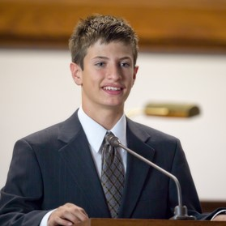
2. Prepared to Bear Testimony
There are truths in which the Lord would reveal only in Zion
Those who were there could testify of those truths, as witnesses. They could bear witness of that which they had heard.
The same came for a witness, to bear witness of the Light, that all men through him might believe.
John 1:7
D&C 58:6 Smith and Sjodahl

Slide 12
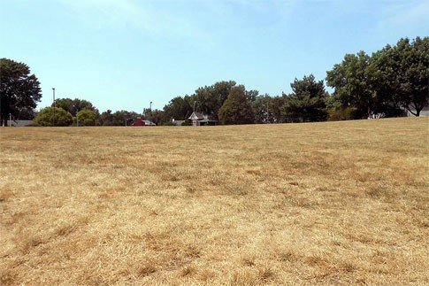
3. Laying a Foundation
One great purpose of God is to establish Zion---to save the world
The Saints were able to build a foundation and dedicated the land and the Temple site
And they that shall be of thee shall build the old waste places: thou shalt raise up the foundations of many generations; and thou shalt be called, The repairer of the breach, The restorer of paths to dwell in.
Isaiah 58:12
D&C 58:7 Smith and Sjodahl

Slide 13
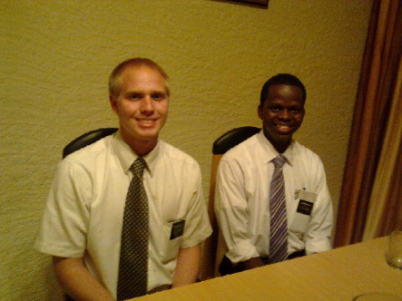
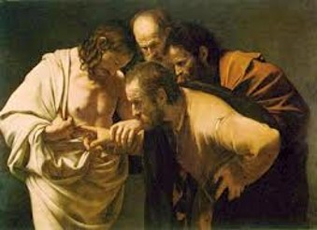
4. Testify
The Saints were to testify, not only of what they had heard but of what they had seen themselves.
And we have seen and do testify that the Father sent the Son to be the Saviour of the world.
1 John 4:14
D&C 58:7 Smith and Sjodahl

Slide 14
5. The Feast
One purpose of God in establishing Zion is to save the world through its laws and institutions, from the curse of poverty and destitution.
To give the world an entirely new social order, to establish a community in which even the poor would share the “fat things” with “the rich and the learned, the wise and the noble” (vs 10)
Zion is to be a place for the “supper of the house of the Lord”
D&C 58:8 Smith and Sjodahl

Slide 15
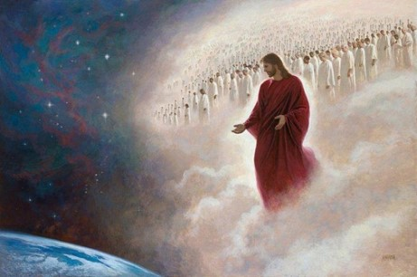
The Supper of the Lamb
To be held when the time has come for God Omnipotent to reign upon this earth
The New Jerusalem—the City of Zion
The two will be united when our Savior comes in His glory
And he saith unto me, Write, Blessed are they which are called unto the marriage supper of the Lamb. And he saith unto me, These are the true sayings of God.
Revelation 19:9
D&C 58:8 Smith and Sjodahl

Slide 16
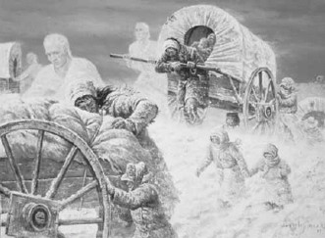
6. The Testimony
Knowledge and a spiritual witness given by the Holy Ghost. A testimony can also be an official or legal declaration of what a person perceives as truth—
The Guide to the Scriptures
That the testimony of the Saints might go forth from Zion
And I fell at his feet to worship him. And he said unto me, See thou do it not: I am thy fellow servant, and of thy brethren that have the testimony of Jesus: worship God: for the testimony of Jesus is the spirit of prophecy.
Revelation 19:10
D&C 58:13 Smith and Sjodahl

Slide 17
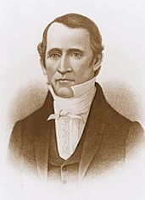
Responsibilities
Bishop Edward Partridge-- to direct the efforts to build the city of Zion.
Bishop Partridge and Sidney Gilbert-- to stay in Missouri to manage the properties of the Church and purchase land in and around Independence, Missouri.
As the Saints prepared to purchase land, Bishop Partridge argued with Joseph Smith about the quality of the land that had been selected.
He felt that different parcels of land should be purchased instead.
This disagreement led to a rebuke from the Lord.
D&C 58:14-15

Slide 18
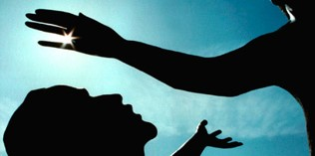
Blindness of Heart
Those who place their affection upon wrong objects, such as belong to the world, in preference to those that pertains to the Kingdom of God, are blind at heart, no matter how clear the physical or mental vision may be.
Weak Faith—
Jesus said unto him, If thou canst believe, all things are possible to him that believeth.
And straightway the father of the child cried out, and said with tears, Lord, I believe; help thou mine unbelief.
Mark 9:23-24
D&C 58:14-15 Smith and Sjodahl

Slide 19
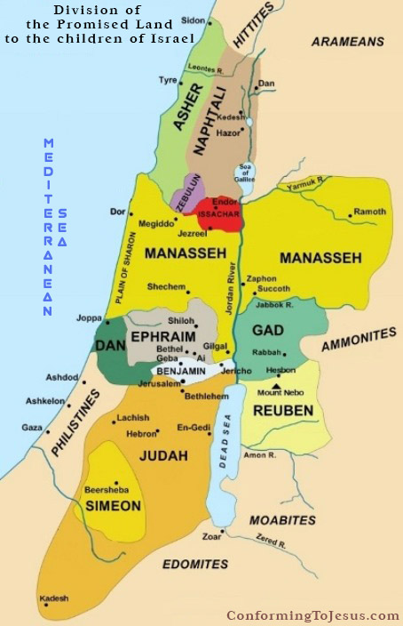
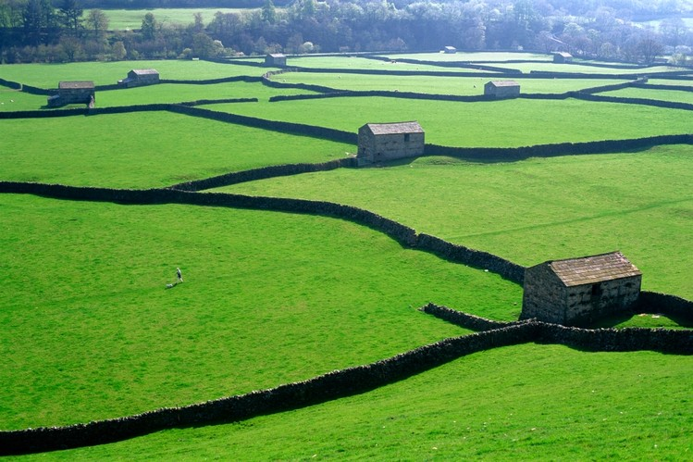
A Judge in Israel
Edward Partridge was called to be a judge among the Saints
He was to divide the land among them
The Judges in Israel preform the same office for the Twelve Tribes
He and his successors were to distribute God’s inheritance among the Saints in the same way.
D&C 58:17-18 Smith and Sjodahl

Slide 20
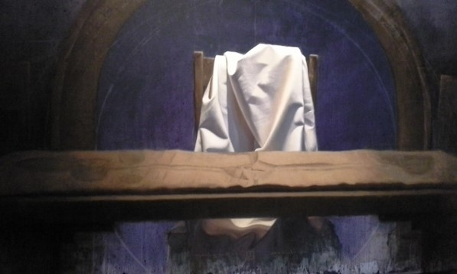
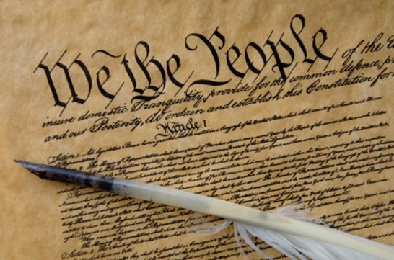
My Law Shall Be Kept
Jesus Christ is the Ruler—His Laws are the Laws
His counselors are His servants
There is no “hierarchy” in the Church
They are to keep the laws that are in the Constitution and all laws that are Constitutional
The Lord expects us to keep the laws of the land until He comes and reigns during the Millennium.
D&C 58:19-23 Smith and Sjodahl

Slide 21
Compelled in All Things
Imagine that as you are walking down the street you see an elderly person fall. Which of the following should you do?
a. Wait for the Spirit to prompt you to help.
b. Wait for someone else to tell you what to do.
c. Wait to see if someone else is going to help.
d. Immediately help the person who fell.
D&C 58:26-28

Slide 22
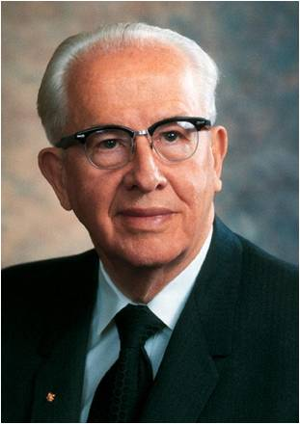
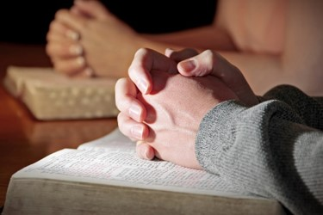
“Usually the Lord gives us the overall objectives to be accomplished and some guidelines to follow, but he expects us to work out most of the details and methods.
The methods and procedures are usually developed through study and prayer and by living so that we can obtain and follow the promptings of the Spirit. Less spiritually advanced people, such as those in the days of Moses, had to be commanded in many things.
Today those spiritually alert look at the objectives, check the guidelines laid down by the Lord and his prophets, and then prayerfully act—without having to be commanded ‘in all things.’ This attitude prepares men for godhood. …
“Sometimes the Lord hopefully waits on his children to act on their own, and when they do not, they lose the greater prize, and the Lord will either drop the entire matter and let them suffer the consequences or else he will have to spell it out in greater detail.
Usually, I fear, the more he has to spell it out, the smaller is our reward.”
Elder Ezra Taft Benson

Slide 23
We have power to choose to act for ourselves. If we wait for the Lord to tell us everything we should do, we will lose our reward
If we use our agency to do things that bring to pass righteousness, we will be rewarded
D&C 58:26-28

Slide 24
Sources:
Video:
My New Life (8:19)
President Henry B. Eyring Mountains to Climb 2012 April Conference
Hyrum M. Smith and Janne M. Sjodahl Doctrine and Covenants Commentary pgs. 336-339
C. S. Lewis, in his book Mere Christianity, (New York: The Macmillan Company, 1952, p. 160.)” shared by Elder Neal A. Maxwell (“The Value of Home Life,” Ensign, Feb. 1972, 5).
Elder Ezra Taft Benson (In Conference Report, Apr. 1965, pp. 121–22.)
Presentation by ©http://fashionsbylynda.com/blog/

Slide 25
Trials:
Elder George Q. Cannon suggested that “the Saints should always remember that God sees not as man sees; that he does not willingly afflict his children, and that if he requires them to endure present privation and trial, it is that they may escape greater tribulations which would otherwise inevitably overtake them. If He deprives them of any present blessing, it is that he may bestow upon them greater and more glorious ones by and by.” (Millennial Star, 3 Oct. 1863, p. 634.)
Trials sometimes come to the Saints as a chastisement when they disregard the Lord’s counsel (see D&C 101:1–8). Even when the Saints are living righteously, trials may come upon them because of the unrighteousness of others. Tribulation provides the Saints with opportunities for spiritual growth and character development. Such needed attributes as humility, faith, empathy, patience, courage, gratitude, and a repentant heart come to individuals in the refiner’s fire of tribulation and persecution.
Trials give Saints the opportunity to prove themselves worthy of eternal blessings by showing their commitment to God and His kingdom, and their willingness to endure privation and forsake the things of the world. This in turn helps them develop the faith necessary to obtain eternal life. According to the Lectures on Faith, prepared under the direction of the Prophet Joseph Smith: “A religion that does not require the sacrifice of all things never has power sufficient to produce the faith necessary unto life and salvation; for, from the first existence of man, the faith necessary unto the enjoyment of life and salvation never could be obtained without the sacrifice of all earthly things. It was through this sacrifice, and this only, that God has ordained that men should enjoy eternal life; and it is through the medium of the sacrifice of all earthly things that men do actually know that they are doing the things that are well pleasing in the sight of God. When a man has offered in sacrifice all that he has for the truth’s sake, not even withholding his life, and believing before God that he has been called to make this sacrifice because he seeks to do his will, he does know, most assuredly, that God does and will accept his sacrifice and offering, and that he has not, nor will not seek his face in vain. Under these circumstances, then, he can obtain the faith necessary for him to lay hold on eternal life.” (6:7.)
Elder Bruce R. McConkie explained:
“The testing processes of mortality are for all men, saints and sinners alike. Sometimes the tests and trials of those who have received the gospel far exceed any imposed upon worldly people. Abraham was called upon to sacrifice his only son. Lehi and his family left their lands and wealth to live in a wilderness. Saints in all ages have been commanded to lay all that they have upon the altar, sometimes even their very lives.
“As to the individual trials and problems that befall any of us, all we need say is that in the wisdom of Him who knows all things, and who does all things well, all of us are given the particular and specific tests that we need in our personal situations. It is to us, His saints, that the Lord speaks when He says: ‘I will prove you in all things, whether you will abide in my covenant, even unto death, that you may be found worthy.
“‘For if ye will not abide in my covenant ye are not worthy of me.’ (D&C 98:14–15) …
“But sometimes the Lord’s people are hounded and persecuted. Sometimes He deliberately lets His faithful saints linger and suffer, in both body and spirit, to prove … that they may be found worthy of eternal life. If such be the lot of any of us, so be it.
“But come what may, anything that befalls us here in mortality is but for a small moment, and if we are true and faithful God will eventually exalt us on high. All our losses and sufferings will be made up to us in the resurrection.” (In Conference Report, Oct. 1976, pp. 158–60; or Ensign,Nov. 1976, pp. 106, 108.)
President Brigham Young taught: “If the Saints could realize things as they are when they are called to pass through trials, and to suffer what they call sacrifices, they would acknowledge them to be the greatest blessings that could be bestowed upon them” (Discourses of Brigham Young,p. 345).
“We talk about our trials and troubles here in this life; but suppose that you could see yourselves thousands and millions of years after you have proved faithful to your religion during the few short years in this time, and have obtained eternal salvation and a crown of glory in the presence of God? Then look back upon your lives here, and see the losses, crosses, and disappointments; … you would be constrained to exclaim, ‘but what of all that? Those things were but for a moment, and we are now here. We have been faithful during a few moments in our mortality, and now we enjoy eternal life and glory’” President Brigham Young (“Remarks,” Deseret News, Nov. 9, 1859, 1). (See also Doctrine and Covenants Student Manual, 2nd ed. [Church Educational System manual, 2001], 119–20.)

Slide 26
Doctrine and Covenants 58:8–11. “The supper of the Lord”
“Two feast symbols from the Old Testament apply to the Supper of the Lord: the ‘feast of fat things,’ and the ‘wine on the lees well refined.’ Both are signs of richness, indicating that the feast mentioned here is of great importance (see also D&C 57:5–14; 65:3;Matthew 22:1–14; Revelation 19:7–9)” (Doctrine and Covenants Student Manual [Church Education System manual, 2001], 120).
Doctrine and Covenants 58:14–15. Bishop Partridge repented of his sins
Bishop Partridge argued with Joseph Smith about the quality of the land that had been selected in Missouri. He felt that different parcels of land should be purchased instead. The Lord chastened Bishop Partridge for his behavior.
Bishop Partridge accepted the Lord’s rebuke in Doctrine and Covenants 58 with humility. Just a few days after this revelation was given, he wrote to his wife: “You know I stand in an important station & as I am occasionally chastened I sometimes feel as though I must fall, not to give up the cause, but I fear my station is above what I can perform to the acceptance of my heavenly father” (letter to Lydia Partridge, Aug. 5–7, 1831, Church History Library, Salt Lake City). Minutes of a meeting in Zion that considered the argument between the Prophet Joseph and Bishop Partridge say that Partridge said that “he is & has always been sorry” for the disagreement (Minute Book 2, Mar. 10, 1832, 23, Church History Library, Salt Lake City; see also josephsmithpapers.org). A revelation given on September 11, 1831, indicated that Partridge had been forgiven for his conduct (Documents, Volume 2: July 1831–January 1833, vol. 2 of the Documents series of The Joseph Smith Papers [2013], 62).
D&C 58:19–23. What Law Were the Saints to Keep in the Land of Zion?
The Saints had entered into a covenant to keep the laws of God, which included the gospel and the law of consecration (see D&C 42:30–42, 53–55; 59:1–24). They were also expected to “be subject to the powers that be” (D&C 58:22) and live according to the laws of the land. President Joseph Fielding Smith said:
“Very strict was the command to the Saints that the law of God should be kept on the land of Zion. ‘Let no man think he is ruler; but let God rule him that judgeth, according to the counsel of his own will, or, in other words, him that counseleth or sitteth upon the judgment seat.’ We, today, do not realize the rigidity of this command. The Saints were to assemble in the land which had been appointed from the beginning as the site of the holy city, New Jerusalem. This land and this site were dedicated. Those who assembled there were placed under covenant that they would keep the law of God, which commandment had been repeated to them many times. Sidney Rigdon, according to appointment, stood up and asked the assembly:
“‘Do you receive this land for the land of your inheritance, with thankful hearts, from the Lord?’
“‘Do you pledge yourselves to keep the law of God on this land, which you never have kept in your own lands?’
“‘Do you pledge yourselves to see that others of your brethren who shall come hither do keep the laws of God?’
“To these questions, they each answered, ‘We do,’ and then the land was dedicated for their gathering and inheritance. The Lord was very jealous of these commandments. This was not to be an empty pledge. Failure to observe the covenant was to bring tribulation. …
“Many of the members of the Church forgot the covenant they had made to ‘keep the law of God’ upon the land, which was mandatory, and this brought them into trouble. Persecutions came and eventually they were driven from their inheritances. The tribulation in part, but not all, which the Lord had promised they should suffer, came upon them because of their disobedience.” (Church History and Modern Revelation, 1:212–13.)

