Slide 2
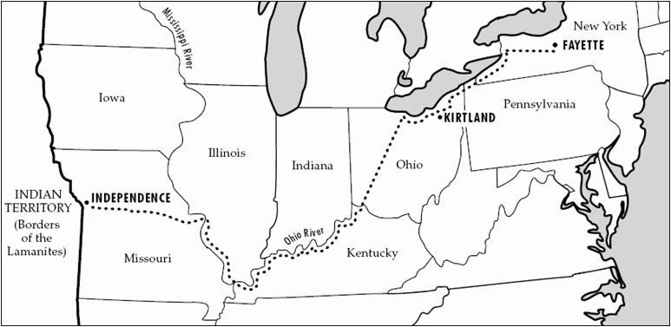
Background
August 8, 1831
Joseph Smith was still in Missouri and commanded along with Sidney Rigdon and Oliver Cowdery to return to Ohio.
Section 60 is the revelation given to Joseph Smith on what the Elders are to do

Slide 3
Hesitation
Can you think of a time when you hesitated to tell others about your beliefs or were reluctant to share your testimony of the gospel?
A group of elders had traveled from Ohio to participate in the dedication of the land and the temple site in Independence, Missouri. The Lord had commanded them to preach the gospel to others as they traveled to Missouri.
However, The Lord said, “They will not open their mouths, but they hide the talent which I have given unto them.”
D&C 60:1-2

Slide 4
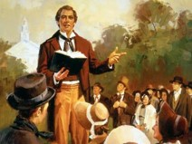
Displeasure
“They had been commanded to preach the Gospel along the way and bear testimony among the people, but some had failed to magnify this commandment because of their fear of man.
It is true that not every man is a natural missionary, and there are those who shrink from the responsibility of raising their voices in proclamation of the Gospel, and yet this is an obligation that we owe to this fallen world.
The elders in the very beginning had been commanded to serve the Lord with all their ‘heart, might, mind and strength,’ for the field is white and ready for the harvest.
A penalty was to be inflicted upon those who failed and they were not to stand blameless at the last day.”
D&C 60:1-2 President Joseph Fielding Smith

Slide 5
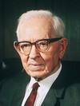
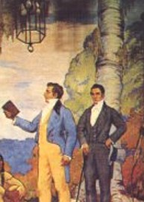
Trust in Him
“The preaching of the Gospel was to be a means to them by which they were not to perish, but bring salvation to their souls.
There are many who have been sent forth who have had a fear of man, yet the Lord has promised to support them in their labors if they will trust in him.”
The Elders had not shared their testimonies of the gospel.
D&C 60:1-2 President Joseph Fielding Smith

Slide 6
Sharing Your Talent--Testimony
What can happen if we do not share our testimonies?
Why do you think we have to share our testimony in order for it to remain with us?
“A man who wishes to receive light and knowledge, to increase in the faith of the Holy Gospel, and to grow in the knowledge of the truth as it is in Jesus Christ, will find that when he imparts knowledge to others he will also grow and increase…so the man who will not impart freely of the knowledge he has received, will become so contracted in his mind that he cannot receive truth when it is presented to him. Wherever you see an opportunity to do good, do it, for that is the way to increase and grow in the knowledge of the truth.”
We can lose our testimony if we do not share them
D&C 60:1-2 President Brigham Young

Slide 7
Jewels—Highly Esteemed By Man
As these precious stones are the best and most valued that the earth can produce, so are those people who prepare themselves by obedience to the commandments, for they will be the jewels the Savior will claim when He comes in glory
Thou shalt also be a crown of glory in the hand of the Lord, and a royal diadem in the hand of thy God. Isaiah 62:3
And they shall be mine, saith the Lord of hosts, in that day when I make up my jewels; and I will spare them, as a man spareth his own son that serveth him.
Malachi 3:17
And the Lord their God shall save them in that day as the flock of his people: for they shall be as the stones of a crown, lifted up as an ensign upon his land.
Zachariah 9:16
D&C 60:4 Student Manual

Slide 8
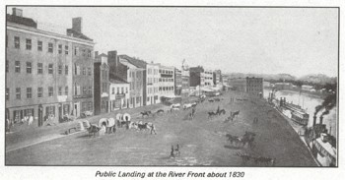
Preach As You Travel
On their return to Ohio, Joseph Smith Jun, Sidney Rigdon, and Oliver Cowdery were to preach as they went and especially in Cincinnati, Ohio
Edward Partridge was to “impart of the money which I have given him, a portion unto mine elders…”
“The expense of the journey, might be borne by the common funds, but those who were able to refund the money, were expected to do so.”
Smith and Sjodahl
D&C 60:5-11

Slide 9
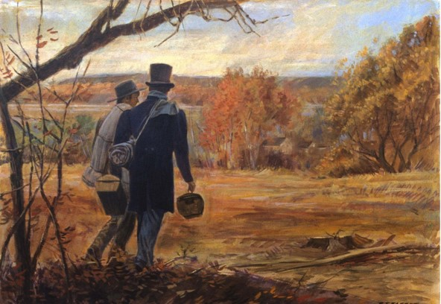
The Residue
Other elders were to be appointed to go on a mission to Jackson county. They were to preach the gospel to the world diligently, and not idle their time away
When they had reached their destination, they were to return and continue preaching, without being in a hurry and without stirring up strife.
D&C 60:12-16

Slide 10
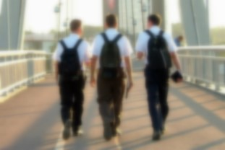
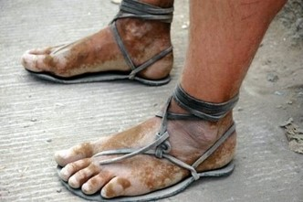
Shake the Dust
“Our Lord instructed His first Apostles to shake the dust off their feet, when they departed from a house or a city in which their message had been rejected.”
And whosoever shall not receive you, nor hear your words, when ye depart out of that house or city, shake off the dust of your feet.
Matthew 10:14
But the Jews stirred up the devout and honourable women, and the chief men of the city, and raised persecution against Paul and Barnabas, and expelled them out of their coasts.
But they shook off the dust of their feet against them, and came unto Iconium.
Acts 13:50-51
D&C 60:12-16 Smith and Sjodahl

Slide 11
Dangers in the Water
Doctrine and Covenants 61-62
Therefore, follow me, and listen to the counsel which I shall give unto you.
D&C 100:2

Slide 12
Background
August 12, 1831
On the bank of the Missouri River, Mcllwaine’s Bend
“On the 9th, in company with ten Elders, I left Independence landing for Kirtland. We started down the river in canoes, and went the first day as far as Fort Osage, where we had an excellent wild turkey for supper.
Nothing very important occurred till the third day, when many of the dangers so common upon the western waters, manifested themselves; and after we had encamped upon the bank of the river, at McIlwaine’s Bend, Brother Phelps, in open vision by daylight, saw the destroyer in his most horrible power, ride upon the face of the waters; others heard the noise, but saw not the vision.
“The next morning after prayer, I
received the following: [D&C 61].”
Prophet Joseph Smith

Slide 13
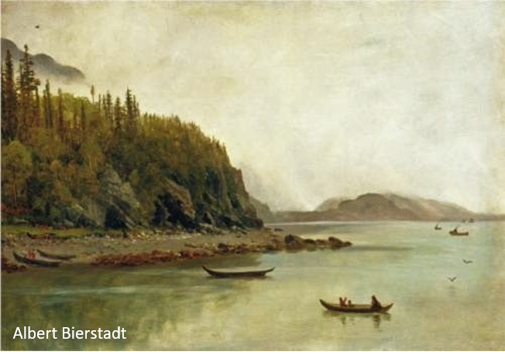
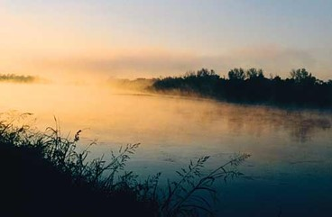
Bear Record of Satan
The Lord commanded the elders to bear record of Satan and his power upon the waters and of the power of God for the benefit of the faithful.
To fulfill this responsibility, it would be necessary for them to come in contact with people, hence, the Lord’s reminder that while traveling by canoe they were not able to meet people who needed to hear the gospel message. (vs. 23)
D&C 61:4, 19 Student Manual

Slide 14
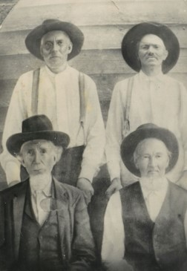
Be of Comfort
Prior to this experience the Elders had ill feelings and disagreements between them.
If they repented of their animosity of each other they were now forgiven (vs. 2)
The Lord was angry yesterday, but not today (vs. 20)
The Lord had not left them (vs. 36)
The blessings of the Kingdom was still theirs (vs. 37)
D&C 61:2, 20, 36-37

Slide 15
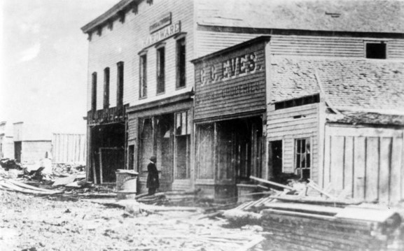
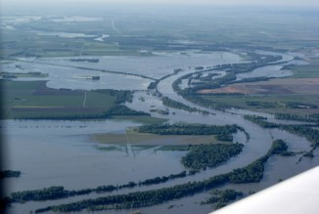
The Waters
The Lord’s words in do not prohibit Latter-day Saints from traveling on or swimming in the water.
The Lord refers specifically to the danger of “these waters,” meaning the Missouri River
Destruction had been decreed upon these rivers, and the Saints were to be warned.
During the year of 1834 the Missouri River lost one steamboat a day for many weeks with its destruction
D&C 61:5-19

Slide 16
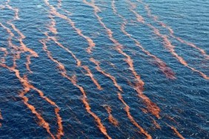
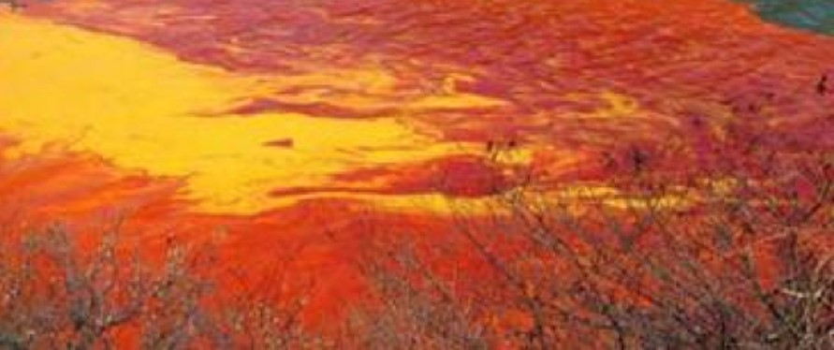
Dangers in Water
Prior to Second Coming
Many destructions” would occur on the waters in the last days
Read Revelation 8:8-11
In describing the curse on the waters in the last days, the Lord may have been referring to passages in the book of Revelation in which the Apostle John describes destruction that will occur in the waters prior to the Second Coming of Jesus Christ.
Read Revelation: 16:2-6
D&C 61:5-19

Slide 17
Does Satan Have Power
Over the Waters?
Satan gets his power from us
…because of these things which are taken away out of the gospel of the Lamb, an exceedingly great many do stumble, yea, insomuch that Satan hath great power over them.
1 Nephi 13:29
However:
The Lord has all power
D&C 61:5-19

Slide 18
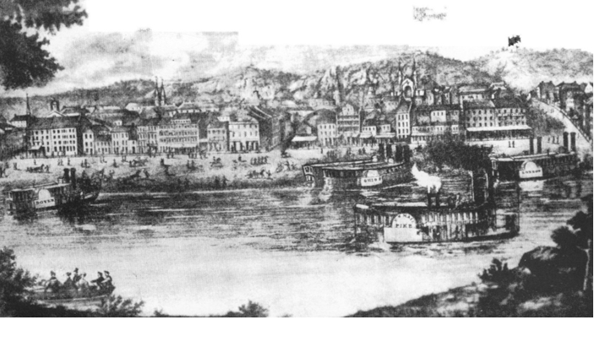
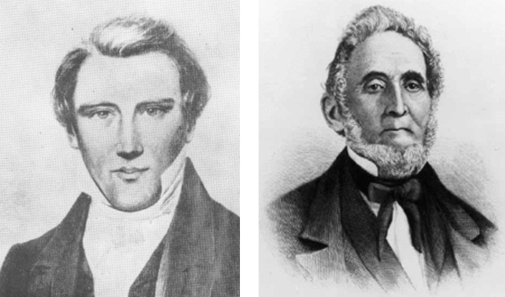
Cincinnati
“At the time of this revelation Cincinnati was only a village, yet it was like other western towns such as Independence, the gathering place of many who had been forced to flee from the larger cities because of the violation of the law.
In all the border towns in that day wickedness to a very great extent prevailed. After fulfilling their mission in Cincinnati these two brethren [the Prophet Joseph and Sidney Rigdon] were to continue their journey back to Kirtland.” (Smith, Church History and Modern Revelation,1:225.)
D&C 61:30-32

Slide 19
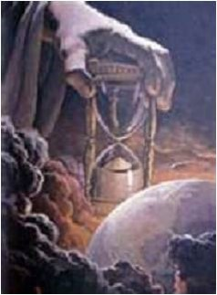
Christ’s Second Coming
No one knows the exact time of Christ’s coming. The Prophet Joseph Smith said: “Jesus Christ never did reveal to any man the precise time that He would come.
Go and read the Scriptures, and you cannot find anything that specifies the exact hour He would come; and all that say so are false teachers.” (History of the Church, 6:254.)
D&C 61:30-32

Slide 20
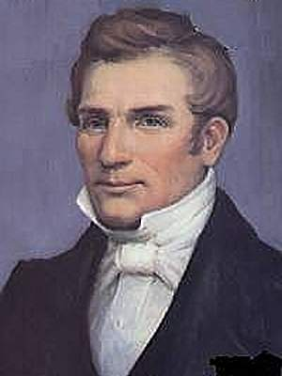
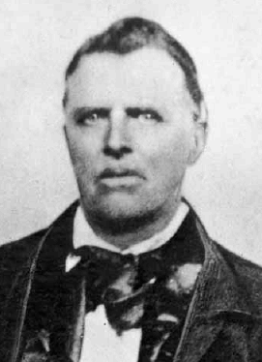
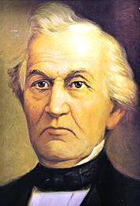
Background
“On the 13th [of August] I met several of the Elders on their way to the land of Zion, and after the joyful salutations with which brethren meet each other, who are actually ‘contending for the faith once delivered to the Saints,’ I received the following: [D&C 62]”
(History of the Church, 1:205).
Hyrum Smith
John Murdock
The elders were not identified in the Prophet’s history, but Reynolds Cahoon named them as follows: Hyrum Smith, John Murdock, Harvey Whitlock, and David Whitmer.
Journal History, 13 August 1831.
Harvey Gilman Whitlock was an early member of the Latter Day Saint movement and one of the witnesses to the Book of Commandments. He was among those Latter Day Saints driven by mobs from Jackson County, Missouri in the summer of 1833.
Born: 1809
Died: 1874
*John Murdock was so ill on this occasion that he was unable to pursue his journey to Zion without some assistance. After this revelation was given, the four missionaries (John Murdock, David Whitmer, Harvey Whitlock, and Hyrum Smith) put their money together and bought a horse for John Murdock to ride, by which means they were able to continue their travels. (vs. 7-8)
David Whitmer
D&C 62

Slide 21
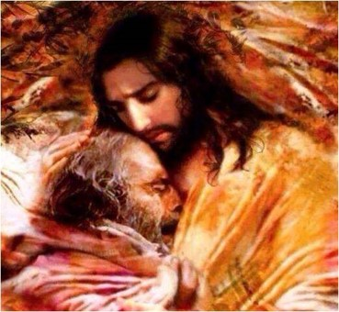
Succor
“Succor means ‘to go to the aid of one in want or distress’ or ‘to relieve.’
Fortunately, the Savior succors those ‘who are tempted’ so they will not commit sin, and if they should sin, he will succor them if they repent.” (Ludlow, Companion, 1:330.)
D&C 62:1

Slide 22
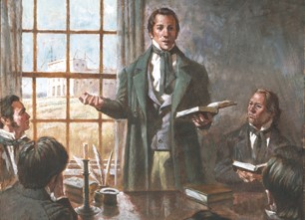
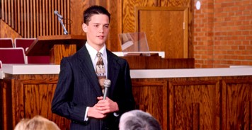
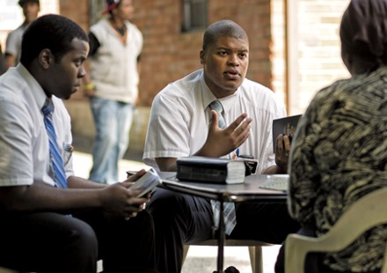
Elders Bearing Testimonies
“In this Revelation we are told that angels are scrutinizing the records kept of the testimonies of the Elders, and that they rejoice over the witnesses.
It appears from this that the ministry on earth has its effects beyond the veil as well as on this side.
An Elder who bears his faithful testimony to the truth does not know how far-reaching the result may be, though his visible audience may consist of but few.”
Smith and Sjodahl
D&C 62:3

Slide 23
What Mattered to the Lord
What Did Not Mattered to the Lord
That the elders take their journey speedily to St. Louis
D&C 60:5
Whether the elders made or bought a craft to travel in
That the elders take their journey in haste and that they fill their mission
D&C 61:21-22
Whether they traveled by water or by land
That the elders be faithful, bear testimony of the gospel, and help the Saints gather
D&C 62:5-7
Whether the elders journeyed all together or two by two; whether the elders rode horses or mules or in chariots

Slide 24
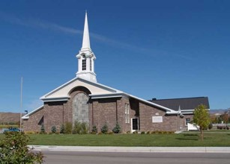
Making Decisions
What color of shirt should I wear today?
Should I go to Church on Sunday?
Should I serve a mission? If so, when?
If my mom offers to fix my favorite meal, what should I choose?
Whom should I date?
Where should we go to eat on our date?
The Lord helped the elders understand that some of the decisions they needed to make mattered more to Him than others
When we make decisions, we are to rely on our judgment and the directions of the Spirit.
D&C 62:8

Slide 25
When we make decisions, we are to rely on our judgment and the directions of the Spirit

Slide 26
Sources:
Video:
Testimony of Truth (3:31)
President Joseph Fielding Smith (Church History and Modern Revelation, 1:220–21.)
Doctrine and Covenants Student Manual Religion 324-325 Section 60
President Brigham Young Journal Discourse Vol. 2, 267
Hyrum M. Smith and Janne M. Sjodahl Doctrine and Covenants Commentary pg. 359-360
Prophet Joseph Smith (History of the Church, 1:202–3.)
Doctrine and Covenants Student Manual Religion 324-325 Section 61
Albert Bierstadt (German-born American artist, 1830-1902)
Hyrum M. Smith and Janne M. Sjodahl Doctrine and Covenants Commentary pg. 371
Presentation by ©http://fashionsbylynda.com/blog/

Slide 27
The first recorded practice of shaking the dust from the feet was by Joseph Smith's brother Samuel Smith, who performed the act on June 30, 1830, a few days or weeks before Smith's first revelation on the subject. After Smith's revelations, the practice became fairly common. Below is a table with many of the known instances of Latter Day Saint missionaries shaking the dust off their feet during the lifetime of Joseph Smith, Jr.:
June 30, 1830 | Samuel Smith washed his feet against an innkeeper who refused to board him after he mentioned the Book of Mormon, while proselytizing in Livonia, New York
June 16, 1831 | Early missionaries Hyrum Smith, Lyman Wight, John Corrill, and John Murdock washed their feet against Detroit, Michigan after a day of unsuccessful proselytizing
September 9, 1831 | Hyrum Smith washed his feet against an angry Christian minister.
November 18, 1831 | William E. McLellin and Samuel Smith washed their feet against a Campbellite congregation, after they had given them time during a meeting but rejected their testimony.
February 16, 1832 | William McLellin and Luke S. Johnson wash their feet against Hubbard, Ohio.
March 1, 16, 18, and June 1, 1832 | Act performed by Samuel Smith against those who do not accept his message.
March, September 16, October 23, 1832 | Orson Hyde routinely either blessed houses or shook the dust off his feet to "seal" them up to the "day of wrath". On September 16, after a tearful meeting with his sister and brother-in-law, he reluctantly shook the dust against them.
February 18, 1833 | Orson Pratt washed his hands and feet as a testimony against the current "wicked generation", as a requirement for admission to the School of the Prophets.
May 7, June 7, 1835 | William McLellin shook the dust against Sinclairville, New York after only one old lady attended a scheduled meeting at the local schoolhouse, which was locked. McLellin and David W. Patten shook the dust against Wolcott, New York when they passed the plate after a two hour sermon to nonbelievers but received no donations.
July 11, 1835 | William McLellin, Brigham Young, and Thomas B. Marsh shook the dust against an innkeeper who became abusive after they asked for free breakfast.
May 22, 1836 | Wilford Woodruff, David Patten, and Benjamin Boydstun wash their hands and feet against people who threatened them and rejected their testimony. They "delivered them unto the hands of God and the destroyer".
May 24, 1836, July 11, 1837, September 30, 1837 | Wilford Woodruff and other missionaries wash their feet against various Christian ministers in New England who reject their message, and against the town of Collinsville, Connecticut. wikipedia

Slide 28
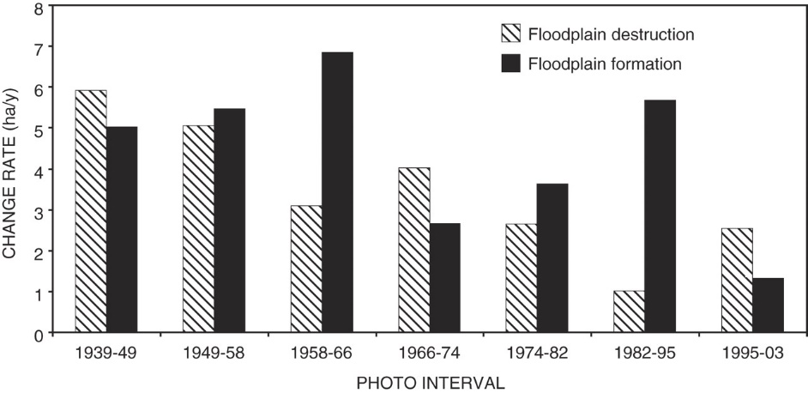
Shake the Dust of thy Feet:
The ordinance of washing the dust from one’s feet was practiced in New Testament times and was reinstituted in this dispensation (see D&C 88:139–40; John 11:2; 12:3; 13:5–14).
The action of shaking or cleansing the dust from one’s feet is a testimony against those who refuse to accept the gospel (see D&C 24:15; 84:92; 99:4).
Because of the serious nature of this act, Church leaders have directed that it be done only at the command of the Spirit. President Joseph Fielding Smith explained: “The cleansing of their feet, either by washing or wiping off the dust, would be recorded in heaven as a testimony against the wicked. This act, however, was not to be performed in the presence of the offenders, ‘lest thou provoke them, but in secret, and wash thy feet, as a testimony against them in the day of judgment.’
The missionaries of the Church who faithfully perform their duty are under the obligation of leaving their testimony with all with whom they come in contact in their work. This testimony will stand as a witness against those who reject the message, at the judgment.” (Church History and Modern Revelation, 1:223; see also Notes and Commentary for D&C 24:15.)
Curse of the Waters:
President Joseph Fielding Smith pointed out how “in the beginning the Lord blessed the waters and cursed the land, but in these last days this was reversed, the land was to be blessed and the waters to be cursed. A little reflection will bear witness to the truth of this declaration. In the early millenniums of this earth’s history, men did not understand the composition of the soils, and how they needed building up when crops were taken from them. The facilities at the command of the people were primitive and limited, acreage under cultivation was limited, famines were prevalent and the luxuries which we have today were not obtainable. Someone may rise up and say that the soil in those days was just as productive as now, and this may be the case. It is not a matter of dispute, but the manner of cultivation did not lend itself to the abundant production which we are receiving today. It matters not what the causes were, in those early days of world history there could not be the production, nor the varieties of fruits coming from the earth, and the Lord can very properly speak of this as a curse, or the lack of blessing, upon the land. In those early periods we have every reason to believe that the torrents, floods, and the dangers upon the waters were not as great as they are today, and by no means as great as what the Lord has promised us. The early mariners among the ancients traversed the seas as they knew them in that day in comparative safety. … Today this manner of travel in such boats would be of the most dangerous and risky nature. Moreover, we have seen the dangers upon the waters increase until the hearts of men failed them and only the brave, and those who were compelled to travel the seas, ventured out upon them. In regard to the Missouri-Mississippi waters, we have seen year by year great destruction upon them, and coming from them. Millions upon millions of dollars, almost annually are lost by this great stream overflowing its banks. Many have lost their lives in these floods as they sweep over the land, and even upon this apparently tranquil or sluggish stream there can arise storms that bring destruction. Verily the word of the Lord has been, and is being, fulfilled in relation to those waters. While the Lord has spoken of the sea heaving itself beyond its bounds, and the waves roaring, yet we must include the great destruction upon the waters by means of war, and especially by submarine warfare as we have learned of it in recent years.” (Church History and Modern Revelation, 1:224; see also Genesis 3:17–19;Ether 7:23–25; 9:16, 28; Revelation 16:1–6; Alma 45:16; D&C 59:3; 16–19.)
Student Manual
Elder B. H. Roberts explained: “During the three days upon the river some disagreements and ill feeling had developed among the brethren and explanations and reconciliations had become necessary; it had also been discovered that progress on their journey by the river in canoes was slow, and hence it became necessary for those who had been appointed to purchase the printing press, Sidney Gilbert and William W. Phelps; and the Prophet, Sidney Rigdon, and Oliver Cowdery, who had been commanded to hasten their return to Kirtland, found it imperative to find a more expeditious means of travel than by the canoes. The greater part of the night at McIlwaine’s Bend was devoted to these matters. The brethren became reconciled to each other, and those whose affairs more especially cried haste started overland the next morning for St. Louis, and the rest of the company continued the journey via the river.” (Comprehensive History of the Church, 1:262–63.)

