Slide 2
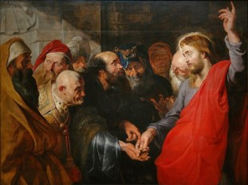
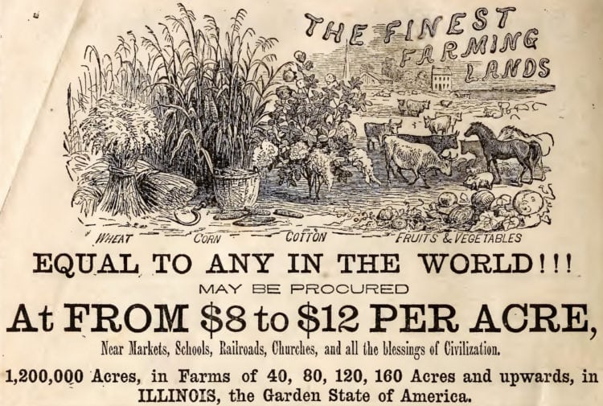
Render Unto Caesar
The chief priests and the scribes tried to set a trap for Jesus by asking Him if it was legal for the Jews to pay tribute to the Roman emperor, Caesar.
They knew that if He said yes, the Jews would reject Him because they hated the Romans, who had conquered them.
If Jesus said no, they could report Him to the Romans, who would arrest Him for treason against Roman rule.
Jesus showed them a coin with Caesar’s image stamped on it and said, “Render therefore unto Caesar the things which be Caesar’s, and unto God the things which be God’s”
Luke 20:19–26
In the Prophet Joseph Smith’s day, the Lord’s reference to that story helped teach the Saints that even though the whole earth belongs to the Lord, the Saints still had to buy the lands on which the Lord had commanded them to build the city of Zion.
This purchase was necessary for the Saints to have legal ownership of the land and to prevent contention about it in the future.
D&C 63:25

Slide 3
Titus Billings
He was born March 1793 at Greenfield, Massachusetts
He was a stonemason and one of the first person to be baptized in Kirtland
He was commanded to dispose of his land and journey to Missouri, and moved to Zion
He consecrated his holdings to the church
He was a counselor to Bishop Edward Partridge but was driven out of Jackson County by a mob
He participated in the Battle of Crooked River
He and his family left Nauvoo and migrated west
He remained faithful to the Church
He died in Provo, Utah Territory on February 6, 1866
Who’s Who

Slide 4
Newel K. Whitney
He was born February 5, 1795 in Marlborough, Vermont
He settled in Ohio as a merchandiser and worked with Sidney Gilbert as a clerk and bookkeeper
Both him and his wife, Elizabeth, were taught the gospel and baptized in November 1830
He was called to be a bishop in December of 1831 and later Presiding Bishop of the Church after the martyrdom of Joseph Smith
He and his family joined the westward trek in 1848
He passed away with chest pains on September 23, 1850 in Salt Lake City, Utah
He is mentioned in the Doctrine and Covenants 13 times
Who’s Who

Slide 5
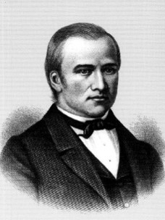
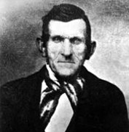
Settling Their Affairs
The Lord, through His Prophet, instructs the Saints in Kirtland to settle their affairs, dispose of their land, and go to the Land of Zion in the spring, and to send funds to the agent in Zion.
He directs Newel K. Whitney to be an agent for those who were to remain in Ohio
In the month of April, 1832, Titus Billings led a company of Saints from Kirtland to Jackson county. He was also instructed to dispose of his land.
D&C 63:38-41

Slide 6
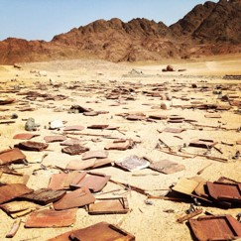
Worries of the Last Days
The Lord spoke of the destruction that would come upon the wicked in the last days, but He also made powerful promises to the Saints.
He directed the Saints, at that time, to purchase land in Missouri for the establishment of Zion, which He had promised would be a place of refuge
D&C 45

Slide 7
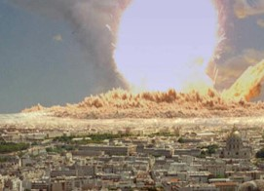
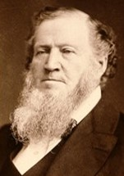
The Last Days
1. During the wars in the last days, wicked people will destroy one another.
Scripture
D&C 63:32–33.
True False
“You will hear of magnificent cities, now idolized by the people, sinking in the earth, entombing the inhabitants. The sea will heave itself beyond its bounds, engulfing mighty cities. Famine will spread over the nations and nation will rise up against nation, kingdom against kingdom and states against states, in our own country and in foreign lands; and they will destroy each other, caring not for the blood and lives of their neighbors, of their families, or for their own lives.”
Brigham Young

Slide 8
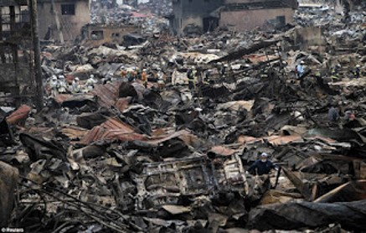
Destruction of the Last Days
2. The righteous Saints will easily escape all the destruction of the last days.
Scripture
D&C 63:34.
True False
“It is a false idea that the Saints will escape all the judgments, whilst the wicked suffer; for all flesh is subject to suffer, and ‘the righteous shall hardly escape;’ … many of the righteous shall fall a prey to disease, to pestilence, etc., by reason of the weakness of the flesh, and yet be saved in the Kingdom of God”
HC

Slide 9
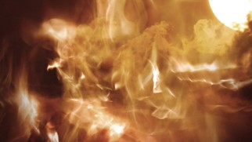
The Last Days
3. When Jesus Christ comes again, He will destroy any wicked people who are still on the earth.
Scripture
D&C 63:34.
True False
“Because of the destruction of the wicked at the Savior’s Second Coming, only righteous people will live on the earth at the beginning of the Millennium. They will be those who have lived virtuous and honest lives. These people will inherit either the terrestrial or celestial kingdom.”
Gospel Principles

Slide 10
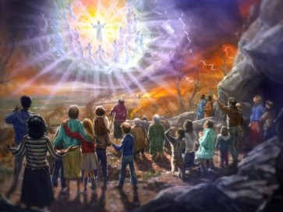
Millennium
4. Those who are faithful will eventually overcome all the challenges of this life.
Scripture
D&C 63:47–48.
True False
During the Millennium, Satan will be bound. This means he will not have power to tempt those who are living at that time The “children shall grow up without sin unto salvation” (D&C 45:58)
During the Millennium, there will be no war. People will live in peace and harmony together. Things that have been used for war will be turned to useful purposes.
Gospel Principles

Slide 11
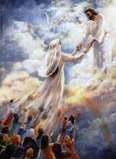
Resurrection
5. Righteous people who die before the Second Coming will be resurrected when the Savior comes to the earth.
Scripture
D&C 63:49.
True False
Those who have obtained the privilege of coming forth in the resurrection of the just will rise from their graves. They will be caught up to meet the Savior as He comes down from heaven.
Those who already have been resurrected and those who will be resurrected at the time of His coming will all inherit the glory of the celestial kingdom. See Mathew 27:52-53
After the resurrection of those who will inherit celestial glory,
another group will be resurrected: those who will receive a
terrestrial glory. When all these people have been resurrected,
the First Resurrection will be completed.
Gospel Principles

Slide 12
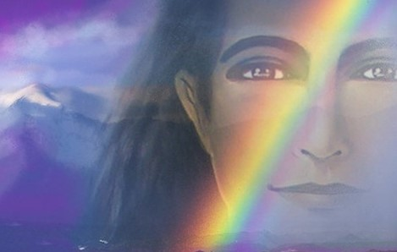
During the Millennium
6. Righteous people who are living on the earth at the time of the Second Coming will never die
Scripture
D&C 63:50–51.
True False
During the Millennium, there will be no death as we know it. When people have lived to an old age, they will not die and be buried. Instead, they will be changed from their mortal condition to an immortal condition in “the twinkling of an eye.”
Gospel Principles

Slide 13
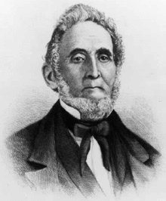
Sidney Rigdon’s Pride
Sidney Rigdon received an important assignment from the Lord but responded with pride.
The Lord commanded him to “write a description of the land of Zion, and a statement of the will of God, as it shall be made known by the Spirit unto him”
This written description would help Saints who lived far away from Independence, Missouri, to know what the land was like (photography was not available at that time).
It would also help inspire Saints to donate money for the purchase of the land.
The Spirit is grieved if we are prideful in doing the Lord’s Work

Slide 14
Come Unto Christ Liberty
Depths of Humility
Seek help from God
Blessings
Prosperity
Humility Cycle
Misery/Endless Wo
We come to ourselves
Selfishness
Self-Indulgence
Become “Lifted Up”
Inequality
Class divisions
Hatred
War
Pride Cycle
Persecution of Others
Seek Control over others
Use others
Insensitivity
Past Feeling
Personal Apostasy
Sin and Bondage
D&C 63:55-56

Slide 15
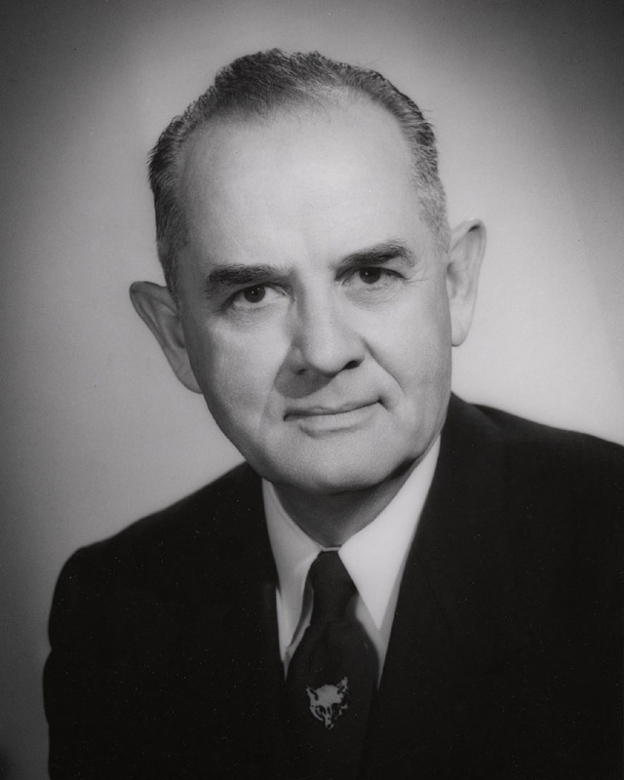
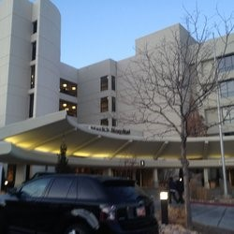
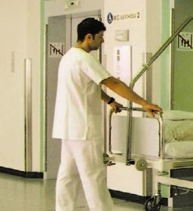
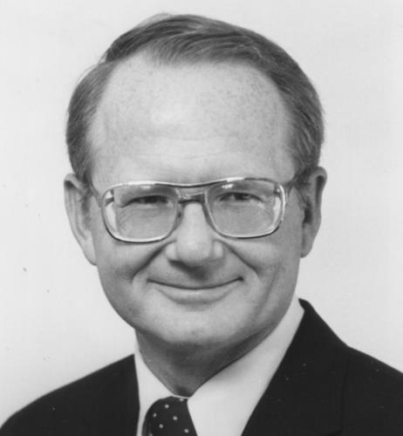
Sacredness of the Savior’s Name
“At St. Mark’s Hospital in Salt Lake City [President Spencer W. Kimball] was put under total anesthesia and operated on, then wheeled on a table back toward his room.
Still drugged, Spencer sensed his table stop by an elevator and heard the orderly, angry at something, profaning the Lord’s name.
Half-conscious, he pleaded with labored sounds: ‘Please don’t say that. I love Him more than anything in this world. Please.’
An absolute silence. Then the orderly answered softly: ‘I shouldn’t have said that. I’m sorry’”
Edward L. Kimball and Andrew E. Kimball Jr.

Slide 16
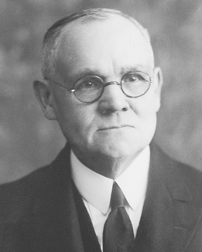
To Take the Lord’s Name in Vain
“1. We may take the name of God in vain by profane speech.
2. We take it in vain when we swear falsely, not being true to our oaths and promises.
3. We take it in vain in a blasphemous sense when we presume to speak in that name without authority.
4. And we take his name in vain whenever we willfully do aught that is in defiance of his commandments, since we have taken his name upon ourselves.”
Elder James E. Talmage

Slide 17
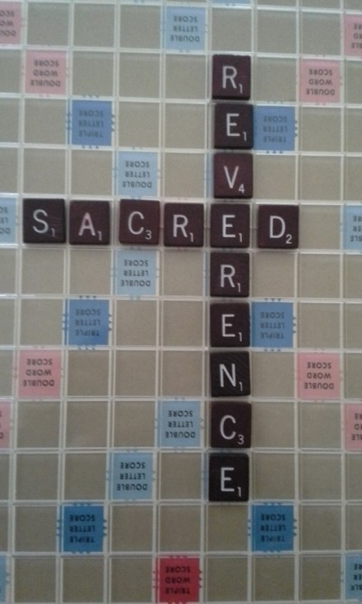
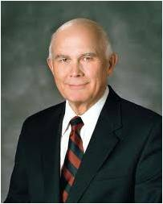
Reverence in a Name
Why do you think we are to use the Savior’s name with reverence?
How does Doctrine and Covenants 63:62 increase your understanding of what it means to take the name of the Lord in vain?
How does this verse apply to priesthood ordinances?
When we use the Savior’s name, what can we do to remember that it is sacred and must be spoken with care?
“There are no more sacred or significant words in all of our language than the names of God the Father and His Son, Jesus Christ” Elder Dallin H. Oaks
D&C 63:61-64

Slide 18
Sources:
Video:
Mountains to Climb (5:04)
Humility and Love (3:40)
Beware How We Take the Lord's Name (0:53)
Doctrine and Covenants Who’s Who by Ed J. Pinegar and Richard J. Allen pgs. 8, 169-171
Brigham Young (Discourse of Brigham Young, 111–12). Also found in Teachings of Brigham Young Chapter 45
History of the Church, 4:11; see also Journals, Volume 1: 1832–1839, vol. 1 of the Journals series of The Joseph Smith Papers [2008], 352–53).
Gospel Principles Chapter 44 and 45
(See Joseph Fielding Smith, Doctrines of Salvation, comp. Bruce R. McConkie, 3 vols. [1954–56], 2:167, 251–52.)
(Edward L. Kimball and Andrew E. Kimball Jr., Spencer W. Kimball: Twelfth President of The Church of Jesus Christ of Latter-day Saints [1977], 264).
Elder James E. Talmage (In Conference Report, Oct. 1931, pp. 53.)
Elder Dallin H. Oaks (“Reverent and Clean,” Ensign, May 1986, 50).
Presentation by ©http://fashionsbylynda.com/blog/

Slide 19
We know, of course, that the rain falls on the just as well as the unjust (see Matt. 5:45). But even though the just die they are not lost, but are saved through the Atonement of the Redeemer. Paul wrote to the Romans, “For whether we live, we live unto the Lord; and whether we die, we die unto the Lord” (Rom. 14:8).
We can heed warnings. We have been told that many had been given concerning the vulnerability of New Orleans. We are told by seismologists that the Salt Lake Valley is a potential earthquake zone. This is the primary reason that we are extensively renovating the Tabernacle on Temple Square. This historic and remarkable building must be made to withstand the shaking of the earth.
We have built grain storage and storehouses and stocked them with the necessities of life in the event of a disaster. But the best storehouse is the family storeroom. In words of revelation the Lord has said, “Organize yourselves; prepare every needful thing” (D&C 109:8).
Our people for three-quarters of a century have been counseled and encouraged to make such preparation as will assure survival should a calamity come.
We can set aside some water, basic food, medicine, and clothing to keep us warm. We ought to have a little money laid aside in case of a rainy day.
If Ye Are Prepared Ye Shall Not Fear Oct. 2005 Gen. Conf.
President GORDON B. HINCKLEY

Slide 20
__1. During the wars in the last days, wicked people will destroy one another. (See D&C 63:32–33.)
__2. The righteous Saints will easily escape all the destruction of the last days. (See D&C 63:34.)
__3. When Jesus Christ comes again, He will destroy any wicked people who are still on the earth. (See D&C 63:34.)
__4. Those who are faithful will eventually overcome all the challenges of this life. (See D&C 63:47–48.)
__5. Righteous people who die before the Second Coming will be resurrected when the Savior comes to the earth. (See D&C 63:49.)
__6. Righteous people who are living on the earth at the time of the Second Coming will never die. (See D&C 63:50–51.)

Slide 21
Come Unto Christ Liberty
Depths of Humility
Seek help from God
Blessings
Prosperity
Humility Cycle
Misery/Endless Wo
We come to ourselves
Selfishness
Self-Indulgence
Become “Lifted Up”
Inequality
Class divisions
Hatred
War
Pride Cycle
Persecution of Others
Seek Control over others
Use others
Insensitivity
Past Feeling
Personal Apostasy
Sin and Bondage

Slide 22
When Jesus Christ comes again to the earth, He will do the following things:
1. He will cleanse the earth. When Jesus comes again, He will come in power and great glory. At that time the wicked will be destroyed. All things that are corrupt will be burned, and the earth will be cleansed by fire (see D&C 101:24–25).
2. He will judge His people. When Jesus comes again, He will judge the nations and will divide the righteous from the wicked (see Matthew 25:31–46; see also chapter 46 in this book). John the Revelator wrote about this judgment: “I saw thrones, and they sat upon them, and judgment was given unto them: and I saw the souls of them that were beheaded for the witness of Jesus, and for the word of God, … and they lived and reigned with Christ a thousand years.” The wicked he saw “lived not again until the thousand years were finished” (Revelation 20:4–5; see also D&C 88:95–98).
3. He will usher in the Millennium. The Millennium is the thousand-year period when Jesus will reign on the earth. The righteous will be caught up to meet Jesus at His coming (see D&C 88:96). His coming will begin the millennial reign. (See chapter 45 in this book.)
President Brigham Young said:
“In the Millennium, when the Kingdom of God is established on the earth in power, glory and perfection, and the reign of wickedness that has so long prevailed is subdued, the Saints of God will have the privilege of building their temples, and of entering into them, becoming, as it were, pillars in the temples of God [see Revelation 3:12], and they will officiate for their dead. Then we will see our friends come up, and perhaps some that we have been acquainted with here. … And we will have revelations to know our forefathers clear back to Father Adam and Mother Eve, and we will enter into the temples of God and officiate for them. Then [children] will be sealed to [parents] until the chain is made perfect back to Adam, so that there will be a perfect chain of Priesthood from Adam to the winding-up scene” (Teachings of Presidents of the Church: Brigham Young [1997], 333–34).
4. He will complete the First Resurrection. Those who have obtained the privilege of coming forth in the resurrection of the just will rise from their graves. They will be caught up to meet the Savior as He comes down from heaven. (See D&C 88:97–98.)
After Jesus Christ rose from the dead, other righteous people who had died were also resurrected. They appeared in Jerusalem and also on the American continent. (See Matthew 27:52–53; 3 Nephi 23:9–10.) This was the beginning of the First Resurrection. Some people have been resurrected since then. Those who already have been resurrected and those who will be resurrected at the time of His coming will all inherit the glory of the celestial kingdom (see D&C 76:50–70).
After the resurrection of those who will inherit celestial glory, another group will be resurrected: those who will receive a terrestrial glory. When all these people have been resurrected, the First Resurrection will be completed.
The wicked who are living at the time of the Second Coming of the Lord will be destroyed in the flesh. They, along with the wicked who are already dead, will have to wait until the last resurrection. All of the remaining dead will rise to meet God. They will either inherit the telestial kingdom or be cast into outer darkness with Satan (see D&C 76:32–33, 81–112).
5. He will take His rightful place as King of heaven and earth. When Jesus comes, He will establish His government on the earth. The Church will become part of that kingdom. He will rule all the people of the earth in peace for 1,000 years.
When Jesus Christ first came to the earth, He did not come in glory. He was born in a lowly stable and laid in a manger of hay. He did not come with great armies as the Jews had expected of their Savior. Instead, He came saying, “Love your enemies, … do good to them that hate you, and pray for them which despitefully use you” (Matthew 5:44). He was rejected and crucified. But He will not be rejected at His Second Coming, “for every ear shall hear it, and every knee shall bow, and every tongue shall confess” that Jesus is the Christ (D&C 88:104). He will be greeted as “Lord of lords, and King of kings” (Revelation 17:14). He will be called “Wonderful, Counsellor, The mighty God, The everlasting Father, The Prince of Peace” (Isaiah 9:6). Gospel Principles Chapter 44

