Slide 2
Isaac Morley
Recap from lesson 69
He was born on March 11, 1786 in Massachusetts
He was a prosperous farmer in Kirtland, Ohio
He became infused with religious fervor through the preaching of Sidney Rigdon and organized a community group called “the family”
The Missionaries who were sent to preach to the Lamanites also converted him and his wife
Joseph Smith resided at his place for a time, and a conference was held at his home in 1831 (the 4th Conference)
He was ordained a high priest and counselor to Bishop Partridge
He was asked to sell his farm and consecrate the proceeds to the Church, which he did, though at first reluctantly
He and his family moved to Independence, Missouri and his family suffered through mob violence forcing them to leave to Clay County, Missouri and then to Far West where he was ordained a patriarch
He moved close to Nauvoo at a place called Yelrome (Morley spelled backwards) until a mob destroyed his property and he was forced to move to Nauvoo after Joseph Smith’s martyrdom
He joined the pioneer exodus to the West and settled in Manti and died on June 24, 1865 staying strong in the Church
Who’s Who

Slide 3
Frederick G. Williams
He was born on October 28, 1787, at Suffield, Connecticut
He was a self trained medical practitioner
He and his wife found their way to Kirtland, Ohio and were converted by the missionaries and baptized in October 1830
He was ordained an elder and then a high priest in 1832
He owned some land in Ohio and the Prophet in D&C 64 told him to hold that land for 5 years and in 1834 he deeded his farm to the Prophet Joseph Smith
He was paymaster in Zion’s Camp
He lost his counsellorship and his membership in 1837
He repented and was rebaptized and joined the saints in Missouri (D&C 90:6)
He passed away in Quincy, Ohio in October 1842 of poor health

Slide 4
The Sacrifice
Isaac Morley
Frederick G. Williams
Commandment
Response
Result
Sell his farm
Most of the money from the sale of his farm would be used to buy land for other Church members in Independence, Missouri.
He obeyed
He was one of the first Saints to settle in Independence, Missouri, where he sought to establish Zion
He was blessed
To not sell his farm
He told Joseph Smith that his farm could be used to house and feed Church members in need. Later, Frederick consecrated his entire farm to the Church without receiving any payment in return.
He obeyed
During these years, the Saints built the Kirtland Temple, which was a source of great blessings to the Saints
He was blessed
D&C 64:20

Slide 5
If we follow the Lord’s will for us, we will not be tempted above that which we can bear

Slide 6
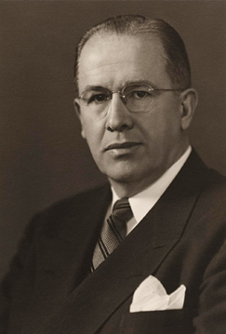
“My beloved brethren and sisters, humbly and gratefully I approach this sacred assignment with a prayer in my heart that what I say will strengthen our resolve to live the principle of sacrifice as a prerequisite to a godly life, for this is a day of sacrifice.”
“Let us here observe, that a religion that does not require the sacrifice of all things never has power sufficient to produce the faith necessary unto life and salvation” (Lectures on Faith, 6:7).
“To sacrifice, be willing to serve a mission.
We ask you to make the sacrifice. We call it that because of want for a better name for it. It’s an investment.”
We are blessed as we obey the Lord and offer the sacrifices He asks of us
“It is a willingness to forgo personal bad habits such as tobacco, alcohol, profanity, an unruly temper, and immorality—habits which cause us, the children of God, to be less than our destiny.”
Excerpts from Elder
Ezra Taft Benson

Slide 7
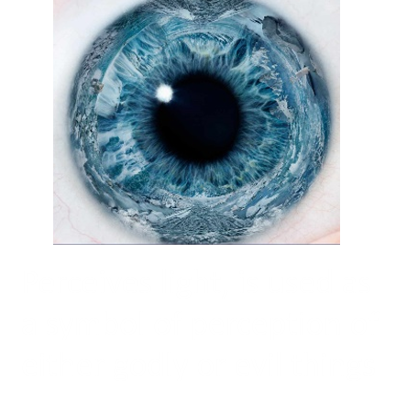
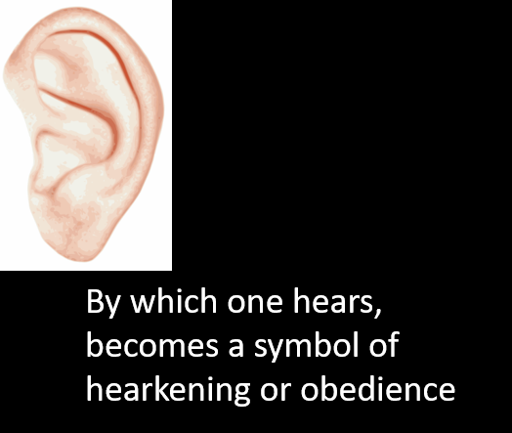
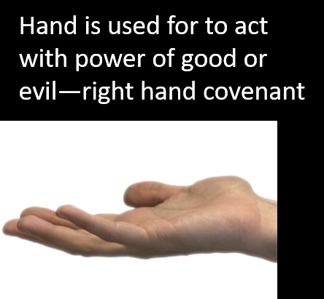
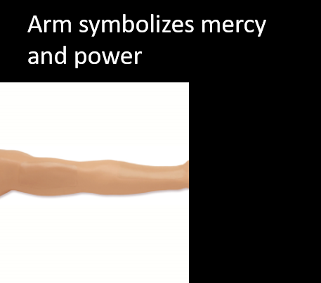
The light of the body is the eye: therefore when thine eye is single, thy whole body also is full of light; but when thine eye is evil, thy body also is full of darkness.
Luke 11:34
He that hath ears to hear, let him hear.
Matthew 11:15
Throughout the scriptures various parts of the human body are used figuratively, and this imagery is generally derived from the function of the body part.
With a strong hand, and with a stretched out arm: for his mercy endureth for ever.
Psalms 136:2
His left hand is under my head, and his right hand doth embrace me.
Solomon 2:6

Slide 8
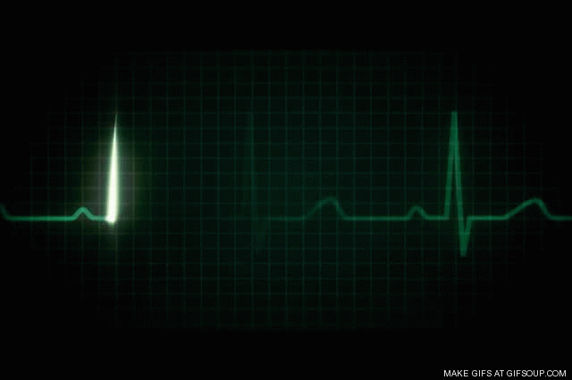
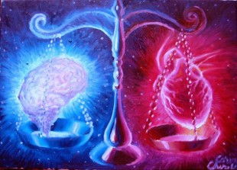
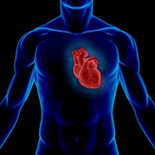
The Heart
The “innermost center” of man
1. Giving life and power
2. Rational and emotional nature of man
Seat of love and hate
Thought and knowledge
Feelings and affections
3. Moral life
Spiritual growth
Dwelling place of either Christ or Satan
Hard or broken
Harboring Good or Evil
D&C 64:22—Bible Dictionary

Slide 9
By Failing to Pay Tithing:
The Spirit of the Lord is withdrawn
The wicked will be destroyed in the end--burning
The righteous will be preserved—The Lord has promised to shield and protect
The power of the priesthood will withdraw
(neglecting of duty)
Gradually drift from the gospel, until they are among the wicked
About seven years later, the Lord revealed that tithing was to be “one-tenth of all [our] interest annually D&C 119:4
D&C 64:23-24 excerpts from Elder Rudger Clawson

Slide 10
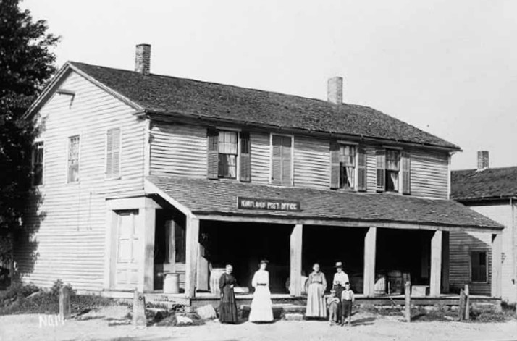
Provide for Needs of the Saints
Newel K. Whitney and Sidney Gilbert.
He commanded them to use their store in Kirtland, Ohio, to help provide for the needs of the Saints.
An example of
sacrifice and
contribute to
the building of
Zion.
D&C 64:26-33

Slide 11
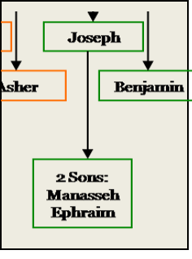
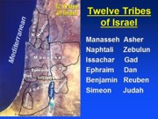
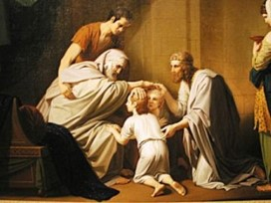
Provide for Needs of the Saints
It seems strange that the Lord would say that blood, a symbol for descendancy, could be influenced by rebelliousness, a spiritual trait.
Isn’t one either a descendant of Ephraim or not a descendant of Ephraim? The answer is no, not in the eyes of the Lord, who views His children in terms of their spiritual qualities.
Paul taught this principle to the early Saints. The Jews took great pride in the fact that they were of the circumcision, that is, that they were the covenant people, circumcision being the token of that covenant. But Paul pointed out that if one of the circumcision violated the law, his “circumcision is made uncircumcision” (Romans 2:25).
Joseph Fielding Smith
D&C 64:34

Slide 12
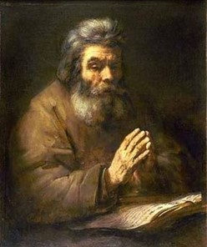
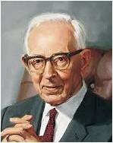
Provide for Needs of the Saints
In other words, by transgression one excludes oneself from being a true Israelite. Paul concluded his reasoning with this statement: “For he is not a Jew, which is one outwardly; neither is that circumcision, which is outward in the flesh: but he is a Jew, which is one inwardly; and circumcision is that of the heart, in the spirit, and not in the letter; whose praise is not of men, but of God” (Romans 2:28–29).
“It is Ephraim, today, who holds the priesthood. It is with Ephraim that the Lord has made covenant and has revealed the fulness of the everlasting gospel. It is Ephraim who is building temples and performing the ordinances in them for both the living and for the dead. When the ‘lost tribes’ come—and it will be a most wonderful sight and a marvelous thing when they do come to Zion—in fulfilment of the promises made through Isaiah and Jeremiah, they will have to receive the crowning blessings from their brother Ephraim, the ‘firstborn’ in Israel.”
Joseph Fielding Smith
D&C 64:34-36

Slide 13
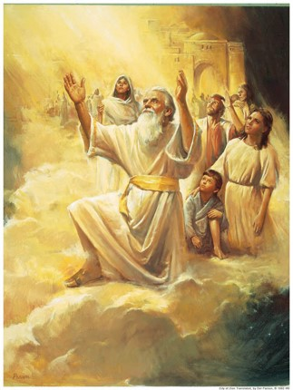
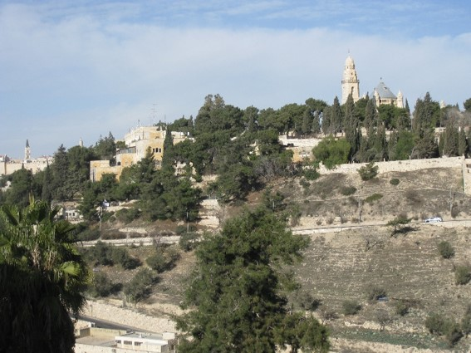
Zion
Zion was the name given to the ancient city of Enoch in the days before the Flood. “And it came to pass in his days, that he built a city that was called the City of Holiness, even Zion” (Moses 7:19).
This Zion endured for some 365 years (see Moses 7:68). The scriptural record states, “And Enoch and all his people walked with God, and he dwelt in the midst of Zion; and it came to pass that Zion was not, for God received it up into his own bosom; and from thence went forth the saying, Zion is fled” (Moses 7:69).
Later, Jerusalem and its temple were called Mount Zion, and the scriptures prophesy of a future New Jerusalem where Christ shall reign as “King of Zion,” when “for the space of a thousand years the earth shall rest” (Moses 7:53, 64).
D&C 64:41-44 Elder D. Todd Christofferson

Slide 14
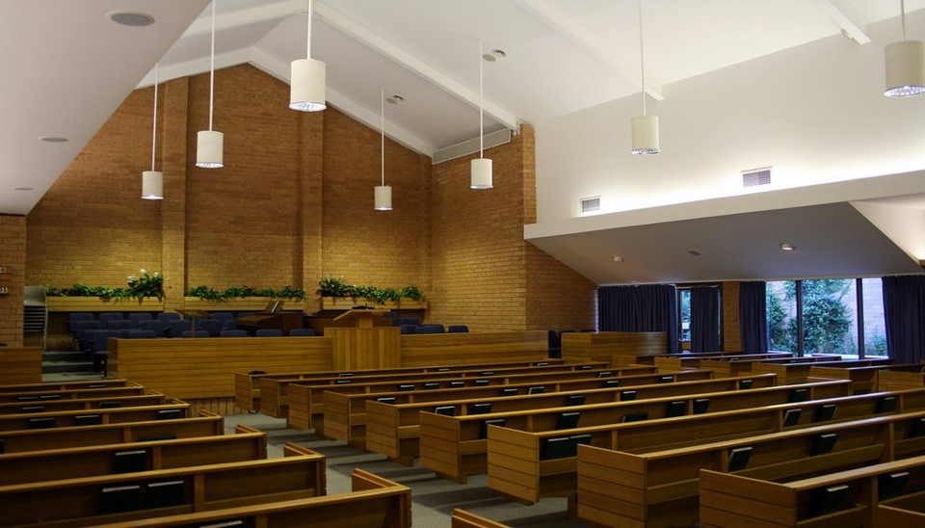
Our Zion Today
“Today the Lord’s people are gathering “out from among the nations” as they gather into the congregations and stakes of The Church of Jesus Christ of Latter-day Saints that are scattered throughout the nations.”
Zion is both a place and a people
D&C 64:41-44 Elder D. Todd Christofferson

Slide 15
Sources:
Videos:
The Heart and a Willing Mind (7:56)
Those Tithed Not Burned at His Coming (1:00)
Flecks of Gold (3:15)
Doctrine and Covenants Who’s Who by Ed J. Pinegar and Richard J. Allen pg 172-173
Unger, Bible Dictionary, “heart,” p. 462; see also Topical Guide, “heart,” 203.
Elder Ezra Taft Benson This Is a Day of Sacrifice April 1979 Gen. Conf.
Excerpts from Elder Rudger Clawson Conference Report, Oct. 1913, p. 59
Joseph Fielding Smith (Doctrines of Salvation,3:252–53.)
Elder D. Todd Christofferson Come to Zion October 2008 Gen. Conf.
Presentation by ©http://fashionsbylynda.com/blog/

Slide 16
The heart is frequently used figuratively in the Bible. One scholar indicated that in the Bible the heart is viewed as the “innermost center” of man, and is representative of:
1. The center of bodily life and power. When the heart is strengthened, the whole man is strengthened.
2. The center of the rational and emotional nature of man. It is the seat of love and hate, the center of thought and knowledge—it understands, deliberates, reflects, estimates. It is the center of feelings and affections, experiencing joy, pain, ill will, dissatisfaction, anxiety, despair, fear, and reverence.
3. The center of moral life. Many degrees of spiritual growth are found in the heart. It is the dwelling place of either Christ or Satan; it can be hard or broken; it can be a treasure of either good or evil. “The heart is the laboratory and place of issue of all that is good and evil in thoughts, words, and deeds. … It is the center of the entire man, the very hearth of life’s impulse.” (Unger, Bible Dictionary, “heart,” p. 462; see also Topical Guide, “heart,” 203.)
When one understands the profound imagery of the heart, one can better understand why the Lord requires the heart of man. In Doctrine and Covenants 64:34 the Lord added a willing mind to that basic requirement.
Student Manual Religion 324-325 Section 64
Sacrifice:
President Kimball has said, “How selfish and thoughtless would it be for a young man to grow to maturity, spend his time preparing for his life’s work and his occupation and be unwilling to serve his Creator in this, the most important service in the world” (Regional Representatives’ seminar, 30 Sept. 1977).
It is true that, the strength of a man/woman lies in their ability to create a good balance between the mind and the heart; without neglecting the power, each one has on their desires and will. But, is there ever really a point of balance between them? Yes, there is. But, the road to getting there, is that of a narrow path.
The mind is a sea of, both; Good&Evil; Truths&Lies; Strengths&Weaknesses; Fiction&Facts; Will&Discouragement; Positives&Negatives; Glory&Destruction. The mind is like a force, which is responsible for our reactions; and it’s main power is to perceive and envision the motives of an action, even, before it’s being put in motion.
The heart, likewise, is a light of, both; Passion&Pain; Faithfulness&Deceit; Love&Hate; Tears&Laughter; Desires&Limitations; Brightness&Darkness; Hope&Death; Faithfulness&Carelessness. The heart, therefore, is like a radiation, solely responsible for illuminating the personality of a person, which is done through, emotions. But, one thing the heart fails to do mostly, is, to guarantee a clear vision.
How can these two, important forces, strike a balance?
Have you ever felt the need to do something so much; and you come real close to achieving it, but, unsure of the possible outcome(s) of that motive? Well, that is the point of balance between the heart and the mind. The heart gives you reason(s) to worry, but, the mind gives you reason(s) to forge ahead.
Ever felt the pain in doing something wrong, but, had no real impact in your life as a whole? This is another point of balance between; your heart feeling sober for the wrong you did, and your mind telling you to move on regardless of your mistakes.
When the mind resists and the heart insists; it is only but a second, to the point of balance before, one of the two forces weighs, heavier than the other.
It is good to listen to your heart often, but, do not lose your mind in the process of doing so. Great people don’t just follow their dreams blindly; they envision and work for it, with great passion! Sometimes, the mind will resist, and the heart will insist; or the other way round. In such situation(s), never neglect one for the other, cause no one truly knows the destination ahead of a journey, but the power to see beyond, is the ability to apply wisdom with passion.
By Evelyn Agekameh
http://eve4evarules.wordpress.com/2013/06/06/when-the-mind-resists-the-heart-insists/
Something of Interest about the Heart
By Evelyn Agekameh

Slide 17
