Slide 2
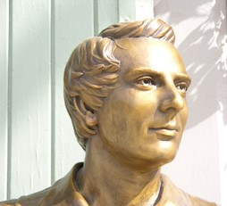
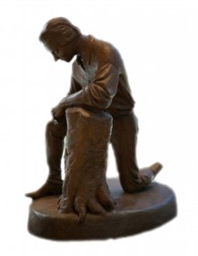
Background
October 1831 in Hiram, Ohio
13 Revelations were received by Joseph Smith at the home of the Johnson’s where he and his family resided
During this time Joseph Smith and Sidney Rigdon, as scribe, were in the process of translating the scriptures
The Prophet Joseph Smith indicated that this section is a prayer. He said, “In the fore part of October, I received the following prayer [D&C 65] through revelation” HC

Slide 3
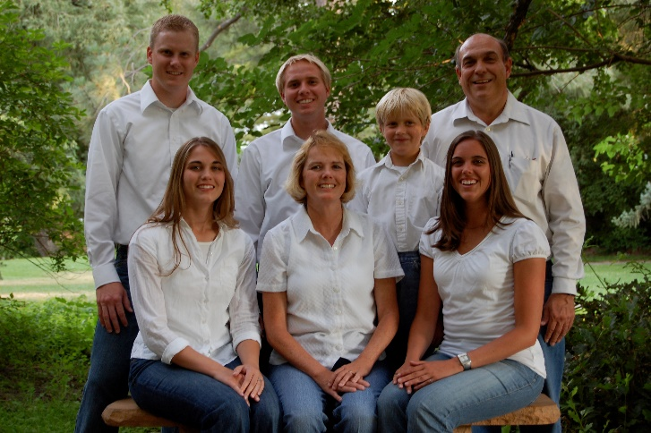
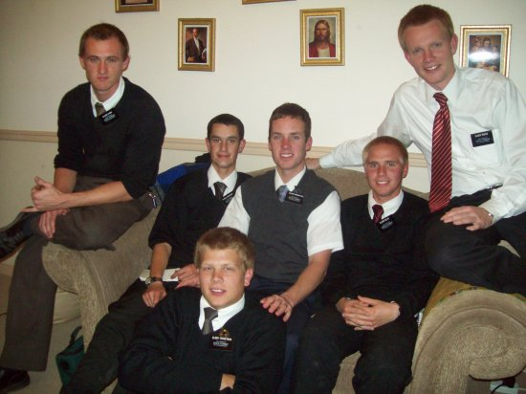
What Do We Pray For?
Food and Clothing
Family
Home
Missionary Effort
Health and Strength
Finding our ancestors

Slide 4
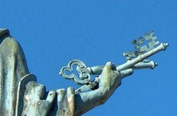
Setting Up the Kingdom of God
The gospel of Jesus Christ will go forth to the ends of the earth.
“committed unto man” -- enables the gospel to fill the whole earth
“keys of the kingdom” --the priesthood authority to preside in the Church.
With these keys, the President of the Church leads our efforts to preach the gospel. He delegates some of the keys to general and local priesthood leaders.
D&C 65:1-2

Slide 5
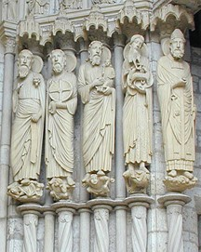
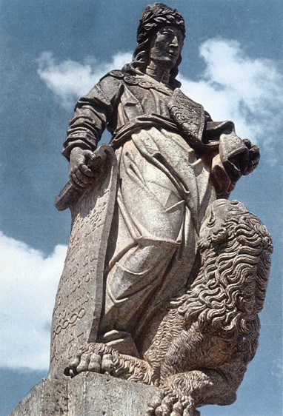
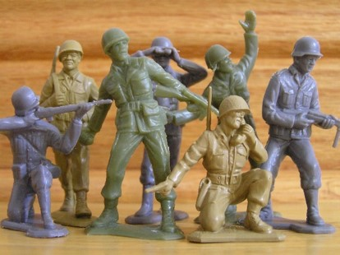
Our Role in the Kingdom
“The ancient prophets declared that in the last days the God of heaven should set up a kingdom which should never be destroyed, nor left to other people; and the very time that was calculated on, this people were struggling to bring it out. …
“I calculate to be one of the instruments of setting up the kingdom of Daniel by the word of the Lord, and I intend to lay a foundation that will revolutionize the whole world. …
It will not be by sword or gun that this kingdom will roll on: the power of truth is such that all nations will be under the necessity of obeying the Gospel.”
HC
D&C 65:1-6

Slide 6
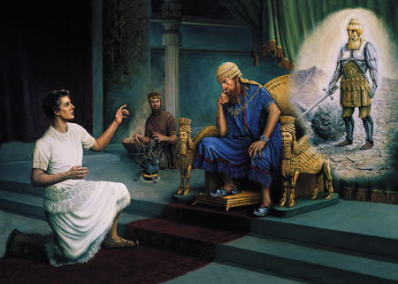
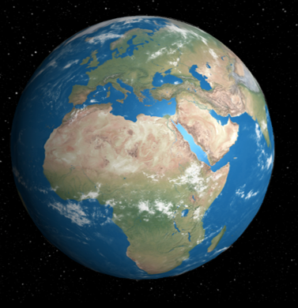
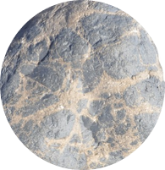
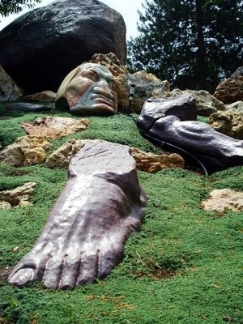
Nebuchadnezzar’s Dream
The Lord revealed the dream and its meaning to Daniel.
In the dream, a great statue, which represented various political kingdoms, was destroyed by a stone cut without hands from a mountain.
The stone started small but grew until it filled the whole earth.
Interpretation of the dream, which was to roll forth and smite the image and break it in pieces and to roll on until it should fill the whole earth.
Daniel 2:31-45

Slide 7
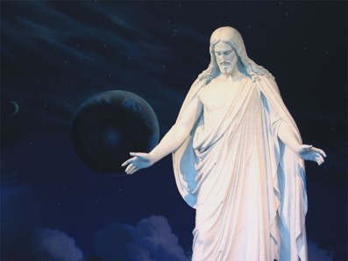
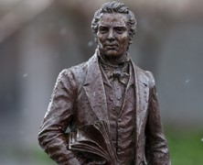
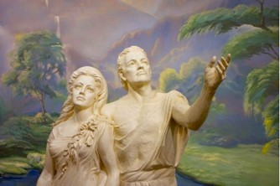
The Kingdom
Kingdom of God set up In the Days of Adam
Righteous men—God reveals His word and gives power and authority to administer in His name
Righteous Man
Priesthood of God
Kingdom of God
Priest
Righteous Man
Oracles of God
Kingdom of God
Prophet
Daniel 2:31-45 Prophet Joseph Smith

Slide 8
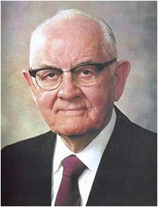
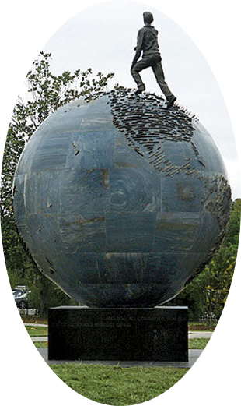
“We are citizens in the greatest kingdom on earth—a kingdom not directed by the wisdom of men but led by the Lord Jesus Christ.
Its presence is real. Its destiny is certain. This is the kingdom of which the prophet Daniel spoke—a stone, as it were, that should be cut out of the mountain without hands and roll forth and fill the earth
“No mortal man created this kingdom”
President Spencer W. Kimball
D&C 65:2

Slide 9
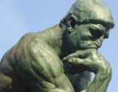
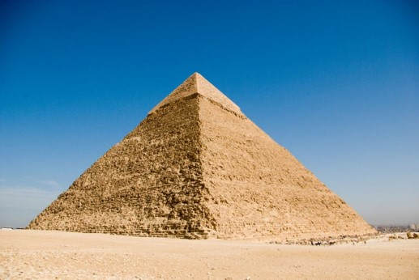
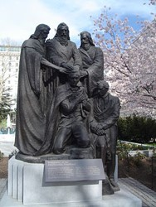
Why am I Here?
“Have you ever thought about why you were sent to earth at this specific time?
You were not born during the time of Adam and Eve or while pharaohs ruled Egypt or during the Ming dynasty.
You have come to earth at this time, 20 centuries after the first coming of Christ.
The priesthood of God has been restored to the earth, and the Lord has set His hand to prepare the world for His glorious return.
Elder Neil L. Andersen

Slide 10
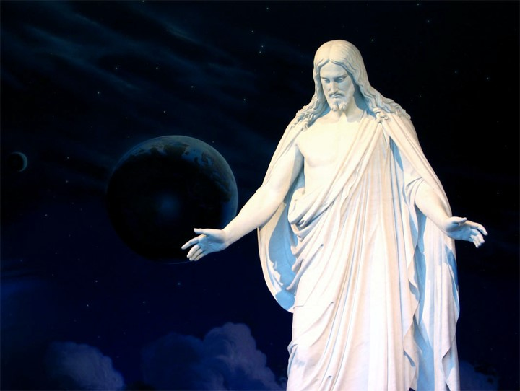
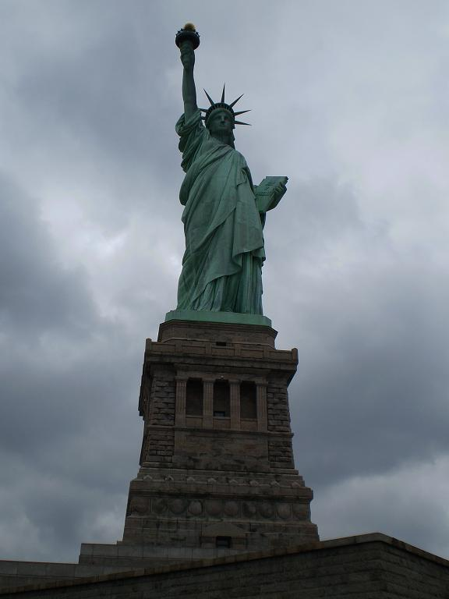
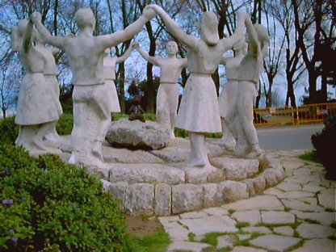
These are days of great opportunity and important responsibilities. These are your days. … One of your important responsibilities is to …”
…help prepare the world for the Second Coming of the Savior”
Elder Neil L. Andersen

Slide 11
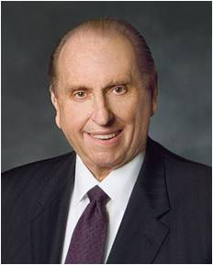
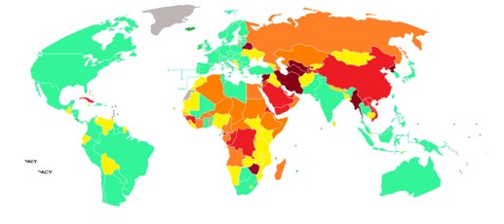
What Should We Pray For?
“I would ask that your faith and prayers continue to be offered in behalf of those areas where our influence is limited and where we are not allowed to share the gospel freely at this time. Miracles can occur as we do so.”
President Thomas S. Monson
D&C 65:10

Slide 12
Sources:
The Church to Fill the Earth (1:36)
The Gospel Shall Roll Forth (2:44)
(History of the Church, 1:218)
(History of the Church,6:364–65.)
Prophet Joseph Smith (Teachings of the Prophet Joseph Smith, pp. 271–272).
President Spencer W. Kimball (“Pillars of Truth,” Ensign, Jan. 1994, 4).
Elder Neil L. Andersen(“Preparing the World for the Second Coming,” Ensign or Liahona, May 2011, 49).
President Thomas S. Monson (“Welcome to Conference,”)
Ensign or Liahona, Nov. 2009, 6).
Presentation by ©http://fashionsbylynda.com/blog/

Slide 13
Kingdom of God:
“‘Some say that the kingdom of God was not set up upon the earth until the day of Pentecost, and that John did not preach the baptism of repentance for the remission of sins, but I say to you in the name of the Lord that the kingdom of God was set up upon the earth in the days of Adam to the present time.
Whenever there has been a righteous man on the earth, unto whom God revealed His word and gave power and authority to administer in His name, and where there is a priest of God … to administer in the ordinances of the gospel, and officiate in the priesthood of God, there is the kingdom of God. … Where there is a prophet, a priest, or a righteous man unto whom God gives His oracles, there is the kingdom of God; and where the oracles of God are not, there the kingdom of God is not.’ Prophet Joseph Smith (Teachings of the Prophet Joseph Smith, pp. 271–272).
Where LDS Cannot Preach---just a blog answer
Saudi Arabia, Iran, Iraq, most Muslim theocratic countries, most communist countries(so North Korea, most of China, Cuba, etc) In Israel, we can't openly proselytize(so no missionaries), but we are allowed to worship and live there. And, of course, as long as someone is a closeted Mormon they can live in those Islamic Theocratic countries and the Communist countries, however they can't be open about it, and no worship is allowed, nor are missionaries allowed. Basically, as long as the country is at least semi-democratic(with the exception of Israel), Missionaries are allowed there. Undemocratic countries we are typically not allowed in. So, if you look at this map of the world, which shows the level of democracy each nation has, we are allowed in all Full and flawed democracies(again, Israel is the exception), and I'd say half of the Semi-dictatorships(We are allowed in Russia, for example). None of the Full dictatorships or oppressive regimes we are allowed in, except China allows us in a very few places, such as in Hong Kong. http://weblog.savetibet.org/wp-content/u...
Source:
I'm Mormon

