Slide 2
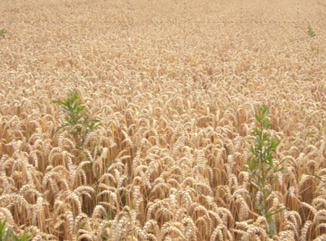
Background
December 6, 1832 at Kirtland, Ohio
Joseph Smith was reviewing and editing the inspired revision of the Bible.
He received a more complete version of the Parable of the Wheat and Tares

Slide 3
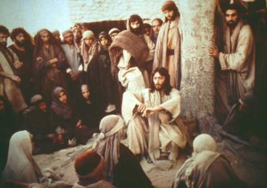
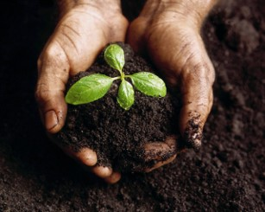
Parables
“Parables are short stories which point up and illustrate spiritual truths. Those spoken by Jesus deal with real events, or, if fictitious, are so consistent and probable that they may be viewed as the commonplace experiences of many people.
“When opposition to his message became bitter and intense, the master Teacher chose to present many of the truths of salvation in parables in order to hide his doctrine from those not prepared to receive it. It was not his purpose to cast pearls before swine.”
Elder Bruce R. McConkie
D&C 86:1

Slide 4
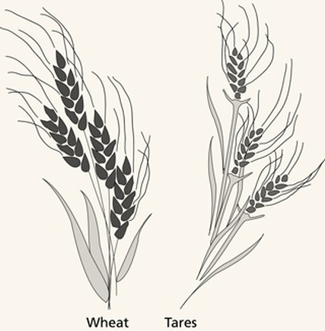
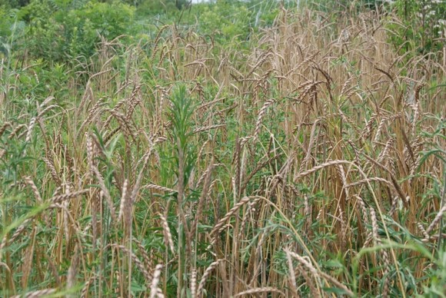
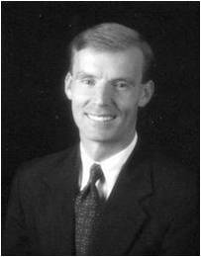
Tares
Tares are a type of poisonous weed. Wheat and tares are almost identical when they sprout, but they can be distinguished once they mature.
“The word tares occurs in the New Testament only in this parable. The Greek word zizanion, translated as “tares,” is said to come from a Semitic root and refers to weeds in grain. Most assume it is the somewhat poisonous bearded darnel, or weed grass.”
John Bytheway
D&C 86:1

Slide 5
Parable in Matthew
The man sowing seed is the Son of Man
The field is the world
Matthew 13:37
Matthew 13:38

Slide 6
The good seed are the children of the kingdom (followers of Jesus).
The tares are children of the wicked one (those who follow the enticements of Satan).
Matthew 13:38
Matthew 13:25-38-39

Slide 7
The harvest is the end of the world
The reapers are the angels sent to reap the field.
Matthew 13:39-40
Matthew 13:41

Slide 8
The tares bound and burned are the evil ones separated out and cast into fire (punishment) at the Judgment.
The wheat gathered into the barn represents the righteous who are separated out and made to “shine forth” in the kingdom of the Father
Matthew 13:42
Matthew 13:43

Slide 9
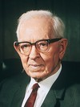
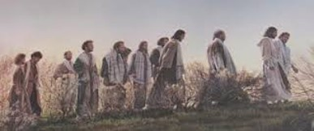
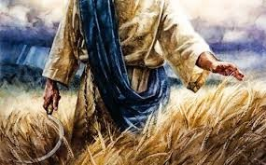
The Rest of the Story
The Apostles are the sowers of the seed
“In Matthew’s account the Lord declares that he is the sower of the good seed, and in the Doctrine and Covenants it is stated that the apostles were the sowers of the seed.
…Christ is the author of our salvation and he it was who instructed the apostles, and under him they were sent to preach the Gospel unto all the world, or to sow the seed, and as the seed is his and it is sown under his command, he states but the fact in this revelation and also in the parable.”
President Joseph Fielding Smith
D&C 86:2

Slide 10
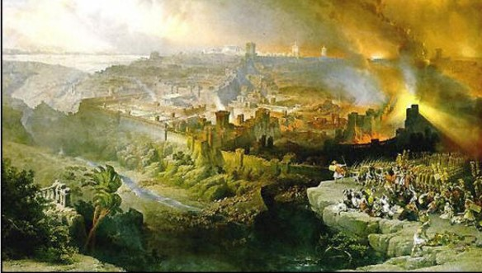
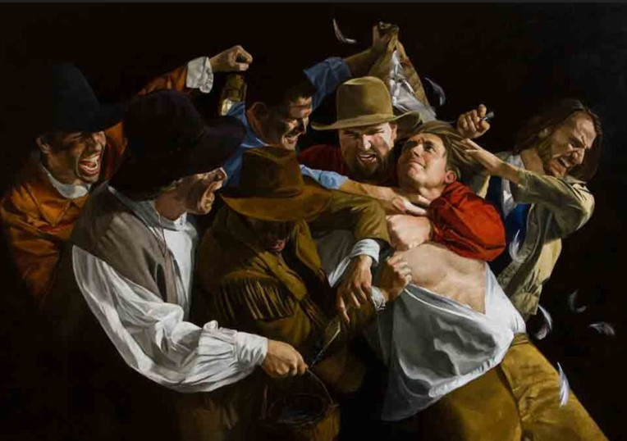
Apostasy
Falling asleep implies the death of the original Apostles
The enemy is Babylon the great whore, which is elsewhere called the great and abominable church (see 1 Nephi 13:4–8).
Babylon is a symbol of worldliness and evil, and therefore may be said to represent the devil’s power in this world.
Those who remain in Babylon are those who follow the practices of the world and who do not accept the word of the Lord.
Sometimes Satan’s persecution of the Church takes the form of aggressive persecution, such as killing the prophets or physically abusing the Saints. More often the persecution consists of social pressure against the humble followers of Christ.
Student Manual
D&C 86:3

Slide 11
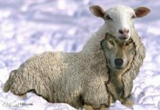
Tares of the World
The tares represent evil doctrines and those who spread them
“Even in the Church the tares are to be found. It is the tares which are to be gathered up and burned from all over the world, but those in the Church will also be gathered out and find their place in the fire.
President Joseph Fielding Smith
False doctrines or individuals who present themselves as faithful members of the Church but are in reality servants of Satan are a source of temptation to the faithful and tend to choke or corrupt the word of God, or the good seed that is sown.
Student Manual
D&C 86:3

Slide 12
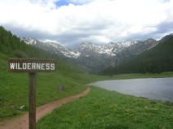
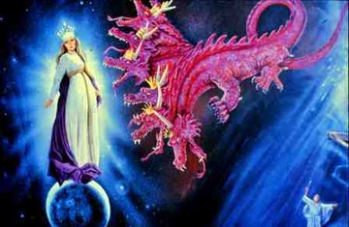
Wilderness
The Church being driven into the wilderness represents the time of the Apostasy
The wilderness represents the period of time when the Church and the priesthood were taken from the earth
And to the woman were given two wings of a great eagle, that she might fly into the wilderness, into her place, where she is nourished for a time, and times, and half a time, from the face of the serpent. Revelation 12:14
D&C 86:3

Slide 13
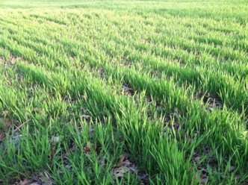
Tenderness of Wheat
The weakness, or newness, in the faith
When this revelation was given in December 1832, the Church was not yet three years old and was, therefore, still very “tender.”
At that time many of the tares were not yet identifiable, and attempts to systematically root out those who would eventually prove themselves to be tares would have been very destructive.
Student Manual
D&C 86:6

Slide 14
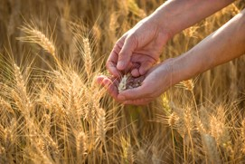
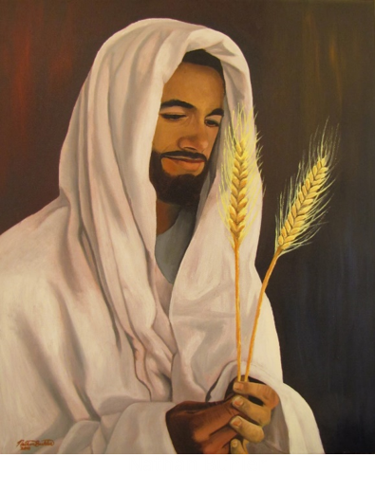
Allowed to Grow Together
The owner of the field advised the householders to “let both grow together” to prevent damaging the entire crop. At the time of the harvest, they would separate the two.
The Lord will gather the righteous during the last days and then destroy the wicked at His Second Coming
D&C 86:7

Slide 15
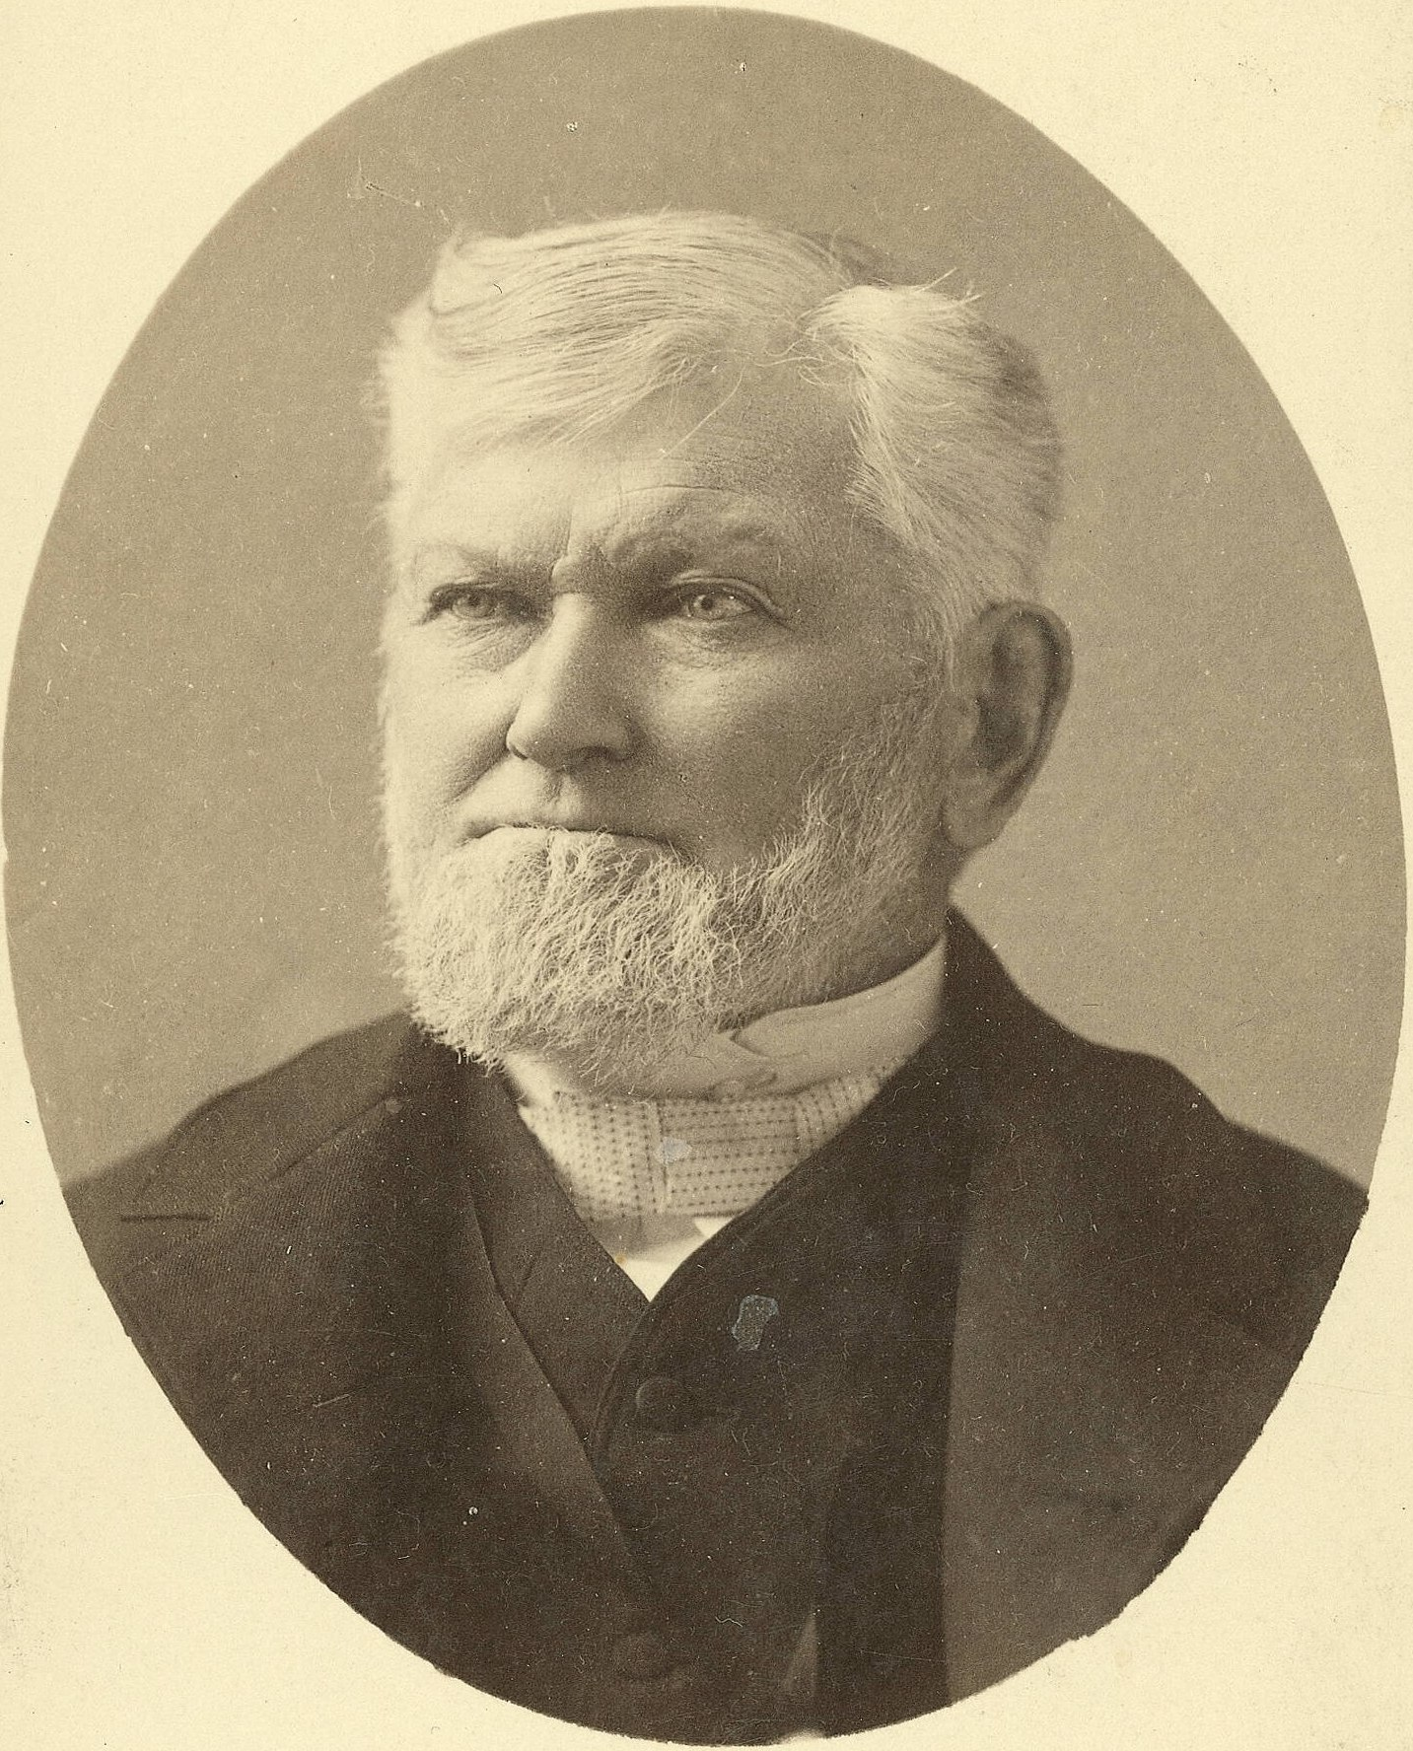
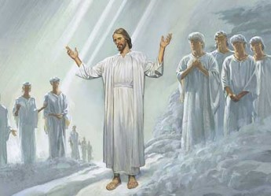
The Reapers
In Matthew—identified as the angels of God
But the Lord also indicates that at the time this revelation was given, the angels were anxiously awaiting permission to carry out their mission.
“God has held the angels of destruction for many years, lest they should reap down the wheat with the tares.
But I want to tell you now, that those angels have left the portals of heaven, and they stand over this people and this nation now, and are hovering over the earth waiting to pour out the judgments. And from this very day they shall be poured out.
Calamities and troubles are increasing in the earth, and there is a meaning to these things. Remember this, and reflect upon these matters. If you do your duty, and I do my duty, we’ll have protection, and shall pass through the afflictions in peace and in safety.”
President Wilford Woodruff
D&C 86:5

Slide 16
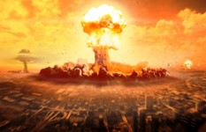
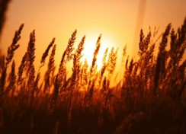
The Last Days
“The harvest and the end of the world have an allusion directly to the human family in the last days. …
As, therefore, the tares are gathered and burned in the fire, so shall it be in the end of the world; that is, as the servants of God go forth warning the nations, both priests and people, and as they harden their hearts and reject the light of truth—these first being delivered over to the buffetings of Satan, and the law and the testimony being closed up…
We understand that the work of gathering together of the wheat into barns, or garners, is to take place while the tares are being bound over, [in preparation] for the day of burning, that after the day of burnings, the righteous shall shine forth like the sun, in the Kingdom of their Father.”
Prophet Joseph Smith
D&C 86:7

Slide 17
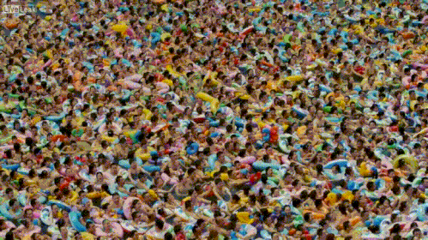
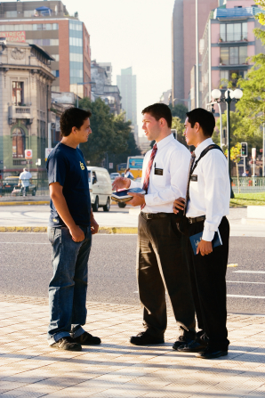
The Lord will gather the righteous during the last days and then destroy the wicked at His Second Coming

Slide 18
Sources:
Videos:
Jesus Declares the Parable of the Wheat and the Tares (1:17)
Blessings of the Priesthood(3:04)
Elder Bruce R. McConkie, Doctrinal New Testament Commentary, 1:283
John Bytheway Of Pigs, Pearls and Prodigals pg. 20
President Joseph Fielding Smith (Church History and Modern Revelation, 1:353-4.)
President Wilford Woodruff in 1894 (Young Women’s Journal, Aug. 1894, pp. 512–13.)
Prophet Joseph Smith(Teachings, p. 101.
Doctrine and Covenants Student Manual Religion 324-325 Section 86
Presentation by ©http://fashionsbylynda.com/blog/

Slide 19
Lawful Heir According to the Flesh—D&C 86:9
This phrase means that one’s right to the priesthood is held by virtue of being of the house of Israel. Elder Theodore M. Burton explained:
“One thing we often fail to realize is that our priesthood comes to us through the lineage of our fathers and mothers. The Lord explained it in these words: ‘Therefore, thus saith the Lord unto you, with whom the priesthood hath continued through the lineage of your fathers. …’ (D&C 86:8.)
“‘Oh,’ I can hear some of you say, ‘there must be something wrong with that statement, for I am the only member of my family who has joined the Church. How could I have received the priesthood from my parents?’
“In this scripture the Lord was not talking about your priesthood line of authority. He was talking about your inherited right to receive and use priesthood power. This readiness to listen and believe is an inherited gift which enabled you to recognize and accept the truth. Jesus explained this thought as he said: ‘My sheep hear my voice, and I know them, and they follow me.’ (John 10:27.)
“That spirit of acceptance is a manifestation of your inherited right to priesthood blessings. Such willingness to believe does not represent predestination, but it does represent foreordination. The Lord continues the revelation: ‘For ye are lawful heirs, according to the flesh, and have been hid from the world with Christ in God.’ (D&C 86:9.)
“This means we receive a right to priesthood blessings from our blood ancestry. I hope you can understand that priesthood with its accompanying blessings is dependent to a great degree on family relationship.” (In Conference Report, Apr. 1975, p. 103; or Ensign, May 1975, p. 71.)
“You live in a world where technological advances occur at an astounding pace. It is difficult for many of my generation to keep up with the possibilities. Depending on how technology is used, these advances can be a blessing or a deterrent. Technology, when understood and used for righteous purposes, need not be a threat but rather an enhancement to spiritual communication.”
Elder Richard G. Scott April 2103 Gen. Conf. For Peace at Home

