Slide 2
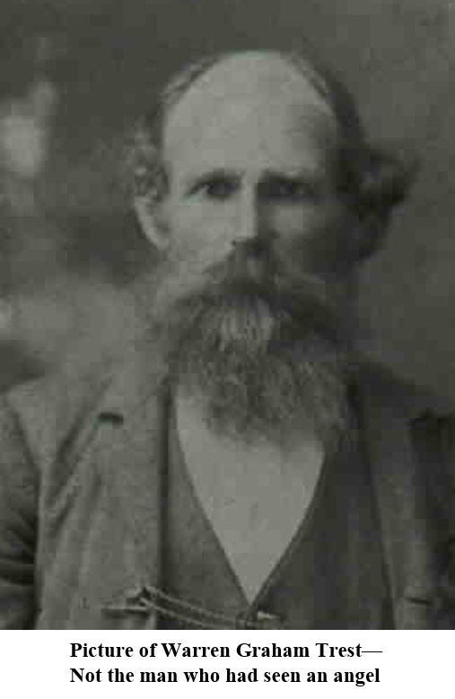
I Have Seen An Angel
“About the time this Revelation was received, a man came to the Prophet Joseph and told him he had seen an angel.
He described his dress.
The Prophet told him that he was mistaken, for in heaven there was no such dress as he had described.
The man then became furious and commanded fire to come down from heaven and consume the Prophet and his house.”
HC

Slide 3
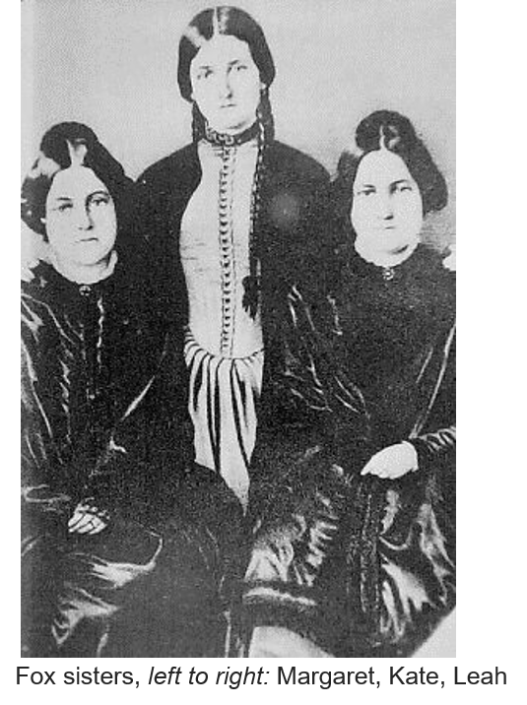
Spirit-rapping
“The Fox family in Hydesville, N.Y in March of 1844 had discovered, or invented “Spiritism”
Because of the Revelation given in 1843 (D&C 129) the Saints were forewarned of the deception of false pretension or by evil spirits.
Smith and Sjodahl

Slide 4
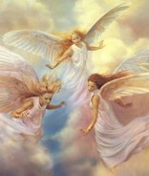
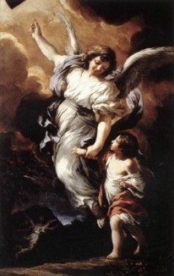
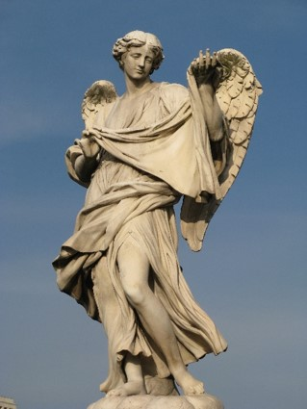
What the World Believes An Angel To Be
An angel is a supernatural being or spirit found in various religions and mythologies.
In Zoroastrianism and Abrahamic religions they are often depicted as benevolent celestial beings who act as intermediaries between Heaven and Earth, or as guardian spirits or a guiding influence.
Other roles of angels include protecting and guiding human beings, and carrying out God's tasks.
The term "angel" has also been expanded to various notions of spirits found in many other religious traditions. The theological study of angels is known as "angelology".
In art, angels are often depicted with bird-like wings on their back, a halo, robes and various forms of glowing light. Wikipedia

Slide 5
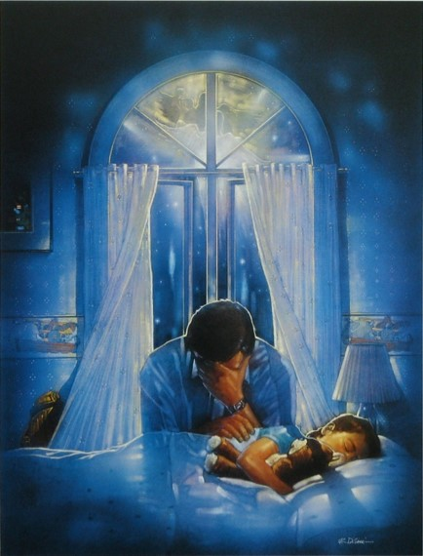
The Ministry of Angels
“From the beginning down through the dispensations, God has used angels as His emissaries in conveying love and concern for His children. …
“Usually such beings are not seen. Sometimes they are. But seen or unseen they are always near.
Sometimes their assignments are very grand and have significance for the whole world.
Sometimes the messages are more private.
Occasionally the angelic purpose is to warn”
Elder Jeffrey R. Holland

Slide 6
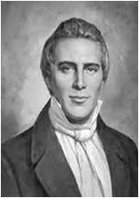
“An Angel of God Never Has Wings”
“Some will say that they have seen a spirit; that he offered them his hand, but they did not touch it. This is a lie. First, it is contrary to the plan of God; a spirit cannot come but in glory; an angel has flesh and bones; we see not their glory.
We may come to Jesus and ask Him; He will know all about it; if He comes to a little child, he will adapt himself to the language and capacity of a little child.”
Teachings of Joseph Smith pg. 162

Slide 7
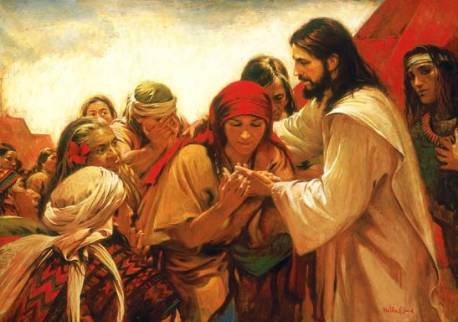
Two Kinds of Angels
Angels have resurrected bodies of flesh and bones; spirits do not
Handle me and see, for a spirit hath not flesh and bones, as ye see me have.
Arise and come forth unto me, that ye may thrust your hands into my side, and also that ye may feel the prints of the nails in my hands and in my feet, that ye may know that I am the God of Israel, and the God of the whole earth, and have been slain for the sins of the world.
3 Nephi 11:14
D&C 129:1-3

Slide 8
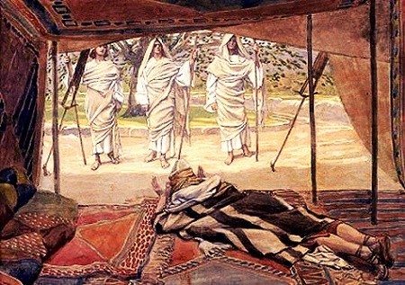
Spirits Of Just Men
“The angels who ministered to father Adam and those of his dispensation of necessity would have been unembodied spirits, that is, righteous men yet to be born on this earth.
In Old Testament times there would have been no angels who were resurrected beings.
During that period it appears that translated beings played a larger roles as divine messengers than they do in our dispensation.”
And he lift up his eyes and looked, and, lo, three men stood by him: and when he saw them, he ran to meet them from the tent door, and bowed himself toward the ground,
Genesis 18:2
D&C 129:1-3

Slide 9
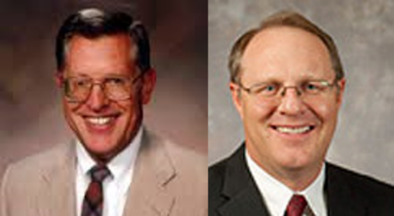
Satan as An Angel
Earlier, Michael helped the Prophet by detecting Satan, who had appeared to Joseph as an angel of light
It was here that John the Baptist restored to the Prophet and Oliver Cowdery the “keys of the ministering of angel”
Joseph Smith History 1:69
Upon you my fellow servants, in the name of Messiah I confer the Priesthood of Aaron, which holds the keys of the ministering of angels, and of the gospel of repentance, and of baptism by immersion for the remission of sins; and this shall never be taken again from the earth…
D&C 13:1
“The right to receive the ministration of angels and the ability to discern true messenger of God from counterfeits came before the Church was organized.”
McConkie and Ostler
…The voice of Michael on the banks of the Susquehanna, detecting the devil when he appeared as an angel of light!...
D&C 128:20
D&C 129:4-7

Slide 10
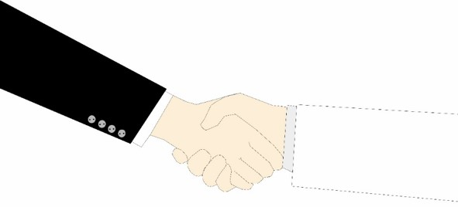
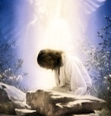
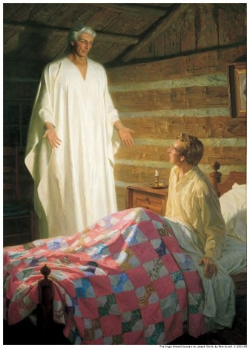
Offer Him Your Hand
An Angel
Of The Spirit
If he be an angel he will do so, and you will feel his hand.
If he be the spirit of a just man made perfect he will come in his glory; for that is the only way he can appear—
Ask him to shake hands with you, but he will not move, because it is contrary to the order of heaven for a just man to deceive; but he will still deliver his message.
“As mortals we are bound by the law of gravity and find physical objects a hindrance. Angels know no such limitation, and yet they are not free to converse with mortals, save it be according to the order of heaven.”
McConkie and Ostler
D&C 129:4-7

Slide 11
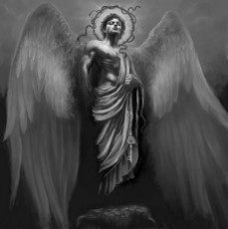
Be of the Devil
Satan attempts to deceive by counterfeiting the light that accompanies the spirit of a just man made perfect.
The once said, “Wicked spirits have their bounds, limits and laws, by which they are governed … and, it is very evident that they possess a power that none but those who have the priesthood can control”
Prophet Joseph Smith (History of the Church,4:576).
“He will offer you his hand”. The mortal will feel nothing, because the devil is an unembodied spirit. He can therefore be distinguished in this manner from a righteous spirit or angel sent from God. The just man will not attempt to deceive; an angel of Satan will not refrain from trying to deceive.
D&C 129:8-9 Student Manual

Slide 12
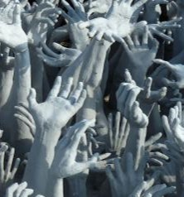
Devil’s Angels
Those spirits who followed Lucifer and were thrust out of God’s presence in the premortal life and cast down to the earth
And our spirits must have become like unto him, and we become devils, angels to a devil, to be shut out from the presence of our God, and to remain with the father of lies, in misery, like unto himself; yea, to that being who beguiled our first parents, who transformeth himself nigh unto an angel of light, and stirreth up the children of men unto secret combinations of murder and all manner of secret works of darkness.
2 Nephi 9:9
True messengers sent from Heavenly Father will not deceive us
Satan cannot tempt little children
Wherefore, they cannot sin, for power is not given unto Satan to tempt little children, until they begin to become accountable before me;
D&C 29:47
D&C 129:8-9 Student Manual

Slide 13
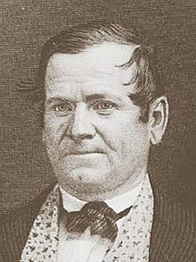
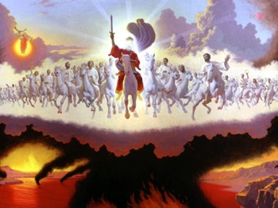
The Meeting
“On the 2nd of April, 1843, the Prophet Joseph attended a meeting at which Orson Hyde spoke and, alluding to the coming of the Savior, said,
‘When He shall appear, we shall be like Him, etc. He will appear on a white horse as a warrior, and may be we shall have some of the same spirit. Our God is a warrior. It is our privilege to have the Father and Son dwelling in our hearts.’
Student Manual

Slide 14
The Correction
What responsibility did the Prophet have in this situation?
To correct any false doctrine taught in the meeting
Presiding leaders in the Church such as prophets, stake presidents, and bishops have the responsibility to ensure that correct doctrine is taught in Church settings.
After the morning meeting, Joseph Smith, Orson Hyde, and a few others had lunch at the home of Joseph’s sister Sophronia. During lunch, the Prophet said that he “was going to offer some corrections to [Brother Hyde’s] sermon.” Brother Hyde responded, “They shall be thankfully received” HC
Orson Hyde had misinterpreted John 14:23
D&C 130 contains the Prophet Joseph Smith’s correction of this idea. It also includes some additional teachings.
Student Manual

Slide 15
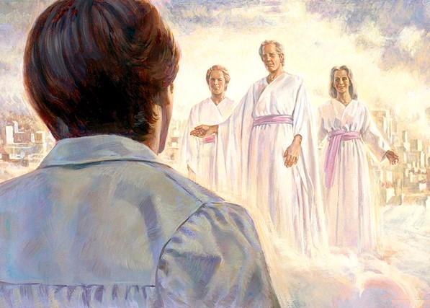
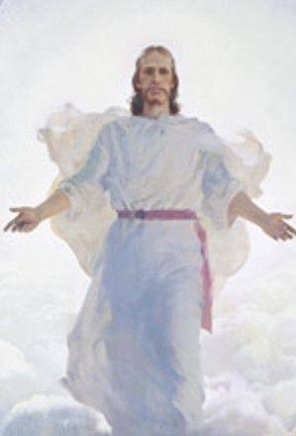
See Him As He Is
A Man like ourselves
Society will exist as the same society in heaven, but coupled with eternal glory
Do you think people will have the same habits and attitudes after the second coming of Christ?
Or, will they have an instant change of heart?
The relationships we can have in heaven are the same as those we enjoy on the earth, but they will include eternal glory
D&C 130:1-2

Slide 16
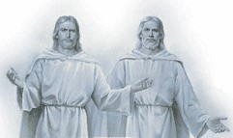
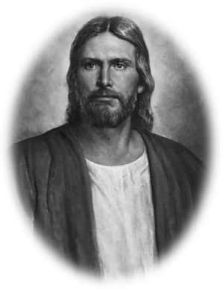
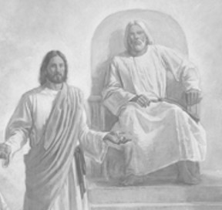
A Personal Appearance
The appearing of the Father and the Son, in that verse, is a personal appearance; and the idea that the Father and the Son dwell in a man’s heart is an old sectarian notion, and is false.
If a man love me, he will keep my words: and my Father will love him, and we will come unto him, and make our abode with him.
John 14:23
Sectarian-- Orson Hyde, who was once a Campbellite preacher, have an incorrect understanding of the nature of Deity because of false traditions.
Christ will appear with a physical body. John testified that “every eye shall see him.”
Revelation 1:7
Unfortunately, because of this misunderstanding of God’s true nature, millions of our Heavenly Father’s children have failed to understand their true identity.
William O. Nelson
D&C 130:3

Slide 17
Doctrinal Mastery
The Father has a body of flesh and bones as tangible as man’s; the Son also; but the Holy Ghost has not a body of flesh and bones, but is a personage of Spirit. Were it not so, the Holy Ghost could not dwell in us.
A man may receive the Holy Ghost, and it may descend upon him and not tarry with him.
D&C 130:22-23

Slide 18
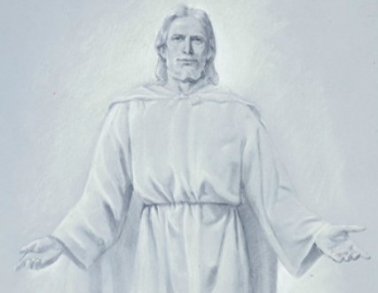
God the Father
It is generally the Father, or Elohim, who is referred to by the title God. He is called the Father because He is the father of our spirits. … God the Father is the supreme ruler of the universe. He is all powerful … , all knowing … , and everywhere present through his Spirit. … Mankind has a special relationship to God that sets man apart from all other created things: men and women are God’s spirit children. …
D&C 130:22-23

Slide 19
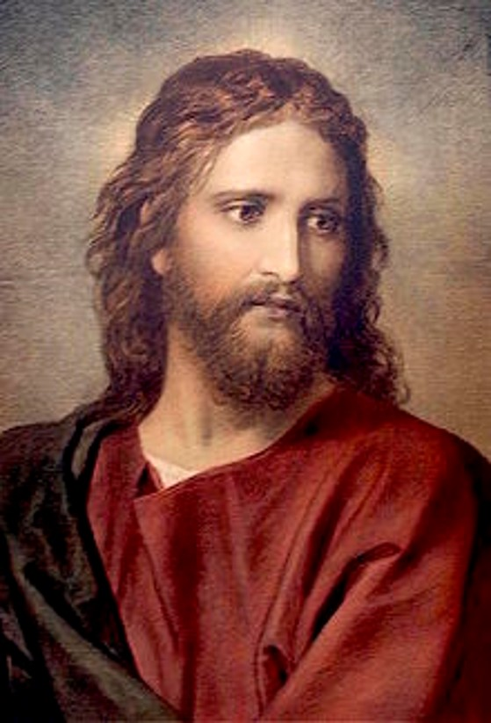
God the Son
The God known as Jehovah is the Son, Jesus Christ. … Jesus works under the direction of the Father and is in complete harmony with him. All mankind are His brothers and sisters, for He is the eldest of the spirit children of Elohim. [He is the Redeemer who suffered the sins and pains of all mankind and overcame physical death for all.] …
D&C 130:22-23

Slide 20
God the Holy Ghost
The Holy Ghost is also a God and is called the Holy Spirit, the Spirit, and the Spirit of God, among other similar names and titles [such as the Comforter].
With the aid of the Holy Ghost, man can know the will of God the Father and know that Jesus is the Christ”
The primary role of the Holy Ghost is to bear witness of God the Father and Jesus Christ. The Holy Ghost teaches and confirms truth.
(Guide to the Scriptures, “God, Godhead,” scriptures.lds.org).
D&C 130:22-23

Slide 21
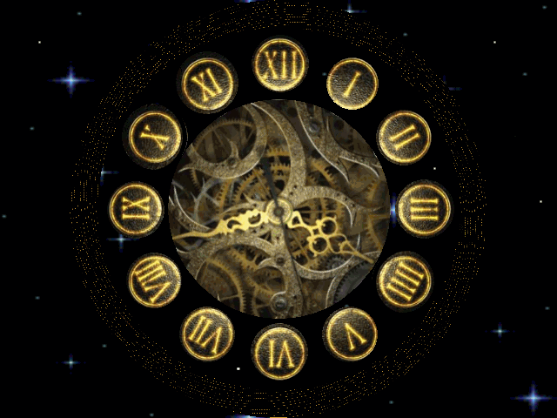
Reckoning of Time
“Time is a relative measurement of duration that enables us to think and speak in terms of past, present, and future. Its meaning is subject to constant change.”
“Time passes relatively slowly for children and quickly for adults.”
“The same unit of time passes slowly when we are waiting, particularly when associated with anxiety, and quickly when we are busy or having an enjoyable experience.”
“Alma 40:8 suggests that only men measure time and that to God all time is as one day. Other scriptures suggest that all things are present before the Lord.”
“The measurement of time in our Premortal estate was very different than known to us in this mortal world.”
Now whether there is more than one time appointed for men to rise it mattereth not; for all do not die at once, and this mattereth not; all is as one day with God, and time only is measured unto men.
Alma 40:8
D&C 130:4 McConkie and Ostler

Slide 22
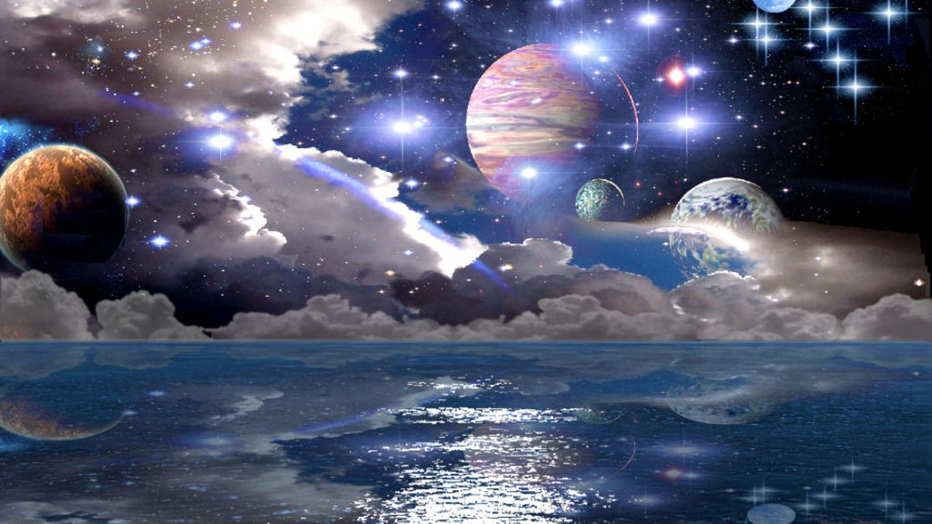
Angels Administer On Earth
“Only those who have lived or will live upon this earth can be ministering spirits to it, some from this earth will be permitted to minister to those on other planets.”
“Many have supposed that the doctrine of translation was a doctrine whereby men were taken immediately into the presence of God, and into an eternal fullness, but this is a mistaken idea. Their place of habitation is that of the terrestrial order, and a place prepared for such characters He held in reserve to be ministering angels unto many planets, and who as yet have not entered into so great a fullness as those who are resurrected from the dead.”
Teachings of the Prophet Joseph Smith, 170
Angels do not reside on this planet. They reside in the presence of God.
D&C 130:5-7 McConkie and Ostler

Slide 23
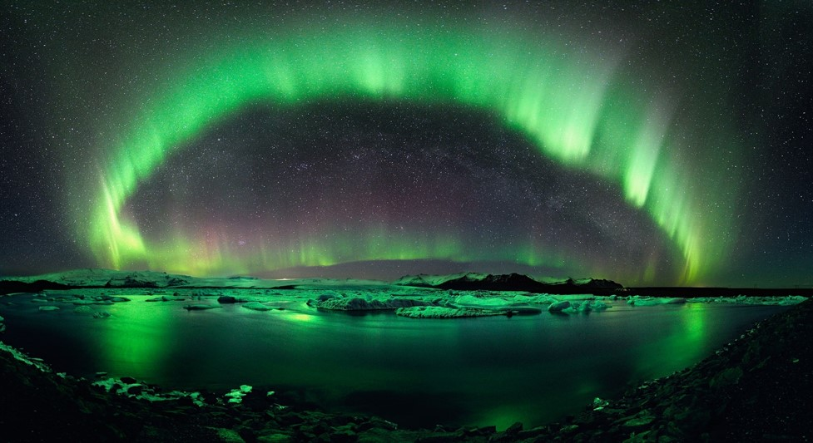
Urim and Thummim
The Earth will be fit for the dwelling place for celestial beings
“When it [the earth] becomes celestialized, it will be like the sun, and be prepared for the habitation of the saints, and be brought back into the presence of the Father and the Son, it will not then be an opaque body as it now is, but it will be like the stars of the firmament, full of light and glory; it will be a body of light. John compared it, in its celestial state, to a sea of glass.”
“This earth, when it becomes purified and sanctified, or celestialized, will become like a sea of glass; and a person, by looking into it, can know things past, present, and to come; though none but celestialized beings can enjoy this privilege. They will look into the earth, and the things they desire to know will be exhibited to them, the same as the face is seen by looking into a mirror.”
D&C 130:8-9 Brigham Young

Slide 24
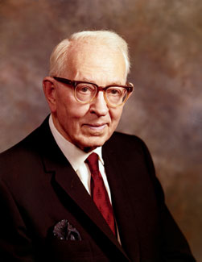
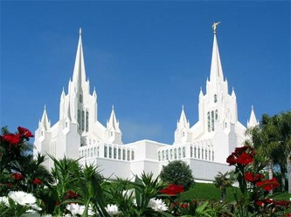
The White Stone
Pertaining to a higher order of kingdoms placed on their possession
To them will be given a white stone symbolizing their innocence and purity before God.
Individuals are initially prepared for these great blessings by keeping God’s commandments and receiving an endowment in the house of God
“The ordinances of the temple, the endowment and sealings, pertain to exaltation in the celestial kingdom, where the sons and daughters are. The sons and daughters are not outside
in some other kingdom.
The sons and daughters
go into the house, belong
to the household, have
access to the home.”
President Joseph Fielding Smith
D&C 130:10-11

Slide 25
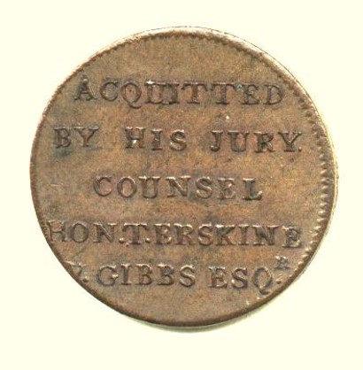
The Black Stone
Custom in ancient times
During the ancient times the judges announced their decision of guilt or innocence on a white or a black stone
The black meant guilty and condemnation
The white meant pardoned
He that hath an ear, let him hear what the Spirit saith unto the churches; To him that overcometh will I give to eat of the hidden manna, and will give him a white stone, and in the stone a new name written, which no man knoweth saving he that receiveth it.
Revelation 2:17
Some innocent tokens were given in more contemporary times to a person being pardoned
D&C 130:10-11 Clarke’s Commentary

Slide 26
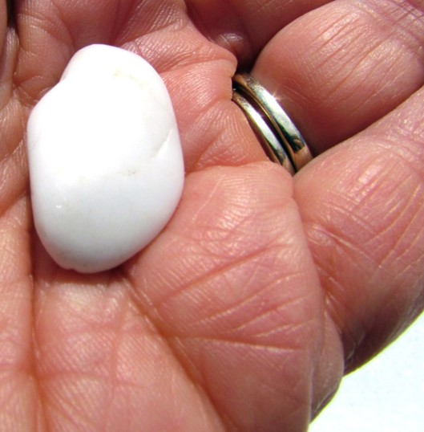
The New Name
A Key Word
On the white stone will be written “a new name” symbolizing their readiness to enter into a new life on a higher stage of existence.
Ancient tradition holds that possession of the "white stone" (viewed as an amulet having magical powers) could, by use of the name written on it, "secure entrance into heaven."
One commentator notes that "the power of a secret name to open closed portals and to give the user supernatural powers was widespread"
(Eiselen, et al., Abingdon Bible Commentary, 1374).
D&C 130:11 McConkie and Ostler

Slide 27
Sources:
Elder Jeffrey R. Holland “The Only True God and Jesus Christ Whom He Hath Sent,” Ensign or Liahona, Nov. 2007, 41).
Video:
Angels Are God’s Emissaries(0:48)
Godhead (1:57)
Joy in Families (0:32)
How Do I Love Thee? (2:48)
History of the Church, 5:267-68; 5:323
Jeffrey R. Holland (“The Ministry of Angels,” Ensign or Liahona, Nov. 2008, 29).
Angels Unseen ~ Ron DiCianni Canvas ~ Mother Daughter Prayer Christian Art
Joseph Fielding McConkie and Craig J. Ostler Revelations of the Restoration pgs. 1040-1042, 1046, 1048
Prophet Joseph Smith (History of the Church,4:576).
Doctrine and Covenants Student Manual Religion 324-325 Section 129
William O. Nelson Is the LDS View of God Consistent with the Bible? July 1987 Ensign
Brigham Young Journal of Discourses, 9:87; 7:163
President Joseph Fielding Smith (Doctrines of Salvation, 2:40–41.)
Clarke’s Commentary 3:979 see also McConkie and Ostler pg. 1048
Presentation by ©http://fashionsbylynda.com/blog/

Slide 28
“God the Father: It is generally the Father, or Elohim, who is referred to by the title God. He is called the Father because He is the father of our spirits. … God the Father is the supreme ruler of the universe. He is all powerful … , all knowing … , and everywhere present through his Spirit. … Mankind has a special relationship to God that sets man apart from all other created things: men and women are God’s spirit children. …
“God the Father: It is generally the Father, or Elohim, who is referred to by the title God. He is called the Father because He is the father of our spirits. … God the Father is the supreme ruler of the universe. He is all powerful … , all knowing … , and everywhere present through his Spirit. … Mankind has a special relationship to God that sets man apart from all other created things: men and women are God’s spirit children. …
“God the Son: The God known as Jehovah is the Son, Jesus Christ. … Jesus works under the direction of the Father and is in complete harmony with him. All mankind are His brothers and sisters, for He is the eldest of the spirit children of Elohim. [He is the Redeemer who suffered the sins and pains of all mankind and overcame physical death for all.] …
“God the Son: The God known as Jehovah is the Son, Jesus Christ. … Jesus works under the direction of the Father and is in complete harmony with him. All mankind are His brothers and sisters, for He is the eldest of the spirit children of Elohim. [He is the Redeemer who suffered the sins and pains of all mankind and overcame physical death for all.] …
“God the Holy Ghost: The Holy Ghost is also a God and is called the Holy Spirit, the Spirit, and the Spirit of God, among other similar names and titles [such as the Comforter]. With the aid of the Holy Ghost, man can know the will of God the Father and know that Jesus is the Christ” (Guide to the Scriptures, “God, Godhead,” scriptures.lds.org). The primary role of the Holy Ghost is to bear witness of God the Father and Jesus Christ. The Holy Ghost teaches and confirms truth.
“God the Holy Ghost: The Holy Ghost is also a God and is called the Holy Spirit, the Spirit, and the Spirit of God, among other similar names and titles [such as the Comforter]. With the aid of the Holy Ghost, man can know the will of God the Father and know that Jesus is the Christ” (Guide to the Scriptures, “God, Godhead,” scriptures.lds.org). The primary role of the Holy Ghost is to bear witness of God the Father and Jesus Christ. The Holy Ghost teaches and confirms truth.

Slide 29
Sisters Catherine (1838–92), Leah (1814–90) and Margaret (1836–93) Fox played an important role in the development of Spiritism. The daughters of David and Margaret Fox, they were residents of Hydesville, New York. In 1848, the family began to hear unexplained rapping sounds. Kate and Margaret conducted channeling sessions in an attempt to contact the presumed spiritual entity creating the sounds, and claimed contact with the spirit of a peddler who was allegedly murdered and buried beneath the house. A skeleton later found in the basement seemed to confirm this. The Fox girls became instant celebrities. They demonstrated their communication with the spirit by using taps and knocks, automatic writing or psychography, and later even voice communication, as the spirit took control of one of the girls.
Skeptics suspected this was deception and fraud, and sister Margaret eventually confessed to using her toe-joints to produce the sound. Although she later recanted this confession, she and her sister Catherine were widely considered discredited, and died in poverty. Nonetheless, belief in the ability to communicate with the dead grew rapidly, becoming a religious movement called Spiritualism, which contributed significantly to Kardec's ideas. Wikipedia
Angels:
“There are angels of various appointments and stations,” wrote President Charles W. Penrose:
“Angels are God’s messengers, whether used in that capacity as unembodied spirits, selected according to their capacities for the work required, or as disembodied spirits, or as translated men, or as resurrected beings. They are agents of Deity of different degrees of intelligence, power and authority, under the direction of higher dignitaries, and subject to law and order in their respective spheres. Elijah, who appeared with Moses on the mount of transfiguration, was a translated man; Moses at that time was either a translated man or a spirit ministering to the Savior; both acted in the capacity of angels. (Luke 9:28–33.) Enoch’s band of translated beings doubtless appeared as angels in manifestations to the patriarchs recorded in the book of Genesis [see Genesis 21:17; 22:11; 32:1].
“Angels high in authority have been clothed on special occasions with the right to represent Deity personally. They have appeared and have been recognized as God himself, just as royal ambassadors of earthly potentates have acted, as recorded in history. The Angel spoken of in Exodus 23:20–22, was one of these. So also was the Angel … who ministered to John on the isle of Patmos, and used the names and titles of the Son of God. (Rev. 1:1.)” (“Who and What Are the Angels?” Improvement Era, Aug. 1912, p. 950.)
Spiritism is a spiritualistic doctrine codified in the 19th century by the French educator Allan Kardec, proposed to the study of "the nature, origin, and destiny of spirits, and their relation with the corporeal world". Spiritism soon spread to other countries, having today 35 countries represented in the International Spiritist Council.^{unreliable source?}
Spiritism postulates that humans are essentially immortal spirits that temporarily inhabit physical bodies for several necessary incarnations to attain moral and intellectual improvement. It also asserts that spirits, through passive or active mediumship, may have beneficent or maleficent influence on the physical world.
The term first appeared in Kardec's book, The Spirits' Book, which sought to distinguish Spiritism from spiritualism.
Spiritism has influenced a social movement of healing centers, charity institutions and hospitals involving millions of people in dozens of countries, most of them in Brazil.Spiritism was also very influential in the new Vietnamese religion called Cao Đài or Caodaism, born in 1926 after three spirit mediums received messages that identified Allan Kardec as a prophet of a new universal religion. After 1975, Caodaism was almost closed down by the Vietnamese government, but it has now re-emerged on the public scene and Caodaists recently visited the Kardec Spiritist Center in Lyon to re-establish contacts with the legacy of French Spiritism. There are about four million Caodaists in Vietnam and in the Vietnamese diaspora, so they are the largest Spiritist group in Asia.
There are two kinds of beings in heaven who are called angels: those who are spirits and those who have bodies of flesh and bone. Angels who are spirits have not yet obtained a body of flesh and bone, or they are spirits who have once had a mortal body and are awaiting resurrection. Angels who have bodies of flesh and bone have either been resurrected from the dead or translated.
There are many references in scripture to the work of angels. Sometimes angels speak with a voice of thunder as they deliver God’s messages (Mosiah 27:11–16). Righteous mortal men may also be called angels (JST, Gen. 19:15). Some angels serve around the throne of God in heaven (Alma 36:22) Guide to the Scriptures: Angels
Jesus “Prince of Peace” made by Akiane Kramarik at age 8. She’s a child art prodigy, born on July 9, 1994 at Mount Morris, Illinois from an Atheist parents.
When she was four, she started to draw using whatever medium she can use. Without someone to teach her, she continued to draw. At a young age her art is way beyond her age and she said “God is my teacher”. She continue to progress in her craft and when she was eight years old she wanted to paint Jesus according to her vision. It took so long and a lot of prayers to find the perfect subject for her painting.
http://wereblog.com/jesus-is-for-real-prince-of-peace-by-akiane-kramarik-a-child-art-prodigy

Slide 30
Sectarianism, according to one definition, is bigotry, discrimination, or hatred arising from attaching importance to perceived differences between subdivisions within a group, such as between different denominations of a religion, class, regional or factions of a political movement.
The New Name--Dallin H. Oaks:
In the ancient world, a name represented the essence of the person named. Thus, a prominent Bible dictionary declares: "In biblical thought a name is not a mere label of identification; it is an expression of the essential nature of its bearer. A man's name reveals his character.... Hence to know the name of God is to know God as he has revealed himself" (Interpreter's Dictionary, 3:500-501)....
For this reason, in biblical thought a change of name signifies a change of nature or essence. The dictionary observes: "It could also be said soberly of anyone that his name is his very self. Thus, when a radical change in a person's character took place so the he became a new man, he was given a new name" (Interpreter's Dictionary, 2:408). Thus, a king receives a new name on his ascending the throne.
This understanding helps to explain the new names given to many key figures in the Bible at the time of an important change in their lives. Examples include Abraham (see Gen. 17:5), Sarah (see Gen. 17:15), Israel (see Gen. 32:28; 35:10) and Peter (see John 1:42). The idea that a name changes when a person's essence changes also helps to explain the scriptural teaching that a new name is given to all persons who come into the celestial kingdom (see D&C 130:11; see also Isa. 56:5, 62:2; Rev. 2:17, 3:12). (His Holy Name, Bookcraft, Salt Lake City, 1998)
D&C 129: 8-9 Satan:
“Satan attempts to deceive by counterfeiting the light that accompanies the spirit of a just man made perfect. A just man made perfect who comes as a messenger will appear in his glory, ‘for that is the only way he can appear’ (D&C 129:6). The Prophet Joseph Smith once said, ‘Wicked spirits have their bounds, limits, and laws by which they are governed … and, it is very evident that they possess a power that none but those who have the priesthood can control’ (in History of the Church, 4:576).
“The Prophet taught that when the devil is offered a hand to shake, ‘he will offer you his hand’ (D&C 129:8). The mortal will feel nothing, because the devil is an unembodied spirit. He can therefore be distinguished in this manner from a righteous spirit or angel sent from God. The just man will not attempt to deceive (see D&C 129:7); an angel of Satan will not refrain from trying to deceive” (Doctrine and Covenants Student Manual, 2nd ed. [Church Educational System manual, 2001], 321).
Do not Take as Gospel: Just a small history of the white stone and what others think:
One of the better-accepted explanations of the white stone has to do with the high priest’s breastplate, which contained twelve stones. Each of these stones had the name of one of the twelve tribes of Israel engraved on it (Exodus 28:21). As he ministered in the temple, the high priest bore the names of God’s people into God’s presence. In the same way, the “white stone” with the believer’s name written on it could be a reference to our standing in God’s presence. Another widely held explanation suggests that the white stone may be a translucent precious stone such as a diamond. The word translated “white” in Revelation 2:17 is leuko sand can also mean “brilliant, bright.” This interpretation holds that on the stone is written the name of Christ, not the name of the believer. Revelation mentions that the name of Christ is written on the foreheads of the saints (Revelation 3:12;Revelation 14:1, and Revelation 14:20 ). The best meaning of the white stone probably has to do with the ancient Roman custom of awarding white stones to the victors of athletic games. The winner of a contest was awarded a white stone with his name inscribed on it. This served as his “ticket” to a special awards banquet. According to this view, Jesus promises the overcomers entrance to the eternal victory celebration in heaven. The “new name” most likely refers to the Holy Spirit’s work of conforming believers to the holiness of Christ (see Romans 8:29;Colossians 3:10). Read more:http://www.gotquestions.org/white-stone-new-name.html#ixzz3UwaFzjNz

Slide 31
Relativity of Time:
Several scriptures suggest that the way we perceive time on earth may not be the way time really is throughout the universe. Alma 40:8 suggests that only men measure time and that to God all time is as one day. Other scriptures suggest that all things are present before the Lord (see D&C 38:2; Moses 1:6). Verses 4–7 in section 130 suggest a similar concept, namely that past, present, and future are continually before the Lord and that time is relative to the planet on which one resides.
In the twentieth century, the field of physics began to speak about time and space in a way that may help explain these revelatory statements. Albert Einstein, in the early part of this century, developed what is known as the theory of relativity. Einstein postulated that what men had assumed were absolutes in the physical world—space, gravity, speed, motion, time—were not absolutes at all but were interrelated with each other. That is why the theory was called the theory of relativity. Physicists now agree that a person’s time reference will vary depending on his relative position in space.
According to Einstein’s theory, if a body moves at very fast speeds (those approaching the speed of light, which is 186,000 miles per second), that body’s time slows down in relation to the time of a body that is on earth; and for the body in motion, space contracts or shrinks. In other words, time and space are not two separate things but are interrelated. Physicists refer to this as the space-time continuum. If an astronaut were to journey out into space at speeds approaching the speed of light, though to himself all would seem perfectly normal, to someone on earth it would appear as though his clock were ticking slower, his heart were beating slower, his metabolism operating slower, and so on. He would actually age more slowly than would a person who remained on the earth. Though the finite mind tends to reject such concepts, Einstein’s theory suggests that reality to us is a product of our relative position in the space-time continuum.
According to this theory, if a being achieved the speed of light, to that being all space would contract to the point that it would be “here” for him, and all time would slow down until it became “now” for him. The theory of relativity thus may suggest how, for a being of light and glory like God, all space and all time could be present. As difficult as such a concept is to understand, increasingly sophisticated experiments continue to substantiate Einstein’s theoretical description of the realities of the universe.
Lael Woodbury, dean of the College of Fine Arts and Communications at Brigham Young University, talked about man’s perception of time and God’s perception of time in an address sponsored by the Church Educational System:
“The evidence suggests that God … perceives time as we perceive space. That’s why ‘all things are before him, and all things are round about him; and he is above all things, and in all things, and is through all things, and is round about all things’ [D&C 88:41]. Time, like space, is ‘continually before the Lord.’ …
“… Right now we perceive music in time as a blind man perceives form in space—sequentially. He explores with his fingers, noting form, texture, contours, rhythms. He holds each perception in his mind, one by one, carefully adding one to the other, until he synthesizes his concept of what that space object must be like. You and I don’t do that. We perceive a space object immediately. We simply look at it, and to a certain degree we ‘know it. We do [not] go through a one-by-one, sequential, additive process. We perceive that it is, and we are able to distinguish it from any other object.
“I’m suggesting that God perceives time as instantaneously as we perceive space. For us, time is difficult. Lacking higher facility, we are as blind about time as a sightless man is about space. We perceive time in the same way that we perceive music—sequentially. We explore rhythm, pitch, amplitude, texture, theme, harmonies, parallels, and contrasts. And from our perceptions we synthesize our concept of the object or event—the musical artwork—that existed in its entirety before we began our examination of it.
“Equally complete now is each of our lives before the Lord. We explore them sequentially because we are time-blind. But the Lord, perceiving time as space, sees us as we are, not as we are becoming. We are, for him, beings without time. We are continually before him—the totality of our psyches, personalities, bodies, choices, and behaviors.” (Continually before the Lord, Commissioner’s Lecture Series [Provo: Brigham Young University Press, 1974], pp. 5–6.)
Einstein’s theory is only a theory, although it is being substantiated again and again as a valid representation of reality. How God operates through the vastness of space and the eternity of time has not been revealed in specific detail, but what information man has been given can be harmonized with what physicists are discovering about the interrelationship of space and time.
Time is relevant to mortality.
Doctrine and Covenants Student Manual Religion 324-325 Section 129

Slide 32
Joseph Smith Visited by Angels
In 1836, Moses, Elias and Elijah appeared to Joseph and Oliver Cowdery in the Kirtland Temple to restore keys.
12. John the Baptist
13. Peter
14. James
15. John (and possibly other New Testament Apostles, according to John Taylor—JD, 21:94)
John the Baptist, Peter, James, and John all appeared to restore the priesthoods to Joseph.
16. Paul (perhaps, judging from Joseph Smith’s thorough description of him in Teachings of the Prophet Joseph Smith, p. 180)
17. Nephi
18. Mormon
Orson Pratt commented that Joseph often received visits from Nephi and Mormon, among other scriptural figures.
19. Alma (perhaps, as well as other Book of Mormon prophets, according to George Q. Cannon—JD, 13:47)
20. The three Nephites (and possibly other Nephite Apostles, according to John Taylor—JD, 21:94)
21. Moroni
22. Unnamed angels at a meeting on January 21, 1836
23. Many angels at the dedication of the Kirtland Temple, March 27, 1836
24. Many angels, not specifically identified, as noted in Doctrine and Covenants 128:20-21. That scripture notes the voices (meaning visits) of Moroni, Michael, and Peter, James, and John. It also speaks of “the voice of Gabriel, and of Raphael, and of divers angels, from Michael or Adam down to the present time, all declaring their dispensations, their rights, their keys, their honors, their majesty and glory, and the power of their priesthood; giving line upon line, precept upon precept; here a little and there a little.”
“He was visited constantly by angels,” Elder George Q. Cannon said of Joseph Smith. “These various angels, the heads of dispensations, . . . ministered unto him. . . . He had vision after vision in order that his mind might be fully saturated with a knowledge of the things of God, and that he might comprehend the high and holy calling that God had bestowed upon him” (Journal of Discourses, 23:362). Historical records of early Latter-day Saints, Doctrine and Covenants, and early Church documents reveal that Joseph Smith's visions and visits by heavenly messengers are too numerous to count.
Here are some of those heavenly messengers that helped teach Joseph Smith the truths of the gospel:
1. Adam
2. Abraham
Father Adam appeared to the Prophet in a vision recorded in D&C 137, along with Abraham and Joseph's brother Alvin.
3. Seth
4. Enoch
5. Isaac
6. Jacob
John Taylor taught that Joseph received visitations from numerous Biblical figures, including Seth, Enoch, Isaac, and Jacob.
7. Raphael
8. Gabriel (Noah)
In D&C 128, the angels Raphael and Gabriel appeared to instruct the Prophet Joseph.
9. Moses
10. Elias
11. Elijah
LDS LIVING: History of the Church, 1:39-41, 2:381, 428; D&C 27:12-13, 110:11-16, 128:20-21; JD, 13:47, 17:374, 21:94; and Andrus, Joseph Smith, the Man and the Seer, p. 95. Photo from iStock

