Slide 2
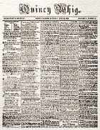
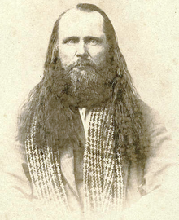
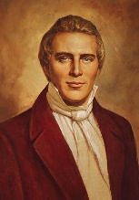
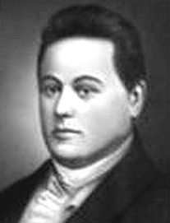
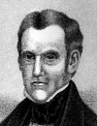
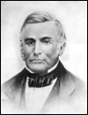
1842 Church History Timeline
Orrin Porter Rockwell was accused also. Boggs recovers and charges him of the crime and a second affidavit charging President Joseph Smith of being an accessory before the fact.
Quincy Whig– guesses are made as to who had shot at Boggs. ‘one of which throws the crime upon the Mormons…Smith…prophesied a year or so ago, his death by violent means. Hence, there is plenty of foundation for rumor.’
Joseph Smith and Orrin Porter Rockwell arrested but applied for habeas corpus
May 6, 1842
August 8, 1842
May 21, 1842
“My hands are clean and my heart pure from the blood of all men” This statement was sent to the Quincy Whig and Nauvoo Wasp.
Missouri’s Governor Reynolds granted Bogg’s request and demanded the governor of Illinois (Thomas Carlin) for surrender of President Smith to E.R. Ford, who was appointed the agent of Missouri, to receive him.
Ex-Governor Lilburn W. Boggs, of Missouri, was seated in a room by himself in the evening, when some person discharged a pistol loaded with buckshot through an adjoining window. Three of the shots took effect in his head. His son, hearing the shot, burst into the room and found his father in a helpless condition. The pistol from which the shot was fired was found under the window and there, too, were the footprints of the would-be-assassin.
Habeas corpus—a right to ask the court to determine if the arrest is legal.
B.H. Roberts A Comprehensive History of the Church Volume 2 pp. 148-151

Slide 3
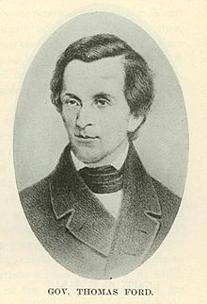
Period of Seclusion—for the remainder of the year
Several attempts were made on the part of the officers of Missouri and Illinois to rearrest President Smith during his period of seclusion, but without avail.
The Prophet sent letters to William Law, elected major-general of the legion, to have all things in readiness to protect the people in their rights, and to not submit to the outrages of the threats
August 14, 1842—”that the peace of the city of Nauvoo is kept, let who will endeavor to disturb it.”
Following the second attempt to arrest the Prophet there were rumors that Sheriff Ford threatened to bring a mob against the “Mormons.” And to search every household.
B.H. Roberts A Comprehensive History of the Church Volume 2 pp. 155-156

Slide 4
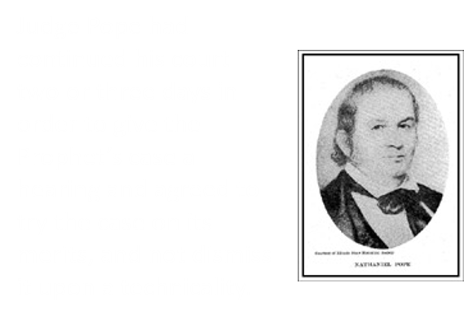
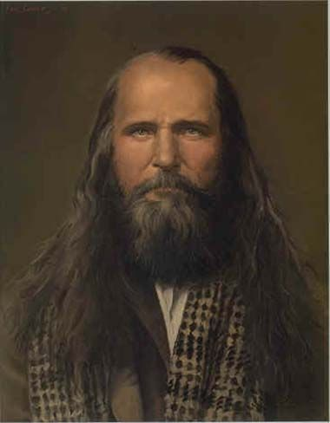
Arrested and Discharged
December 30, 1842
“The mis-recitals and overstatements in the requisition and warrant are not supported by oath and cannot be received as evidence to deprive a citizen of his liberty, and transport him to a foreign state for trial. For these reasons Smith must be discharged.” Judge Pope
History of the Church Period 1 Volume 5, 209-245
Joseph Smith, Hyrum Smith, John Taylor and others were in the charge of William Law
Rockwell spent several months in the east pending the subsidence arrest in Nauvoo. When he returned to the west he was arrested on March 4, 1843 in St. Louis. He was taken to Independence for trial, and his bail fixed at 5,000 dollars.
He suffered great cruelty while in prison, but when his case came before the grand jury, the evidence was insufficient to warrant an indictment.”
Rockwell tried an effort to escape, and was held on the charge of jail-breaking, for when he came to be tried, he was sentences to five minutes imprisonment, though they kept him several hours while trying to trump up new charges against him.
B.H. Roberts A Comprehensive History of the Church Volume 2 pp. 157-159

Slide 5
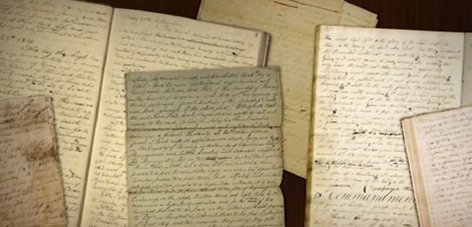
The Book—The Law of the Lord
The Book of the Law of the Lord was never intended for publication.
While the Prophet was in seclusion he prepared a book in which he recorded the names of those who ministered to him in kindness.
He recorded names and pronounced blessing upon his special friend and companions.
Some of the names included in the book:
Friends on the island in the Mississippi, midway between Nauvoo and Montrose
Hyrum Smith
Newel K. Whitney…bishop of the Church
B.H. Roberts A Comprehensive History of the Church Volume 2 pp. 161-162

Slide 6
1843 Church History Timeline
Disguised as Mormon Elders, Reynolds and Wilson arrest Joseph. While in Dixon, Ill. He asked to obtain the writ of habeas corpus
Governor Reynolds, Missouri, issues a requisition on Governor Ford, and J. H. Reynolds as agent of Missouri to receive Joseph Smith from the authorities of Illinois
Joseph and His family leave Dixon, Ill and arrive in Nauvoo
June 5, 1843
July 4, 1943
June 24, 1843
June 23, 1843
June 13, 1843
June 30, 1843
The Municipal Court of Nauvoo dismissed the warrant and freed Joseph Smith.
Governor Ford issued extradition papers and placed them in the hands of Harmon T. Wilson for execution
Counter actions against Wilson and Reynolds, and they were arrested by Sheriff Campbell of Lee County.
Joseph is released
Revival of Old Missouri Charges
Dixon, Illinois
Emma Smith’s Sister’s Home
B.H. Roberts A Comprehensive History of the Church Volume 2 pp. 160-173

Slide 7
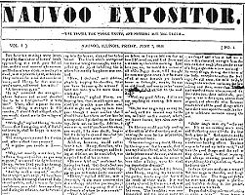
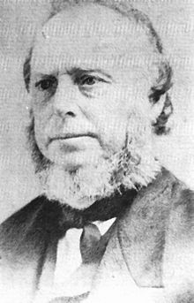
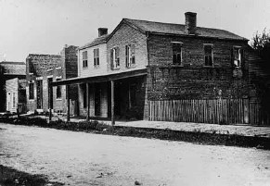
Diversity Sets In
By June 1844, animosity against the Church had greatly intensified.
Some citizens in Illinois were discussing driving the Saints from the state, while others were plotting to kill the Prophet
Some of those who were conspiring against the Prophet and the Church were former members of the Church who had apostatized.
On June 7, 1844, William Law, who had served as second counselor in the First Presidency, and other apostates printed the first issue of a newspaper called the Nauvoo Expositor
In an attempt to inflame the public against the Prophet and the Church, these men used this newspaper to slander Joseph Smith and other Church leaders.
Joseph Smith and the majority of the Nauvoo city council recognized that the inflammatory newspaper would lead to mob violence against the city.
They declared it a public nuisance and ordered that the Nauvoo Expositor press be destroyed. (June 10, 1844)
Doctrine and Covenants and Church History Seminary Teacher Manual, 2013

Slide 8
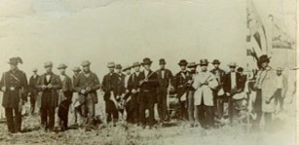
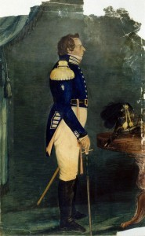
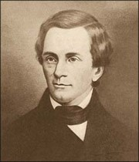
Owners of Press Bring Charges Against
The contents of the Nauvoo Expositor, along with the destruction of the press, caused anti-Mormon hostility to escalate.
The owners of the press brought legal charges against Joseph Smith and other city leaders, accusing them of inciting a riot.
Joseph Smith was cleared of the charges, but his release only further angered his enemies. As reports began circulating that mobs were gathering to attack the city of Nauvoo, Joseph Smith, as mayor, declared Nauvoo to be under martial law (temporary military rule).
With the direction of Governor Thomas Ford of Illinois, Joseph ordered the Nauvoo Legion to defend the city.
Doctrine and Covenants and Church History Seminary Teacher Manual, 2013

Slide 9
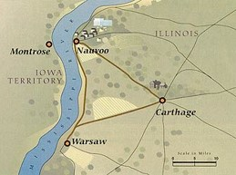
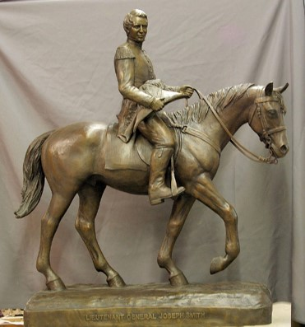
Carthage-- the Center of Government for the Region
At Carthage Governor Ford tries to neutralize the volatile situation
Joseph replied that his life would be in danger on the journey and that he would not come.
As Joseph Smith counseled with his brethren about what to do next, he felt that if he and Hyrum left Nauvoo and traveled to the West, the Saints in Nauvoo would not be harmed.
Doctrine and Covenants and Church History Seminary Teacher Manual, 2013

Slide 10
Going West
June 22, 1844--Acting on this counsel, Joseph and Hyrum crossed the Mississippi River into Iowa.
June 23, 1844—At the request of Emma, Reynolds Cahoon, and Orrin Porter Rockwell found them in Montrose.
A posse had come for Joseph and Hyrum that morning warning that the governor had promised to garrison troops in Nauvoo until the brothers submitted to arrest.
The brethren were told that the people of Nauvoo feared what the troops might do.
History of the Church, 6:549

Slide 11
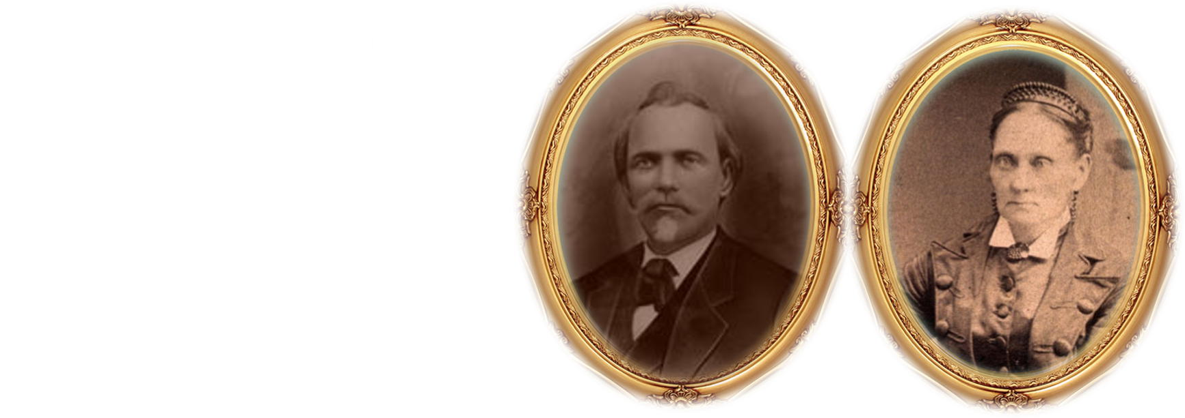
Upon Returning to Nauvoo
Joseph wanted to speak to the Saints once more, but there was not enough time. He went home to his family, fully aware that it would probably be his last evening with them.
Student Manual

Slide 12
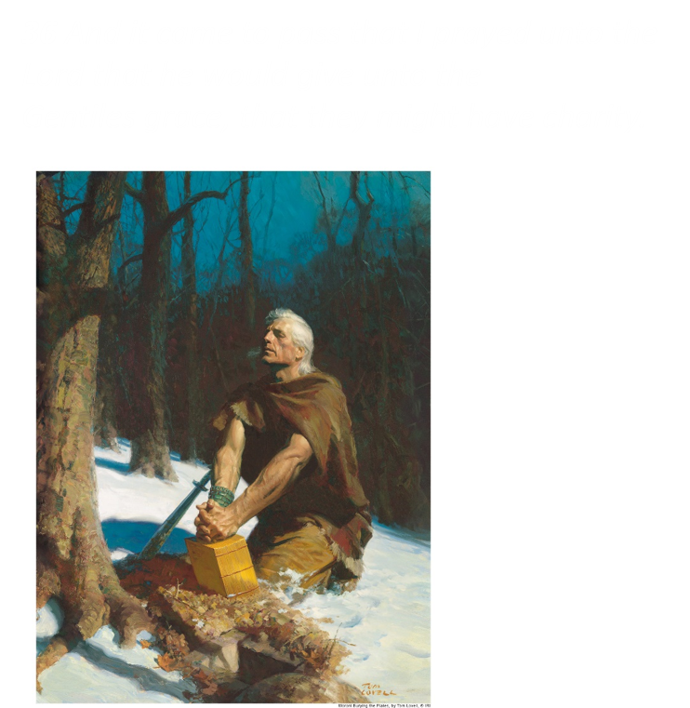
Hyrum Reads From the Book of Mormon
D&C 135:5 and Ether 12:36-38

Slide 13
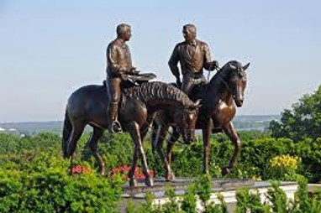
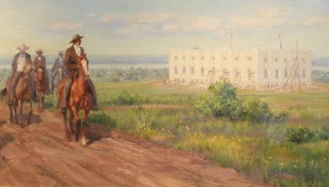
Monday June 24, 1844
A Sunny Day--At 6:30 AM
Joseph, Hyrum, John Taylor, and fifteen other members of the Nauvoo city council set out on horseback for Carthage, accompanied by Willard Richards and a number of other friends.
They paused at the temple site, the Prophet looked on the sacred edifice, then on the city, and remarked, “This is the loveliest place and the best people under the heavens; little do they know the trials that await them.”
To the assembled Saints, he said, “If I do not go there [to Carthage], the result will be the destruction of this city and its inhabitants; and I cannot think of my dear brothers and sisters and their children suffering the scenes of Missouri again in Nauvoo; no, it is better for your brother, Joseph, to die for his brothers and sisters, for I am willing to die for them. My work is finished.”
Student Manual

Slide 14
On the Way to Carthage
Daniel H. Wells
At about ten o’clock the group arrived at a farm four miles west of Carthage, where they met a company of sixty mounted Illinois militia. Captain Dunn presented an order from Governor Ford for all the state arms in the possession of the Nauvoo Legion to be surrendered.
At Dunn’s request, Joseph Smith agreed to return to Nauvoo to forestall any resistance. Joseph then sent a note explaining his delay to the governor in Carthage.
Student Manual

Slide 15
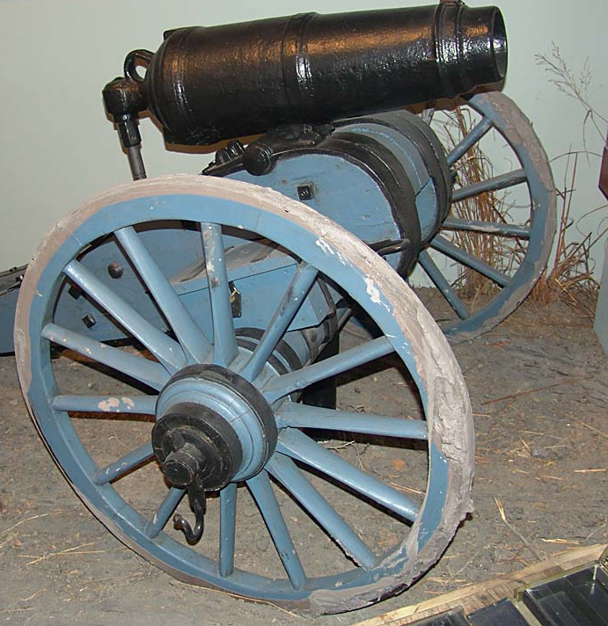
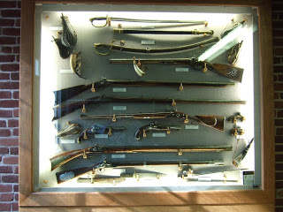
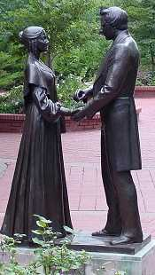
The Final Farewell—Evening of June 24, 1844
In Nauvoo the arms were collected
Joseph directed that three small cannons and about two hundred firearms be turned over to the militia
Joseph and the others left at 6:00 PM for Carthage
Student Manual

Slide 16
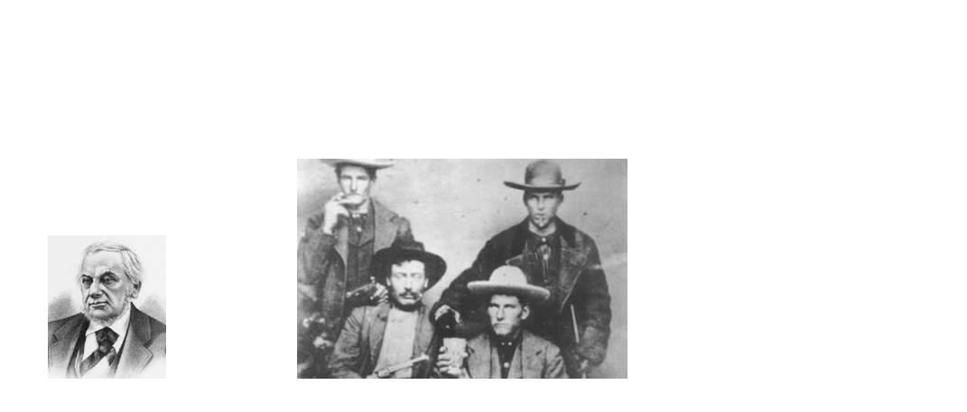
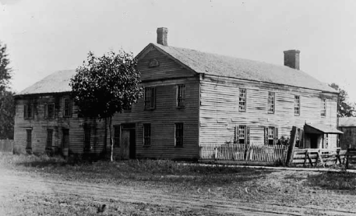
Hamilton House—the First Night
Through Captain Dunn’s efforts, the prisoners were safely placed in the Hamilton House hotel. The Greys still clamored to see Joseph Smith. Finally Governor Ford put his head out the window and calmed the crowd by announcing that Mr. Smith would be paraded before the troops the next day.
Under the same roof were apostates of Nauvoo:
Joseph H. Jackson
The Foster Brothers
The Higbees
The Laws
They had sworn to take the life of President Joseph Smith
BH Roberts pp. 249-251 and Student Manual

Slide 17
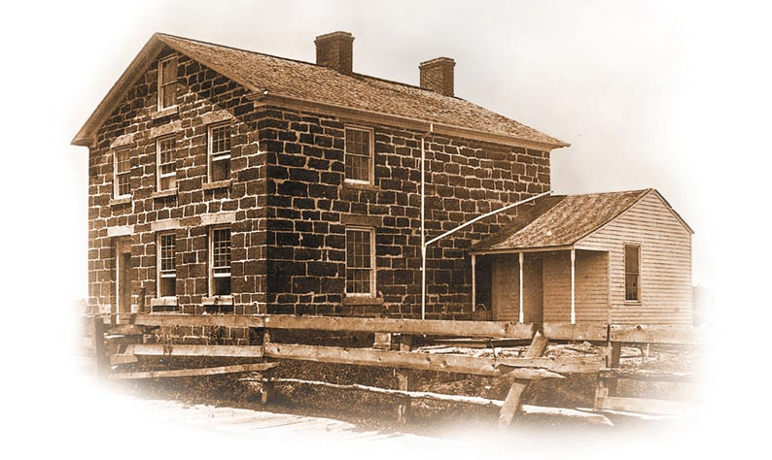
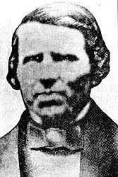
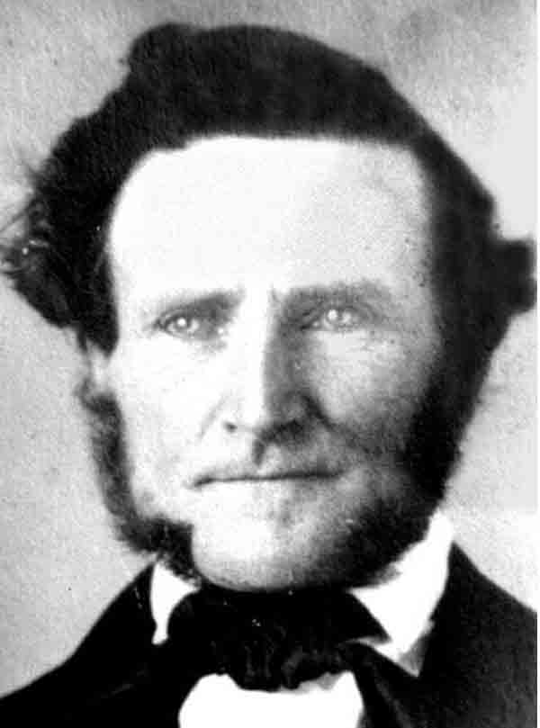
Posting Bail—But Charged for Treason
On June 25, 1844, Joseph and Hyrum Smith and other leaders posted bail at Carthage and were freed until a formal trial could be held to address the charge of inciting a riot (referring to the destruction of the Nauvoo Expositor).
Eight of their friends went with them, including John Taylor, Willard Richards, and John S. Fullmer. Dan Jones, and Stephen Markham with his hickory cane, which he called the “rascal beater,” walked on either side of the Prophet and his brother warding off the drunken crowd. As it turned out, the stone jail was the safest place in town. Several of Joseph and Hyrum’s friends were permitted to stay with them.
Dan Jones
John S. Fullmer
Justice of the Peace Robert F. Smith, who also served as captain of the Carthage Greys militia, left the courtroom without calling Joseph and Hyrum to answer the second charge.
No bail could be posted for treason, so they had to stay in Carthage—and remained in danger.
However, that evening Joseph and Hyrum were charged of “treason’ for calling the Nauvoo Legion to assemble on June 18th and for declaring martial law—actions that had been prompted by justified fears of mob attack on Nauvoo.
Joseph and his lawyers protested that it was illegal because that charge had not been mentioned at their earlier bail hearing.
Possible photo of Robert F. Smith
BH Roberts pp. 255—259 and Student Manual

Slide 18
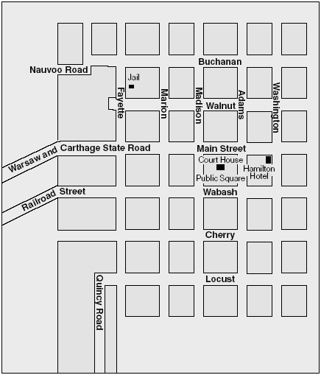
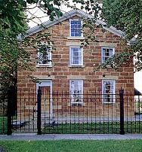
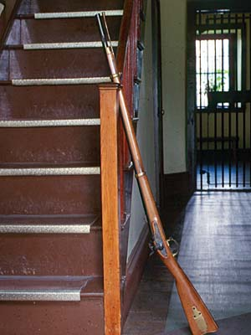
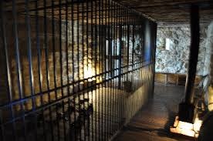
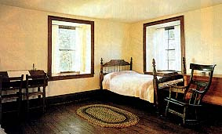
Jail Near Warsaw Road
The jail stood near the Warsaw road on the northwest edge of town, one block north and two blocks west of the town square. The jailer and his family lived on the first floor of the two-story stone building.
The Church leaders spent their first night in a cell on the lower floor.
On the second floor were a cell and a bedroom; the brethren were moved into the bedroom on the second day.
Eight militiamen, posted from the ranks of the Carthage Greys, acted as guards.
310 Buchanan Street, Carthage, IL 62321
Ensign 1994 October

Slide 19
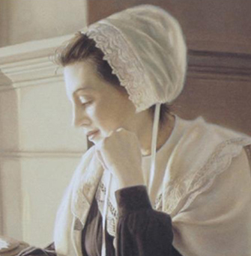
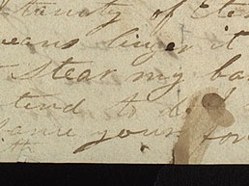
Testimony
On June 26, 1844, Joseph met with Governor Ford in the jail. Governor Ford was contemplating going to Nauvoo, and Joseph asked to go along, feeling he was not safe in Carthage.
Governor Ford promised that if he left Carthage he would take Joseph and Hyrum with him.
That evening, the Prophet bore testimony to the guards of the authenticity of the Book of Mormon and the Restoration of the gospel.
On the morning of June 27, 1844, Joseph wrote in a letter to Emma: “I am very much resigned to my lot, knowing I am justified, and have done the best that could be done. Give my love to the children and all my friends”.
Later that day, despite knowing of plans by local citizens to storm the jail and kill the prisoners, Governor Ford left Carthage to speak to the citizens of Nauvoo. He broke his promise and did not take Joseph and Hyrum with him. Before leaving, Governor Ford placed the Carthage Greys—the most visibly hostile of the militias gathered in Carthage—in charge of guarding the jail and disbanded the other militias.
History of the Church, 6:605

Slide 20
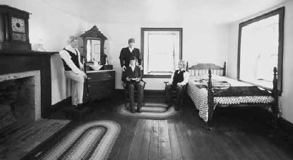
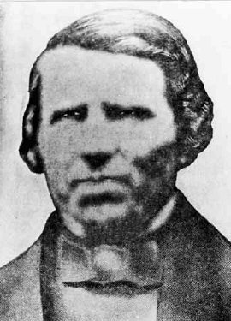
Time Spent in Carthage Jail
The defendants had no witnesses present; since treason was a non-bailable charge, they were required to remain in custody until another hearing could be held on 29 June.
Joseph spent the afternoon dictating to his scribe, Willard Richards, while Dan Jones and Stephen Markham whittled at the warped door to their room in the jail with a penknife so it could be latched securely to prepare against possible attack.
That night Willard Richards, John Taylor, and Dan Jones remained with Joseph and Hyrum in jail. They prayed together and read from the Book of Mormon. Joseph bore his testimony to the guards.
Much later, Joseph was lying on the floor next to riverboat captain Dan Jones. “Joseph whispered to Dan Jones, ‘are you afraid to die?’ Dan said, ‘Has that time come, think you? Engaged in such a cause I do not think that death would have many terrors.’ Joseph replied, ‘You will yet see Wales [Jones’s native land], and fulfill the mission appointed you before you die.’”
Elder Jones later fulfilled the prophecy, serving a great mission in Wales.
Student Manual

Slide 21
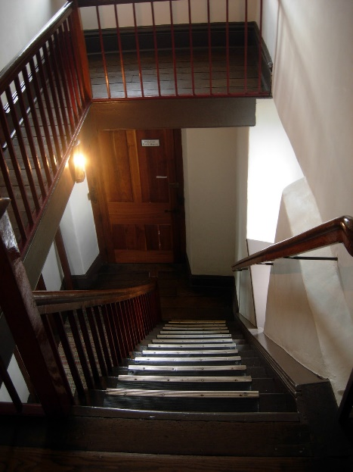
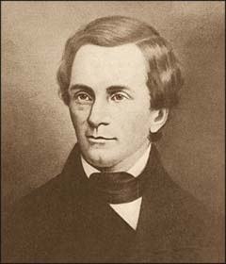
Midnight—June 27, 1844—the Mob
About midnight several men surrounded the jail and started up the stairs to the prisoners’ room. One of the brethren grabbed a weapon that had been smuggled into their room during the day. Members of the mob, standing near the door, heard them moving and hesitated.
“The Prophet with a ‘Prophet’s voice’ called out ‘Come on ye assassins we are ready for you, and would as willingly die now as at daylight.’”
The mob retreated.
The next morning, Thursday, 27 June, “Joseph requested Dan Jones to descend and inquire of the guard the cause of the disturbance in the night.
Frank Worrell, the officer of the guard, who was one of the Carthage Greys, in a very bitter spirit said, ‘We have had too much trouble to bring Old Joe here to let him ever escape alive, and unless you want to die with him you had better leave before sundown; … and you’ll see that I can prophesy better than Old Joe. …’
Joseph directed Jones to go to Governor Ford and inform him what he had been told by the officer of the guard.
History of the Church, 6:602–4.

Slide 22
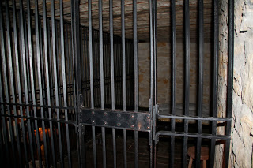
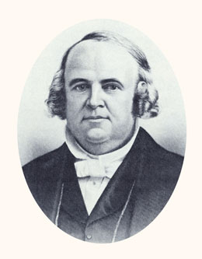
Safer in the Cell
Late in the afternoon Mr. Stigall, the jailor, came in and suggested that they would be safer in the cells.
Joseph told him that they would go in after supper.
Joseph said to Elder Richards, “If we go into the cell will you go with us?”
“Brother Joseph, you did not ask me to cross the river with you—you did not ask me to come to Carthage—you did not ask me to come to jail with you—and do you think I would forsake you now? But I will tell you what I will do; if you are condemned to be hung for ‘treason,’ I will be hung in your stead, and you shall go free.”
Willard Richards
BH Roberts pp. 282-283

Slide 23
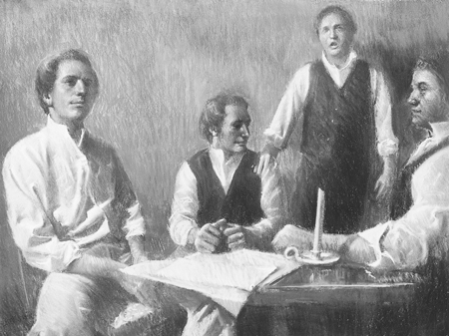
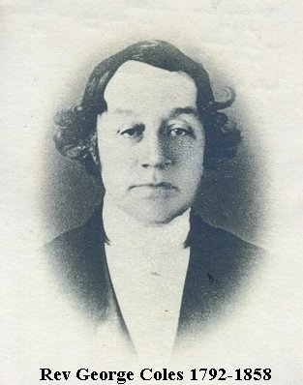
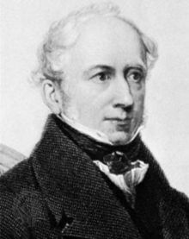
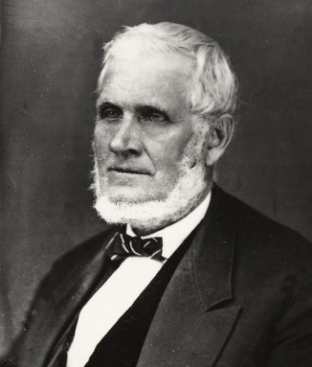
“A Poor Wayfaring Man of Grief”
On the hot and humid afternoon of June 27, the spirit of foreboding came upon the Prophet and those who were with him as they sat in the jailer’s bedroom on the second floor of the jail.
Hyrum Smith asked John Taylor to sing “A Poor Wayfaring Man of Grief”
"A Poor Wayfaring Man of Grief" (originally titled "The Stranger and His Friend") is a seven-stanza poem written in 1826 by James Montgomery. The words of the poem have since been adopted as a Christian hymn.
Melody by George Coles.
The hymn was introduced in the church by apostle John Taylor, who learned the hymn in 1840 as a missionary in England.
James Montgomery.
John Taylor loved the poem, but found the music a bit bland. He adapted from it his own version of the tune. It is this variation that was sung in Carthage Jail.
Wikipedia

Slide 24
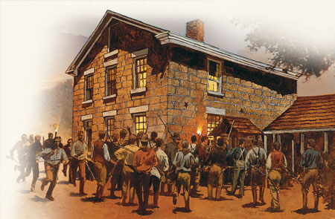
The Mob Surrounds the Building
Shortly after 5:00 p.m. on June 27, 1844, a mob of approximately 150–200 men, with faces painted to hide their identities, surrounded the jail.
The guards provided little resistance as several members of the mob rushed up the stairs to the room where the Prophet and his friends were located.

Slide 25
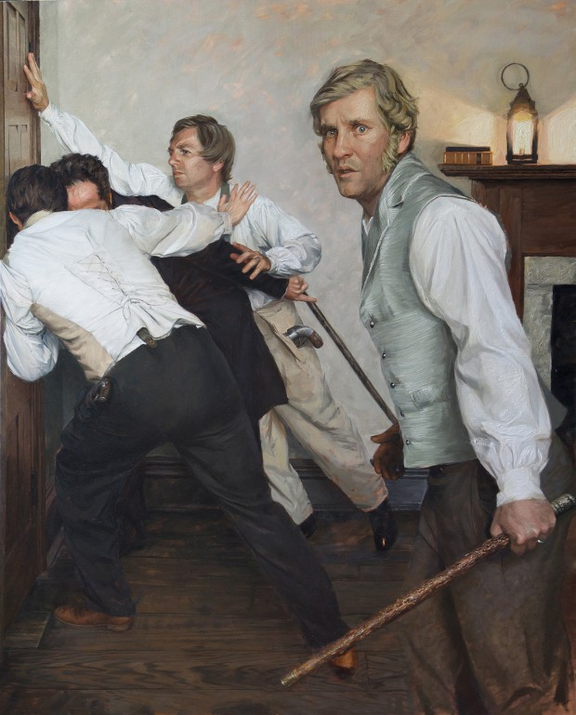
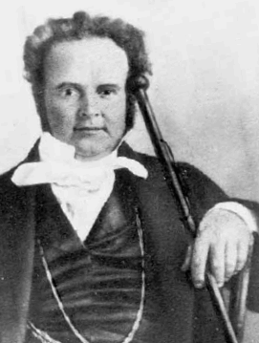
The Pistol
Earlier in the day a visitor had given Joseph a revolver. Acting in defense of everyone in the room, Joseph sprang to the door and reached around the doorframe to shoot the pistol into the hall. Only three of the six chambers fired, wounding several members of the mob. The mob then forced their guns through the half-closed door, and John Taylor tried to beat the barrels of their guns back with a walking stick.
As the conflict at the doorway increased, John Taylor tried to escape the room through a window. As he attempted to leap out of the window, he was shot in the thigh from the doorway and was also shot by someone outside. He fell to the floor, and while attempting to get under the bed next to the window, he was severely wounded by three more shots. Meanwhile, as guns came through the doorway, Willard Richards began striking them with a cane.

Slide 26
Shots Fired
Joseph and the others pushed against the door to prevent the mob from forcing it open.
Someone in the mob fired a shot through the upper panel of the door, striking Hyrum on the left side of his nose.
He fell backwards, exclaiming, “I am a dead man!”
John Taylor said, “I shall never forget the deep feeling of sympathy and regard manifested in the countenance of Brother Joseph as he drew nigh to Hyrum, and, leaning over him, exclaimed, ‘Oh! my poor, dear brother Hyrum!’”
by Andrew Knaupp
History of the Church, 6:617, 7:102

Slide 27
Through the Window
Joseph Smith then decided to try to escape through the same window, likely to preserve his life and, some believed, to save the lives of Willard Richards and John Taylor.
As Willard Richards continued to deflect the mob at the door, the Prophet leaped to the open window.
As he did so, he was struck by bullets from both inside and outside the jail. He fell out of the window, exclaiming, “O Lord, my God!” and landed on the ground below.
The members of the mob who were inside the jail rushed outside to assure themselves that Joseph was dead.
Although there were no members of the Church on their way to Carthage, someone yelled, “The Mormons are coming!” and the entire mob fled.
History of the Church, 6:618, 620–21; see also Church History in the Fulness of Times Student Manual, 283.)

Slide 28
The Fate of John Taylor and Willard Richards
“When another shot from the outside, striking the watch in his vest pocket, threw him back into the room. … He drew himself as rapidly as possible in his crippled condition under the bedstead that stood near the window.”
While on his way three other bullets struck him; one a little below the left knee—it was never extracted; another tore away the flesh to the size of a man’s hand from his left hip… another entered the forepart of his left arm, a little above the wrist, and, passing down by the joint, lodged in the palm of his left hand.
Willard Richards only had his left ear grazed by a bullet, which fulfilled a prophecy Joseph had made more than a year before that “the time would come that the balls would fly around him like hail, and he should see his friends fall on the right and on the left, but that there should not be a hole in his garment” Joseph Smith
Ensign January 2003 and History of the Church,6:619.

Slide 29
Martyr
A person who suffers death as a witness to the truth of his or her beliefs or cause. Martyr comes from a Greek word for witness
Paul Robert Schneider (August 29, 1897 – July 18, 1939) was an Evangelical Church of the old-Prussian Union pastor who was the first Protestant minister to be martyred by the Nazis. He was murdered with a lethal injection of strophanthin in the camp infirmary.
"I cannot salute this criminal symbol". He also refused, as he had done earlier, the Hitler salute.
First Christian martyr Stephen
Saint Andrew Kim Taegon, the first Korean Catholic priest in 1846. He was tortured and beheaded
"This is my last hour of life, listen to me attentively: if I have held communication with foreigners, it has been for my religion and for my God. It is for Him that I die. My immortal life is on the point of beginning. Become Christians if you wish to be happy after death, because God has eternal chastisements in store for those who have refused to know Him.” Saint Andrew Kim Taegon
Bible Dictionary “Martyr” and Wikipedia

Slide 30
Sources:
Joseph Smith: Prophet of the Restoration (Show from time codes 1:01:00 to End)
Testimony of the Book of Mormon (4:39)
Joseph Smith History of the Church Volume 5 pp. 465-473
B.H. Roberts A Comprehensive History of the Church Volume 2
Ensign 1994 October Issue Martyrdom at Carthage by Reed Blake
Church History In The Fulness Of Times Student Manual, (2003), 273–285 Chapter 22—The Martyrdom

Slide 31
Governor Thomas Reynolds Death:
Despite all his success Thomas Reynolds was not a well man, either physically or mentally. For several months prior to his death Reynolds was reported in ill health and suffering from melancholia. Political opponents in Missouri's Whig party, and certain newspapers under their influence, were particularly harsh in their criticism of Reynolds, his actions and positions as governor. During breakfast on the morning of February 9, 1844 Reynolds asked a blessing, which was not usual for him. Following the meal he locked himself in his Executive Mansion office and drew the shutters closed. Some time later a passer-by heard a shot and upon investigation Reynolds was found dead at his desk with an apparently self-inflicted gunshot wound. On the governors writing table was a sealed message addressed to his friend, Colonel William G. Minor in which he said "I have labored and discharged my duties faithfully to the public, but this has not protected me from the slanders and abuse which has rendered my life a burden to me…I pray to God to forgive them and teach them more charity."
Thomas Ford (December 5, 1800 – November 3, 1850) was the eighth Governor of Illinois, and served in this capacity from 1842 to 1846. A Democrat, he is remembered largely for his involvement in the death of Joseph Smith, Jr., and the subsequent Illinois Mormon War. He is also the author of A History of Illinois (Chicago, 1854), published posthumously about the state from its founding in 1818 until 1847.
His tenure as governor is best remembered for the "Illinois Mormon Expulsion,“ particularly his dealings with the Mormon city of Nauvoo, Hancock County, Illinois, and with the assassination of their leader, Joseph Smith, Jr in 1844.
The conflict grew heated, with hundreds being driven from their homes, and mobs that eventually employed several thousands of people.
At one point, Ford encouraged Joseph and his brother, Hyrum Smith, to go to Carthage, the county seat, to face criminal charges in the destruction of the newspaper, the Nauvoo Expositor. Once there, the Smiths were charged with treason, and Ford abandoned them to be guarded by the Carthage Greys, an anti-Mormon militia that helped murder them on June 27, 1844.
Ford denied being responsible. However, two men later gave affidavits suggesting Ford knew of the plot and could have approved of it. Dan Jones, a riverboat captain and one of the few eyewitnesses to both sides of the event, repeatedly warned Ford throughout the day of comments he heard from the guards and jail keepers concerning their plot to assassinate the Mormon leaders. In response, Ford replied, "You are unnecessarily alarmed for your friends safety sir. The people are not that cruel." Irritated by the remark, Jones urged the necessity of placing better men than professed assassins to guard them. He stressed that they [the Smiths] were American citizens surrendered to his [Ford's] pledged honour. When Ford showed little interest in Jones' concerns, Jones commented "[I] had then but one request to make; if you [Ford] left their lives in the hands of those men to be sacrificed, that the Almighty will preserve my life to a proper time and place to testify that you have been timely warned of their danger." Later that day, returning to Nauvoo on horseback, Jones passed Ford's company while it passed by a painted mob ready to enter Carthage to kill the Mormon leaders. Jones records that while the assassination was taking place in Carthage, Ford addressed the citizens of Nauvoo saying that a "severe atonement must be made so prepare your minds for the emergency." The officials of the governor were heard urging him to hasten from there assuring him that the deed (that is the assassination) "was sure of having been accomplished by then." Both Ford's statement and the comments of his supporting officials provide strong evidence of Ford's involvement. He was later claimed to have said, "it's all nonsense; you will have to drive the Mormons out yet." This is exactly what happened. Several residents of Hancock County, and many residents from several surrounding counties, met and decided on a plan of action that later forced the Mormon retreat into Utah, led by Brigham Young, by 1846. Wikipedia
Pope, Nathaniel secretary of the Territory of Illinois under Governor Edwards, a cousin of the governor, and delegate to the U.S. Congress from the territory from 1815 to 1818; judge in the federal district court established in Illinois in 1819; in April 1818, when a bill for an enabling act to provide statehood for Illinois was being considered in the U.S. House of Representatives, Pope convinced the assembly that the new state of Illinois should have its northern border moved N by an additional 61 miles, deviating from the stipulation of the ordinance, in order for the state to gain access to Lake Michigan. Thus Chicago became part of the state of Illinois, and Illinois became more closely allied to the northern states, else possibly siding with southern slave states during a civil war yet to come. Pope was first judge to hold federal court in Chicago in 1837, the session taking place over Meeker`s store on Lake Street, between State and Dearborn. Nathaniel Pope School, 1852 S Albany Ave. Early Chicago Encyclopedia
James Montgomery (4 November 1771 – 30 April 1854) was a British poet, hymn writer and editor. He was particularly associated with humanitarian causes such as the campaigns to abolish slavery and to end the exploitation of child chimney sweeps.
Hymn Writer of A Poor Wayfaring Man of Grief originally titled The Stanger and His Friend.

Slide 32
The title “THE BOOK of the LAW of the LORD,” written in ornate style, adorns a ledger-style record book maintained by several of JS’s scribes in Nauvoo, Illinois, between 1841 and 1845. In this volume, JS’s scribes copied nine of his revelations, kept a portion of his journal, and recorded donations made by church members for the construction of the Nauvoo temple and the Nauvoo House (a boardinghouse). For a detailed historical introduction to the Book of the Law of the Lord, particularly the journal portion, read the Historical Introduction to Journal, December 1841–December 1842.
The journal portion of the Book of the Law of the Lord, comprising a little less than twenty percent of the volume and covering the period 11 December 1841 to 20 December 1842, is published in full in Journals, Volume 2. This material was recorded by Willard Richards, William Clayton, Eliza R. Snow, and Erastus Derby. To view images and transcripts of the journal entries, along with detailed annotation, visit Journal, December 1841–December 1842.
The revelation and donation portions of the Book of the Law of the Lord are here published for the first time. JS’s scribe, Robert B. Thompson, copied nine revelations into the volume between January 1841 and his death on 27 August of that year. The record began with the 19 January 1841 revelation commanding the building of the temple in Nauvoo and the Nauvoo House. Six of the nine revelations were later canonized and constitute, in order of their recording by Thompson, sections 124, 125, 105, 111, 87, and 103 in the present Doctrine and Covenants of The Church of Jesus Christ of Latter-day Saints.
The three other revelations remain uncanonized. One (dated 20 March 1841) concerns the appointment of agents for the Nauvoo House Association. The remaining two, which were received in January 1838 just prior to JS’s abrupt departure from Ohio to Missouri, deal with questions related to the sustaining of the church’s First Presidency and the protocol for removing them from office in cases of transgression. Willard Richards subsequently made minor revisions to the texts as recorded by Thompson. Transcripts of these revelations accompany the images for pages 3–25 of the Book of the Law of the Lord. The links below provide direct access to each of the nine revelations:
Page 3—Revelation, 19 January 1841 [D&C 124]
Page 15—Revelation, 20 March 1841
Page 16—Revelation, ca. March 1841 [D&C 125]
Page 17—Revelation, 12 January 1838–A
Page 18—Revelation, 12 January 1838–B
Page 19—Revelation, 22 June 1834 [D&C 105]
Page 22—Revelation, 6 August 1836 [D&C 111]
Page 22—Revelation, 25 December 1832 [D&C 87]
Page 23—Revelation, 24 February 1834 [D&C 103]
The donation entries comprise approximately seventy-five percent of the record. They were recorded by Willard Richards and William Clayton between late 1841 and 1845. Journal entries and donation records were kept concurrently in the book, alternating sometimes every other page and chronologically leapfrogging each other. This pattern was especially pronounced near the beginning of the book, where donations and journal entries occasionally appear together on a single page. Over time, however, larger and larger blocks of text were dedicated to either donations or journal entries until the journal was transferred by Richards to another volume, the memorandum book.
All donation pages are here published as images without an accompanying transcript. They have been divided into chronological subsections to aid research; readers may use the table of contents button in the top left of the document viewer to navigate within the volume. Two indexes to the donation portions of the Book of the Law of the Lord were created in the Nauvoo period. These will be published on the Joseph Smith Papers website at a future time.
The interspersing of journal entries with pages of donation records, as well as JS’s conscious efforts to record the names of people who helped him, suggests that the volume as a whole was understood in terms of a letter JS wrote in 1832 stating that “a history and a general church record” must be kept “of all things that transpire in Zion and of all those who consecrate properties.” That record was to be kept in a book called “the book of the Law of God”—a book whose name parallels usage in the Old Testament. (See, for example, Joshua 24:26, 2 Chronicles 17:9, and Nehemiah 9:3.)
Concerning the significance of the Book of the Law of the Lord, Alex Smith, a volume editor for the Joseph Smith Papers, wrote, “For today’s researchers, the journal entries in the Book of the Law of the Lord are frequently the most primary sources for descriptions of Joseph Smith’s daily activities during 1842. Certain details about key events (e.g., the organization of the Female Relief Society of Nauvoo, John C. Bennett’s expulsion from the Church, the second attempt to extradite Joseph Smith to Missouri, the creation of the Nauvoo Masonic Lodge, and the construction of the temple and Nauvoo House) are found only in this book. . . . Its record of financial donations is a rich cultural history resource—providing valuations of common goods and services.” Smith concluded, “Perhaps the greatest importance of the book lies in its theological implications—a record decreed by revelation to record for heaven and earth the deeds and consecrations of the Saints.” (Alex D. Smith, “The Book of the Law of the Lord,” Journal of Mormon History 38, no. 4 [Fall 2012], 161.)
http://josephsmithpapers.org/paperSummary/the-book-of-the-law-of-the-lord

Slide 33
The Arrest
Wednesay, June 12, 1844.-At 10 a. m. in my office.
At half-past one I was arrested by David Bettisworth on the following writ:
STATE OF ILLINOIS, HANCOCK COUNTY,
The People of the State of Illinois to all Constables, Sheriffs and Coroners of State, Greeting: Whereas complaint hath been made before me, one of the justices of the peace within and for the countv of Hancock aforesaid, upon the oath of Francis M. Higbee of said county, that Joseph Smith, Samuel Bennett, John Taylor and William W. Phelps, Hyrum Smith, John P. Greene, Stephen Perry, Dimick B. Huntington, Jonathan Dunham, Stephen Markham, William Edwards, Jonathan Holmes, Jesse P. Harmon, John Lytle, Joseph W. Coolidge, Harvey D. Redfield, Porter Rockwell and Levi Richards, of said county did on the 10th day of June instant commit a riot at and within the county aforesaid, wherein they, with force and violence broke into the office of the Nauvoo Expositor, and unlawfully and with force burned and destroyed the printing press, type and fixtures of the same, being the property of William Law, Wil­son Law, Charles Ivins, Francis M. Higbee, Chauncey L. Higbee, Robert D. Foster, and Charles A. Foster. These are therefore to command you forthwith to apprehend the said Joseph Smith, Samuel Bennett, John Taylor, William W. Phelps, Hyrum Smith, John P. Greene, Stephen Perry, Dimick B Huntington, Jonathan Dunham, Stephen Markham, William Edwards, Jonathan Holmes, Jesse P. Harmon, John Lytle, Joseph W. Coolidge, Harvey D. Redfield, Porter Rockwell and Levi Richards, and bring them before me or some other justice of the peace, to answer the premises, and further to be dealt with according to Law.
Given under my hand and seal at Carthage, in the county aforesaid, this 11th day of June. A. D. 1844.
[Seal] THOMAS MORRISON, J. P.
History of the Church, Volume VI (p. 453)

Slide 34
Daniel H. Wells (known as Squire Wells) was a "Jack Mormon" in the original sense of the word. Daniel Hanmer Wells was born October 27, 1814 in Trenton, New York to Daniel Wells and his wife Catherine Chapin. He married Eliza Rebecca Robison March 12, 1837 in Commerce (later Nauvoo), Illinois. Later he would practice plural marriage. Though not yet a member of the Church, he was in Commerce to greet the struggling refugees from the horrors of the Missouri Persecutions. A landowner, he divided an eighty acre tract into lots which he sold at low prices and attractive terms, thereby affording home ownership to many who otherwise could not afford it. His efforts brought comfort to many and he remained with the Saints for years. This was the original meaning of the epithet, "Jack Mormon," a non-member who supported and helped the Saints and Daniel fit the description well.
When, after the martyrdom of the Prophet Joseph Smith, the mobs raged about Nauvoo, Squire Wells, as he was known, defended the city. Indeed he fought valiantly in the last battle of Nauvoo, serving as a leader of the defenders as they provided cover for the straggling evacuees. It would not be the last time he faced the mob. He was not baptized until August 9, 1846, a move not supported by his wife, who refused go west with her husband and the Saints.
Well respected for his many years of integrity, he was elected Attorney General of Deseret in 1849. He was elected mayor of Salt Lake City and served for a period of ten years, As such he would again face the mob as the unholy host raged about the city attempting to interfere with the election of 1874. Although physically assaulted and his coat torn, Daniel stood calmly on the balcony of city hall and read the official order to disperse.
Later when Jedediah M. Grant died at the age of forty, Daniel was ordained an Apostle and set apart as Second Counselor to President Brigham Young. Though an Apostle, President Wells was never sustained as a member of the Twelve. When President Young died in 1877, he was sustained as a Counselor to the Twelve Apostles.
President Wells died in Salt Lake City on March 24, 1891 in Salt Lake City at the age of seventy-six.
http://www.gapages.com/wellsdh1.htm
Warsaw Regulators and Carthage Greys (guards):
In 1841, Thomas C. Sharp of Warsaw, Illinois organized an anti-Mormon political party and began publishing vitriolic editorials in his Warsaw Signal newspaper attacking Joseph Smith's concentration of power, the creation of a Mormon military force called The Nauvoo Legion, and Mormon land speculation.
In February 1844, Sharp resumed ownership of the Warsaw Signal. The Signal was vigorously anti-Mormon in its editorial stance. In a June 11, 1844 editorial, Sharp wrote:
War and extermination is inevitable! Citizens ARISE, ONE and ALL!!!—Can you stand by, and suffer such INFERNAL DEVILS! to ROB men of their property and RIGHTS, without avenging them. We have no time for comment, every man will make his own. LET IT BE MADE WITH POWDER AND BALL!!
Three prosecution witnesses, members of the Carthage Greys who were assigned guard duty, placed Aldrich, Williams, and Sharp in Carthage just before the five o'clock assault on the jail. The witnesses described a chaotic scene around the jail and then Joseph Smith's fall from the second-floor window. By the time the troops reached the jail, according to the witnesses, the Smiths were dead and the mob was beating a hasty retreat. None of the three witnesses reported overhearing any conversations that would specifically tie any of the defendants to the actual murders.
James Montgomery (4 November 1771 – 30 April 1854) was a British poet, hymn writer and editor. He was particularly associated with humanitarian causes such as the campaigns to abolish slavery and to end the exploitation of child chimney sweeps.
Hymn Writer of A Poor Wayfaring Man of Grief originally titled The Stanger and His Friend.
Rev. George Coles was born on 2 Jan 1792 in Stewkley , England. He died on 1 May 1858 in New York , New York. Buried: Ivandell Cemetery, Somers, New York. Near the end of John Taylor’s life and as President of the Church, he commissioned from the conductor of the Mormon Tabernacle Choir, Ebenezer Beesley, a new tune for this song. This tune is informed by John Taylor's version. Brother Beesley named this tune HYRUM. It is also known as MAN OF GRIEF. So, George Coles wrote DUANE STREET, John Taylor adapted it, and the modern MAN OF GRIEF tune is a further adaptation by Ebenezer Beesley, but was not actually written by Rev. Coles. Unnamed tune by John Taylor: (Original 'Poor Wayfaring Man' had different tune): Original 'Poor Wayfaring Man' had different tune—
Roots Web
Dan Jones (1811–62) was born in Flintshire, Wales, and later emigrated to America, where he joined the Church. In fulfillment of a prophetic promise given him by the Prophet in the Carthage Jail, Dan served a mission in Wales from 1845 to 1849. He wrote and translated Church publications for the Welsh, and assisted in bringing over two thousand converts into the Church.
He was called a second time to Wales in 1852 and became mission president in 1854, where he again performed a great work among the people of his native land.

Slide 35
June 26, 1844, 9:15 p.m.—Elder John Taylor prayed. Willard Richards, John Taylor, John S. Fullmer, Stephen Markham and Dan Jones stayed with Joseph and Hyrum in the front room.
During the evening the Patriarch Hyrum Smith read and commented upon extracts from the Book of Mormon, on the imprisonment and deliverance of the servants of God for the Gospel's sake. Joseph bore a powerful testimony to the guards of the divine authenticity of the Book of Mormon, the restoration of the Gospel, the administration of angels, and that the kingdom of God was again established upon the earth, for the sake of which he was then incarcerated in that prison, and not because he had violated any law of God or man.
They retired to rest late. Joseph and Hyrum occupied the only bedstead in the room, while their friends lay side by side on the mattresses on the floor. Dr. Richards sat up writing until his last candle left him in the dark. The report of a gun fired close by caused Joseph to rise, leave the bed, and lay himself on the floor, having Dan Jones on his left, and John S. Fullmer on his right. Joseph laid out his right arm, and said to John S. Fullmer, "Lay your head on my arm for a pillow, Brother John;" and when all were quiet they conversed in a low tone about the prospects of their deliverance. Joseph gave expression to several presentiments that he had to die, and said, "I would like to see my family again," and "I would to God that I could preach to the Saints in Nauvoo once more." Fullmer tried to rally his spirits, saying he thought he would often have that privilege, when Joseph thanked him for the remark and good feelings expressed to him. (June 26, 1844—midnight.) DHC 6:600-601.
-- Teachings of the Prophet Joseph Smith, Section Six 1843–44, p.384
THE AFTERNOON OF JUNE 27, 1844.—I do not remember the names of all who were with us that night and the next morning in jail, for several went and came; among those that we considered stationary were Stephen Markham, John S. Fullmer, Captain Dan Jones, Dr. Willard Richards, and myself. Dr. Bernhisel says that he was there from Wednesday in the afternoon until eleven o'clocknext day.
---John Taylor, The Gospel Kingdom, p.358
“At 7 a.m. Jospeh, Hyrum, Dr. Richards, Stephen Markham and John S Fullmer ate breakfast together. “ “ John S. Fullmer went to the Governor to get a pass…”
At “8:30 a.m. John S. Fullmer returned to the jail.”
At “11: a.m. John S. Fullmer left the jail for Navuoo, with a verbal charge to assist Cyrus Wheelock in gathering and forwarding witnesses for the promised trial.”
--History of the Church 6:604-12
“Brother Jones, Fullmer and Markham, who had all been sent out on errands, were refused admittance when they returned to the jail.”
--Joseph Feilding Smith, Church History and Modern Revelation, Vol. 4, p 196

Slide 36
John Taylor: John Taylor: Defender of Truth By Karla C. Erickson 2003 January Ensign
On 27 June 1844 Elder Taylor, Elder Willard Richards, also of the Quorum of the Twelve Apostles, the Prophet Joseph Smith, and the Prophet’s brother Hyrum were in Carthage Jail awaiting word from the governor. While the four friends waited in prison, Elder Taylor sang the hymn “A Poor Wayfaring Man of Grief.” The mood was somber and melancholy. “Shortly Hyrum asked him to sing the song again, to which he replied:
“‘Brother Hyrum, I do not feel like singing.’
“‘Oh, never mind; commence singing and you will get the spirit of it.’
“Soon after finishing the song the second time, as he was sitting at one of the front windows of the jail, he saw a number of men, with painted faces. … The mob reaching the landing in front of the door, and thinking it was locked, fired a shot through the key hole. Hyrum and Doctor Richards sprang back, when instantly another ball crashed through the panel of the door and struck Hyrum in the face; at the same instant a ball … entered his back, and he fell exclaiming, ‘I am a dead man!’ …
“… Elder Taylor took his place next [to] the door, and with a heavy walking stick … parried the guns as they were thrust through the doorway and discharged. …
“… Streams of fire as thick as a man’s arm belched forth from the ever increasing number of guns in the door-way, yet calm, energetic and determined, Elder Taylor beat down the muzzles of those murderous guns.
“‘That’s right, Brother Taylor, parry them off as well as you can,’ said Joseph, as he stood behind him.”
But as the gunfire continued and more mobbers pushed their way up the stairs, Elder Taylor sprang for the open window.
“As [Elder Taylor] was in the act of leaping from the window, a ball fired from the door-way struck him about midway of his left thigh. He fell helpless on the window sill and would have dropped on the outside of the jail—when another shot from the outside, striking the watch in his vest pocket, threw him back into the room. … He drew himself as rapidly as possible in his crippled condition under the bedstead that stood near the window.
“While on his way three other bullets struck him; one a little below the left knee—it was never extracted; another tore away the flesh to the size of a man’s hand from his left hip and spattered the wall with blood and the mangled fragments; another entered the forepart of his left arm, a little above the wrist, and, passing down by the joint, lodged in the palm of his left hand.”
While he lay in pain, he heard the mob shout that the Prophet had leaped from the window.
“Dr. Richards … confirmed his worst fears—the Prophet was dead!
“‘I felt,’ says Elder Taylor, ‘a dull, lonely, sickening sensation at the news.’”
Several days later, Elder Taylor discovered that one ball of shot, aimed at his heart, had smashed into the crystal of his pocket watch, preventing him from falling from the jail window. He said, “I felt that the Lord had preserved me by a special act of mercy; that my time had not yet come, and that I had still a work to perform upon the earth.”
As a witness to the Martyrdom, Elder Taylor wrote the powerful and eloquent words that are now section 135 of the Doctrine and Covenants: “Joseph Smith, the Prophet and Seer of the Lord, has done more, save Jesus only, for the salvation of men in this world, than any other man that ever lived in it” Life of John Taylor

