Slide 1
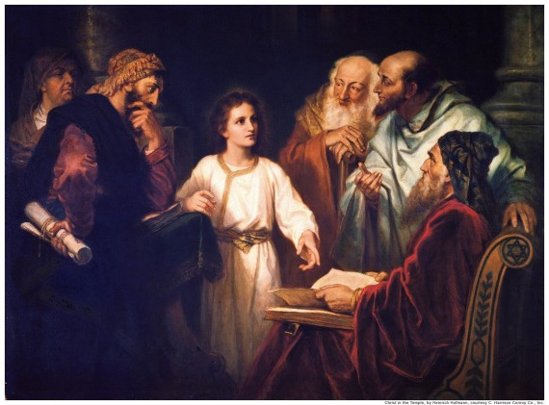
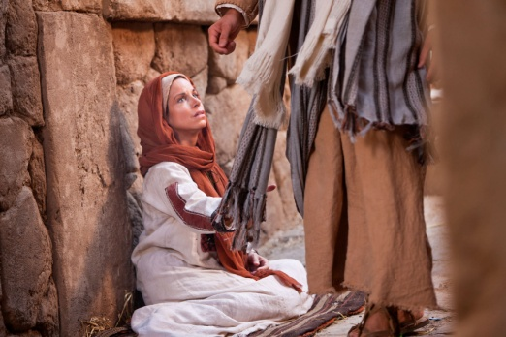
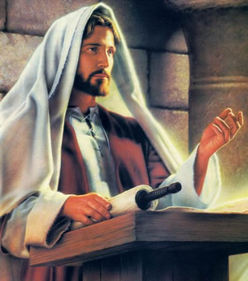
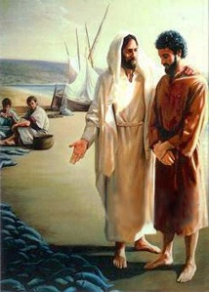
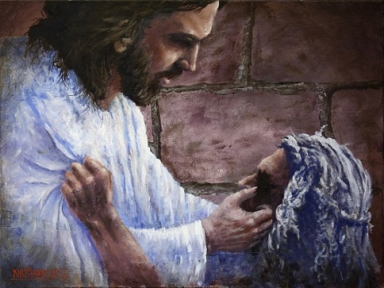
Duties of the Priesthood

Slide 2
Duties of the Priesthood
April 6, 1830
Preach
To deliver a sermon or religious address to an assembled group of people, typically in church.
Teach
To cause or help (someone) to learn about a subject by giving lessons
Expound
To teach something in greater detail
Exhort
Warn
Invite
To strongly encourage someone to do something
to urge or advise to be careful
To ask (someone) to Come Unto Christ
D&C 20:38

Slide 3
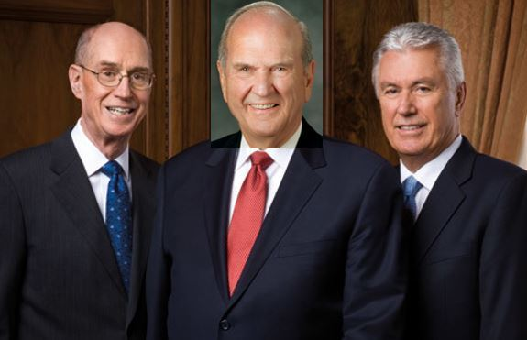
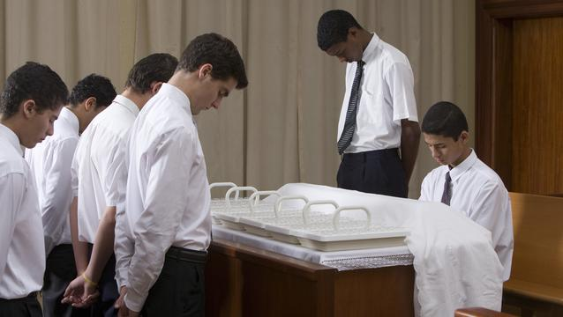
Aaronic Priesthood
Prophets, apostles, other Church leaders, and full-time missionaries have these responsibilities.
However,
These are duties that all priesthood holders, including Aaronic Priesthood holders, can carry out.
The Aaronic Priesthood holders in your class have been trusted with significant opportunities to serve.

Slide 4
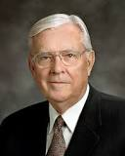
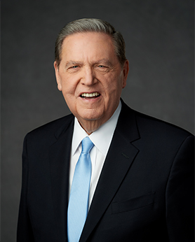
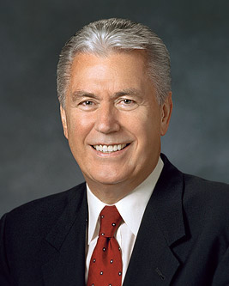
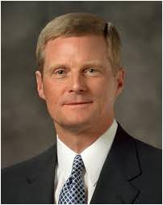
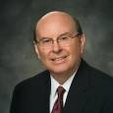
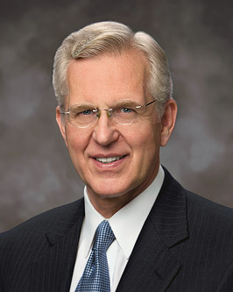
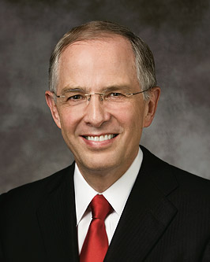
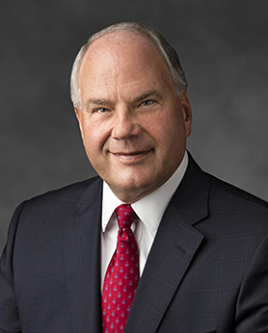
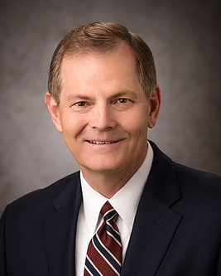
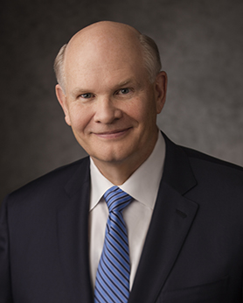
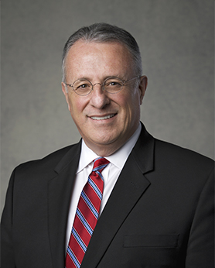
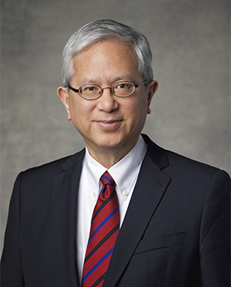
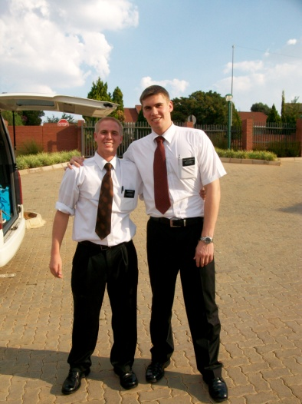
Duties of an Elder
Elders
D&C 20:38-45
An Apostle is an Elder
Baptize and Confirm the Gift of the Holy Ghost by laying on of hands
Ordain other Elders, Priest, Teachers and Deacons
Administer the Sacrament
Teach, Expound, Exhort, and watch of the church
Take lead in all meetings and conduct with the Holy Spirit
M. Russell Ballard
Jeffrey R. Holland
Dieter F. Uchtdorf
David A. Bednar
Quentin L. Cook
D. Todd Christofferson
Neil L. Anderson
Ronald A. Rasband
Gary E. Stevenson
Dale G. Renlund

Slide 5
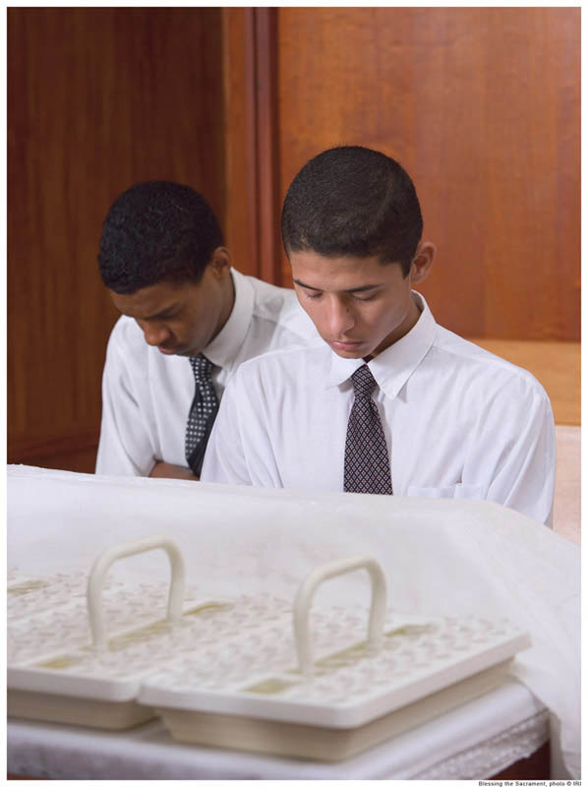
Duties of a Priest
Priests
D&C 20:46-52
Teach, Expound, Exhort, Baptize
Administer the Sacrament
Visit the house of each member, and exhort them to pray vocally and in secret and attend to all family duties.
Ordain other Elders, Priest, Teachers and Deacons
Confirm the Gift of the Holy Ghost
Take lead in all meetings when there is no Elder present
Assist an Elder if occasion arises

Slide 6
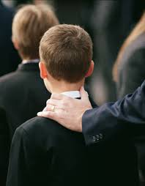
Duties of a Teacher
Teachers and Deacons
D&C 20:53-59
Watch over the church continually and strengthen them
To see that there is no iniquity in the church, neither hardness with each other, neither lying, backbiting, nor evil speaking
See that the church meet together often, and also see that all the members do their duty.
To take the lead of meetings in the absence of the elder or priest—
They are to assisted always, in all their duties in the church, by the deacons, if occasion requires.
But neither teachers nor deacons have authority to baptize, administer the sacrament, or lay on hands;
To warn, expound, exhort, and teach, and invite all to come unto Christ.

