Slide 1
Engagement and Wedding:
The Parable of the Ten Virgins
Part 1
Matthew 24:42-51

Slide 2
The world began with a wedding and will end with the same.

Slide 3
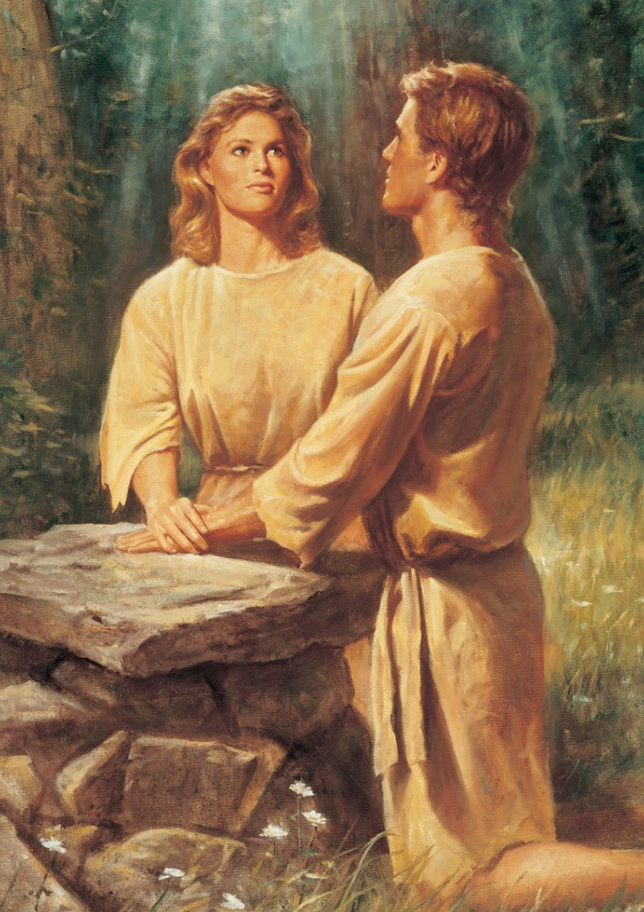
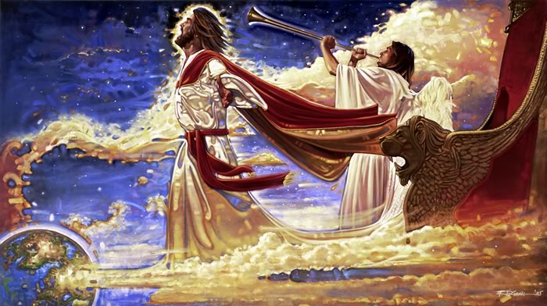
Adam and Eve were married by God in the Garden of Eden.
The world will end with a marriage feast with Christ as the Bridegroom and the Church as the Bride.

Slide 4
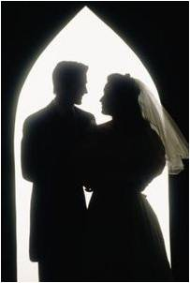
Salvation: (Jeshua) Hebrew = feminine term…
they believed you had to be married.
There is no word in Hebrew for “Bachelor.”
In Christ’s time marriage was not just an option.

Slide 5
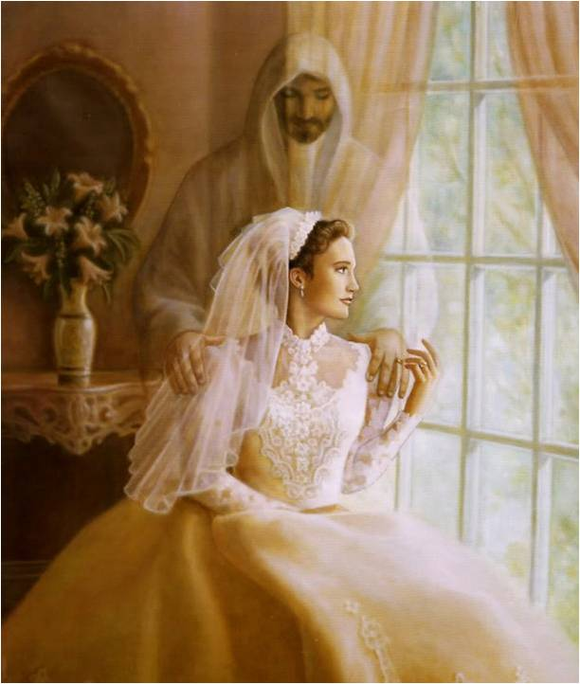
Hebrew youth had no expectations of finding “the right one.”
Love wasn’t important until after the marriage. Social interaction would have been bewildering and unappealing to the youth of Bible times.

Slide 6
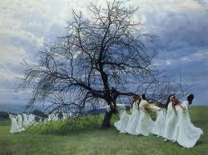
Young girls would dance in a white dress
Before
for the Betrothal
After the Day of Atonement, while young men observed, but were told not to give attention to the face…only the goodness of the family

Slide 7
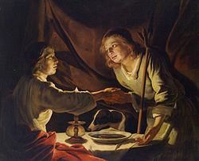
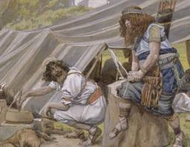
Only a disobedient son would marry a woman of his own choice without consent of the father.
Esau married 2 Hittite women and lost his birthright

Slide 8
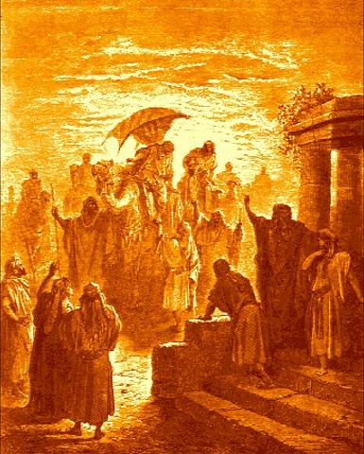
The First two wives of Esau. They were Hittites, and that means they were Canaanites. (Gen 26:34) "And Esau was forty years old when he took to wife Judith the daughter of Beeri the Hittite, and Bashemath the daughter of Elon the Hittite:" The Cursed Line of Canaan (Gen 9:22-27) The family line of Canaan was cursed because of his father, Ham. These two wives were a grief of mind to Isaac and Rebekah.
(Gen 26:35; 27:46; 28:6-8)

Slide 9
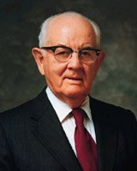
Order of Betrothal and Marriage:
Bridegroom=Christ
Bride=Church=Endowed portion
“I Believe that the Ten Virgins represent the people of the Church of Jesus Christ and not the rank and file of the world”
Spencer W. Kimball, Faith Precedes the Miracle. P. 253

Slide 10
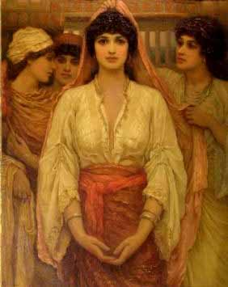
Betrothal:
Like our engagements
Serious covenant
Legally binding
Could not break without a divorce.
Legally married but not consummated.
Choosing a companion was not the prerogative of the bride…only the groom, she could only accept or reject.

Slide 11
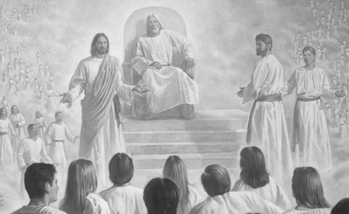
Christ loved and chose us from the Pre-Existence.
Ours is to accept Him or reject Him.
(Ephesians 1:4)

Slide 12
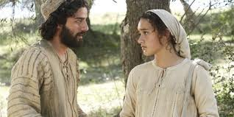
Betrothal
“Kiddushin”
Dedication to one another…”One Soul in Two Bodies”
Meaning to be devoted irrevocably, being sanctified and set apart, and being consecrated.

Slide 13
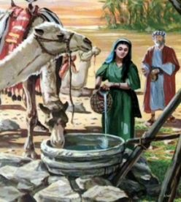
The Meeting
Shidduch, or Matchmaking:
A parent or close friend or relative of the young man or woman suggests they meet.
Purpose:
Prospective bride and groom to
determine if compatible.
The Talmud states that the
couple must also be
physically
attractive to each other.

Slide 14
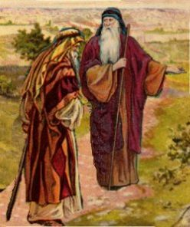
Young man with his father or male,
“Friend of the Bridegroom” would meet the father of the woman on a Wednesday (Wed…nes…day) in the middle of the month during a full moon (The day the heavenly lights were created.)

Slide 15
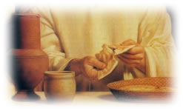
They would refuse food until the interview with the bride’s father was granted.
They couldn’t “break bread” because that was the “covenant meal” to seal the agreement.

Slide 16
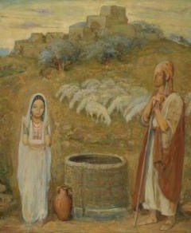
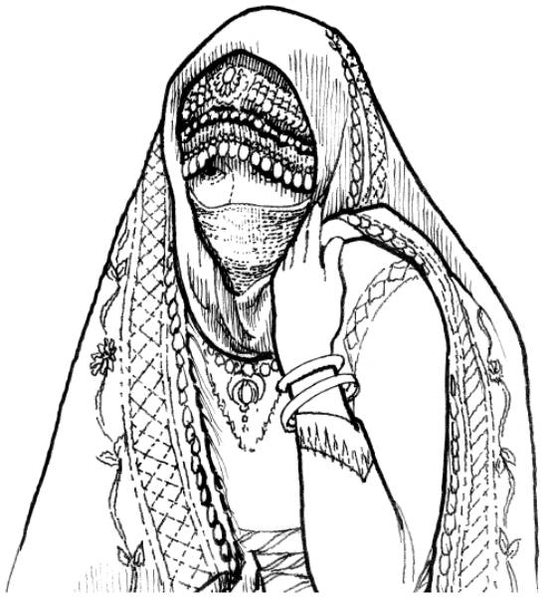
Three parts to a marriage proposal:
As Jacob did for Rachel

Slide 17
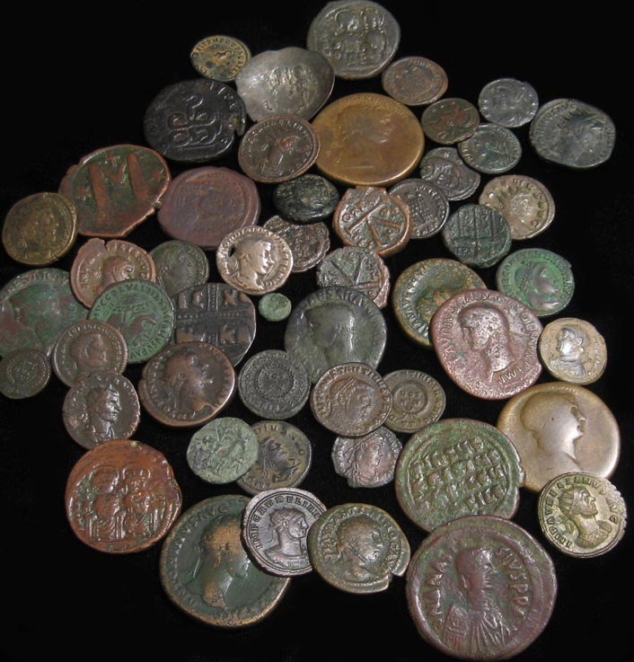
1. Money
Bride Price
“Mohar”
Negotiated in the presence of the bride.
Value and esteem= to the size of the price paid for her.

Slide 18
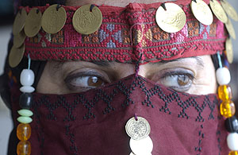
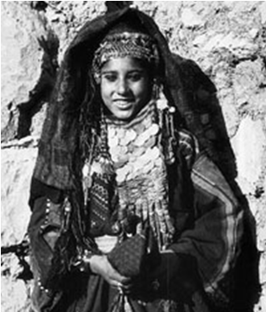
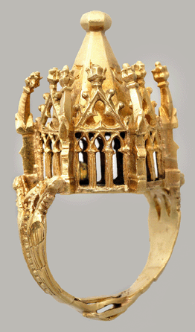
Gift from the
Bridegroom
guarded carefully…
Bride would usually adorn herself
Bride Gift

Slide 19
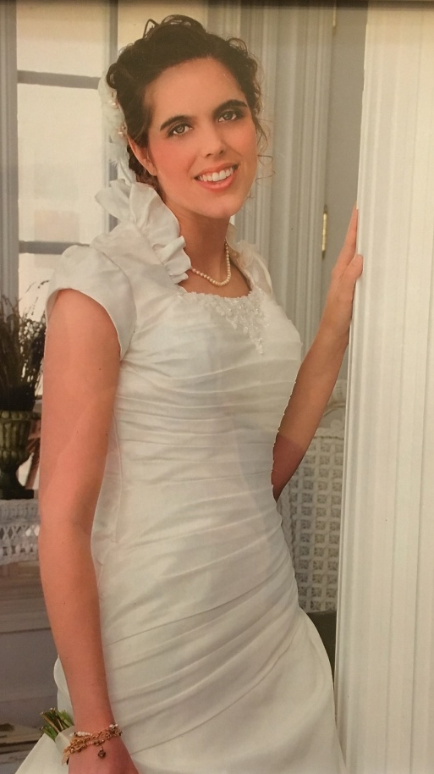
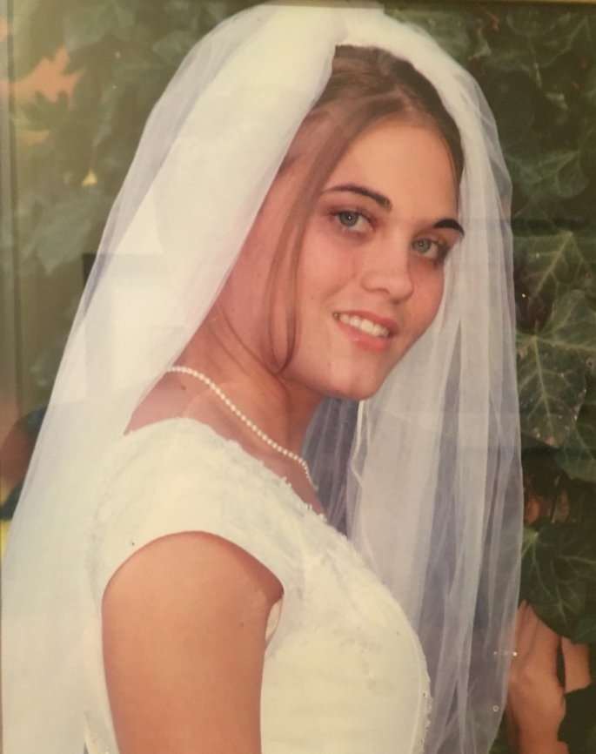
The Free Gift of redemption.
It is a free gift to us, but it cost Him His life.
We “adorn” ourselves with the evidence of living the atonement in our lives.

Slide 20
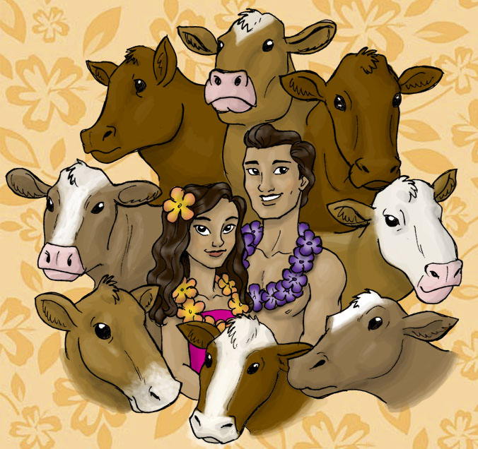
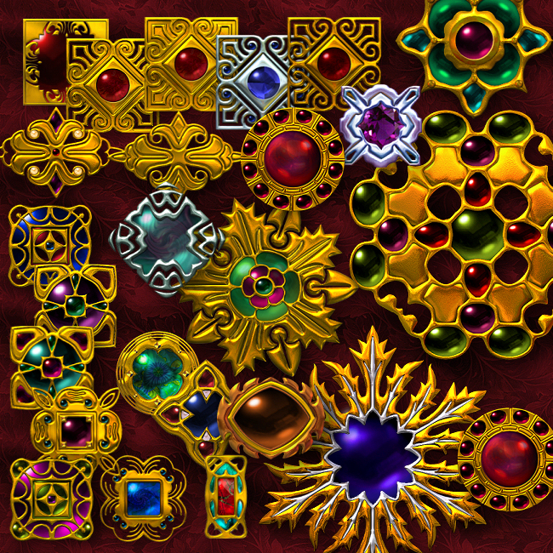
Mahana= 8 cow wife
This bride price was usually paid in livestock, money or jewels.
Service could also be offered
(Jacob worked 14 years for his 2 wives)

Slide 21
Dowry:
Part of the bride price became her security if her husband died or divorced her.
Symbolism:
“en-dow-ment”
A shield and safeguard.

Slide 22
Christ paid the highest possible “bride price” for us (Acts 20:28)
Paid in installments:
Sinless life in Pre-Existence
Mortality
Atonement and Death

Slide 23
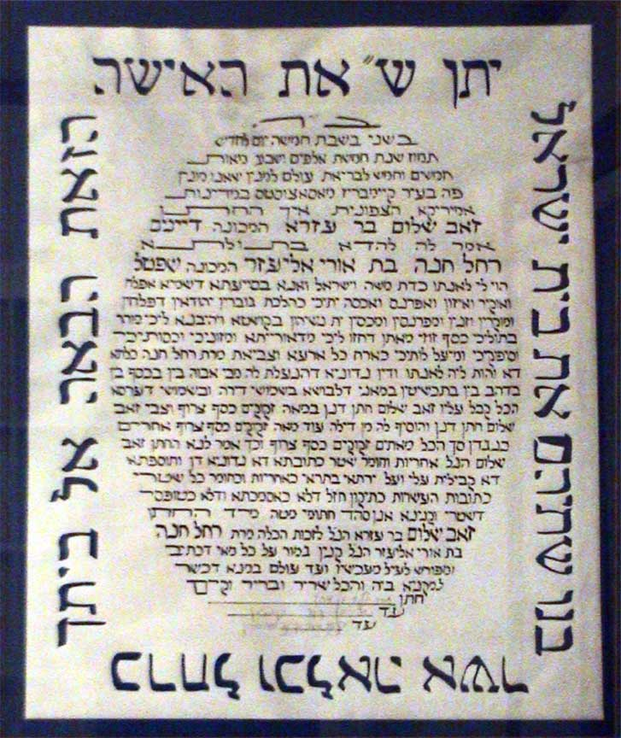
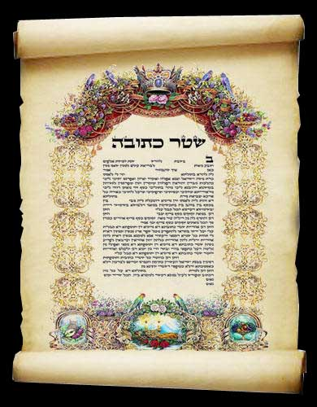
2. Marriage Contract
becomes her guarded possession
“Ketubah”
The woman does not need to promise anything.

Slide 24
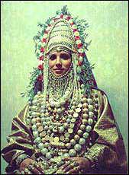
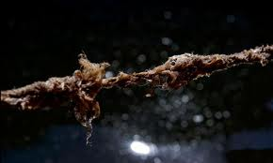
Ancient Israel brides were considered a personal possession.
Pagan tradition: after physical intimacy, making a wife a woman, if he wanted a divorce all he had to do was say 3 times, “I hate you.”

Slide 25
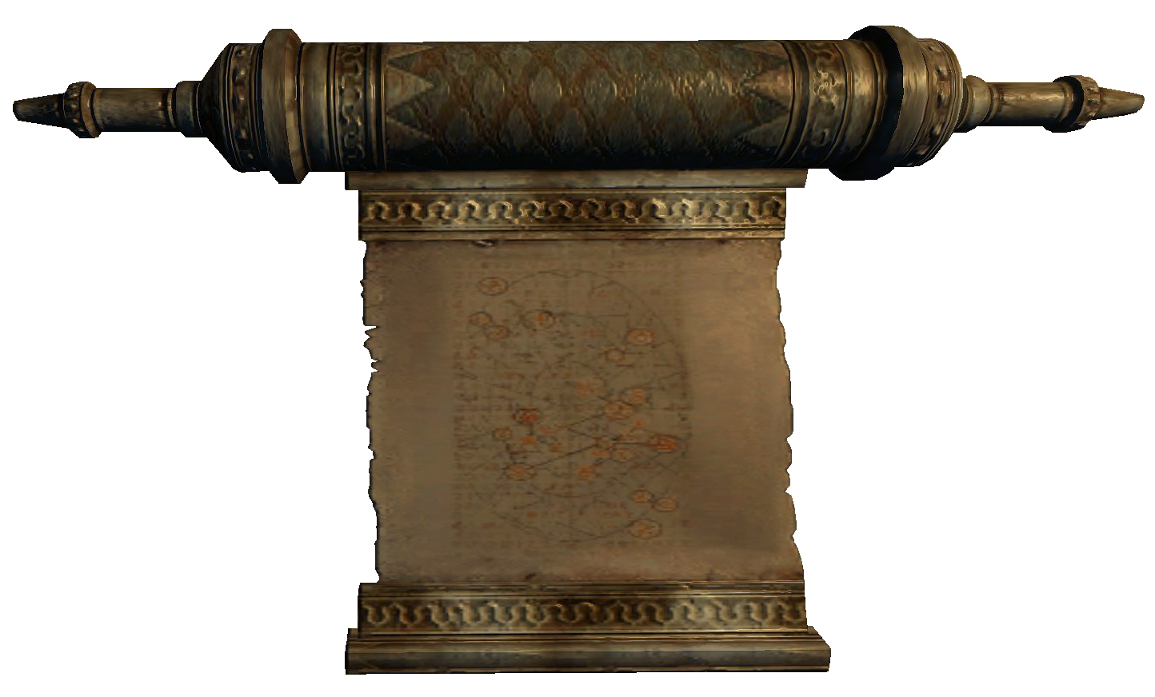
Bridegroom makes 3 main promises in the Ketubah:
I will provide all for you
I will redeem you
(if you are ever taken in war)
I will “know” you as a husband
(provide children)

Slide 26
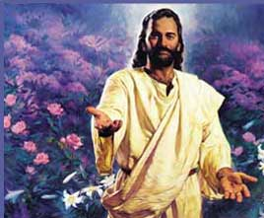
1. I will provide all for you--- Christ has provided all we need for salvation---Resurrection
2. I will redeem you (if you are ever taken in war)---Christ redeems us from bondage/Satan
3. I will “Know” you as a husband---If we take Christ and his law into our hearts and we can come to intimately know and love Him.

Slide 27
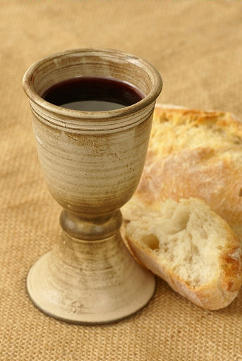
3. Seal it with a Cup of Wine and Bread
The young man pours the cup of wine then places it before the woman.
She has about 30 seconds to make up her mind.
If she does not drink, he leaves forever.
If she does drink, then she is willing to take his name upon her.
2 witnesses have to be present.

Slide 28
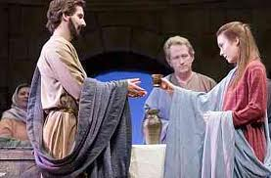
Covenant Meal
They eat together symbolizing the joining of two families.
Bread = God’s word
Salt = preserving the covenant
If we eat and drink the symbol of His sacrifice for us then we are taking upon ourselves His name and all it represents.

Slide 29
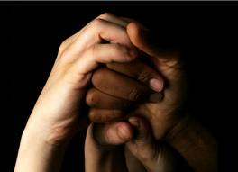
Ritual Statement and Consecration:
Bridegroom would then say, “Thou are set apart (or consecrated) for me according to the Law of Moses and Israel.
Set apart = made sure
We, the bride, only remain faithful and true to Christ if we put Him first in all things.
The covenant is “made sure” upon our righteousness

Slide 30
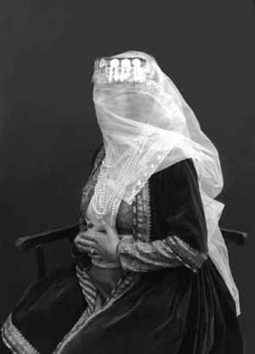
Bride now would:
Wear a veil over her hair when in public. She was now sanctified and dedicated to another…for the rest of her life.
Her hair was her “glory” and now exclusively to be seen only by her husband.
Temple veil conceals the Holy of Holies…she is now “set apart” for the greatest holiness possible … bringing forth of life

Slide 31
We, the bride, now are sanctified and dedicated to Christ and reserve ourselves to Him and not to the world or Satan.

Slide 32
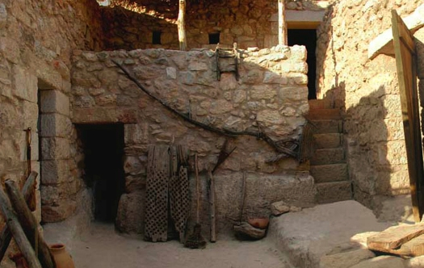
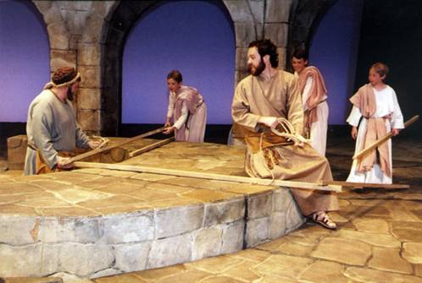
Bridegroom prepares a Place for the Bride:
Returns to his father’s place…a man on a mission
Builds a home on father’s land or attached to his father’s house.
Under the father’s direction it is to be well built and stocked
Everything that son did was a reflection of his father.
Only with the father’s permission was the son allowed to get his bride.
Only the father knew when the wedding would be once the preparations had been finished.

Slide 33
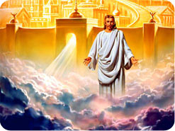
“In my Father’s house are many mansion: if it were not so I would have told you. I go to prepare a place for you. (John 14:2)
“If I go and prepare a place for you, I will come again and receive you unto myself; that where I am, there ye may be also.” (John 14:3)
“But of that day and hour (the Bridegroom’s return) knoweth no man, no not the angels of heaven, but my Father only.” (Matthew 24:36)

Slide 34
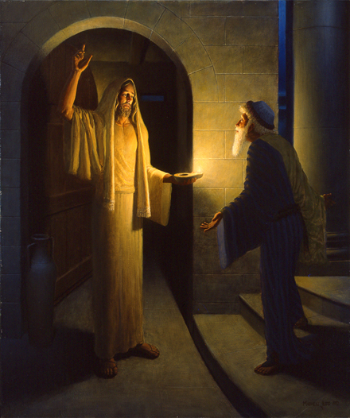
Friend of the Bridegroom
Delivers invitations to the wedding
Acts as a liaison between the bride and bridegroom (bride and bridegroom do not communicate except through the friend.)
And becomes the guarantor of the bride's virgin chastity until the consummation takes place.

Slide 35
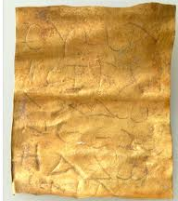
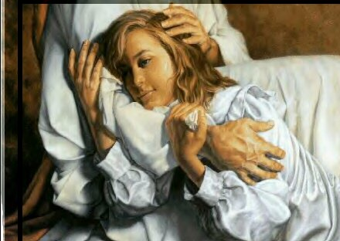
The Comforter acts as the ultimate “friend of the bridegroom.”
He gives us messages, gifts, watches over our chastity, assists with our learning and comforts us.
Comforter---Greek translated into Latin (fortis) means “brave”. Someone who puts courage into us.

Slide 36
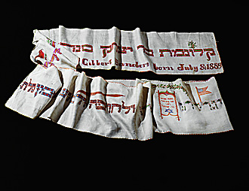
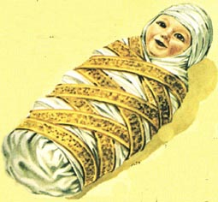
Bride’s Preparation
Swaddling Bands---the embroidery must be exactly the same on both sides.
Symbolic of outward life and inner life were the same, they were never to
have a “wrong side” to their character.

Slide 37
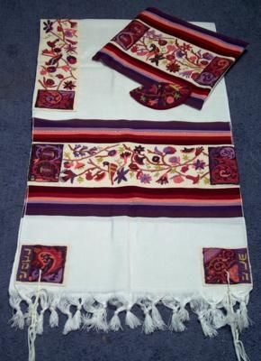
Symbols on the bands:
Indicate the family history
Mary was from the tribe of Judah, so she may have used symbols common
to that lineage such as a lion, a lamb, or a tree of life.. As a descendant of
David, she was also entitled to use the royal colors of blue and white.

Slide 38
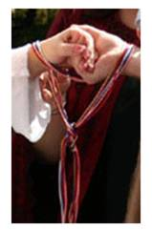
Under the wedding canopy, the decorated bands would be tied around the clasped right hand on the bride and groom.
These bands would later be used to wrap around the swaddling clothes of their children. (Christ)
Our primary life preparation should be to build up our character; to have honor and integrity, To live a single-minded life so that the same high character we show publicly is who we are in our private life.

Slide 39
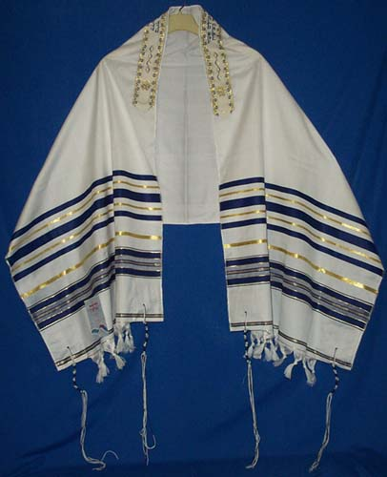
Gift for the Bridegroom
“Tallit”
Prayer shawl
A man may begin wearing a tallit for prayers when he is married and everyday until he dies.

Slide 40
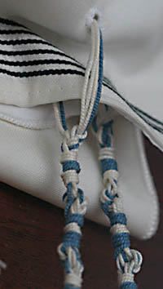
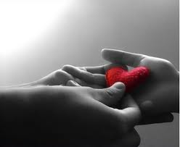
Special meaning for a bride to give this gift
A tallit has 4 tassels, called Tzitzit, with 8 strings in
each = 32.
The number 32 is the number of “lev” which is “heart” in Hebrew. She is giving her “heart” to her husband for all to see every day.

Slide 41
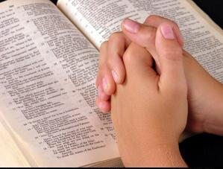
In What ways do we give our whole hearts to our Savior?

Slide 42
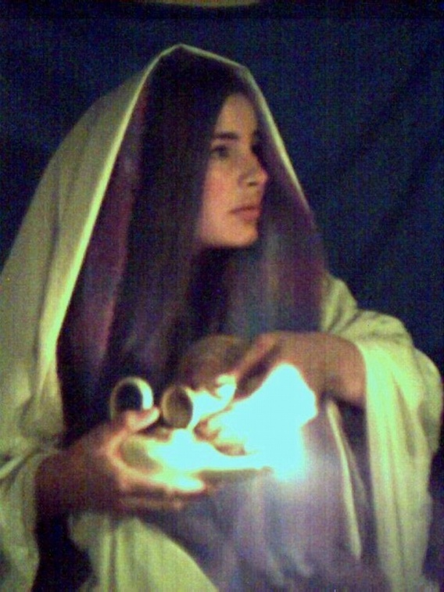
Another Duty for the Bride
Providing oil for cooking and lighting the home, especially for the Sabbath lamp.

Slide 43
Our Daily Duty
It is our responsibility to make ourselves worthy for the Spirit and to actively seek it.
Our personal commitment to daily private spiritual study is a way of keeping the light burning.

Slide 44
The Endowment and Adornment
A betrothed bride also wore special items of clothing which set her apart.
Fine Linen---clean and white.
She adorns herself with the gifts that her bridegroom has given her.

Slide 45
Adornment

Slide 46
Our Spiritual Wardrobe
Christ’s bride has been clothed with garments that mark us too.
Luke 24:49
“Ye will be endowed with power from on high.”

Slide 47
Ceremonial Washing
“Mikevah”
A ritual bath or immersion
A pool that was filled from a natural water source like a spring or lake.

Slide 48
“Mikevah”
Immersion means “to dip, soak, immerse” into liquid so that what is dipped take on the quality of what it has been dipped in.

Slide 49
“Living Water”
The idea was to take on the qualities of the “living water” for purity and cleanliness.
Her life and body were to be the gift of living sacrifice without spot or blemish to her husband.

Slide 50
Sacrifice “korban” Hebrew word
“to come near, to approach, to become closely involved in a relationship”
להקריב; למכור בהפסד
Our translation of the Hebrew idea of sacrifice not an accurate one since there is no English word to describe it.

Slide 51
Coming Close to God---sacrifice connection
The bride did not immerse herself to wash herself…
It was a preparation for holiness..to be fruitful and multiply… a preparation for motherhood.

Slide 52
Baptized by Water and the Spirit
Are we immersing ourselves daily in the Spirit so that our nature is continually changing and we can have a greater connection with God?
Are we sacrificing the world so that we can become closely involved in the relationship with the Savior?

Slide 53
Anointing
After the Mikvah the bride’s friends would anoint her with fragrant oils…
…to protect, heal and make her pleasant to others.

