Slide 1
Lesson 1
Introduction to the
New Testament
New Testament
A collection of inspired writings (originally in Greek) about the life and ministry of Jesus Christ, the Apostles, and other followers of Jesus Christ.
Presentation by ©http://fashionsbylynda.com/blog/

Slide 2
Two Themes of New Testament
The Savior’s repeated invitation to come unto Him
The responsibility of His disciples to assist others to do the same.
The New Testament teaches us about Jesus Christ’s mortal and post-resurrection ministries, including His teachings, miracles, atoning sacrifice, and visits to early church disciples.

Slide 3
What is In the New Testament?
The New Testament is commonly divided into the Gospels, the Acts of the Apostles, Paul’s epistles, the general epistles, and the book of Revelation.
The four Gospels—the books of Matthew, Mark, Luke, and John—are accounts of the life of Christ.
The book of Acts records the history of the Church and the Apostles, especially Paul’s missionary travels, after Christ’s death. Paul’s letters give instruction to Church leaders and members.
The other letters were written by other Apostles and give additional counsel to the early Saints.
The book of Revelation, which was written by the Apostle John, contains mostly prophecies pertaining to the last days.
(The Guide to the Scriptures)

Slide 4
The Burden
How would you feel if you had to carry this burden all day?
As we come unto Jesus Christ with our burdens, He will give us rest
Come unto me, all ye that labour and are heavy laden, and I will give you rest.
Matthew 11:28

Slide 5
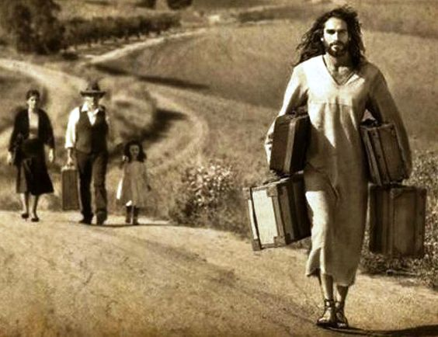
My Yoke
A yoke is a wooden beam that joins or couples a pair of oxen or other animals, enabling them to pull together on a load.
Although the yoke is a weight or a burden, it allows both animals to combine their power and strength, thereby increasing their productivity.
Take my yoke upon you, and learn of me; for I am meek and lowly in heart: and ye shall find rest unto your souls.
For my yoke is easy, and my burden is light.
Matthew 11:29-30

Slide 6
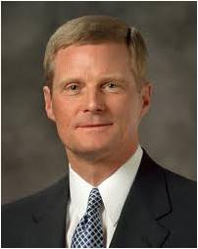
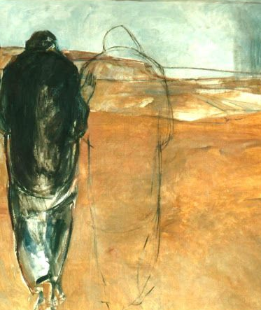
“A yoke places animals side-by-side so they can move together in order to accomplish a task.
“Consider the Lord’s uniquely individual invitation to ‘take my yoke upon you.’ Making and keeping sacred covenants yokes us to and with the Lord Jesus Christ. In essence, the Savior is beckoning us to rely upon and pull together with Him, even though our best efforts are not equal to and cannot be compared with His. As we trust in and pull our load with Him during the journey of mortality, truly His yoke is easy and His burden is light.
“We are not and never need be alone. We can press forward in our daily lives with heavenly help. Through the Savior’s Atonement we can receive capacity and ‘strength beyond [our] own’”. (1)
Janet Brooks-Gerloff

Slide 7
Setting Specific Goals
Developing Good Study Habits
Being wise with social media
Waking up Earlier
Eating Heathier and Exercising
Better Relationships with parents
Reading the Scriptures Daily
“Although we are left to find and follow that path which will lead us back to our Father in Heaven, He did not send us here without direction and guidance. … He will assist us as we seek His help and strive to do all in our power to endure to the end and gain eternal life.” (2)
Better Relationship With the Savior
Better relationships with friends

Slide 8
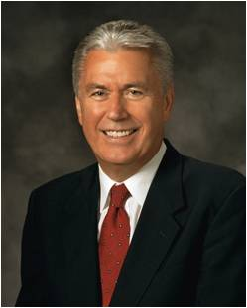
So what happens when you set goals and you don’t reach them?
“God loves you this very day and always. He is not waiting to love you until you have overcome your weaknesses and bad habits. He loves you today with a full understanding of your struggles. …
He knows of your remorse for the times you have fallen short or failed. And still He loves you. … He wants you to achieve your destiny—to return to your heavenly home in honor.” (3)

Slide 9
What Is A Disciple?
A pupil or learner… All followers of Jesus Christ.
A name used to denote the Twelve, also called Apostles
The New Testament contains numerous examples of individuals who were strengthened, taught, or blessed by the Lord and then felt a desire to tell others about Him
As we come unto Jesus Christ, we will have a greater desire to invite others to come unto Him
(4)

Slide 10
Coming Unto Christ
Come unto Jesus Christ Yourself
Invite Others to Come Unto Christ
“When you give your heart to inviting people to come unto Christ, your heart will be changed. … By helping others come unto Him, you will find that you have come unto Him yourself.”
(5)

Slide 11
Those Who Heeded the Invitation
“Come and See…Follow Me”
Peter brought his brother Andrew
Philip brought Nathanael
Andrew
What can we do to invite others to come unto Him?
Nathanael
1 John 1:37-51

Slide 12
Sources:
Suggested Hymn: #220 Lord, I Would Follow Thee
Elder David A. Bednar Bear Up Their Burdens with Ease Ensign or Liahona, May 2014, 88.
President Thomas S. Monson (“Ponder the Path of Thy Feet,” Ensign or Liahona, Nov. 2014, 86
President Dieter F. Uchtdorf (“Living the Gospel Joyful,” Ensign or Liahona, Nov. 2014, 123).
Bible Dictionary
President Henry B. Eyring (“Come unto Christ,” Ensign, Mar. 2008, 49).
Presentation by ©http://fashionsbylynda.com/blog/

Slide 13
Take Christ’s Yoke Upon Us:
“In biblical times the yoke was a device of great assistance to those who tilled the field. It allowed the strength of a second animal to be linked and coupled with the effort of a single animal, sharing and reducing the heavy labor of the plow or wagon. A burden that was overwhelming or perhaps impossible for one to bear could be equitably and comfortably borne by two bound together with a common yoke. His yoke requires a great and earnest effort, but for those who truly are converted, the yoke is easy and the burden becomes light.
“Why face life’s burdens alone, Christ asks, or why face them with temporal support that will quickly falter? To the heavy laden it is Christ’s yoke, it is the power and peace of standing side by side with a God that will provide the support, balance, and the strength to meet our challenges and endure our tasks here in … mortality.” President Howard W. Hunter (“Come unto Me,” Ensign, Nov. 1990, 18; see also “Take My Yoke upon You” [Ensign, Sept. 2013, 22–23] for a picture of a yoke and further explanation of its use and function).
How we can follow the Savior’s example to share the gospel with others:
“The Savior taught us how to share the gospel. I like the story of Andrew, who asked, ‘Master, where dwellest thou?’ [John 1:38]. Jesus could have responded with the location of where He lived. But instead He said to Andrew, ‘Come and see’ [John 1:9]. I like to think that the Savior was saying, ‘Come and see not only where I live but how I live. Come and see who I am. Come and feel the Spirit.’ …
“To those who show an interest in our conversations, we can follow the Savior’s example by inviting them to ‘come and see.’ Some will accept our invitation, and others will not. We all know someone who has been invited several times before accepting an invitation to ‘come and see.’ Let’s also think about those who once were with us but who now we rarely see, inviting them to come back and see once more” Elder Neil L. Andersen (“It’s a Miracle,” Ensign or Liahona, May 2013, 79).

