Slide 2
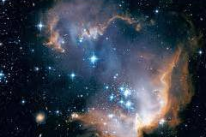
Premortal Spirit World
From the Beginning
Moses 4: 1-2
Intelligences
Abraham 3:22-28
Through this plan, we would be able to become like Him and dwell in His presence forever.

Slide 3
The purpose of Heavenly Father’s plan is to provide a way for us to receive immortality and eternal life.

Slide 4
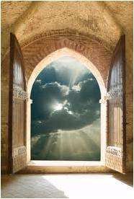
What is the Plan of Salvation?
The fulness of the gospel of Jesus Christ, designed to bring about man’s immortality and eternal life

Slide 5
What is included in this plan?
The Creation
The Fall
The Atonement
God-given laws, ordinances, and doctrines.
Alma 22:12-14
2 Nephi 2:25-28
Doctrinal
Mastery
2 Nephi 9:6-7
2 Nephi 11:5
This plan makes it possible for all people to be exalted and live forever with God.
Alma 24:14

Slide 6
Other Names for this plan
The merciful plan of the great Creator
The great and eternal plan of deliverance
from death
The plan of redemption
The plan of salvation
The great plan of happiness
The plan of mercy
2 Nephi 9:6
2 Nephi 11:5
Alma 12:25
Alma 24:14
Alma 42:8
Alma 42:15
Heavenly Father’s plan is designed to bring His children eternal salvation and happiness.

Slide 7
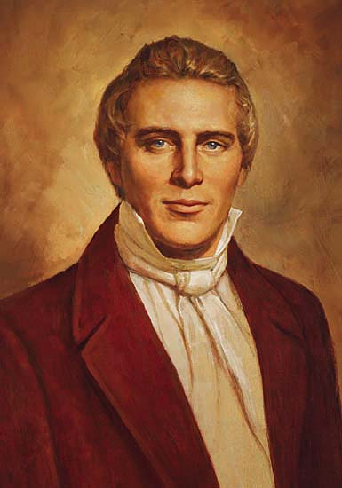
Divine Help
Mosiah 3:17
Jesus Christ is the central figure in the plan of salvation, and His Atonement is what makes the plan work for all God’s children.
“The fundamental principles of our religion are the testimony of the Apostles and Prophets, concerning Jesus Christ, that He died, was buried, and rose again the third day, and ascended into heaven; and all other things which pertain to our religion are only appendages to it”
Joseph Smith

Slide 8
Salvation—Saving Us
We need to be saved from:
2 Nephi 9:6-10
3 Nephi 9:21-22
Physical death, the fall, and transgression
Worldly sin
What would happen if there were no Atonement?
2 Nephi 9:7,9
Our bodies would die and never rise again, and our spirits would become subject to the devil.

Slide 9
Receiving God’s Offer
Doctrinal
Mastery
2 Nephi 2:25-28
2 Nephi 31:17-20
Alma 34:15-16
Freedom
Repentance, Baptism, Remission of Sin, Receiving Holy Ghost
Mercy, justice, safety
How do our actions influence our ability to receive the blessings of the Atonement?
As we choose to live the gospel of Jesus Christ and follow God’s plan, we prepare to receive eternal life through the Savior’s Atonement.

Slide 10
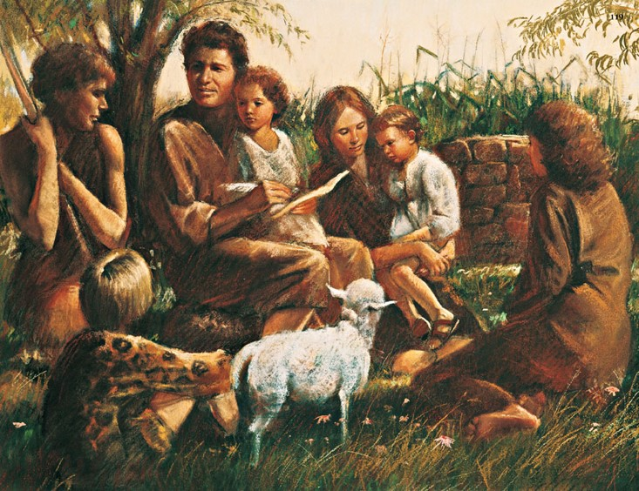
Rewards
2 Nephi 2:25
“Adam fell that men might be; and men are, that they might have joy.”
Doctrinal
Mastery

Slide 11
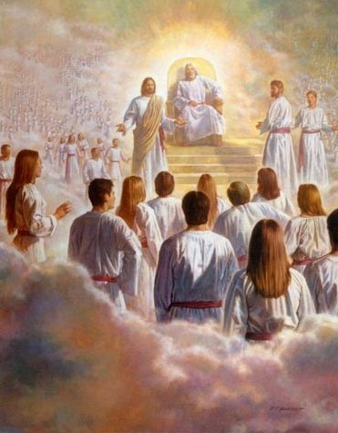
Pre-earth life
The Presence of God
In our pre-earth life, we lived as spirits in the presence of our Heavenly Father.
Heavenly Father had a perfected body and character…we did not.

Slide 12
Pre-earth life
The Presence of God
Why did we need to leave God’s presence in order to become more like Him?
To gain a body; to learn and grow by using our agency
Morality

Slide 13
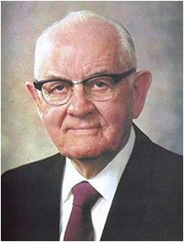
“God has given us a plan. He has sent us all to earth to obtain bodies and to gain experience and growth.”
God has sent us to the earth to obtain bodies and to gain experience and growth

Slide 14
Obstacles
No unclean thing can dwell in the presence of God
Sin
Morality

Slide 15
Overcoming Sin
What makes it possible for us to overcome sin?
Jesus Christ suffered and was crucified for the sins of all people
Sin
Morality

Slide 16
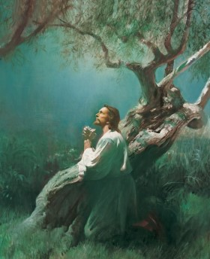
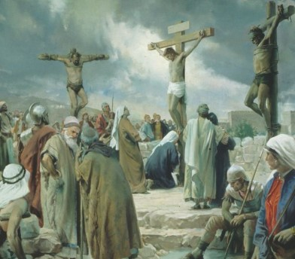
Pre-earth life
The Presence of God
What must we do to come unto Jesus Christ and receive the blessings of His atoning sacrifice?
Morality
Sin

Slide 17
If we are obedient to the principles and ordinances of the gospel, we can overcome sin through the Atonement of Jesus Christ.

Slide 18
Pre-earth life
The Presence of God
What happens to our spirits and bodies after we die?
Morality
Sin
Physical Death

Slide 19
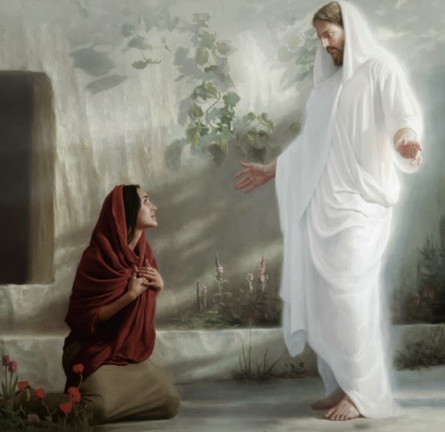
For man is spirit. The elements are eternal, and spirit and element, inseparably connected, receive a fulness of joy;
And when separated, man cannot receive a fulness of joy.
D&C 93:33-34
Because of the Resurrection of Jesus Christ, all mankind will be resurrected and will live forever
We cannot be like Heavenly Father without a body of flesh and bones.

Slide 20
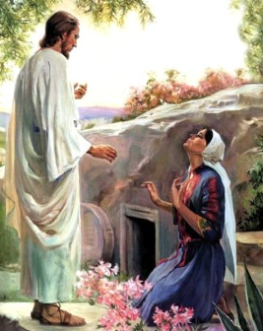
Pre-earth life
The Presence of God
Eternal Life
Covenants
Repentance
Obedience
Baptism
Faith
Holy Ghost
Endurance
Morality
Sin
Physical Death

Slide 21
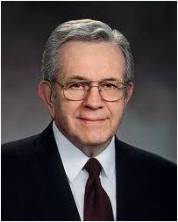
The End of Act 3
“We are in the second act of a three act play:
If you expect to find only ease and peace and bliss during act 2, you surely will be frustrated. You will understand little of what is going on and why things are permitted to be as they are.
Remember this! The line “And they all lived happily ever after” is never written into the second act. That line belongs in the third act. When the mysteries are solved and everything is put right…
Do not suppose that God willfully causes that which, for his own purposes he permits. When you know the plan and purpose of it all, even these things will manifest a loving Father in Heaven.
--Pres. Boyd K. Packer

Slide 22
Sources:
Related Videos:
Our Eternal Life (3:46)
What Happens After We Die? (1:40)
Joseph Smith “Teachings of the Presidents of the Church” (2007)
President Spencer W. Kimball The Teachings of Spencer W. Kimball, ed. Edward L. Kimball [1982], 25
Paintings: Harry Anderson, Joseph Brickley
President Boyd K. Packer “The Play and the Plan,” given by President Boyd K. Packer (1924–2015), President of the Quorum of the Twelve Apostles, in a Church Educational System fireside for young adults on May 7, 1995.

