Slide 1
Lesson 10
Sermon on the Mount
A Higher Law
Matthew 5:17-48
“Be ye therefore perfect, even as your Father which is in heaven is perfect. Matthew 5:48

Slide 2
Which Commandment is the Most Difficult to Keep?
Be ye therefore perfect, even as your Father which is in heaven is perfect.
Be: JST Matt. 5:50 Ye are therefore commanded to be perfect …
Perfect = complete, finished, fully developed.
Father = Elohim.
Perfect = Perfection of God
Sources:
To become complete or fully developed means to become like Heavenly Father.
Matthew 5:48

Slide 3
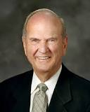
“The term perfect was translated from the Greek teleios, which means ‘complete.’ …
The infinitive form of the verb is teleiono, which means ‘to reach a distant end, to be fully developed, to consummate, or to finish.’
Please note that the word does not imply freedom from error; it implies achieving a distant objective. …
“We need not be dismayed if our earnest efforts toward perfection now seem so arduous and endless.
Perfection is pending. It can come in full only after the Resurrection and only through the Lord. It awaits all who love him and keep his commandments.”
“We all need to remember: men are that they might have joy—not guilt trips!
We also need to remember that the Lord gives no commandments that are impossible to obey. But sometimes we fail to comprehend them fully.”
(1)

Slide 4
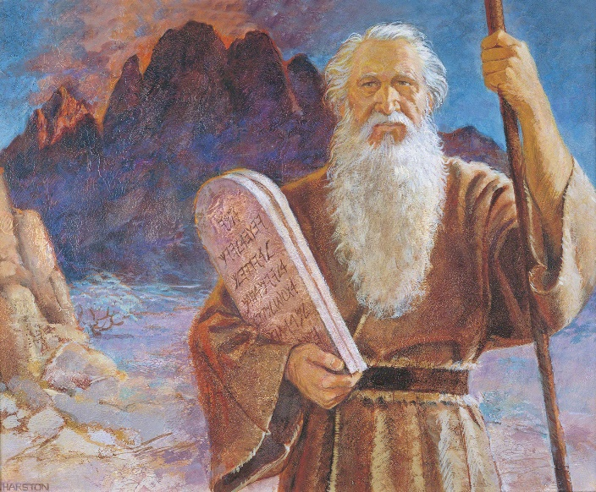
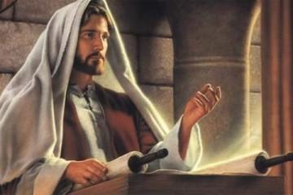
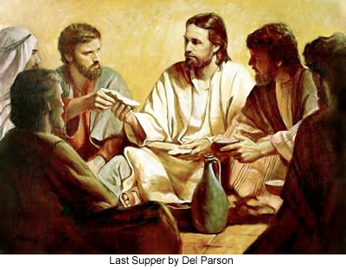
To Fulfill the Law of Moses
Jesus came to fulfill the law of Moses, not to destroy, or do away with, any of the eternal truths in the law of Moses.
Jesus Christ restored the fulness of the gospel that had been lost due to wickedness and apostasy, corrected false teachings, and fulfilled the prophecies made by Old Testament prophets.
Eventually, as part of the Restoration of the fulness of the gospel, some aspects of the law of Moses were discontinued, such as circumcision and animal sacrifice.
Matthew 5:17-20
Del Parson

Slide 5
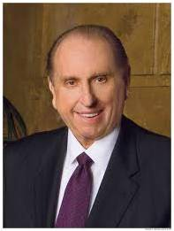
True Meaning of the laws
A higher way of righteousness.
Members of His kingdom must live this higher law. These higher laws provided guidance to help disciples of Jesus Christ avoid breaking God’s commandments.
“To be angry is to yield to the influence of Satan. No one can make us angry. It is our choice. If we desire to have a proper spirit with us at all times, we must choose to refrain from becoming angry. I testify that such is possible. …
“… We are all susceptible to those feelings which, if left unchecked, can lead to anger. We experience displeasure or irritation or antagonism, and if we so choose, we lose our temper and become angry with others. Ironically, those others are often members of our own families—the people we really love the most. …
“May we make a conscious decision, each time such a decision must be made, to refrain from anger.” (2)
Illuminate Anger
Matthew 5:22

Slide 6
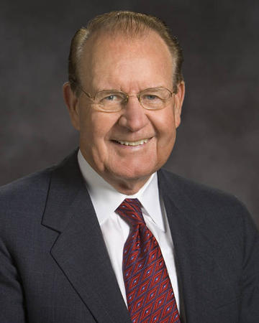
Agreeing with one’s adversary means working out disagreements before they lead to a worse situation
If we desire to come unto Jesus Christ, we must first do our part to be reconciled with others
“… commanding us to resolve our differences early on, lest the passions of the moment escalate into physical or emotional cruelty, and we fall captive to our anger. Nowhere does this principle apply more than in our families.” (3)
Agree with Adversary
Illuminate Anger
Matthew 5:25

Slide 7
“Why is lust such a deadly sin? Well, in addition to the completely Spirit-destroying impact it has upon our souls, I think it is a sin because it defiles the highest and holiest relationship God gives us in mortality—the love that a man and a woman have for each other and the desire that couple has to bring children into a family intended to be forever. …
if we choose to entertain lustful thoughts or desires, it is like committing adultery in our hearts
Do Not Lust After Others
Agree with Adversary
Love makes us instinctively reach out to God and other people. Lust, on the other hand, is anything but godly and celebrates self-indulgence.
Love comes with open hands and open heart; lust comes with only an open appetite.” (4)
Illuminate Anger
Matthew 5:27-28

Slide 8
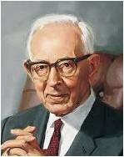
The Joseph Smith Translation makes it clear that the Savior did not encourage His followers to literally cut or disfigure themselves.
If we choose to entertain lustful thoughts or desires, it is like committing adultery in our hearts.)
Remove yourself from sin
Do Not Lust After Others
Agree with Adversary
“…close friends or relatives who [endeavor] to lead us from the path of rectitude and humble obedience to the divine commandments we receive from the Lord. If any friend or relative endeavors to lead a person away from the commandments, it is better to dispense with his friendship and association than to follow him in evil practices to destruction.” (5)
Illuminate Anger
Matthew 5:29-30

Slide 9
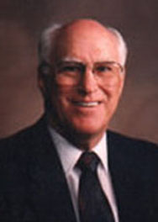
Thou shalt not avenge, nor bear any grudge against the children of thy people, but thou shalt love thy neighbour as thyself: I am the Lord.
Leviticus 19:18
Love Thy Neighbors
Remove yourself from sin
Do Not Lust After Others
“A man [or woman] who loves his [her] neighbor will not only avoid doing wrong to him, but will deliberately help him…
…Not only are we to help in time of trouble, but we are actually obligated to take steps to prevent physical harm from coming to a neighbor…
…one’s neighbor is anyone who is in need; he [she] also shows that neighborliness consists of ministering to that need.” (6)
Agree with Adversary
Illuminate Anger
Matthew 5:43-47

Slide 10
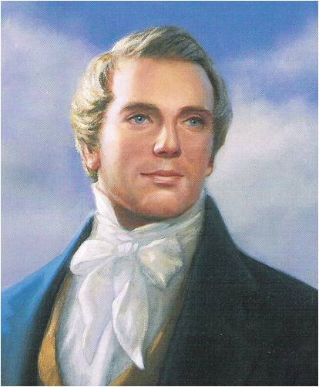
“When you climb up a ladder, you must begin at the bottom, and ascend step by step, until you arrive at the top; and so it is with the principles of the gospel—you must begin with the first, and go on until you learn all the principles of exaltation.
But it will be a great while after you have passed through the veil before you will have learned them. It is not all to be comprehended in this world; it will be a great work to learn our salvation and exaltation even beyond the grave’” (7)
As we follow the Savior’s teachings and commandments, we can become perfect like our Father in Heaven

Slide 11
Sources:
Suggested Hymn: #308 As I Have Loved You
Videos: The Sermon on the Mount: The Higher Law (2:19)
The Healing Power of Forgiveness (1:45)
Elder Russell M. Nelson (“Perfection Pending,” Ensign, Nov. 1995, 86, 88).
President Thomas S. Monson (“School Thy Feelings, O My Brother”), Ensign or Liahona, Nov. 2009, 68–69).
Elder David E. Sorensen (“Forgiveness Will Change Bitterness to Love,” Ensign or Liahona, May 2003, 11).
Elder Jeffrey R. Holland (“Place No More for the Enemy of My Soul,” Ensign or Liahona, May 2010, 44–45).
President Joseph Fielding Smith (Answers to Gospel Questions, 5 vols. [1957–66], 5:79).
Robert J. Matthews What “Loving Your Neighbor” Really Means Oct. 1975 General Conf.
Teachings: Joseph Smith, 268.
Presentation by ©http://fashionsbylynda.com/blog/

Slide 12
Matthew 5:22 The word raca comes from an Aramaic word meaning “imbecile, fool, or empty-headed person.”
“Profane and vulgar expressions vary from nation to nation and age to age, but the intent of this passage is to condemn any language which conveys improper feelings about another.” Elder Bruce R. McConkie(Doctrinal New Testament Commentary, 3 vols. [1965–73], 1:222).
Matthew 5:22 Anger
“A cunning part of [Satan’s] strategy is to dissociate anger from agency, making us believe that we are victims of an emotion that we cannot control. … The Lord expects us to make the choice not to become angry. … When the Lord eliminates the phrase ‘without a cause,’ He leaves us without an excuse. …
“Anger is a yielding to Satan’s influence by surrendering our self-control. It is the thought-sin that leads to hostile feelings or behavior. … Understanding the connection between agency and anger is the first step in eliminating it from our lives” Elder Lynn G. Robbins(“Agency and Anger,” Ensign, May 1998, 80–81).
Matthew 5:27-28 Lust/Pornography
Elder Dallin H. Oaks of the Quorum of the Twelve Apostles spoke about the effects of pornography—a prevalent cause and promoter of lust—on those who view it: “Pornography impairs one’s ability to enjoy a normal emotional, romantic, and spiritual relationship with a person of the opposite sex. It erodes the moral barriers that stand against inappropriate, abnormal, or illegal behavior. As conscience is desensitized, patrons of pornography are led to act out what they have witnessed, regardless of its effects on their life and the lives of others” (“Pornography,” Ensign or Liahona, May 2005, 89).
Matthew 5:43 Love Your Neighbors
The commandment “Love thy neighbour” is found in Leviticus 19:18, but no scripture in the Old Testament commands us to hate thine enemy. It appears the Savior was referring to a saying common in His day. The discovery of the Dead Sea Scrolls in 1946 may reveal that some Jews at the time of Christ did in fact teach that they should love fellow members of their community but hate outsiders (see Dana M. Pike, “Is the Plan of Salvation Attested in the Dead Sea Scrolls?” in Donald W. Parry and Dana M. Pike, eds., LDS Perspectives on the Dead Sea Scrolls [1997], 93, note 19).

