Slide 1
Lesson 101
Spiritually Reborn
Romans 8-11
Brethren, my heart’s desire and prayer to God for Israel is, that they might be saved.
Romans 10:1

Slide 2
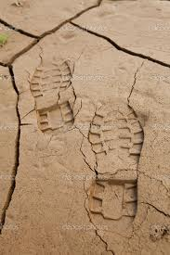
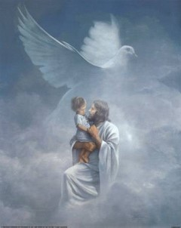
The Law of the Spirit
“There is therefore now no condemnation to them which are in Christ Jesus, who walk not after the flesh, but after the Spirit.”
The “Spirit” and to the “flesh” = “The law of the Spirit of life in Christ Jesus”
“For the law of the Spirit of life in Christ Jesus hath made me free from the law of sin and death.”
The atoning sacrifice of Jesus Christ and the gospel established after the law of Moses
Romans 8:1-2

Slide 3
Weak through the Flesh
The Law of Moses
“Life and peace come, not through the law of Moses, but through Christ and his saving grace.
The Mosaic performances deal with carnal things, the things of the flesh, the things of death.
There is not power in them to atone, to ransom, to save, to bring joy and peace here and eternal life hereafter.
But Christ deals with spiritual things, the things of the Spirit, the things that bring life.
Because of him, ‘he who doeth the works of righteousness shall receive his reward, even peace in this world, and eternal life in the world to come.’ (D. & C. 59:23.)”
Romans 8:3
(2)

Slide 4
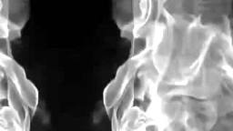
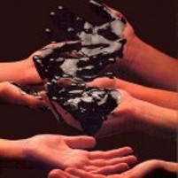
To be Carnally minded
“For to be carnally minded is death; but to be spiritually minded is life and peace.”
If we follow the influence of the Spirit, we can overcome the tendency of the natural man to sin
Satan deals only with the physical temptations of the mind and body.
The needs of our body often become the vulnerable base of operations.
Romans 8:13

Slide 5
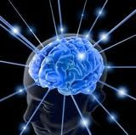
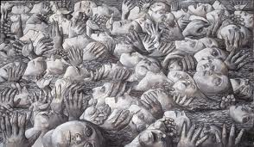
Satan’s Snare
How many souls have been won by Satan as they surrendered to bodily appetites?
How many eternal life’s have been lost because they were not spiritually minded but rather were dominated by “the mind of the flesh” ?
Some groups in Christianity and other religious traditions have believed that the only way to overcome desires of the flesh is to abstain completely from physical pleasures. However, many physical pleasures are not sinful, but are good. (1)
(3)

Slide 6
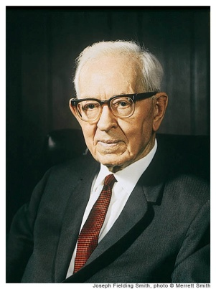
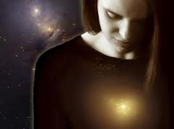
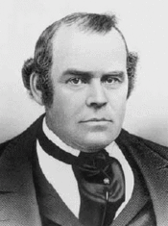
Influence on Mortal Life
“The spirit influences the body to a great extent, just as the body in its desires and cravings has an influence on the spirit.” (4)
“The gift of the Holy Ghost … purifies all the natural passions and affections, and adapts them, by the gift of wisdom, to their lawful use” (5)

Slide 7
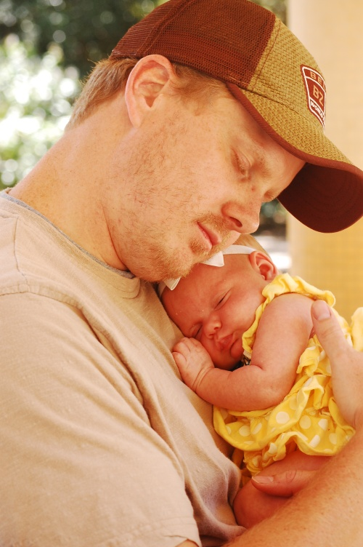
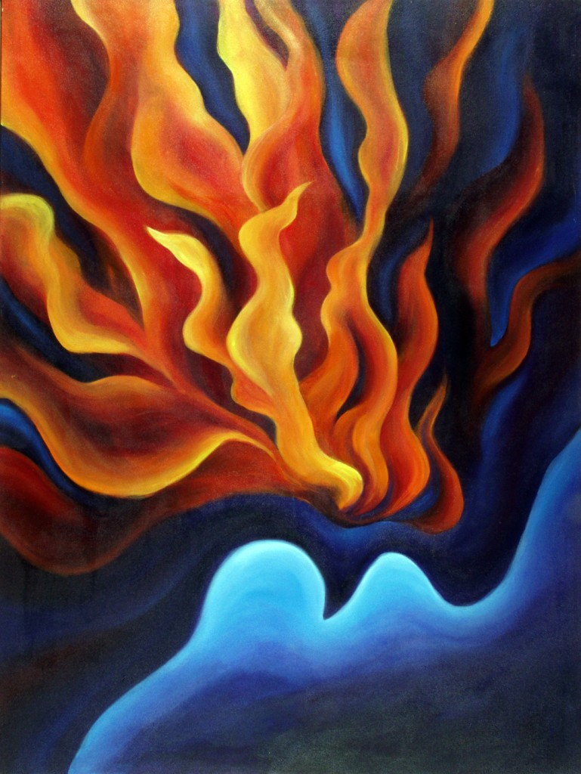
Spirit of Adoption
Every human being is literally a beloved spirit child of Heavenly Father
“For as many as are led by the Spirit of God, they are the sons of God.”
We are “reborn” as children of God through a covenantal relationship when we manifest faith in Jesus Christ, repent, are baptized,
and receive the Holy Ghost (1)
Romans 8:14-15

Slide 8
Free Agency
“God gave his children free agency, even in the spirit world…
...by which the individuals spirits had the privilege, just as men have here, of choosing the good and rejecting the evil, or partaking of the evil to suffer the consequences of their sins.”
Romans 8:15

Slide 9
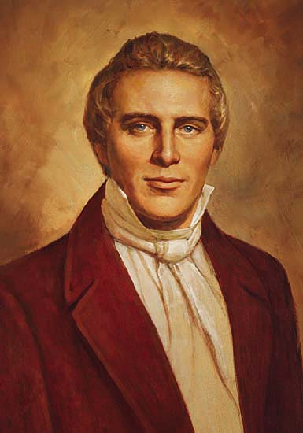
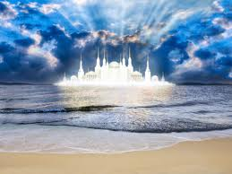
Joint-heirship
“To inherit the same power, the same glory and the same exaltation, until you arrive at the station of God, and ascend the throne of eternal power, the same as those who have gone before.”—Joseph Smith
If we are faithful covenant children of God, we can become joint-heirs with Jesus Christ of all Heavenly Father has

Slide 10
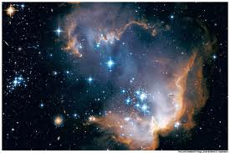
Inheritance
“A joint-heir is one who inherits equally with all other heirs including the Chief Heir who is the son.”
“Each joint-heir has an equal and an undivided portion of the whole of everything.”
“If one knows all things, so do all others. If one has all power, so do all those who inherit jointly with him.”
“If the universe belongs to one, so it does equally to the total of all upon whom the joint inheritances are bestowed.”
(2)

Slide 11
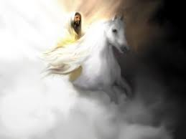
Glorified Together
(D&C 88:107)
“For ye are all the children of God by faith in Christ Jesus…
…for ye are all one in Christ Jesus.”
(Galatians 3:26,28)
…And the saints shall be filled with his glory, and receive their inheritance and be made equal with him.”
“And thn shall the angels be crowned with the glory of his might,…

Slide 12
Suffer With Him
Paul did not mean that we would suffer what the Savior did as part of His atoning sacrifice,
…but rather that we would go through our own suffering with Him.
Romans 8:17
(1)

Slide 13
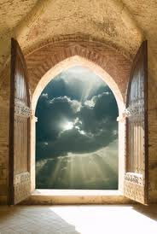
Qualifying for Inheritance
“…those who walk not after the flesh, but after the Spirit.”
Choosing God’s ways not the world’s ways
“…if so be that the Spirit of God dwell in you.”
To have the spirit with you at all times
“…is so be that we suffer with him…”
To repent of our sins no matter how difficult
“…waiting for the adoption, to wit, the redemption of our body.”
Being patient for spiritual things do not come instantly
Romans 8:1,9,17,23

Slide 14
Saved by Hope
Satan’s way is an instance gratification
The Lord’s way takes time and effort.
In Satan’s grasp you will find your freedoms taken away and severe consequences to follow
If we are spiritually minded you will find freedom and peace in your life
Romans 8:24-25

Slide 15
If we love God, all things will work together for our good. Through Jesus Christ we can overcome all the challenges and tribulations of mortality. Nothing can separate us from God’s love, which is manifest in the Atonement of Jesus Christ.
Romans 8:26-28

Slide 16
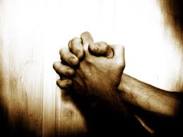
Intersession
To intercede is to plead or act on behalf of another person
“And we know that all things work together for good to them that love God, to them who are the called according to his purpose.”
Romans 8:26-28

Slide 17
Foreordination
“Predestinate”—determining beforehand one’s state, condition, and actions in life by divine decree.
Predestination is the Divine foreordaining or foreknowledge of all that will happen; with regard to the salvation of some and not others. It has been particularly associated with the teachings of John Calvin.
Romans 8:29
(6)

Slide 18
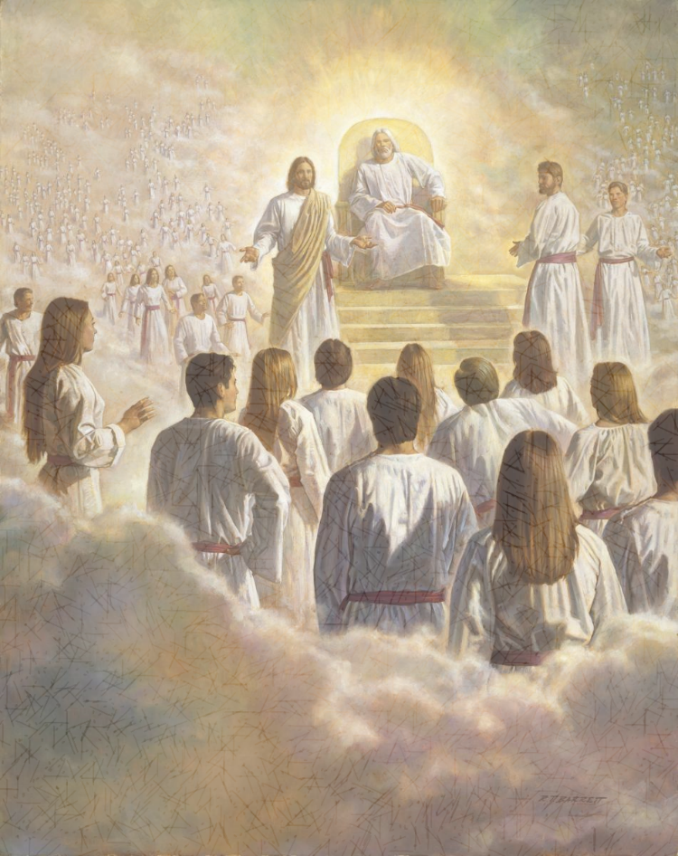
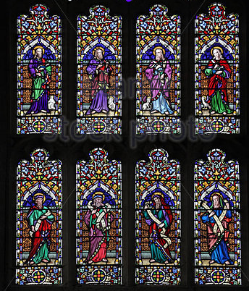
Premortal life
“We once had an estate before we came here, and were obedient, more or less, to the laws that were given us there.”
Robert Barrett
“Those who were faithful in all things there received greater blessings here, and those who were not faithful received less.”
(4)

Slide 19
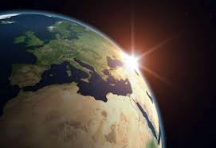
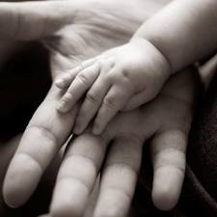
Called for His purpose
“Every soul coming into this world came here with the promise that through obedience he would receive the blessings of salvation.”
“ No person was foreordained or appointed to sin or to perform a mission of evil.”
Because of Free Agency
(4)

Slide 20
Before the World was Created and Adoption into the Kingdom of God
Romans 9-11

Slide 21
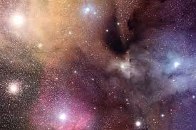
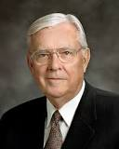
Before the world was created
Lived with Heavenly Father as spirit children
Some of what our Eternal Father is, we have inherited.
Members of the House of Israel
Inheritance—embryo traits and attributes
Foreordained to receive blessing
What He has become --
we may become
Chosen before birth
Talents of spirituality
(2,7)

Slide 22
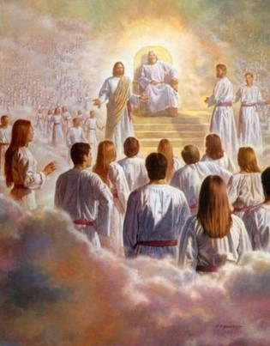
“And God saw these souls that they were good, and he stood in the midst of them, and he said: These I will make my rulers; for he stood among those that were spirits, and he saw that they were good; and he said unto me: Abraham, thou art one of them; thou wast chosen before thou wast born.”
Abraham 3:23

Slide 23
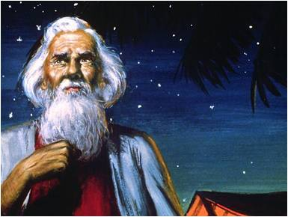
Acceptance in Heaven and on Earth
Law of election
saved by obedience—accept and follow Christ
Obedience to the gospel
Promises, blessings, and responsibilities
Through the acceptance of Jesus Christ
If Israel rejects Christ-- looses promises
Inherit all of Israel’s blessings
If we accept and obey Jesus Christ and His gospel, we can receive the blessings of God’s covenants and be saved
Grafting—partaking fully of blessings and promises of the gospel
Romans 9: 1-5

Slide 24
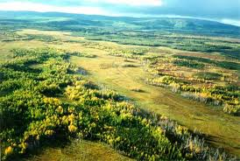
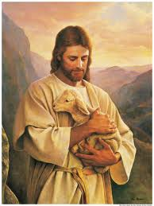
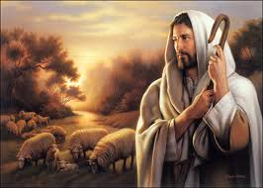
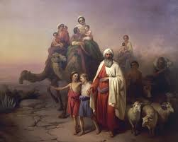
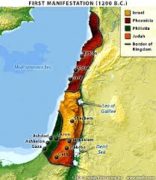
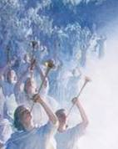
Promises and Blessings
Heavenly Father will honor them by:
Nourishing them
Watching over them
Giving Land to them
Making them a great nation
Multiplying their posterity
Receiving eternal life

Slide 25
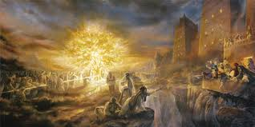
However:
Premortal faithfulness, foreordained promises or being born into a certain lineage do not guarantee salvation.
D&C 64:35-36

Slide 26
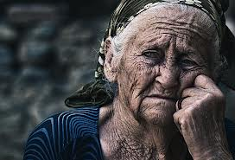
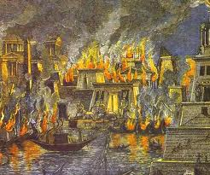
Rejection and Rebellious
Heavenly Father removes His Spirit by:
Long suffering and curses
Destruction
Taking away their land
Cutting them off from the land of Zion
Scattering
Eternal Damnation

Slide 27
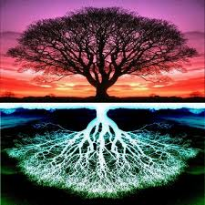
Branches and Roots
“For if the firstfruit be holy, the lump is also holy; and if the root be holy, so are the branches.” ---Israel
“And if some of the branches be broken off, and thou, being a wild olive tree, wert graffed in among them, and with them partakest of the root and fatness of the olive tree.”
Romans 11:16-17

Slide 28
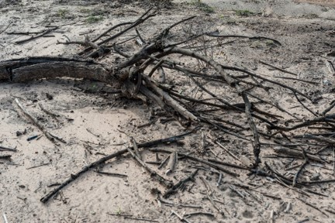
Israel Rejects Christ
“Well; because of unbelief they were broken off…
“For if God spared not the natural branches, take heed lest he also spare not thee.”
Romans 11:20

Slide 29
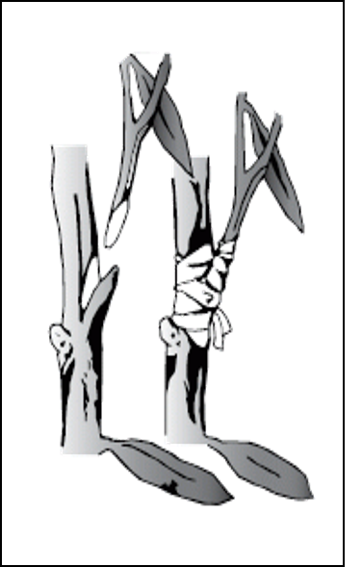
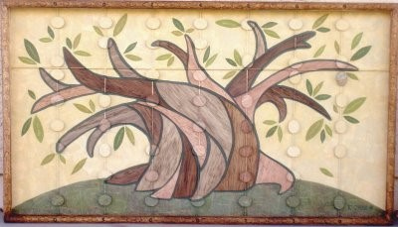
Israel Rejects Christ—Gentiles Receive Him
“…if they abide not still in unbelief, shall be graffed in: for God is able to graff them in again.”
“…lest ye should be wise in your own conceits; that blindness in part is happened to Israel, until the fulness of the Gentiles be come in.”
Romans 11:16-25

Slide 30
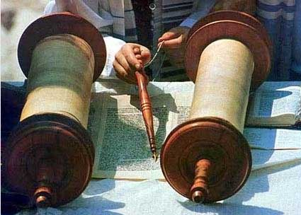
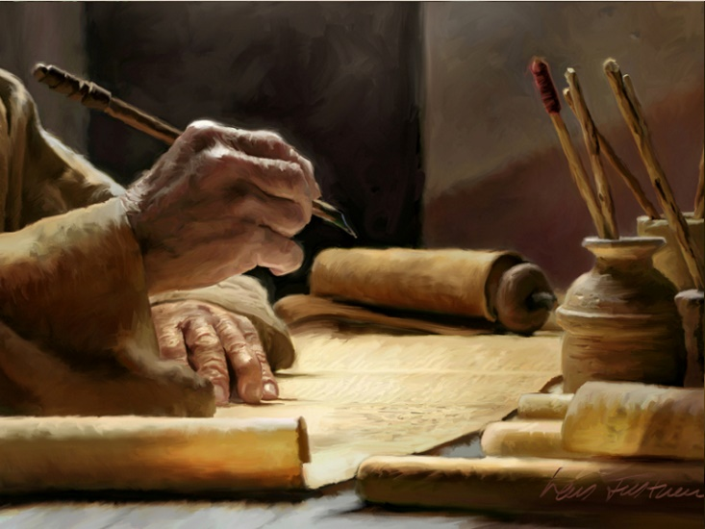
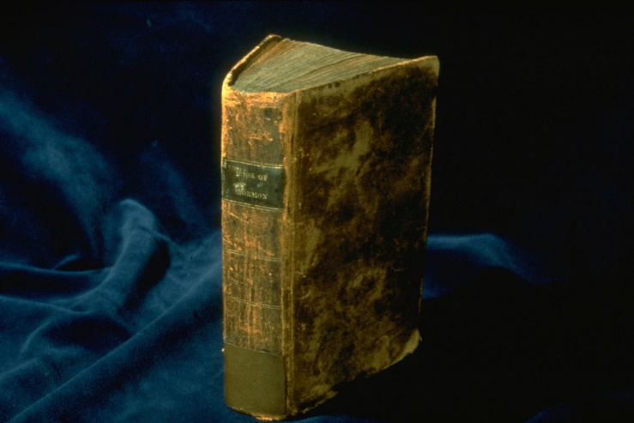
“There was a period or time appointed for the Jews to hear the word, and then a period of time for the Gentiles to take precedence.
The times of the Gentiles is the period during which the gospel goes to them on a preferential basis, and this will continue until they have had a full opportunity to accept the truth, or in other words until the fulness of the Gentiles.
Then the message will go again to the Jews, meaning to the Jews as a nation and as a people.”
Romans 11:25
(2)

Slide 31
Will the grafted branch ever become part of the tree just as the original branches are?
If an original branch gets its nourishment from the roots, where does the grafted branch gets its nourishment?
When and why might a gardener use grafting?
What benefits come to a tree through grafting?
What benefits come to a branch that has been grated?
Yes
Also from the roots
Open for discussion
It increases in size and may produce more or better fruit
It becomes part of the tree
Romans 11:16-25

Slide 32
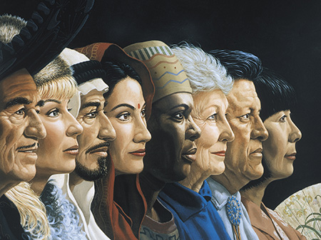
What spiritual process does Paul compare to grafting?
How will the Gentiles who are adopted into the house of Israel benefit?
How does this grafting process show the great love that the Lord has for all His Children?
Who is the Root?
The adoption of Gentiles into the house of Israel.
Gentile converts who join the Church are counted as part of the house of Israel, fulfilling the scripture
Roger Loveless
Romans 11:25

Slide 33
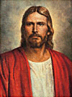
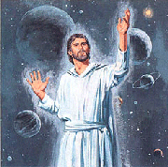
“I Jesus have sent mine angel to testify unto you these things in the churches. I am the root and the offspring of David, and the bright and morning star.”
Revelations 22:16

Slide 34
Sources:
Suggested Hymn: #117 Come Unto Jesus
Video:
Organists, Part 3 (3:46)
New Testament Institute Student Manual Chapter 36-37
Bruce R. McConkie Mormon Doctrine p. 395
Doctrinal New Testament Commentary, 2:259–60; 2:290.
A New Witness for the Articles of Faith, 512-13
Life and Teachings of Jesus Christ page 324
Joseph Fielding Smith “Doctrine of Salvation” page 58-61
Elder Parley P. Pratt (Key to the Science of Theology [1978], 61).
Wikipedia
M. Russell Ballard Our Search for Happiness: An Invitation to Understand The Chruch of Jesus Christ of latter-day Saints [1993] ,70
Presentation by ©http://fashionsbylynda.com/blog/

Slide 35
PAUL’S Letters to the Romans
The Law of Christ Brings Life and Peace | 8:1–13
The Sons of God Are Joint-Heirs with Christ | 8:14–19
Faithful Men Receive the Hope of Eternal Life | 8:20–25
How the Spirit Intercedes for Man | 8:26, 27
God’s Elect Are Foreordained to Eternal Life | 8:28–34
Christ Intercedes for Men | 8:34–39
How the Law of Election Operates | 9:1–33
How Faith and Salvation Come | 10:1–18
Israel Is Chosen According to the Election of Grace | 10:19–21; 11:1–10
Gentile Converts Are Adopted into Israel | 11:11–24
The Fulness of the Gentiles to Precede the Conversion of the Jews | 11:25–36
Adoption During Christ’s Time:
Caesar Augustus (see Luke 2:1), who was the ruler of Rome at the time of Christ’s birth, was adopted by his predecessor, Julius Caesar. Adoption was common in the Roman world and would have been a familiar concept to Paul’s readers.
A person who legally adopted someone conferred on that person all the rights and privileges that a natural-born child would have. Therefore, when we receive “the Spirit of adoption” (Romans 8:15) through entering the gospel covenant, we become the children of God and “joint-heirs with Christ” (Romans 8:17). (1)
Joint-Heirs Romans 16-17:
“In the theology of the restored church of Jesus Christ, the purpose of mortal life is to prepare us to realize our destiny as sons and daughters of God—to become like Him. … The Bible describes mortals as ‘the children of God’ and as ‘heirs of God, and joint-heirs with Christ’ (Rom. 8:16–17). It also declares that ‘we suffer with him, that we may be also glorified together’ (Rom. 8:17) and that ‘when he shall appear, we shall be like him’ (1 Jn. 3:2). We take these Bible teachings literally. We believe that the purpose of mortal life is to acquire a physical body and, through the atonement of Jesus Christ and by obedience to the laws and ordinances of the gospel, to qualify for the glorified, resurrected celestial state that is called exaltation or eternal life.” Elder Dallin H. Oaks (“Apostasy and Restoration,” Ensign, May 1995, 86).
Life and Teachings of Jesus and His Apostles Chapter 40-41
Suffer With Him Romans 8:17:
“We can learn spiritual lessons if we can approach suffering, sorrow, or grief with a focus on Christ. Anciently Paul wrote that our suffering may give us an opportunity to know the Savior better. Paul wrote to the Romans:
“‘The Spirit itself beareth witness with our spirit, that we are the children of God:
“‘And if children, then heirs; heirs of God, and joint-heirs with Christ; if so be that we suffer with him, that we may be also glorified together.’ [Romans 8:16–17.]
“Now, lest anyone go looking for hardship and suffering, that is not what is taught. Rather, it is the attitude with which we approach our hardships and trials that allows us to know the Savior better. …
“As we are called upon to endure suffering, sometimes inflicted upon us intentionally or negligently, we are put in a unique position—if we choose, we may be allowed to have new awareness of the suffering of the Son of God. …
“… We can have a greater appreciation for that which He did, and we can feel His spirit succoring us, and we can know the Savior in a very real sense.” Elder Keith R. Edwards (“That They Might Know Thee,” Ensign or Liahona, Nov. 2006, 99–101).
“We are the children of God.” Romans 14-17:
The children of God that Paul spoke of were those who, by virtue of their covenant relationship with Christ, were “led by the Spirit of God”. The companionship of the Holy Ghost is God’s assurance that we are His covenant children and that if we are faithful we will one day be “glorified together” with Jesus Christ. The blessings Paul discussed in Romans 8—blessings such as being “heirs of God”, the Spirit’s intercession on our behalf, and the full manifestations of God’s enduring love—are enjoyed by God’s covenant children, but not necessarily by all of His spirit children. (1)
Spirit of Adoption Romans 8:15-16:
“our spirit”, meaning our spirit bodies, was created by Heavenly Father, making every person literally a spirit child of Heavenly Father. However, it is by making covenants with God through ordinances and then keeping those covenants that people are spiritually reborn, or adopted, as His sons and daughters in the gospel covenant. The companionship of the Holy Ghost indicates that such people are not only God’s spirit children by virtue of creation, but they are also His covenant children.

Slide 36
All Things Work Together Romans 8:28:
Our Heavenly Father, who loves us completely and perfectly, permits us to have experiences that will allow us to develop the traits and attributes we need to become more and more Christlike. Our trials come in many forms, but each will allow us to become more like the Savior as we learn to recognize the good that comes from each experience. As we understand this doctrine, we gain greater assurance of our Father’s love. We may never know in this life why we face what we do, but we can feel confident that we can grow from the experience.” Elder James B. Martino(“All Things Work Together for Good” Ensign or Liahona, May 2010, 101).
The Bible Dictionary explains that election is “a theological term primarily denoting God’s choice of the house of Israel to be the covenant people with privileges and responsibilities, that they might become a means of blessing to the whole world. …
“The elect are chosen even ‘before the foundation of the world,’ yet no one is unconditionally elected to eternal life. Each must, for himself, hearken to the gospel and receive its ordinances and covenants from the hands of the servants of the Lord in order to obtain salvation. If one is elected but does not serve, his election could be said to have been in vain, as Paul expressed in 2 Cor. 6:1.
“… An ‘election of grace’ spoken of in … Rom. 11:1–5 has reference to one’s situation in mortality; that is, being born at a time, at a place, and in circumstances where one will come in favorable contact with the gospel. This election took place in the premortal existence. Those who are faithful and diligent in the gospel in mortality receive an even more desirable election in this life and become the elect of God. These receive the promise of a fulness of God’s glory in eternity (D&C 84:33–41)” (Bible Dictionary, “Election”; see also Alma 13:3–4).
The Prophet Joseph Smith explained that “unconditional election of individuals to eternal life [predestination] was not taught by the Apostles. God did elect or predestinate, that all those who would be saved, should be saved in Christ Jesus, and through obedience to the Gospel” (in History of the Church, 4:360). That is, all people who will be saved will receive salvation through the Atonement of Jesus Christ and in no other way.
Firstborn Among Many Others Romans 8:29:
Some Latter-day Saints have tended to focus on Christ’s Sonship as opposed to His Godhood. As members of earthly families, we can relate to Him as a child, as a Son, and as a Brother because we know how that feels. We can personalize that relationship because we ourselves are children, sons and daughters, brothers and sisters. For some it may be more difficult to relate to Him as a God. And so in an attempt to draw closer to Christ and to cultivate warm and personal feelings toward Him, some tend to humanize Him, sometimes at the expense of acknowledging His Divinity. So let us be very clear on this point: it is true that Jesus was our Elder Brother in the premortal life, but we believe that in this life it is crucial that we become ‘born again’ as His sons and daughters in the gospel covenant” M. Russell Ballard (“Building Bridges of Understanding,” Ensign, June 1998, 67).
Foreordination Romans 8:28-29:
the Greek term translated as predestinate means ‘to appoint or determine beforehand’ and refers to the foreordination some people receive, based on God’s foreknowledge, to follow Jesus Christ and become like Him (see also Ephesians 1:3–4; 1 Peter 1:2). ‘Foreordination does not guarantee that individuals will receive certain callings or responsibilities. Such opportunities come in this life as a result of the righteous exercise of agency, just as foreordination came as a result of righteousness in the premortal existence’ (‘Foreordination’ True to the Faith: A Gospel Reference [2004], 69; see also Alma 13:3–4)” (New Testament Student Manual [Church Educational System manual, 2014], 350).

Slide 37
Understanding Paul’s words
“Accursed from Christ”
“To Whom Pertaineth the Adoption”
For they stumbled at that stumbling block”
JST indicates that Paul actually wrote, “For once I could have wished that myself were accursed from Christ” He probably was referring to the time when he persecuted the Church of Jesus Christ
Using imagery, he refers to those not of the house of Israel who accepted the gospel and lived its teaching. They were adopted into the family of Abraham and literally became Israelites.
Jesus Christ is the rock or stone upon which the Jews stumbled. He fulfilled the law of Moses and restored the gospel in its fulness, but the Jews rejected Him and continued to believe that they could be saved by the “works of the law” without His help.

Slide 38
“The Fulness of the Gentiles”
“Election of Grace”
“Graffed in among Them”
Peter opened the door to preaching the gospel to the Gentiles, and Paul became their chief apostolic advocate and teacher. There was a period of time for the Jews to hear the gospel and one for the Gentiles. This will continue throughout time until they have all had the opportunity to hear the message.
Heavenly Father’s plan requires that all of His children have an opportunity to accept or reject the gospel. The “election of grace” gives members of the Church the assignment to fulfil this assignment in our day.
When branches on fruit trees begin to die, a gardener can cut them off and graft in new branches from a healthy tree. If done correctly, the new branches will grow and become part of the old tree. Paul taught that converted Gentiles are new branches “graffed…”

