Slide 1
Lesson 102
Armour of Light
Romans 12-16
Let your light so shine before men, that they may see your good works, and glorify your Father which is in heaven.
Matthew 5:16

Slide 2
The Shape of Water
If you pour the water into this container, how will the shape of the water change?
It will conform to the shape of the container.
If you pour that water into another container how will it change the shape of the water?
It will conform to the shape of that container.
The water represents people and the containers represent different worldly beliefs and practices.
What dangers can come from continually conforming to worldly beliefs and practices?

Slide 3
The REAL Meaning: Romans 12: 1-3
“Present your bodies”
“Conformed to this world”
3. “Transformed”
4. “Think soberly”
Change
Sacrifice all you enjoy
Wicked
Copying worldly ways
Living a life of service
Improved
Don’t have pride
Avoid humor

Slide 4
A Living Sacrifice
Old Testament practice of sacrificing animals = These animals were dedicated offerings to God.
Mosaic Law
Lust
lust
Church members are to dedicate themselves completely to God by giving up sinful desires.
God expects us to dedicate our lives to Him and refrain from conforming to the world

Slide 5
A Living Sacrifice
Romans 12:9-16
Romans 12:17-21
Romans 13:8-13
Love should be shown without hypocrisy
Be honest in all things
Do not barrow and not return
Live peaceably
Love one another
Be kind to all
Do not seek revenge
Do not commit adultery, steal, bear false witness, covet, or kill
Learn the value of hard work
Take care of the poor and the needy
Live with hope
Overcome evil thoughts and intentions
Cast off darkness and put on the ‘armour of light’
Be hospitable and generous
Be of one mind

Slide 6
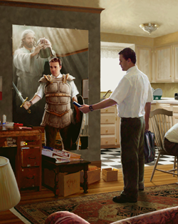
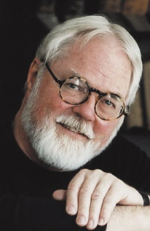
Armour of Light
“put on the whole armour of God.”
“I came to understand that I am not the light or the source of light. But light—the light of truth, understanding, and knowledge—is there, and that light will only shine in many dark places if I reflect it.
“… I can reflect light into the dark places of this world … and change some things in some people. Perhaps others may see and do likewise. This is what I am about. This is the meaning of my life.”
When we encounter people who are struggling, can we reflect the Savior’s light to encourage them?
The Apostle Paul taught the Romans, “Let us therefore cast off the works of darkness, and let us put on the armour of light”. How do we do this?
Doc Christensen
Doc Christensen
Romans 13:12

Slide 7
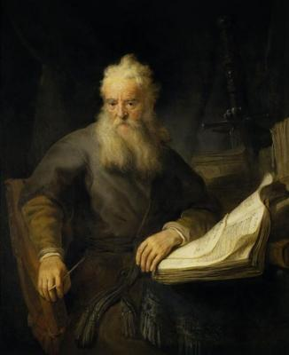
Paul has written the conditions that are required in order to qualify for salvation
for now is our salvation nearer than when we believed
Romans 13:11

Slide 8
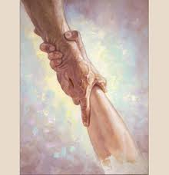
Salvation
“…for we know that it is by grace that we are saved, after all we can do.”
What does it mean to be saved?
“…if thou shalt confess with thy mouth the lord Jesus, and shalt believe in thin heart that God hath raised him from the dead, thou shalt be saved.”
2 Nephi 25:23 Romans 10:9

Slide 9
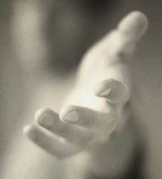
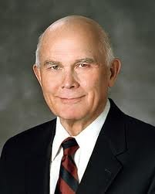
Have you been saved?
“There are 6 different meanings of the words saved and salvation…
“…Some of these, our salvation is assure---we are already saved.
Some salvation is spoken as a future event or as conditioned upon the future.”
(3)

Slide 10
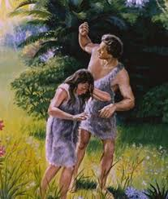
Meaning #1
We are all saved from physical death
(Alma 11:43-44)
First, all mortals have been saved from the permanence of death through the Resurrection of Jesus Christ.
“For as in Adam all die, even so in Christ shall all be made alive”
1 Corinthians 15:22.
(3)

Slide 11
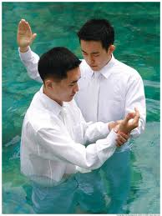
Meaning #2
“We can be saved from sin through
obedience to the law and ordinances of
the gospel if we endure to the end.
(D&C 14:7) and Article of Faith 3
Saved with conditions
“Believers may not be saved until they completed their mortal probation, having faith, repentance, baptism and receiving the gift of the Holy Ghost.”
(3)

Slide 12
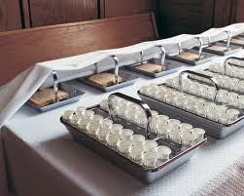
Meaning #3
“We can be saved by being “born again”
(John 3:3-5 and Mosiah 27:24-26)
Born again---enter into a covenant relationship
Born of Water, and of the spirit and by taking upon us the name of Jesus Christ.
Renewal---Rebirth---Sacrament
(3)

Slide 13
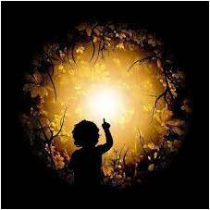
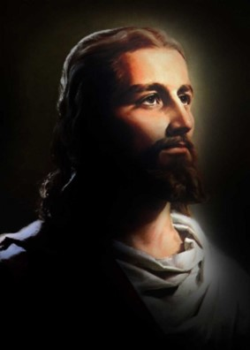
Meaning #4
“We can be saved from ignorance
through the light of the gospel.
(John 8:12)
Being saved from the darkness of ignorance of God, and His son
“I am the light of the world, he that followeth me shall not walk in darkness, but shall have the light of life”
(John 12:46)
(3)

Slide 14
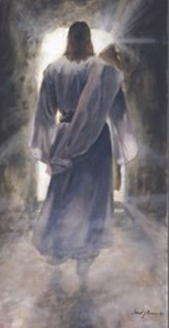
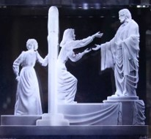
Meaning #5
“We can be saved from the second death.”
( 1 Corinthians 15:40-42 and Revelation 2:11)
The final spiritual death---assurance of the kingdom of glory
“Resurrection—every person who ever lived upon the face of the earth—except for a very few—is assured of salvation.
(D&C 76:52-60)
(3)

Slide 15
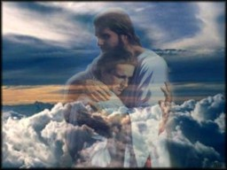
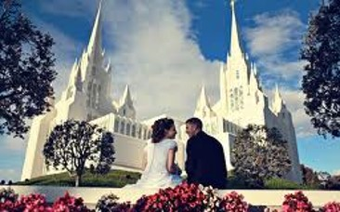
Meaning #6
“We can be saved by receiving exaltation.”
( D&C 76:52-60)
Exaltation = Eternal Life = The fulness of salvation
Requires more than repentance and baptism by priesthood authority
Requires making sacred covenants, including eternal marriage in the temple of the Lord
(3)

Slide 16
“But in all meanings, or kinds of salvation, salvation is in and through Jesus Christ.”
(3)

Slide 17
“If we use the word salvation to mean ‘exaltation,’ it is premature for any of us to say that we have been ‘saved’ in mortality. That glorious status can only follow the final judgment”
(4)

Slide 18
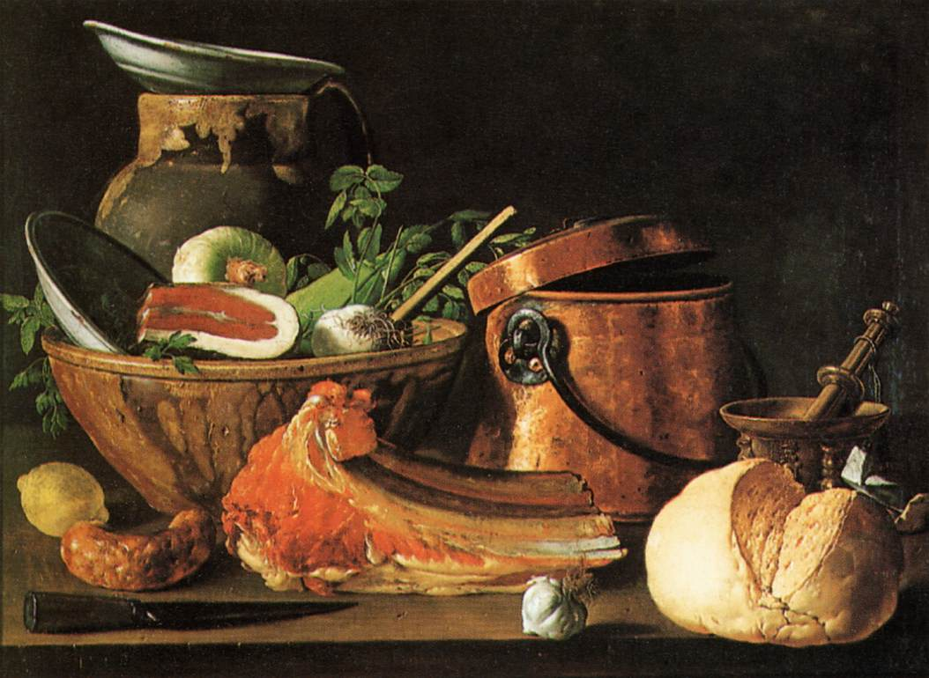
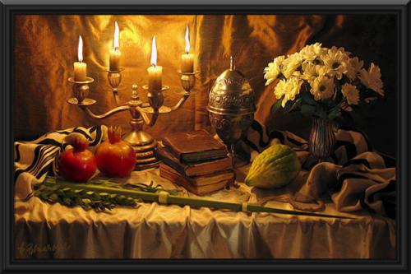
Conflict In Rome
Handling matters of personal preference
Paul pointed out that some Church members chose to “eat all things” while others chose to eat only “herbs,” or in other words, vegetables
Those who ate only vegetables were likely Jewish converts, while those who ate other foods were probably Gentile converts.
Luis Meléndez
Sue Zimmermann
These differences in personal practices led to divisions among Saints in Rome and other locations.
Albert Benaroya
Some Church members chose to follow Jewish customs, practices, and holidays.
Romans 14:1-15
(1)

Slide 19
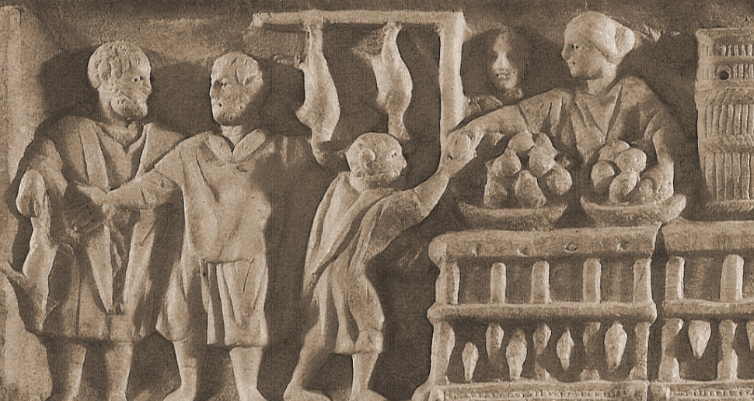
Avoiding Conflict
Paul taught that many personal choices concerning diet and other practices were not addressed by any specific commandment.
Therefore, these were matters to be decided between the individual and the Lord
Paul taught Church members to refrain from judging others in this matter of personal preference.
In matters not addressed by specific commandments, we are to refrain from judging others’ choices
Romans 14:1-15
(1)

Slide 20
Consider the Effects
Why is it a problem when Church members look down on or condemn other Church members who make different choices in matters where no commandment requires or forbids a certain behavior?
Paul counseled the Saints to be considerate of the effect of their personal practices on others and be willing to forgo actions that could influence others to stumble spiritually
In matters not addressed by specific commandments, we are to be considerate of how our choices affect others
Paul taught that we should not impose our private interpretations on fellow Church members or pass judgment on those who live differently
Romans 14:1-15
(1)

Slide 21
Consider This…
Is an alcoholic beverage unclean?
Is it the alcohol or tobacco which tarnishes our souls?
The answer is no, for 'there is nothing unclean of itself' and it is 'not that which goeth into the mouth [that] defileth a man; but that which cometh out of the mouth, this defileth a man' (Matt. 15:11).
A man who has not been taught the Word of Wisdom is not made unclean by a cigarette or a glass of beer.
His choice may be unwise, but it is not sinful. Nevertheless, he may find some Mormons looking down on him.
Like the judgmental Romans, we sometimes fall prey to judgmental attitudes about those who smoke and drink.
But how can we hold him accountable for violating a law he has never covenanted to keep?
'why dost thou judge thy brother?
Romans 14:1-15
(1)

Slide 22
Breaking the Work of Wisdom
When a member of the church breaks the Word of Wisdom, he is unclean-not because the substance itself is unclean but because he has broken his covenants to be obedient to God's law.
Faith, hope, charity, peace and joy are the fruits of the Spirit and are much more important than our latter-day dietary code.
Word of Wisdom "faddists," as Elder McConkie calls them, sometimes forget to place this law in its proper perspective.
If we liken the scriptures to ourselves, we might correctly declare, 'For the kingdom of God is not abstinence from tobacco and alcohol; but righteousness, and peace, and joy in the Holy Ghost' (v. 17).
However:
We are not to Judge
Romans 14:1-15
(4, 5)

Slide 23
Bear the Infirmities of the Weak
“Remember, we are not alone. We belong to a great body of friends, thousands upon thousands who are striving to follow the teachings of the Lord. …
“I remember interviewing a discouraged missionary. He was having trouble with a language which was not his own. He had lost the spirit of his work and wanted to go home. He was one of 180 missionaries in that mission.
“I told him that if he were to go home he would break faith with his 179 companions. Every one of them was his friend. Every one of them would pray for him, fast for him, and do almost anything else to help him. They would work with him. They would teach him. They would get on their knees with him. They would help him to learn the language and be successful because they loved him.
Romans 15:1
(6)

Slide 24
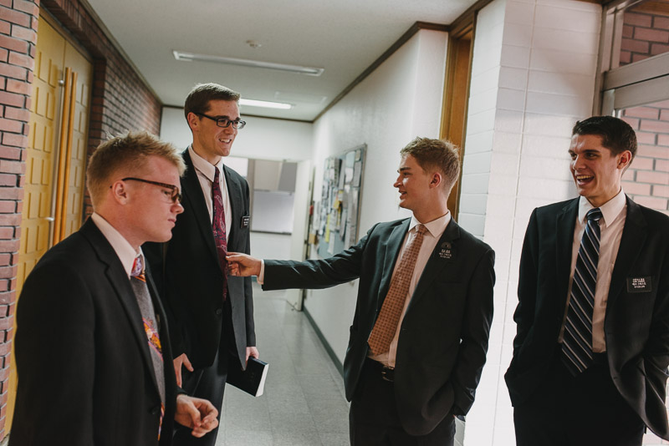
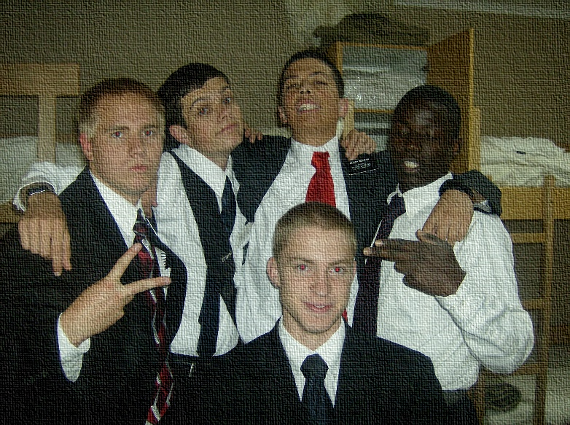
“I am happy to report that he accepted my assurance that all of the other missionaries were his friends. They rallied around him, not to embarrass him, but to strengthen him.
The terrible feeling of loneliness left him. He came to realize that he was part of a winning team. He became successful, a leader, and he has been a leader ever since.
“That’s what each of us must do for one another.”
Romans 15:1
(6)

Slide 25
The Scriptures Are For Us
“for our learning” and to provide comfort and hope
Therefore will I give thanks unto thee, O Lord, among the heathen, and sing praises unto thy name.
(Psalm 18:49)
Rejoice, O ye nations, with his people: for he will avenge the blood of his servants, and will render vengeance to his adversaries, and will be merciful unto his land, and to his people.
(Deuteronomy 32:43)
O praise the Lord, all ye nations: praise him, all ye people. (Psalm 117:1)
And in that day there shall be a root of Jesse, which shall stand for an ensign of the people; to it shall the Gentiles seek: and his rest shall be glorious. (Isaiah 11:10)
Paul quoted several Old Testament scriptures to reassure the Saints that missionary work to the Gentiles was in accordance with God’s plan, and he encouraged all Church members to accept one another
Romans 15:4; 9-12
(1)

Slide 26
The End of the Epistle
Paul concluded his epistle by describing his efforts to preach the gospel. He also warned about those who cause divisions, teach false doctrines, and seek to deceive others.
A warning about the dangers of allowing individual amplifications of gospel principles to become expectations for others:
“Sometimes, well-meaning amplifications of divine principles—many coming from uninspired sources—complicate matters further, diluting the purity of divine truth with man-made addenda. One person’s good idea—something that may work for him or her—takes root and becomes an expectation. And gradually, eternal principles can get lost within the labyrinth of ‘good ideas.’” (7)
Romans 15-16

Slide 27
Testimony of Paul to the Romans:
“For I am not ashamed of the gospel of Christ: for it is the power of God unto salvation to every one that believeth; to the Jew first, and also to the Greek.
For therein is the righteousness of God revealed from faith to faith: as it is written, The just shall live by faith.”
Romans 1:16-17

Slide 28
Sources:
Suggested Hymn: #267 How Wondrous and Great
Video:
195 Dresses (5:11)
New Testament Institute Student Manual Chapter 37
Robert Fulghum, What on Earth Have I Done? (2007), 290–91
Dallin H. Oaks April 1998 Conf. or May Ensign 1998
Bruce R. McConkie “The Mortal Messiah” vol. 4 (1979-81), 1:242
Word of Wisdom “Food Faddists” (Doctrinal New Testament Commentary, Vol.2, p.313)
gospeldoctrine.com
President Gordon B. Hinckley (“Strengthening Each Other,” Ensign, Feb. 1985, 3).
President Dieter F. Uchtdorf (“The Love of God,” Ensign or Liahona, Nov. 2009, 21).
Presentation by ©http://fashionsbylynda.com/blog/

Slide 29
PAUL’S Letters to the Romans
Be A Living Sacrifice Through Obedience to God | 12:1–3
Talents Are Given Saints for Service | 12:4–8
Resist Evil with Charity | 12:9–21
Submission to Church Authorities | 13:1–7
“Love Is the Fulfilling of the Law” | 13:8–10
Righteousness Leads to Salvation | 13:11–14
What are Matters of True Religion? | 14:1–23
True Saints Fellowship Each Other | 15:1–7
Gospel Gifts Poured Out upon Gentiles | 15:8–33
Paul Salutes the Saints | 16:1–27
Ordained Power Romans 13:1:
"Governments are instituted of God, sometimes by His direct interposition, sometimes by His permission. When the Jews had been brought into subjection by Nebuchadnezzar, king of Babylon, the Lord commanded through the prophet Jeremiah (27:4-8) that the people render obedience to their conqueror, whom He called His servant; for verily the Lord had used the pagan king to chastise the recreant and unfaithful children of the covenant. The obedience so enjoined included the payment of taxes and extended to complete submission. After the death of Christ the apostles taught obedience to the powers that be, which powers, Paul declared 'are ordained of God.' See Rom. 13:1-7; Titus 3:1; 1 Tim. 2:1-3; see also 1 Pet. 2:13, 14. Through the medium of modern revelation, the Lord has required of His people in the present dispensation, obedience to and loyal support of the duly established and existing governments in all lands. See D&C 58:21-22; 98:4-6; and section 134 throughout. The restored Church proclaims as an essential part of its belief and practice: 'We believe in being subject to kings, presidents, rulers, and magistrates, in obeying, honoring, and sustaining the law.'" James E. Talmage (Jesus the Christ: A Study of the Messiah and His Mission According to Holy Scriptures Both Ancient and Modern [Salt Lake City: Deseret Book Co., 1983], 522, footnote 2.)
JST There is no power in the church but of God Romans 13:1:
The Joseph Smith Translation is helpful for two reasons. First, it reminds the leaders in the church that they are powerless without God, for the 'powers of heaven cannot be controlled nor handled only upon the principles of righteousness' (DC 121:36).
Secondly, it preempts misinterpretation. Paul's phrase, 'there is no power but of God,' could be misinterpreted to justify the wicked rule of kings, tyrants, and despots. Hereby, the wicked could lay claim to their unjust rule, saying that their power is 'ordained of God.' Certainly, we are to understand that Paul was not justifying all forms of government. Furthermore, we know that Satan often uses kings and queens, "false priests who oppress" in order to "reign with blood and horror." God doesn't ordain wicked governments, but he does permit them in order to preserve the free exercise of man's agency. Hence, the Joseph Smith Translation arms us against false interpretation by allowing an alternative to those who wrest the scriptures unto their own destruction. As with many inspired alterations by the Prophet, the change is not so much intended to restore Paul's original intent as it is to defuse Satan's powers of doctrinal distortion.
Gospeldoctrine.com
Life and Teachings of Jesus and His Apostles Chapter 41
The Higher Power Romans 13:1-7 "The Church believes that 'Governments were instituted of God for the benefit of man; and that He holds men accountable for their acts in relation to them, both in making laws and administering them, for the good and safety of society.' (D. & C. 134:1.)
"Governments must be righteous to receive the support of the Church. They must be in harmony with the principles of justice acknowledged by believers in God. This includes the full and unqualified right of the free exercise of individual liberty whenever it does not infringe upon the rights and liberties of others. Moreover, governments must be organized and maintained for the good and safety of society, that is for the governed, rather than for those who govern. This implies a constitutional form of Government, a form of Government in which the people participate.
"The Church believes 'that all governments necessarily require civil officers and magistrates to enforce the law of the same; and that such as will administer the law in equity and justice should be sought for and upheld by the voice of the people if a republic, or the will of the sovereign.' (D. & C. 134:3.)" (John A. Widtsoe, Program of The Church of Jesus Christ of Latter-day Saints [Salt Lake City: The Church of Jesus Christ of Latter-day Saints, 1937], 100.)

Slide 30
The Full Story of Light:
A story is told by Robert Fulghum, a Unitarian minister, about a seminar he once attended in Greece.
On the last day of the conference, the discussion leader walked over to the bright light of an open window and looked out. Then he asked if there were any questions.
Fulghum laughingly asked him what was the meaning of life. Everyone in attendance laughed and stirred to leave. However, the leader held up his hand to ask for silence and then responded “I will answer your question.”
He took his wallet out of his pocket and removed a small round mirror about the size of a quarter. Then he explained:
When I was a small child during World War II, we were very poor and we lived in a remote village. One day on the road, I found the broken pieces of a mirror. A German motorcycle had been wrecked in that place. I tried to find all the pieces and put them together, but it was not possible, so I kept the largest piece. This one. And by scratching it on a stone, I made it round.
I began to play with it as a toy and became fascinated by the fact that I could reflect light into dark places where the sun could never shine. It became a game for me to get light into the most inaccessible places that I could find. I kept the little mirror, and as I grew up, I would take it out at idle moments and continue the challenge of the game.
As I became a man, I grew to understand that this was not just a child’s game, but a metaphor of what I could do with my life. I came to understand that I am not the light or the source of the light. But light – be it truth or understanding or knowledge – is there, and it will only shine in many dark places if I reflect it.
I am a fragment of a mirror whose whole design and shape I do not know. Nevertheless, with what I have, I can reflect light into the dark places of this world – into the dark places of human hearts – and change some things in some people. Perhaps others seeing it happen will do likewise. This is what I am about. This is the meaning of my life.
Found in “Put on the Armour of Light” by Elder S. Gifford Nielsen of the Seventy March 2015 Ensign
Artist: Albert Benaroya is a unique artist who specializes in oil paintings. One of Albert’s most burning passions in life is to create original and quality works of art such as oil paintings, portraits and Jewish painting.
Albert's jewish paintings are created under the strictest standards of quality. In addition to that, every time he paints he uses only the best quality oil paints in order to make sure he will be able to breathe life in the most sincere manner into his creative and imaginative thoughts, out of which he creates amazing and wonderful paintings. Albert Benaroya is a popular jewish painter in Israel and all over the world.
http://www.albertbenaroya.com/Jewish-Paintings
Maintaining personal preferences Romans 14:13-15, 19; 15:1-3:
Church members should consider the effect of their personal practices on others and be willing to forgo some actions if they might cause another to stumble spiritually Promoting peace and edification in the Church is a higher priority than maintaining personal preferences Some actions and priorities simply matter more than others. (1)
Unity within the Church
Unity within the Church and among the saints is the goal of the gospel. There is no place in the Church of God for division, for disagreement on doctrine, for cults and cliques, for liberal views as contrasted with conservative concepts. Among the faithful saints there is only one mind and one judgment and these are the Lord's; those with the full enjoyment of the Spirit learn the Lord's views on all things and conform their minds and hearts to his, becoming one with him. "Be one; and if ye are not one ye are not mine," is his everlasting decree to his saints. (D. & C. 38:27.) Elder Bruce R. McConkie Commentary I, pp. 426- 427; 765-767.

