Slide 1
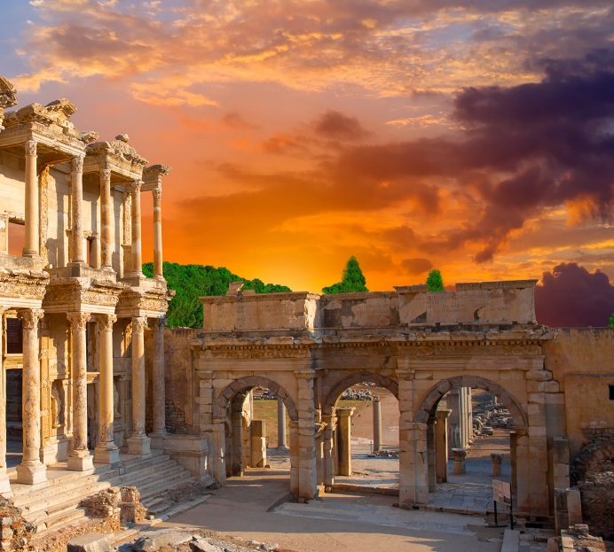
Lesson 103
That There Be No Division
1 Corinthians 1-2
Behold, how good and how pleasant it is for brethren to dwell together in unity!
Psalm 133:1
Presentation by ©http://fashionsbylynda.com/blog/

Slide 2
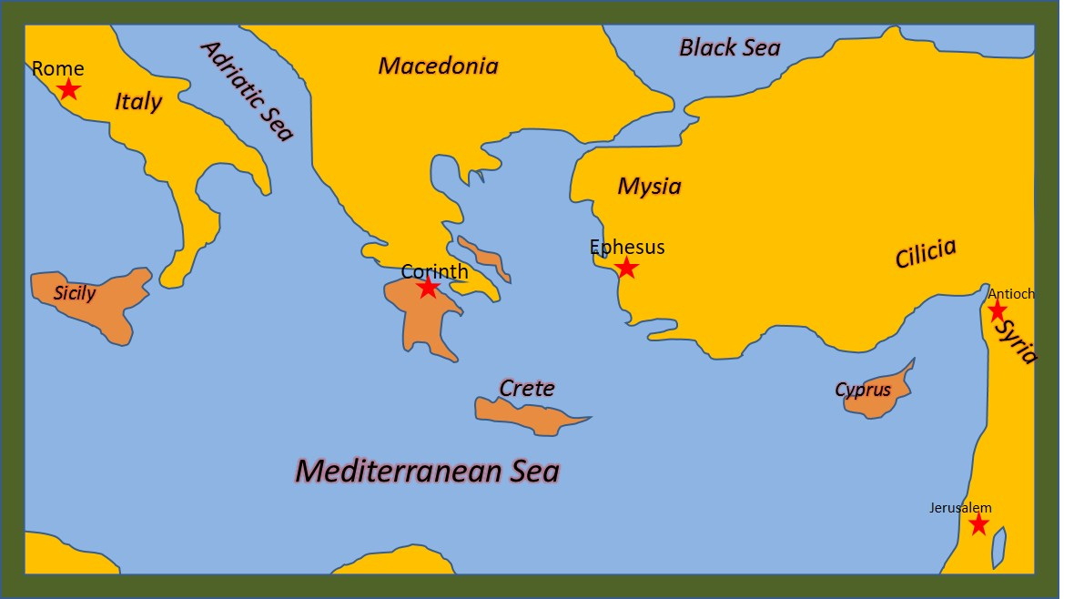
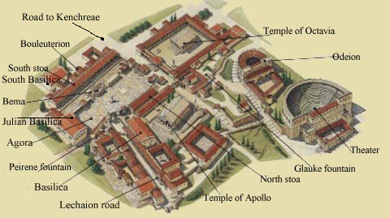
Corinth
Corinth is on an isthmus connecting mainland Greece with the Peloponnesian peninsula.
Corinth was the capital of the Roman province Achaia, which covered most of ancient Greece south of Macedonia.
Corinth was the most important city in Greece during Paul’s day.
It was the hub for commerce, philosophy, and religion from the East and the West.
Religious culture included idol worship. People worshiped in 12 temples throughout the city. They also engaged in immoral behavior.
Corinth was destroyed by Romans in 146 BC and rebuilt by Julius Caesar as a Roman colony in 46 BC.
The official language was Latin, but a common language remained Greek
(2,3)

Slide 3
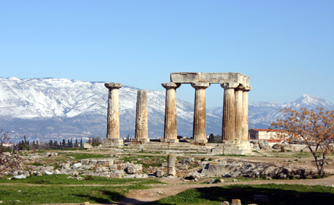
Church Established
For a year and a half Paul established the Church in Corinth during his second missionary journey around A.D. 50
Acts 18:1-17.
Persecution drove Paul to Athens.
The Corinthian Saints became divided and combined pagan beliefs and rituals with some of the true gospel principles and ordinances Paul had taught them.
Paul wrote these letters near the conclusion of his three-year visit in Ephesus (during his third mission), which likely ended sometime between A.D. 55 and 56
Earlier during his mission he received communication from Church members in Corinth. He wrote a response to the branch (1 Corinthians 5:9), but unfortunately this epistle was lost and is therefore not found in our scriptures.
(2,3)

Slide 4
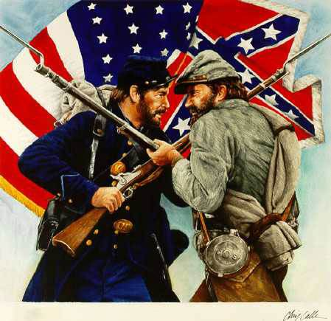
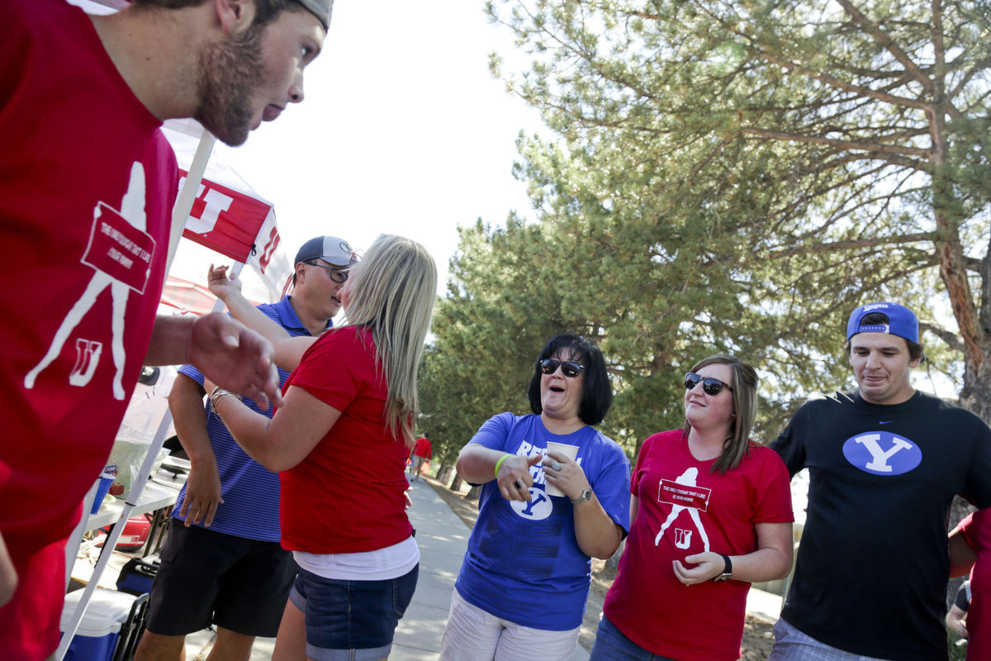
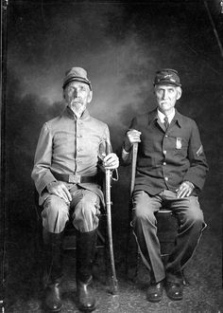
“That there be no division among you”
What might cause divisions and contention in each of these groups?
How can such divisions and contention affect a family, team, or group of friends?
How can such divisions and contention among Church members affect the Church?
1 Corinthians 1:10-11
“Brother vs. Brother”

Slide 5
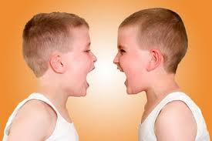
A Voice of Warning
Divisions and petty bickering
“…and that there be no divisions among you: but that ye be perfectly joined together in the same mind and in the same judgment.”
1 Corinthians 1:10

Slide 6
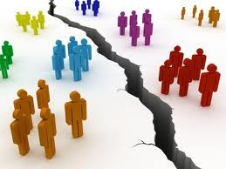
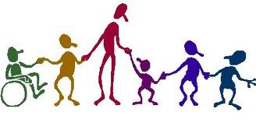
How To Treat One Another
That ye all speak the same thing
That there be no division among you
That ye be perfectly joined together in the same mind and in the same judgment
1 Corinthians 1:10

Slide 7
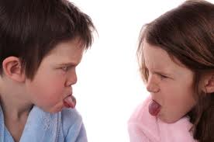
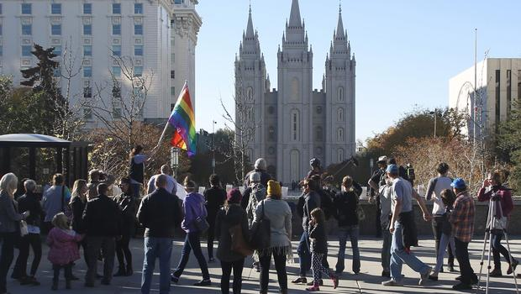
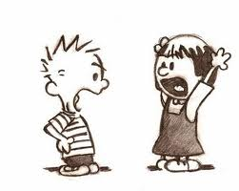
Division of Unity
Jealousy, leads to contention
Some are divided in doctrine and principles
“…he that hath the spirit of Contention is not of me, but is of the devil…
…who is the father of contention, and he stirreth up the hearts of men to contend with anger, one with another.”
The Lord expects us as Saints to be united and to eliminate divisions and contention
3 Nephi 11:29

Slide 8
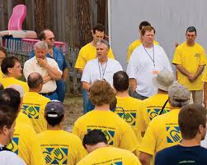
To Be Called A Saint
“…chastened for all your sins, that you might be one…” (D&C 61:8)
“…the Lord called his people Zion, because they were of one heart and one mind.” (Moses 7:18)
“That they all may be one; as thou, Father, art in me, and I in thee, that they also may be one in us…” (John 17:21)

Slide 9
One Purpose of Mind
This is not to say that we should be merged into one physical mass; Being controlled like robots.
But it is to say that we must be of one purpose and of one mind.

Slide 10
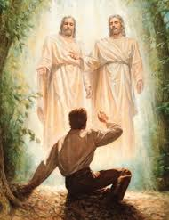
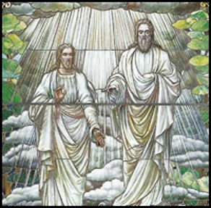
Just As Jesus and Heavenly Father Are One
“Understand that Jesus did not say “I and the Father am one, but are one.”
The word “are” refers to two persons
“I and my Father are one. (John 10:30)

Slide 11
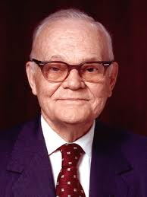
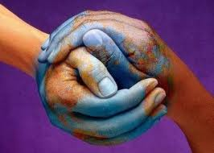
Unified and Bound Together In Our Beliefs
“The way to unity is for us to learn the will of the Lord and then to do it…
“The power of the Church for good in the world depends upon the extent to which we, the members thereof, observe this principle.”
(5)

Slide 12
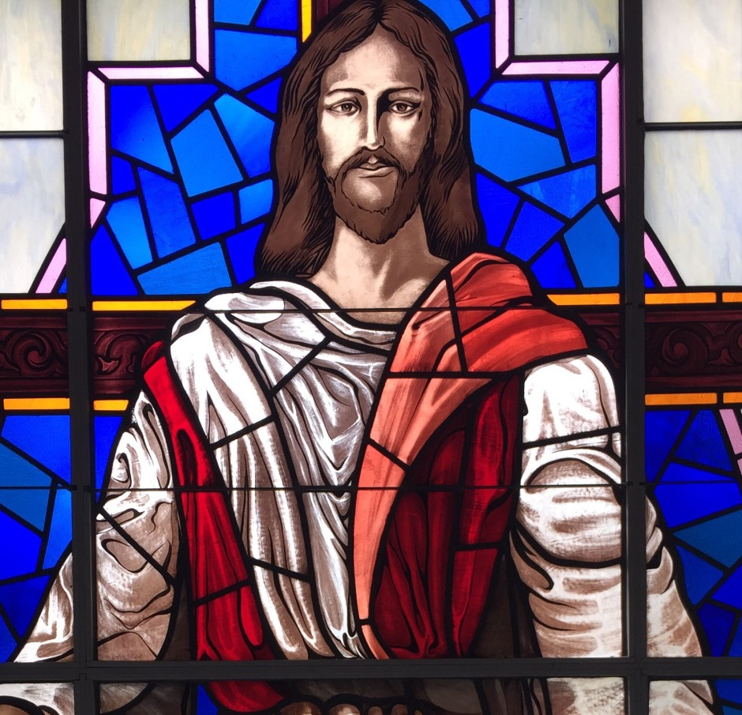
Who Baptized You?
The Saints in Corinth were dividing into groups based on who baptized them.
Contention developed because they believed their status in the Church was determined by the importance of the person who baptized them.
Church at Grace Park, White House, TN
Paul taught that there was no status gained by receiving baptism from a specific individual. Members were to be “perfectly joined together in the same mind and in the same judgment,” with Christ at their head
1 Corinthians 1:12-16
(4)

Slide 13
Crispus
Where the size of a congregation permitted, the Jewish synagogue was presided over by a college of elders, who in turn were under control of one who was “the chief of the synagogue”
Crispus was in charge of the synagogue in Corinth at the time that Paul ministered the gospel in that city.
He was converted by Paul’s words and shortly thereafter baptized, with his household, by the great apostle to the gentiles.
Paul mentions him specifically as being one of the few he baptized in Corinth along with Gaius and the household of Stephans.
1 Corinthians 1:14, 16
(4)

Slide 14
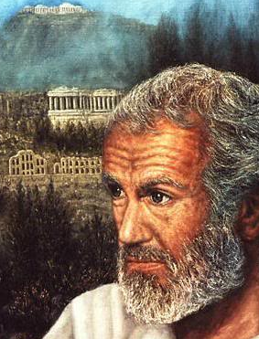
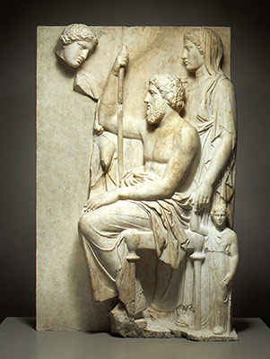
The Greeks
During the time of Paul, many Greeks lived in Corinth. These Greeks placed a high value on philosophical ideas and worldly wisdom.
Why might someone who values worldly philosophies find it difficult to accept the gospel?
O that cunning plan of the evil one! O the vainness, and the frailties, and the foolishness of men! When they are learned they think they are wise, and they hearken not unto the counsel of God, for they set it aside, supposing they know of themselves, wherefore, their wisdom is foolishness and it profiteth them not. And they shall perish.
2 Nephi 9:28
1 Corinthians 1:17
(4)

Slide 15
World’s Wisdom VS God’s Wisdom
1 Corinthians 1:17-18
1 Corinthians 1:19-20
1 Corinthians 1:21-22
1 Corinthians 1:23-24
Paul referred to the flawed philosophical traditions of his day and not to the worthwhile pursuit of learning and education that the Lord encourages.
"Those who rely exclusively on study and reason reject or remain doubtful of all absolutes that cannot be established through the five senses, including good and evil and the existence and omniscience of God. They also reject all other methods of acquiring knowledge, including revelation. They tend to be self-sufficient, self-important, and enamored of their own opinions. Reason is their god and intellectualism is their creed. They dwell in that 'large and spacious building' seen in a prophet's vision of the 'wisdom' and 'pride of the world.‘” (6)
Paul was not sent to build a reputation of baptisms based on numbers
"A major stumbling block of the Jews in Jesus' day,… was their expectation about what the Messiah would do when He came, such as emancipating them politically. But Jesus of Nazareth was not such an emancipator; thus to the Jews His death was a confirming stumbling block!
The Greeks, on the other hand, regarded the whole idea of a crucified Messiah as foolishness. (6)
He was there to preach the word of God, by the saving grace of the atonement
Philosophical ideas were regularly the subject of public debates. Paul contrasted limited human wisdom with the powerful message of God’s crucified Son. (1)
Preaching from the cross =
A shortened word for atonement. (4)

Slide 16
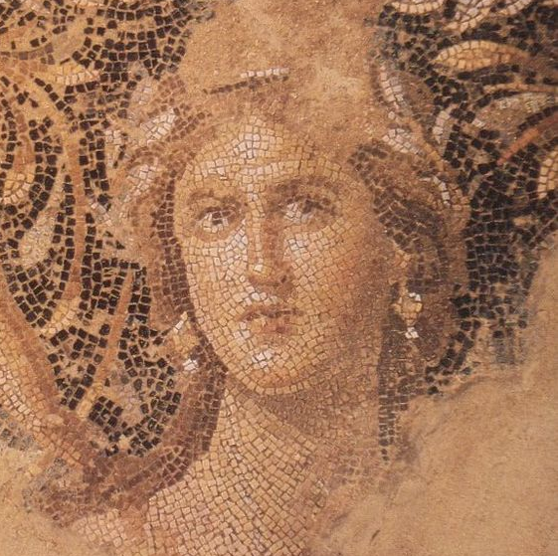
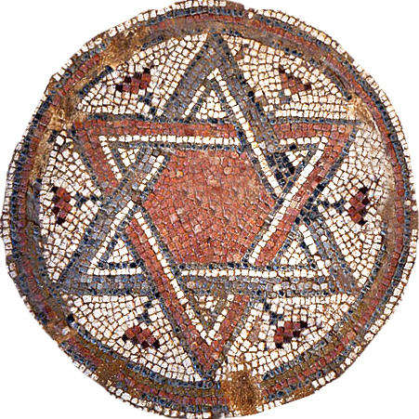
The Message of the Crucifixion
In the Roman world, crucifixion was a punishment reserved for criminals or slaves and symbolized shame and defeat.
The idea of someone vicariously suffering and dying for others, then subsequently coming back to life, was “foolishness” to the philosophically minded Greeks
For the Jews, whose concept of the Messiah brought the expectation of royalty, power, and victory, the message that the Messiah had died on a cross was a “stumblingblock” and an unacceptable idea.
1 Corinthians 1:23
(1)

Slide 17
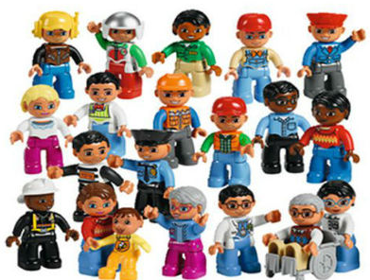
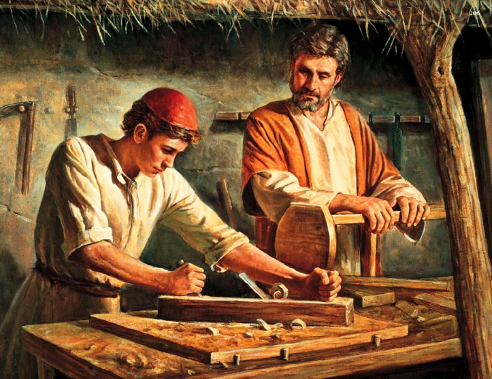
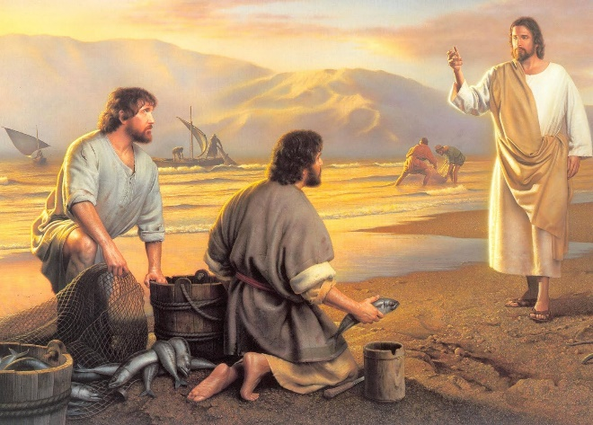
God’s wisdom is greater than human wisdom
"Unlike some other religions, the gospel of Jesus Christ does not grant special status to theologians, philosophers, or other academics. All are welcome to enjoy the bounteous blessings of the gospel, regardless of educational background or social status.
Those called by the Savior to serve in His kingdom represent this broad cross-section of humanity.
Jesus Christ, raised by Mary and by Joseph the carpenter, first called as His disciples fishermen and others engaged in common professions. (8)
1 Corinthians 1:26-27

Slide 18
“I sat on a plane next to a professed atheist who pressed his disbelief in God so urgently that I bore my testimony to him. ‘You are wrong,’ I said, ‘there is a God. I know He lives!’
“When I used the words Spirit and witness, the atheist responded,
‘You don’t know. Nobody knows that! You can’t know it!’
‘I don’t know what you are talking about.’
When I would not yield, the atheist, who was an attorney, asked perhaps the ultimate question on the subject of testimony. In a sneering condescending way he said…
The words prayer, discernment, and faith, were equally meaningless to him.
‘you don’t really know. If you did, you would be able to tell me how you know.’
‘All right…you say you know. Tell me how you know.’
“When I attempted to answer, even though I held advanced academic degrees, I was helpless to communicate. …
“I … was at a loss as to what to do”
What would you have said to the atheist?
(9)

Slide 19
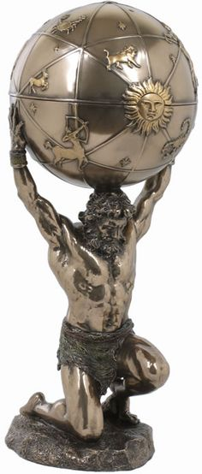
Teaching by the Spirit
Paul did not use the world’s wisdom to convince them of the gospel. He taught them by the Spirit so they would have faith in God.
But to be learned is good if they hearken unto the counsels of God. 2 Nephi 9:29
Paul told them that unbelievers cannot understand the mysteries of God.
Regardless of those who scoffed at the gospel, the Saints’ faith should not depend on “the wisdom of men, but … the power of God” (1)
1 Corinthians 2:1-8

Slide 20
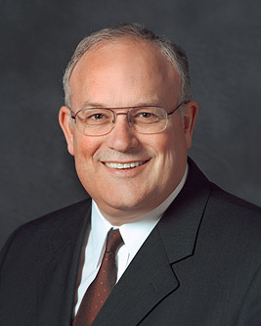
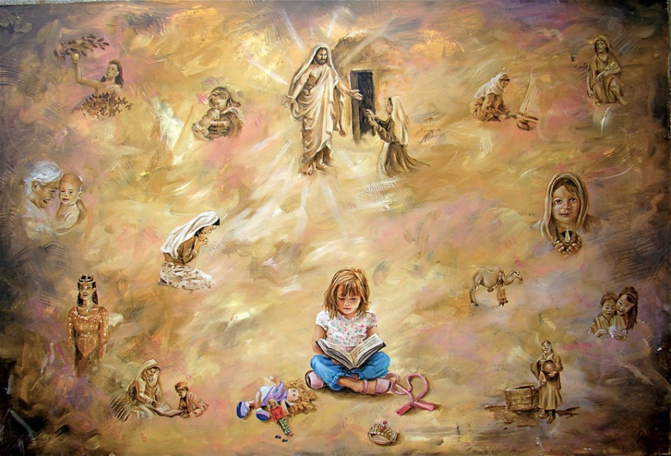
“In the scientific world the scientific method is used to learn truth and advance knowledge.
It has been extremely helpful over the years and has yielded tremendous amounts of scientific knowledge and continues to push back the curtain of ignorance about our physical world.
Learning spiritual things, however, requires a different approach than learning scientific things.
The scientific method and intellect are very helpful, but they alone will never bring spiritual knowledge.
(10)

Slide 21
“Learning spiritual things involves the intellect, but that is not enough. We only learn spiritual things by the Spirit. …
“… Answers to spiritual questions are given to individuals who don’t harden their hearts; who ask in faith, believing they will receive; and who diligently keep the commandments.
Even when we follow this pattern, we don’t control the timing of getting answers.
?
Sometimes our answers come quickly, and sometimes we must place questions on the shelf for a time and rely on our faith that has developed from the answers we do know.”
(10)

Slide 22
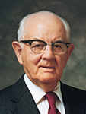
"We must remember that neither God nor his gospel can be found and understood through research alone. … (11)
We can only know and understand the things of God through His Spirit
"There are 'hidden treasures' of knowledge-truths beyond the reach of reason alone. Paul recognized this basic truth when writing to the Corinthians.
He said: 'For what man knoweth the things of man, save the spirit of man which is in him? even so the things of God knoweth no man, but the Spirit of God.' (1 Cor. 2:11.) (12)

Slide 23
Doctrinal Mastery
That your faith should not stand in the wisdom of men, but in the power of God.
But as it is written, Eye hath not seen, nor ear heard, neither have entered into the heart of man, the things which God hath prepared for them that love him.
But God hath revealed them unto us by his Spirit: for the Spirit searcheth all things, yea, the deep things of God.
For what man knoweth the things of a man, save the spirit of man which is in him? even so the things of God knoweth no man, but the Spirit of God.
1 Corinthians 2:5, 9-11

Slide 24
The Mind of Christ
"The Apostle Paul said that persons who have been converted 'have the mind of Christ'
I understand this to mean that those who have been converted begin to see things as our Savior sees them and to hear and follow His voice instead of the voice of the world.
Persons with 'the mind of Christ' will do things in His way instead of by the ways of the world." (13)
1 Corinthians 2:16

Slide 25
“What do you think salt tastes like?”
“After several attempts, of course, he could not do it. He could not convey, in words alone, so ordinary an experience as tasting salt.
‘I know there is a God. You ridiculed that testimony and said that if I did know, I would be able to tell you exactly how I know.
My friend, spiritually speaking, I have tasted salt. I am no more able to convey to you in words how this knowledge has come than you are to tell me what salt tastes like. But I say to you again, there is a God! He does live!
And just because you don’t know, don’t try to tell me that I don’t know, for I do!’
“As we parted, I heard him mutter,
‘I don’t need your religion for a crutch! I don’t need it.’
“From that experience forward, I have never been embarrassed or ashamed that I could not explain in words alone everything I know spiritually”
(9)

Slide 26
What Are the Things of God?

Slide 27
Sources:
Suggested Hymn: #143 Let the Holy Spirit Guide
New Testament Institute Student Manual Chapter 38
Bible Dictionary
“Talk Thru The Bible” by Bruce Wilkinson and Kenneth Boa p. 382
The Life and Teachings of Jesus Christ and His Apostles Chapter 34
Pres. Marion G. Romney – Conference Report April 1983 or Ensign May 1983
Elder Dallin H. Oaks The Lord's Way [Salt Lake City: Deseret Book Co., 1991], 53.
Elder Neal A. Maxwell (If Thou Endure It Well [Salt Lake City: Bookcraft, 1996], 32.)
Paul Alan Cox, On Becoming a Disciple Scholar, ed. by Henry B. Eyring, [Salt Lake City: Bookcraft, 1995], 25
President Boyd K. Packer (“The Candle of the Lord,” Ensign, Jan. 1983, 51).
Elder Paul V. Johnson (“A Pattern for Learning Spiritual Things”[Seminaries and Institutes of Religion satellite broadcast, Aug. 7, 2012]; si.lds.org).
President Spencer W. Kimball ("Seek Learning Even by Study and Also by Faith," Ensign, Sept. 1983, 6)
President Ezra Taft Benson (So Shall Ye Reap, compiled by Reed A. Benson [Salt Lake City: Deseret Book Co., 1960], 153 - 154.)
(Henry B. Eyring, ed., On Becoming a Disciple Scholar [Salt Lake City: Bookcraft, 1995], 94.)
Presentation by ©http://fashionsbylynda.com/blog/

Slide 28
First Letter of Paul to the Saints at Corinth— Written from Ephesus, ca. Spring, A.D. 57
Dissensions Among the Saints | 1:1–16
True and False Wisdom | 1:17–31
Christ is Known by the Spirit | 2:1–16
"Academic credentials are not requisite for service in the Lord's kingdom. Indeed there are explicit warnings within the scriptures to both the rich and the learned to avoid pride. Yet we can see within such scriptures an intriguing pattern: the warnings to the learned are often given by prophets and Apostles who have themselves sought learning. Paul, for example, was a student of Gamaliel and an associate of the Sanhedrin. He gained fluency in several languages, and, as demonstrated by his masterful address on Mars Hill, was conversant with Greek philosophy." (Paul Alan Cox, On Becoming a Disciple Scholar, ed. by Henry B. Eyring, [Salt Lake City: Bookcraft, 1995], 25.)
Life and Teachings of Jesus and His Apostles Chapter 34
Worldly Wisdom 1 Corinthians 2:1-8:
“If all the talent, tact, wisdom, and refinement of the world had been combined in one individual, and that person had been sent to me with the Book of Mormon, and had declared in the most exalted of earthly eloquence, the truth of it, undertaking to prove it by his learning and worldly wisdom, it would have been to me like the smoke which arises only to vanish. But when I saw a man without eloquence, or talents for public speaking, who could only just say, ‘I know by the power of the Holy Ghost that the Book of Mormon is true, that Joseph Smith is a Prophet of the Lord,’ the Holy Ghost proceeding from that individual illuminates my understanding, and light, glory, and immortality is before me; I am encircled by it, filled with it, and know for myself that the testimony of the man is true” President Brigham Young (Deseret News Weekly, Feb. 9, 1854, 24).
First Corinthians reveals the problems, pressures, and struggles of a church called out of a pagan society.
The oldest recorded title of this epistle is Pros Korinthious A, in effect, the “First to the Corinthians.” The A was no doubt a later addition to distinguish this book from Second Corinthians.
In Paul’s day the population of Corinth was approximately 700,000, about 2/3 of whom were slaves.
Greek philosophy influenced any speculative thought that was there. “Talk Thru the Bible” by Bruce Wilkinson and Kenneth Boa pp. 382-383
“Brother vs. Brother, Richwood, West Virginia, 1910s” by Finley Taylor Early Appalachian Photographer “America has no north, no south, no east, no west. The sun rises over the hills and sets over the mountains, the compass just points up and down, and we can laugh now at the absurd notion of there being a north and a south. We are one and undivided.” ~Pvt. Sam Watkins, 1st Tennessee, Co. H. “Brother Against Brother” is a slogan used in histories of the American Civil War describing the predicament faced in families (primarily, but not exclusively, residents of border states) in which loyalties and military service were divided between the Union and the Confederacy. There are a number of stories of brothers fighting in the same battles on opposite sides, or even of brothers killing brothers over the issues.
Learning Through the Sprit:
The Lord’s prescribed methods of acquiring sacred knowledge are very different from the methods used by those who acquire learning exclusively by study. For example, a frequent technique of scholarship is debate or adversarial discussion, a method with which I have had considerable personal experience. But the Lord has instructed us in ancient and modern scriptures that we should not contend over the points of his doctrine. (See 3 Ne. 11:28–30; D&C 10:63.) … Gospel truths and testimony are received from the Holy Ghost through reverent personal study and quiet contemplation” Elder Dallin H. Oaks (“Alternate Voices,” Ensign ,May 1989, 29).
Contention: 1 Corinthians:
Many years ago I read the following Associated Press dispatch which appeared in the newspaper: An elderly man disclosed at the funeral of his brother, with whom he had shared, from early manhood, a small, one-room cabin near Canisteo, New York, that following a quarrel, they had divided the room in half with a chalk line, and neither had crossed the line or spoken a word to the other since that day—62 years before. Just think of the consequence of that anger. What a tragedy!
May we make a conscious decision, each time such a decision must be made, to refrain from anger and to leave unsaid the harsh and hurtful things we may be tempted to say.
President Thomas S. Monson School Thy Feelings, Oh My Brother Oct. 2009 Gen. Conf.
"The gospel requires us to yield our minds as well as bend our knees. Minds are often more arthritic than knees. No wonder we are to seek to obtain the 'mind of Christ' (1 Corinthians 2:16). Yielding intellectually, but only partially, is often the problem. There is the intellectual equivalent of Ananias and Sapphira's holding back a portion of their money (see Acts 5:1-11). Such holding back may be motivated by a mistaken notion that by so doing a person somehow preserves his individuality or demonstrates his God-given agency." Elder Neal A. Maxwell (That Ye May Believe [Salt Lake City: Bookcraft, 1992], 101.)

