Slide 1
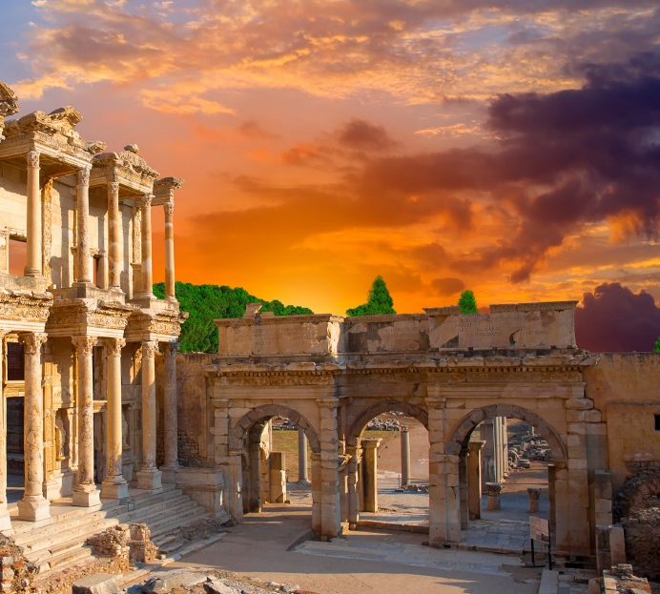
Lesson 104
Line Upon Line
1 Corinthians 3-4
For precept must be upon precept, precept upon precept; line upon line, line upon line; here a little, and there a little
Isaiah 28:10:
Presentation by ©http://fashionsbylynda.com/blog/

Slide 2
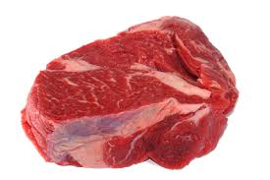
Milk and Meat
Line Upon Line
Milk comes before the meat
Those who do not understand the full principles
Those who are ready and worthy to receive the sacred things of the Lord
1 Corinthians 3:1-3

Slide 3
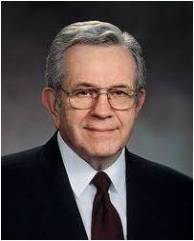
"Undernourished children must be carefully fed; so it is with the spiritually underfed. Some are so weakened by mischief and sin that to begin with they reject the rich food we offer. They must be fed carefully and gently.
"Some are so near spiritual death that they must be spoon fed on the broth of fellowship, or nourished carefully on activities and programs.
But we must take care lest the only nourishment they receive thereafter is that broth."
(2)

Slide 4
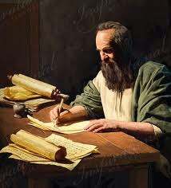
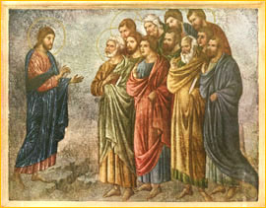
Those in Corinth
… were not yet ready to receive greater truths, they were not unified and that some of them included pagan (ungodly) beliefs and practices in their observance of the gospel.
Paul used several metaphors to teach these Saints the importance of being unified, to correct false beliefs and practices, and to strengthen their faith in the gospel of Jesus Christ.
1 Corinthians 3:4-7

Slide 5
Paul Planted-Apollos Watered
Apollos (Greek: Ἀπολλώς) was a 1st century Alexandrian Jewish Christian mentioned several times in the New Testament.
A contemporary of Paul the Apostle, he played an important role in the early development of the churches of Ephesus and Corinth.
And a certain Jew named Apollos, born at Alexandria, an eloquent man, and mighty in the scriptures, came to Ephesus.
This man was instructed in the way of the Lord; and being fervent in the spirit, he spake and taught diligently the things of the Lord, knowing only the baptism of John. Acts 18:24-25
1 Corinthians 3:5
(1)

Slide 6
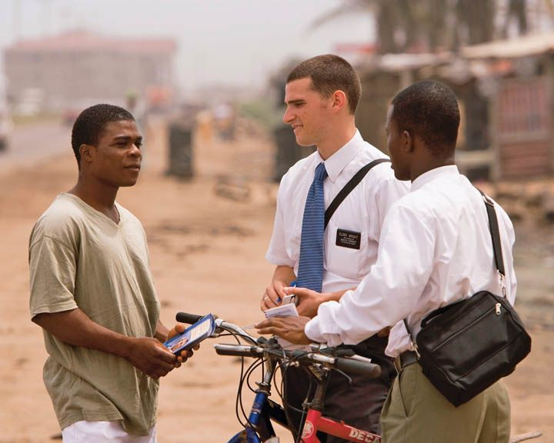
The Harvest
Those who plant and water
Missionaries are instruments in the hands of God, but it is “God that giveth the increase,” meaning that God causes the changes in people’s hearts and souls that lead to conversion.
In the Book of Mormon, Ammon expressed similar sentiments…
Read Alma 27:11-14
1 Corinthians 3:4-7
(1)

Slide 7
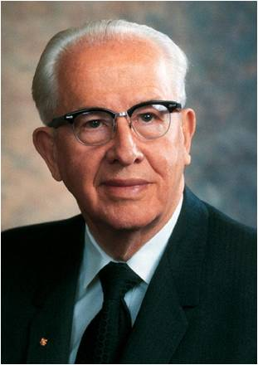
"...in the conversion process some missionaries will plant, some will water, and some will baptize.
You are not concerned with who gets the credit for the baptisms because 'God [gives] the increase‘.
While we can help others learn about the gospel of Jesus Christ, it is through the power of the Holy Ghost that people are converted.
1 Corinthians 3:6
(3)

Slide 8
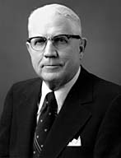
Legend of Stone Cutters
"No man can be engaged in a more godly business than that of building the character, excellence, and righteousness that will go with him throughout eternity.”
'I am cutting stones. I work four hours in the morning and four hours in the afternoon. I am a stone cutter.'
What are you doing?
1st man
1 Corinthians 3:9-10
(4)

Slide 9
2nd man
'I am cutting stones. I make four dollars in the morning and four dollars in the afternoon. I am a stone cutter.'
What are you doing?
1 Corinthians 3:9-10
(4)

Slide 10
"'. . . ye are God's building .... [therefore] let every man take heed how he buildeth....'
What are you doing?
'I am building a cathedral.'
3rd man
"Each of us is also building a cathedral, one that is far more important than a mere physical structure."
1 Corinthians 3:9-10
(4)

Slide 11
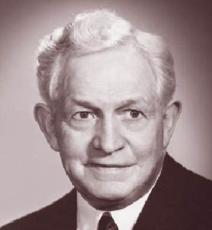
…the purpose of the gospel is to make men better.
The primary objective in the mission of Jesus was to provide the world with better men and women. God himself has said…
It is God's work to build character, ability, and Godliness into the lives of his children.
Any influence that works against that purpose is evil, and whenever we build evil into our lives, we are tending toward failure."
…this is my work and my glory-to bring to pass the immortality and eternal life of man.' (Moses 1:39.)
1 Corinthians 3:
(5)

Slide 12
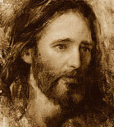
The Foundation
Who needs to be the foundation of our lives?
Other foundation can no man lay than that is laid, which is Jesus Christ
And also: Ye 'are built upon the foundation of the apostles and prophets, Jesus Christ himself being the chief corner stone' (Eph. 2:20).
Jared Barnes
Jesus Christ is the foundation upon which we must build.
1 Corinthians 3:11

Slide 13
Temples—Our Bodies
Paul used ye, a plural pronoun, to refer to the Corinthian Saints collectively as God’s temple. Paul’s point was that the congregations of the Church functioned as temples where the Spirit of God could dwell.
In whom all the building fitly framed together groweth unto an holy temple in the Lord:
Ephesians 2:21
"If we truly want to be as living temples of our God, we would do well to remember, in our thoughts and words and actions, the dedication that is inscribed on each of the sacred buildings we call temples: 'Holiness to the Lord.'“ (6)
1 Corinthians 3:16-17
(1)

Slide 14
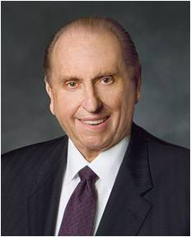
"In our own personal temple building, as in the building of this holy house, the words of John Ruskin typify my personal feelings:
'When we build let us think that we build forever. Let it not be for present delight, nor for present use alone; let it be such work as our descendants will thank us for, and let us think as we lay stone on stone that a time is to come when those stones will be held sacred, because our hands have touched them; and men will say, as they look upon the labour and wrought substances of them: See, this our fathers did for us.'"
1 Corinthians 3:16-17
(7)

Slide 15
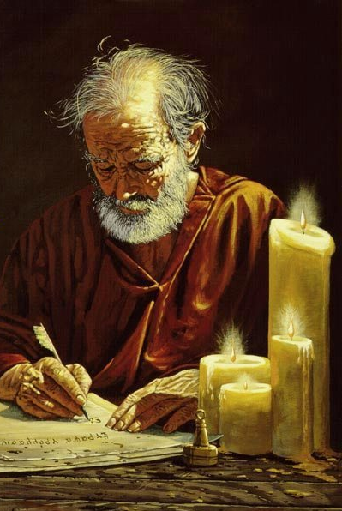
Judgment
It appears that some members of the Church in Corinth had judged Paul’s performance as a missionary and Church leader.
They may have questioned his judgment or thought someone else might have done a better job.
…that ye might learn in us not to think of men above that which is written, that no one of you be puffed up for one against another.
The Lord will judge us fairly because He knows all things, including the thoughts and intents of our hearts
1 Corinthians 4:1-6

Slide 16
Apostles Were Called To ‘Suffer’
Paul told the Saints in Corinth that the Apostles of Jesus Christ are called to suffer because of the wickedness of the world.
The world judges the Apostles and other Church leaders to be “fools” for seeking to follow Christ.
James, brother of the Lord
A.D. 62
James, brother of John,
A.D. 44
Peter
A.D. 67
Paul
A.D. 67
John outlived the rest but was not seen after the 'times of Trajan' (A.D. 98 to 117).“ (8)
1 Corinthians 4:9-10

Slide 17
The Kingdom of God
God is not in word, but in power
“... men do not gain the kingdom...until they possess the power. The gospel is the power of God unto salvation.
There must be priesthood...or there is no kingdom of God, no Church of Jesus Christ, no saving gospel.
Where God's power is manifest, there is the Church and kingdom of God on earth, and where his power is not found, there the Church and kingdom is not."
1 Corinthians 4:20
(9)

Slide 18
Sources:
Suggested Hymn: #220 Lord, I Would Follow Thee-- verse 2
New Testament Institute Student Manual Chapter 38
President Boyd K. Packer (Let Not Your Heart Be Troubled [Salt Lake City: Bookcraft, 1991], 34.)
President Ezra Taft Benson Mission Presidents Seminar, Provo, Utah, 25 June 1986.)" (The Teachings of Ezra Taft Benson [Salt Lake City: Bookcraft, 1988], 201.)
Sterling W. Sill (Thy Kingdom Come [Salt Lake City: Deseret Book Co., 1975], 150.)
President David O. McKay (Conference Report, April 1962, First Day-Morning Meeting 13.)
(Selected Writings of Robert L. Millet: Gospel Scholars Series [Salt Lake City: Deseret Book Co., 2000], 450.)
Thomas S. Monson ("News of the Church," Ensign, July 1992, 77)
(Richard Lloyd Anderson, "Clement, Ignatius, and Polycarp: Three Bishops between the Apostles and Apostasy," Ensign, Aug. 1976, 51)
Elder Bruce R. McConkie (Doctrinal New Testament Commentary, 3 vols. [Salt Lake City: Bookcraft, 1965-1973], 2:333.)
Presentation by ©http://fashionsbylynda.com/blog/

Slide 19
First Letter of Paul to the Saints at Corinth— Written from Ephesus, ca. Spring, A.D. 57
Milk Comes Before Meat | 3:1–7
Fire Shall Test All Work | 3:8–15
“Ye Are the Temple of God” | 3:16, 17
Saints Shall Inherit All Things | 3:18–23
Apostles Suffer, Minister, Keep the Faith | 4:1–21
The Harvest 1 Corinthians 3:6:
"One of Satan's techniques for thwarting the work of the Lord is to convince members and missionaries alike that certain individuals who decline invitations to attend church or to hear the gospel discussions 'have had their chance.' The number of converts to the Church who have 'gone through' several sets of missionaries emphasizes the fact that none of us can judge when another person has had an adequate opportunity to hear and accept the gospel.
"The apostle Paul observed: 'I have planted, Apollos watered; but God gave the increase.' (1 Cor. 3:6.) What if Apollos had failed to make efforts with those who were not converted with Paul's initial contact? Some of us become discouraged when our gospel green thumbs don't seem to bear fruit. Often some soul-searching will reveal that our approach has been ill timed or hastily planned, or perhaps that we were anxious to accept the credit for a future conversion, even though God gives the increase.“ Elder Spencer J. Condie ("Bring Them to Church," Ensign, Oct. 1977, 36)
Life and Teachings of Jesus Christ and His Apostles Chapter 34-35
Building upon a Foundation 1 Corinthians 3:11:
"...If we build our house of salvation on the rock of personal revelation; if we build it on the revealed reality that Jesus is the Lord; if we build it on him who is the eternal rock-it will stand forever. If we are guided by the spirit of inspiration while here in mortality, we will be able to withstand all the floods and storms that beat upon us. If we are founded upon a rock, we worship the Father in the name of the Son by the power of the Holy Ghost." (Sermons and Writings of Bruce R. McConkie [Salt Lake City: Bookcraft, 1998], 116.)
Milk and Honey 1 Corinthians 3:1-7:
"One essential element in [God's] plan is the principle of 'line upon line, precept upon precept.' Not only does he leave to us the initiative to believe, he also imparts to his hearers only what they are ready to hear. Milk comes before meat. 'I have yet many things to say unto you, but ye cannot bear them now.' (John 16:12.)...Hugh Nibley has described this guiding principle as the 'policy of reticence,' which the Lord has always followed 'to protect sacred things from common misunderstandings and to protect the unworthy from damaging themselves with them.'" Elder Bruce C. Hafen (The Believing Heart, 2nd ed. [Salt Lake City: Deseret Book Co., 1990], 6.)
"The scriptures teach emphatically that we must give milk before meat. The Lord made it very clear that some things are to be given only to those who are worthy.
"It matters very much not only what we are told but when we are told it. Be careful that you build faith rather than destroy it.“ President Boyd K. Packer (Let Not Your Heart Be Troubled [Salt Lake City: Bookcraft, 1991], 108.)
The Body is Your Temple 1 Corinthians 3:16-17:
"Your physical body is a magnificent creation of God. It is his temple as well as yours, and it must be treated with reverence." Elder Russell M. Nelson (The Power within Us [Salt Lake City: Deseret Book Co., 1988], 60.)
"'Ye must give thanks unto God,' said the Lord, 'for whatsoever blessing ye are blessed with.' (DC 46:32) And we can practice virtue and holiness before Him continually.
"We will regard our body as a temple of our very own. We will not let it be desecrated or defaced in any way. We will control our diet and exercise for physical fitness." Elder Russell M. Nelson ("We Are Children of God," Ensign, Nov. 1998, 87)
Giving credit to God 1 Corinthians 3:7
Men and women who even momentarily take their eyes off of God's glory and seek to exalt themselves, or who become entangled in the vain things of this world, will find that the kingdom quickly moves on without them. Unfortunately, none of us is immune from this all-too-human tendency.“ Marlin K. Jensen ("An Eye Single to the Glory of God," Ensign, Nov. 1989, 28)

Slide 20
Student 1 Invite your group to imagine that they attended a sacrament meeting in which a returned missionary talked about his mission. During his talk, he related that he had baptized several people. A week later, another returned missionary talked in sacrament meeting about her mission and related that she had taught many people who were eventually baptized after she had been transferred to other areas. • How would you respond if someone said the missionary who baptized several people on his mission was more successful than the missionary whose investigators were not baptized until after she had left the area? Write the words planted and watered on a piece of paper, and show it to your group. Explain that Paul compared missionaries to people who plant seeds and water crops. Remind your group that the Saints in Corinth had begun dividing into groups based on who had baptized them. They believed their status in the Church was based on the importance of the person who baptized them. (See 1 Corinthians 1:10–16.) Take turns with the members of your group reading aloud from 1 Corinthians 3:4–9. Ask the group to follow along, looking for what Paul said about the missionaries who had taught and baptized the people in Corinth. • According to verse 5, what did Paul say he and Apollos were? (Point out verse 5, footnote a, and explain that ministers means servants.) • According to verses 6–7, what did Paul say about missionaries who plant the seeds of the gospel and missionaries who help those seeds grow? If necessary, point out the phrases “neither is he that planteth any thing, neither he that watereth” in verse 7, and explain that Paul used these phrases to teach that neither of these roles is more important than God’s role. • What does the phrase “God that giveth the increase” (verse 7) mean? (It is God, through the Holy Ghost, who causes the changes in people’s hearts that lead to conversion, not those who teach and baptize.) • What truth can we learn from 1 Corinthians 3:6–7 about our role and God’s role in helping others become converted to the gospel of Jesus Christ? (After your group responds, invite them to write the following truth in their scriptures next to 1 Corinthians 3:6–7: While we can help others learn about the gospel of Jesus Christ, it is through the power of the Holy Ghost that people are converted.) Clarify that in order for people to receive the Holy Ghost and be converted, they must do their part by exercising faith and following God’s commandments. • How do you think knowing this truth might h

Slide 21
Student 2 Write the word foundation on a piece of paper, and show it to your group. • Why is the foundation an important part of a building? • What might happen if there is a problem with the foundation? Invite a member of your group to read 1 Corinthians 3:10 aloud, and ask the rest of your group to look for what Paul said about his missionary labors among the Corinthians. • What did Paul say he did while laboring as a missionary in Corinth? • What do you think Paul meant when he said “another buildeth thereon”? Invite another member of your group to read 1 Corinthians 3:11 aloud, and ask the rest of your group to look for what foundation Paul laid for the Saints in Corinth. • What foundation did Paul lay while he taught in Corinth? • According to verse 11, who needs to be the foundation of our lives? (Make sure your group identifies the following truth: Jesus Christ is the foundation upon which we must build. Consider inviting your group to mark this truth in verse 11.) • How can building upon the foundation of Jesus Christ help us endure temptations and trials? (See also Helaman 5:12.) • How can we ensure our lives are built on the foundation of Jesus Christ? Invite a member of your group to share about someone he or she knows whose life reflects being built upon the foundation of Jesus Christ. Ask this student to explain how building upon Christ has blessed this person. Invite each group member to set a goal that will help him or her build on the foundation of Jesus Christ.

Slide 22
Student 3 Write the word temple on a piece of paper, and show it to your group. Explain that Paul often referred to the temple figuratively. As recorded in 1 Corinthians 3:16–17, he used the word temple to refer to the congregations of the Church. Invite a member of your group to read 1 Corinthians 3:16–17 aloud. Ask the group to follow along, looking for what Paul said the Church members in Corinth needed to understand. Explain that ye (verse 16) refers to the congregations of the Church and that the phrase “if any man defile the temple of God” (verse 17) refers to anyone who tries to destroy God’s people. • According to verse 16, what did Paul want the members of the Church to understand about their congregations? Although 1 Corinthians 3:16–17 likely refers to the body of the Church as a congregation, these verses can also be applied to our physical bodies. • How might 1 Corinthians 3:16–17 also apply to our physical bodies? What are the consequences of defiling our bodies? Summarize 1 Corinthians 3:18–23 by explaining to your group that Paul taught the Saints that true wisdom is found in Jesus Christ and worldly wisdom is “foolishness with God” (verse 19).

