Slide 1
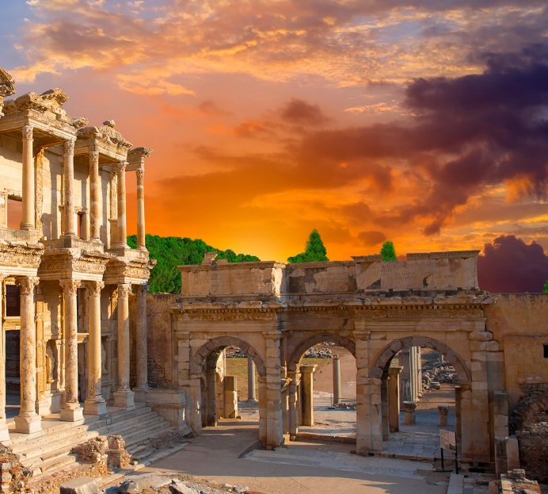
Lesson 105
One Bad Apple
1 Corinthians 5-6
Because thou hast spoiled many nations, all the remnant of the people shall spoil thee
Habakkuk 2:8

Slide 2
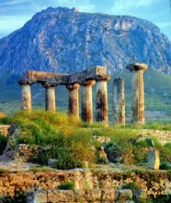
Corinth in a state of wickedness
“It is reported commonly that there is fornication among you, and such fornication as is not so much as named among the Gentiles, that one should have his father’s wife.”
The spoilage in rotten fruit will spread to good fruit.
Corinth had a worldwide reputation in the ancient world for its immorality. It was located very close to two major ports and subject to many of the evils which accompany centers of commerce and trade.
1 Corinthians 5:1-13

Slide 3
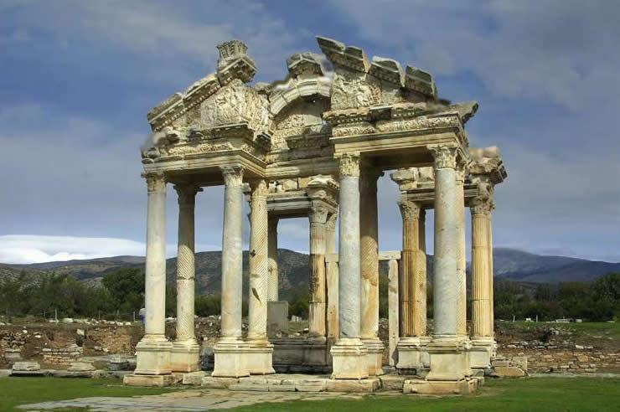
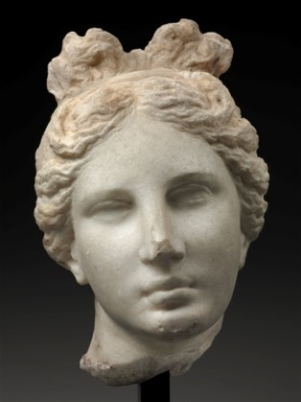
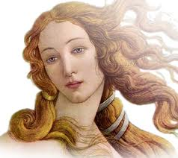
Corinth
Corinth was the site of the famous temple of Aphrodite (Venus), the goddess of love, where there were a thousand “priestesses.”
Priestesses---prostitutes glorified by the cloak of religious worship

Slide 4
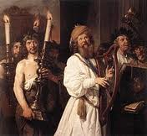
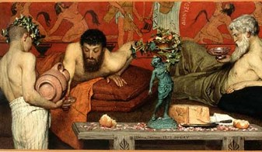
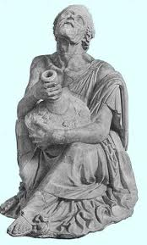
“Corinthianize” – meant to engage in reckless debauchery
Usually portrayed on the stage as drunkards.
Sometimes when one is called a “Corinthian” means he is given totally over to licentious desires.

Slide 5
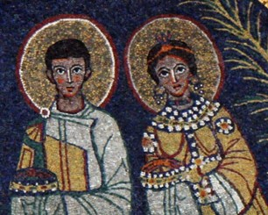
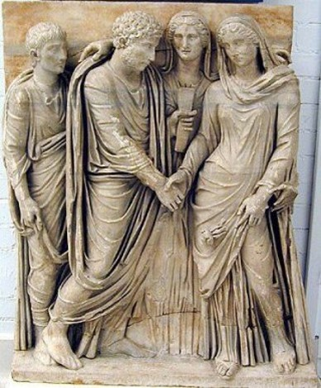
Paul’s stepmother had married a member of the Church in Corinth
She may have been a widow or had been separated from her prior husband.
Such Marriages were forbidden by the Mosaic code under penalty of excommunication (Lev. 18:6-8, 29)
Paul describes the intimacies resulting from such unions as fornication and condemns his Corinthian brethren.

Slide 6
Paul felt that if Church members who sin were left in Church, the sin would spread throughout the church.
“The Church must, therefore, purge out this old leaven of wickedness and replace it with a new influence or leaven of righteousness.”
One bad apple spoils the barrel
1 Corinthians 5:7
(2)

Slide 7
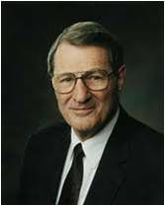
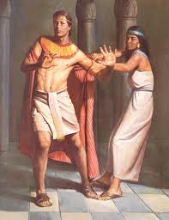
“ …do not company with fornicators—not because you are too good for them, but as C. S. Lewis wrote, because you are not good enough.
Remember that bad situations can wear down even good people. Joseph had both good sense and good legs in fleeing from Potiphar’s wife.”
If we choose to closely associate with those who embrace sin, we can be influenced by their wickedness
(3)

Slide 8
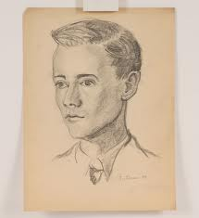
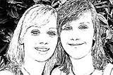
“Everyone needs good friends and true friends. They will be a great strength and blessing to you. They will influence how you think and act, and even help determine the person you will become. They will help you be a better person and will make it easier for you to live the gospel of Jesus Christ…
…Choose friends who share your values so you can strengthen and encourage each other in living high standards.”
(6)

Slide 9
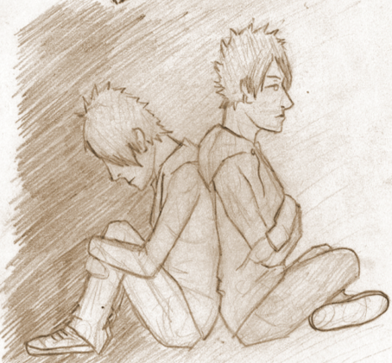
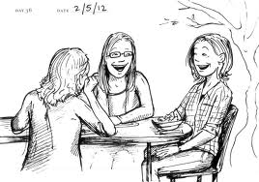
This does not mean we should avoid those who are not members of the Church.
We have a duty to help others through our examples and through proclaiming the gospel.

Slide 10
Disciplinary Measures
As in Paul’s day, Church members today are sometimes excommunicated for sinful behavior. Formal Church councils carry out disciplinary actions, always with the goal of helping and saving the sinner by assisting him or her in the repentance process. (1)
1 Corinthians 5

Slide 11
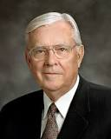
Disciplinary Measures
(See D&C 102)
“In the scriptures, the Lord has given direction concerning Church disciplinary councils. The word council brings to mind a helpful proceeding—one of love and concern, with the salvation and blessing of the transgressor being the foremost consideration.
“Members sometimes ask why Church disciplinary councils are held. The purpose is threefold: to save the soul of the transgressor, to protect the innocent, and to safeguard the Church’s purity, integrity, and good name. …
“… The miracle of the gospel is that we all can repent. Church government calls for Church disciplinary councils. But the Lord’s system also calls for restoration following repentance. Disfellowshipment or excommunication is not the end of the story, unless the member so chooses.”
1 Corinthians 5
(5)

Slide 12
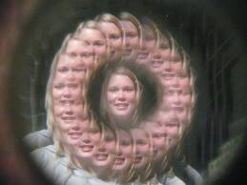
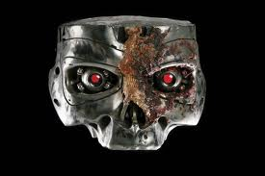
“But them that are without God judgeth. Therefore put away from among yourselves that wicked person.”
“For what have I to do to judge them also that are without? Do not ye judge them that are within?”
"Paul observed that he was not in the business of judging the actions of those 'without,' meaning those outside the Church, but that saints were obliged to evaluate adherence to gospel standards of those 'within,' meaning those inside the Church."
1 Corinthians 5:12-13
(4)

Slide 13
Sinful Behaviors:
Fornicators
Idolaters
Covetous
Extortioners
Railer
Drunkard
Fornication typically refers to consensual sexual in nature between two people not married to each other
"Idolatry not only refers to false pagan worship. Man commits idolatry whenever he honors and reveres a creature in place of God, whether this be gods, or demons (for example satanism), power, pleasure race, ancestors, the state, money etc.
to covet; to desire; to want
Extortion (also called blackmail*, shakedown, outwresting, and exaction) is a criminal offence of unlawfully obtaining money, property, or services from a person, entity, or institution, through coercion.
Railer: anyone is to use insolent or reproachful language toward one.
A person who is habitually drunk
(7)
1 Corinthians 6:9-11

Slide 14
Avoid Legal Disputes With Fellow Saints
Paul counseled the Corinthian Saints to righteously resolve disputes among themselves rather than immediately resorting to civil courts.
One of the causes for division among Church members in Corinth was that Christians were bringing fellow Church members before civil magistrates over trivial civil disputes. Paul counseled Church members to seek to resolve their differences among themselves rather than entering a lawsuit against a fellow member.
Modern-day scripture acknowledges that there are times when it may be appropriate for Church members to pursue solutions to legal problems through the law of the land. (1)
See D&C 42:78–89
1 Corinthians 6:1-8

Slide 15
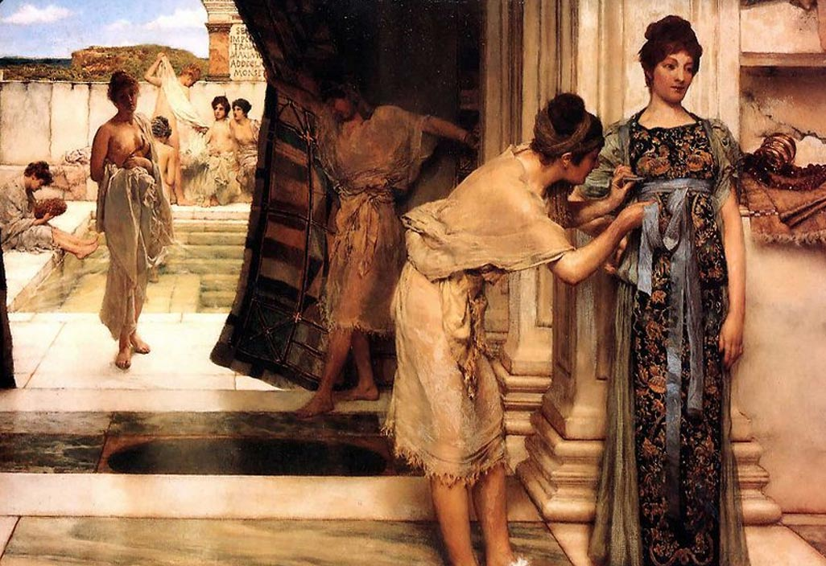
Immorality
“All these things are not lawful unto me, and all these things are not expedient. All things are not lawful for me, therefore I will not be brought under the power of any” JST 1 Corinthians 6:12
While many of the Corinthians apparently believed that the body was made simply for physical pleasures, Paul corrected that view by teaching that our bodies were created to accomplish the Lord’s purposes.
Paul refuted the notion that “all things were lawful” and that sexual immorality is incompatible with a spiritual relationship with Jesus Christ.
Those who commit fornication sin against their own bodies
1 Corinthians 6:12-13

Slide 16
Flee Fornication
Sinful behavior, particularly the act of being “joined to an harlot,” was incompatible with a spiritual relationship or oneness with Jesus Christ.
Church leaders today continue to emphasize the importance of reserving sexual intimacy for marriage:
“Before marriage, do not participate in passionate kissing, lie on top of another person, or touch the private, sacred parts of another person’s body, with or without clothing.
Do not do anything else that arouses sexual feelings.
Do not arouse those emotions in your own body” (8)

Slide 17
Doctrinal Mastery
1 Corinthians 6:19-20
What? know ye not that your body is the temple of the Holy Ghost which is in you, which ye have of God, and ye are not your own?
For ye are bought with a price: therefore glorify God in your body, and in your spirit, which are God’s.

Slide 18
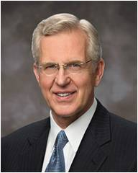
“Those who believe that our bodies are nothing more than the result of evolutionary chance will feel no accountability to God or anyone else for what they do with or to their body.
We who have a witness of the broader reality of premortal, mortal, and postmortal eternity, however, must acknowledge that we have a duty to God with respect to this crowning achievement of His physical creation.
Our bodies are temples of God in which the Spirit can dwell.
(9)

Slide 19
“Acknowledging these truths … , we would certainly not deface our body, as with tattoos; or debilitate it, as with drugs; or defile it, as with fornication, adultery, or immodesty.
… As our body is the instrument of our spirit, it is vital that we care for it as best we can.
We should consecrate its powers to serve and further the work of Christ.”
(9)

Slide 20
“Please, never say: ‘Who does it hurt? Why not a little freedom? I can transgress now and repent later.’ Please don’t be so foolish and so cruel. You cannot with impunity ‘crucify Christ afresh’
‘Flee fornication’ … Why?
Well, for one reason because of the incalculable suffering in both body and spirit endured by the Savior of the world so that we could flee.
We owe Him something for that. Indeed, we owe Him everything for that.”
Because we have been bought with a price through the Atonement of Jesus Christ, our bodies are not our own
(10)

Slide 21
Sources:
Suggested Hymn: #273 Truth Reflects Upon Our Senses Verse 4
Video:
Bodies Are Temples (4:41)
New Testament Institute Student Manual Chapter 38
Bruce R. McConkie (The Mortal Messiah: From Bethlehem to Calvary, 4 vols. [Salt Lake City: Deseret Book Co., 1979-1981], 1: 164.)
Elder Neal A. Maxwell Reasons to Stay Pure March 2003 New Era
(Eldin Ricks, "A Short Glossary of Obsolete Words in the King James New Testament," New Era, Apr. 1977, 11)
Elder M. Russell Ballard (“A Chance to Start Over: Church Disciplinary Councils and the Restoration of Blessings,”Ensign, Sept. 1990, 15, 18).
For the Strength of Youth Pamphlet page 16
Bible Dictionary
(For the Strength of Youth [booklet, 2011], 36).
Elder D. Todd Christofferson (“Reflections on a Consecrated Life,” Ensign or Liahona ,Nov. 2010, 17).
Elder Jeffrey R. Holland (“Personal Purity,” Ensign, Nov. 1998, 76).
Presentation by ©http://fashionsbylynda.com/blog/

Slide 22
Church Disciple: 1 Corinthians 5:13
Church leaders carefully consider many factors before excommunication or any other form of Church discipline takes place. In addition to considering how serious the transgression is, Church leaders consider the various purposes for Church discipline: to help a person repent, to protect those who would be negatively affected by a person’s actions or the spreading of that person’s beliefs, and to protect the integrity of the Church’s teachings (see “Church Discipline” mormonnewsroom.org/articles/church-discipline).
When the Church formally puts away a person who is embracing serious sin, it is called Church discipline. The following entry from True to the Faith: A Gospel Reference explains the process of Church discipline:
“Bishops and branch presidents and stake, mission, and district presidents have a responsibility to help members overcome transgression through repentance. The most serious transgressions, such as serious violations of civil law, spouse abuse, child abuse, adultery, fornication, rape, and incest, often require formal Church discipline. Formal Church discipline may include restriction of Church membership privileges or loss of Church membership.
“The process of formal discipline begins when a presiding priesthood leader calls for a disciplinary council. The purposes of disciplinary councils are to save the souls of transgressors, protect the innocent, and safeguard the purity, integrity, and good name of the Church.
“Church discipline is an inspired process that takes place over a period of time. Through this process and through the Atonement of Jesus Christ, a member can receive forgiveness of sins, regain peace of mind, and gain strength to avoid transgression in the future. Church disciplinary action is not intended to be the end of the process. It is designed to help Heavenly Father’s children continue in their efforts to return to full fellowship and the full blessings of the Church. The desired result is that the person make whatever changes are necessary to repent completely” (“Church Disciplinary Councils,” True to the Faith [2004], 37–38).
Church Disciple:
Church leaders carefully consider many factors before excommunication or any other form of Church discipline takes place. In addition to considering how serious the transgression is, Church leaders consider the various purposes for Church discipline: to help a person repent, to protect those who would be negatively affected by a person’s actions or the spreading of that person’s beliefs, and to protect the integrity of the Church’s teachings (see “Church Discipline” mormonnewsroom.org/articles/church-discipline).
Our Bodies Are Gifts from God: 1 Corinthians 6:20
"'We have been taught . . . to look upon these bodies of ours as gifts from God. We Latter-day Saints do not regard the body as something to be condemned, something to be abhorred. . . . We regard [the body] as a sign of our royal birthright. . . . We recognize the fact that those who kept not their first estate . . . were denied that inestimable blessing.. . . We believe that these bodies . . . may be made, in very truth, the temple of the Holy Ghost. . . .
"'It is peculiar to the theology of the Latter-day Saints that we regard the body as an essential part of the soul. Read your dictionaries, the lexicons, and encyclopedias, and you will find that nowhere, outside of the Church of Jesus Christ, is the solemn and eternal truth taught that the soul of man is the body and the spirit combined.' Elder James E. Talmage (Conference Report, October 1913, p. 117.)
"When we use our eyes to improve our minds and to edify our spirits, we do, indeed glorify God with our body. And when we listen to sublime music and to the spoken word of the Lord's servants, we pay Him honor. When we use our voices to share the gospel, to proclaim the truth, and to comfort and cheer others, we show our gratitude for the price by which our sins were bought. When we adorn our bodies with modest clothing, and when our behavior is also modest, we demonstrate that we are the Lord's children.
"Whenever we eat a well-balanced diet (including brussels sprouts and broccoli because we know they'll be good for us) and when we follow a program of physical exercise we are, in essence, paying tribute to our Father who created us all. When we take care of our eyes and ears and skin and cardiovascular and muscular-skeletal systems, we not only enjoy better health and vigor of mind and body now, but we are also better prepared to 'waste and wear out our lives' in building the Kingdom of God. May each of us take good care of the Lord's property-our bodies-the temples of our spirits." (In Perfect Balance [Spencer J. Condie Salt Lake City: Bookcraft, 1993], 240.)

Slide 23
First Letter of Paul to the Saints at Corinth— Written from Ephesus, ca. Spring, A.D. 57
Why the Church Cannot Fellowship Sinners | 5:1–13
Take Civil Cases to Church Courts | 6:1–11
The Body is Not for Immorality | 6:12–20
1 Corinthians 6:2,3:
“The man who passes through this probation, and is faithful, being redeemed from sin by the blood of Christ, through the ordinances of the gospel, and attains to exaltation in the kingdom of God, is not less but greater than the angels, and if you doubt it, read your Bible, for there it is written that the Saints shall ‘judge angels,’ and also they shall ‘judge the world.’ And why? Because the resurrected, righteous man has progressed beyond the pre-existent or disembodied spirits, and has risen above them, having both spirit and body as Christ has, having gained the victory over death and the grave, and having power over sin and Satan; in fact, having passed from the condition of the angels to that of a God. He possesses keys of power, dominion and glory that the angel does not possess—and cannot possess without gaining them in the same way that he gained them, which will be by passing through the same ordeals and proving equally faithful.” (Smith, Gospel Doctrine, pp. 18–19.)
Life and Teachings of Jesus and His Apostles Chapter 35
In today’s modern world, and in the Church as well, fornication has taken on a more technical meaning than it had during the time of the King James translation. Today it is defined as sexual intercourse between unmarried people. But the word which Paul used is porneia (the root word for our pornography) and meant any extramarital intercourse. Perhaps it might be well to point out here that Corinth had a worldwide reputation in the ancient world for its immorality. It was located very close to two major ports and therefore subject to many of the vices and evils which accompany centers of commerce and trade. In addition, Corinth was the site of the famous temple of Aphrodite (Venus), the goddess of love, where there were a thousand “priestesses.” They were actually nothing more than prostitutes glorified by the cloak of religious worship. Anciently, Corinth’s reputation was such that to “Corinthianize” meant to engage in reckless debauchery, and Corinthians were usually portrayed on the stage as drunkards. Even in modern English a person is sometimes called a Corinthian, meaning that he is given totally over to licentious desires. It is not surprising, then, that in this and the following chapter, Paul sharply condemns immorality and the lusts of the flesh.
“Apparently a member of the Church in Corinth had married his stepmother, either because she was a widow or had been separated from her prior husband. Such marriages were forbidden by the Mosaic code under penalty of excommunication. (Lev. 18:6–8, 29.) Paul endorses the Mosaic prohibition, describes the intimacies resulting from such unions as fornication, condemns his Corinthian brethren for winking at the offense, and directs the excommunication of the offender. If the sinner were left in the Church, Paul reasons, his influence, as leaven, would spread throughout the whole Church. The Church must, therefore, purge out this old leaven of wickedness and replace it with a new influence or leaven of righteousness.” (McConkie, DNTC, 2:335.) Life and Teachings of Jesus and His Apostles Chapter 35
Disputes:
"A 1919 article by Elder James E. Talmage explains the Church's continuing counsel that disputes among members should first be settled by brotherly mediation. If that failed, members disputing one another should go to the bishop's court, then to the high council, and only then to the Council of the Twelve Apostles. The article continues with what now seems to be the Church's last statement of counsel that members should not take their disputes to the civil courts. 'The courts of the Church in no sense assume to oppose or supersede the secular law,' the article states. However, it continues, 'We hold that in matters of difference between brethren, in which no specific infraction of the secular law is involved, and in offenses called `civil` as distinguished from `criminal,` it is as truly unworthy of members of the Church today as it was in Paul's time that `brother goeth to law with brother`; and that it stands to our shame if righteous judgment cannot be rendered among ourselves. (1 Cor. 6:5-7.)'" Elder Dallin H. Oaks (The Lord's Way [Salt Lake City: Deseret Book Co., 1991], 167.)
Fornicators:
"Alternatives to the legal and loving marriage between a man and a woman are helping to unravel the fabric of human society. That fabric, of course, is the family. These so-called alternative lifestyles cannot be accepted as right because they frustrate God's commandment for a life-giving union of male and female within a legal marriage (see Gen. 1:28). If practiced by all adults, these lifestyles would mean the end of family." (James E. Faust and James P. Bell, In the Strength of the Lord: The Life and Teachings of James E. Faust [Salt Lake City: Deseret Book Co., 1999], 264 - 265.)

Slide 24
Christ our Passover is sacrificed for us
1 Corinthians 5:7
Symbolic Elements of the Passover
The paschal lamb was without blemish | Ex. 12:5,21
The lamb was not to have any bone broken | Ex. 12:46, Jn. 19:31-36
The lamb was slaughtered in the evening, the same time as the death of Christ | Ex. 12:6
The lamb was to be eaten. The sacrament represents the same concept | Ex. 12:8; Jn. 6:53-54
Neither the paschal feast nor the sacrament is appropriate for the "stranger" | Ex 12:43; 1 Cor. 11:29
The lamb's blood symbolized the token of the covenant | Ex. 12:13
The ordinance was given for a perpetual memorial | Ex. 13:9; Luke 22:19
The Egyptian firstborn die for sin; God's Firstborn dies for sin | Ex:12:29-30
The blood of the lamb spares Israel for the destroying angel; the blood of the Lamb saves us from sin and death | Ex. 12:13; DC 19:16-19
Great plagues and signs were shown in Egypt before the Passover; great miracles and signs were shown before Christ's crucifixion | Ex. 7-12
The many signs of God's power are rejected among the Egyptians and among the Jews | Ex. 7:4; Matt 11:20-21
There were three days of darkness in Egypt; there were three days of darkness in the Americas and three hours of darkness in Jerusalem after the Crucifixion | Ex. 10:22; 3 Ne. 8:20-23; Luke 23:44
Moses would deliver the house of Israel from physical bondage; Christ would hereby deliver the house of Israel from spiritual bondage.

Slide 25
10 Warnings—How to Stay Pure
6. Where mistakes have been made, remember we have the glorious gospel of repentance. The miracle of forgiveness awaits all who are seriously sorry and who will follow the necessary steps. Bear in mind, however, these are situations in which the soul must first be scalded by shame, for only with real cleansing can real healing occur. But the road of repentance is really there.
1. Resist the rhetoric of the world, and you will find that, if you stand fast, so will others—some surprisingly. As Paul said, “Where the Spirit of the Lord is, there is liberty” (2 Cor. 3:17). Neither women nor men can be truly free if they behave so as to lose the Spirit.
7. Where the impulse to do wrong appears, act against that impulse while the impulse is still weak and while the will is still strong. Dalliance merely means that the will weakens and the impulse grows stronger. There is a Parkinson’s law of temptation: Temptation expands so as to fill the time and space available to it. Keep “anxiously engaged” (D&C 58:27) in doing good things.
2. Since you don’t let people come in and walk around in your house with muddy feet, do not let them walk through your minds with muddy feet.
3. Build your strong personal link in a chain of chastity and family fidelity, so it can proceed forth from grandparents to parents to children and then on to their posterity. To be so welded together is, of course, to be drawn together in the strongest kind of bond and is to affirm, by your actions, that you believe in the commandments in spite of what is going on in the world around you..
8. Because our Church’s behavioral standards are different, connect that fact with what several prophets have told us about how we must come to despise the shame of the world. We must not hold the people of the world in contempt; we must love them. But we must come to have contempt for the shame of the world, because it matters so little in the end.
4. Do not company with fornicators—not because you are too good for them but because you are not good enough. Remember that bad situations can wear down even good people. Joseph had both good sense and good legs in fleeing from Potiphar’s wife.
9. Remember, those who are in error must not call the cadence for your life, for those who boast of their sexual conquests are only boasting of that which has conquered them. We may pity behavioral clones, but we do not envy them.
5. Along with the traditional, predatory, selfish male there is now the predatory, selfish female. Both, driven by appetite, have a false sense of being free—but it is, alas, the same sort of empty freedom Cain possessed (after he had broken a commandment by slaying Abel) when, ironically, he said, “I am free” (Moses 5:33).
10. … in your concern for justice, deal justly with yourselves! There is a very telling verse in the Book of Mormon that describes an ancient political leader with these words: “And he did do justice unto the people, but not unto himself because of his many whoredoms” (Ether 10:11 ).
Elder Neal A. Maxwell Reasons to Stay Pure March 2003 New Era Also found in (“The Stern but Sweet Seventh Commandment,” in Morality [1992], 29).

