Slide 1
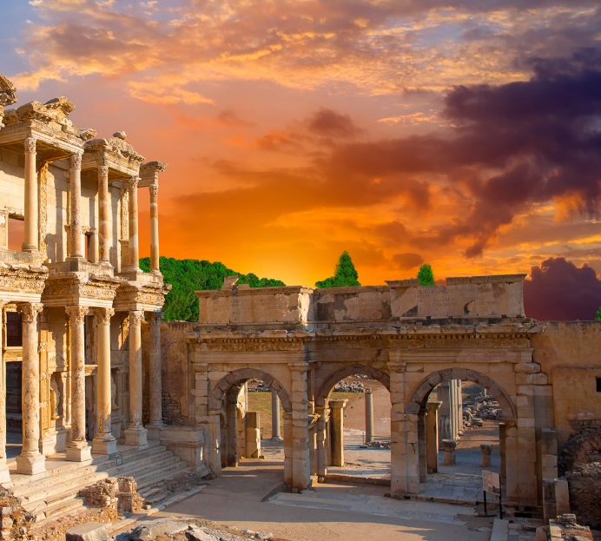
Lesson 106
Marriage-Ordained of God
1 Corinthians 7-8

Slide 2
False Beliefs
OR
It is acceptable to participate in physical intimacy with anyone.
It is never acceptable to participate in physical intimacy, not even in marriage.
The Corinthian Saints had questions about when and if physical intimacy was appropriate.
These are extreme views that vary from God’s standard for physical intimacy.
1 Corinthians 7:1-3

Slide 3
Avoid Fornication
Fornication = sexual relations outside of marriage
In the world today, Satan has led many people to believe that sexual intimacy outside of marriage is acceptable. But in God's sight, it is a serious sin.
It is an abuse of the power He has given us to create life.
1 Corinthians 7:2
(4)

Slide 4
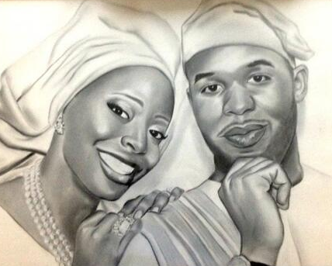
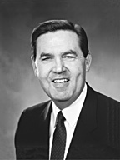
“One who uses the God-given body of another without divine sanction abuses the very soul of that individual, abuses the central purpose and processes of life.”
(5)

Slide 5
Due Benevolence
The love and intimacy expressed between husband and wife
“Physical intimacy between husband and wife is beautiful and sacred. It is ordained of God for the creation of children and for the expression of love between husband and wife. God has commanded that sexual intimacy be reserved for marriage.”
1 Corinthians 7:3
(2)

Slide 6
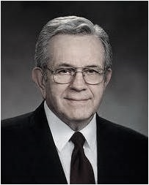
“The power of procreation is not an incidental part of the plan; it is the plan of happiness; it is the key to happiness.
“The desire to mate in humankind is constant and very strong.
Our happiness in mortal life, our joy and exaltation are dependent upon how we respond to these persistent, compelling physical desires.”
(3)

Slide 7
Being Married
What are the purposes of physical intimacy between husband and wife?
Why is procreation—the ability to create mortal life—so important in Heavenly Father’s plan?
CHITRAMSUDHEER
1 Corinthians 7:3

Slide 8
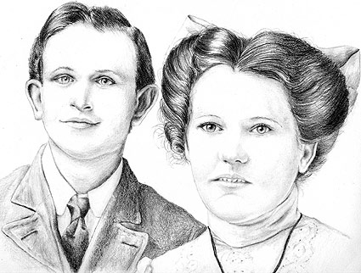
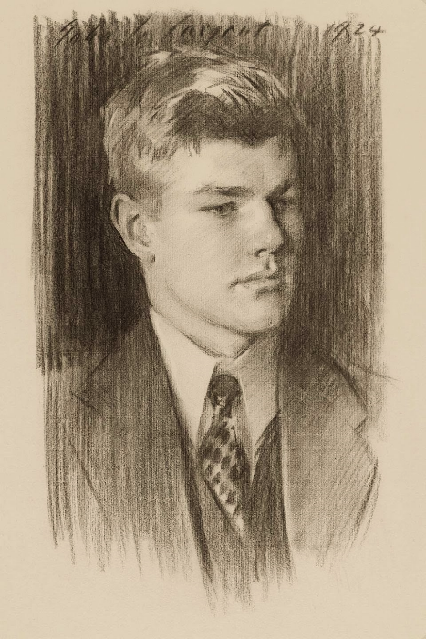
Paul Taught:
Spouses should not generally withhold marital affection from each other.
Widowed and divorced members of the Church were permitted to remarry if they chose.
Church members should “abide with God” whatever their circumstances.
David Malan
Harold Erving Pratt
Paul also discouraged divorce.
1 Corinthians 7:4-24

Slide 9
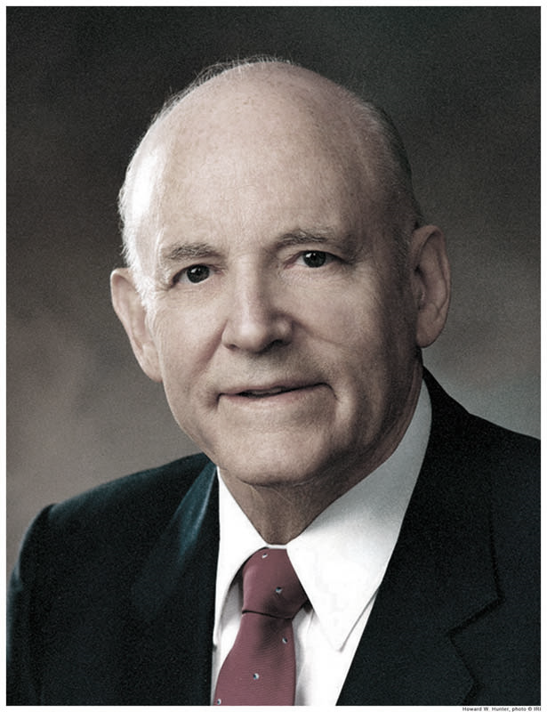
“Keep yourselves above any domineering or unworthy behavior in the tender, intimate relationship between husband and wife.
Because marriage is ordained of God, the intimate relationship between husbands and wives is good and honorable in the eyes of God….
“Tenderness and respect—never selfishness—must be the guiding principles in the intimate relationship between husband and wife.
Each partner must be considerate and sensitive to the other’s needs and desires”
(6)
1 Corinthians 7:5

Slide 10
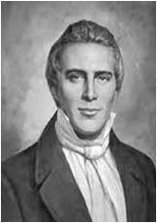
Better to Marry and Burn
The meaning of Paul’s counsel is not entirely clear. The Greek word which the King James translators have rendered burn is a passive infinitive used to convey the idea of being inflamed with passion, lust, or anger.
The Prophet Joseph Smith’s inspired account is even more explicit than the King James: “But if they cannot abide, let them marry; for it is better to marry than that any should commit sin.”
(1)
1 Corinthians 7:9

Slide 11
Unbelieving Spouses
Paul counseled members who were married to unbelievers not to divorce their spouses on the grounds of their unbelief, but to remain married and live as faithful followers of Christ.
In doing so, a marriage partner can become the means of sanctifying the unbelieving spouse.
Read D&C 74
(1)
1 Corinthians 7:12-19

Slide 12
Children Are Holy
The Jews had a tradition that little children were unholy, but the Lord declared, “Little children are holy, being sanctified through the atonement of Jesus Christ,” and He taught that male children need not be circumcised as required by the law of Moses.
But little children are holy, being sanctified through the atonement of Jesus Christ; and this is what the scriptures mean. D&C 74:7
(1)
1 Corinthians 7:12-19

Slide 13
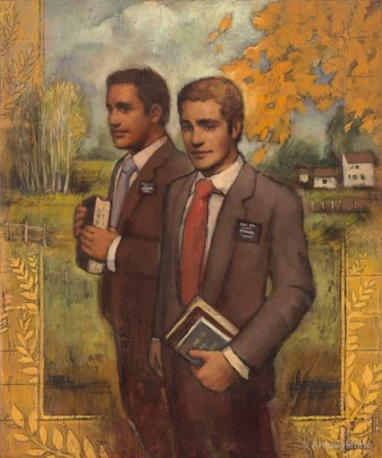
Called to the Ministry
Paul explained that their circumstances allowed them to serve the Lord “without distraction”, or without temporal concerns related to providing for a family.
However, he did not forbid them to marry.
Annie Henrie
1 Corinthians 7:35

Slide 14
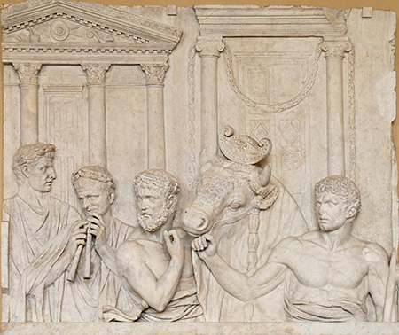
Acceptable Food to Eat
Church members in Corinth wondered if it was acceptable for them to eat food that had been offered to idols, or pagan gods.
A Roman marble relief depicting the preparation of an animal sacrifice; early second century
1 Corinthians 8:1-6

Slide 15
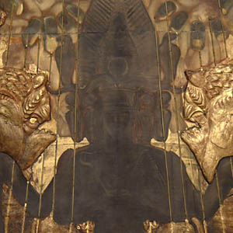
“He [Paul] replies that in theory it is completely immaterial whether the saints eat such meat or not, because idols are not true gods, and there is actually no religious significance to the pseudo-sacrifices one way or the other.
But, he reasons, in practice it may be wise not to eat this meat, since such a course might cause those who are weak in the faith to assume there was virtue and benefit in the sacrifices themselves and therefore to be led astray” (7)
The greater concern was to avoid doing anything that might weaken the faith of others, unintentionally leading them into sin.
1 Corinthians 8:1-6

Slide 16
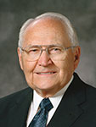
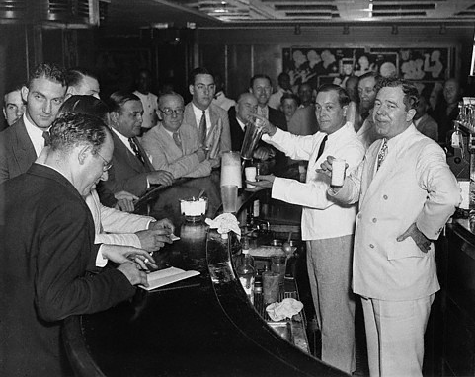
“I spent my career in the department store business. Because I was part of a management team, it was important for me to interact socially with local business organizations.
The meetings with most of these organizations always started with a cocktail hour [during which alcoholic drinks are traditionally served]. It was a time to mix and get acquainted with the men who belonged to the organization. I have always felt uncomfortable in these social hours.
At first I started asking for a lemon-lime soda. I soon discovered that lemon-lime soda looks like many of the other drinks. I could not build the impression I was a nondrinker with a clear soda in my hands”
(8)

Slide 17
“I decided I had to have a drink that would clearly mark me as a nondrinker.
The bartender had never had such a request. He went into the kitchen and found a glass of milk for me.
Now I had a drink that looked very different from the alcoholic beverages the others were drinking. …
“Milk became my drink of choice at the cocktail hours. It soon became common knowledge I was a Mormon. The respect I received really surprised me, as did an interesting event that started to occur. Others soon joined me in a pure milk cocktail!”
(8)

Slide 18
Rather Than offend
To stumble spiritually or lose faith
“Wherefore, if meat make my brother to offend I will eat no flesh while the world standeth, lest I make my brother to offend.”
What should we do to be better examples to our friends, member or non-member?
1 Corinthians 8:7-13

Slide 19
Weak-weakness in understanding
Paul counseled:
If a Church member who was weaker in faith saw another member eat at a dining hall connected to a local pagan temple, the member of weaker faith may also believe that nothing was wrong with idol worship.
How do the nonmembers relate to the unrighteous actions of members of the church?
How might it appear for a member of the church to see another member eating or drinking something that is breaking the commandments?
What things might a member do that would weaken a nonmember from learning the gospel?

Slide 20
What can we do as members to be good examples?
In our Homes?
In the church?
Among our friends?
In our place of work?
With our technology connections?

Slide 21
Sources:
Suggested Hymn: #300 Families Can Be Together Forever
Video:
Law of Chastity (2:04)
“Be an Example Like She Was” (1:26)
New Testament Institute Student Manual Chapter 38
For the Strength of Youth, 35
President Boyd K. Packer (“The Plan of Happiness,” Ensign or Liahona, May 2015, 26)
Chastity lds.topics.
Elder Jeffrey R. Holland Personal Purity Jan. 1999 Liahona
President Howard W. Hunter (“Being a Righteous Husband and Father,” Ensign, Nov. 1994, 51)
Elder Bruce R. McConkie (Doctrinal New Testament Commentary, 3 vols. [1966–73], 2:348).
Elder L. Tom Perry (“The Tradition of a Balanced, Righteous Life,” Ensign, Aug. 2011, 48–49).
Presentation by ©http://fashionsbylynda.com/blog/

Slide 22
First Letter of Paul to the Saints at Corinth— Written from Ephesus, ca. Spring, A.D. 57
Marriage Is Ordained of God | 7:1–24
Missionaries—Married or Single? | 7:25–40
Gods Many and Lords Many | 8:1–13
Life and Teachings of Jesus and His Apostles Chapter 35
Married Couples 1 Corinthian 7:1-3:
Human intimacy is reserved for a married couple because it is the ultimate symbol of total union, a totality and a union ordained and defined by God. From the Garden of Eden onward, marriage was intended to mean the complete merger of a man and a woman—their hearts, hopes, lives, love, family, future, everything. Adam said of Eve that she was bone of his bones and flesh of his flesh, and that they were to be “one flesh” in their life together.¹³ This is a union of such completeness that we use the word seal to convey its eternal promise. The Prophet Joseph Smith once said we perhaps could render such a sacred bond as being “welded”¹ one to another.
(5)
Stumbling Block 1 Corinthians 8:9:
"Another important aspect to providing a nurturing environment for new members is to give them a sense of safety, love, and acceptance when they come to church. In particular, we must take care to avoid offending others even if this causes us discomfort. Jesus taught that it would be better to perish than to offend one of the 'little ones,' a caution that can also apply to new converts (see Matt. 18:14; Mark 9:42; Luke 17:2). The Apostle Paul indicates that new converts, who generally lack in gospel knowledge, can be offended by the otherwise harmless actions of those with greater knowledge, leading weaker new members to fall away. He taught that we should avoid such words and actions, even if our information is correct (see 1 Cor. 8:8-13). For example, it might be correct to point out that a new convert has made a mistake, but to do so publicly or in a way that causes unnecessary pain may harm a fragile, young soul. The way a new member prays or dresses or speaks may be different from our traditions or teachings, but correcting such differences should be undertaken only by a loving leader if done at all and only with the benefit and needs of the new member utmost in mind." David E. Sorenson ("Why Baptism Is Not Enough," Ensign, Apr. 1999, 20)

Slide 23
Helpful Information about Corinthians 7
First Corinthians 7 has been the source of more confusion regarding the doctrine of marriage than any other chapter in the Bible. Hereby, celibacy has been touted as a state of higher spiritual attainment than marriage, and sexual relations-even between a man and wife-have been considered sinful. Neither conclusion is true, nor can either conclusion be fairly drawn if one understands the context of Paul's comments.
By way of explanation, let's first take note that Joseph Smith made more corrections to this chapter than to any other chapter written by Paul save one (Romans 7). Second, Paul specifically addresses questions put to him by the Corinthian saints in a previous letter (v. 1); so some of his advice is specific to them and cannot be universally applied to all saints of all times. Third, Paul expressly states that his advice is his own opinion and not the word of the Lord (v. 25). Paul is only speaking the word of the Lord in the following seven verses: 1-5, 10, and 11 (see v. 6, 12, and 25); the rest is given as advice from 'one that hath obtained mercy of the Lord' (v. 25).
The point is not to discount what Paul has said but to place it in its appropriate historical context. At the time, Paul was writing as a single apostle and missionary of the Lord. In effect, he is married to his work and his children are his converts (1 Tim. 1:2; 2 Tim. 1:2). Therefore, when he says 'I would that all men were even as I' (meaning unmarried), he says that in the context of performing missionary work with its rigors of travel and perpetual persecution. Hence, no latter-day saint should place more emphasis on these comments by Paul than on Joseph Smith's heavenly teachings on the new and everlasting covenant of marriage or the First Presidency's proclamation on the family (1995).
"The Joseph Smith Translation makes many clarifications and corrections to the records about Paul, but two of the most useful deal with Paul's teachings about marriage (1 Cor. 7) and about how the gospel of Jesus Christ changed his life (Rom. 7:14-25). The popular myth that Paul was opposed to marriage is corrected by the Joseph Smith Translation so that his dictum that there is an advantage to remaining unmarried is limited to those on temporary mission assignments. This practice was advocated by Paul for efficiency in the temporary ministry, and is similar to the practice of The Church of Jesus Christ of Latter-day Saints today in calling young men and women, unmarried, to serve missions, and refrain from marriage while in the mission field. Paul's teachings against marriage were not for all Church members, any more than the policy for young missionaries to remain unmarried today is a permanent rejection of marriage. The Joseph Smith Translation restores the proper context." (Robert J. Matthews, Behold the Messiah [Salt Lake City: Bookcraft, 1994], 341.)

Slide 24
Was Paul Married? The Life and Teachings of Jesus and His Apostles Chapter 35
It is possible that Paul, who had once been married, was a widower at the time of his writing of First Corinthians. His heart was thoroughly set on missionary work, and thus he might have chosen not to remarry. Hence his counsel to those in similar circumstances was “I would that all men were even as I myself.”
Aside from the fact that marriage is an eternal command of God, which Paul, an apostle of Jesus Christ, would know as well as anyone, there are some other compelling reasons why the answer to the question Was Paul married? should be yes.
In the first place, Paul’s writings indicate a positive attitude toward marriage. Some of the finest counsel given in scripture on the subject comes to us from Paul (Ephesians 5:21–6:4; Colossians 3:8–21). It would be presumptive indeed for Paul to give such counsel if he had not obeyed the law of God himself.
In 1 Corinthians 9:5 Paul argues that apostles have as much right to marry as anyone else, “Have we not power to lead about a sister, a wife, as well as other apostles, and as the brethren of the Lord, and Cephas?” But marriage is more than a right; it is a solemn duty. Hence Paul writes in 1 Corinthians 11:11: “Nevertheless neither is the man without the woman, neither the woman without the man, in the Lord.” The need for all to marry if they would find approval “in the Lord” is thus undisputed.
Faithful Jews regarded marriage as a religious obligation and a condition of extraordinary importance. It was the custom for Jewish men and women to marry at an early age, generally between sixteen and eighteen but sometimes as early as fourteen. Paul, a strict Pharisee (Acts 26:5) was “taught according to the perfect manner of the law of the fathers, and was zealous toward God” (Acts 22:3), as faithful Jews were enjoined to be. Thus “there would seem to be no good reason … why Paul, a trained and ardent Pharisee, should fail to honor an obligation esteemed so sacred in the eyes of his people.” (Sperry, Paul’s Life and Letters, p. 9.) When a list of 613 precepts contained in the law of Moses was first drawn up, marriage was listed as number one. If Paul “lived unmarried as a Jerusalem Pharisee, his case was entirely exceptional.” (Farrar, The Life and Work of St. Paul, p. 46.)
Most scholars acknowledge that Paul was either a member of the Jewish ruling body, the Sanhedrin, or a close associate thereof (Acts 8:3; 9:1, 2; 22:5; 26:10). If he were indeed a member of the Sanhedrin, Paul would have been expected to be in compliance with the special requirements for membership in the body, one of which was marriage. If he were not a member, Paul would still, as an official representative of the ruling group, be expected to be in harmony with all accepted Jewish customs. Only such a condition would prevent his being charged with advocating obedience to laws with which he himself was not in strict compliance.
“For I would that all men were even as I myself. … I say therefore to the unmarried and widows, It is good for them if they abide even as I.” Elder Spencer W. Kimball has commented on this passage as follows: “Taking such statements in conjunction with others [Paul] made it is clear that he is not talking about celibacy, but is urging the normal and controlled sex living in marriage and total continence outside marriage. (There is no real evidence that Paul was never married, as some students claim, and there are in fact indications to the contrary.)” (Miracle of Forgiveness, p. 64.)

