Slide 1
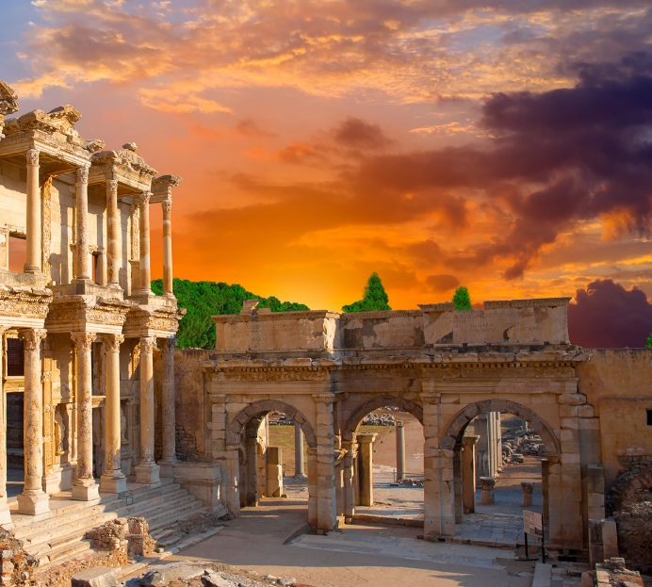
Lesson 107
Temporal Needs
1 Corinthians 9-10

Slide 2
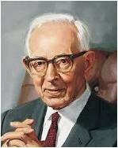
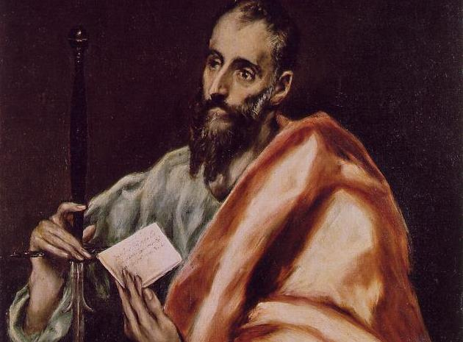
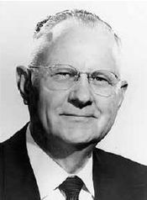
Paul Was Ordained
“We are extremely lacking in information in relation to many important details that failed to seep through the ages to our day, and we are left in darkness to know when and where Paul was ordained. …
“When he was ordained, Saul became a great defender of the faith, a dynamic teacher of righteousness, and a fearless preacher to the world.” (3)
“… The fact may be correctly surmised that Paul did find time to mingle with his brethren [of the Twelve] and that through the divine inspiration the apostleship was conferred on him by their action. …
We have no reason to believe that Paul received his ordination independent of the action of the other apostles.” (2)
1 Corinthians 9:1

Slide 3
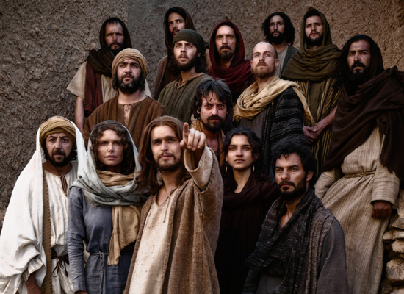
Paul Is Criticized
Women Traveling with the Apostles
Paul may be responding to criticisms that he had traveled at times with a sister missionary in his group. In his response, we learn that the other apostles, including the Lord's half-brothers and Peter, often performed missionary labors in company with their wives or other sister missionaries.
Paul saw nothing wrong with this and used it as his defense in this particular case. (4)
1 Corinthians 9:3-5

Slide 4
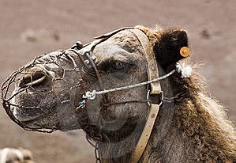
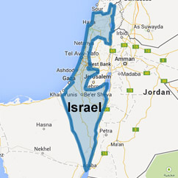
Muzzle
A muzzle was a device to keep an animal from eating or biting
"Paul was frequently criticized by his enemies, who accused him of living on the liberality of the Saints, taking food and money of them for his own advantage.
It was probably these accusations that caused him to emphasize so many times that he labored with his hands for his support." (5)
Paul's reasoning in referring to this passage from Deut. 25:4 is as follows:
If the Lord was concerned enough to command the House of Israel not to place unnecessary restrictions upon their beasts of burden, then the Corinthians should not place an unnecessary burden, or muzzle, on Paul.
1 Corinthians 9:9-11

Slide 5
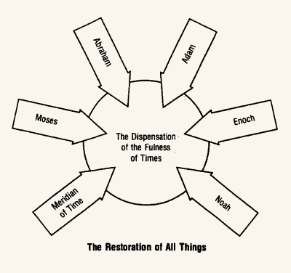
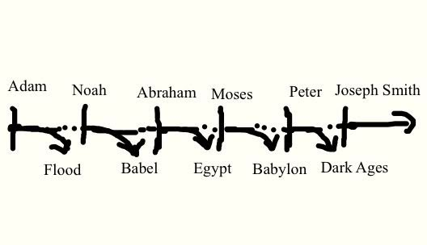
Gospel Dispensations
"Gospel dispensations are those periods of time during which the Lord reveals or dispenses the doctrines of the gospel to men so that reliance need not be placed on past ages for this saving knowledge.
If the priesthood and keys have not come down by proper descent from a previous dispensation, these also must necessarily be conferred upon men again by the opening of the heavens.
1 Corinthians 9:17
(6)

Slide 6
All Things to All Men
Paul was committed to sharing the gospel of Jesus Christ with all people, regardless of whether they were Jews or Gentiles, and he willingly adapted his behavior in order to minister more effectively to people from various cultural backgrounds. (1)
”Paul adapted himself to the conditions and circumstances of all classes of people, as a means of getting them to pay attention to his teachings and testimony.” (6)
1 Corinthians 9::20-23

Slide 7
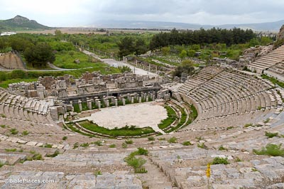
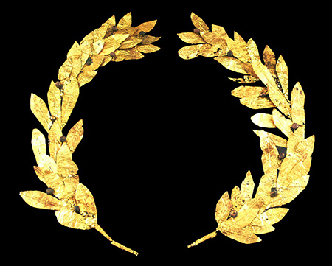
Athletic Contest
Greeks and Romans placed great importance on athletic contests. The ancient Olympic games were highly anticipated every four years throughout the Mediterranean area.
In Corinth, the Isthmian games were held every two years. Athletes competed for honor and for the winner’s crown made of natural olive, laurel, or pine branches.
Paul was probably alluding to the strict diets and training regimens that athletes adopted as they trained for competition.
1 Corinthians 9::24
(1)

Slide 8
Incorruptible Crown
Eternal Life
To obtain eternal life, we must learn to exercise self-mastery in all things
Paul suggested that followers of Jesus Christ should strive for victory in a similar manner, working to overcome temptation and achieve spiritual self-mastery.
Saints run a race not against others, but against sin and the challenges of mortal life.
And the reward is not a “corruptible” or perishable crown, but a crown of eternal life that lasts forever
1 Corinthians 9::24-25
(1)

Slide 9
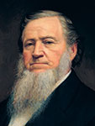
“You cannot inherit eternal life, unless your appetites are brought in subjection to the spirit that lives within you, that spirit which our Father in Heaven gave.
I mean the Father of your spirits, of those spirits which he has put into these tabernacles.
The tabernacles must be brought in subjection to the spirit perfectly, or your bodies cannot be raised to inherit eternal life. … Seek diligently, until you bring all into subjection to the law of Christ. …
“… If the spirit yields to the body, [the spirit] becomes corrupt; but if the body yields to the spirit [the body] becomes pure and holy”
(7)

Slide 10
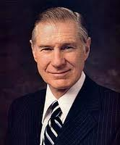
Invincible
“One of the great myths in life is when [individuals] think they are invincible. Too many think that they are [made] of steel, strong enough to withstand any temptation. They delude themselves into thinking, ‘It cannot happen to me.”
1 Corinthians 10:1-5
(8)

Slide 11
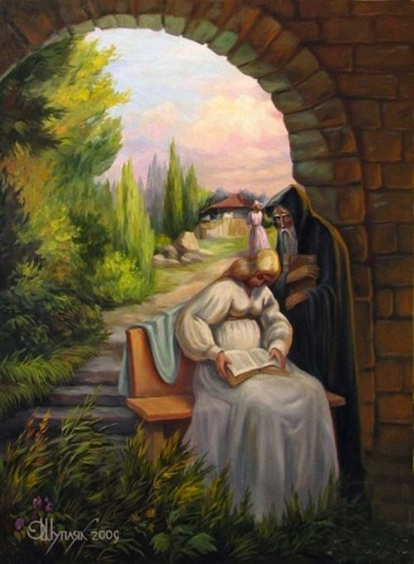
History of the Israelites
Paul referred to examples from Israelite history to warn the Corinthian Saints about temptation and sin.
Oleg Shuplyak
1 Corinthians 10:1-5
(8)

Slide 12
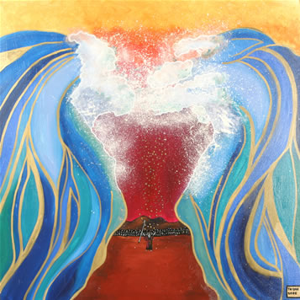
The ‘Spiritual Rock’
“[Paul] is saying that even as Israel, when they passed through the Red Sea, fled from the worldliness of Egypt, so their Christian descendants, through baptism, are to forsake the lusts of the flesh and live godly lives.”
1 Corinthians 10:1-5
(6)

Slide 13
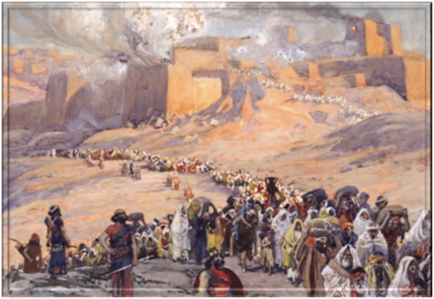
Ensamples
Paul wanted to warn the Corinthians Saints so they would avoid repeating the sins of the ancient Israelites
Paul also reassured his readers that if they would rely on the Lord, they would not be tempted beyond their strength to endure
1 Corinthians 10:6-11
(1)

Slide 14
Able To Withstand
There hath no temptation taken you but such as is common to man: but God is faithful, who will not suffer you to be tempted above that ye are able; but will with the temptation also make a way to escape, that ye may be able to bear it.
God will provide a way for us to escape temptation, but we must choose to separate ourselves from the temptation
1 Corinthians 10:13

Slide 15
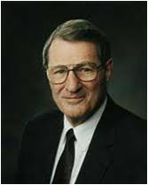
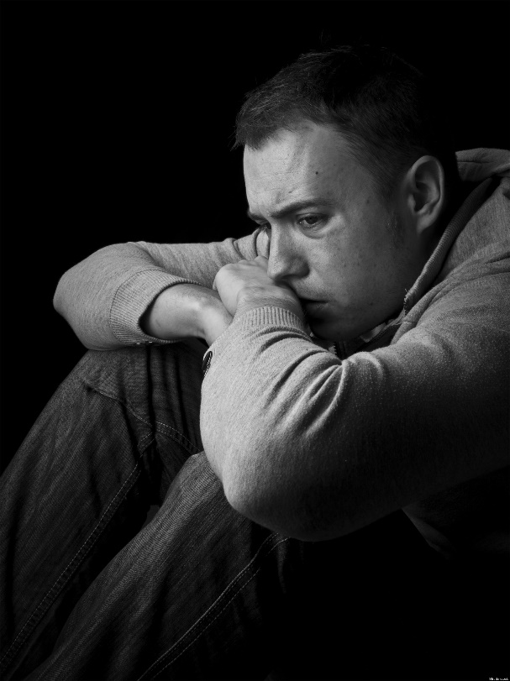
"...it is not uncommon for individuals to feel that the temptations and the trials they face are simply too much for them to manage.
Happily, we can feel overwhelmed and yet not be overwhelmed, but self-pity adds to our vulnerability. Paul gave us, therefore, a much-needed promise when he wrote this to the saints at Corinth:
"Certain temptations are common to those who come to this earth. It is our task to deal with these common temptations in an uncommon manner. The Lord has promised to succor us in our temptations, reminding us that He 'knoweth the weakness of man and how to succor them who are tempted’.
He truly knows our infirmities firsthand because He has actually borne them. “
1 Corinthians 10:6-11
(9)

Slide 16
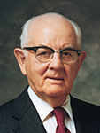
“Right decisions are easiest to make when we make them well in advance, having ultimate objectives in mind; this saves a lot of anguish [during moments of decision], when we’re tired and sorely tempted. …
“Develop discipline of self so that, more and more, you do not have to decide and redecide what you will do when you are confronted with the same temptation time and time again. You only need to decide some things once! …
“The time to quit evil ways is before they start. The secret of the good life is in protection and prevention. Those who yield to evil are usually those who have placed themselves in a vulnerable position.”
(10)

Slide 17
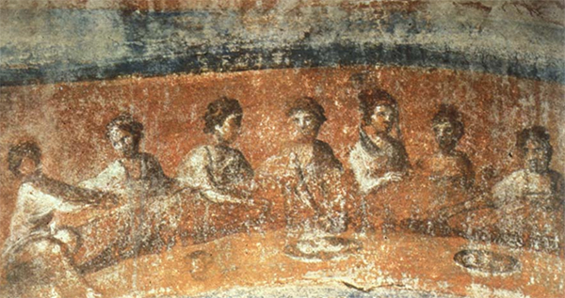
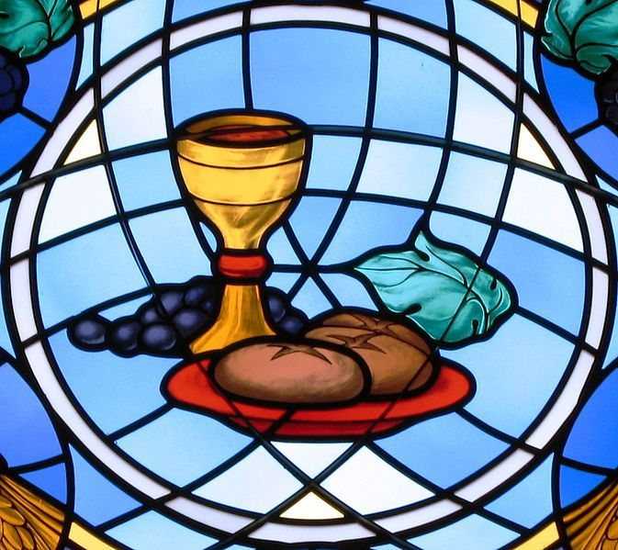
Cup and Bread of Communion
“partakers of that one bread”
In the culture of the ancient Near East, dining together at the same table was an expression of unity, peace, and friendship.
If there had been problems or disagreements among individuals before they sat down to eat, these were resolved, and all parties were reconciled.
Communion = fellowship, partnership, sharing
Sacrament symbol = a partnership with the Savior, Jesus Christ
1 Corinthians 10:16-21
(1)

Slide 18
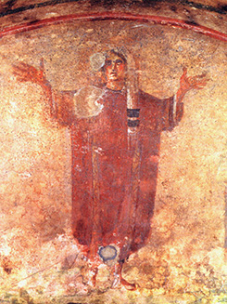
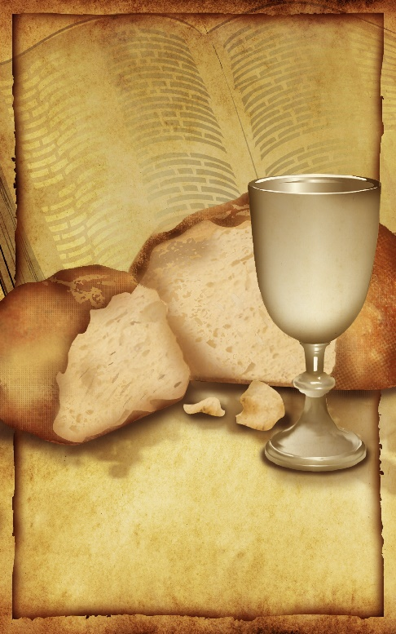
To Reconcile With Him
Partakers of the Lord’s Table
When members partake of “one bread” (loaf) during the ordinance of the sacrament, they affirm oneness or unity not only with Christ but also with one another.
They are “partakers of the Lord’s table” and have the opportunity to be reconciled with Christ and enjoy greater communion with Him.
Third century A.D. painting from the Priscilla Catacomb in Rome depicts a Christian woman praying according to custom—with her head covered with her arms lifted up
1 Corinthians 10:16-21
(1)

Slide 19
Sources:
Suggested Hymn: #243 Let Us All Press On
Video:
Staying Spiritually Fit (3:31
Ability To Bear (1:17
New Testament Institute Student Manual Chapter 38
President Joseph Fielding Smith, Answers to Gospel Questions, 4:99–100. Gospel Doctrine, p. 272.)
Delbert L. Stapley Teachings of the Apostle Paul October 1976 Gen Conf.
Gospeldoctrine.com
Robert J. Matthews, Behold the Messiah [Salt Lake City: Bookcraft, 1994], 336
Bruce R. McConkie (Mormon Doctrine, 2d ed. [Salt Lake City: Bookcraft, 1966], 201.)
Doctrinal New Testament Commentary, 2:353, 2:355)).
President Brigham Young (Teachings of Presidents of the Church: Brigham Young [1997], 204–5).
Pres. James E. Faust (“It Can’t Happen to Me,” Ensign, May 2002, 46).
Elder Neal A. Maxwell (We Will Prove Them Herewith [Salt Lake City: Deseret Book Co., 1982], 41.)
Teachings of Presidents of the Church: Spencer W. Kimball [2006], 108–9
Presentation by ©http://fashionsbylynda.com/blog/

Slide 20
First Letter of Paul to the Saints at Corinth— Written from Ephesus, ca. Spring, A.D. 57
Paul Rejoices in Christian Freedom | 9:1–12
Gospel Preached Without Cost | 9:13–18
Paul: All Things to All Men | 9:19–27
Christ Is the God of Israel | 10:1–4
Ancient Israel Rebelled Against Christ | 10:5–15
The Sacrament vs. Idolatry | 10:16–33
Paul Ordained 1 Corinthians 9:1:
Many have not understood that Saul joined the Church in addition to gaining a testimony of Christ, and was consequently obedient to church authorities as well as to the Savior; many mistakenly assume that the two allegiances can conflict. These people think that Saul was independent from the church and had sufficient authority from his vision to perform his new duties.
Instead, we see that after being healed, Saul submitted to baptism (see Acts 9:18), later went to Tarsus as commanded by “the brethren” (see Acts 9:30), went to Antioch under the direction of Barnabas (see Acts 11:26), and went on his missionary journey after being set apart and commissioned by the church authorities.
Although Saul represented the gentile churches as their leader in the Jerusalem Council.
The New Testament gives no record of Paul’s ordination, yet there are strong indications that he received his office at the end of his second journey. Although Barnabas and Paul are called apostles in Acts 14:4 and Acts 14:14 the term there likely refers to a missionary calling, since they were set apart by men who were not members of the Twelve. In his two letters to the Thessalonian saints, written from Corinth during the second journey, Paul does not refer to himself as an apostle in the introduction. Beginning with the correspondence of the third journey, however, Paul begins his epistles with “Paul, an Apostle of Jesus Christ” or some similarly worded phrase. (The exceptions are Philippians and Philemon, written from Rome during Paul’s imprisonment.) Further evidence may be seen in the Corinthian letters, written during the third journey, in which Paul defends his apostolic calling to a church that may still remember him as not being an apostle during his 18-month Stay in the second journey. Paul: The Long Road from Damascus
By C. Wilfred Griggs Sept. 1975 Ensign
Life and Teachings of Jesus and His Apostles Chapter 35
Contention: 1 Corinthians:
Many years ago I read the following Associated Press dispatch which appeared in the newspaper: An elderly man disclosed at the funeral of his brother, with whom he had shared, from early manhood, a small, one-room cabin near Canisteo, New York, that following a quarrel, they had divided the room in half with a chalk line, and neither had crossed the line or spoken a word to the other since that day—62 years before. Just think of the consequence of that anger. What a tragedy!
May we make a conscious decision, each time such a decision must be made, to refrain from anger and to leave unsaid the harsh and hurtful things we may be tempted to say.
President Thomas S. Monson School Thy Feelings, Oh My Brother Oct. 2009 Gen. Conf.
“Gospel Dispensation 1 Corinthians 9:17:
Since the gospel, 'the power of God unto salvation' (Rom. 1:16), was first revealed to Adam, we speak of the Adamic dispensation as the first from the standpoint of time. (Moses 5:57-59.) Thereafter, the saving knowledge and powers of the gospel, as Paul expressed it, were 'revealed from faith to faith' (Rom. 1:17), that is from era of faith to era of faith or from dispensation to dispensation...
"When we speak of the great gospel dispensations, we generally have in mind those given to Adam, Enoch (Moses 6; 7), Noah (Moses 8), Abraham (Abra. 2:6-11; Gal. 3:6-8, 18) Moses (D. & C. 84:17-28); the apostles in the meridian of time (Matt. 16:18-19; 18:18; D. & C. 27:12-13; 128:20), and to Joseph Smith and his associates, (D. & C. 112:14-32.) The keys and powers exercised by the Lord's prophets in each of these ancient dispensations have been conferred upon men in this final dispensation, for in 'the fulness of times,' the Lord says, 'I will gather together in one all things, both which are in heaven, and which are on earth.' (D. & C. 27:13; Eph. 1:10.)" Bruce R. McConkie (Mormon Doctrine, 2d ed. [Salt Lake City: Bookcraft, 1966], 201.)

Slide 21
Athletic Contests 1 Corinthians 9:24-27:
"Among the Greeks the rage for theatrical exhibitions was such that every city of any size possessed its theatre and stadium. At Ephesus an annual contest was held in honor of Diana. It is probable that St. Paul was present when these games were proceeding. A direct reference to the exhibitions that took place on such occasions is made in 1 Cor. 15:32; St. Paul's epistles abound with allusions to the Greek contests, borrowed probably from the Isthmian games, at which he may well have been present during his first visit to Corinth...The contests took place in the presence of a vast multitude of spectators, Hebrews 12:1; the competitors being the spectacle. 1 Cor. 4:9; Hebrews 10:33; The games were opened by the proclamation of a herald, 1 Cor. 9:27; whose office it was to give out the name and country of each candidate, and especially to announce the name of the victor before the assembled multitude. The judge was selected for his spotless integrity; 2 Timothy 4:8; his office was to decide any disputes, Colossians 3:15; and to give the prize, 1 Cor. 9:24; Philip. 3:14; consisting of a crown, 2 Timothy 2:6; 2 Timothy 4:8; of leaves of wild olive at the Olympic games, and of pine, or at one period ivy, at the Isthmian games. St. Paul alludes to two only out of the five contests, boxing and running, more frequently to the latter." (William Smith, Dictionary of the Bible, "Games")
Those Who May Be Tempted 1 Corinthians 10:13:
“With the help of the Holy Ghost, we can watch over ourselves. We can pray to recognize and reject the first thoughts of sin. … And we can, when we must, pray for the humility and the faith to repent.
“There will surely be some who hear my voice who will have this thought come into their minds: ‘But the temptations are too great for me. I have resisted as long as I can. For me, the commandments are too hard. The standard is too high.’
“That is not so. The Savior is our Advocate with the Father. He knows our weaknesses. He knows how to succor those who are tempted” Pres. Herny B. Eyring (“As a Child,” Ensign or Liahona, May 2006, 17).
Test of Mortal Life 1 Corinthians 9:27:
“In the premortal world before we left the presence of Heavenly Father, He warned and cautioned us about new experiences we would have in mortality. We knew that we would have a physical body of flesh and bone. Never having been mortal before, we had no experience dealing with the temptations of mortality. But Heavenly Father knew and understood. He charged us to control our mortal bodies and to make them subject to our spirits. Our spirits would have to master the physical temptations that our bodies would encounter in a temporal world. Spiritual power over the influence of Satan comes to us by keeping the commandments of our Lord, Jesus Christ” Elder M. Russell Ballard (“Keeping Covenants,” Ensign, May 1993, 6).
A Spiritual Rock 1 Corinthians 10:1-5:
"In the wilderness of Zin, the Israelites ran out of water to drink and once again began to murmur to Moses. By command of the Lord, Moses and Aaron gathered the people before a rock, Moses smote it, water came forth, and Israel lived (see Exod. 17:1-7). At the well in Samaria, Jesus told the woman of the 'living water' he could give, which, if partaken of, would become 'a well of water springing up into everlasting life' (John 4:14). In the closing parable of the Sermon on the Mount, Jesus likened his teachings to a rock. Moses and other Old Testament prophets called Jehovah the Rock of salvation (see, for example, Deut. 32:4, Deut. 32:15, Deut. 32:18; Sam. 22:32, Sam. 22:47; Ps. 18:2, Ps. 18:31, Ps. 18:46). Thus we see that when Israel hungered they were fed the bread that came down from heaven and when they thirsted they received the waters of life from the Rock." Gerald N. Lund (Neal A. Lambert, ed., Literature of Belief: Sacred Scripture and Religious Experience [Provo: BYU Religious Studies Center, 1981], 56.)

