Slide 1
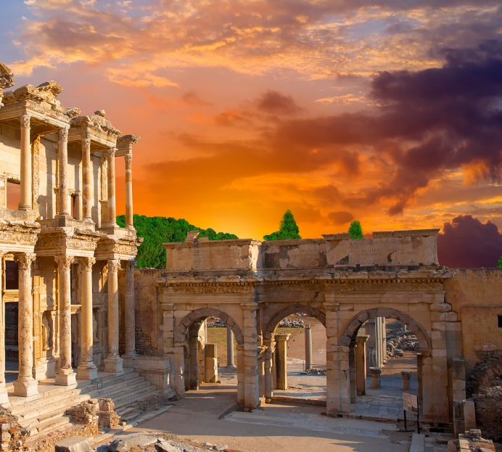
Lesson 108
Equal in God’s Eye
1 Corinthians 11

Slide 2
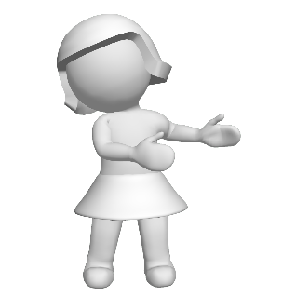
Common Feelings About Marriage
“I don’t want to commit to a long-term relationship. I worry about making a decision that I will later regret.”
“Being successful in my career is everything to me.
I don’t want to divide my attention between my career goals and my marriage.”
“Marriage would tie me down. I wouldn’t be able to do whatever I wanted.”
“I know that marriage is the most important decision I will ever make, and I look forward to it.”
How Do You Feel About Marriage?

Slide 3
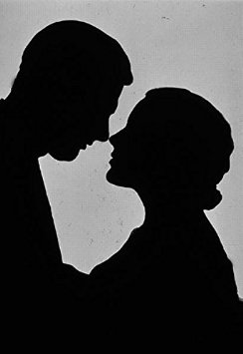
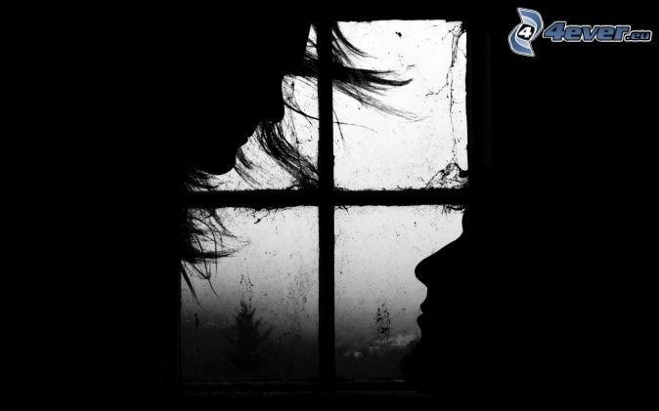
The Institution of Marriage
“The house of the Lord is a house of order and not a house of confusion; and that means that the man is not without the woman in the Lord, neither is the woman without the man in the Lord; and that no man can be saved and exalted in the kingdom of God without the woman, and no woman can reach the perfection and exaltation in the kingdom of God alone.
God instituted marriage in the beginning.
He made man in his own image and likeness, male and female, and in their creation it was designed that they should be united together in sacred bonds of marriage, and one is not perfect without the other.
Furthermore, it means that there is no union for time and eternity that can be perfected outside of the law of God, and the order of his house.
Men may desire it, they may go through the form of it, in this life, but it will be of no effect except it be done and sanctioned by divine authority, in the name of the Father and of the Son and of the Holy Ghost.”
1 Corinthians 11:11
(2)

Slide 4
Doctrinal Mastery
1 Corinthians 11:11
Nevertheless neither is the man without the woman, neither the woman without the man, in the Lord.

Slide 5
The Roles
“the head of the woman is the man” = the husband has the sacred responsibility of presiding in the home.
To preside means to righteously lead and guide others in spiritual and temporal matters.
Who is to preside over and guide the husband as he presides in his family?
Some readers of the New Testament misunderstand Paul’s teachings to mean that the man’s role is more important than the woman’s role or that the man is superior to or of more worth than the woman
1 Corinthians 11:11

Slide 6
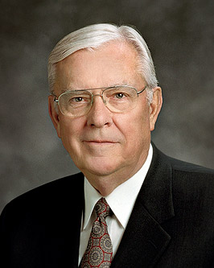
“Men and women are equal in God’s eyes and in the eyes of the Church, but equal does not mean they are the same.
The responsibilities and divine gifts of men and women differ in their nature but not in their importance or influence.
Our Church doctrine places women equal to and yet different from men. God does not regard either gender as better or more important than the other.”
1 Corinthians 11:11
(2)

Slide 7
The Lord’s Plan
Nevertheless neither is the man without the woman, neither the woman without the man, in the Lord.
In the Lord’s plan, men and women cannot obtain eternal life without each other.
1 Corinthians 11:11

Slide 8
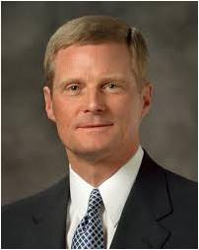
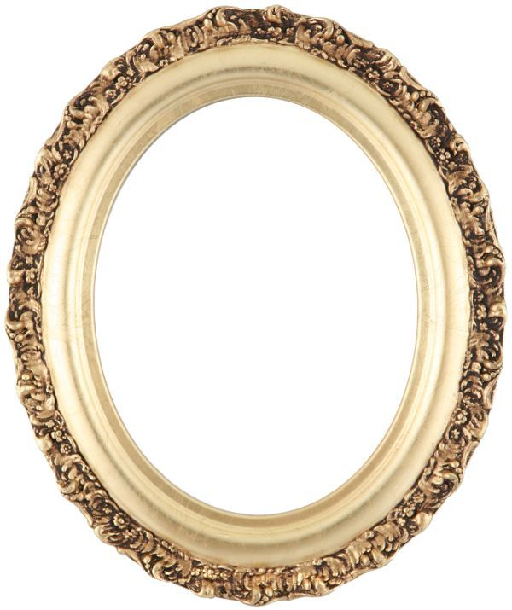
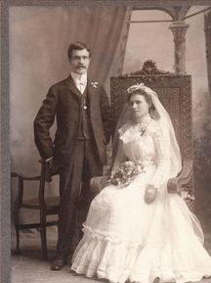
“By divine design, men and women are intended to progress together toward perfection and a fulness of glory. Because of their distinctive temperaments and capacities, males and females each bring to a marriage relationship unique perspectives and experiences.
The man and the woman contribute differently but equally to a oneness and a unity that can be achieved in no other way.
The man completes and perfects the woman and the woman completes and perfects the man as they learn from and mutually strengthen and bless each other.”
1 Corinthians 11:11
(3)

Slide 9
Power of the Sacrament
1 Corinthians 11: 23-31

Slide 10
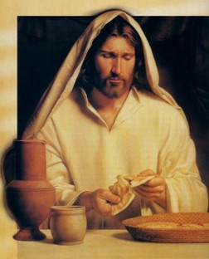
Remembrance—the body
“For I have received of the Lord that which also I delivered unto you, that the Lord Jesus the same night in which he was betrayed took bread:
…and when he had given thanks, he brake it, and said, Take, eat: this is my body, which is broken for you: this do in remembrance of me.”
1 Corinthians 11:23-24

Slide 11
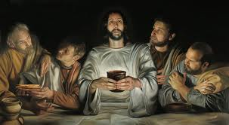
Remembrance—the blood
“After the same manner also he took the cup, when he had supped, saying, This cup is the new testament in my blood: this do ye, as oft as ye drink it in remembrance of me.
“For as often as ye eat this bread, and drink this cup, ye do shew the Lord’s death till he come.”
1 Corinthians 11:25-26

Slide 12
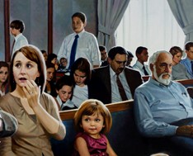
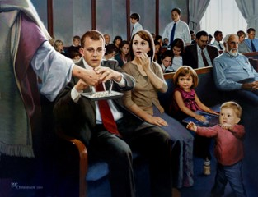
Which is more important?
What we take for the sacrament…
…or how prepared we are to partake of the sacrament?

Slide 13
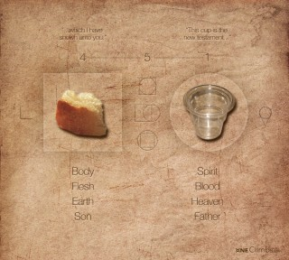
Importance of Sacrament
“For behold, I say unto you, that it mattereth not what ye shall eat or what ye shall drink when ye partake of the sacrament…
…if it so be that ye do it with an eye single to my glory---remembering…
D&C 27:2

Slide 14
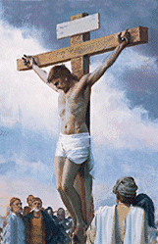
…unto the Father my body which was laid down for you…
…and my blood which was shed for the remission of your sins.”
D&C 27:2

Slide 15
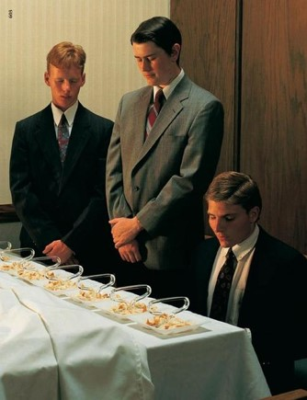
Sacramental Covenants
Eat and Do in Remembrance:
Witness unto thee
Willing to take upon them the name of thy Son
Always remember him and keep his commandments
Always have his Spirit to be with them
D&C 20:77-78

Slide 16
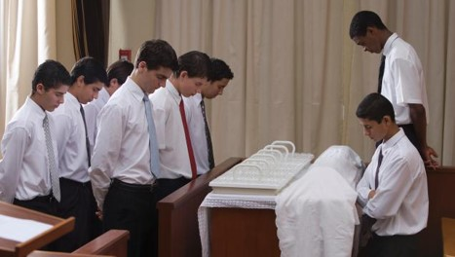
Sacramental Ordinance
The sacrament is the only ordinance we experience for ourselves more than once.

Slide 17
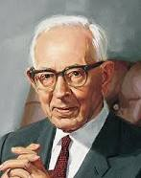
“The partaking of these emblems constitutes one of the most holy and sacred odinances in the Church”
(4)

Slide 18
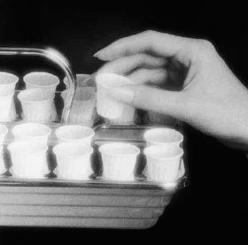
Warnings from Paul
“Wherefore, whosoever shall eat this bread, and drink this cup of the Lord, unworthily, shall be guilty of the body and blood of the Lord.”
1 Corinthians 11:27-31

Slide 19
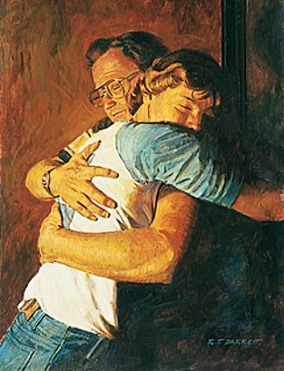
Warnings to Nephites
“For whoso eateth and drinketh my flesh and blood unworthily eateth and drinketh damnation to his soul…”
Nevertheless…
…ye shall not cast him our from among you, but ye shall minister unto him and shall pray for him.”
3 Nephi 18: 29-32

Slide 20
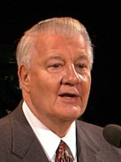
“If we desire to improve (which is to repent) and are not under priesthood restriction, then, in my opinion, we are worthy….
If, however, we refuse to repent and improve, if we do not remember him and keep his commandments, then we have stopped our growth…
The sacrament is an intensely personal experience, and we are the ones who knowingly are worthy or otherwise.”
(6)

Slide 21
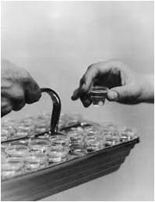
How Do You Know If You Are Worthy?
If we partake of the sacrament while living in serious sin or with an unrepentant heart, having no desire to remember and follow the Savior, we are partaking of the sacrament unworthily.
We “do not need to be perfect in order to partake of the sacrament, but [we] should have a spirit of humility and repentance in [our] heart.”
(7)

Slide 22
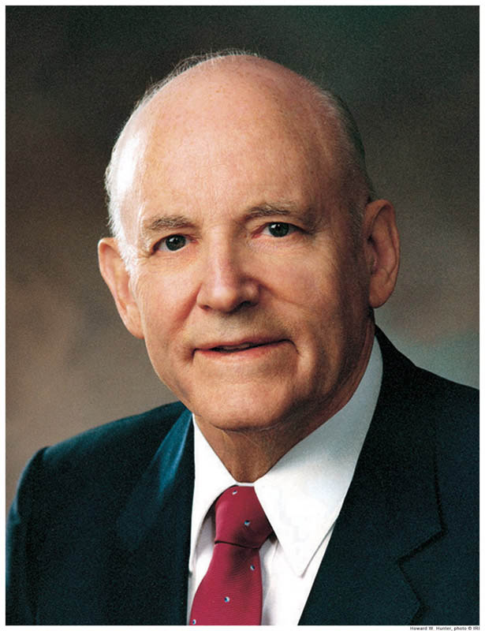
I asked myself this question: ‘Do I place God above all other things and keep all of His commandments?’ Then came reflection and resolution.
To make a covenant with the Lord to always keep His commandments is a serious obligation, and to renew that covenant by partaking of the sacrament is equally serious.
The solemn moments of thought while the sacrament is being served have great significance. They are moments of self-examination, introspection, self-discernment—a time to reflect and to resolve.”
(8)

Slide 23
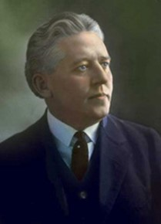
We should examine our lives as we partake of the sacrament
“If we have sincerely repented and put ourselves in proper condition, we shall be forgiven, and spiritual healing will come to our souls.”
(5)

Slide 24
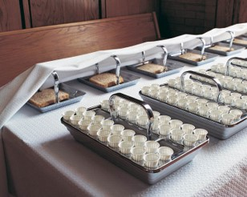
The Sacred Nature and Power of the Sacrament in our lives is determined by your worthiness to partake…renew covenants with the Lord…and receive all the blessings the Lord has to offer.

Slide 25
Sources:
Suggested Hymn: #177 Tis Sweet to Sing the Matchless Love
Video:
The Women in Our Lives (2:43)
Always Remember Him (5:28)
New Testament Institute Student Manual Chapter 38
Elder M. Russell Ballard “Men and Women in the Work of the Lord,” New Era, Apr. 2014, 4).
Elder David A. Bednar “Marriage Is Essential to His Eternal Plan,” Ensign, June 2006, 83–84).
Joseph Fielding Smith—”Doctrines of Salvation, 2:339
Elder Melvin J. Ballard “The Sacramental Covenant” New Era, Jan. 1976, 8
Elder John H. Groberg “The Beauty and the Importance of the Sacrament” Conference Report Apr. 1989, 49-50; or Ensign, May 1989
(True to the Faith: A Gospel Reference [2004], 148).
President Howard W. Hunter (“Thoughts on the Sacrament,” Ensign, May 1977, 25).er and follow the Savior, we are partaking of the sacrament unworthily.
Presentation by ©http://fashionsbylynda.com/blog/

Slide 26
First Letter of Paul to the Saints at Corinth— Written from Ephesus, ca. Spring, A.D. 57
The Status of Man and Woman | 11:1–16
Why We Partake of the Sacrament | 11:17–34
“The Family: A Proclamation to the World” outlines the God-given responsibilities of husbands and wives:
“By divine design, fathers are to preside over their families in love and righteousness and are responsible to provide the necessities of life and protection for their families. Mothers are primarily responsible for the nurture of their children. In these sacred responsibilities, fathers and mothers are obligated to help one another as equal partners” (“The Family: A Proclamation to the World,” Ensign, Nov. 2010, 129).
“A man who holds the priesthood accepts his wife as a partner in the leadership of the home and family with full knowledge of and full participation in all decisions relating thereto. Of necessity there must be in the Church and in the home a presiding officer (see D&C 107:21). By divine appointment, the responsibility to preside in the home rests upon the priesthood holder (see Moses 4:22). The Lord intended that the wife be a helpmeet for man (meet means equal)—that is, a companion equal and necessary in full partnership. Presiding in righteousness necessitates a shared responsibility between husband and wife; together you act with knowledge and participation in all family matters. For a man to operate independent of or without regard to the feelings and counsel of his wife in governing the family is to exercise unrighteous dominion” President Howard W. Hunter (“Being a Righteous Husband and Father,” Ensign ,Nov. 1994, 50–51.)
Life and Teachings of Jesus and His Apostles Chapter 35
Woman and Man 1 Corinthians 11:11:
“The house of the Lord is a house of order and not a house of confusion; and that means that the man is not without the woman in the Lord, neither is the woman without the man in the Lord; and that no man can be saved and exalted in the kingdom of God without the woman, and no woman can reach the perfection and exaltation in the kingdom of God alone. That is what it means. God instituted marriage in the beginning. He made man in his own image and likeness, male and female, and in their creation it was designed that they should be united together in sacred bonds of marriage, and one is not perfect without the other. Furthermore, it means that there is no union for time and eternity that can be perfected outside of the law of God, and the order of his house. Men may desire it, they may go through the form of it, in this life, but it will be of no effect except it be done and sanctioned by divine authority, in the name of the Father and of the Son and of the Holy Ghost.” (Joseph Fielding Smith, Gospel Doctrine, p. 272.)
The Sacrament:
“We want every Latter-day Saint to come to the sacrament table because it is the place for self-investigation, for self-introspection, where we may learn to rectify our course and make right our own lives, bringing ourselves into harmony with the teachings of the Church and with our brethren and sisters. It is the place where we become our own judges. …
“… The one thing that would make for the safety of every man and woman would be to appear at the sacrament table every Sabbath day. We would not get very far away in one week—not so far away that, by the process of self-investigation, we could not rectify the wrongs we may have done. … The road to the sacrament table is the path of safety for Latter-day Saints” (Bryant S. Hinckley, Sermons and Missionary Services of Melvin Joseph Ballard [1949], 150–51).
Roles of Men and Women:
“In our Heavenly Father’s great priesthood-endowed plan, men have the unique responsibility to administer the priesthood, but they are not the priesthood. Men and women have different but equally valued roles. Just as a woman cannot conceive a child without a man, so a man cannot fully exercise the power of the priesthood to establish an eternal family without a woman. … In the eternal perspective, both the procreative power and the priesthood power are shared by husband and wife” (“This Is My Work and Glory,” Ensign or Liahona, May 2013, 19).

