Slide 1
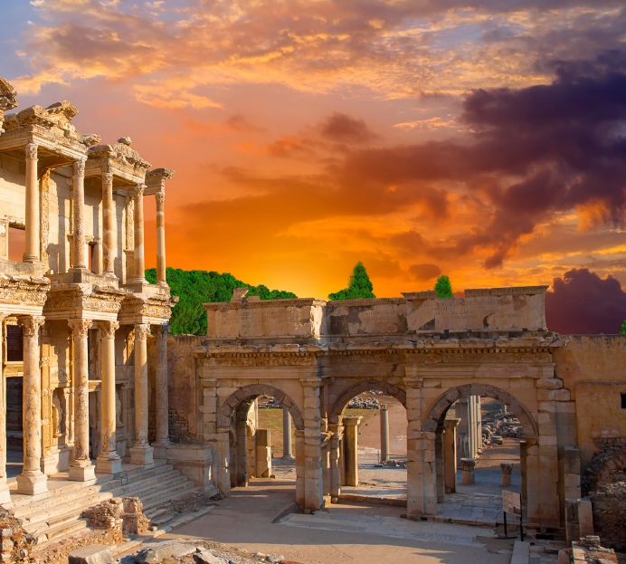
Lesson 109
Gifts of the Spirit
But the manifestation of the Spirit is given to every man to profit withal.
1 Corinthians 12:7
1 Corinthians 12
1 Corinthians 12

Slide 2
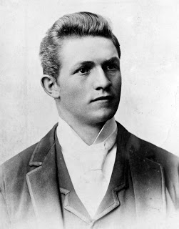
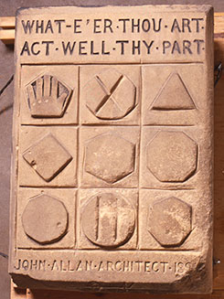
President David O. McKay was serving a mission in Scotland, he saw this stone above the door of a building near Stirling Castle and was inspired by its message.
If any of these shapes were rearranged or if their values changed, the rows and columns on the stone would no longer add up to 18 in every direction.
Each symbol in the nine squares of this stone represents a numerical value.
From left to right, the symbols represent 5, 10, and 3 in the top row; 4, 6, and 8 in the middle row; and 9, 2, and 7 in the bottom row.
What is the sum of the three numbers represented in the top row? the middle row? the bottom row?
Consider:
we as members of the Church are like the shapes on the stone.
18
(2)

Slide 3
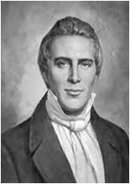
Gifts of the Spirit
Wherefore I give you to understand, that no man speaking by the Spirit of God calleth Jesus accursed: and that no man can say that Jesus is the Lord, but by the Holy Ghost.
“Say” Should Be “Know”
(3)
How can we obtain a personal testimony of Jesus Christ?
1 Corinthians 12
Only through the Holy Ghost can we obtain a personal testimony that Jesus Christ is our Savior
1 Corinthians 12:3

Slide 4
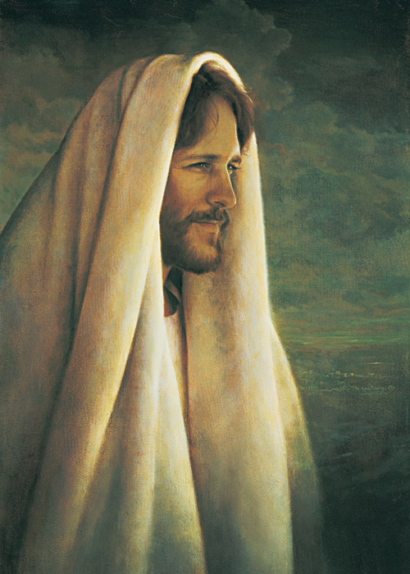
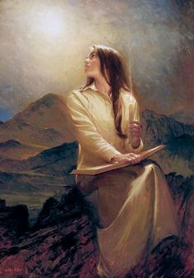
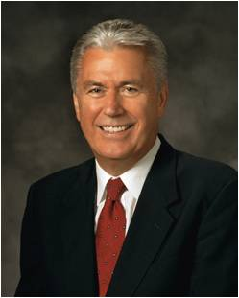
“A testimony is a most precious possession because it is not acquired by logic or reason alone, it cannot be purchased with earthly possessions, and it cannot be given as a present or inherited from our ancestors.
We cannot depend on the testimonies of other people.
We need to know for ourselves.
President Gordon B. Hinckley said, ‘Every Latter-day Saint has the responsibility to know for himself or herself with a certainty beyond doubt that Jesus is the resurrected, living Son of the living God’
Greg Olsen
“We receive this testimony when the Holy Spirit speaks to the spirit within us. We will receive a calm and unwavering certainty that will be the source of our testimony and conviction.”
Elspeth C. Young
(4)

Slide 5
“Every good gift and every perfect gift is from above, and cometh down from the Father of lights…”
—James 1:17
1 Corinthians 12
1 Corinthians 12:4-6

Slide 6
Spiritual Gifts
“For all have not every gift given unto them; for there are many gifts, and to every man is given a gift by the Spirit of God.”
D&C 46:11
1 Corinthians 12
“Now there are diversities of gifts, but the same Spirit.”
1 Corinthians 12:4

Slide 7
Manifestations of the Spirit-Paul
1 Corinthians 12
The word of wisdom
Knowledge
Faith—healing, working miracles and prophecy
Discerning of tongues
Good judgment and the appropriate application of knowledge
A knowledge of God and his laws;
Recognizing truth and untruth and perceiving the good and evil in others;
The ability to speak in foreign or unknown languages.
1 Corinthians 12:4-11

Slide 8
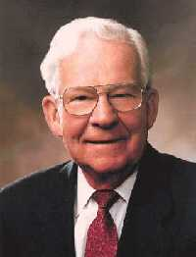
Manifestation of the Spirit—Marvin J. Ashton
Less conspicuous gifts
The gift of asking
The gift of listening
1 Corinthians 12
?
1 Corinthians 12
I hear what you are saying
The gift of hearing—a still, small voice
1 Corinthians 12
1 Corinthians 12
I hear you
The gift of being able to weep
I’m sorry
(5)

Slide 9
1 Corinthians 12
I agree
The gift of avoiding contention
1 Corinthians 12
That could work
The gift of being agreeable
The gift of avoiding vain repetition
The gift of seeking that which is righteous
1 Corinthians 12
1 Corinthians 12
Bla Bla
Bla Bla
Bla
CTR
(5)

Slide 10
1 Corinthians 12
Can you help me?
The gift of not passing judgment
1 Corinthians 12
He is such a nice person
The gift of looking to God for guidance
The gift of being a disciple
The gift of caring for others
1 Corinthians 12
1 Corinthians 12
I am trying to be like Jesus
Do you need any help?
(5)

Slide 11
1 Corinthians 12
The gift of being able to ponder
I’d be glad to say the prayer
1 Corinthians 12
The gift of offering prayer
The gift of bearing a mighty testimony
1 Corinthians 12
I feel what I am doing is right
1 Corinthians 12
I know
The gift of receiving the Holy Ghost
(5)

Slide 12
“Neglect not the gift that is in thee, which was given thee by prophecy, with the laying on of the hands of the presbytery {priesthood}.” 1 Timothy 4:14
1 Corinthians 12
“Every Good Gift and every perfect gift is from above…”

Slide 13
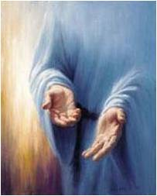
“But covet earnestly the best gifts: and yet shew I unto you a more excellent way.”
1 Corinthians 12:31

Slide 14
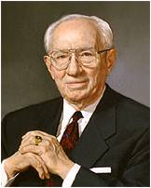
1 Corinthians 12
As we use our unique spiritual gifts to serve others, we can strengthen the Church.
“We are all in this great endeavor together.
We are here to assist our Father in His work and His glory, ‘to bring to pass the immortality and eternal life of man’ (Moses 1:39).
Your obligation is as serious in your sphere of responsibility as is my obligation in my sphere. No calling in this church is small or of little consequence.
All of us in the pursuit of our duty touch the lives of others.”
(6)

Slide 15
1 Corinthians 12
Faith
Hope & Charity
Paul taught that of the spiritual gifts of faith, hope, and charity, the greatest is charity.

Slide 16
“And though I have the gift of prophecy, and understand all mysteries, and all knowledge; and though I have all faith, so that I could remove mountains, and have not charity, I am nothing.”
—1 Corinthians 13:2

Slide 17
Coming up next:
Moroni 7:47
“But Charity is the pure love of Christ and it endureth forever…”

Slide 18
Sources:
Suggested Hymn: #301 I Am A Child of God
Video:
With All Your Heart (3:27)
New Testament Institute Student Manual Chapter 39
David O. McKay (see Francis M. Gibbons, David O. McKay: Apostle to the World, Prophet of God [1986], 45).
Joseph Smith History of the Church, 4:602–3
President Dieter F. Uchtdorf (‘Fear Not to Do Good,’ Ensign, May 1983, 80). (“The Power of a Personal Testimony,” Ensign or Liahona, Nov. 2006, 38
Marvin J. Ashton Conference Report, Oct. 1987, or Ensign, Nov. 1987
President Gordon B. Hinckley (“This Is the Work of the Master,” Ensign, May 1995, 71).
Presentation by ©http://fashionsbylynda.com/blog/

Slide 19
First Letter of Paul to the Saints at Corinth— Written from Ephesus, ca. Spring, A.D. 57
The Holy Ghost Bears Witness of Christ | 12:1–3
Spiritual Gifts of the Church | 12:4–11
The Importance of Each Member | 12:12–31
To Find Spiritual Gifts 1 Corinthians 12:7:
“To find the gifts we have been given, we must pray and fast. Often patriarchal blessings tell us the gifts we have received and declare the promise of gifts we can receive if we seek after them. I urge you each to discover your gifts and to seek after those that will bring direction to your life’s work and that will further the work of heaven.” Elder Robert D. Hales (“Gifts of the Spirit,” Ensign, Feb. 2002, 16).
Feeling Inadequate? 1 Corinthians 12:22:
“You may feel that there are others who are more capable or more experienced who could fulfill your callings and assignments better than you can, but the Lord gave you your responsibilities for a reason. There may be people and hearts only you can reach and touch. Perhaps no one else could do it in quite the same way.” President Dieter F. Uchtdorf (“Lift Where You Stand,” Ensign or Liahona, Nov. 2008, 56).
Life and Teachings of Jesus and His Apostles Chapter 36
Something of Interest
David O. McKay: In 1897 a young David O. McKay stood at a door with a religious tract in his hand. As a missionary in Stirling, Scotland, he had done this many times before. But on that day a very haggard woman opened the door and stood before him. She was poorly dressed and had sunken cheeks and unkempt hair.
She took the tract Elder McKay offered to her and spoke six words that he subsequently would never forget: “Will this buy me any bread?”
This encounter left a lasting impression on the young missionary. He later wrote: “From that moment I had a deeper realization that the Church of Christ should be and is interested in the temporal salvation of man. I walked away from the door feeling that that [woman], with … bitterness in [her heart] toward man and God, [was] in no position to receive the message of the gospel. [She was] in need of temporal help, and there was no organization, so far as I could learn, in Stirling that could give it to [her].”...
A few decades later the world groaned under the burden of the Great Depression. It was during that time, on April 6, 1936, that President Heber J. Grant and his counselors, J. Reuben Clark and David O. McKay, announced what would later become known as the welfare program of the Church of Jesus Christ of Latter-Day Saints.
Posted by: http://riseaboveyourlimits.blogspot.com/2011/11/have-or-have-not.html
Unity 1 Corinthians 12:25:
"Within this Church there is a constant need for unity, for if we are not one, we are not his. (See D&C 38:27.) We are truly dependent on each other, 'and the eye cannot say unto the hand, I have no need of thee: nor again the head to the feet, I have no need of you.' (1 Cor. 12:21.) Nor can the North Americans say to the Asians, nor the Europeans to the islanders of the sea, 'I have no need of thee.' No, in this church we have need of every member, and we pray, as did Paul when he wrote to the church in Corinth, 'that there should be no schism in the body; but that the members should have the same care one for another.
"It is unity and oneness that has thus far enabled us to bear our testimony around the globe, bringing forward tens of thousands of missionaries to do their part. More must be done. It is unity that has thus far enabled the Church, its wards and stakes, branches and districts, and members, to construct temples and chapels, undertake welfare projects, seek after the dead, watch over the Church, and build faith. More must be done. These great purposes of the Lord could not have been achieved with dissension or jealousy or selfishness. Our ideas may not always be quite like those who preside in authority over us, but this is the Lord's church and he will bless each of us as we cast off pride, pray for strength, and contribute to the good of the whole.“ President Howard W. Hunter ("That We May Be One," Ensign, May 1976, 106)
Testimony 1 Corinthians 12:3:
“Real testimony of … precious truths comes as a witness by the Holy Ghost after sincere and dedicated effort, including teaching in the home, prayer, scripture study, service to others, and diligent obedience to Heavenly Father’s commandments. To gain and forever hold on to a testimony of gospel truths is worth whatever price in spiritual preparation we may be required to pay.” Elder M. Russell Ballard (“Pure Testimony,” Ensign or Liahona, Nov. 2004, 40).
Charity 1 Corinthians 13:2:
Paul emphasized the gift of charity, which he characterized as being pure, unselfish love and concern for the well-being of others. He taught that charity should govern the exercise of all other spiritual gifts in the Church. He cautioned that the gift of speaking in tongues, if used improperly, will fail to edify the Church and will distract members from seeking superior spiritual gifts. (1)

Slide 20
Comparison of Gifts Scriptures
Paul 1 Corinthians 12:8-11 Given By the Spirit | Joseph Smith D&C 46:11-26 Some is given one, and to some is given another | Moroni 10:8-19 Different Ways, but Same God who worketh in all:
The Word of Wisdom | To know that Jesus Christ is the Son of God | Teach the Word of Wisdom
Knowledge | Eternal life through faithfulness | Teach the work of knowledge
Faith | To know the differences of administration | Faith—exceedingly great
Healing | To know diversities of operation | Healing
Working miracles | Word of Wisdom | Working mighty miracles
Prophecy | Knowledge – to be wise | Prophecy
Discerning of spirits | Faith to be healed | Beholding of angels and ministering spirits
Divers kinds of tongues | Faith to heal | All kinds of tongues
Interpretation of tongues | Working of miracles | Interpretation of tongues
 | Prophesy
 | Discerning of spirits
 | Speak with tongues
 | Interpretation of tongues

Slide 21
The Gifts
"No matter who believeth, these signs, such as healing the sick, casting out devils, etc., should follow all that believe, whether male or female" (Teachings of the Prophet Joseph Smith, 224)
"Paul enumerates many gifts of the Spirit. The greatest gift, however, is not the performing of miracles or talking in tongues, or prophesying, etc.; but the inception of an individual testimony is the greatest of all gifts of the Spirit. And that is a gift which comes from God through the Holy Ghost and can be received by any man, woman, or child in the world who desires to know the truth." Henry D. Moyle (Conference Report, April 1957, Afternoon Meeting 32.)
The Gift of Healing:
The gift of healing can be one of the most dramatic examples of a spiritual manifestation. However, the gift can apply to spiritual as well as physical blessings. The gift of healing can be applied to any ailment, whether physical spiritual, or emotional. Unlike many other gifts, the application of this gift depends upon the faith of the administrator and the recipient (see DC 46:19).
"He said the reason of these remarks being made was, that some little foolish things were circulating in the society, against some sisters not doing right in laying hands on the sick. Said that if the people had common sympathies they would rejoice that the sick could be healed...No matter who believeth, these signs, such as healing the sick, casting out devils, etc., should follow all that believe, whether male or female. He asked the Society if they could not see by this sweeping promise, that wherein they are ordained, if it is the privilege of those set apart to administer in that authority, which is conferred on them; and if the sisters should have faith to heal the sick, let all hold their tongues, and let everything roll on.
"...Respecting females administering for the healing of the sick he further remarked, there could be no evil in it, if God gave His sanction by healing; that there could be no more sin in any female laying hands on and praying for the sick, than in wetting the face with water; it is no sin for anybody to administer that has faith, or if the sick have faith to be healed by their administration." (Teachings of the Prophet Joseph Smith, 223-224)
The Gift of Wisdom:
"The fundamental knowledge which the Church brings to you will bring you understanding. Your testimony, your spirit, and your service will direct the application of your knowledge; that is wisdom. Every man needs it a hundred times a day. Every woman needs it. Every youth needs it. The foolish and the wise are the antipodes of mankind as are the two poles of the earth. The foolish build on the sand; the wise on the rock. The one perishes; the other endures. Thank God for the gift of wisdom." Elder Stephen L. Richards (Where Is Wisdom? [Salt Lake City: Deseret Book Co., 1955], 201.)
The Gift of Knowledge:
"The greatest knowledge is that which opens the way to exaltation. As with wisdom, there are varying degrees of knowledge, temporal and spiritual, greater and smaller. The ultimate and sublime purpose of knowledge is 'for the salvation of our souls.' (Jacob 4:13.)
"Firsthand knowledge comes with the aid of the Spirit. To read the scriptures gives one knowledge of what others have said. That is secondhand knowledge. When the Spirit bears witness to the truth of what the prophets have written, it becomes the personal and firsthand knowledge of the reader. The knowledge thus obtained is a gift of God." (S. Brent Farley, Studies in Scripture, Vol. 8: Alma 30 to Moroni, ed. by Kent P. Jackson, [Salt Lake City: Deseret Book Co., 1988], 307.)
The Gift of Working Miracles:
"I bear my witness to you that if a record had been made of all those who have been afflicted, those who have been given up to die, and who have been healed by the power of God since the establishment of the Church of Christ in our day, it would make a book much larger than the New Testament. More miracles have been performed in the Church of Jesus Christ of Latter-day Saints than we have any account of in the days of the Savior and His Apostles. Today, sickness is cured by spiritual power ... The dead have been raised. My own brother was announced to be dead, but by the prayer of faith he lives and presides over one of the stakes of Zion. I know, as I know I live, that the healing power of Almighty God ... is in the Church of Christ of which you and I are members." (Conference Reports, October 6, 1910, p. 119)
The Gift of Faith:
"Faith is a gift, of course, and reason, by itself, cannot lead man out of the apparent maze. Man does not understand the mind of God and his timetable; nor do we have his perspective. The gift of faith, then, often gives form to what has been called 'tacit knowledge,' that form of knowledge that lies just below the level of the individual's powers of articulation, which whispers things to him that are true but which are difficult to share and can seldom be put in persuasive form for the ears of others. Nevertheless, without the gift of faith or the perspective-giving insights of the gospel, man's reason will sweep him into sadness and cynicism." (For the Power is in Them..., 18)

Slide 22
The Gift of Prophecy:
"We believe that we have a right to revelations, visions, and dreams from God, our Heavenly Father, and light and intelligence through the gift of the Holy Ghost, in the name of Jesus Christ, on all subjects pertaining to our spiritual welfare, if it so be that we keep his commandments so as to render ourselves worthy in his sight." Joseph Smith (Kent P. Jackson, comp. and ed., Joseph Smith's Commentary on the Bible [Salt Lake City: Deseret Book Co., 1994], 160.)
The Gift of Tongues:
"The gift of tongues is the smallest gift perhaps of the whole, and yet it is one that is the most sought after." (History of the Church, 5:28-30.)
"Be not so curious about tongues, do not speak in tongues except there be an interpreter present; the ultimate design of tongues is to speak to foreigners, and if persons are very anxious to display their intelligence, let them speak to such in their own tongues. The gifts of God are all useful in their place, but when they are applied to that which God does not intend, they prove an injury, a snare and a curse instead of a blessing." (History of the Church 5:31-32)
The Gift of Discerning Spirits:
"This power of discernment is essential if we are to distinguish between genuine spiritual gifts and the counterfeits Satan seeks to use to deceive men and women and thwart the work of God. The Prophet Joseph Smith said, 'Nothing is a greater injury to the children of men than to be under the influence of a false spirit when they think they have the spirit of God.' (Teachings, p. 205.) He also taught that 'no man nor sect of men without the regular constituted authorities, the Priesthood and discerning of spirits, can tell true from false spirits.' (Teachings, p. 213.)
"Satan-inspired and man-made counterfeits of spiritual gifts have been present throughout our religious history. This is evident from the enchantments wrought by Pharoah's sorcerers and magicians (see Ex. 7:11, 22; Ex. 8:7), and from Isaiah's warnings against 'wizards that peep, and that mutter' and 'them that have familiar spirits' (Isa. 8:19). The Savior warned against false Christs and false prophets who 'shall show great signs and wonders, insomuch, that, if possible, they shall deceive the very elect ... according to the covenant.' (JS-H 1:22.) The Apostle John said, 'Try the spirits whether they are of God: because many false prophets are gone out into the world.' (1 Jn. 4:1.)
"Just a few months after the Church was organized, Hiram Page, one of the earliest members, was receiving revelations through a seer stone. The Lord told the Prophet Joseph Smith to tell Hiram Page privately that 'those things which he has written from that stone are not of me and that Satan deceiveth him.' (D&C 28:11.) The receipt of revelation had not been 'appointed unto' Hiram Page, the Lord explained, 'neither shall anything by appointed unto any of this church contrary to the church covenants. For all things must be done in order, and by common consent in the church, by the prayer of faith.' (D&C 28:12-13.)
"Here we learn that Satan gives revelations to deceive the children of men and that our protection is in following the order of the Church on who should receive revelation for what subject. In this, both men and women have equal responsibility to follow the duly ordained leaders of the church who have the obligation to lead and, on occasion, to correct." Elder Dallin H. Oaks ("Spiritual Gifts," Ensign, Sept. 1986, 72)
The Gift of Interpretation of Tongues:
"The Gift of Interpretation-The occasion was a conference held at Huntly, New Zealand, a thousand people assembled. Before that time I had spoken through interpreters in China, Hawaii, Holland, and other places, but I felt impressed on that occasion to speak in the English language. In substance I said, 'I have never been much of an advocate of the necessity of tongues in our Church, but today I wish I had that gift. But I haven't. However, I am going to speak to you, my brothers and sisters, in my native tongue and pray that you may have the gift of interpretation of tongues. We will ask Brother Stuart Meha who is going to interpret for me, to make notes, and if necessary he may give us a summary of my talk afterwards.'
"Well, the outpouring of the gift of tongues on that occasion was most remarkable. Following the end of my sermon Brother Sid Christy, who was a student of Brigham Young University, a Maori, who had returned to New Zealand, rushed up and said, 'Brother McKay, they got your message!'
"Well, I knew they had by the attention and the nodding of their heads during the talk. I said, 'I think they have but for the benefit of those who may not have understood or had that gift, we shall have the sermon interpreted.'
"While Brother Meha was interpreting that or giving a summary of it in the Maori language some of the natives, who had understood it, but who did not understand English, arose and corrected him in his interpretations. Gospel Ideals: Selections from the Discourses of David O. McKay [Salt Lake City: Improvement Era, 1953], 552.)

