Slide 1
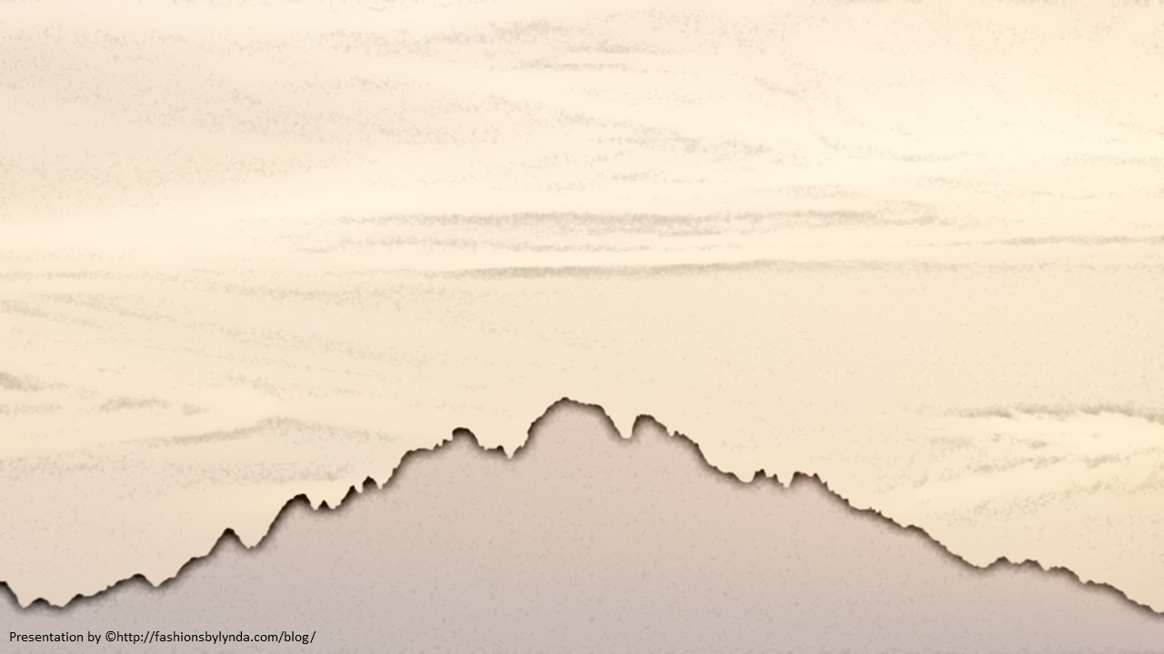
Lesson 11
The Sermon on the Mount
Treasures in Heaven
Matthew 6
… but that ye may do these things to lay up for yourselves a treasure in heaven, yea, which is eternal, and which fadeth not away; yea, that ye may have that precious gift of eternal life, which we have reason to suppose hath been given to our fathers.
Helaman 8:5

Slide 2
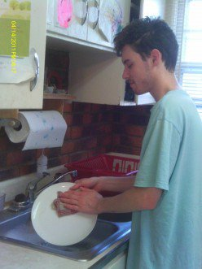
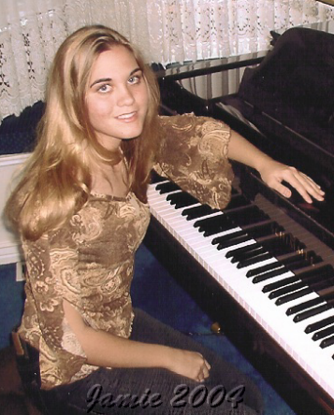
What do We do to Get Rewards?
Getting good grades?
Hugging mom?
Helping at home?
Cleaning your room?
Practicing an art?

Slide 3
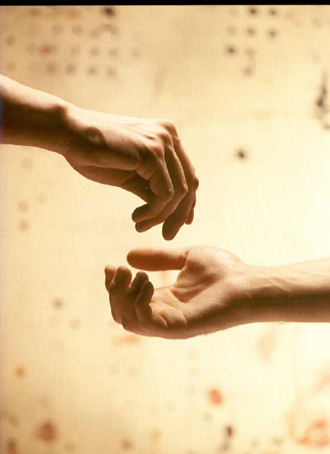
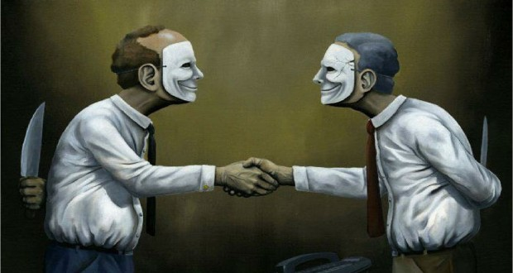
Improper Motives For a Reward
And it came to pass that, as Jesus taught his disciples, he said unto them, Take heed that ye do not your alms before men, to be seen of them: otherwise ye have no reward of your Father which is in heaven.
Alms = righteousness, acts of religious devotion.
Hypocrite = pretenders; the Greek word means “a play actor,” or “one who feigns, represents dramatically, or exaggerates a part.
Calling attention to oneself while they are performing a service or an act

Slide 4
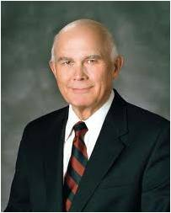
“Some may serve for hope of earthly reward. Such a man or woman might serve in Church positions or in private acts of mercy in an effort to achieve prominence or cultivate contacts that would increase income or aid in acquiring wealth. Others might serve in order to obtain worldly honors, prominence, or power. …
“In contrast, those who serve quietly, even ‘in secret,’ qualify for the Savior’s promise that ‘thy Father, who seeth in secret, shall reward thee openly.’
“‘Charity is the pure love of Christ.’ The Book of Mormon teaches us that this virtue is ‘the greatest of all.’
“If our service is to be most efficacious, it must be accomplished for the love of God and the love of his children. …
“I know that God expects us to work to purify our hearts and our thoughts so that we may serve one another for the highest and best reason, the pure love of Christ.”
Matthew 6:4; Moroni 7:46-47; 3 Nephi 13:18
(2)

Slide 5
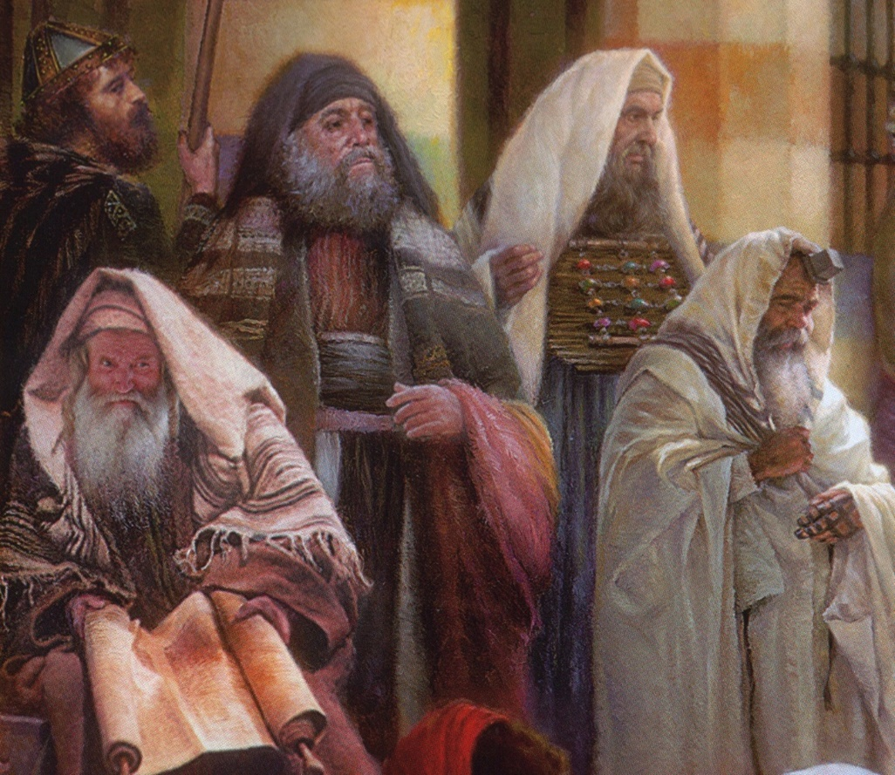
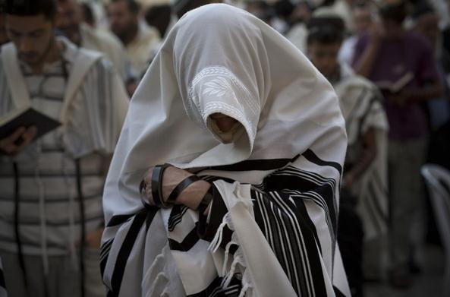
Prayer Practices
“Devout Jews, at set times, faced Jerusalem, covered their heads, cast their eyes downward, and ostentatiously went through the ritual of prayer.
If the hour of prayer found them in the streets, so much the better, for all men would see their devoutness!
“To attract attention by saying one’s own prayers aloud in the synagogue was not uncommon. Such were among the practices of the day.”
Matthew 6:4-6
(3)

Slide 6
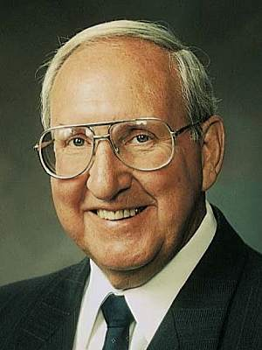
Pray in Your Closets
“…What happens to us when we pray in secret?
First, our faith is put to the test.
When we pray alone, there is no one to impress….
We take problems that no one else, not another living soul, can help us with.
We become like little children…
We do not have to worry about embarrassment if our prayers are not answered the way we think they should be, because only we and God know for what we pray.
We can be totally honest, knowing that we cannot lie to or deceive the Spirit or God.
When we have personal problems or struggles, we can pray and know that these things are kept totally confidential.
We can discuss our weaknesses, our sins, our frustrations, our needs, and know that He will listen and respond."
If we perform acts of devotion to please Heavenly Father rather than to seek the attention of others, then He will reward us openly
Matthew 6:6
(4)

Slide 7
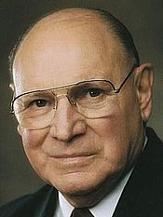
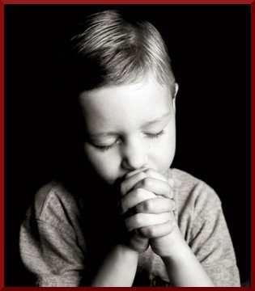
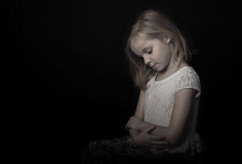
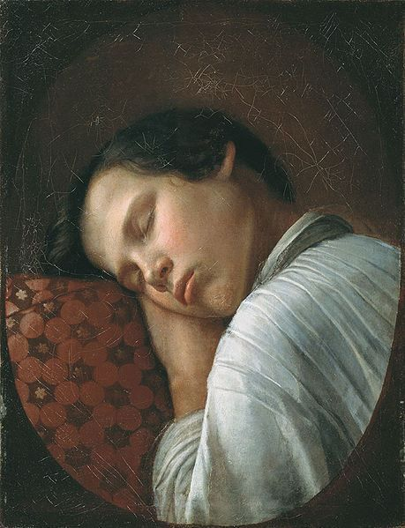
Vain Repetitions
“Our prayers become hollow when we say similar words in similar ways over and over so often that the words become more of a recitation than a communication.
This is what the Savior described as ‘vain repetitions’. …
“Do your prayers at times sound and feel the same?
Have you ever said a prayer mechanically, the words pouring forth as though cut from a machine?
Do you sometimes bore yourself as you pray?
Matthew 6:7
(5)

Slide 8
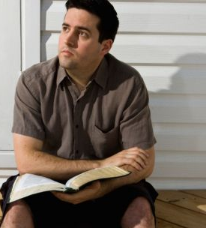
Improving Our Prayers
“Will prayers that do not demand much of your thought merit much attention from our Heavenly Father?
When you find yourself getting into a routine with your prayers, step back and think. Meditate for a while on the things for which you really are grateful. Look for them. They don’t have to be grand or glorious. …
“Think of those things you truly need.
Bring your goals and your hopes and your dreams to the Lord and set them before Him. Heavenly Father wants us to approach Him and ask for His divine aid.”
Matthew 6:7
(5)

Slide 9
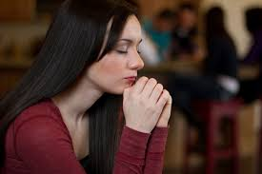
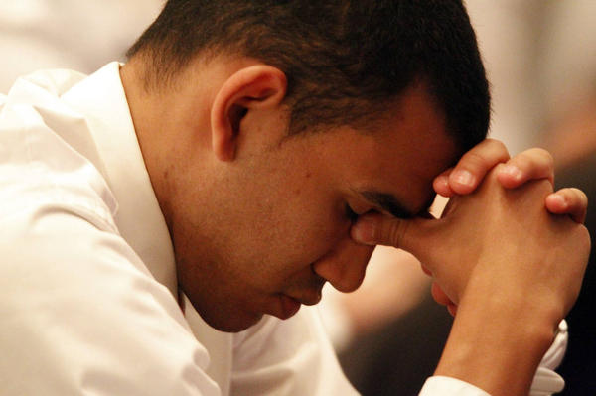
Your Father Knoweth
Some people might ask what purpose is served in asking for blessings if Heavenly Father already knows what we need.
Through prayer we acknowledge our dependence on the Lord, exercise our faith in His ability to bestow desired blessings, and acknowledge that ultimately all blessings come from Him.
Approached properly, prayer helps us evaluate our lives and align with the will of God.
Matthew 6:8
(6)

Slide 10
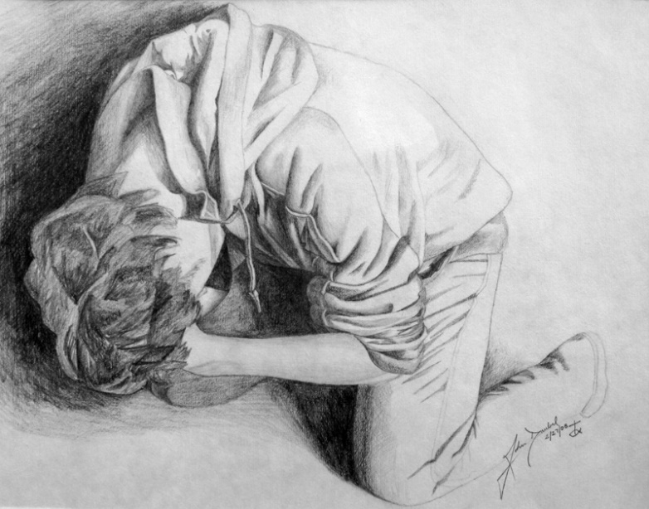
Prayer
“Prayer is the act by which the will of the Father and the will of the child are brought into correspondence with each other.
The object of prayer is not to change the will of God but to secure for ourselves and for others blessings that God is already willing to grant but that are made conditional on our asking for them.
Blessings require some work or effort on our part before we can obtain them. Prayer is a form of work and is an appointed means for obtaining the highest of all blessings”
Rick Moore
(7)

Slide 11
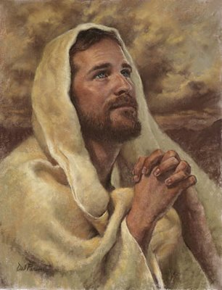
After This Manner Therefore Pray Ye
“The Lord’s Prayer serves as a pattern to follow and not as a piece to memorize and recite repetitively.” (8)
How can we enrich our own prayers and our own witness of the truth of Jesus’ message?

Slide 12
Hallowed Be Thy Name
“When we go to worship in a temple or a church, we put aside our working clothes and dress ourselves in something better.
This change of clothing is a mark of respect.
Similarly, when we address our Heavenly Father, we should put aside our working words and clothe our prayers in special language of reverence and respect.
In offering prayers in the English language, members of our church do not address our Heavenly Father with the same words we use in speaking to a fellow worker, to an employee or employer, or to a merchant in the marketplace.
We use special words that have been sanctified by use in inspired communications, words that have been recommended to us and modeled for us by those we sustain as prophets and inspired teachers.
Thee
Thou
Thy
Thine
“The special language of prayer follows different forms in different languages, but the principle is always the same.
We should address prayers to our Heavenly Father in words which speakers of that language associate with love and respect and reverence and closeness.”
Matthew 6:9
(2)

Slide 13
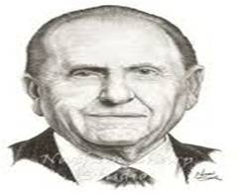
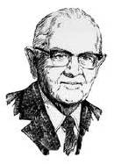
Thy Kingdom Come
“The Church is steadily growing; it has since its organization over 178 years ago. …
There remain, however, areas of the world where our influence is limited and where we are not allowed to share the gospel freely.
As did President Spencer W. Kimball over 32 years ago, I urge you to pray for the opening of those areas, that we might share with them the joy of the gospel. As we prayed then in response to President Kimball’s pleadings, we saw miracles unfold as country after country, formerly closed to the Church, was opened. Such will transpire again as we pray with faith.”
Matthew 6:10
(9)

Slide 14
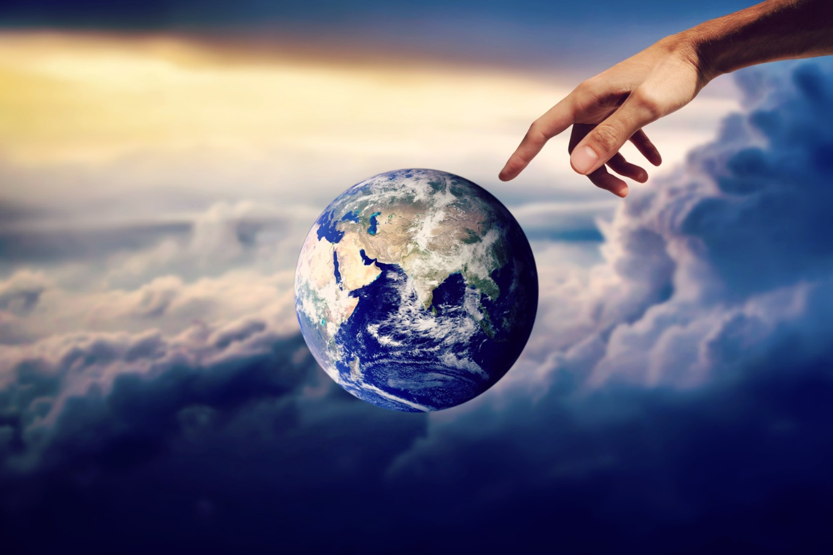
Thy Will Be Done—on Earth—In Heaven
Praying for His will to be done and then not trying to live it, gives you a negative answer at once.
If we pray for the success of some cause or enterprise, manifestly we are in sympathy with it. It is the height of disloyalty to pray for God's will to be done, and then fail to conform our lives to that will.” (10)
Our thoughts should be brought to that point upon every occasion when we approach the Lord, that his will in us may be done as it is done in heaven.” (11)
Matthew 6:10

Slide 15
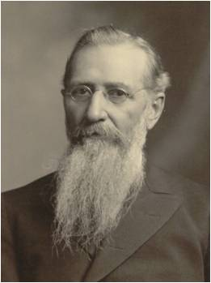
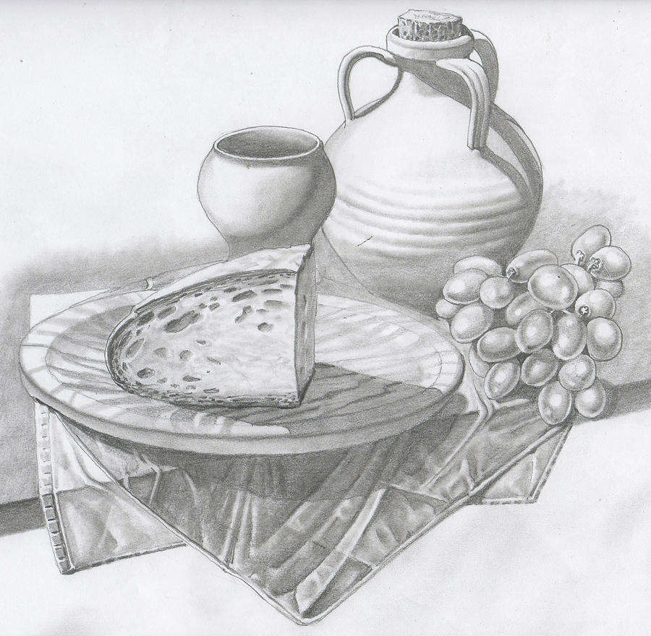
Daily Bread—The Lord Will Feed
Are we to sit in perpetual idleness and ask the Lord to give us our daily bread?
Are we to think that our food is His responsibility, that if we are hungry, it is His fault?
As with all blessings, those of temporal prosperity come only after diligence and obedience.
“We thank Him for the blessings that we enjoy, and we acknowledge His goodness and mercy in bestowing upon us the blessings that we possess.
But we do not have to repeat the Lord's prayer, every day, which was given to His ministry, the apostles in ancient times when they were sent out like lambs in the midst of wolves, and He taught them that they were not to take thought of what they should eat or what they should drink, or wherewithal they should be clothed; that the Lord would feed them; that the Lord would open the hearts of those they ministered unto, to provide for their necessities.” (12)
Matthew 6:11

Slide 16
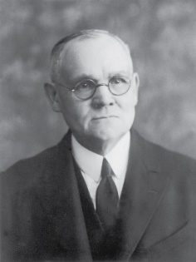
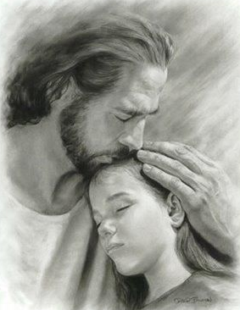
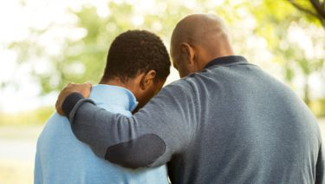
forgiveness
"Forgiveness is too precious a pearl to be cast at the feet of the unforgiving; and, without the sincerity that springs from a contrite heart, no man may justly claim mercy.
If others owe us, either in actual money or goods as suggested by debts and debtors, or through some infringement upon our rights included under the broader designation as a trespass, our mode of dealing with them will be taken into righteous account in the judgment of our own offenses." (1)
I, the Lord, will forgive whom I will forgive, but of you it is required to forgive all men. D&C 64:10
Matthew 6:12, 14

Slide 17
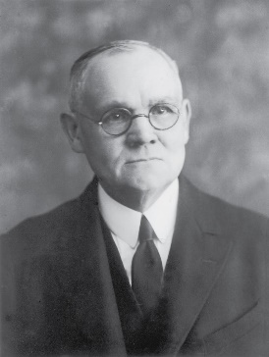
Lead Us Not Into Temptation
The Joseph Smith Translation clarifies that the Lord does not lead us into temptation:
“And suffer us not to be led into temptation, but deliver us from evil” (JST Matthew 6:14)
“We are not to understand that God would ever lead a man into temptation except, perhaps, by way of wise permission, to test and prove him, thereby affording him opportunity of overcoming and so of gaining spiritual strength ...
The intent of the supplication appears to be that we be preserved from temptation beyond our weak powers to withstand;
Can such souls as these be other than hypocrites in asking God to deliver them from the evils they have sought?
Temptation will fall in our way without our seeking, and evil will present itself even when we desire most to do right; …”
Click Here!
Matthew 6:13
(1)

Slide 18
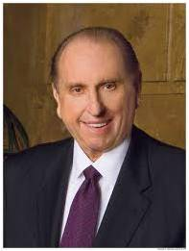
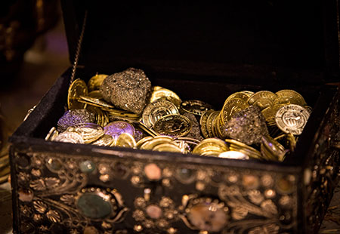
Treasures in Heaven
Where is your treasure?
How much time is spent?
How much money is spent?
How much devotion is put into it?
“The promised reward was not a treasure of ivory, gold, or silver. Neither did it consist of acres of land or a portfolio of stocks and bonds.
The Master spoke of riches within the grasp of all—even joy unspeakable here and eternal happiness hereafter.”
Matthew 6:19-21
(9)

Slide 19
If Therefore Thine Eye Be Single
Single = sound, healthy, simple, sincere
Giving alms, praying, and fasting should all be done with a simple and sincere focus on our Father in Heaven or on the recipient.
And if your eye be single to my glory, your whole bodies shall be filled with light, and there shall be no darkness in you; and that body which is filled with light comprehendeth all things. D&C 88:67
When I give to the poor, do I hope to bring glory to God or to myself?
When I serve the Lord, am I doing so to receive approval from the Lord or from men?
When I pray in public, am I addressing God or those in the congregation?
Matthew 6:22-23
(6)

Slide 20
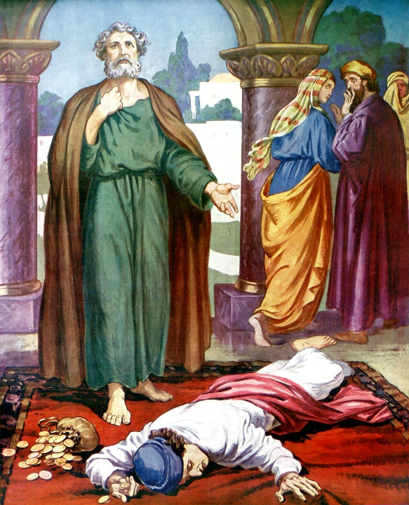
No man can serve two masters
'Some would never sell Jesus for thirty pieces, but they would not give Him their all either! Unfortunately, we tend to think of consecration only in terms of property and money. But there are so many ways of keeping back part.
One might be giving of money and time and yet hold back a significant portion of himself...
One might accept a Church calling but have his heart more set on maintaining a certain role in the world...
Each of us is an innkeeper who decides if there is room for Jesus! Consecration is the only surrender which is also a victory. It brings release from...selfishness and emancipation from the dark prison of pride...
Consecration may not require giving up worldly possessions so much as being less possessed by them...”
See Acts 5:1-11
Matthew 6:24
(13)

Slide 21
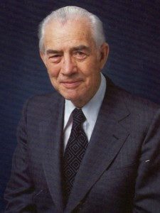
Mammon comes from an Aramaic term meaning “worldly riches” or “wealth.” (6)
We cannot serve both God and mammon
“Must we not recognize now that we cannot serve two masters? If we should try, the Lord will reject us. He will never be found in tandem with Lucifer, so let us not try to put Him there.”
Mammon = To set our hearts on worldly things in a way leads us away from God.
God
Mammon
Matthew 6:24
(14)

Slide 22
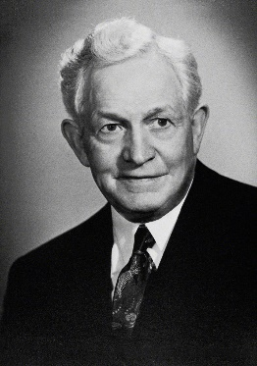
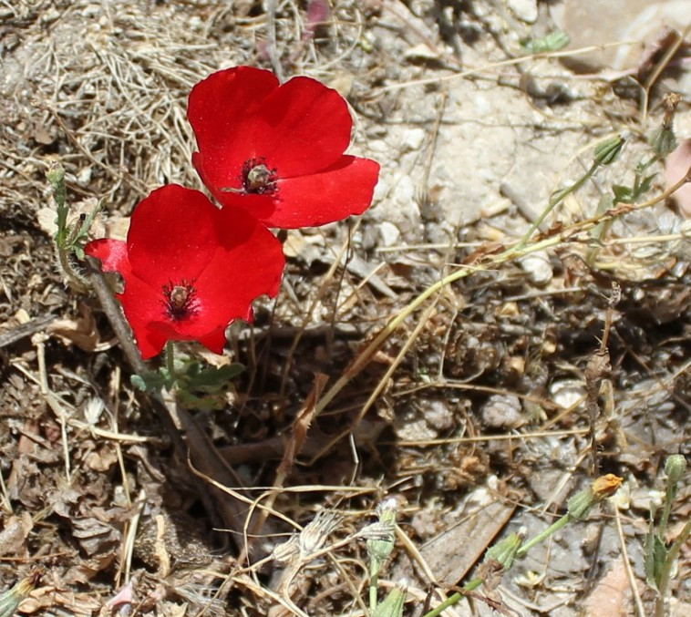
Consider the Lilies of the Field
“Let us consider the lily in the field.
It is buried in the ground with a root, which strikes out in the darkness to receive strength and moisture from the soil; and soon a stalk pushes its way through the earth, and pushes it up and up until finally the lily blooms in the sunshine and produces its kind.”
Mount of Olives May 2016
Matthew 6:28-29
(16)

Slide 23
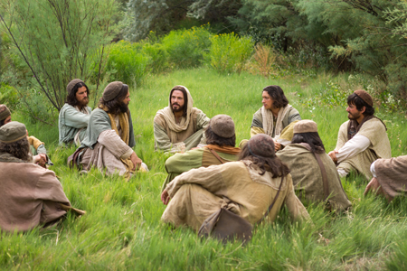
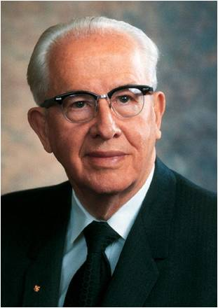
Seek the Kingdom First
No Thought = anxious concern
The Savior instructed His disciples to not be excessively anxious about providing for their basic needs.
The Lord is teaching all of us that we are not to let worldly concerns cause us to lose trust in our Father in Heaven or become diverted from seeking His kingdom. (6)
“We must put God in the forefront of everything else in our lives. …
“When we put God first, all other things fall into their proper place or drop out of our lives. Our love of the Lord will govern the claims for our affection, the demands on our time, the interests we pursue, and the order of our priorities.
“We should put God ahead of everyone else in our lives”
Matthew 6:25-34
(15)

Slide 24
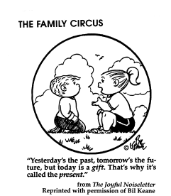
Sufficient unto the day is the evil thereof
Evil = is used in this phrase to mean the troublesome, annoying, problems of everyday life.
In the Matthew version, it reads, sufficient unto the day is the evil thereof.
In other words, every day brings enough problems that we don't need to waste our time worrying about the problems of tomorrow or the next day.
We should live in the present and concern ourselves with today's issues. Within reason, we are to live life one day at a time.
Matthew 6:25-34
(17)

Slide 25
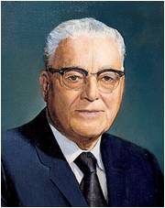
Yesterday
"...the only day you have to worry about is today.
There is nothing you can do about yesterday except repent. That means if you made mistakes yesterday, don't be making them today.
Don't worry about tomorrow, because you may have no tomorrows. This is the masterpiece you ought to be thinking about today.
And if you can always witness honestly that whatever you did, you did to the best of your ability, and next day try improvement on that, when your life's end comes, of you it can be said in truth, his was a successful life because he lived to the best that was in him.
Today
Tomorrow
That's all the Lord expects of any one of His children. We are all born with different capacities, some to do one thing, some to do the other, and all He asks is that we do our best; and that's the measure by which we'll be judged when that time comes."
Matthew 6:34
(18)

Slide 26
Sources:
Suggested Hymn: #229 Today, While the Sun Shines verse 2
Videos:
The Sermon on the Mount: Treasures in Heaven
The Sermon on the Mount: The Lord’s Prayer
In Search of Treasure (3:35)
A Work in Progress (7:30)
James E. Talmage (Jesus the Christ, p. 224-225, 237)
Elder Dallin H. Oaks(“Why Do We Serve?” Ensign, Nov. 1984, 13–15).
(“The Language of Prayer,” Ensign, May 1993, 15–16)
Elder Bruce R. McConkie (The Mortal Messiah: From Bethlehem to Calvary, 4 vols. [1979–81], 2:147).
Excerpts from Vaugh J. Featherstone (The Incomparable Christ: Our Master and Model, 60 - 61.)
Elder Joseph B. Wirthlin (“Improving Our Prayers,” Ensign, Mar. 2004, 24, 26).
New Testament Institute Student Manual
Bible Dictionary
Elder Russell M. Nelson “Lessons from the Lord’s Prayers,” Ensign or Liahona, May 2009, 46.
President Thomas S. Monson (“Welcome to Conference,” Ensign or Liahona, Nov. 2008, 6).
In Search of Treasure Ensign or Liahona, May 2003, 19
President David O. McKay (Pathways to Happiness [Salt Lake City: Bookcraft, 1957], 226.)
Frances M. Lyman (Collected Discourses 1886-1898, ed. by Brian Stuy, vol. 2, Francis M. Lyman, Oct. 6, 1895)
Joseph F. Smith Conference Report, April 1912, 7 – 8
Neal A. Maxwell (Ensign, Nov. 1992, pp. 66-67 as taken from Latter-day Commentary on the Book of Mormon compiled by K. Douglas Bassett, p. 424
Mark E. Peterson “We Believe in Being Honest” April 1982 Gen. Conf.
President Ezra Taft Benson “The Great Commandment—Love the Lord,” Ensign, May 1988, 4).
President David O. McKay Man May Know for Himself: Teachings of President David O. McKay, compiled by Clare Middlemiss, 104.)
Gospeldoctrine.com
President Harold B. Lee (The Teachings of Harold B. Lee, p. 64-5)
Presentation by ©http://fashionsbylynda.com/blog/

Slide 27
Alms "The tossing of alms to a beggar, the pouring of offerings into the temple treasure chests, to be seen of men, and similar displays of affected liberality, were fashionable among certain classes in the time of Christ; and the same Spirit is manifest today. Some there be now who cause a trumpet to be sounded, through the columns of the press perchance, or by other means of publicity, to call attention to their giving, that they may have glory of men -- to win political favor, to increase their trade or influence, to get what in their estimation is worth more than that from which they part. With logical incisiveness the Master demonstrated that such givers have their reward. They have received what they bid for; what more can such men demand or consistently expect?" (Jesus the Christ, p. 237)
"The Lord's Prayer is more than just a way of getting through life, a code of morals or a pattern of behavior. It is an appeal to a Father we have known before and hope to dwell with hereafter. It asks for help in carrying out the first and greatest commandment. In this very short prayer, God, man as the child of God, and fellowman are all put in their proper relationship, which is the closest possible family association, approaching identity. The Tempter and his methods are introduced without which the statement of the Gospel plan would be incomplete; for the prayer by its very nature is an appeal from those in distress who are supplicating for something much better than what they have.
"What we want is to dwell in the Father's Kingdom under the sole dominion of his divine will by his power and in his glory forever and ever." Hugh Nibley (Of All Things: Classic Quotations from Hugh Nibley, 2nd ed., edited by Gary P. Gillum [FARMS], 180.)
Matthew 6:34 Sufficient:
"It's basic to realize that we don't run things. We are not in control. We can't make people do anything, and so we have nothing to lose. So don't get flustered and don't worry. Your Heavenly Father is in control." Brigham Young (Brother Brigham challenges the Saints, p. 462)

Slide 28
The Lord’s Prayer Comparison
Matthew 6:9-17 | Luke 11:2-4
Our father which art in heaven | Our Father which art in heaven
Hallowed be thy name | Hallowed be thy name
Thy kingdom come | Thy kingdom come
Thy will be done | Thy will be done
In earth, as it is in heaven. | as in heaven, so in earth.
Give us this day our daily bread, | Give us day by day our daily bread.
And forgive us our debts, | And forgive us our sins;
as we forgive our debtors. | for we also forgive every one that is indebted to us
And lead us not into temptation, | And lead us not into temptation;
But deliver us from evil | But deliver us from evil
For thine is the kingdom, And the power, and the glory, for ever. Amen

Slide 29
Something of Interest --The Three Daily Prayers by Nissan Mindel
Jewish Law makes it our duty to pray three times daily: in the morning, in the afternoon and at nightfall. These prayers are called morning prayer (shacharit), afternoon prayer (minchah) and evening prayer (arvith or maariv ).
Our Sages tell us that the custom of praying three times a day was originally introduced by our Patriarchs, Abraham, Isaac and Jacob. Abraham introduced prayer in the morning, Isaac—in the afternoon, and Jacob added one at night.
When the Torah was given to us at Mount Sinai, our way of life was set out for us by G‑d. Torah means "teaching," "instruction," "guidance"; for the Torah teaches us our way of life in every detail of our daily life. The Torah contains 613 commandments. Among them is the command to "serve G‑d with all our heart and all our soul."⁴ How do we serve G‑d with our heart? By praying to Him. In doing so, we fulfill not only the commandment of praying to G‑d, but also other commandments, such as to love G‑d and to fear Him, which are separate commandments.
During the first one thousand years, or so, since the time of Moses, there was no set order of prayer. Each individual was duty-bound to pray to G‑d every day, but the form of prayer and how many times a day to pray was left to the individual.
There was, however, a set order of service in the The Holy Temple in Jerusalem, known as the Beit Hamikdosh, in connection with the daily sacrifices, morning and evening, while the evening sacrifice extended into the night. On special days, such as Shabbos, Rosh-Chodesh and Festivals, there were also "additional" (musaf) sacrifices.
Accordingly, it was perhaps not unusual for some Jews to pray three times a day, morning, evening and night, in their own way. King David, for example, declared that he prayed three times daily, and Daniel (in Babylon) prayed three times daily facing in the direction of Jerusalem. There is evidence that there were, even during the time of the first Temple in Jerusalem, public places of prayer, called BeitHa'am, which the Chaldeans (Babylonians) destroyed when they destroyed Jerusalem and the Holy Temple.
After the Holy Temple was destroyed and the Jews were led into captivity in Babylon, Jews continued to gather and pray in congregation. The places of prayer became like "small sanctuaries"—Beit Mikdash Me'at, during the years of exile, the children who were born and brought up in Babylon lacked adequate knowledge of the Holy Tongue (Hebrew) and spoke a mixed language. Therefore, when the Jews returned to their homeland after the seventy years' exile was over, Ezra the Scribe together with the Men of the Great Assembly (consisting of prophets and sages, 120 members in all) fixed the text of the daily prayer (Shemone Esrei—the "Eighteen Benedictions"), and made it a permanent institution and duty in Jewish life to recite this prayer three times daily. Ever since then it became part of Jewish Law (Halachah) for each and every Jew to pray this ordained and fixed order of prayer three times daily, corresponding to the daily sacrifices in the Holy Temple, with additional (musaf) prayers on Shabbat, Rosh-Chodesh and Festivals, and a special "closing" prayer (Neilah) on Yom Kippur.
Thus, the main parts of the daily prayers were formulated by our Sages. These included the Shema prayer and Shemone Esrei, which still are the main parts of our morning and evening prayers, while the Shemone Esrei isthe main part of the Minchah service also. The daily Psalm (from Tehillim)which used to be sung by the Levites in the Holy Temple, the Holy Temple in Jerusalem, became part of the morning prayer. Other Psalms of David were included in the morning prayer, and special benedictions before and after theShema were added. By the time the Mishnah was recorded by Rabbi Judah the Prince (about the year 3910—some 500 years after Ezra), and especially by the time the Talmud was completed (some 300 years later, or about 1500 years ago), the basic order of our prayers, as we know them now, had been formulated.
http://www.chabad.org/library/article_cdo/aid/682091/jewish/The-Three-Daily-Prayers.htm

Slide 30
25 ways to Improve Your Prayers
11. The Psalm
Most of us are not songwriters, but most of us are singers. God has said, “For my soul delighteth in the song of the heart; yea, the song of the righteous is a prayer unto me, and it shall be answered with a blessing upon their heads” (D&C 25:12). Notice the Lord said nothing about how well we sing. Sing the hymns as if you had written the words yourself, and they become one of the strongest ways to pray.
12. The Communal Prayer
Many prayers performed by Mormons are for the congregation, too, as with opening prayers in sacrament meeting or Relief Society, but this specifically refers to the Church and to God’s kingdom rolling forth in preparation for the Second Coming of Christ. Most prayers in ancient Israel were communal in that they were prayers for all Israel, and not just for the individual. These prayers can be lifted for missionary work, for humanitarian relief, for our church leaders, for the sincere-hearted of the world to be prepared to receive the gospel.
13. The Prayer in the Temple
For all those whose names have been submitted due to trials or illness, these have a special, profound power not just because of where the prayer takes place, but because of the worthiness of the supplicants.
14. The Prayer for Healing
Often accompanied by fasting and with family and friends participating, these prayers are lifted in emergencies where a loved one is sick or injured. Where the priesthood power is not present, the prayer of faith can bring forth its own miracles.
15. The Prayer of Remembrance
In Old Testament times, the yizkor, or prayer for dead, was thought to aid in their salvation. We utter prayers of remembrance on holidays set apart to remember all our dead, or those who died in battle. We can pray for ancestors to accept the gospel in the spirit world. We can pray for those whose names we take to the temple. Another form of a prayer of remembrance is to recount our spiritual experiences that are the anchors of our faith.
16. The Sacramental Prayer
This is perhaps the only prayer in Mormonism that is pre-written and read verbatim. In fact, it must be perfectly recited, because it is an ordinance with saving power.
17. The Covenantal Prayer
We make covenants at baptism and in the temple, but we also make covenants personally and privately in prayers lifted to our Father in Heaven. We might be reminded of the experience of Lucy Mack Smith, who, ill and near death, covenanted with God that if He would save her life, she would seek Him with all her strength. She recovered, and kept that covenant.
18. The Prayer for Help in Service
This is the prayer of Visiting and Home Teachers as they seek to be perceptive to the needs of the families they teach; also of the Relief Society, Primary, and other auxiliary presidencies as they seek guidance in the service they render. Some members of the Church claim that these prayers are the ones that elicit the most inspiring answers, the most spiritual experiences.
1. The Prayer of Gratitude
The perfect time to acknowledge God’s greatness and loving kindness. It’s always a wonderful experience to just give thanks and not ask for anything.
2. The Prayer for Forgiveness
For this, preparation is needed. We must first acknowledge our distance from God and wish to be reconciled with Him. This is a first step in the repentance process and begins with the realization that our thoughts and actions have offended God.
3. The Prayer Over Sacrifice
One of the great ways to pray is over your tithing and fast offerings, or that quilt you made for humanitarian aid. Notify God that you are making an offering, and you wish it to go to building up the kingdom, helping the poor, or rescuing the afflicted. Send it on its way with a prayer in your heart and try to imagine the people who might benefit from your offering.
4. The Prayer Upon Rising
Does the prayer with which you greet the day differ from the prayer that ends it? Perhaps it should. Productivity, safety, guidance, and the company of the Holy Spirit are all needed as you begin your day. Also thanks for a night’s sleep (whenever you happen to get one) and the realization that you’ve awakened in good shape.
5. The Prayer Upon Retiring
What a great time to review the day and repent of the harsh word, the hasty judgment, the unkind thought. This is when I go child by child and pray for my children.
6. The Acknowledgement of God’s Children Around You
7. The Prayer Before a Meal
If any Mormon prayer has become formulaic, it’s this one. A great family home evening exercise would be to dissect this prayer and see what you’re really after. I am always grateful to have food available when I want it, a blessing unknown to many of God’s children on the earth.
8. The Prayer after a Meal
Mormons don’t do this, but Jews do, and think of the value of thanking God for a meal well-enjoyed after it’s done.
9. The Prayer of Invocation
An invocation is the act or process of petitioning for help or support; a prayer of entreaty (as at the beginning of a service of worship). So, an invocation would be the opening prayer in any church meeting, but could it also be the prayer just as you are leaving for a trip or starting school?
10. The Prayer of Benediction
Surprisingly, a benediction is also an invocation. We invoke blessings from God at the closing of a church meeting or other event. Usually the benediction is the closing prayer, the short blessing with which public worship is concluded, but could it also be the prayer of thanks after a successful trip or semester at school?

Slide 31
Glossary Matthew 6
Take heed Make sure
Alms Help for the poor
Vain repetitions Repeating the same things over and over in a way
that does not mean anything
Heathen People who do not believe in the true and living God
Hallowed Holy, sacred
Debts sins, faults, offenses
Trespasses Sins
Countenance Appearance especially facial
Disfigure Make it look bad
Mammon Worldly riches
Sow Plant
Reap To pick or harvest ripe fruits orvegetables
Add one cubit to his stature Increase his height
Toil Work
Spin Make yarn or thread for cloth
Arrayed Clothed (taken care of)
Sufficient unto the day is the evil thereof means: Take Care of today’s work and don’t let the problems
foreseeable in the future rob you of what you can accomplish today

