Slide 1
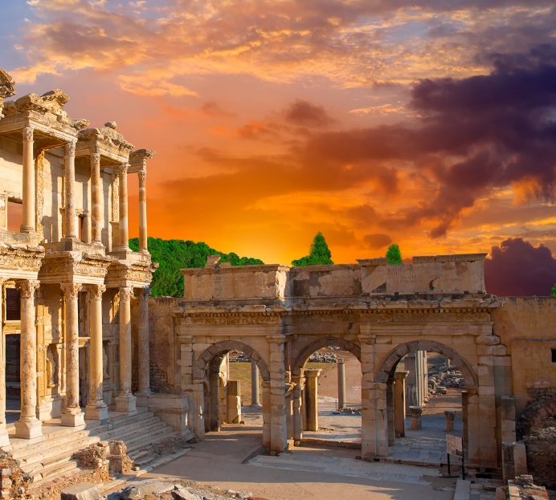
Lesson 110
Charity
1 Corinthians 13-14
But charity is the pure love of Christ, and it endureth forever; and whoso is found possessed of it at the last day, it shall be well with him.
Moroni 7:47

Slide 2
Charity
Moroni 7:45
“ And charity suffereth long, and is kind, and enveith not, and is not puffed up, seeketh not her own, is not easily provoked, thinketh no evil, and rejoiceth not in iniquity but rejoiceth in the truth, beareth all things, believeth all thing, hopeth all thing, endureth all things.”

Slide 3
Harmful effects resulting from having certain attitudes and behaviors
Classmates are rude to you, so you feel justified in being rude in response.
You frequently get annoyed and upset by the behavior of a sibling.
You feel envious of a friend’s talents and accomplishments.
Sometimes you find it easy to gossip and speak badly about others.

Slide 4
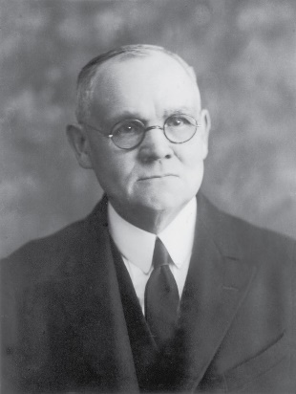
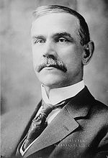
A Sounding Brass and Tinkling Cymbal
"Religion without morality, professions of godliness without charity, church-membership without adequate responsibility as to individual conduct in daily life, are but as sounding brass and tinkling cymbals-noise without music, the words without the spirit of prayer.“ (2)
"Wherever I go, outside of the families of the Church and the conferences that I attend in different places in which the Church gathers, there are few places where prayer is offered. And sometimes when I hear prayer in other places it is like a tinkling cymbal and sounding brass. It goes in one ear and out of the other. No power whatever is back of it. It is mere words and nothing else." (3)
1 Corinthians 13:1

Slide 5
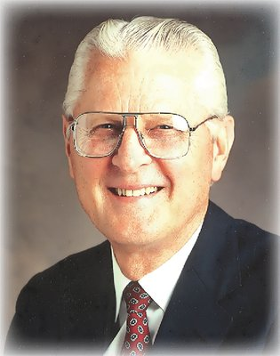
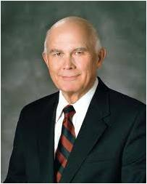
Prophecy, Mysteries, Knowledge and Faith
"We have been taught in other scripture that no matter how great and significant our mortal accomplishments, no matter how much was accomplished under our hand-as a bishop, a clerk, a president, a teacher, or a parent-unless we learn to exhibit charity, we are nothing.
All our good deeds will not weigh in our favor if charity is lacking.“ (4)
Even the most extreme acts of service fall short of the ultimate 'profit' unless they are motivated by the pure love of Christ. If our service is to be most efficacious, it must be unconcerned with self and heedless of personal advantage. It must be accomplished for the love of God and the love of his children." (5)
1 Corinthians 13:2-3

Slide 6
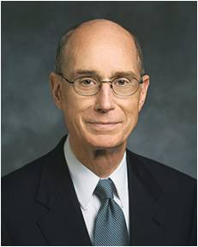
Charity Suffereth Long
Forgives, forgets, tries again: does not judge or hold grudges; is kind, thoughtful, and concerned for others; is patient, even under adversity
“We do not know the hearts of those who offend us. Nor do we know all the sources of our own anger and hurt.
The Apostle Paul was telling us how to love in a world of imperfect people, including ourselves.”
Forget
Forgive
Be Patient
Try Again
“…And then he gave solemn warning against reacting to the fault of others and forgetting our own.” (6)
1 Corinthians 13:4-5

Slide 7
Rejoice in the Truth
“True charity … is shown perfectly and purely in Christ’s unfailing, ultimate, and atoning love for us. … It is that charity—his pure love for us—without which we would be nothing, hopeless, of all men and women most miserable. …
As we seek to obtain the spiritual gift of charity, we become more like our Savior, Jesus Christ
“Life has its share of fears and failures. Sometimes things fall short. Sometimes people fail us, or economies or businesses or governments fail us. But one thing in time or eternity does not fail us—the pure love of Christ.” (7)
1 Corinthians 13:6-8

Slide 8
Bareth All Things—Admonition of Paul
And charity suffereth long, and is kind, and envieth not, and is not puffed up, seeketh not her own, is not easily provoked, thinketh no evil, and rejoiceth not in iniquity but rejoiceth in the truth, beareth all things, believeth all things, hopeth all things, endureth all things.
Moroni 7:45
"Our trials need not overcome us. In fact, they can teach us humility, faith, courage, and compassion, and can ultimately help us develop charity, the pure love of Christ, which 'beareth all things, believeth all things, hopeth all things, [and] endureth all things.‘ (7)
1 Corinthians 13:8

Slide 9
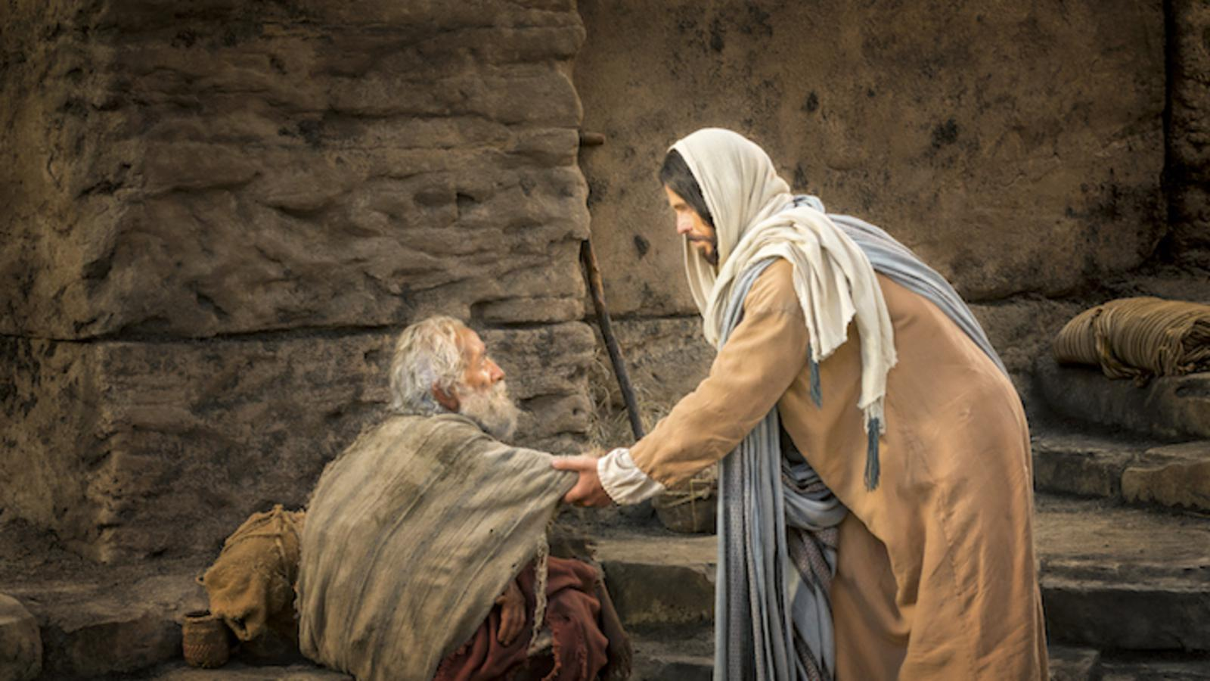
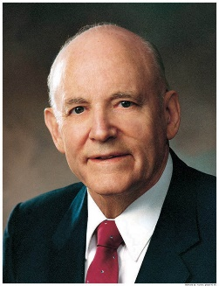
Charity Never Faileth
“Shall the gifts of the Spirit cease? Is there to be a day when the saints shall no longer possess the gifts of prophecy and tongues? Or the gift of knowledge?
Yes, in the sense that these shall be swallowed up in something greater, and shall no longer be needed in the perfect day.
When the saints know all tongues, none will be able to speak in an unknown tongue.
When the saints become as God and know all things—past, present, and future—there will be no need or occasion to prophesy of the future.” (8)
“Charity encompasses all other godly virtues. It distinguishes both the beginning and the end of the plan of salvation. When all else fails, charity—Christ’s love—will not fail. It is the greatest of all divine attributes.” (9)
1 Corinthians 13:8

Slide 10
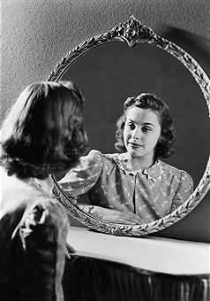
Perfect Eternal Knowledge
Paul observed that the knowledge available in this life is incomplete as compared with the perfect knowledge we will enjoy in eternity.
Paul compared our current, imperfect knowledge to viewing a person’s image in the imperfect reflection of a metal mirror.
He then compared perfect eternal knowledge to the clarity of seeing that same person “face to face.” (1)
1 Corinthians 13:9-12

Slide 11
Through a Glass Darkly
A latter-day analogy might be that the Lord has sent each of us into mortality wearing a pair of sunglasses.
He gives them to us for our own protection. We may not take them off.
Still, we have the option of dwelling in light or darkness.
If we choose darkness, we are bound to stumble, living life with skinned knees and stubbed toes.
If we choose light, we will navigate the obstacle course of life successfully, without suffering the harmful effects of too much sunlight.
Indeed, it takes a long time of living in the light before our eyes can fully accommodate. (11)
1 Corinthians 13:9-12

Slide 12
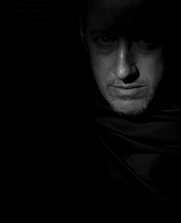
Those Who Reject the Darkness
Those who have totally rejected the darkness-though they may not remove their sunglasses by themselves-may find that the Lord will briefly remove their sunglasses for them.
Such an illuminating experience can only happen to those who have developed far beyond the near-sightedness and darkness of mortality. (11)
Horace Spatula
"Could you gaze into heaven five minutes, you would know more than you would by reading all that ever was written on the subject." (10)
Apparently, Paul had gazed into heaven for at least five minutes, so he knew that his mortal eyes saw only 'through a glass, darkly.'
Read: 2 Cor. 12:1-4
1 Corinthians 13:9-12

Slide 13
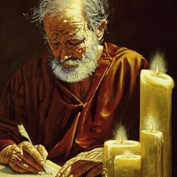
The Gift of Prophecy
A prophecy consists of divinely inspired words or writings, which a person receives through revelation from the Holy Ghost. The testimony of Jesus is the spirit of prophecy.
And I fell at his feet to worship him. And he said unto me, See thou do it not: I am thy fellow servant, and of thy brethren that have the testimony of Jesus: worship God: for the testimony of Jesus is the spirit of prophecy. Revelation 19:10
When a person prophesies, he speaks or writes that which God wants him to know, for his own good or the good of others” (12)
1 Corinthians 14:1-3

Slide 14
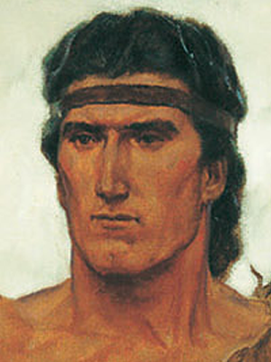
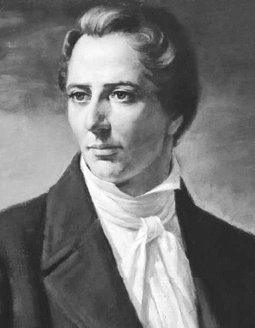
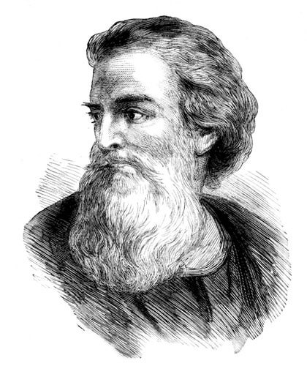
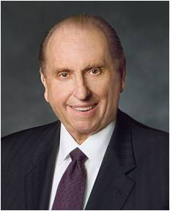
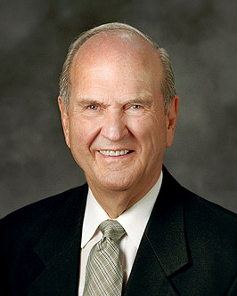
A True Prophet
"A true prophet is one who has the testimony of Jesus; one who knows by personal revelation that Jesus Christ is the Son of the living God, and that he was to be-or has been-crucified for the sins of the world; one to whom God speaks and who recognizes the still small voice of the Spirit.
“A true prophet is one who holds the holy priesthood; who is a legal administrator; who has power and authority from God to represent him on earth.
“A true prophet is a witness, a living witness, one who knows, and one who testifies. Such a one, if need be, foretells the future and reveals to men what the Lord reveals to him." (8)
“A true prophet is a teacher of righteousness to whom the truths of the gospel have been revealed and who presents them to his fellowmen so they can become heirs of salvation in the highest heaven.
As we teach and testify by inspiration, we can help edify and comfort others
1 Corinthians 14:3

Slide 15
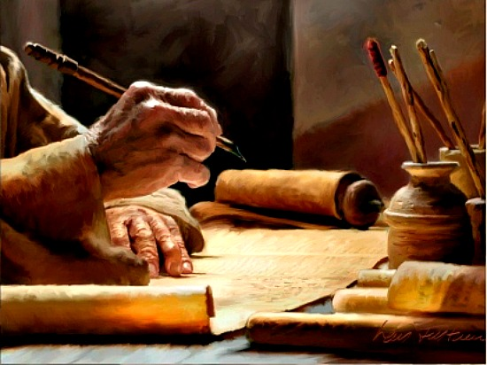
Improper Use of Gift of Tongues
Paul warned that if used improperly, the gift of tongues would fail to edify the Church and would distract members from seeking more useful spiritual gifts.
Acts 2:4-8 The Day of Pentecost:
The gift of tongues was manifest through God’s servants teaching the gospel in languages that were known to their listeners but unknown to the speakers.
Another manifestation of the gift of tongues occurs when a person is moved by the Spirit to speak in a language that is unknown to either the speaker or the hearers (8).
The second manifestation of the gift of tongues seems to have been highly sought after by some members of the Church in Corinth as supposed evidence of a person’s spirituality. Paul corrected this misunderstanding as he explained that this form of the gift of tongues provided unbelievers with evidence of God’s power but did not teach or edify the Saints.
1 Corinthians 14:5-7, 19, 22, 26

Slide 16
The Trumpet Gives An Uncertain Sound
If you are unfamiliar with the gift of the Holy Ghost…how will you know what is right?
A shofar, or ram’s horn trumpet.
The loud, clear signal of such trumpets was used in ancient Israel to call people to gather for battle or for important religious occasions. Paul drew upon this image as he counseled the Corinthian Saints about the ineffectiveness of speaking in unknown tongues and the importance of clear teaching in the Church. (1)
1 Corinthians 14:8-9

Slide 17
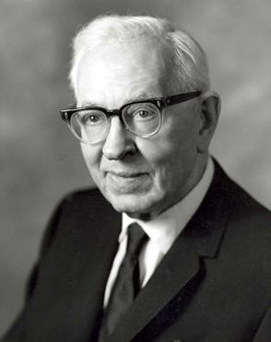
Edify—Build Upon
One reason we should seek for spiritual gifts is to build up or strengthen the Church of God.
For all have not every gift given unto them; for there are many gifts, and to every man is given a gift by the Spirit of God.
To some is given one, and to some is given another, that all may be profited thereby. D&C 46:11-12
"All members of the Church should seek for the gift of prophecy, for their own guidance, which is the spirit by which the word of the Lord is understood and his purposes made known." (14)
1 Corinthians 14:12

Slide 18
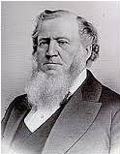
One By One
All, both male and female, may prophesy, or teach and testify. This should be done in order, one person at a time.
In the Church of Jesus Christ, all things are to be done in order
"Without revelation direct from heaven, it is impossible for any person to understand fully the plan of salvation. We often hear it said that the living oracles must be in the Church, in order that the Kingdom of God may be established and prosper on the earth. I will give another version of this sentiment. I say that the living oracles of God, or the Spirit of revelation must be in each and every individual, to know the plan of salvation and keep in the path that leads them to the presence of God." (13)
"Revelations are given for a two-fold purpose: to furnish guidance for the Church, and to give comfort to the individual.” (15)
1 Corinthians 14:31, 33. 40

Slide 19
Women Speaking In Church
It is difficult to understand the intent of Paul’s counsel since he clearly did not forbid women from praying or speaking in Church meetings
Let your women keep silence in the churches: for it is not permitted unto them to speak;
The Joseph Smith Translation:
(to rule)
This word change suggests the possibility that Paul was trying to correct a situation in which some Corinthian women were either being disorderly during worship services or were improperly seeking to take responsibility to lead rather than sustaining and following priesthood leaders. (16)
1 Corinthians 14:34-35

Slide 20
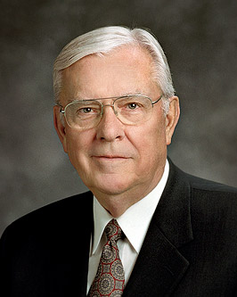
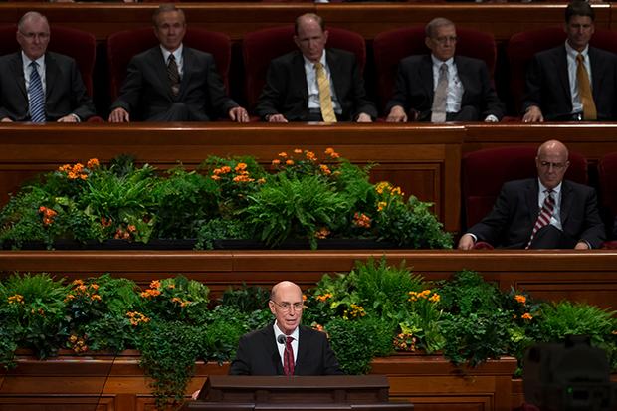
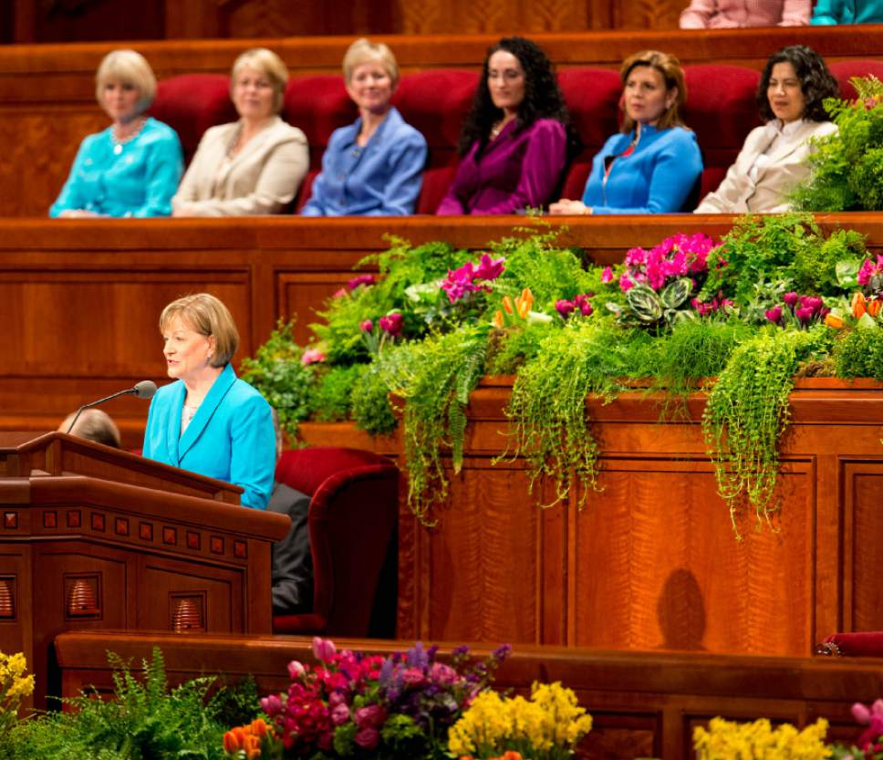
“‘In our Heavenly Father’s great priesthood-endowed plan, men have the unique responsibility to administer the priesthood, but they are not the priesthood.
Men and women have different but equally valued roles. Just as a woman cannot conceive a child without a man, so a man cannot fully exercise the power of the priesthood to establish an eternal family without a woman. …
… In the eternal perspective, both the procreative power and the priesthood power are shared by husband and wife.’ (17)
1 Corinthians 14:31, 33. 40

Slide 21
Sources:
Suggested Hymn: #223 Have I Done Any Good?
Video: My Brother Hyrum (2:41)
New Testament Institute Student Manual Chapter 39
James E. Faust (Articles of Faith [Salt Lake City: Deseret Book Co., 1981], 389.)
Elder Reed Smoot (Conference Report, October 1931, Third Day-Morning Meeting 113.)
Harold Burke Peterson ("Our Responsibility to Care for Our Own," Ensign, May 1981, 81)
Elder Dallin H. Oaks (Pure in Heart [Salt Lake City: Bookcraft, 1988], 47.)
President Henry B. Eyring (“That We May Be One,” Ensign, May 1998, 68).
Elder Jeffrey R. Holland (Christ and the New Covenant [1997], 337).
Elder Bruce R. McConkie (Doctrinal New Testament Commentary, 2:380 and 383). The Mortal Messiah: From Bethlehem to Calvary, 4 vols. [Salt Lake City: Deseret Book Co., 1979-1981], 2: 169.)
President Howard W. Hunter (“A More Excellent Way,” Ensign, May 1992, 61).
Joseph Smith (History of The Church, 6: 50.)
Gospeldoctrine.com
Guide to the Scriptures, “Prophecy, Prophesy, scriptures.lds.org.
Brigham Young…John A. Widtsoe, comp., Discourses of Brigham Young, Salt Lake City: Deseret Book Co., 1954, p. 38.)
President Joseph Fielding Smith (Church History and Modern Revelation, 1:184.)
John A. Widtsoe, Evidences and Reconciliations, Salt Lake City: Bookcraft, 1960, pp. 98-99, 101; italics added.)" (Dean Sorensen, "I Have a Question," Ensign, Apr. 1990, 54
New Testament Student Manual [Church Educational System manual, 2014], 380).
Elder M. Russell Ballard (“This Is My Work and Glory,” Ensign or Liahona, May 2013, 19.)
Presentation by ©http://fashionsbylynda.com/blog/

Slide 22
First Letter of Paul to the Saints at Corinth— Written from Ephesus, ca. Spring, A.D. 57
Charity: The Pure Love of Christ | 13:1–13
Tongues and Prophecy Compared | 14:1–28
Prophecy—the Greatest Gift | 14:29–40
Pure Love of Christ 1 Corinthians 13:8:
"The pure love of Christ will eventually triumph over all the evils, including power, pride, boasting, worldly acclaim, cruelty, wars, perversion, sadness, and heartache. The Lord through His servants has promised that charity will never fail. One day charity, the pure love of Christ, will triumph over all the world. Those who are possessors of charity will triumph over all evil and will dwell with the author of this 'new commandment' forever and forever." Vaughn J. Featherstone (The Incomparable Christ: Our Master and Model [Salt Lake City: Deseret Book Co., 1995], 78 - 79.)
Fail, Cease, and Vanish Away 1 Corinthians 13:8:
"That is perfectly natural; for when that which is perfect is come, we shall see as we are seen, and know as we are known. There will be no need for men to prophesy what shall take place, for we shall all see and understand it. In that day it will not be necessary for one to say to another, Know ye the Lord; for all shall know Him. Perfect knowledge will be enjoyed by all. We shall see eye to eye, and be of one heart and mind in the kingdom of God. It will not be necessary for any to speak in an unknown tongue; for the original Adamic language will be restored, and all shall speak in the one tongue. Hence how consistent it is to say, 'When that which is perfect is come, then that which is in part shall be done away.' These gifts are now given to us as a lamp to lighten our pathway, to encourage us when our spirits are drooping, to heal our bodies when we are afflicted, and to give us knowledge of things to come, that we may be buoyed up and go on to perfection.“ Elder John W. Taylor (Conference Report, October 1903, Overflow Meeting 97.)
"Thus it will be seen that the gifts were not to cease until 'that which is perfect is come'-until we see the Lord face to face-until we know as we are known. Then tongues will cease, and the heavenly glorified throng will all speak the same language. Then prophesying in part will be done away; for the knowledge of the future will be fully understood. Then knowledge in part shall vanish away and the Saints will know in full. Then the day of perfection will come, and all the Saints shall enjoy the fullness of Christ, and see Him no longer through a glass darkly, but face to face. Until that day of glory and perfection shall arrive, all the spiritual gifts will be indispensably necessary, without which the Saints can never attain to that great salvation promised." (Orson Pratt's Works [Salt Lake City: Deseret News Press, 1945], 100.)
Life and Teachings of Jesus and His Apostles Chapter 36
Developing True Charity:
"We don't develop character by chance. Good character is the result of continual effort in righteous thinking and the righteous acts that such thinking brings about.
"The scriptures tell us, 'As he thinketh in his heart, so is he' (Prov. 23:7), and 'Let virtue garnish thy thoughts unceasingly; then shall thy confidence wax strong in the presence of God' (D&C 121:45). Both the Apostle Paul and the prophet Mormon taught that charity, the pure love of Christ, 'thinketh no evil.' (See 1 Cor. 13:4-5; Moro. 7:45.) Clearly, we are what we think. And if we think righteous thoughts, we will very likely live righteously...
"We are the masters of our thoughts. Just as we would tend, prune, and cultivate a garden, so should we tend and cultivate our minds, pruning and weeding impure, negative, or sinful thoughts while cultivating righteous ones...
"To develop purity of mind, we need to do more than dismiss or avoid evil, negative, or impure thoughts. We also need to learn to think virtuous thoughts. Just as it takes effort to discover material treasures of the earth, it takes effort to develop good thoughts. The scriptures guide us in choosing what to think about:
"'Whatsoever things are true, whatsoever things are honest, whatsoever things are just, whatsoever things are pure, whatsoever things are lovely, whatsoever things are of good report ... think on these things.' (Philip. 4:8.)
"We can learn to 'think on' such things by seeking good surroundings, reading the scriptures and other good books, praying, singing hymns, fasting, observing the Sabbath, selecting uplifting entertainment, wearing modest clothing, developing talents, participating in church and community service, and striving to keep the commandments.
"As we learn to think virtuous thoughts, our lives become more virtuous. We will want to live righteously, in thought and in deed. We will be more Christlike." ("Charity Thinketh No Evil," Ensign, Aug. 1988, 61) Visiting Teaching Message

Slide 23
Faith Hope And Charity 1 Corinthians 13:13:
“The Apostle Paul taught that three divine principles form a foundation upon which we can build the structure of our lives. They are faith, hope, and charity. (See 1 Cor. 13:13.) Together they give us a base of support like the legs of a three-legged stool. Each principle is significant within itself, but each also plays an important supporting role. Each is incomplete without the others. Hope helps faith develop. Likewise, true faith gives birth to hope. When we begin to lose hope, we are faltering also in our measure of faith. The principles of faith and hope working together must be accompanied by charity, which is the greatest of all. According to Mormon, ‘charity is the pure love of Christ, and it endureth forever.’ (Moro. 7:47.) It is the perfect manifestation of our faith and hope.
“Working together, these three eternal principles will help give us the broad eternal perspective we need to face life’s toughest challenges, including the prophesied ordeals of the last days. Real faith fosters hope for the future; it allows us to look beyond ourselves and our present cares. Fortified by hope, we are moved to demonstrate the pure love of Christ through daily acts of obedience and Christian service.” Elder M. Russell Ballard (“The Joy of Hope Fulfilled,” Ensign, Nov. 1992, 33).
The Gift of Tongues 1 Corinthians 14:5-7, 19, 22, 26:
“We are told by prophets in this dispensation that revelation for the direction of the Church will not be given through the gift of tongues. The reason for this is that it is very easy for Lucifer to falsely duplicate the gift of tongues and confuse the members of the Church.
“Satan has the power to trick us as it pertains to some of the gifts of the Spirit. One in which he is the most deceptive is the gift of tongues. Joseph Smith and Brigham Young (1801–77) explained the need to be cautious when considering the gift of tongues.
“‘You may speak in tongues for your own comfort, but I lay this down for a rule, that if anything is taught by the gift of tongues, it is not to be received for doctrine’ (Teachings: Joseph Smith, 384).
“‘Speak not in the gift of tongues without understanding it, or without interpretation. The devil can speak in tongues’ (Teachings: Joseph Smith, 384).
“‘The gift of tongues is not … empowered to dictate … the Church. All gifts and endowments given of the Lord to members of his Church are not given to control the Church; but they are under the control and guidance of the Priesthood, and are judged of by it’ (Discourses of Brigham Young, comp. John A. Widtsoe [1941], 343)
“The gift of tongues is used by missionaries to teach the gospel to the nations of the world” Elder Robert D. Hales (“Gifts of the Spirit,” Ensign, Feb. 2002, 14–15)..
The Gift of Prophecy 1 Corinthians 14:1-3:
“The nouns prophecy and prophet and their variations, such as the adjective prophetic and the verb prophesy, are used in several different senses.
“When we hear the word prophet in our day, we are accustomed to thinking of the prophet. These words signify him who holds the prophetic office and is sustained as the prophet, seer, and revelator. The priesthood offices and powers exercised by the President of the Church are unique. …
“The spiritual gift of prophecy is quite different. As we read in the Book of Revelation, ‘The testimony of Jesus is the spirit of prophecy.’ (Rev. 19:10.) The Prophet Joseph Smith relied on this scripture in teaching that ‘every other man who has the testimony of Jesus’ is a prophet [in History of the Church, 3:28]. Similarly, the Apostle Paul states that ‘he that prophesieth speaketh unto men to edification, and exhortation, and comfort.’ (1 Cor. 14:3.) Thus, in the sense used in speaking of spiritual gifts, a prophet is one who testifies of Jesus Christ, teaches God’s word, and exhorts God’s people. In its scriptural sense, to prophesy means much more than to predict the future.
“… In our day, Elder Joseph Fielding Smith declared that ‘all members of the Church should seek for the gift of prophecy, for their own guidance, which is the spirit by which the word of the Lord is understood and his purpose made known.’ (Church History and Modern Revelation, 3 vols., Salt Lake City, Deseret Book Co., 1953, 1:201.)
“It is important for us to understand the distinction between a prophet, who has the spiritual gift of prophecy, and the prophet, who has the prophetic office” Elder Dallin H. Oaks (“Spiritual Gifts,” Ensign, Sept. 1986, 71).
The Gift of Tongues and the Gift of Prophecy:
"There are only two gifts that could be made visible-the gift of tongues and the gift of prophecy. These are things that are the most talked about, and yet if a person spoke in an unknown tongue, according to Paul's testimony, he would be a 'barbarian' to those present. They would say that it was gibberish. And if he prophesied, they would call it nonsense. The gift of tongues is the smallest gift perhaps of the whole, and yet it is one that is the most sought after. . . . Be not so curious about tongues. Do not speak in tongues except there be an interpreter present. The ultimate design of tongues is to speak to foreigners, and if persons are very anxious to display their intelligence, let them speak to such in their own tongues." (Kent P. Jackson, comp. and ed., Joseph Smith's Commentary on the Bible [Salt Lake City: Deseret Book Co., 1994], 167.)

Slide 24
Men’s and Women’s Roles in the Church 1 Corinthians 14:34-35
“Why are men ordained to priesthood offices and not women? President Gordon B. Hinckley explained that it was the Lord, not man, ‘who designated that men in His Church should hold the priesthood’ and that it was also the Lord who endowed women with ‘capabilities to round out this great and marvelous organization, which is the Church and kingdom of God’ (“Women of the Church,” Ensign, November 1996, 70). When all is said and done, the Lord has not revealed why He has organized His Church as He has.
“When thinking about those things we do not fully understand, I am reminded of these words by my deceased friend and Apostle, Elder Neal A. Maxwell, who said, ‘What we already know about God teaches us to trust him for what we do not know fully’ (Deposition of a Disciple [Salt Lake City: Deseret Book, 1976], 56).
“And Elder Jeffrey R. Holland stated in this last April general conference, ‘In this Church, what we know will always trump what we do not know’ (“Lord, I Believe,” Ensign, May 2013, 94).
“Brothers and sisters, this matter, like many others, comes down to our faith. Do we believe that this is the Lord’s Church? Do we believe that He has organized it according to His purposes and wisdom? Do we believe that His wisdom far exceeds ours? Do we believe that He has organized His Church in a manner that would be the greatest possible blessing to all of His children, both His sons and His daughters?
“… Women are integral to the governance and work of the Church through service as leaders in Relief Society, Young Women, and Primary; through their service as teachers, full-time missionaries, and temple ordinance workers; and in the home, where the most important teaching in the Church occurs” Elder M. Russell Ballard (“Let Us Think Straight” [Brigham Young University campus education week devotional, Aug. 20, 2013], 4–5; speeches.byu.edu).

Slide 25
Charity
Quality Example
Suffereth long and is kind Forgives, forgets, tries again; does not judge or hold grudges; is kind, thoughtful, and concerned for others; is patient, even under adversity
Envieth not Is not jealous, discontented, or envious. Can appreciate others gifts, abilities and material blessings
Is not puffed up Is not self-righteous, conceited or proud. Is humble, and can correction and learn from it
Seeketh not her own Is not self-centered and selfish, is thoughtful of the feelings, desires and needs of others. Expresses appreciation easily and often.
Not easily provoked Does not lose temper; is not overly sensitive. Is patient even in irritation circumstances. Tolerant, thoughtful and returns good for evil. Absorbs the poison given out by some and does not let it pass to others
Thinketh no evil Is clean in thought and action; always looks for good in others; is not suspicious or hateful; is forgiving, does not hold grudges.
Rejoiceth not in iniquity Does not enjoy thinking, speaking or doing evil; seeks only uplifting entertainment. Does not (even secretly) rejoice over others’ trials or wrong-doing does not gossip, criticize, slander, or backbite.
Rejoiceth in the truth Studies and lives the gospel. Speaks the truth and searches for the truth. Improves talents, disposition, and relationships with others.
Beareth all things Bears injustice with dignity; endures sickness of self or family members with fortitude; accepts misfortune with patience.
Believeth all things Is trusting and believing, exhibits confidence in others.
Hopeth all things Sets high goals and has faith in the ability to reach them. Develops faith in the Lord, in self, and in others. Is optimistic
and develops and attitude of happiness.
Endureth all things Reacts to disappointments, sorrows, and trials with dignity. Keeps the channel of communication open with Heavenly Father for strength. Continues and functions and serves in time of adversity and trial. Sets the celestial kingdom as a goal.

