Slide 1
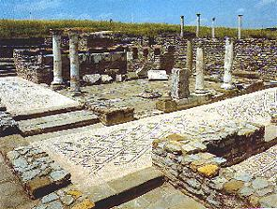
Lesson 113
In Him I Shall Find Comfort
2 Corinthians 1-3
"I will try to be contented with my lot knowing that God is my friend. In him I shall find comfort.“
--Joseph Smith’s Teachings

Slide 2
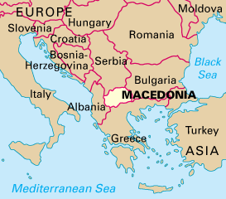
2 Corinthians
*A riot developed in Ephesus in opposition to Paul’s teaching while he waited for word of a close friend Titus who visited Corinth after the 1st letters.
*Paul fled to Macedonia, and Titus joined him while he heard news from Corinth
*Teachers from Corinth had accused Paul of taking money that was collected for the poor in Jerusalem. They also challenged Paul’s authority as an Apostle.
Paul is the author of 2 Corinthians
2nd Corinthians is a follow-up letter. It is to the same Church members and also to the Saints living in Achaia a Roman province comprising all of Greece.
The ruins of the ancient city of Heraclea Lyncestis in Bitola, Macedonia.
Acts 19:23-41

Slide 3
Letters to Corinth
The letter reveals that Paul wrote for at least five reasons:
A growing discontent due to accusations of false teachers. On his third mission Paul writes to answer these accusations and reassures the Saints in their faith.
To express gratitude to and strengthen the Saints who had responded favorably to his previous letter
To warn of false teachers who corrupted the pure doctrines of Christ
To defend his personal character and authority as an Apostle of Jesus Christ
To encourage the Corinthian Saints to
make a generous financial offering to the impoverished Saints of Jerusalem
To speak of an impending third visit to Corinth

Slide 4
The Letter Carriers
When the letter was completed, and there is good evidence to suggest that it was written in haste, Paul sent it with Titus on a return journey to Corinth.
Titus was accompanied by two companions one of whom may have been Luke.
Paul commends Titus and his party strongly to the Corinthians and urges them to make “proof” of their love and of Paul’s boasting in their behalf by making a generous contribution for the poor and sending it back with Titus. (2)
2 Corinthians 8:18, 22, 24; 9:5

Slide 5
Forgive and Comfort
Blessed be God, even the Father of our Lord Jesus Christ, the Father of mercies, and the God of all comfort;
Who comforteth us in all our tribulation, that we may be able to comfort them which are in any trouble, by the comfort wherewith we ourselves are comforted of God.
"For anyone seeking the courage to repent and change, I remind you that the Church is not a monastery for the isolation of perfect people. It is more like a hospital provided for those who wish to get well. Do whatever you have to do to come into the fold and be blessed.” (3)
2 Corinthians 1:4-5

Slide 6
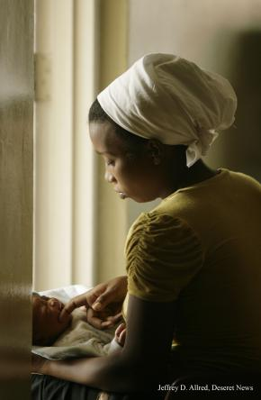
One of our many consolations in Christ is that our sufferings for His cause never go unnoticed.
When Heavenly Father comforts us in our tribulations, we are able to help others receive His comfort
Church response on 13 January 2010:
“We express our sympathy and prayers on behalf of the citizens of Haiti following the recent devastating earthquake. The Church of Jesus Christ of Latter-day Saints is immediately shipping humanitarian relief, including personal hygiene kits and supplies for newborns. Efforts are underway to determine further humanitarian response in coordination with government and disaster relief organizations.”
2 Corinthians 1:4-5

Slide 7
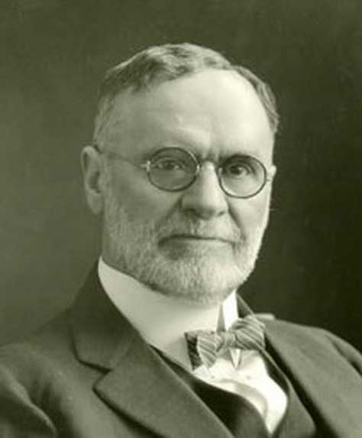
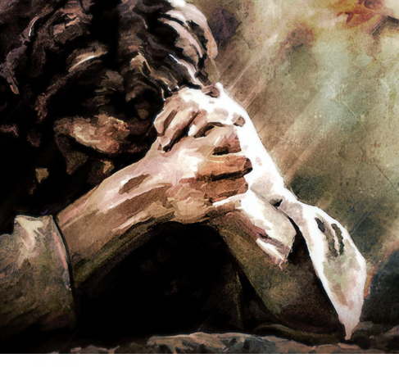
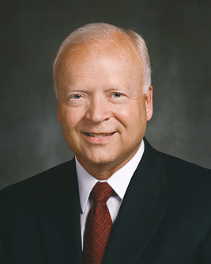
“… Is not this God’s purpose in causing his children to suffer? He wants them to become more like himself.
God has suffered far more than man ever did or ever will, and is therefore the great source of sympathy and consolation.” (4)
“Much of our suffering is not necessarily our fault. Unexpected events, contradicting or disappointing circumstances, interrupting illness, and even death surround us and penetrate our mortal experience. Additionally, we may suffer afflictions because of the actions of others.
Opposition is part of Heavenly Father’s plan of happiness. We all encounter enough to bring us to an awareness of our Father’s love and of our need for the Savior’s help.
The Savior is not a silent observer. He Himself knows personally and infinitely the pain we face.” (5)
And he cometh into the world that he may save all men if they will hearken unto his voice; for behold, he suffereth the pains of all men, yea, the pains of every living creature, both men, women, and children, who belong to the family of Adam.
2 Nephi 9:21
2 Corinthians 1:4-5

Slide 8
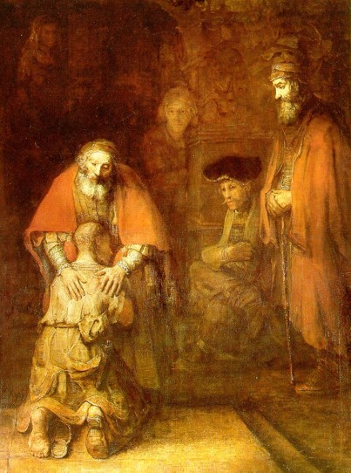
“And whether we be afflicted, it is for our consolation and salvation…
…which is effectual in the enduring of the same sufferings which we also suffer…”
2 Corinthians 1:6

Slide 9
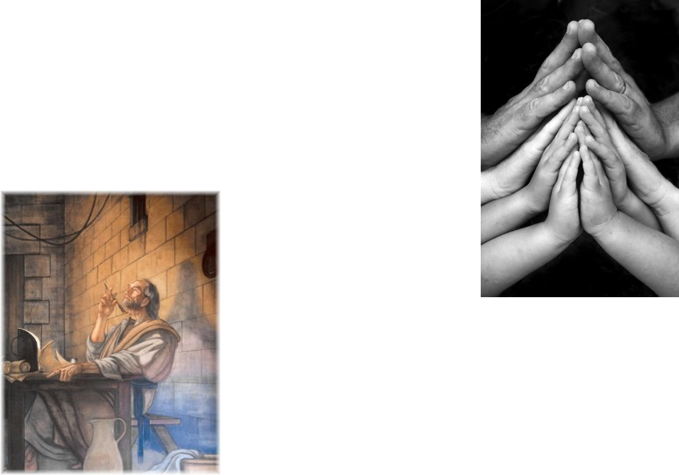
Paul and Companion’s Trials
“Ye also helping together by prayer for us, that for the gift bestowed upon us by the means of many persons thanks may be given by many on our behalf.”
Our prayers can help those who are experiencing trials
2 Corinthians 1:9-11

Slide 10
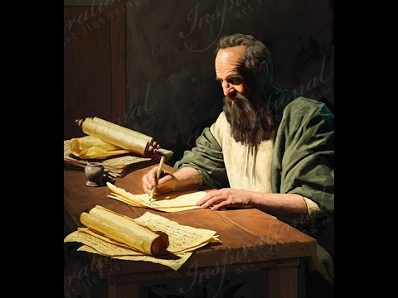
Change of Plans
Paul responded to those who found fault with him when he changed his plans to visit them. Some of Paul’s critics seemed to say that because Paul changed his travel plans they could no longer trust him or his teachings. Paul declared that the message of the gospel was true, regardless of his change in plans.
2 Corinthians 1:15-24

Slide 11
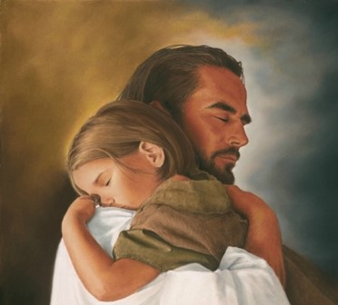
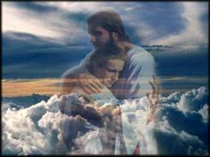
Comforter—Holy Spirit
earnest = “a pledge or security
“And I will pray the Father, and he shall give you another Comforter, that he may abide with you for ever.”
“I will not leave you comfortless: I will come to you.”
2 Corinthians 1:22; John 14:16

Slide 12
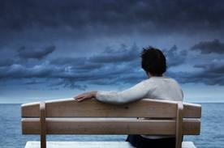
Where Can I Turn For Peace?
“Peace I leave with you, my peace I give unto you: not as the world giveth, give I unto you. Let not your heart be troubled, neither let it be afraid.”
2 Corinthians 1:22; John 14:27

Slide 13
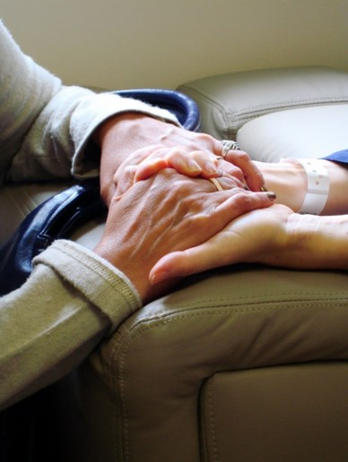
Consolation—
Comfort, soothing, relief from grief
“And our hope of you is stedfast, knowing, that as ye are partakers of the suffering, so shall ye be also of the consolation.”
John 14:27

Slide 14
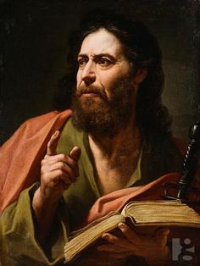
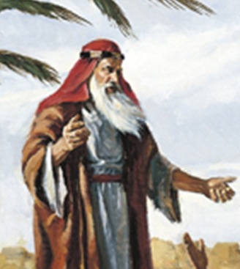
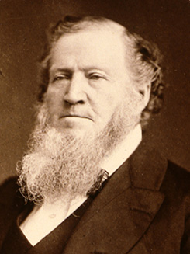
Harshness In Paul’s Writings
Paul acknowledged that some of his writings in a previous epistle could have seemed harsh because he was chastening the members.
Prophets of all ages have carried the responsibility to teach, warn, and correct God’s children.
“At times I may to many of the brethren appear to be severe. I sometimes chasten them; but it is because I wish them to live so that the power of God, like a flame of fire, will dwell within them and be around about them.” (6)
2 Corinthians 2:1-4
(1)

Slide 15
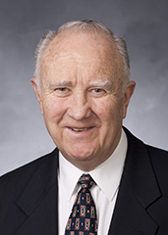
“When we take the position of withholding forgiveness from our fellow men, we are attempting to block his progress towards salvation.
This position is … not Christlike.
We are endeavoring to impede the progress of a living soul and deny him the forgiving blessings of the atonement.
This philosophy is saturated with impure motives that are designed to destroy the soul.” (7)
2 Corinthians 2:1-4

Slide 16
To Forgive
“So that contrariwise ye ought rather to forgive him, and comfort him,…
… lest perhaps such a one should be swallowed up with overmuch sorrow.”
2 Corinthians 2:7

Slide 17
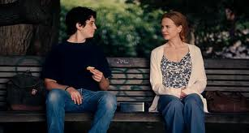
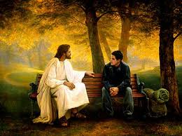
Obedient in all things
“To whom ye forgive any thing, I forgive also: for if I forgave any thing…
…to who I forgave it, for your sakes forgave I it in the person of Christ;”
Forgiving others does not mean that the sinner should not be held accountable for his or her actions. Nor does it mean putting ourselves in situations in which people can continue to mistreat us. Rather, forgiving others means treating with love those who have mistreated us and harboring no resentment or anger toward them. We are commanded to forgive all men. (10)
2 Corinthians 2:9-11

Slide 18
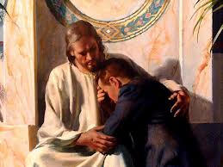
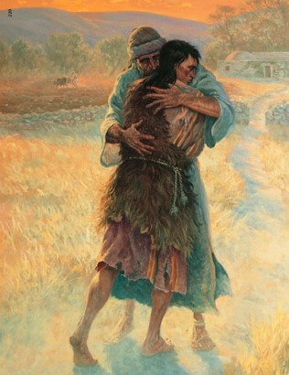
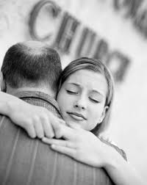
A Greater Sin
“…that ye ought to forgive one another; for he that forgiveth not his brother his trespasses standeth condemned before the Lord; for there remaineth in him the greater sin.”
“I, the Lord, will forgive whom I will forgive, but of you it is required to forgive all men.”
D&C 64:9-10

Slide 19
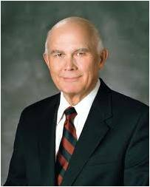
Satan’s Devices
“to get advantage over us”
Paul knew that if the Corinthian Saints failed to forgive the man who had received Church disciplinary action, there would be increased discord among them..
“Satan’s most strenuous opposition is directed at whatever is most important to the Father’s plan. Satan seeks to discredit the Savior and divine authority, to nullify the effects of the Atonement, to counterfeit revelation, to lead people away from the truth, to contradict individual accountability, to confuse gender, to undermine
marriage, and to discourage childbearing
(especially by parents who will raise children in righteousness)” (8)
2 Corinthians 2:11

Slide 20
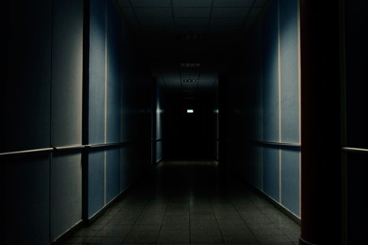
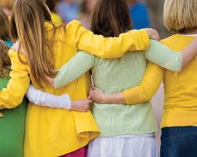
Satan uses the unforgiving spirit as a device to cause division between people.
If we do not forgive others, Satan will have an advantage over us
“True compassion for one’s fellow men is a mark of a true saint. It consists in sorrow for their sufferings, in having pity and sympathy for them, and in exhibiting mercy, tenderness and kindness towards them.” (9)

Slide 21
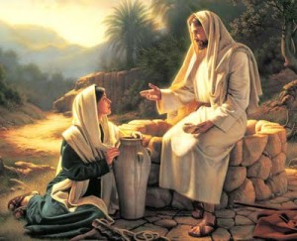
Character of Christ
To Christ’s enemies, the sweet fragrance of the Saints and their witness of Christ was like the savor of death, but to those who accepted the Apostles and their teachings, it was the savor of life.
Albin Veselka
"Those who partake of the spirit breathed by the saints, the spirit of the gospel, the sweet influence that results from obedience to God's laws, gain eternal life; those who reject it inherit eternal death.
That is, the gospel is an instrument of life and of
death, of life to the obedient, of death to the
disobedient." (9)
2 Corinthians 2:16

Slide 22
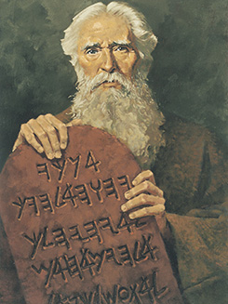
Living Epistles of the Truth
During Paul’s absence from Corinth, some false teachers began to oppose Paul’s teachings and tried to discredit Paul by telling the converts that they still needed to follow the law of Moses.
In response to those who tried to discredit him, Paul asked the members of Corinth rhetorically if he needed to provide them with a “[letter] of commendation” that testified of his character and his legitimacy as a true Apostle of Jesus Christ.
Ted Henninger
“In the ultimate sense, the gospel is not written on tablets of stone or in books of scripture, but in the bodies of faithful and obedient persons; the saints are, thus, living epistles of the truth, the books of whose lives are open for all to read.” (9)
2 Corinthians 3:1-2

Slide 23
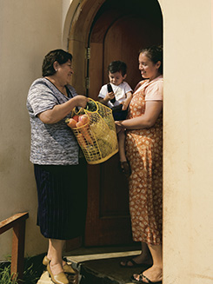
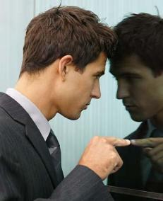
Judging the Church By Its Members
Many people throughout the world have kind feelings toward the Church because of the acts of kindness and service they see manifest in the lives of Church members. (1)
"Ye shall know them by their fruits. Do men gather grapes of thorns, or figs of thistles? Even so every good tree bringeth forth good fruit; but a corrupt tree bringeth forth devil fruit. A good tree cannot bring forth evil fruit, neither can a corrupt tree bring forth good fruit. Every tree that bringeth not forth good fruit is hewn down, and cast into the fire. Wherefore by their fruits ye shall know them.“ Matthew 7:16-21
2 Corinthians 3:2-3

Slide 24
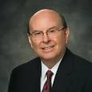
The Letter Killeth But the Spirit Liveth
Paul declared to the Corinthian Saints that he was a minister of the “new testament,” meaning the new covenant of the gospel of Jesus Christ.
He referred to the old covenant, which was the law of Moses, as the “letter” and the new covenant as “the spirit.”
Why ?
What ?
How ?
“Doctrine usually answers the question ‘why?’
Principles usually answer the question ‘what?’
Whenever we emphasize how to do something without reference to why we do it or what we do, we risk looking beyond the mark.” (11)
2 Corinthians 3:6

Slide 25
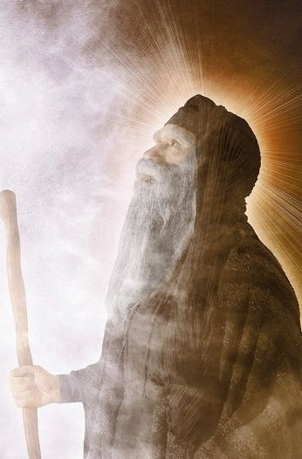
Veil Done Away With In Christ
Paul states that they are ministers of the new covenant of Christ, which does away with the old.
Paul refers to the scriptural records when he talks of the reading of the old testament, he is not using it in the same sense we think of the Old Testament, but rather in the sense of the Mosaic law, or the old covenant. (2)
2 Corinthians 3:14-15

Slide 26
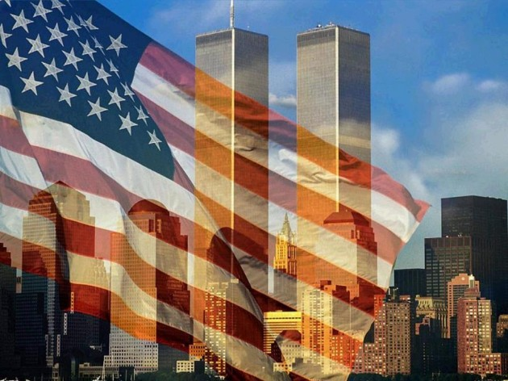
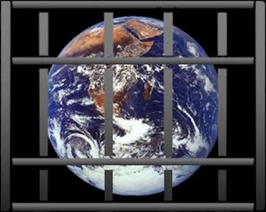
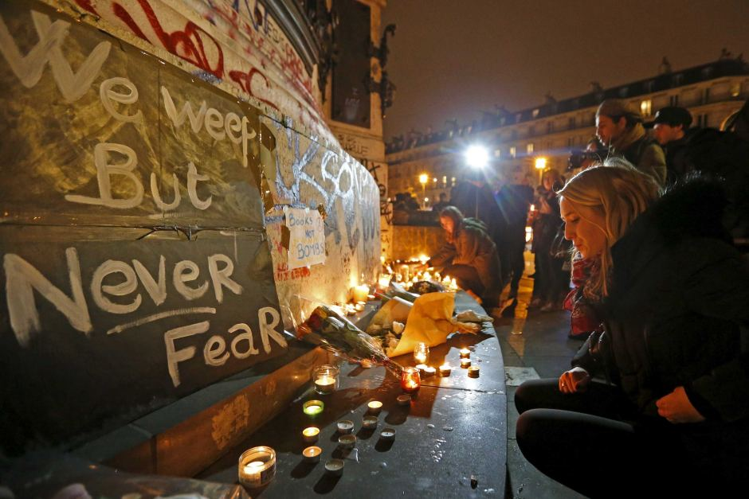
Spirit Brings Liberty
It is Satan, not God, who seeks to destroy agency and liberty
“Since Satan always seeks to destroy the agency of man, he influences churches and governments to deny freedom of worship and to force man to perform acts contrary to the divine will.
“Governments and churches which curtail or deny man the power to worship God according to the dictates of his own conscience, are not of God; they are not directed by the power of his Spirit” (9)
2 Corinthians 3:17

Slide 27
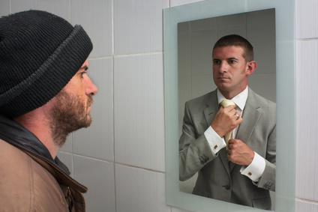
Change and Transformed
The Spirit is the means by which God gradually transforms us into glorious beings like Him.
"As a mirror reflects the likeness of a person, so the saints should reflect the image of Christ, and as they progress in obedience and personal righteousness, they attain this image; by the power of the Spirit, they become like Christ." (9)
As we turn our hearts to the Lord, we will have the Spirit, which will gradually help us become more like God.
2 Corinthians 3:18

Slide 28
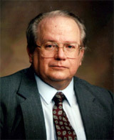
"For Latter-day Saints the focal point of this life must be coming to Christ and beginning the process, but we also look forward to that greater moment in eternity when we shall finally be like him.
And toward that glorious day as faithful sons and daughters we consecrate ourselves in the everyday unfolding of our lives, that by our labors we might close the gap between us.
When we use the term coming to Christ in describing conversion, it is a figure of speech that describes our intent and our desires.
But the ultimate realization of coming to Christ is in actually closing the distance between us by becoming what he is through doing what he does." (12)
2 Corinthians 3:18

Slide 29
Sources:
Suggested Hymn: #129 Where Can I Turn For Peace?
Video: Forgiveness: My Burden Was Made Light (8:24)
Title Page: (Encyclopedia of Joseph Smith's Teachings, edited by Larry E. Dahl and Donald Q. Cannon [Salt Lake City: Bookcraft, 1997], "Comfort".)
New Testament Institute Student Manual Chapter 39
Life and Teachings of Jesus and His Apostles Chapter 37
Elder Jeffrey R. Holland ("Come unto Me," Ensign, Apr. 1998, 18-19)
Elder Orson F. Whitney (“A Lesson from the Book of Job,” Improvement Era, Nov. 1918, 7; see also James E. Faust, “Refined in Our Trials,” Ensign or Liahona, Feb. 2006, 5).
Elder Kent F. Richards The Atonement Covers All Pain April 2011 Gen. Conf.
(Discourses of Brigham Young, sel. John A. Widtsoe [1954], 115).
Elder C. Max Caldwell (Sacred Truths of the Doctrine and Covenants, 2 vols. [1993], 1:314; see also D&C 64:9–11).
Elder Dallin H. Oaks (“The Great Plan of Happiness,” Ensign, Nov. 1993, 72).
Elder Bruce R. McConkie Mormon Doctrine p. 152. (Doctrinal New Testament Commentary, 3 vols. [Salt Lake City: Bookcraft, 1965-1973], 2: 413-416
(See Guide to the Scriptures, “Forgive,” scriptures.lds.org; D&C 64:9–11.)
Elder Quentin L. Cook (“Looking beyond the Mark,” Ensign, Mar. 2003, 44).
Stephen E. Robinson, Following Christ: The Parable of the Divers and More Good News [Salt Lake City: Deseret Book Co., 1995], 69 - 70.)
Presentation by ©http://fashionsbylynda.com/blog/

Slide 30
Second Letter of Paul to the Saints at Corinth— Written from Macedonia about AD 57
God Cares for the Saints | 1:1–24
Saints Love and Forgive One Another | 2:1–17
The Gospel Is Greater Than the Law of Moses | 3:1–18
Judging the Church By Its Members 2 Corinthians 3:2:
“The only things that can ever embarrass this work are acts of disobedience to its doctrine and standards by those of its membership. That places upon each of us a tremendous responsibility. This work will be judged by what the world sees of our behavior. God give us the will to walk with faith, the discipline to do what is right at all times and in all circumstances, the resolution to make of our lives a declaration of this cause before all who see us” President Gordon B. Hinckley (“This Thing Was Not Done in a Corner,” Ensign, Nov. 1996, 51).
Testament 2 Corinthians 3:6:
"'Testament' here is a Greek legal term (diatheke) for the binding promise of a will, but it was used in the Greek translation of the Old Testament for God's covenant with Israel. Thus, Paul's 'new testament' is the Lord's new covenant with the Saints wherein their sins are forgiven through the atonement of Christ. And 2 Corinthians 3 takes its joyful tone not from the disappearance of divine commands but from the rejoicing of the believer that the 'letter'-the searching by study and the multiplicity of Mosaic rules-had been replaced by Christ's atonement and gospel, in which 'my yoke is easy, and my burden is light' (Matt. 11:30). The King James Version uses 'covenant' and 'testament' interchangeably as Paul teaches that the work of Christ fulfills the laws of Moses." (Richard Lloyd Anderson, Understanding Paul [Salt Lake City: Deseret Book Co., 1983], 134.)
Life and Teachings of Jesus and His Apostles Chapter 37
Trials 2 Corinthians 1:1-5:
“In order to be tested, we must sometimes face challenges and difficulties. At times there appears to be no light at the tunnel’s end—no dawn to break the night’s darkness. We feel surrounded by the pain of broken hearts, the disappointment of shattered dreams, and the despair of vanished hopes. We join in uttering the biblical plea ‘Is there no balm in Gilead?’ [Jeremiah 8:22.] We are inclined to view our own personal misfortunes through the distorted prism of pessimism. We feel abandoned, heartbroken, alone. If you find yourself in such a situation, I plead with you to turn to our Heavenly Father in faith. He will lift you and guide you. He will not always take your afflictions from you, but He will comfort and lead you with love through whatever storm you face” (“Looking Back and Moving Forward,” President Thomas S. Monson Ensign or Liahona, May 2008, 90).
The Veil: "Moses descended Mount Sinai twice with the law of the Lord in his hands. The first descent ended with Moses destroying the tablets of stone upon which the law was written (see Exodus 32:19). On the second descent Moses came 'with the two tables of testimony in [his] hand,' but he did not realize 'that the skin of his face shone while [the Lord] talked with him' (Exodus 34:29). The rulers of Israel were afraid to approach Moses because of his appearance. He therefore 'put a vail on his face' until he had finished speaking with them (v. 33). When Moses entered the tabernacle to speak with the Lord, 'he took the vail off' (v. 34).
"Fifteen hundred years later the Apostle Paul lamented that the Israelites of his day could not see the glory of the gospel of Christ because a 'vail [was] upon their heart' when they read the books of Moses (2 Corinthians 3:15). He said that the veil that blinded their minds in the days of Moses 'until this day remaineth . . . untaken away in the reading of the old testament' (v. 14). Nevertheless, he gave the children of Israel a solution to that problem: 'When [their heart] shall turn to the Lord,' he said, 'the vail shall be taken away' (v. 16). (Robert England Lee, The Lord of the Gospels: The 1990 Sperry Symposium on the New Testament, ed. by Bruce A. Van Orden and Brent L. Top, [Salt Lake City: Deseret Book Co., 1991], 102)
Corrupt 2 Corinthians 2:17:
Here it is taken from the Greek word for a peddler. “The term included dealers in victuals and all sorts of wares, but was especially applied to retailers of wine, with whom adulterations and short measures were a matter of course.” (Vincent, Word Studies, 2:813.) This class of merchants had such an unsavory reputation for unscrupulousness and dishonesty in their trading that in some cases they were barred from holding public office. False teachers in the church were of the same mentality, watering down or changing the word of God at will so they could further their own selfish ends. Thus we get a picture of Paul, who is not only capable of slowing great love but is also able to demonstrate great sharpness in condemning those who would bring havoc upon the church. (2)

Slide 31
Something of Interest—Short History of Macedonia
Macedonia is located in the center of the Southern Balkans, north of ancient Hellas (Greece), east of Illyria, and west of Thrace. The name "Macedonia" is the oldest surviving name of a country on the continent of Europe. The ancient Macedonians were a distinct nation, ethnically, linguistically, and culturally different from their neighbors. Their origins are in the ancient Brygian (Phrygian) substratum that occupied the whole of Macedonian territory and in Indo-European superstratum, which settled here at the end of the 2nd millennium. Archaeological evidence shows that old European civilization flourished in Macedonia between 7000 and 3500 BC.
[808-399 BC] Caranus establishes the ancient Macedonian kingdom and is the first known Macedonian king (808-778 BC). Alexander I "Philhellene" (498-454 BC) expend the kingdom and fight as Persian ally in the Greek-Persian wars. Alexander’s son Perdiccas II (453 - 413 BC) instigates a conflict between Athens and Sparta which turns into a 27 year long Peloponnesian War resulting in a near exhaustion of almost every Greek city-state. Archelaus (413-399 BC) turns Macedonia into an economic power and reorganizes the Macedonian army.
[359-336 BC] Philip II (359-336 BC) raises Macedonia into the greatest European Power after subduing all of Macedonia's neighbors - Illyrians, Thracians, and Greeks. The Battle of Chaeronea where the Macedonians defeat the Greeks on August 2, 338 BC, marks an end of Greek history and the beginning of the Macedonian Era. The ancient Greek writer Theopompus declares Philip “the greatest man that Europe had ever given.”
[336-323 BC] Philip’s son Alexander III the Great (356-323 BC) carries the Macedonian armies into Asia and conquers the Persian Empire. Macedonia becomes the world’s largest Empire stretching from Europe, to North Africa and India.
323-300 BC] The death of Alexander the Great plunges the Macedonian nation into a civil war as the leading Macedonian generals fight over the rule of the Empire. By 300 BC, the Macedonian Empire is carved up between the dynasties of Alexander’s generals Antigonus I (Macedonia and Greece), Ptolemy I (Egypt), and Seleucus I (Asia).
[300-146 BC] Under Antigonus II Gonatas (276-239), the grandson of Antigonus I, Macedonia achieves a stable rule and strengthens its occupation of Greece. His grandson Philip V (222-179 BC) clashes with Rome that begun expanding eastward. The two "Macedonian Wars" against the Romans end up in defeat of Philip V’s armies. Macedonia loses the whole of Greece and is reduced to its original borders. In the third "Macedonian War", Rome defeats the Macedonian army under the last Macedonian king, Philip's son Perseus (179-168 BC). Perseus dies prisoner in Italy, a rebellion against the Roman rule fails, and by 146 Macedonia is a Roman province.
[65 BC] Rome conquers the Seleucid Macedonian kingdom in Asia under its last king Antiochus XII
[30 BC] The Roman victory over Cleopatra VII puts an end to the last of the Macedonian descendants in Egypt, and with it to the last remains of the Macedonian Empire.
AD 51-63 “And a vision appeared to Paul in the night; There stood a Macedonian man, and prayed him, saying, Come over into Macedonia, and help us" (Bible, Acts 16:9). Apostle Paul and his epistles preach Christianity for the first time on European soil, in the Macedonian towns Philippi, Thessalonica, and Beroea. The first European to convert to Christianity is a Macedonian girl by the name of Lydia.
[1993] Macedonia is admitted to the United Nations.
1995] Macedonia becomes a member of the Council of Europe. The Human Rights Watch condemns Greece for the oppression of its large ethnic Macedonian minority, which Greece denies it exists. Both Amnesty International and the European Parliament also urge Greece to recognize the existence of the Macedonian language and stop the oppression of the ethnic Macedonians on the Macedonian territory it appropriated in 1913.
http://www.historyofmacedonia.org/ConciseMacedonia/timeline.html

