Slide 1
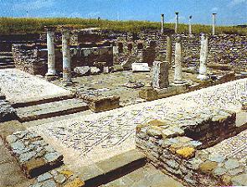
Lesson 114
The Bigger Picture
2 Corinthians 4-5
For behold, this is my work and my glory—to bring to pass the immortality and eternal life of man.
Moses 1:39

Slide 2
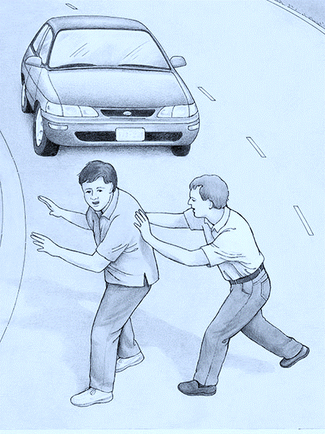
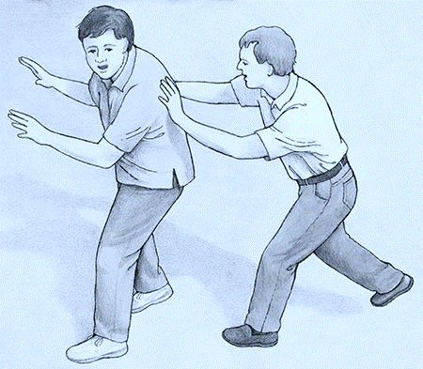
Seeing the bigger picture, does this change your judgment on that person?
What might the person being pushed think about the person who is pushing him?
Paul wrote to the Corinthian Saints to help them see the larger context of their tribulations.

Slide 3
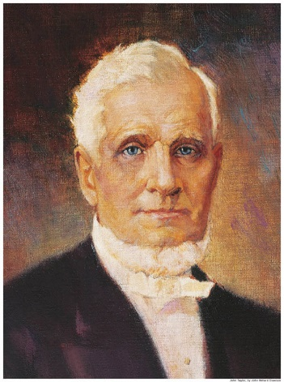
The God of This World
The “god of this world” is Satan, who blinds people’s eyes and hides the gospel from those who are spiritually lost. (1)
"[Satan] exerts an invisible agency over the spirits of men, darkens their minds, and uses his infernal power to confound, corrupt, destroy and envelope the world in confusion, misery, and distress; and, although deprived personally of operating with a body, he uses his influence over the spirits of those who have bodies, to resist goodness, virtue, purity, intelligence, and the fear of God; and consequently, the happiness of man; and poor erring humanity is made the dupe of his wiles.” (2)
2 Corinthians 4:4

Slide 4
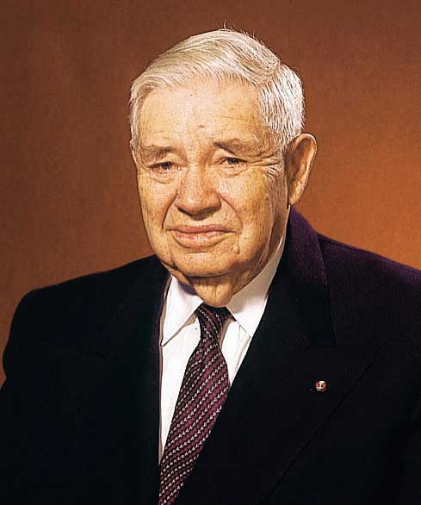
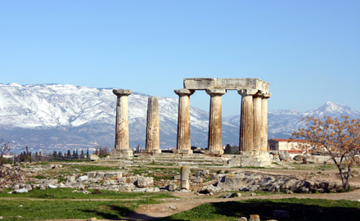
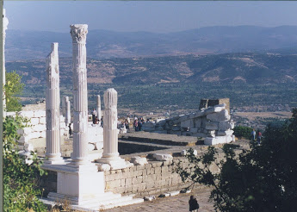
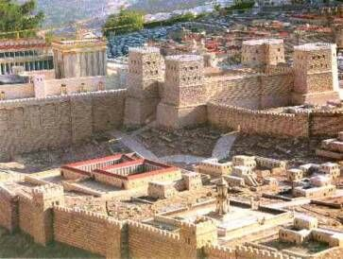
The Image of God
"Paul time and time again declared that Christ was in the image and likeness of God.
To the Corinthians he said Christ 'is the image of God.'
To the Colossians he exclaimed in exaltation of Christ, he 'is the image of the invisible God.'
To the Hebrews he affirmed that Christ is 'the express image of his person'
Corinth
Pergamum and Colossia
2 Corinthians 4:4; Colossians 1:15; Hebrews 1:3
Ancient Jerusalem
(3)

Slide 5
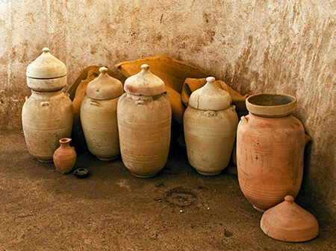
Treasure of the Light
Paul compared himself and his fellow ministers of the gospel to ordinary-looking clay jars that contain the “treasure” of “the light of the knowledge of the glory of God”.
Paul stated that the contrast between humble, unimpressive missionaries and the light they bear—the gospel of Jesus Christ—reveals a divine purpose: “That the excellency of the power may be of God, and not of us”
(1)
Earthen vessels” in modern-day Israel
It is a privilege that can be enjoyed in mortality-while still inhabiting an 'earthen vessel.‘
Of all the treasures of godliness, of all the rewards of righteousness, this is the greatest-even a personal knowledge of
'the only true God, and Jesus Christ, whom [he] hast sent'
2 Corinthians 4:6-7; John 17:3

Slide 6
Troubled On Every Side
Yet Not Distressed
Though many of these perils were extreme, Paul testified that because he was always supported by God, he was able to continue to be of service to God and the Saints. (1)
2 Corinthians 4:8-9

Slide 7
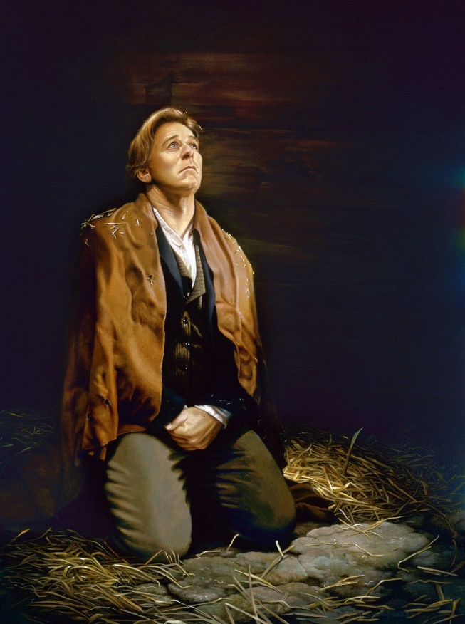
"[While a prisoner of the Missouri mob] Notwithstanding that every avenue of escape seemed to be entirely closed, and death stared me in the face, and that my destruction was determined upon, as far as man was concerned, yet, from my first entrance into the camp [of displaced saints], I felt an assurance that I, with my brethren and our families, should be delivered.
Yes, that still small voice, which has so often whispered consolation to my soul, in the depths of sorrow and distress, bade me be of good cheer, and promised deliverance, which gave me great comfort.
And although the heathen raged, and the people imagined vain things, yet the Lord of Hosts, the God of Jacob was my refuge; and when I cried unto Him in the day of trouble, He delivered me; for which I call upon my soul, and all that is within me, to bless and praise His holy name.
For although I was 'troubled on every side, yet not distressed; perplexed, but not in despair; persecuted, but not forsaken; cast down, but not destroyed.' (4)
Liz Lemon Swindle
2 Corinthians 4:8-9

Slide 8
Death is Temporary
Paul taught that even though some people would die for the gospel of Jesus Christ, their death would be temporary.
Physical death is the separation of the spirit from the mortal body.
In the spirit world, the spirits of the righteous “are received into a state of happiness, which is called paradise, a state of rest, a state of peace, where they shall rest from all their troubles and from all care, and sorrow”
When the physical body dies, the spirit continues to live.
2 Corinthians 4:11-14
(5)

Slide 9
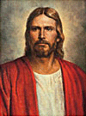
Spirit Prison
A place called spirit prison is reserved for “those who [have] died in their sins, without a knowledge of the truth, or in transgression, having rejected the prophets.”
(D&C 138:32).
The spirits in prison are “taught faith in God, repentance from sin, vicarious baptism for the remission of sins, the gift of the Holy Ghost by the laying on of hands, and all other principles of the gospel that [are] necessary for them to know” (D&C 138:33-34).
If they accept the principles of the gospel, repent of their sins, and accept ordinances performed in their behalf in temples, they will be welcomed into paradise.
The soul shall be restored to the body, and the body to the soul; yea, and every limb and joint shall be restored to its body; yea, even a hair of the head shall not be lost; but all things shall be restored to their proper and perfect frame. Alma 40:23
2 Corinthians 4:11-14
(5)

Slide 10
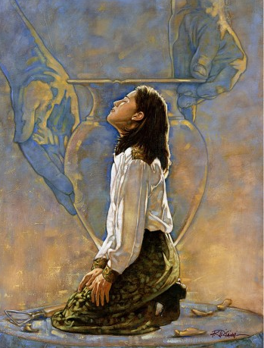
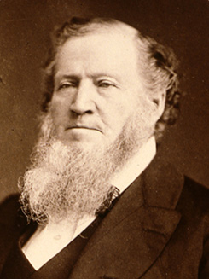
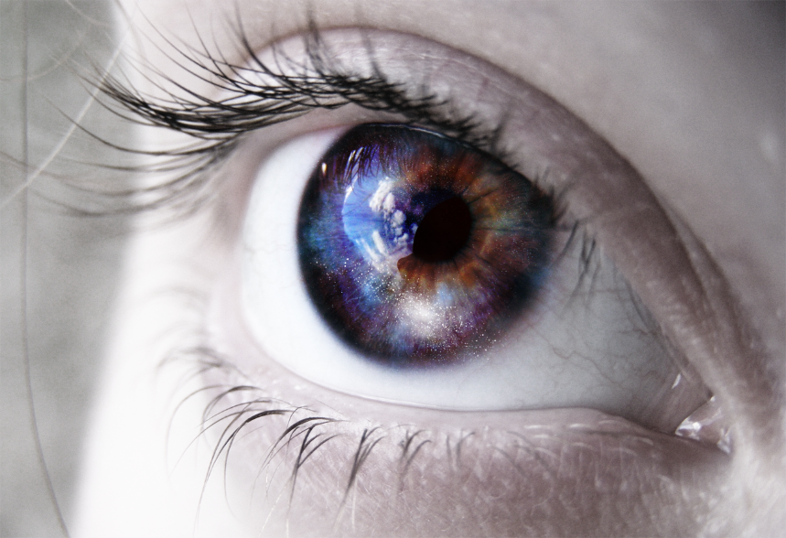
Light of Affliction
Paul was beaten, stoned, shipwrecked, imprisoned, and experienced many other trials.
… Every trial and experience you have passed through is necessary for your salvation” (6)
Ron DiCianni
It is not the passing things of this world, but the lasting things, the things not seen with mortal eyes, that are eternal.
2 Corinthians 4:17-18

Slide 11
Our trials and afflictions in this life are small compared to the everlasting blessings and growth that come as we faithfully endure them.
Because temporary afflictions can bring about eternal growth and glory, we need not despair in times of trouble.
There is eternal purpose in our afflictions, even when we cannot see it in mortality.
2 Corinthians 4:17-18

Slide 12
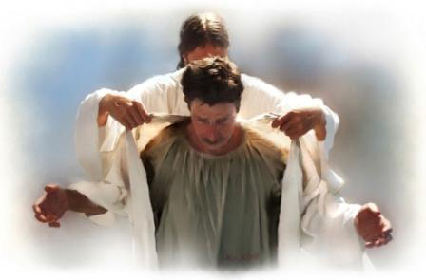
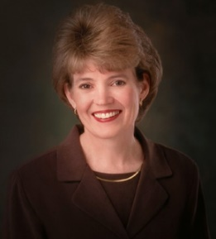
Clothed Upon
Our earthly tabernacle will be “clothed upon” during our resurrection
“Our bodies are our temples.
We are not less but more like Heavenly Father because we are embodied. I testify that we are His children, made in His image, with the potential to become like Him.
Let us treat this divine gift of the body with great care.
Someday, if we are worthy, we shall receive a perfected, glorious body—pure and clean like my new little granddaughter, only inseparably bound to the spirit. And we shall shout for joy to receive this gift again for which we have longed.
2 Corinthians 5:1-4
(7)

Slide 13
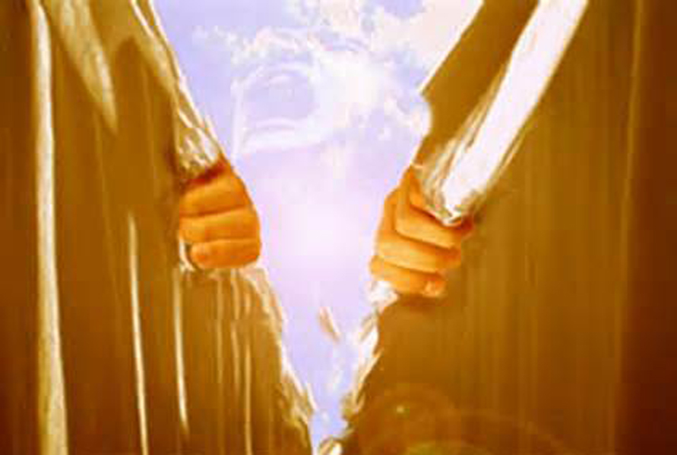
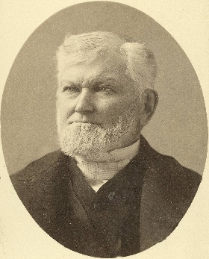
Walking By Faith
Because we are separated from God in mortality, we are to walk by faith and not by sight
“When we get to the other side of the veil, we shall know something. We now work by faith. We have the evidence of things not seen. The resurrection, the eternal judgment, the celestial kingdom, and the great blessings that God has given in the holy anointings and endowment in the temples, are all for the future, and they will be fulfilled, for they are eternal truths. We will never while in the flesh, with this veil over us, fully comprehend that which lies before us in the world to come. It will pay any man to serve God and to keep His commandments the few days he lives upon the earth.”
2 Corinthians 5:5-7
(8)

Slide 14
How Can We Walk By Faith?
Missionary
By deciding to serve a mission
By keeping the standards of the Church and keeping the Commandments
By sharing your testimony, not just in church but to your friends and family
(8)

Slide 15
Appear Before Christ
To Be Judged
“The Son, not the Father, is the Judge of the whole earth, but his judgment is made in accordance with the will of the Father and therefore is just [see John 5:22, 30]. …
“Because Jesus is the Son of Man of Holiness he has been given the power to execute judgment, to sit in judgment at the great and last day, to call all men forth in immortality to stand before his bar.” (9)
Each of us will be judged by Jesus Christ according to what we have done in mortality
And hath given him authority to execute judgment also, because he is the Son of man. John 5:27
2 Corinthians 5:8-11
(8)

Slide 16
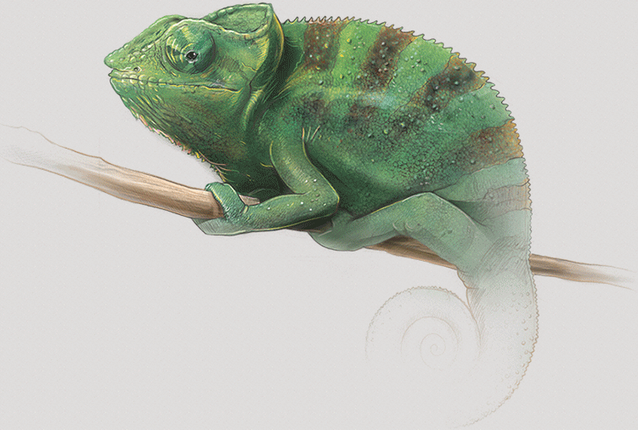
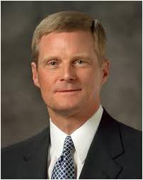
Believers—New Creatures in Christ
The Atonement changes everyone who accepts it; those who choose to follow Jesus Christ no longer “live unto themselves, but unto him which died for them, and rose again.” They become a “new creature” (1)
“…True conversion brings a change in one’s beliefs, heart, and life to accept and conform to the will of God and includes a conscious commitment to become a disciple of Christ.
“… As we honor the ordinances and covenants of salvation and exaltation ‘press forward with a steadfastness in Christ’, and endure in faith to the end), we become new creatures in Christ.”
2 Corinthians 5:15-17
(10)

Slide 17
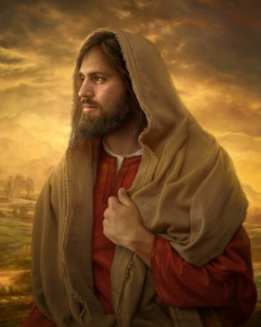
Reconciled To God
After teaching that all people are accountable for their actions and will one day stand before Jesus Christ to be judged, Paul pleaded with the Corinthian Saints to be reconciled to God through the Atonement of Christ.
There are only a few biblical verses that explicitly state that Jesus Christ was completely without sin
For he hath made him to be sin for us, who knew no sin; that we might be made the righteousness of God in him.
As a result of His Atonement, Jesus Christ can say to us, “I will take your sins and I will give you my righteousness.” Jesus Christ became a vicarious sacrifice for our sins, meaning that all of our sins were laid upon Him and He bore them, even though He had never sinned.
Because of this great sacrifice, upon condition of our repentance, we can share in the Savior’s righteousness.
Howard Lyon
2 Corinthians 5:18-21
(1)

Slide 18
Sources:
Suggested Hymn: #305 The Light Divine
New Testament Institute Student Manual Chapter 39
John Taylor (The Government of God [Liverpool: S. W. Richards, 1852], 32 - 33.)
J. Reuben Clark Jr. (Behold the Lamb of God [Salt Lake City: Deseret Book Co., 1991], 194.)
Prophet Joseph Smith (History of The Church of Jesus Christ of Latter-day Saints, 7 vols. 3:329)
LDS Topics (Physical Death)
President Brigham Young (Teachings of Presidents of the Church: Brigham Young [1997], 261–62). Photograph by Charles R. Savage
Susan W. Tanner (“The Sanctity of the Body,” Ensign or Liahona, Nov. 2005, 13, 15).
President Wilford Woodruff (Teachings of Presidents of the Church: Wilford Woodruff [2004], 154).
Elder Bruce R. McConkie Doctrinal New Testament Commentary 1:192, 195
Elder David A. Bednar (“Converted unto the Lord,” Ensign or Liahona, Nov. 2012, 107).
Presentation by ©http://fashionsbylynda.com/blog/

Slide 19
Second Letter of Paul to the Saints at Corinth— Written from Ephesus, ca. Spring, A.D. 57
The Gospel Light Shines Through the Darkness | 4:1–6
Mortal Trials and Eternal Hopes | 4:7–18
Saints Seek Tabernacles of Immortal Glory | 5:1–11
The Gospel Reconciles Man to God | 5:12–21
Scripture of Jesus Christ—He is without sin
Hebrews 4:14-15 | Seeing then that we have a great high priest, that is passed into the heavens, Jesus the Son of God, let us hold fast our profession. For we have not an high priest which cannot be touched with the feeling of our infirmities; but was in all points tempted like as we are, yet without sin.
1 Peter 2:22 | Who did no sin, neither was guile found in his mouth:
1 John 3:5 | And ye know that he was manifested to take away our sins; and in him is no sin.
2 Corinthians 5:21 | For he hath made him to be sin for us, who knew no sin; that we might be made the righteousness of God in him.
Life and Teachings of Jesus and His Apostles Chapter 37
Troubled on Every Side 2 Corinthians 14:8-9:
“On some days we will have cause to remember the unkind treatment [the Savior] received, the rejection he experienced, and the injustice—oh, the injustice—he endured. When we, too, then face some of that in life, we can remember that Christ was also troubled on every side, but not distressed; perplexed, but not in despair; persecuted, but not forsaken; cast down, but not destroyed…
To those who stagger or stumble, he is there to steady and strengthen us. In the end he is there to save us, and for all this he gave his life. However dim our days may seem they have been darker for the Savior of the world." (see 2 Cor. 4:8–9)” Elder Jeffrey R. Holland (“This Do in Remembrance of Me,” Ensign, Nov. 1995, 69).
President George A. Smith (1817–75) of the First Presidency received counsel in the spirit of Paul’s inspiring words from his cousin the Prophet Joseph Smith at a time of great difficulty: “He told me I should never get discouraged, whatever difficulties might surround me. If I was sunk in the lowest pit of Nova Scotia and all the Rocky Mountains piled on top of me, I ought not to be discouraged but hang on, exercise faith, and keep up good courage and I should come out on the top of the heap at last” (Teachings of Presidents of the Church: Joseph Smith [2007], 235).
“Reconciliation is the process of ransoming man from his state of sin and spiritual darkness and of restoring him to a state of harmony and unity with Deity. Through it God and man are no longer enemies. Man, who was once carnal and evil, who lived after the manner of the flesh, becomes a new creature of the Holy Ghost; he is born again; and, even as a little child, he is alive in Christ” Elder Bruce R. McConkie (Doctrinal New Testament Commentary, 2:422–23; see also the commentary for Romans 5:11).

Slide 20
People of Faith
Hebrews 11:7 | Noah | By faith Noah, being warned of God of things not seen as yet, moved with fear, prepared an ark to the saving of his house; by the which he condemned the world, and became heir of the righteousness which is by faith.
Alma 32:27 | Alma Teaches | But behold, if ye will awake and arouse your faculties, even to an experiment upon my words, and exercise a particle of faith, yea, even if ye can no more than desire to believe, let this desire work in you, even until ye believe in a manner that ye can give place for a portion of my words
Luke 8:48 | The woman who touches Jesus’ hem | And he said unto her, Daughter, be of good comfort: thy faith hath made thee whole; go in peace.
Mark 10:52 | Jesus Heals the blind man | And Jesus said unto him, Go thy way; thy faith hath made thee whole. And immediately he received his sight, and followed Jesus in the way.
Enos 1:8 | Enos | And he said unto me: Because of thy faith in Christ, whom thou hast never before heard nor seen. And many years pass away before he shall manifest himself in the flesh; wherefore, go to, thy faith hath made thee whole.
Moroni 10:4 | Moroni | And when ye shall receive these things, I would exhort you that ye would ask God, the Eternal Father, in the name of Christ, if these things are not true; and if ye shall ask with a sincere heart, with real intent, having faith in Christ, he will manifest the truth of it unto you, by the power of the Holy Ghost.
Ether 12:7 | Ether Teaches | For it was by faith that Christ showed himself unto our fathers, after he had risen from the dead; and he showed not himself unto them until after they had faith in him; wherefore, it must needs be that some had faith in him, for he showed himself not unto the world.
Ether 12:20 | The Brother of Jared recorded by Ether | And behold, we have seen in this record that one of these was the brother of Jared; for so great was his faith in God, that when God put forth his finger he could not hide it from the sight of the brother of Jared, because of his word which he had spoken unto him, which word he had obtained by faith.
Daniel 6:23 | Daniel in the Lion’s Den | So Daniel was taken up out of the den, and no manner of hurt was found upon him, because he believed in his God.
Hebrews 11:23-30 | Moses | By faith Moses, when he was born, was hid three months of his parents, because they saw he was a proper child; and they were not afraid of the king’s commandment; By faith Moses, when he was come to years, refused to be called the son of Pharaoh’s daughter; By faith he forsook Egypt, not fearing the wrath of the king: Through faith he kept the passover, By faith they passed through the Red sea as by dry land: By faith the walls of Jericho fell down.
Joseph Smith—History 1:11-17 | Joseph Smith | By Faith Joseph Smith Went to the woods to pray

