Slide 1
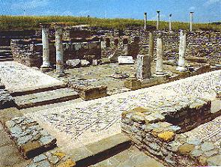
Lesson 115
Godly Sorrow VS Worldly Sorrow
2 Corinthians 6-7
I beseech of you that ye do not procrastinate the day of your repentance until the end; for after this day of life, which is given us to prepare for eternity, behold, if we do not improve our time while in this life, then cometh the night of darkness wherein there can be no labor performed.
Alma 34:33

Slide 2
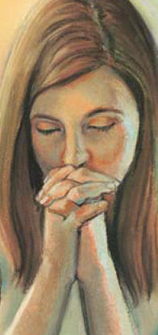
“Workers Together with Christ”
In an acceptable time have I heard thee, and in a day of salvation have I helped thee: and I will preserve thee, and give thee for a covenant of the people, to establish the earth, to cause to inherit the desolate heritages;
Isaiah 49:8
A Day to Prepare to Meet God
Individuals who do not honor their gospel covenants in this life should not assume that they will have a second chance in the life to come. (1)
2 Corinthians 6:1-2

Slide 3
Giving No Offence
"When my sister was in the Young Women program, she, like many girls then and now, enjoyed talking with her friends and being silly whenever she had a chance.
On one occasion a teacher finally got fed up and told her,
'Leave the class and don't come back until you can behave.'
My sister left and never did come back. That was 30 years ago.
"As Proverbs 18:19 reminds us, 'A brother offended is harder to be won than a strong city.' It is so easy to offend someone-and so dangerous
2 Corinthians 6:3
(2)

Slide 4
No Offence in Any Thing
The Apostle Paul, knowing how a thoughtless action or comment could affect a member's attitude about the Church, urged us to give 'no offence in any thing, that the ministry be not blamed'
"...This leads us to the other side of the issue: we have a responsibility to avoid taking offense and to freely forgive, even when we have not been asked to do so.
One of the most frequently reported reasons for Church inactivity is 'Someone offended me.'
We need to exercise patience with others. If we allow ourselves to be offended, any excuse will do."
2 Corinthians 6:3
(2)

Slide 5
Qualities of Those Who Are Called to Minister
Therefore, O ye that embark in the service of God, see that ye serve him with all your heart, might, mind and strength, that ye may stand blameless before God at the last day.
Patience
Love
Kindness
Diligence
Knowledge
Humility
Godliness
Charity
Virtue
Faith
…qualify him for the work.
Ask, and ye shall receive; knock, and it shall be opened unto you. Amen.
2 Corinthians 6:4-6; D&C 4:2, 5-7

Slide 6
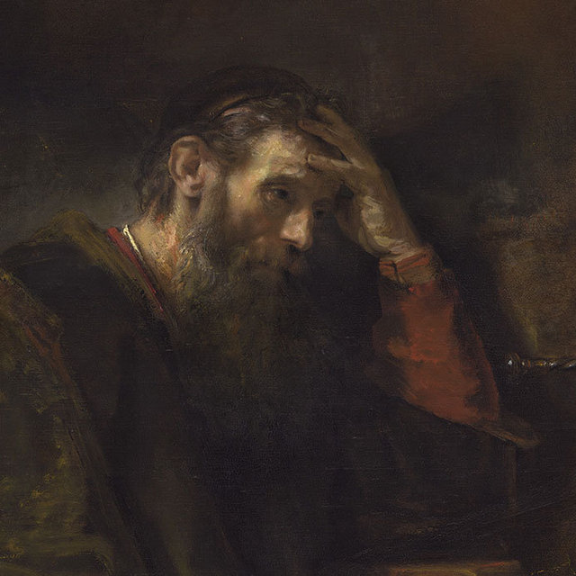
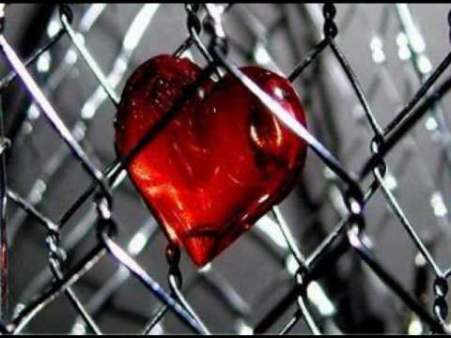
Straightened In Your Own Bowels
To restrict or withhold love
Bowels = often refers to the inner source of pity, love, and kindness, because when we feel love or compassion we often experience strong internal feelings.
Rembrandt Harmensz van Rijn
Paul was telling the Corinthian Saints that there was no lack of love on his part, despite the fact that some of the Saints were apparently withholding their love from him.
2 Corinthians 6:12
(1)

Slide 7
Be Ye Separate
Touch No Unclean Things
Concord
Belial
Infidel
Temple
Wickedness- one of the names of Satan
An unbeliever or one who believes in other gods
Them as a people
Harmony
As we separate ourselves from false practices and unclean things, the Lord will receive us
2 Corinthians 6:14-18
(1)

Slide 8
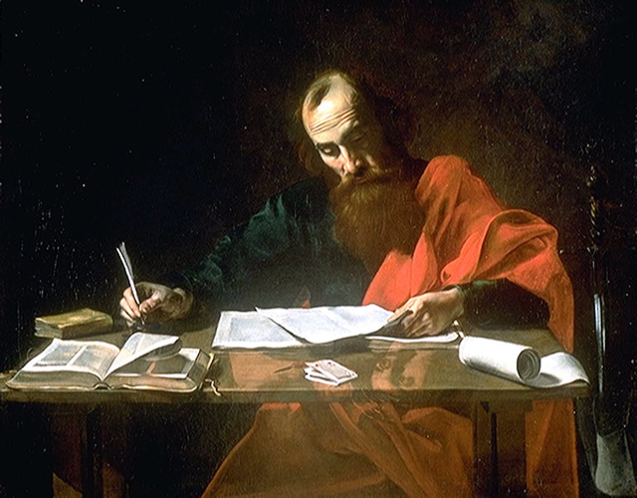
Paul Reprimands
Paul continued his defense against those who sought to discredit him.
He assured the Corinthian Saints that he had not wronged or defrauded anyone.
He pointed out that news of their well-being had brought him such joy that he was able to endure serious trials in Macedonia.
HOWEVER:
There are those who will say they are sorry, but continue in the offence.
2 Corinthians 7:2-7
(1)

Slide 9
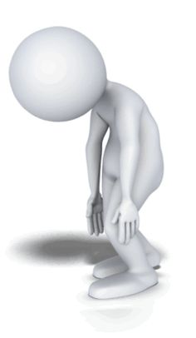
What is Repentance?
Not doing the offence again?
A constant groaning over a past sin?
Saying : “I’m sorry”?
I’m Sorry
NO
2 Corinthians 7:8-11

Slide 10
Worldly Sorrow
Godly Sorrow
Being caught and punished for actions
Saying : “I’m sorry”?
Stopping the sin
Knowing we have offended God
We are sorry because we know that we have alienated God from our lives
Besides stopping the sin it requires a broken heart and a contrite spirit.
2 Corinthians 7:8-11

Slide 11
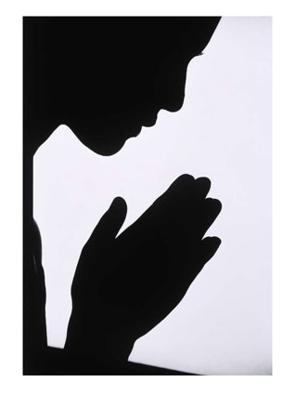
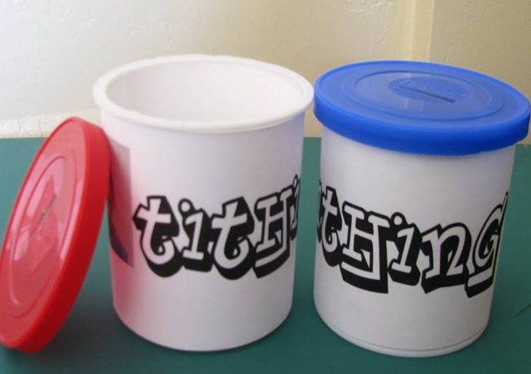
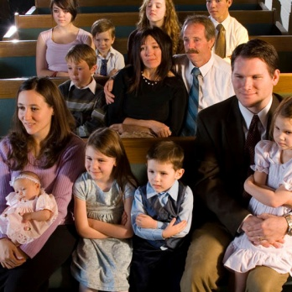
Worldly Repentance
Sometimes people think that they can sin and then do a few outward things, such as:
Offer apologies
Say a few prayers
Pay tithing
Attend all church meeting
These are important HOWEVER…
Worldly sorrow can lead us to spiritual death, or separation from God
(3)

Slide 12
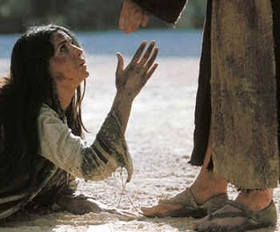
Godly Repentance
Godly sorrow leads us to repent of our sins and receive salvation
Repentance is:
a broken heart and contrite spirit
(3 Nephi 9:20)
bringing a deep sorrow for our sins
a renewal of our covenants with the Lord
determining to serve him to the end
(4)
(3)

Slide 13
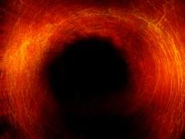
Repentance and the Holy Spirit
The Spirit will cleanse us
The Spirit will bring peace of conscience
The Spirit will help us to lose the desire for sin
The Spirit will teach us how we can continue to draw near to the Lord
The Spirit gives us strength to keep the covenants we have made.
(3)

Slide 14
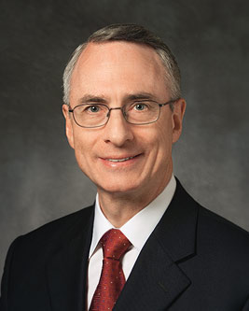
“There is only one way to rid ourselves of this suffering (sin).
It is by means of sincere repentance.
I learned that if I could present unto the Lord a broken heart and a contrite spirit, feeling a godly sorrow for my sins, humbling myself, being repentant of my faults, He, through His miraculous atoning sacrifice, could erase those sins and remember them no more” (5)

Slide 15
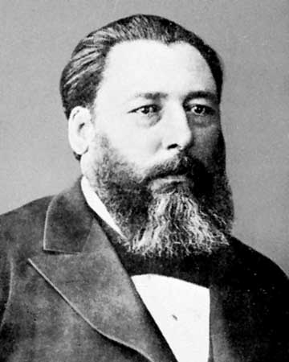
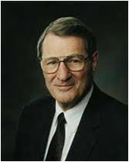
“A man loses a lot of things
and sometimes finds them again,
but it’s my duty to inform you,
and you’ll do well to remember it,
if once your sense of shame gets lost
it will never again be found.” (6)
“Pride prefers cheap repentance, paid for with shallow sorrow. Unsurprisingly, seekers after cheap repentance also search for superficial forgiveness instead of real reconciliation.
Thus, real repentance goes far beyond simply saying, ‘I’m sorry’” (7)

Slide 16
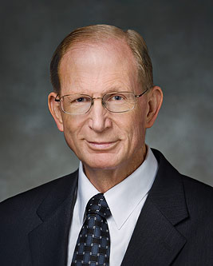
The Desire For Godly Sorrow
“For Godly sorrow worketh repentance to salvation not to be repented of: but the sorrow of world worketh death”
“We are willing to do anything and everything that God asks of us.”
“We cease doing things our way and learn to do them God’s way instead.”
2 Corinthians 7:10
(7)

Slide 17
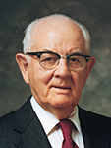
Read: Alma 42:29-30
“Godly Sorrow …changes, transforms, and saves. …Repentance of the gold type means that one comes to recognize the sin and voluntarily and without pressure from outside sources begins his transformation.”
(9)

Slide 18
Sources:
Suggested Hymn: #130 Be Thou Humble
Video:
Godly Sorrow Leads to Repentance (9:15)
New Testament Institute Student Manual Chapter 39
Denise Turner, "If Any Man Offend Not," Ensign, Aug. 1998, 46-47
Old Testament Manual Hosea 6 (Repentance)
Elder U. Soares “Abide in the Lord’s Territory” 2012 April General Conference
Claudio D. Zivic “After All We Can Do” 2007 Oct. Conference
Jose Hernandez—Poet—”Martin Fierro”
Bruce D. Porter “A Broken Heart and a Contrite Spirit” 2007 Oct. General Conference
Elder Neal A. Maxwell (“Repentance,” Ensign, Nov. 1991, 31).
Spencer W. Kimball “The Miracle of Forgiveness” page 153
Worldly sorrow can lead us to spiritual death, or separation from God
Presentation by ©http://fashionsbylynda.com/blog/

Slide 19
Second Letter of Paul to the Saints at Corinth— Written from Macedonia
How God’s Ministers Gain His Approval | 6:1–10
Avoid Union with Nonbelievers | 6:11–18
Godly Sorrow Leads to Repentance | 7:1–16
Temple of the Living God 2 Corinthians 6;16:
"Virtue is protected by modesty and should garnish the thoughts and adorn the lives of our people, young and old, that we may be known for our decency, propriety, culture, and integrity. Let our thoughts, words, dress, and general deportment indicate our belief in the sanctity of the body as the temple of God even as Paul declared it to be: '... for ye are the temple of the living God; as God hath said, I will dwell in them, and walk in them; and I will be their God, and they shall be my people.'" Hugh B. Brown (The Abundant Life [Salt Lake City: Bookcraft, 1965], 73.)
First Presidency Message:
"You who have observed the law of chastity have kept the temples of God undefiled. You can stand unabashed before the Lord. He loves you. He will bestow honor and reward upon you. Every overcoming of temptation brings strength and glory to the soul. May the Lord continue to bless and prosper you in all your works of righteousness." (James R. Clark, comp., Messages of the First Presidency of The Church of Jesus Christ of Latter-day Saints, 6 vols. (Salt Lake City: Bookcraft, 1965-75), 6: 175.)
Life and Teachings of Jesus and His Apostles Chapter 37
Bowels 2 Corinthians 6:12:
As used in scripture, the word bowels very often refers to the center of pity or kindness. When we feel love or compassion for someone or something, we usually experience pain within. “Let thy bowels be full of charity towards all men” (D&C 121:45) means, “Demonstrate a Christlike love for others.” As used here the word bowels is part of a larger expression, “ye are straitened in your own bowels.”
It is simply Paul’s way of telling the Corinthians that they had not been restricted by any lack of affection on his part but rather by their own failure to show a proper love and compassion. Similar uses of the word in the New Testament are found in Philippians 1:8; 2:1; Colossians 3:12; and 1 John 3:17. Life and Teachings of Jesus and His Apostles Chapter 37
True Repentance 2 Corinthians 7:8-10:
“Often people indicate that they have repented when all they have done is to express regret for a wrong act. But true repentance is marked by that godly sorrow that changes, transforms, and saves. To be sorry is not enough. Perhaps the felon in the penitentiary, coming to realize the high price he must pay for his folly, may wish he had not committed the crime. That is not repentance. The vicious man who is serving a stiff sentence for rape may be very sorry he did the deed, but he is not repentant if his heavy sentence is the only reason for his sorrow. That is the sorrow of the world.
“The truly repentant man is sorry before he is apprehended. He is sorry even if his secret is never known. … Repentance of the godly type means that one comes to recognize the sin and voluntarily and without pressure from outside sources begins his transformation.” (Kimball, Miracle of Forgiveness, p. 153.)
“not unequally yoked together with unbelievers” 2 Corinthians 6:14:
“You are taking a desperate chance if you say, ‘Well, maybe he will join after we are married. We will go ahead and try it and see.’ It is a pretty serious thing to take a chance on. …
“Over the years many times women have come to me in tears. How they would love to train their children in the Church, in the gospel of Jesus Christ! But they were unable to do so. How they would like to accept positions of responsibility in the Church! How they would like to pay their tithing! How they would love to go to the temple and do the work for the dead, to do work for themselves, to be sealed for eternity, and to have their own flesh and blood, their children, sealed to them for eternity! …
“No implication is here made that all members of the Church are worthy and that all nonmembers are unworthy, but eternal marriage cannot be had outside of the temple, and nonmembers are not permitted to go into the temple. …
“Paul said: ‘Be ye not unequally yoked together with unbelievers: for what fellowship hath righteousness with unrighteousness? and what communion hath light with darkness?’ (2 Cor. 6:14). Perhaps Paul wanted them to see that religious differences are fundamental differences” President Spencer W. Kimball (“The Importance of Celestial Marriage,” Ensign, Oct. 1979, 3–4).
“Godly sorrow is a gift of the Spirit. It is a deep realization that our actions have offended our Father and our God. It is the sharp and keen awareness that our behavior caused the Savior, He who knew no sin, even the greatest of all, to endure agony and suffering. Our sins caused Him to bleed at every pore. This very real mental and spiritual anguish is what the scriptures refer to as having ‘a broken heart and a contrite spirit.’ Such a spirit is the absolute prerequisite for true repentance.” President Ezra Taft Benson (“A Mighty Change of Heart,” Ensign, Oct. 1989, 4).

